Slide 1

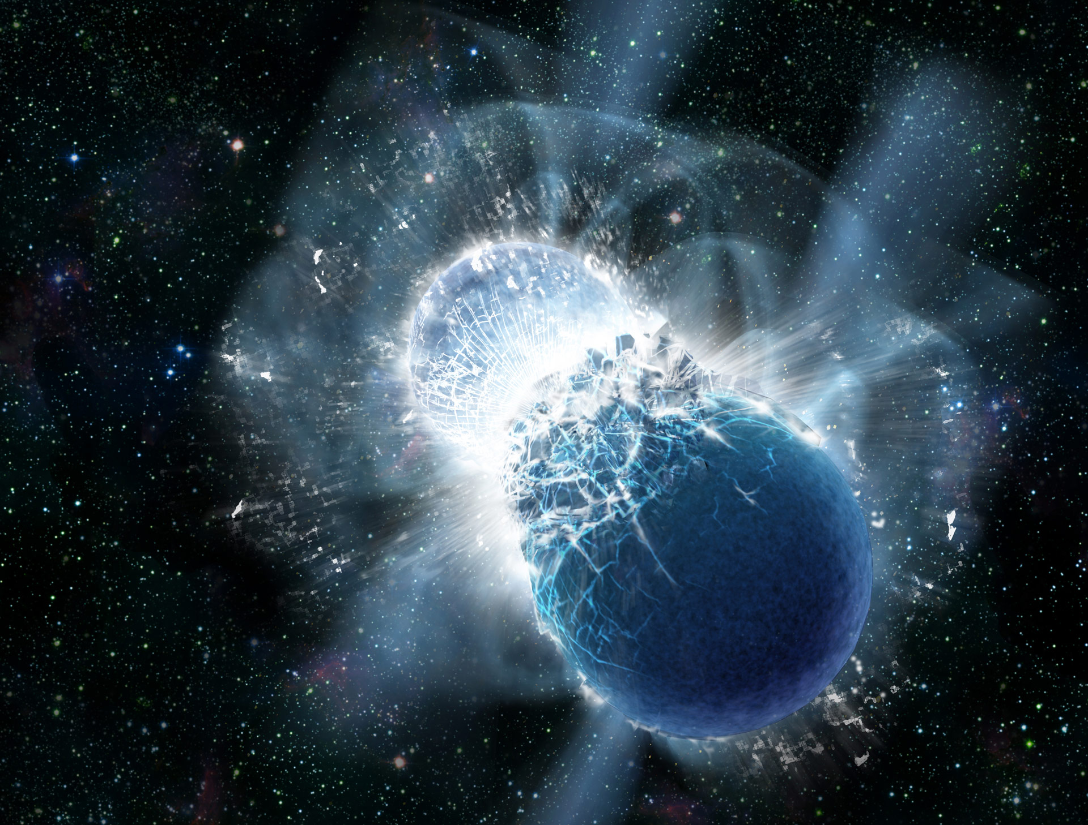






GRANDMA
A network of facilities dedicated to the electromagnetic follow-up of the GW-O3 candidates
Damien TURPIN
on behalf of the GRANDMA team
dturpin@nao.cas.cn
Les Houches May, 2018
3rd SVOM Scientific Workshop --- Disentangling the merging universe with SVOM

Slide 2
OUTLINES
The EM (optical) follow-up of the GW events
The GRANDMA project for the GW/O3 follow-up campaign
Short GRB afterglow and kilonova detection with GRANDMA

Slide 3
I.
The EM follow-up of the GW events
Problematics

Slide 4
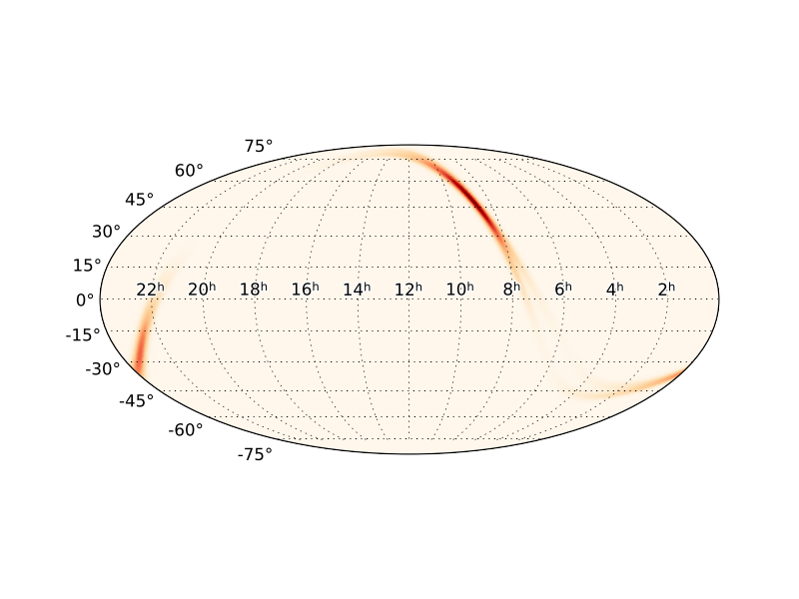
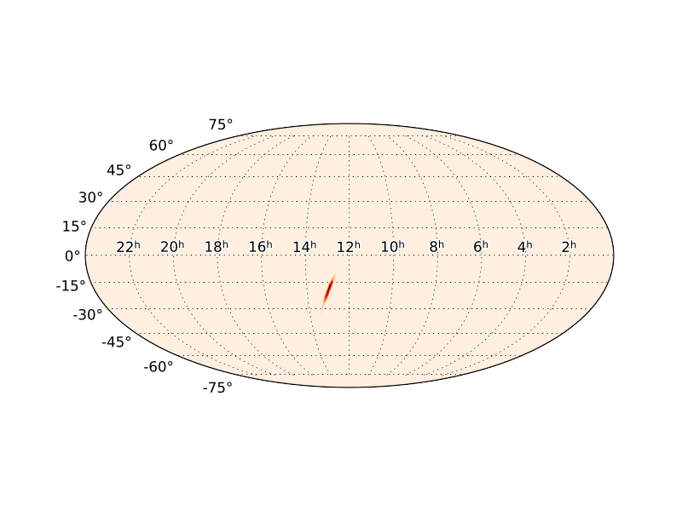
The EM follow-up of GW events Large error boxes
dec [°]
Refined position of GW 170817A -BNS-
(GW detectors only)
Error box at 90% C.L : 28 deg² (best localization)
GW 170817
GW 170104
RA [hr]
Refined position of GW 170104 -BBH-
Error box at 90% C.L : 1200 deg² (best localization)

Slide 5

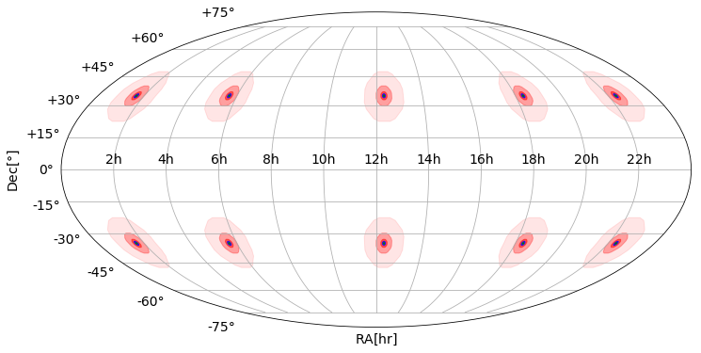

The EM follow-up of GW events Large error boxes
Rough correspondance with FoV of
Optical Facilities FoV
ᶲ ^{(°)}
Area cov
(sq degrees)
^{GWAC (1 mount)}
^{LSST}
^{TAROT}
^{SVOM/GFT}
²⁵
¹⁰
⁴
²
^{30’}
^{~500}
^{~80}
^{~12}
^{~3}
^{~0.2}
GW 170817
HARD to cover the whole GW error box with the FoVs of the optical telescopes
GW 170104
1200 deg²
28 deg²

Slide 6
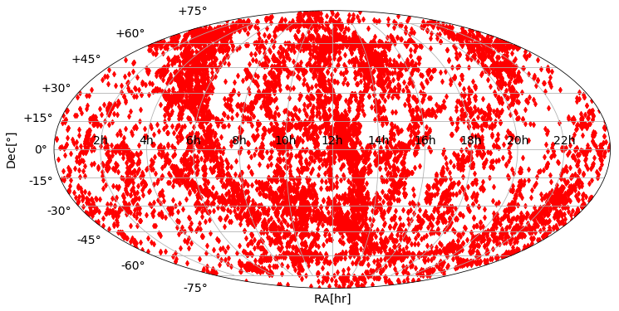
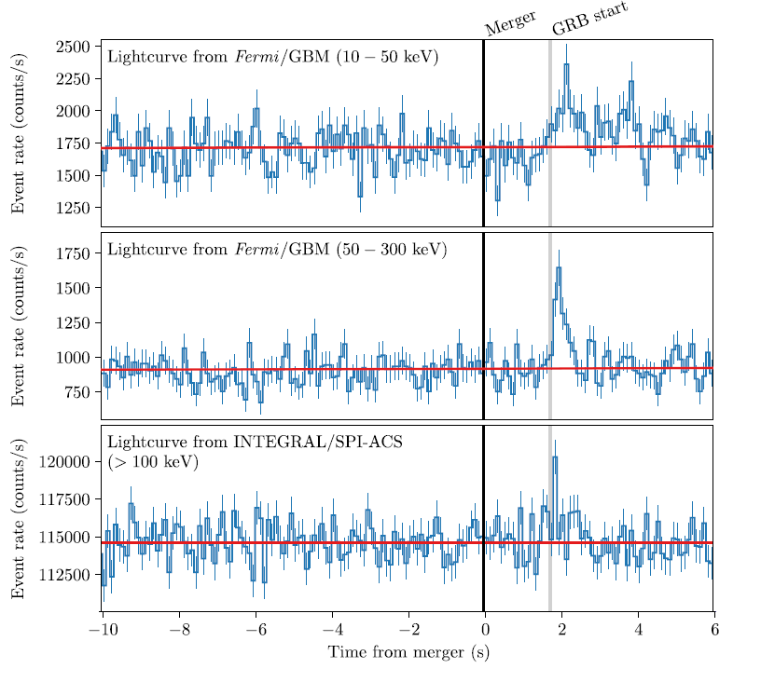
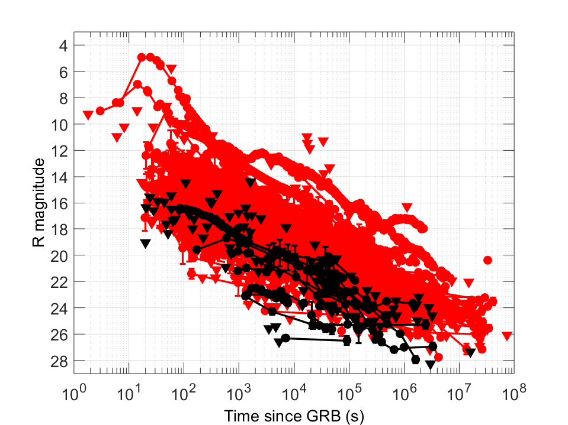
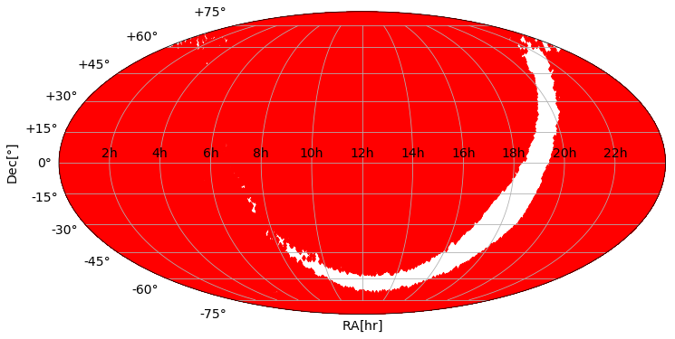

The EM follow-up of GW events Fast response
GLADE catalog
GRB lightcurve of GRB 170817A
Goldstein et al. (2017)
Many galaxies to target with blind or optimized search
GW170817 d = [26-48] Mpc -> 11583 gal
In 28 deg² (assuming a circle error box) : ~ 0-100 gal
Optical afterglow lightcurve of GRB from GRBase
Time is running out to catch the early EM emission of fast fading transients !!
GW170104 d = [490-1330] Mpc -> 589287 gal
In 1200 deg² (assuming a circle error box) : > 10 000 gal

Slide 7
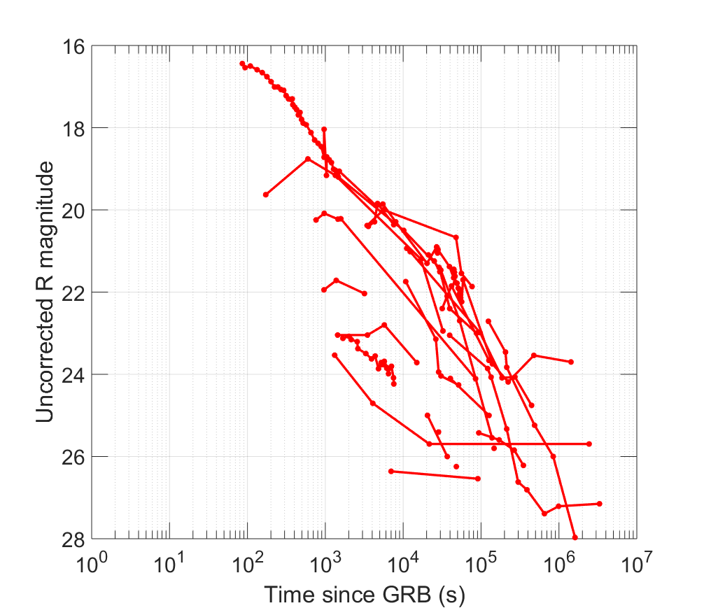
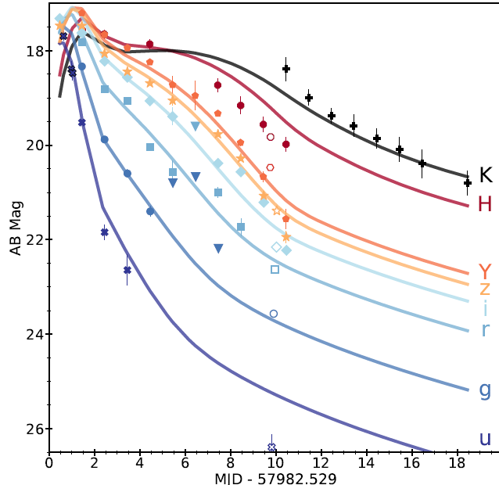
The EM follow-up of GW events Deep photometry
SGRB Afterglows
Optical emission from GW BNS
Kilonova emission of GW 170817
+ Others (BBH,BH-NS, etc…) ?
Optical LC of 23 short* GRB (1997-2015)
Delay >~0.5 days
<D(z)> = 2.8 Gpc
On-axis
40 Mpc
Delay <~ 1h
Tel <1m
Delay > 1h
Tel >1m
Turpin et al. (prep)
Cowperthwaite et al. (2017)
The sources are quite faint !
* Corresponding to the T₉₀ definition. Some no-merger events may be classified as short GRBs here

Slide 8
The EM follow-up of GW events Optimising each facility perf.
FoV
« PROMPT SCAN » search
Bright event required for a detection
-
GWAC
>10°
m_{lim} = 16
m_{lim} = 17-18
« PROMPT TARGET » optimised search in a list of galaxies + specific targets from the scan search
+
TAROT/MASTER
Deepness of the photometry
>1°
C-GFT
m_{lim} = 20-21
1 m class
m_{lim} = 19-21
>30’
« WAITING ToO »
Good loc required / already a detection
2-3 m class
m_{lim} = 22-24
>10’
VLT, Keck, Gemini, GTC, etc.
m_{lim} > 24
Delay since the
GW trigger time
- few hrs
< few secs
< few min/hrs
< few 10 hrs
< few days

Slide 9
The EM follow-up of GW events Classification of the EM candidates
Gravitational wave
EM astronomers
Large Error boxes
~100 deg² (for O3)
Large telescope FoV
>>10deg²
Many unrelated transients
+
Many fake transients
Big challenge of the incoming years for the time-domain astronomy
Powerful tools to quickly classified the transients and identify the good one
Auto-vetting, Deep Machine Learning, Likelihood algo, automatised image subtraction, etc.

Slide 10
The EM follow-up of GW events A need for a world wide network
The « Four GW commandments » for the astronomers
Have a large FoV
Be Fast
Be deep in photometry
Be efficient in identifying the good EM counterpart
One telescope can not fulfill this task !
- EM (and GW) observers must be connected and share the huge observational work.
- A world wide network of telescope is needed to get the most scientific returns back from each GW/EM follow-up campaign !

Slide 11
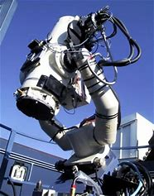
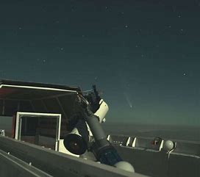
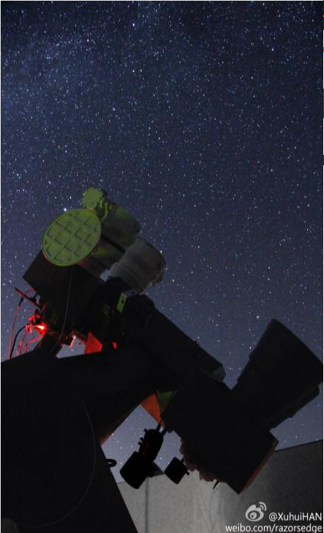
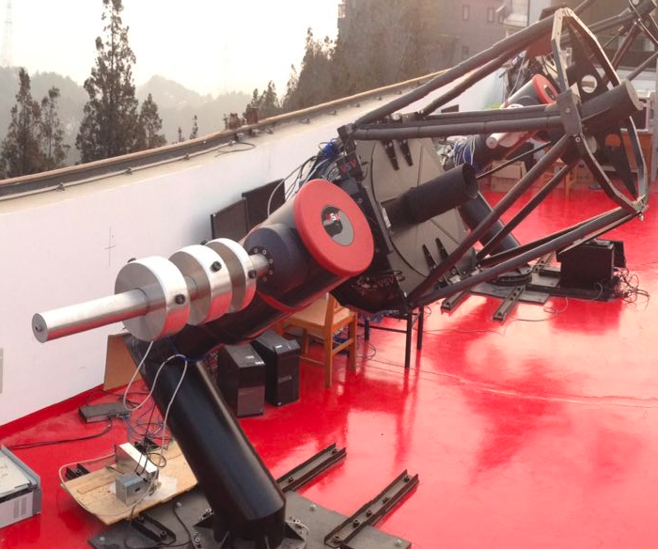
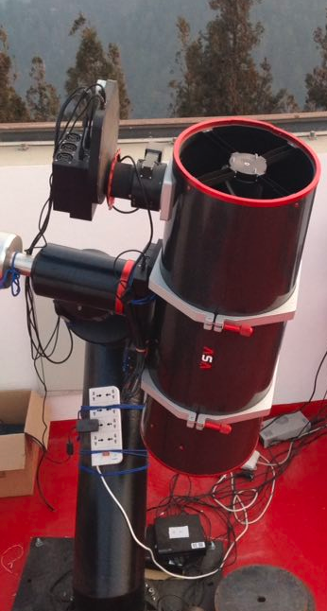
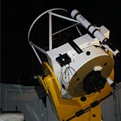
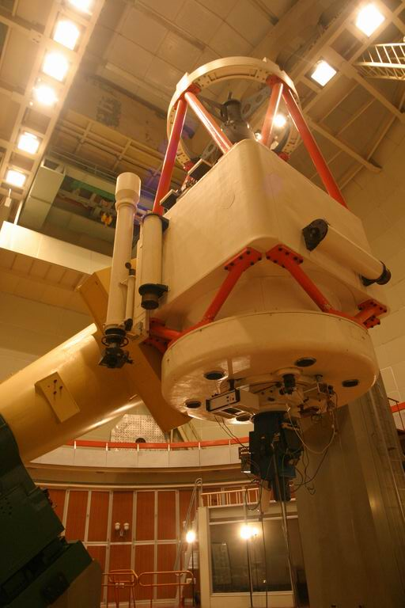
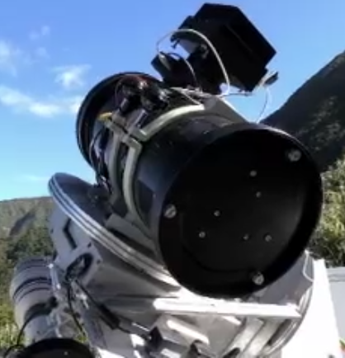
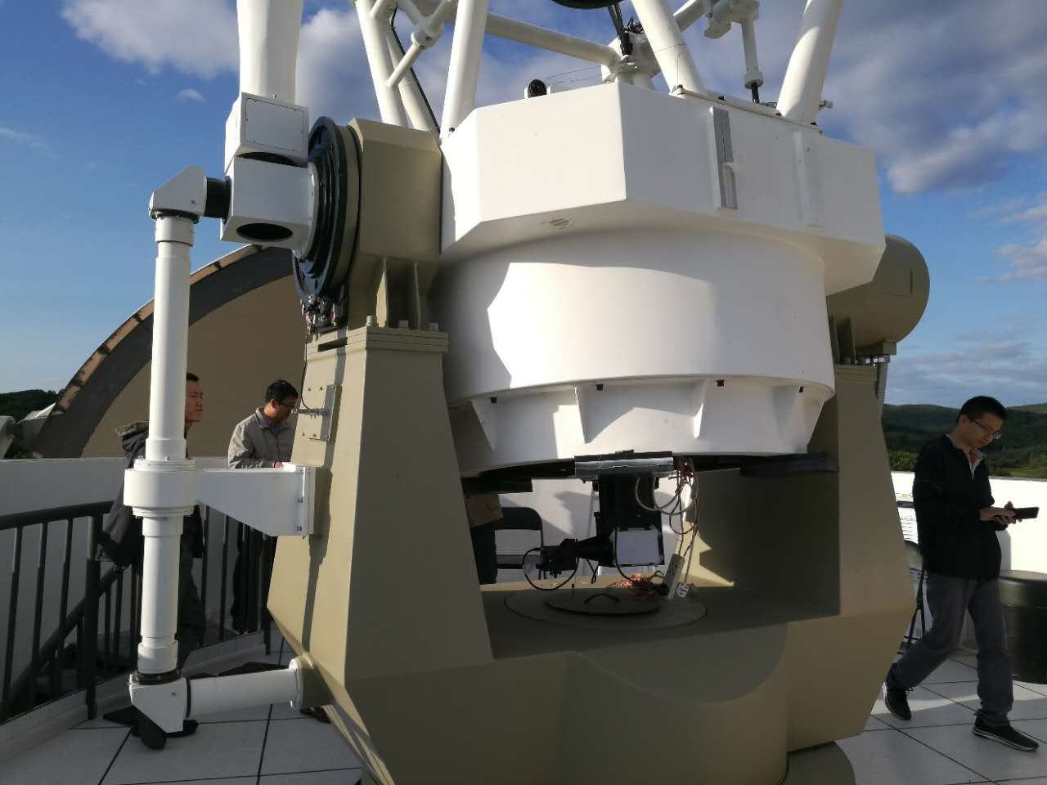
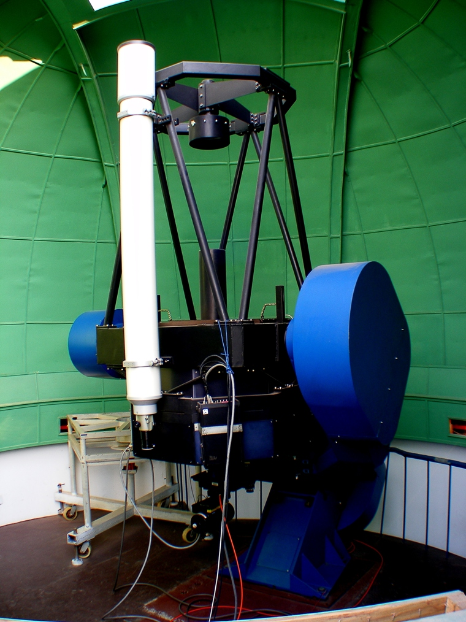
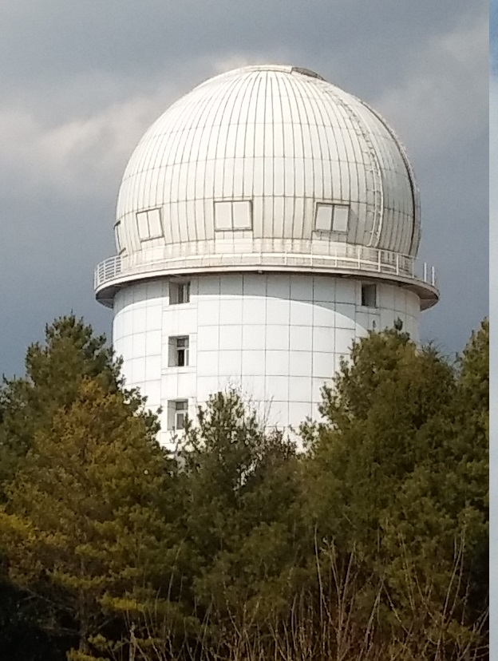
Tarot-Calern
TAROT-Chile
F60
30cm
Zadko
GWAC
2.16 m Xinglong
TAROT-Reunion
C-GFT
II.
GRANDMA
Global Rapid Advanced Network Devoted to the Mm Addicts
TNT Xinglong
2.4 m GMG

Slide 12
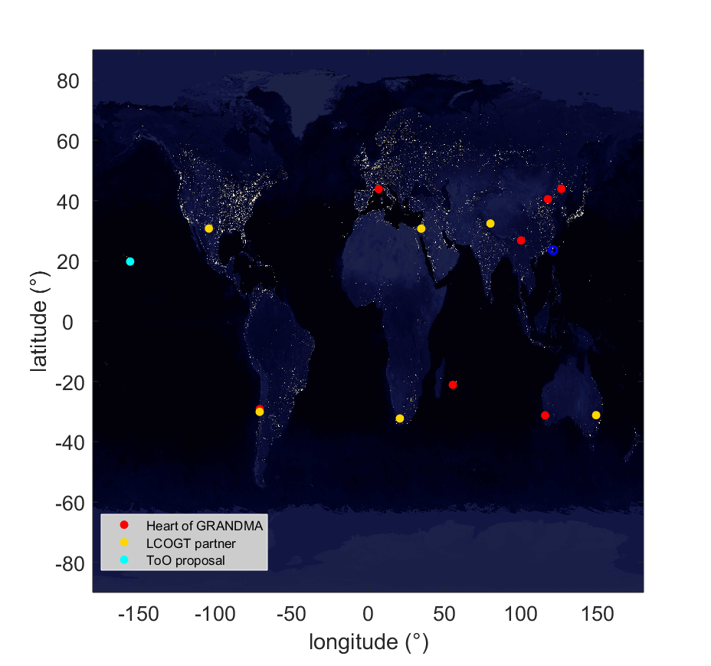
GRANDMA The network
The fusion of the TZAC & Chinese networks of telescope
TAROT & Zadko
experience on the MM astronomy
GRB / neutrinos / GW
>200 GCNs, ~40 publications
Chinese facilities
experience on the MM astronomy
(mini-)GWAC : O2 campaign / Fermi GRB follow-up
TNT : GRB science
> 130 GCNs
GMG : GRB science
35 GCNs, 1 paper
TCA
C-GFT
Xinglong
LCO-Ali
See X.H Han’s talk
LCO-McO
LCO-WO
GMG-Lijiang
LOT
CFHT
TRE
TCH
Zadko
LCO-CTIO
LCO-SAAO
LCO-SSO
A strong experience on the field of the time-domain & MM astronomy

Slide 13





GRANDMA Some Partners
optical
GW
GRANDMA
Coincident obs. + share obs strategy & results with the LCOGT network
+ collaborators
Discussion on GW Sub-threshold
Contact : N. Leroy (LAL)
γ-rays
60 cm La Reunion island + others (TBD)
contact : M.Boër /A.Klotz (Artemis/IRAP)
CFHT (Hawaii, US) ToO request
PIs : M.Boër / J.Y. Wei (Artemis/NAOC)
GBM Sub-threshold
Coincidence with GRANDMA OTs
Contact : N. Christensen (Artemis)
Lulin observatory (Taiwan)
Under discussion
Proposal for O3
agreed
Discussion with the LOT team (1m) : ToOs
GRANDMA contact : L.P Xin (NAOC)

Slide 14
GRANDMA Science case & motivations
Motivations
Build a world wide network of various facilities dedicated to the detection and the follow-up of the EM (optical) counterpart of GW/O3 candidates. Provide quick GRANDMA alerts to the scientific community as soon as an optical detection is confirmed or perform a quick follow-up of interesting optical transients (OTs) found by external teams.
Science case
Detect the optical counterpart of any GW candidate : GRB (early on-axis/ late orphan) afterglow, unkown OTs, etc…
Perform a highly sampled « late » follow-up of the OT related to the GW candidate in different color band to identify the radiative processes and the lightcurve features.
Identify the source redshift and the emission/absorption spectral features thanks to spectroscopic observations.
Detect the early (and/or late) stage of the BNS kilonova emission (color photometry + spectroscopy if possible). Identify the nature of the ejecta and the origin of the chromatic evolution of the KN emission.

Slide 15
GRANDMA Individual performances
16 telescopes covering a wide field of performances
Telescope | Num. | location | Aperture (m) | FoV | filter | m_{lim} [Single/stack] | Obs.mode
GWAC | 3 | China | 0.18 | 25° | Clear | 16/17 | Survey
30 cm | 1 | China | 0.30 | 1° | Clear, BRI | 16.5/17 | Gal. target
F-60A/B | 2 | China | 0.60 | 18’ | Clear, BRI | 18/19 | Gal. target
TNT | 1 | China | 0.80 | 12’ | Clear, R | 19/20 | Gal. Target or ToO ?
2.16 m | 1 | China | 2.16 | ~9’ | BFOSC (im/spec) | 22 (18.5) | ToO (pho/spectro)
C-GFT | 1 | China | 1.20 | 1.5° | Clear (for O3) | 19/20 | Gal. target
GMG-2.4 | 1 | China | 2.40 | ~10’ | YFOSC (im/spec) | 22/24 (18) | ToO (spectro)
TAROT | 3 | France / Chile | 0.25 x2 + 0.18 | 1.9° x2 + 4° | Clear, RI | 17/18+ 16/17 | Gal. target
CFHT | 1 | US | 3.6 | 1° / 20’ | gri, JH | 23, 22 | ToO
Zadko | 1 | Australia | 1.00 | 23’ | Clear, gri | 20/22 | Gal. target
60cm | 1 | France | 0.6 | 23’ | Clear, gr | 18/19 | Gal. target

Slide 16
GRANDMA Collective performances
A~3 deg²
m = 17-18
Gal. Target
Photo
A~1500 deg²
m = 16-22
Survey/Gal. Target
Photo/spectro
Ensure the coverage of the both hemisphere
Quick answer to any trigger in the sky
Almost continuous monitoring of the GW error box
Quasi instantaneous vetting of fake candidates and/or confirmation of valuable OTs
Ensure the high sampling (in different filters) of the GW/OT lightcurve in case of a detection
Ensure spectroscopic measurement
~40 Gal/night
Prompt answer<20s
A~3 deg²
m = 17-18
Gal. Target
Photo
~40 Gal/night
Prompt answer<20s
~100 Gal/night
Prompt answer<2min
A~13 deg²
m = 16-21
Gal. Target
Photo
~60 Gal/night
Prompt answer<30-60s

Slide 17
GRANDMA Observation strategy
OT classification and human BA check of the best candidates pre-classified
See L.P Xin’s talk
Fast answer
Late actions
GWAC/TAROT survey mode (if available)
Galaxy targeting mode for the available telescopes : optimisation of the number of galaxies to be observed per night
Smart schedule of obs. on other tel.
continuous follow-up over a duration >12h after the GW alert receipt
If credible OTs (internal or external) :
Launch ToO obs. on our largest telescope >2m
Pursue the photometric follow-up with our small telescope (if bright enough)
Spread out the OT alert to the scientific community (GCN, ATeL, mail)
End of the follow-up campaign
Offline analysis of all the images
Internal report of our obs. results
GW notice
Search for the GW OT (single + stacked frames)
Late follow-up of the GW/OT
< 5 min
< few hours/day ??
few days

Slide 18
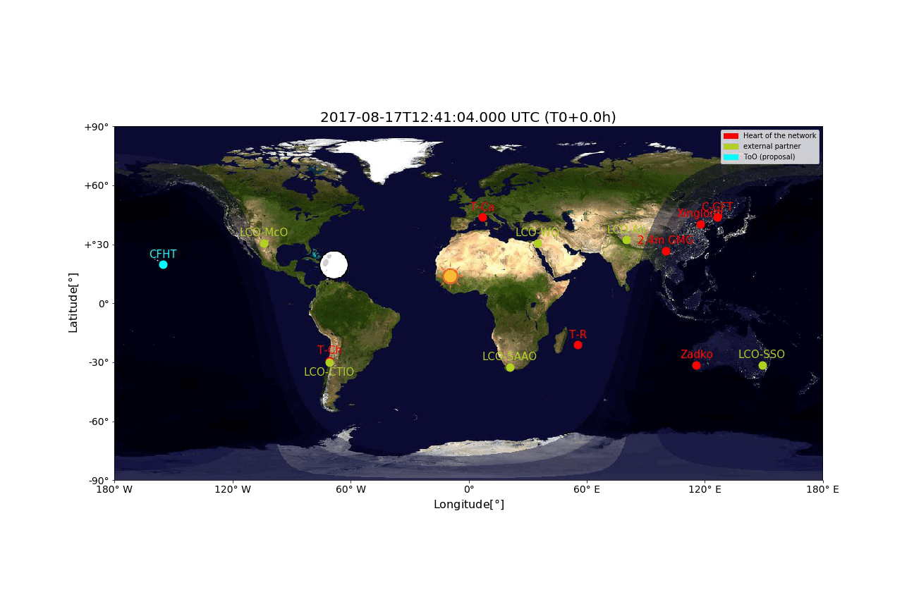
GRANDMA Management
Availability of each telescope and visibility of the trigger position
GW 170817A
From T0 -> T0+24h

Slide 19
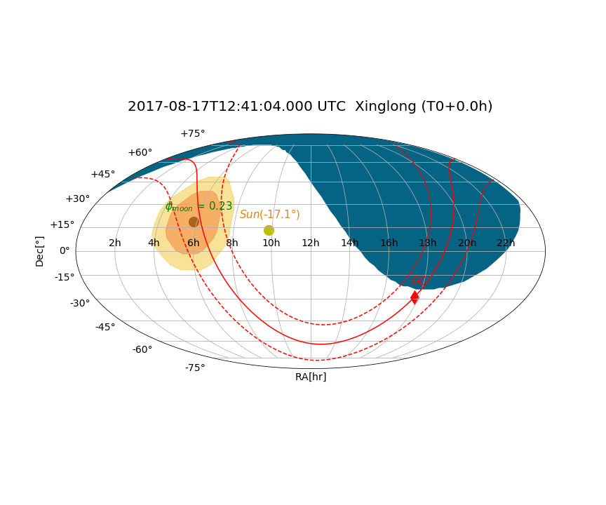
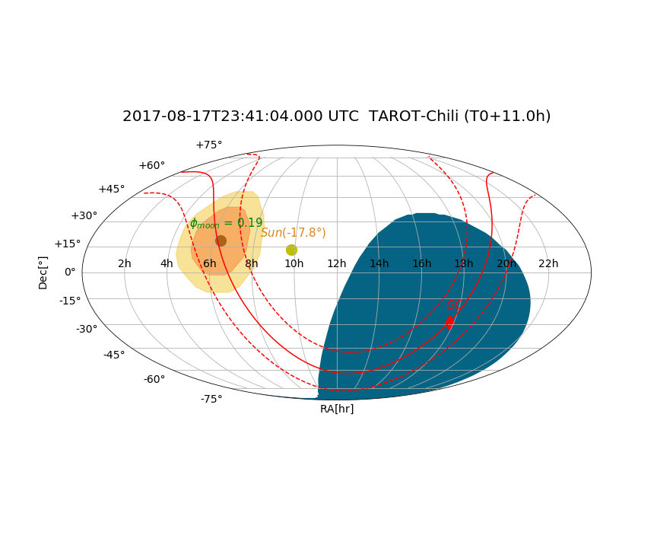
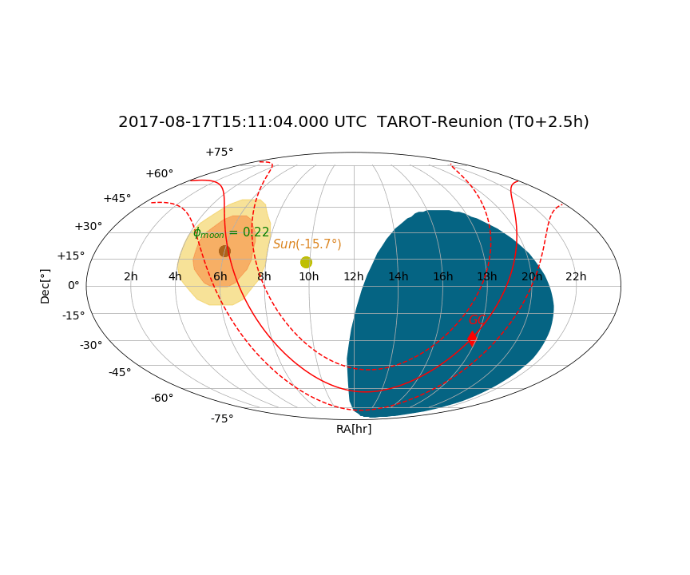
GRANDMA Management
Availability of each telescope and visibility of the trigger position
GW 170817A

Slide 20
GRANDMA Organisation of the observations
A smart and dynamic schedule of the observations
GRANDMA DB
See X.H Han’s talk
Wheather conditions
Telescope availability
Visibility of the trigger position
current pointing
Observing mode (survey, galaxy targeting, waiting)
Performance of each tel. (FoV, mag_lim, response delay, etc.)
Telescope 1
Telescope 1
Telescope 2
Telescope 2
Telescope 3
Scheduler
Telescope 3
Tilling schedule for survey mode
Optimised targeting : Galaxy list tel. per tel. knowing each other telescope pointings (no strong overlap)
Telescope N
Telescope N

Slide 21
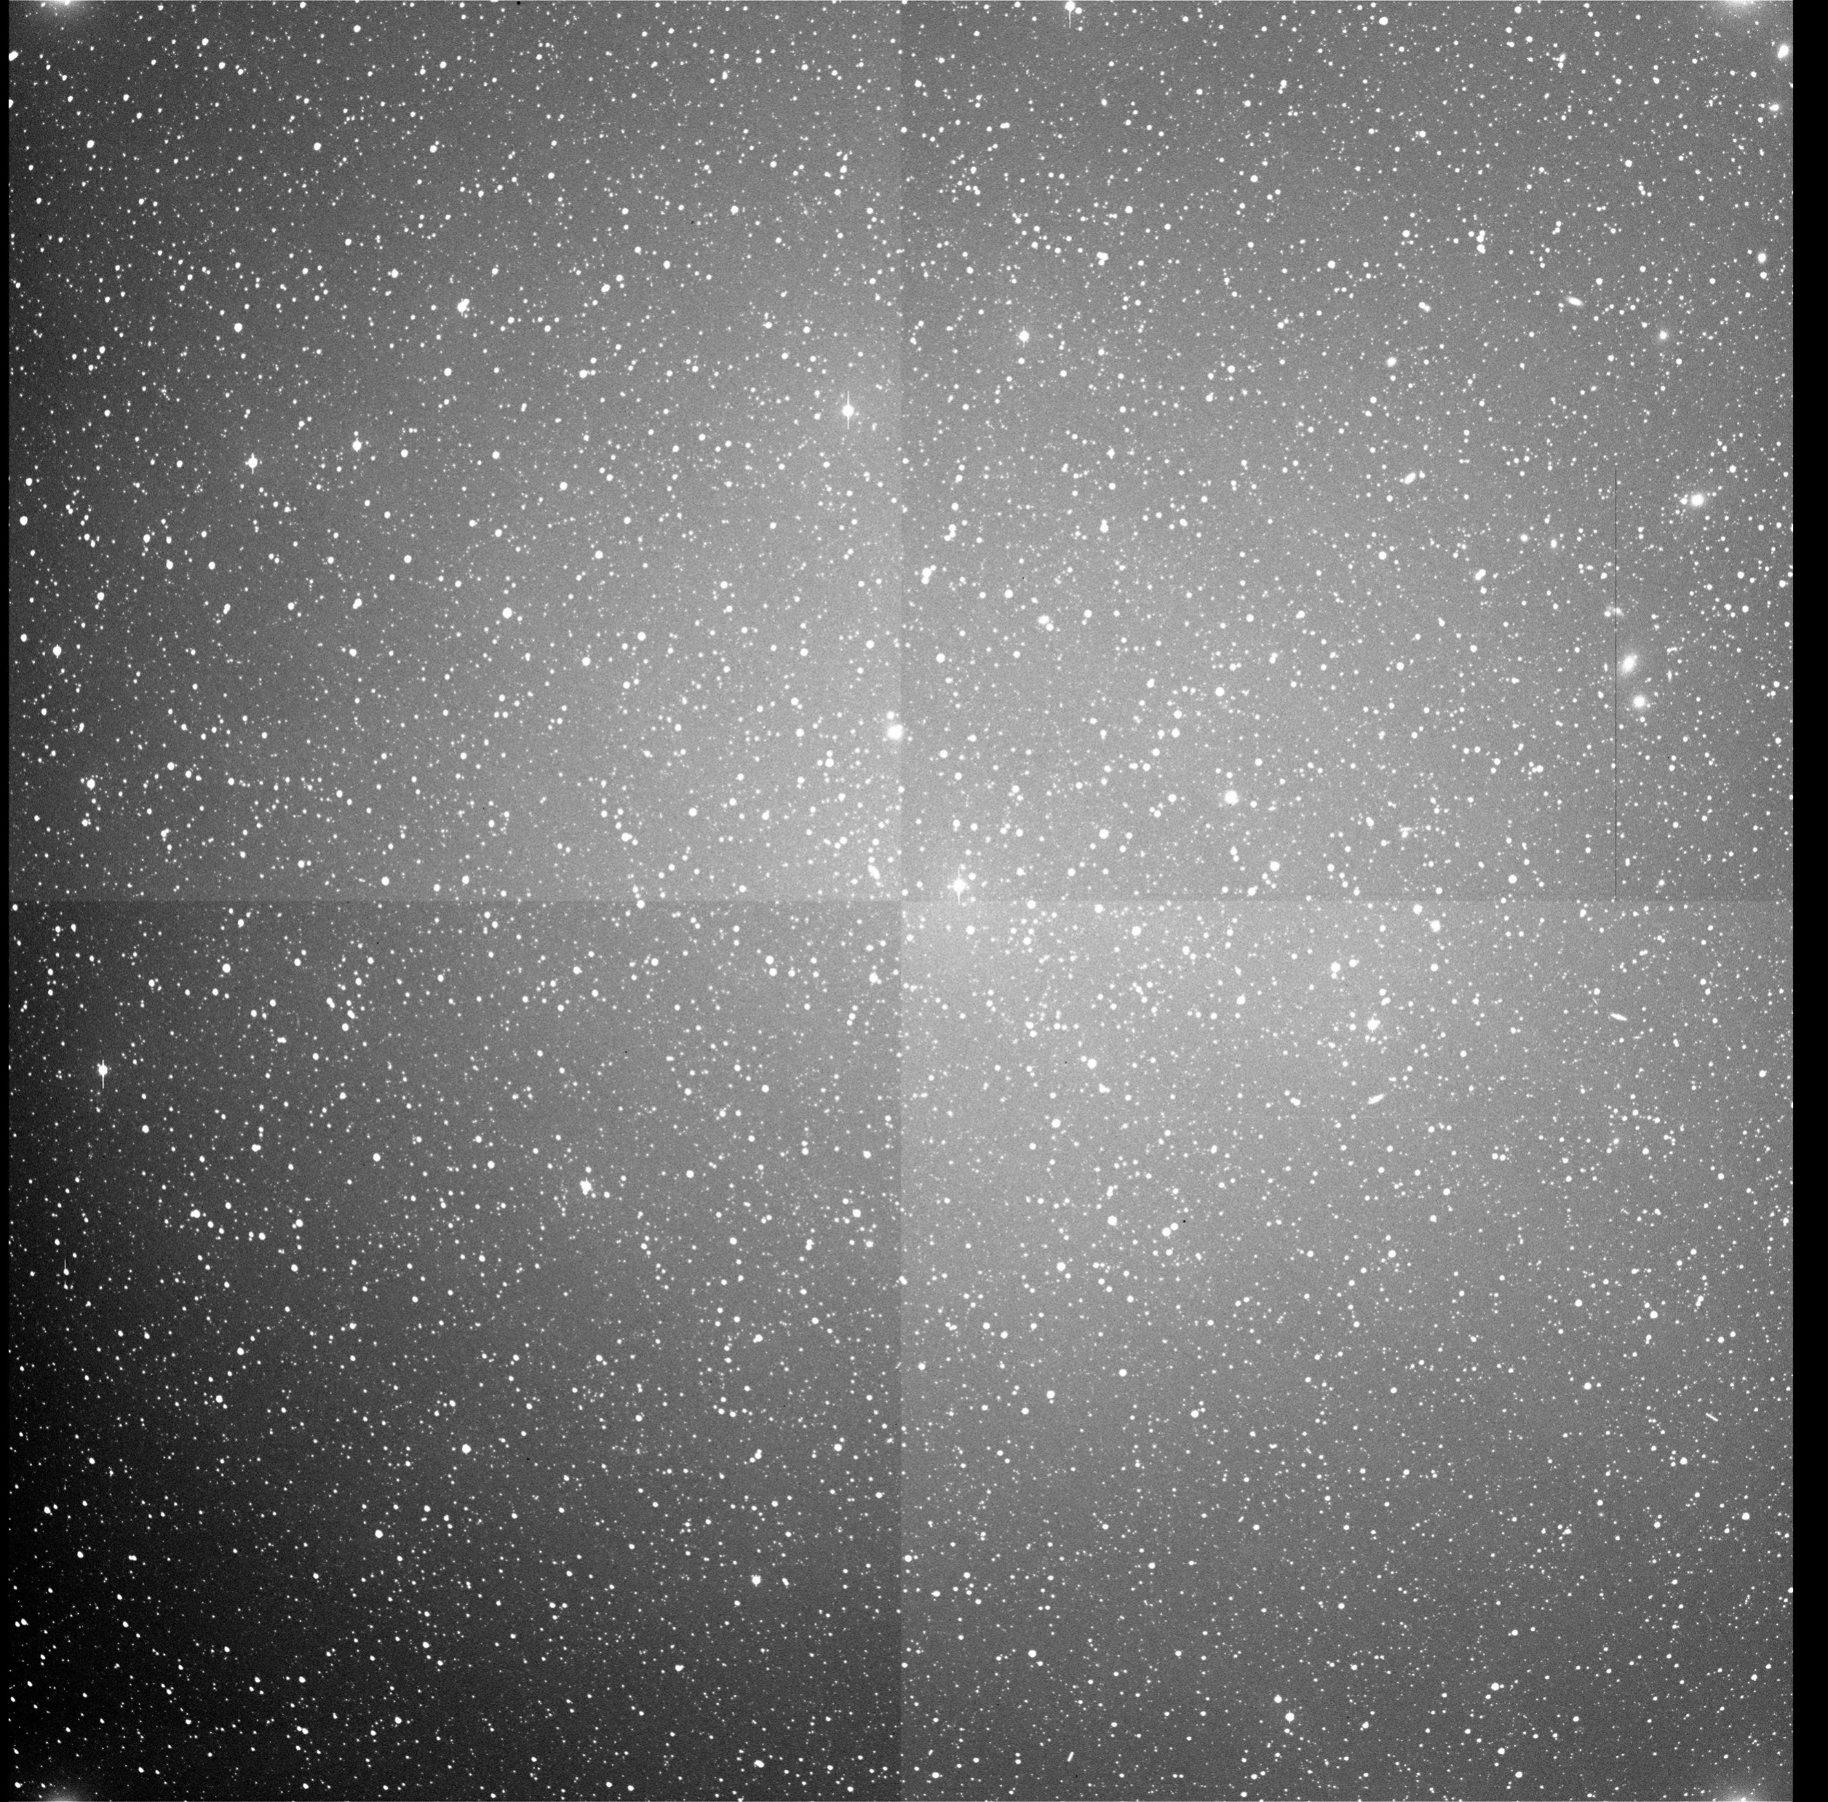
GRANDMA OT detection & classification
Large FoV = large number of OTs / image
(more than few hundreds / night with GWAC)
Our large FoV telescope
GWAC (25°x25°), TAROT-Reunion (4°x4°), TAROT-Calern & La Silla (1.9°x1.9°), C-GFT (1.5°x1.5°)
GWAC raw image
See L.P Xin’s talk
OT detection (automatised)
Standard filters (cross catalog matching, MP check, hot pixels, etc..)
OT search : Blind + galaxy in the field
Differential imaging : residual analysis
Cross check with other instrument images
Machine Learning algorithm
~25°
OT identification (semi-automatised)
Likelihood analysis with known template (SN, KN, GRB afterglow, etc.)
Confirmation by other telescopes
Human-eye check (BA of GRANDMA)
~25°

Slide 22
III.
Short GRB afterglow and kilonova detection with GRANDMA
Short GRB afterglow emission & the kilonova of GW170817

Slide 23
SGRB & kilonova detection with GRANDMA short GRB afterglow
~6h
GWAC, T-Reunion single frame
GWAC, T-Reunion stacking / T-Calern & Chili + 30cm Xinglong single frame
T-Calern & Chili + 30cm Xinglong stacking / 60 cm Xinglong+Reunion single frame
60 cm Xinglong+Reunion stacking
1m class single frame (Zadko, LCOGT, C-GFT)
1m class stacking / 2m class single frame
2m class stacking / 3m class single frame (CFHT )
Up to R~21, a GRANDMA discovery is possible for a maximum delay wrt the SGRB trigger time not more than ~ 6 hours* BUT actually even with larger delays if the GRB (on-axis) is within the expected GW horizon distances (~100Mpc)
But D>>100-200 Mpc
* BUT for a short GRB at <z>~0.5

Slide 24
SGRB & kilonova detection The case of GW 170817 (40Mpc)
GWAC, T-Reunion stacking / T-Calern & Chili + 30cm Xinglong single frame
T-Calern & Chili + 30cm Xinglong stacking / 60 cm Xinglong+Reunion single frame
60 cm Xinglong+Reunion stacking
1m class single frame (Zadko, C-GFT)
1m class stacking
2m class single / 3m class single frame (CFHT, griJH )
The kilonova of GW170817 would have been detectable by almost all our instruments from 0.45 to ~10 days after the GW /GRB trigger time
Cowperthwaite et al. (2017)

Slide 25
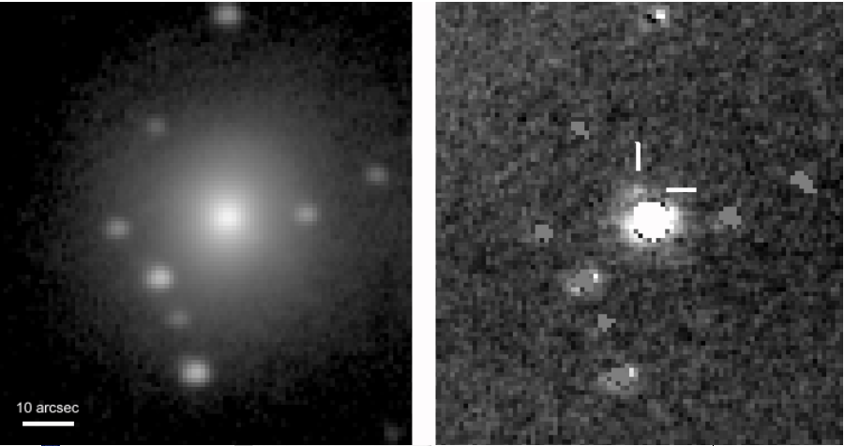
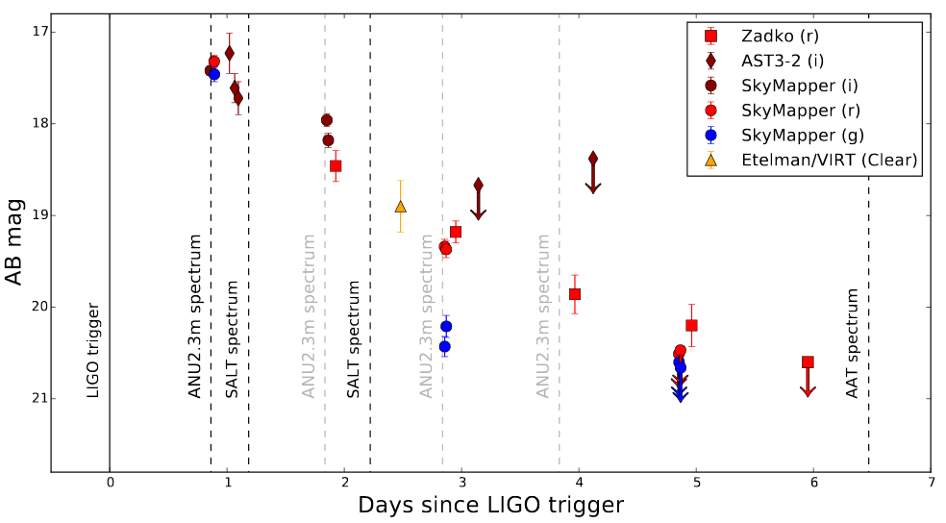
SGRB & kilonova detection The case of GW 170817 (Zadko)
NGC 4993 (ref)
NGC 4993 (residual)
KN GW170817
Optical light curve obtained by some Australian facilities
Zadko residual image of the GW170817 kilonova
The Zadko telescope catched the optical counterpart of the GW170817 kilonova up to 5 days after the GW trigger time down to r = 20.2
Andreoni et al. 2017

Slide 26
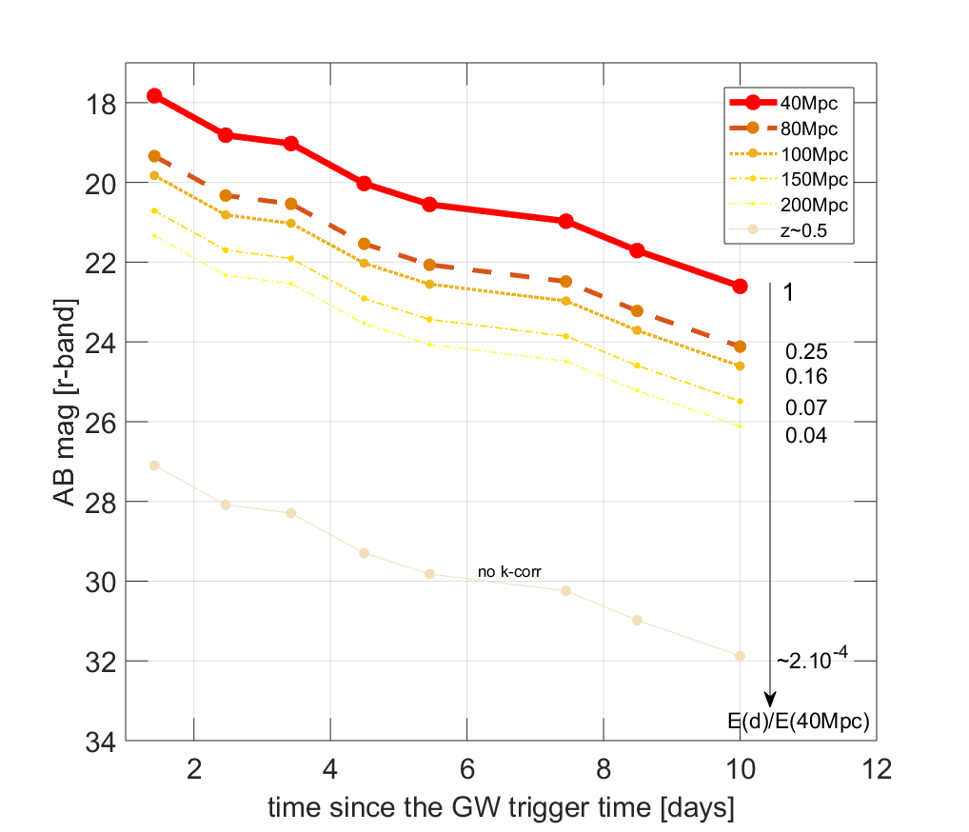
SGRB & kilonova detection and at larger distances…
GW170817 KN at larger distances
1m class
Just by a distance effect, a GW170817-like kilonova is hard to catch with 1m class telescopes for D>100-150 Mpc (in r-band)
2m class
At D = 100Mpc, the KN signature could be still detectable (by 1m tel) within T-T_{GW} < 2-3 days

Slide 27
General Conclusions
WE MUST BE READY TO FACE THE GW/O3 RUN CHALLENGES !
GRANDMA
16 telescopes + external partners for O3
Wide variety of perf. : FoV [10’ – 25°], fast response to a GW trigger <few secs/mins, photo/spectro, m_{lim} [16-23], Survey/Gal.target/ToO, continuous monitoring of the both sky hemisphere
Powerful tools to manage the network + make the online OT classification + broadcast the results
Public OT alerts will be released and we will follow-up OTs found by other teams
GRANDMA science
Early detection of an « on-axis » BNS/SGRB afterglow if T-T₀ < 6h* / delayed emission of orphan afterglows
Early detection of a BNS kilonova-like (GW170817) up to 100-150 Mpc within T-T₀ < 2 days (otherwise at 40Mpc detectable up to 10 days post GW trigger time)
Color photometry + spectro of the SGRB afterglow and/or the KN
Distance/redshift measurements
Other unpredictable detections from BBHs and BNs too
* but at cosmological distance <z> = 0.5

Slide 28
Back-up

Slide 29
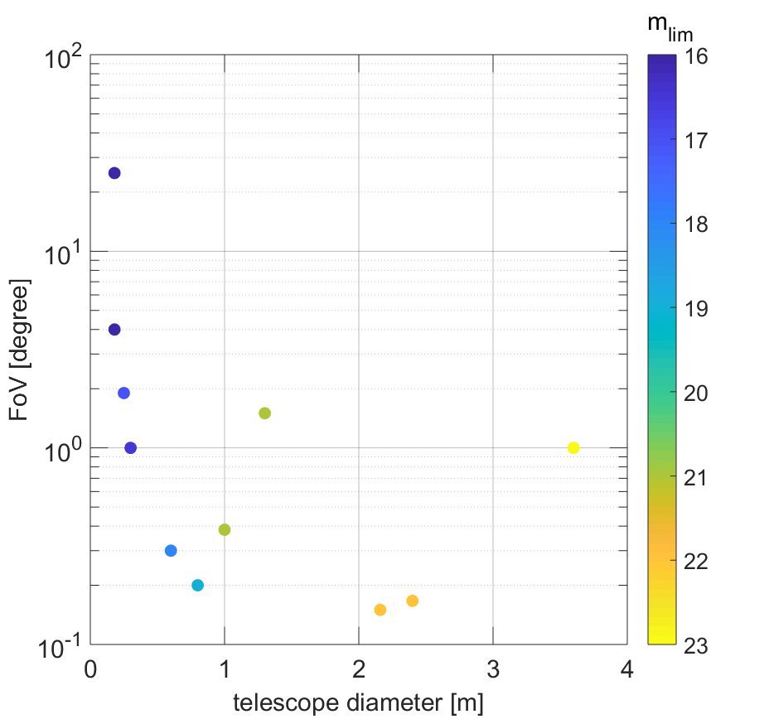
GRANDMA Individual performances
Survey mode
m_{lim} = [16-17]
Survey
Gal. targeting
ToO (photo/spec)
Gal. target mode
m_{lim} = [16-21 -> 22]
ToO mode
m_{lim} = [22-24] photo
m_{lim} ~ 18-19 spectro

Slide 30
GRANDMA Collective performances with external partners
GRANDMA + LCOGT
Ensure the full coverage of the both hemisphere and so are able to have a quick answer to any trigger in the sky
Continuous monitoring of the GW error box
Quasi instantaneous vetting of fake candidates and/or confirmation of valuable OTs
Ensure the high sampling of the GW/OT lightcurve in case of a detection
Ensure spectroscopic measurement at almost any time for several candidates
Full coverage of both hemisphere down to r = 21

Slide 31
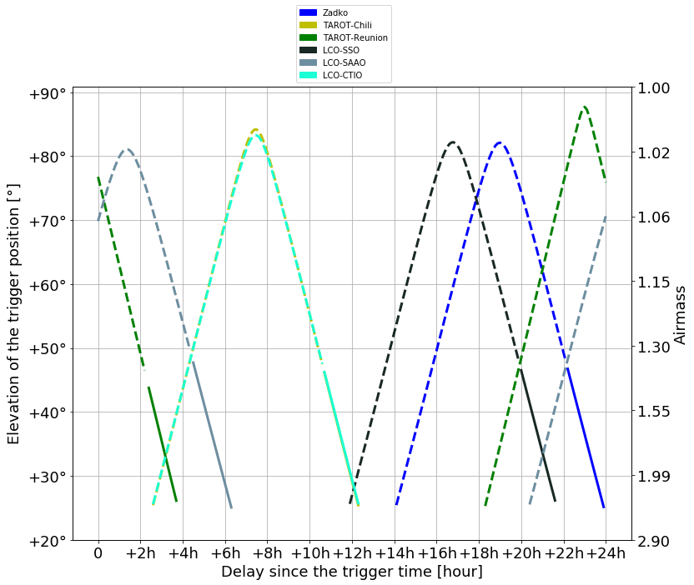
GRANDMA Management
Availability of each telescope and visibility of the trigger position
GW 170817A
Date : 12:41:04.000
Galaxy target : NGC 4993
Same tools used in the LCOGT system
Night time
Day time or HA<5hr
Elev_{min} = 25°

