Slide 1
SVOM workshop - May 2018
The host of GW170817
and determination of H₀
Nial Tanvir
University of Leicester

Slide 2
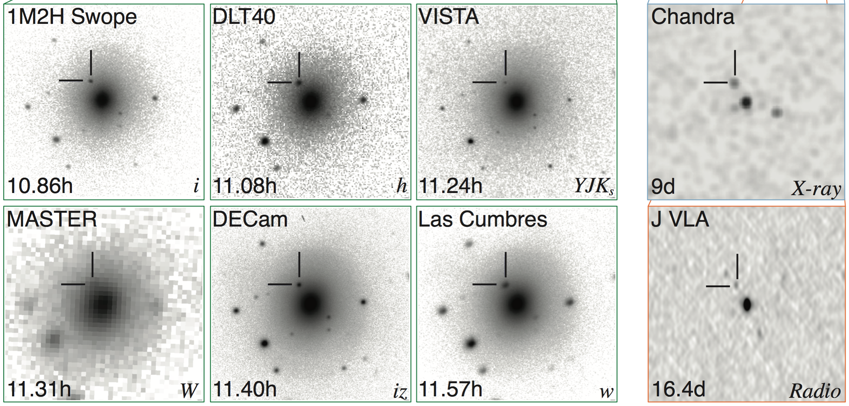
O/IR (X/Radio) counterpart discovery
GW 170817/AT2017gfo
Abbott et al. 2017, ApJL

Slide 3
Disturbed lenticular galaxy
D~40 Mpc
NGC4993
Analysis of shells suggests merger event ~400 Myr ago
(Ebrova & Bilek 2018)
HST

Slide 4
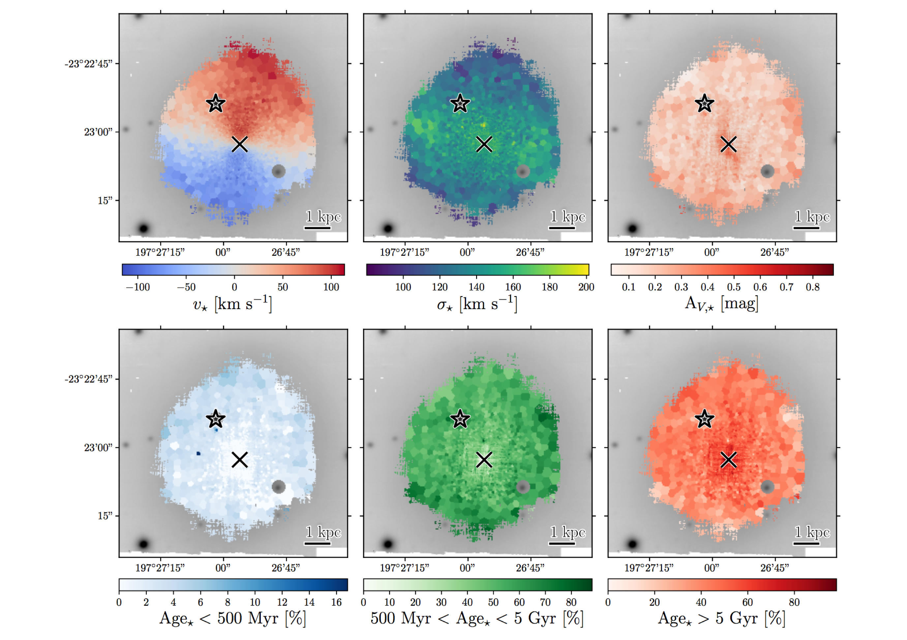
Predominantly old, with some young and intermediate population.
Levan et al. 2017
VLT/MUSE

Slide 5
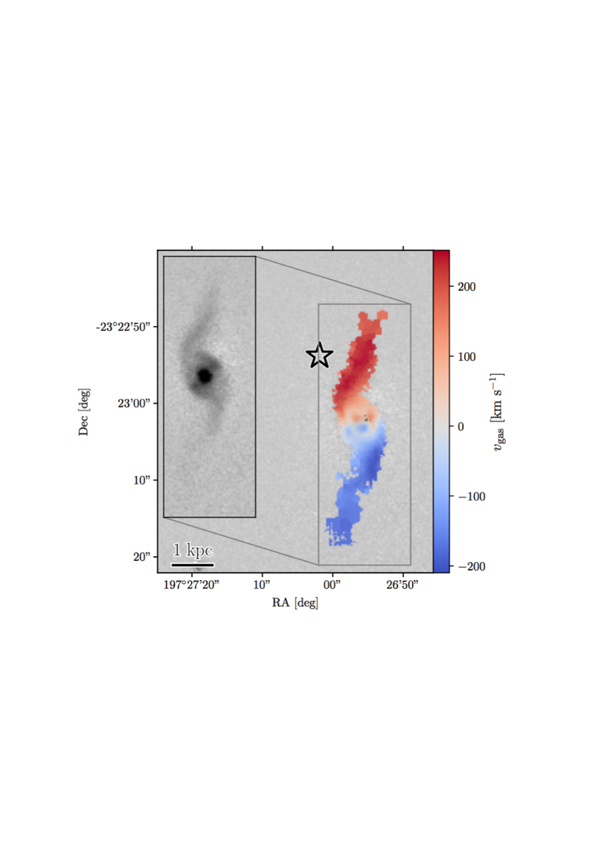
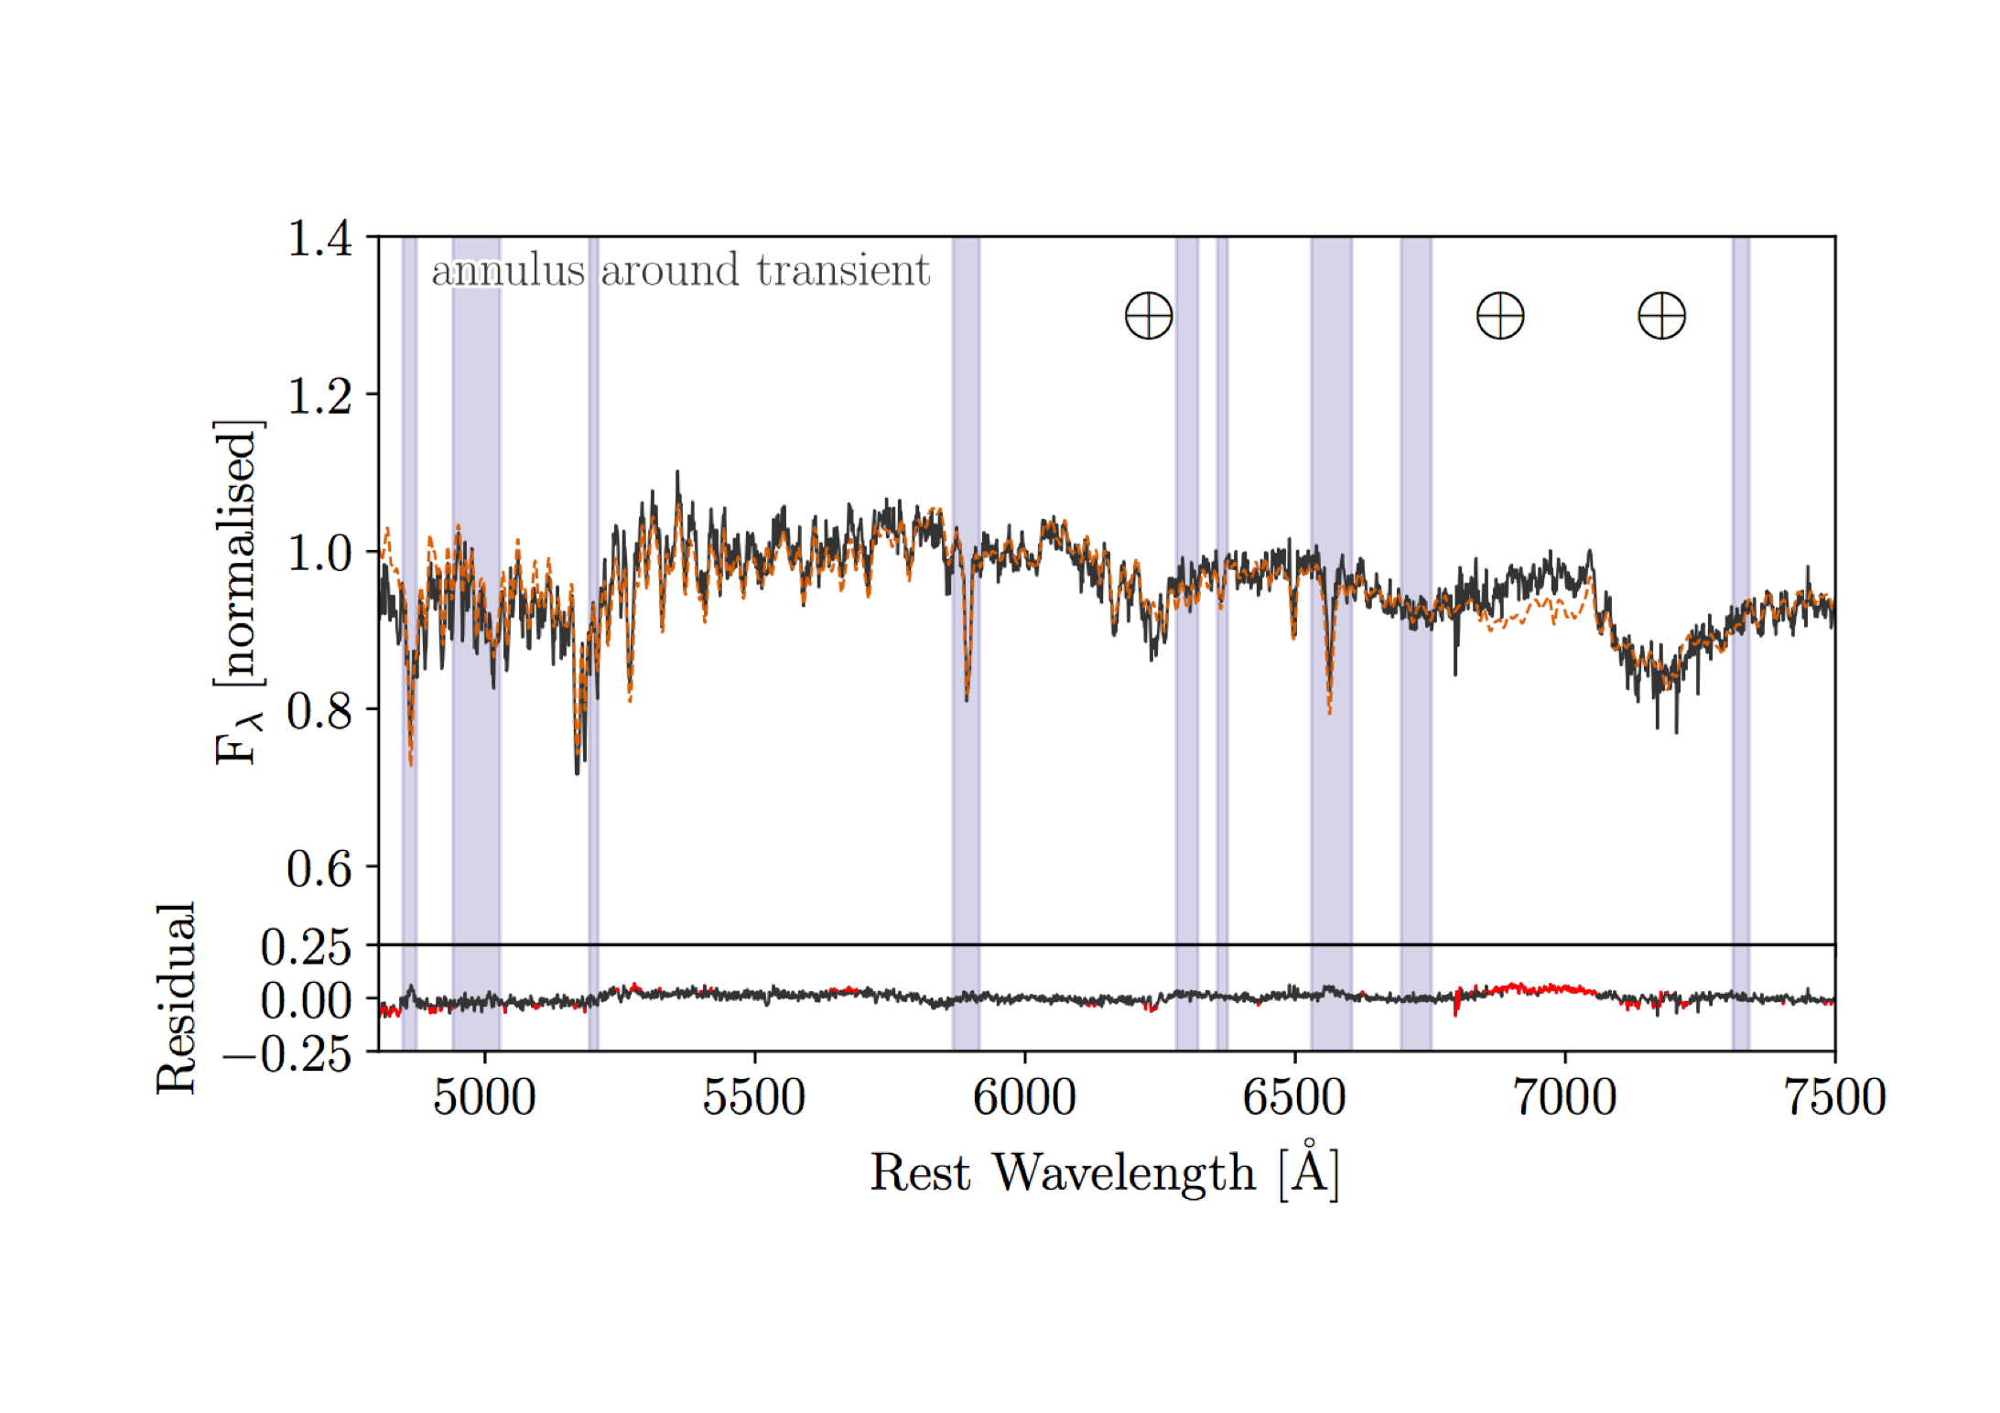
Ionized gas traces a more edge-on and rapidly rotating disk, presumably debris of the merger.
Location of transient – largely old population, with no sign for globular cluster or star formation.

Slide 6
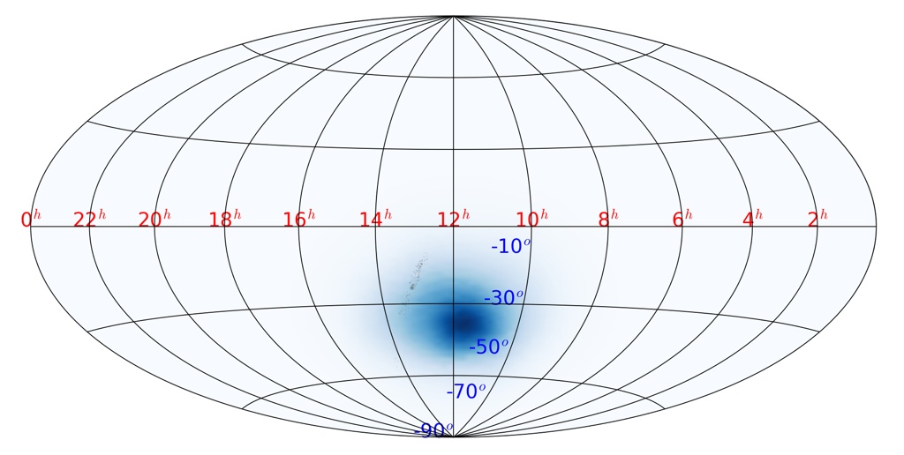
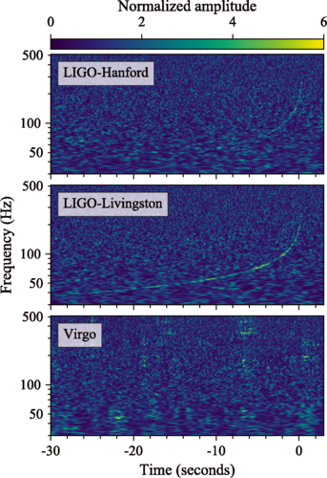
GW 170817 / GRB170817A

Slide 7
If Swift had been looking …

Slide 8
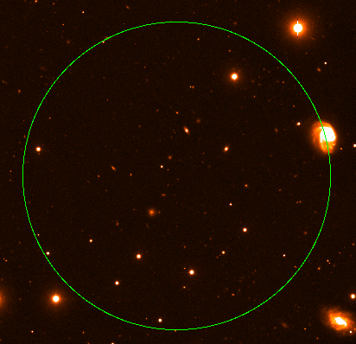
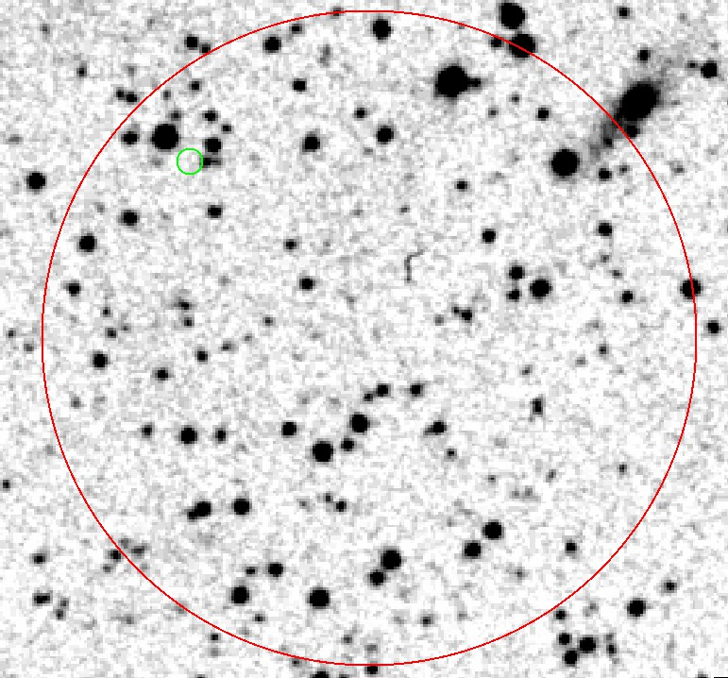
Not seen before
Out of ~100 short-GRBs from Swift, none consistent with such a low redshift host (even when host has not been identified)
GRB090506
Levan et al. 2007
GRB111020A
Tunnicliffe et al. 2014

Slide 9
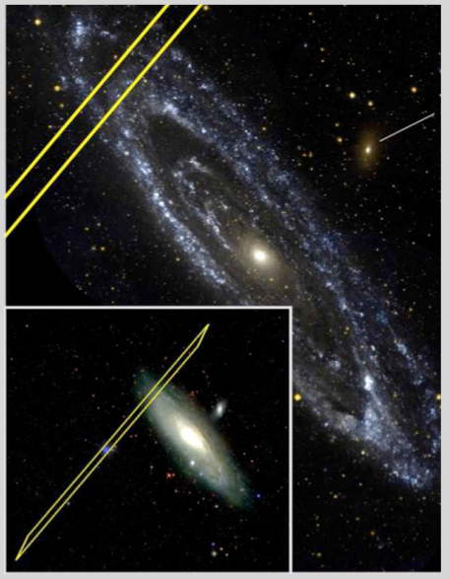
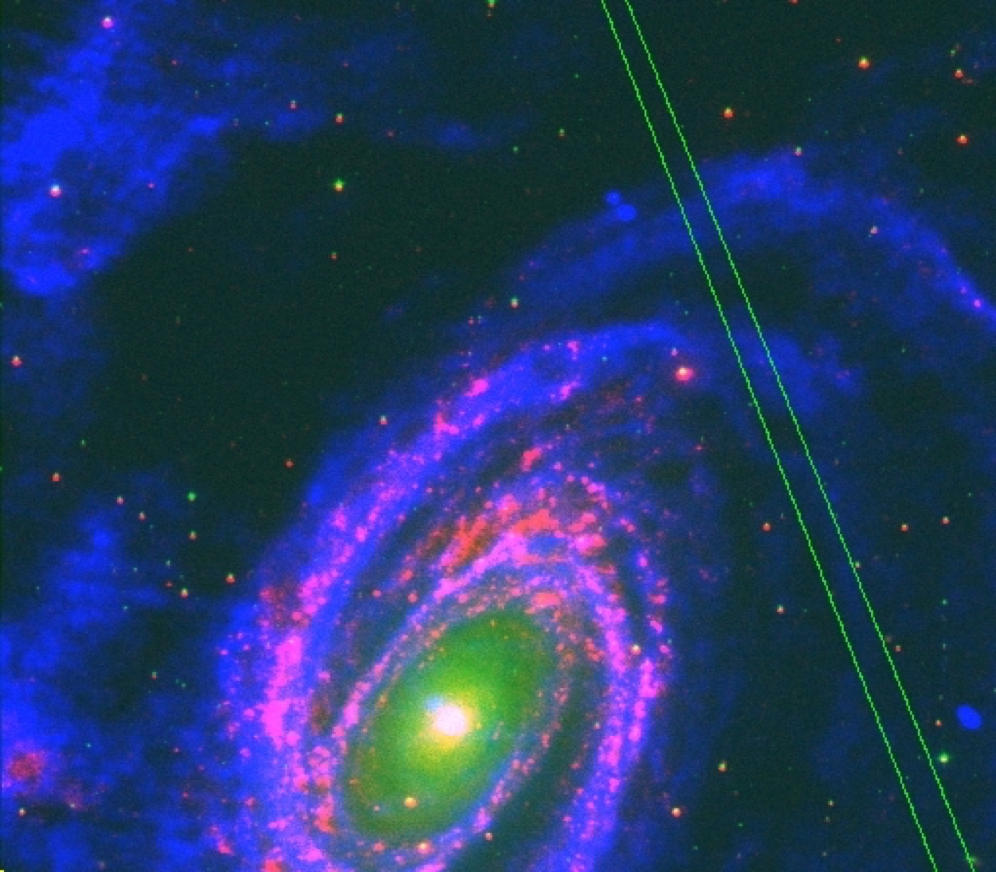
Not seen before
Potentially in M31 (e.g. Hurley et al. 2007) - similarly, lack of GW signal rules out binary merger (Abbott et al. 2008).
Potentially in M81 (e.g. Hurley et al. 2010), but lack of GW signal rules out BNS binary merger (Abadie et al. 2012).
GRB051103
GRB070201
Figure 2: M81 with optical in green (Digital Sky Survey), UV in pink (Martin et al. 2005) and 21cm radio emission in blue (Walter et al. 2008).
Figure 2: M81 with optical in green (Digital Sky Survey), UV in pink (Martin et al. 2005) and 21cm radio emission in blue (Walter et al. 2008).
Figure 2: M81 with optical in green (Digital Sky Survey), UV in pink (Martin et al. 2005) and 21cm radio emission in blue (Walter et al. 2008).
Figure 2: M81 with optical in green (Digital Sky Survey), UV in pink (Martin et al. 2005) and 21cm radio emission in blue (Walter et al. 2008).

Slide 10
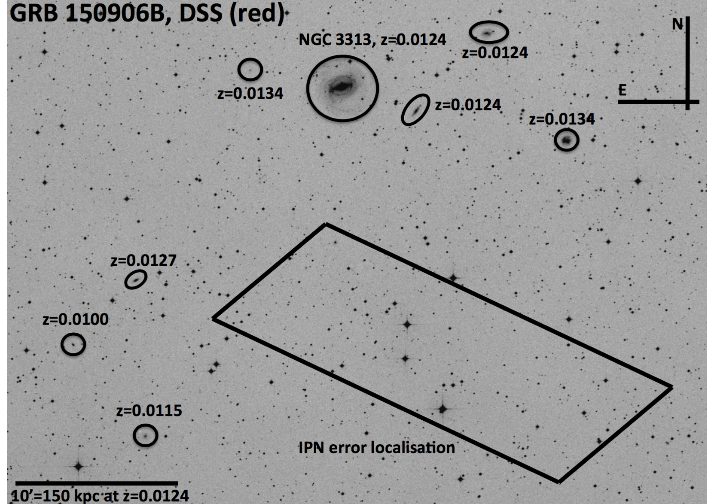
Not seen before
Levan et al. 2015
Also ruled out as source of GW (Abbott et al. 2017)

Slide 11
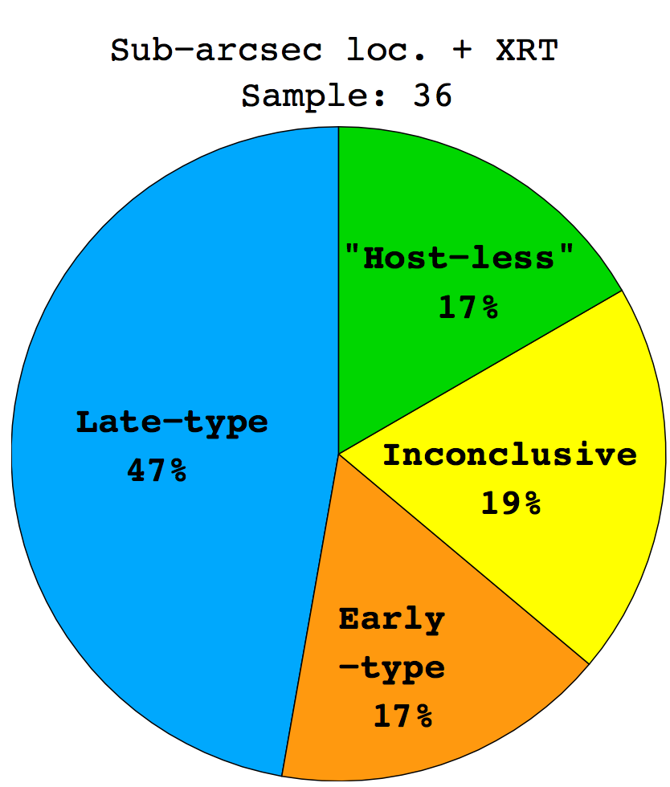
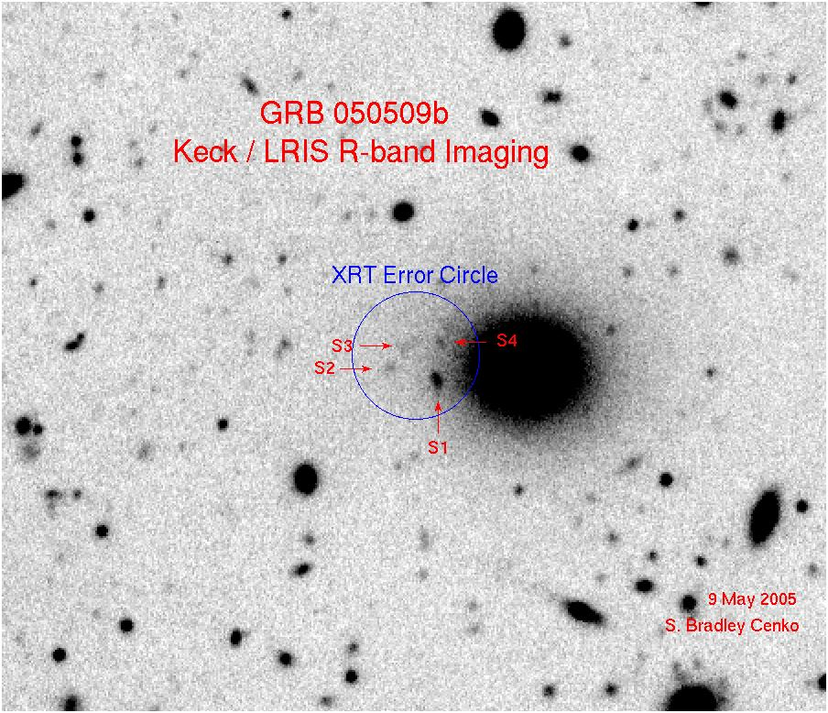
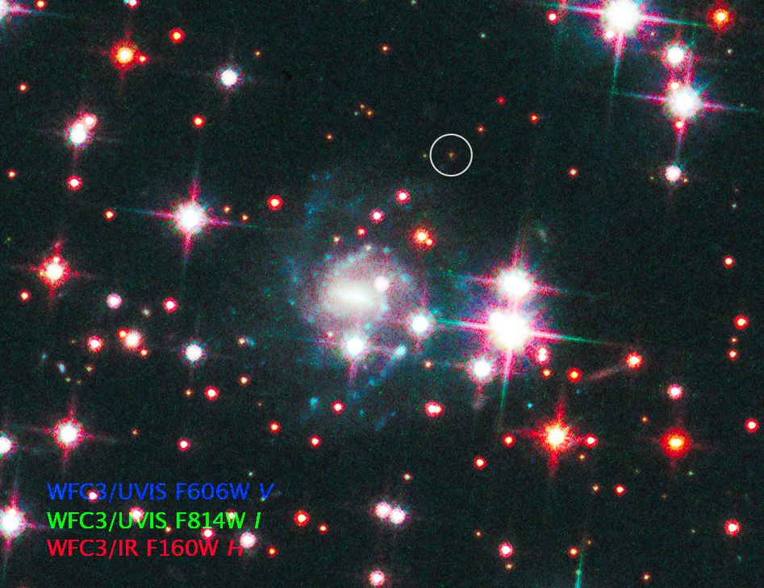
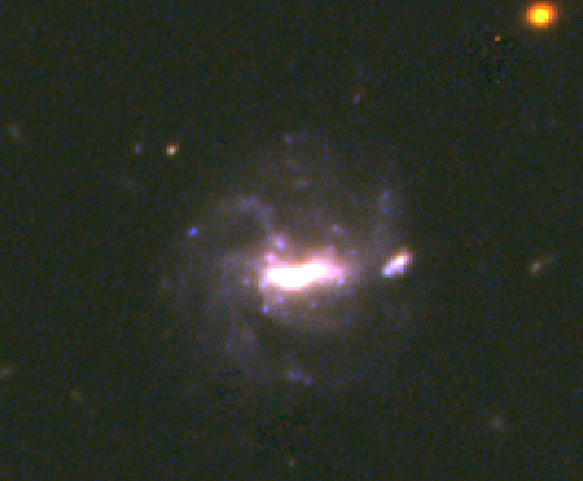
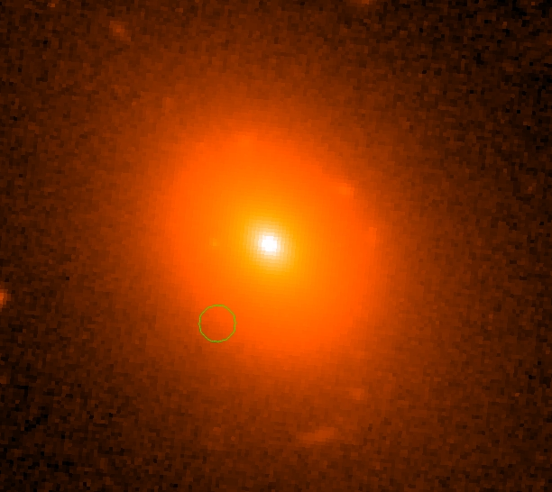
Hosts of short-GRBs
Host galaxies span a much larger range of stellar populations than long-GRBs.
050709B
Fox et al.
Consistent with NS compact binaries, with long merger times.
Fong et al. 2013

Slide 12
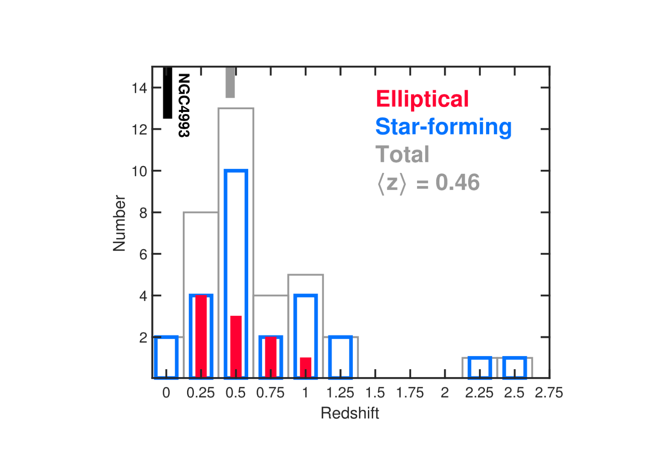
Hosts of short-GRBs
Host galaxies span a much larger range of stellar populations than long-GRBs.
050709B
Fox et al.
Fong et al. 2017
Consistent with NS compact binaries, with long merger times.

Slide 13
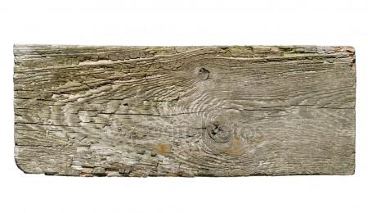
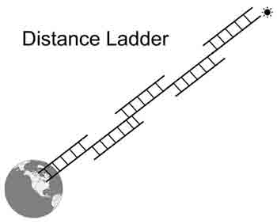
Hubble constant
Planck Collaboration 2016
Riess+2016 (SHOES)
67.8 ± 0.9 km/s/Mpc
73.2 ± 1.8 km/s/Mpc
Planck+2016

Slide 14
Standard sirens
Schutz 1986
d = 43.8⁺³₋₇ Mpc Abbott et al. 2017
d = 44 ± 8 Mpc (FP) Hjorth et al. 2017
d = 38 ± 9 Mpc (FP) Im et al. 2017
d = 40.7 ± 1.4 ± 1.9 Mpc (SBF) Cantiello et al. 2018
d = 41.7 ± 3 Mpc (GCLF) Lee et al. 2018

Slide 15
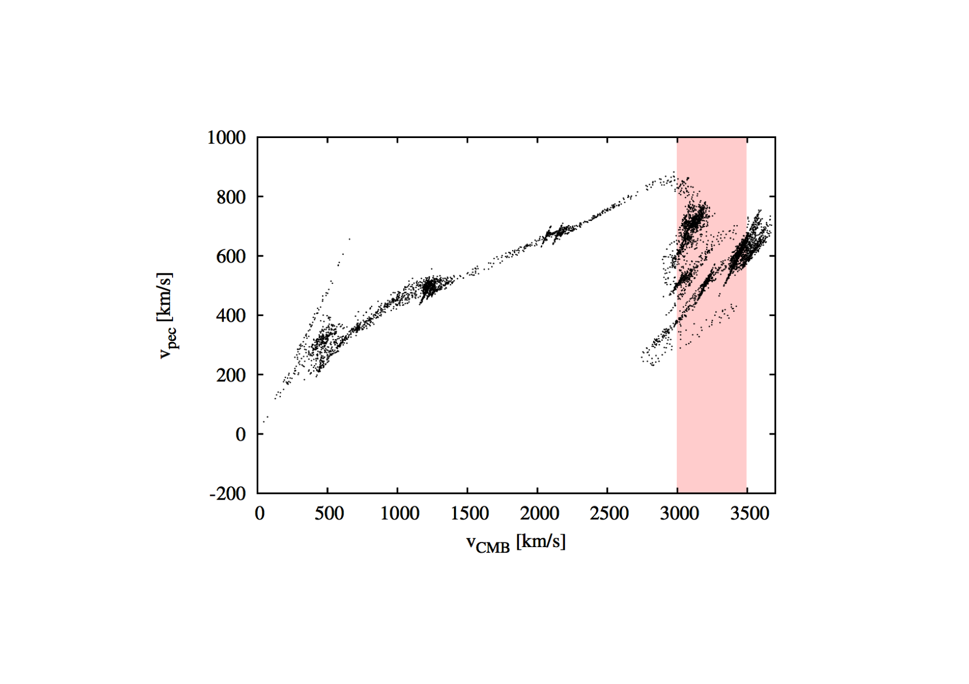
Recession velocity
vCMB = 3231±53 km s⁻¹
Hjorth et al. 2017 (after Li et al. 2014)
vCOSMIC = 2924±236 km s⁻¹

Slide 16
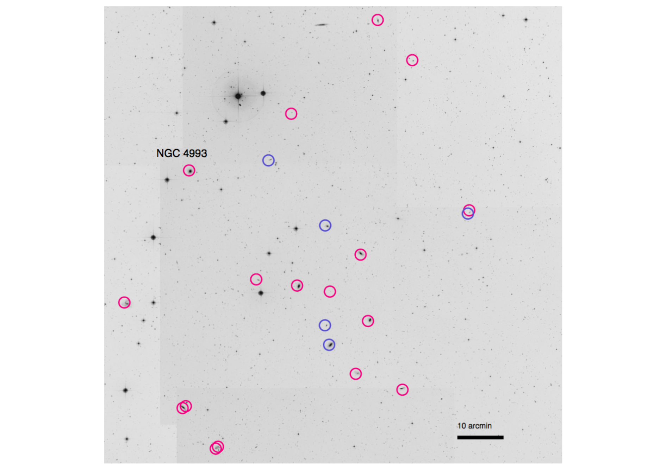
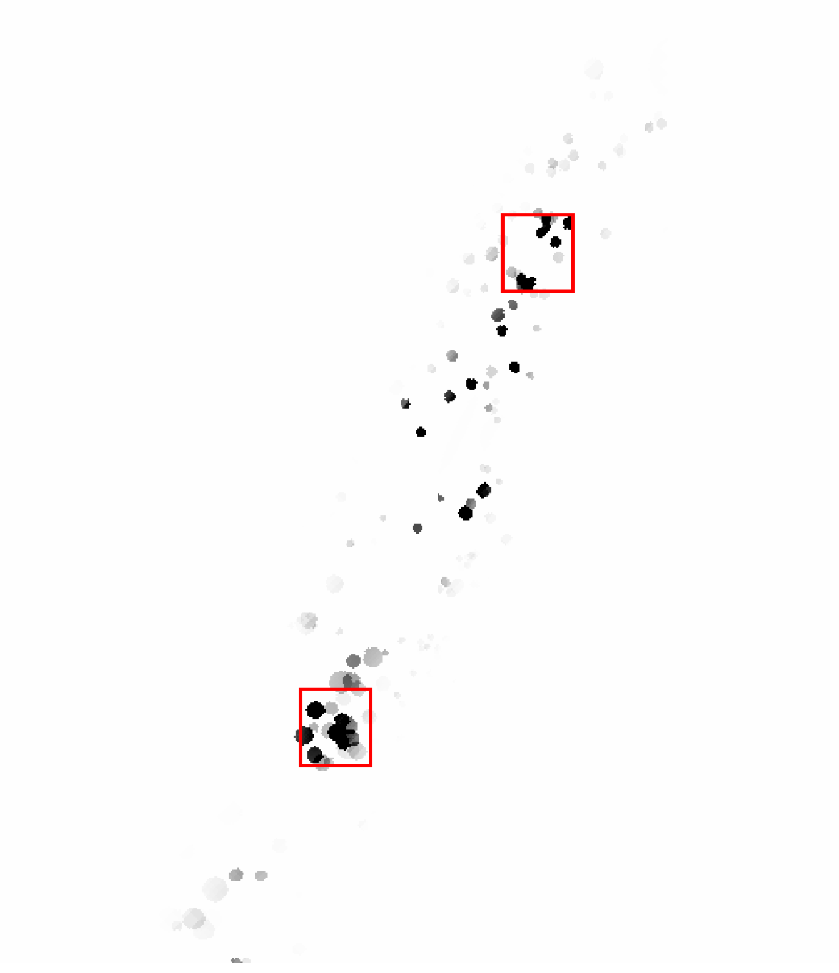

Slide 17
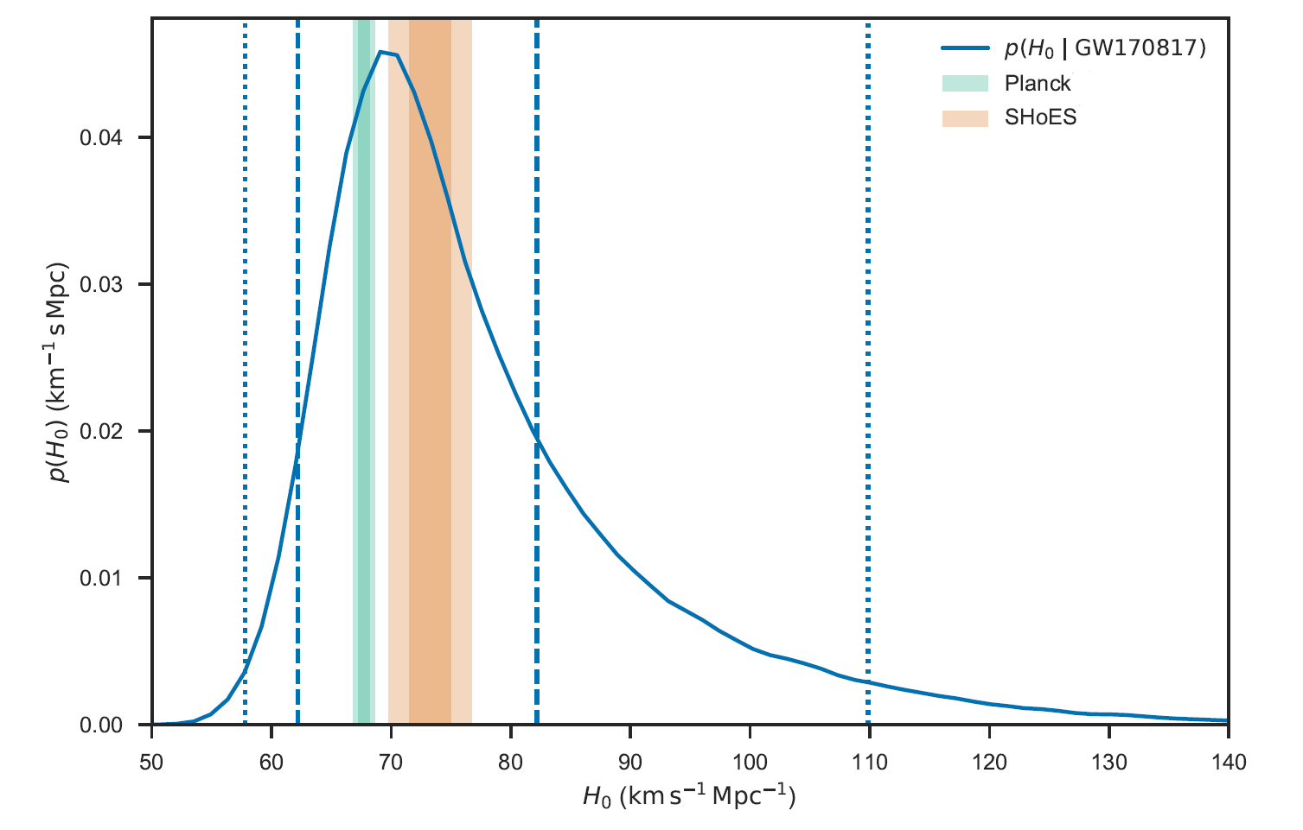
Hubble constant
Adopt vCOSMIC = 3017±166 km s⁻¹
70⁺¹²₋₈ km/s/Mpc
Abbott et al. 2017

Slide 18
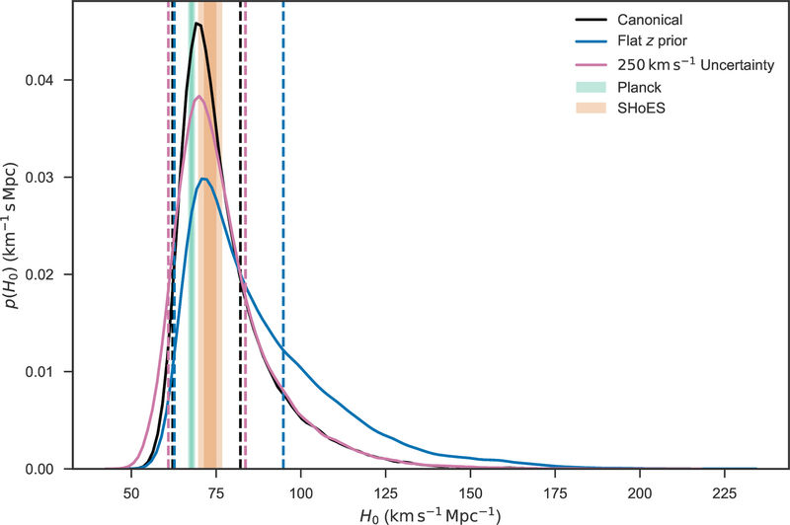
Sensitivity to priors

Slide 19
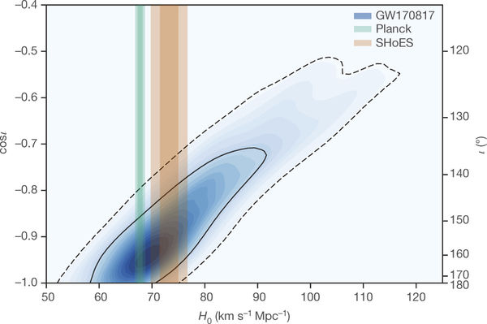
Degeneracy with inclination
Guidorzi et al. 2017
Cantiello et al. 2018

Slide 20
Conclusions and Future…
NGC 4993 now a well studied galaxy!
Disturbed early-type galaxy with primarily old stellar population.
Nothing remarkable with respect to the population of low-z SGRB hosts.
Merger itself well within the host.
Such SGRBs must be rare (no good evidence for previous examples in well-localised SGRBs)
First determination of Hubble constant from standard siren method, in good agreement with conventional methods i.e. ~70 ± 10 km/s/Mpc. Precision limited by uncertainty in inclination and comparatively large peculiar velocity.
Doesn’t yet help with tension between distance scale and CMBR measurements, but future samples of 10s of events would begin to do so. Peculiar velocity corrections become relatively small at >100 Mpc, although one may need to worry about other low level biases and systematics.

