Slide 1
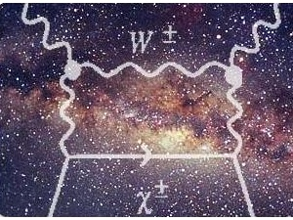
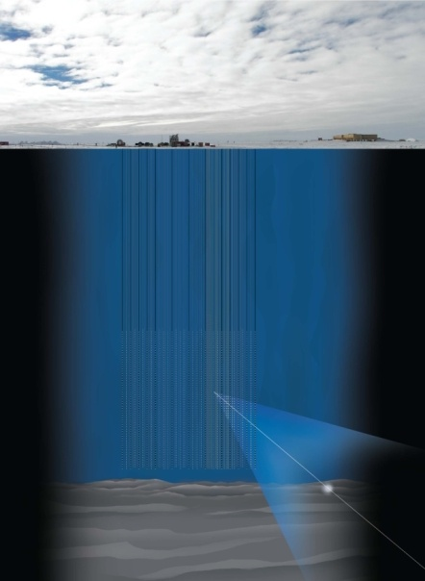
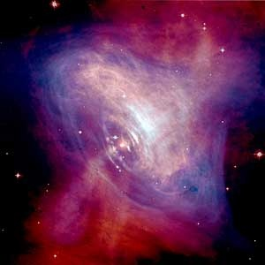
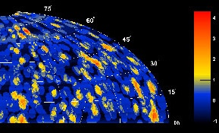
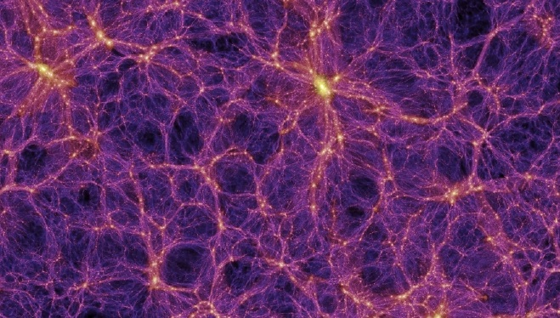
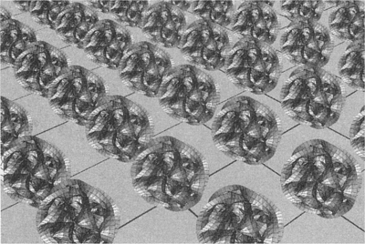
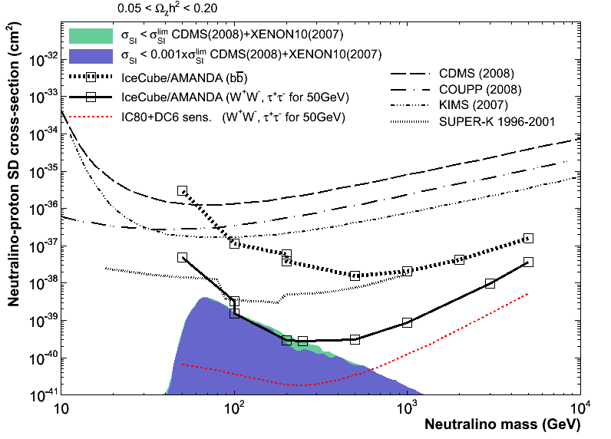
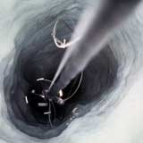
dark matter searches with IceCube
Carlos de los Heros
Uppsala University
IDM2010, Montpellier, July 20-25.2010

Slide 2
conclusions
IceCube is 92% complete (taking data with 79 strings from May)
Plan to reach 86 strings after the 2010/11 deployment season
First results from the 2008/09 data taking period (22/40 strings) are coming
IceCube is reaching the Galactic Center and Halo
  opens possibility for a multi-wavelength approach to dark matter searches
IceCube searches for DM competitive/(better) than direct searches
The low-energy extension, DeepCore, deployed. First data taking this year

Slide 3
outline
status of IceCube construction
dark matter searches with neutrino telescopes
search techniques and results from the Sun and Galaxy

Slide 4
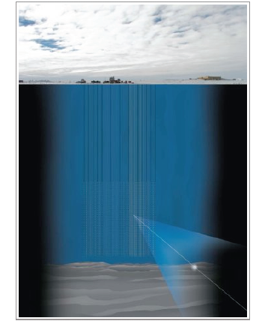
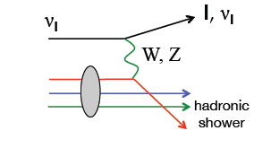
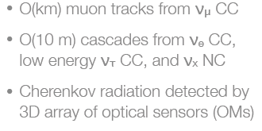
Neutrino telescopes
Neutrinos interact in or near the detector

Slide 5
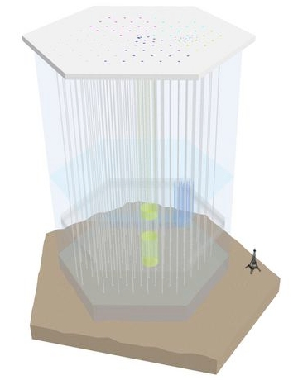
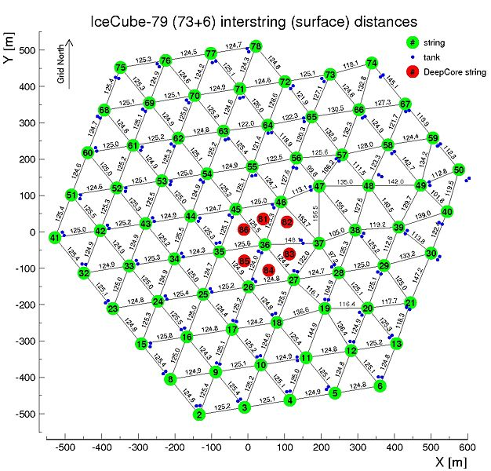
IceCube status
IceTop: Air shower detector
80 stations/2 tanks each
threshold ~ 300 TeV
20 strings installed during the 2009-2010 austral summer (Nov-Feb)
Total of 79 strings and 73 IceTop tanks
→ over 90% complete!
AMANDA
120m x 450 m
1450 m
InIce array:
80 Strings
60 Optical Modules
17 m between Modules
125 m between Strings
2450 m
DeepCore array:
6 additional strings
60 Optical Modules
7/10 m between Modules
72 m between Strings

Slide 6
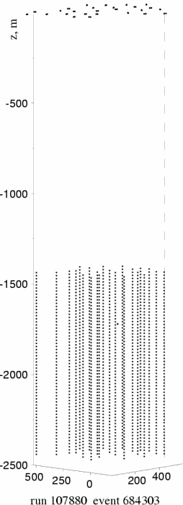
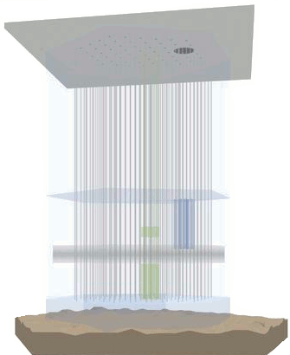
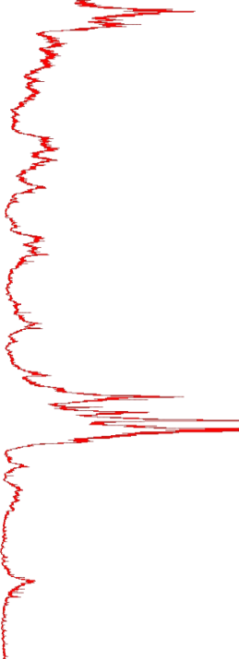
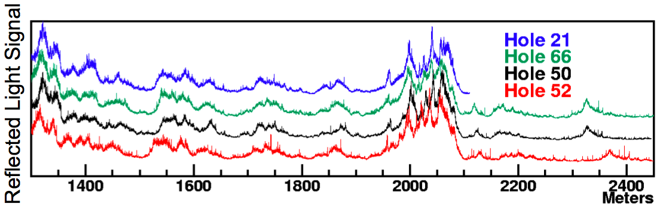
IceCube ice
Analyses sensitive to the optical properties of ice
South Pole Ice: extremely pure but presence of dust layers
Determine optical properties using LED and LASER sources
Average optical parameters at 400 nm:
  λ_{abs} ~110 m, λ_{sca} ~20 m above the dust layer
  λ_{abs} ~220 m, λ_{sca} ~40 m below the dust layer

Slide 7
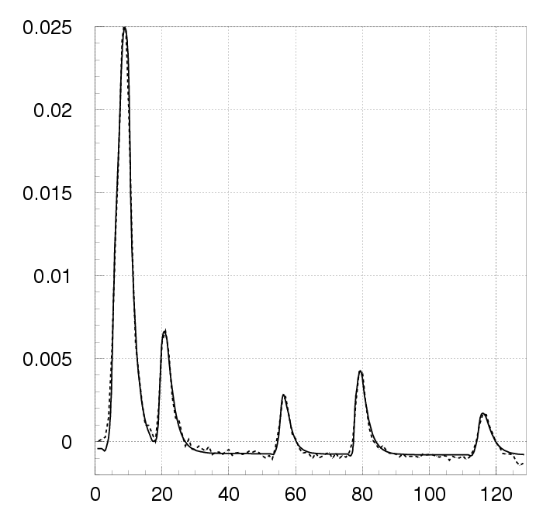
the Digital Optical Module
Each DOM is an autonomous data collection unit
- PMT: Hamamatsu, 10’’
- Digitizers:
ATWD: 3 channels. Sampling 300MHz, capture 400 ns
FADC: sampling 40 MHz, capture 6.4 μs
Dynamic range 500pe/15 nsec, 25000 pe/6.4 μs
- Flasher board:
12 controllable LEDs at 0º or 45º
digitized Waveform
Dark Noise rate ~ 400 Hz
Local Coincidence rate ~ 15 Hz
Deadtime < 1%
Timing resolution ≤ 2-3 ns
Power consumption: 3W
Clock stability: 10⁻¹⁰ ≈ 0.1 nsec / sec
Synchronized to GPS time every ≈5 sec at 2 ns precision

Slide 8

search for dark matter
A wealth of candidates from different theoretical models:
dark baryons (primordial nucleosynthesis constraints)
MACHOs – BHs, neutron stars, white/brown dwarfs... (microlensing constraints)
neutrinos (mass constraint)
primordial Black Holes (cosmological constraints)
Weakly Interacting Massive Particles ( “x”MSSM neutralinos, Kaluza-Klein modes...)
‘Strongly’ Interacting Supermassive particles (Simpzillas)
axions (too light+astrophysical constrains)
many others
... + (alternative gravity theories)

Slide 9
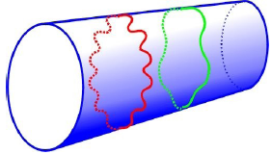
dark matter candidates considered
WIMPS SIMPS
Arise in extensions of the Standard Model
Assumed to be stable: relics from the Big Bang
weak-type Xsection gives needed relic density
m from few GeV to few TeV
MSSM candidate: lightest neutralino,
χ⁰₁ = N₁B + N₂W³ + N₃Hº₁+ N₄Hº₂
extra dimensions: Lightest Kaluza-Klein mode, B¹
SIMPS/Simpzillas/Superheavy DM
Produced non-thermally at the end of inflation through vacuum quantum fluctuations
strong Xsection = not-weak
m from ~10⁴ GeV to 10¹⁸ GeV
can be accommodated in
supersymmetric or UED models
R

Slide 10
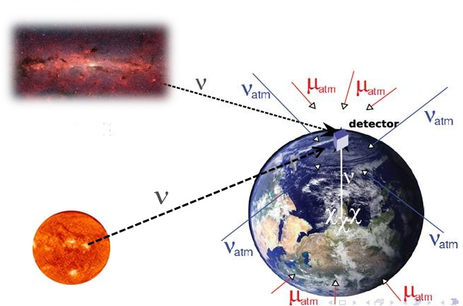
indirect searches for DM candidates
DM-induced neutrinos:
qq
κκ, χχ,ss → l⁺l⁻ → ν W, Z, H
Kaluza-Klein modes an additional useful channel:
κκ → νν
signature: ν excess over background from
Sun/Earth/Galactic Halo direction
look at objects where the WIMP can be gravitationaly trapped and annihilate:
Sun, Earth and Galactic Halo
A lot of physics uncertainties involved:
- relic density calculations
- DM distribution in the halo
- velocity distribution
- χ,Κ,S properties (MSSM/UED...)
- interaction of χ,K,S with matter (capture)
- self interaction (annihilation)
Atmospheric muons ~O(10⁹) events/year (downwards)
Atmospheric neutrinos ~O(10³) events/year (all directions)

Slide 11
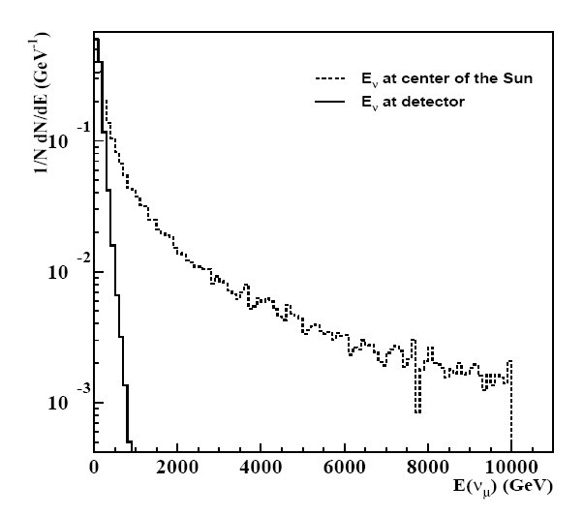
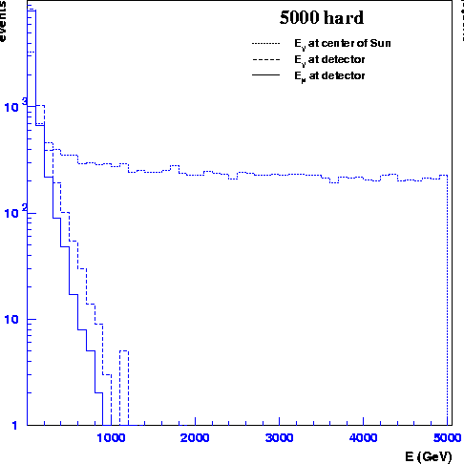
expected neutrino energies at the detector
Simpzilla → tt @ Sun
5000 GeV Neutralino → WW @ Sun
(2.8x10⁵ √m_{x}/(10¹² GeV) tops per annih.)
GeV (W⁺W⁻)
→ Indirect dark matter searches from the Sun are a low-energy analysis in neutrino
telescopes: even for the highest DM masses, we do not get muons above few 100 GeV
Not such effect for the Earth and Halo (no ν energy losses in dense medium)

Slide 12
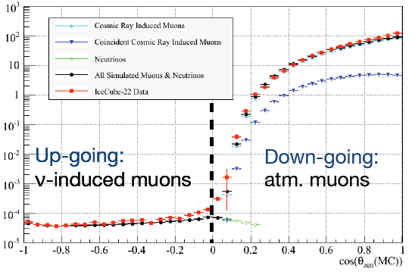
example: background rejection in IceCube-22
Background:
atmospheric muons
coincident atmosph. muons
atmospheric neutrinos
Data/MC comparison IceCube-22
High-purity atmospheric neutrino
sample achieved after quality cuts

Slide 13
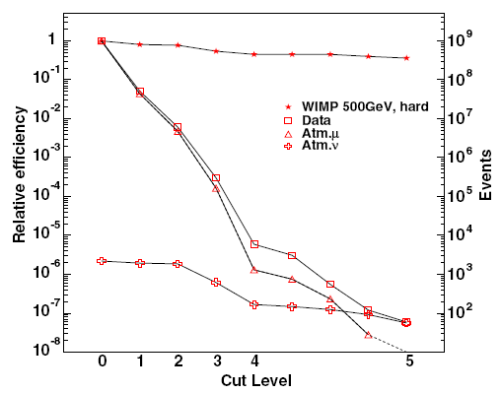
analysis strategies
sequential cuts
Triggered data still dominated by atmospheric muons
Reject misreconstructed atmospheric
muon background through event and track quality parameters
Use of linear cuts and/or multivariate methods to extract irreducible atmospheric neutrino background
(Neural Nets, Support Vector Machines, Boosted Decision Trees)
DM searches directional: good additional handle on event selection → distribution-shape analysis
(allow for a higher background contamination)
shape analysis
Solid angle to the Sun ψ (rad)

Slide 14
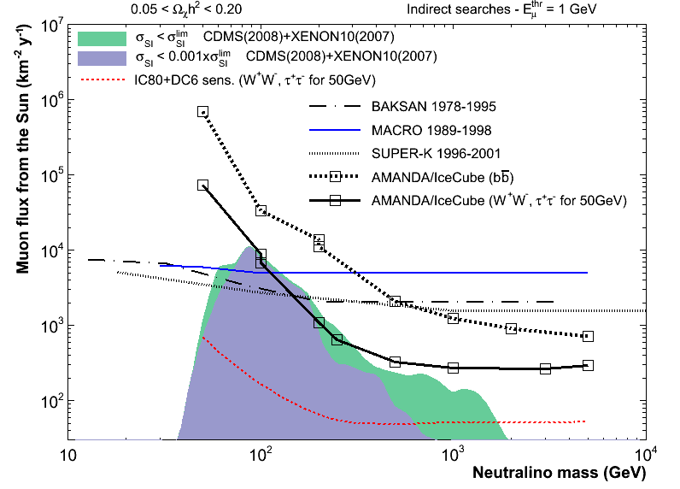
analysis chain
Experimentally
obtained quantity
N_{data}, N_{bck}
→ N₉₀
ψ_{data}, ψ_{bck}
Use additional
MC-based scripts
for conversion
to a muon flux

Slide 15
Solar WIMP search results: I
90% CL muon flux limit from the Sun vs neutralino mass
(compared to MSSM scans)
90% CL neutralino-p Xsection limit vs neutralino mass
(compared to MSSM scans)
Φ_{μ} → Γ_{A} → C_{c} → σ_{Xp}
(particle physics and solar model)
Phys.Rev.Lett.102,201302,2009

Slide 16
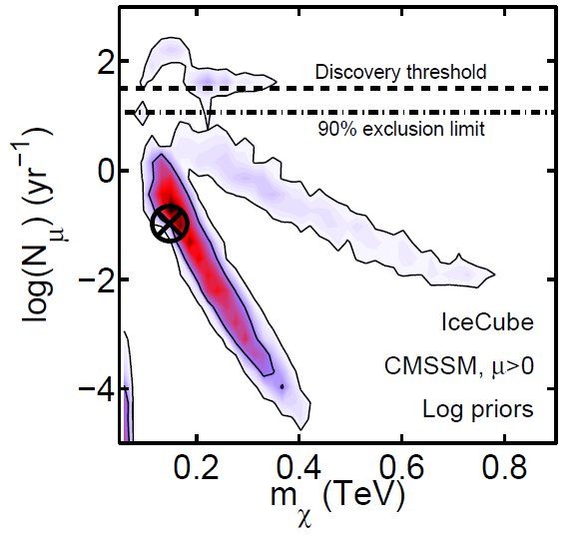
Solar WIMP search results: II
expected number of events from the Sun vs neutralino mass
(compared to cMSSM scans using Bayesian scans)
Markov-Chain MC sampling allows
to make statements about the
relative probability of different models,
given the current data
The density of sampled points
is proportional to the probability
density
JCAP 0908:034,2009

Slide 17
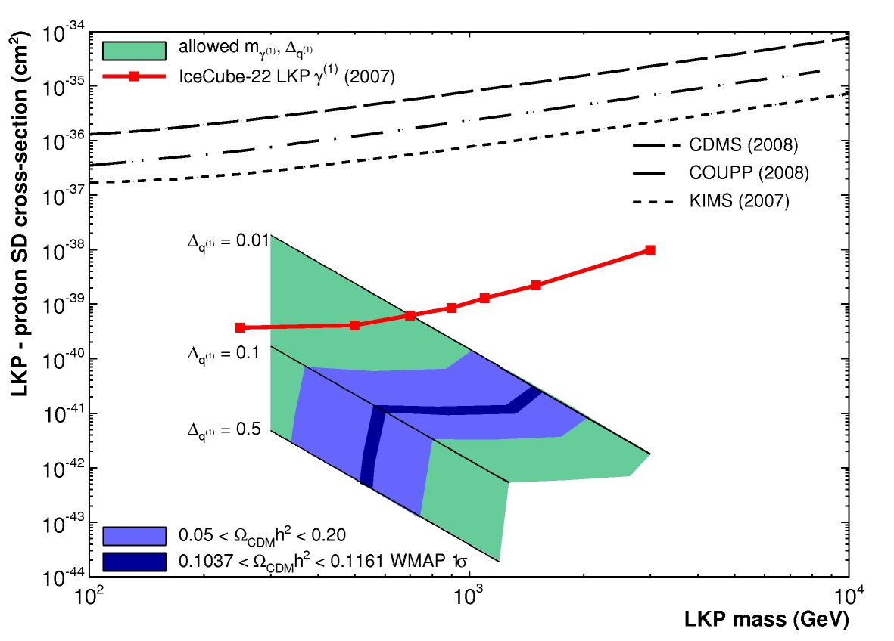
Solar LKP search results
90% CL LKP-p Xsection limit vs LKP mass
Phys. Rev. D 81, 057101 (2010)

Slide 18
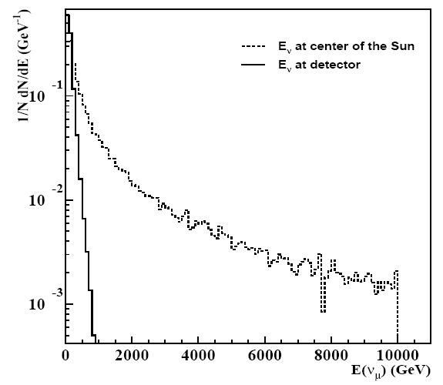
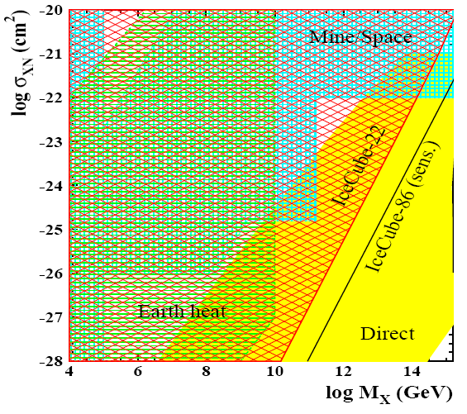

Solar simpzilla search results
90% CL simpzilla-p Xsection limit vs simpzilla mass
Albuquerque, de los Heros, Phys. Rev.D81, 063510 (2010)

Slide 19
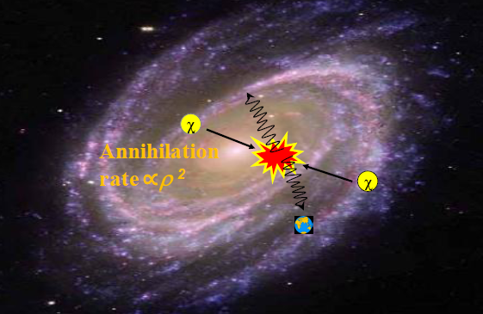
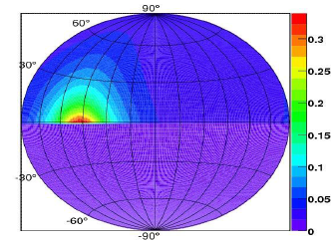

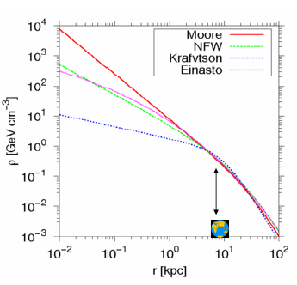
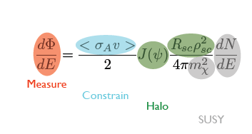
DM from the Galactic halo
signal
region
bckgr
region
Look for an excess of events in the on-source region w.r.t. the off-source:
IC22: observed on-source: 1367 evts
observed off-source: 1389 evts
Need expected neutrino flux from SUSY and halo model. Limit on the self annihilaton cross section:
limit

Slide 20
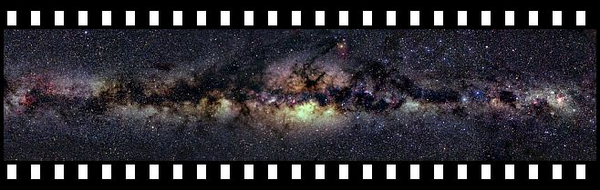
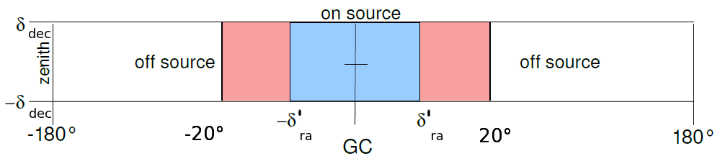
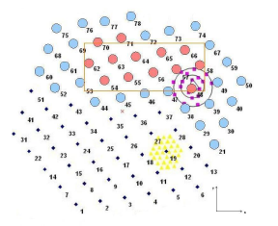
DM from the Galactic center
not to scale
Look for an excess of events in the on-source region w.r.t. the off-source
on-source region below the horizon: need to veto downgoing μs.
Use central strings of detector as fiducial volume, surrounding layers as veto. Only from IC40 this is possible.
IC40: observed on-source: 798842 evts
observed off-source: 798819 evts
veto
region
fiducial
volume
Same strategy as in the galactic halo analysis:

Slide 21
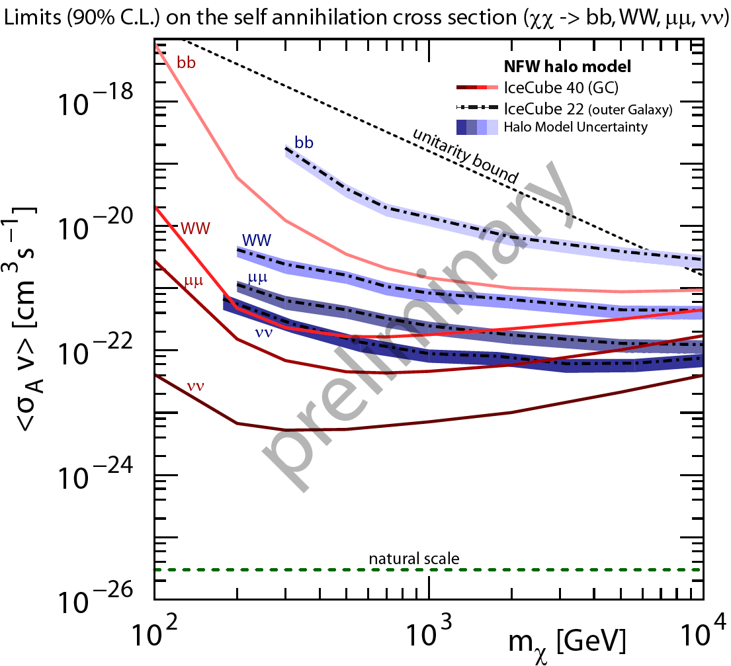
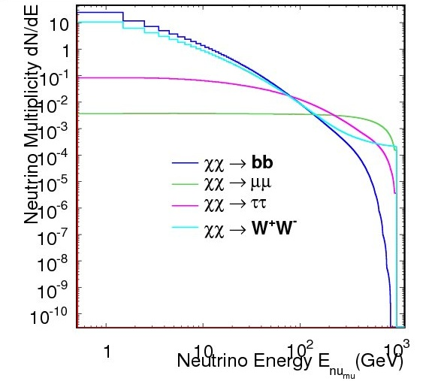
IC-22/40 results from DM searches from the galaxy
line thickness reflects uncertainty due to halo profile
no energy loss of secondaries before decay: harder spectra than in Sun for same annihilation channel

Slide 22
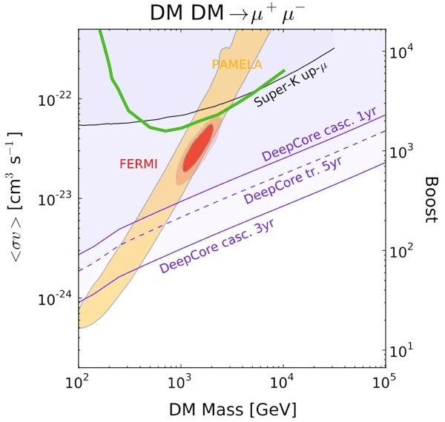
IC-40 galactic center results
multi-wavelength approach to dark matter searches:
IceCube results in the context of Pamela and Fermi anomaly
IceCube-40
preliminary
not IceCube
predictions
Phys Rev D81, 043508, (2010)

Slide 23
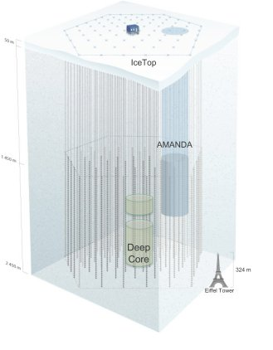
IceCube DeepCore
Aim: lower energy threshold through a denser core in the center of the IceCube array
6 additional strings of 60 high quantum efficiency PMTs
denser instrumentation:
7 m DOM vertical spacing (17m in IceCube),
72 m inter string spacing (125m in IceCube)

Slide 24
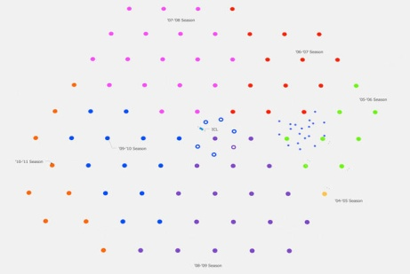
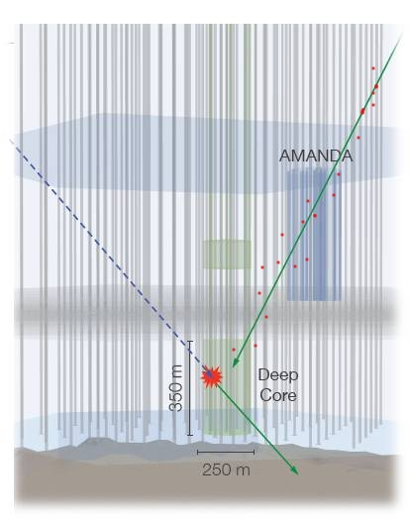
full sky sensitivity using IceCube surrounding strings as a veto:
375m thick detector veto: three
complete IceCube string layers
surround DeepCore
◊ access to southern hemisphere, galactic center and all-year Sun visibility
preliminary studies show 10⁴ background rejection with 98% signal efficiency possible
Vetoing capabilities

Slide 25
conclusions
IceCube is 92% complete (taking data with 79 strings from May)
Plan to reach 86 strings after the 2010/11 deployment season
First results from the 2008/9 data taking period (22/40 strings) are coming
IceCube is reaching the Galactic Center and Halo
  opens possibility for a multi-wavelength approach to dark matter searches
IceCube searches for DM competitive/(better) than direct searches
The low-energy extension, DeepCore, deployed. First data taking this year

Slide 26
FIN
  “In order to make further progress, particularly in the field of cosmic rays, it will be necessary to apply all our resources and apparatus simultaneously and side-by-side”
  (V. Hess. Nobel Lecture, 1936)
All these searches should be taken as a part in the grand scheme of efforts in searches of physics beyond the SM using accelerators, underground detectors, space-based detectors, gamma-ray telescopes and air shower arrays

