Slide 1
Simplified Study of
Storey Configurations
“Km3NeT-SOFT-0001”
WP2WPD ELOG entry 02
John Carr (CPPM)
Full details in note
Simplified study with some conclusions today
Complete simulations in progress

Slide 2
Motivations for study
Optimise “NuOne” configuration
- in particular OM orientation
Comparison of different layouts

Slide 3
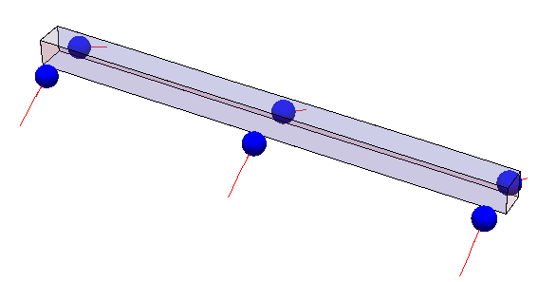
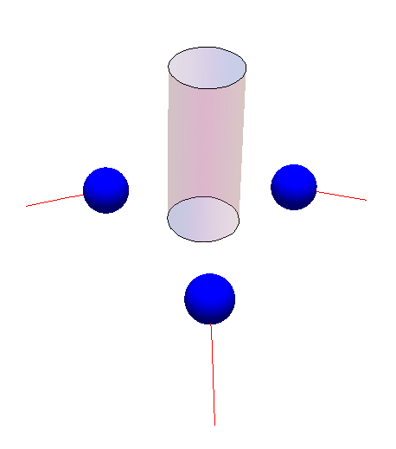
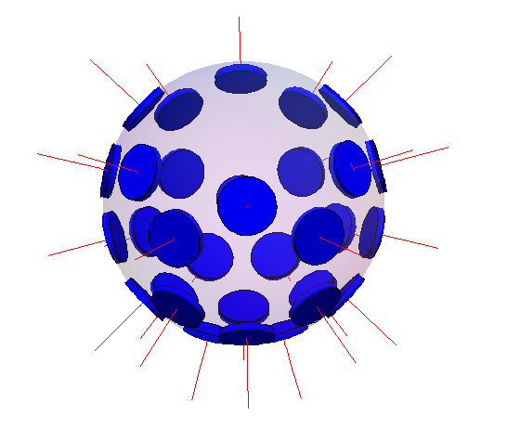
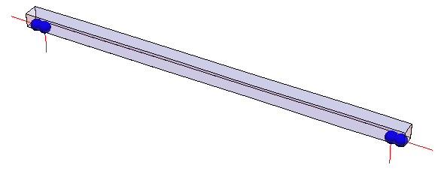
Storey Configurations Simulated
8m
NuOne
12m
0.4m
1m
NEMO
ANTARES
MultiPMT

Slide 4
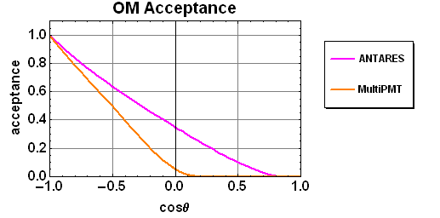
Storey parameters
Detector name | PMT /storey | PMT orientation | PMT size | Quantum efficiency | OM transmission | area per storey
NuOne | 6 | 60° | 8" | 35% | 0.98 | 0.067 m²
NEMO | 4 | 0°, 90° | 10" | 23% | 0.94 | 0.044 m²
ANTARES | 3 | 45° | 10" | 23% | 0.94 | 0.033 m²
MultiPMT | 31 | 0°-124° | 3" | 42% | 0.97 | 0.057 m²
Angular acceptance of OM
ANTARES
NuONE
NEMO
MultiPMT J-P. Ernenwein
ANTARES
“Genova”

Slide 5
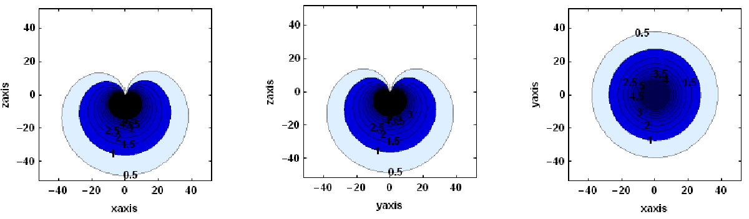
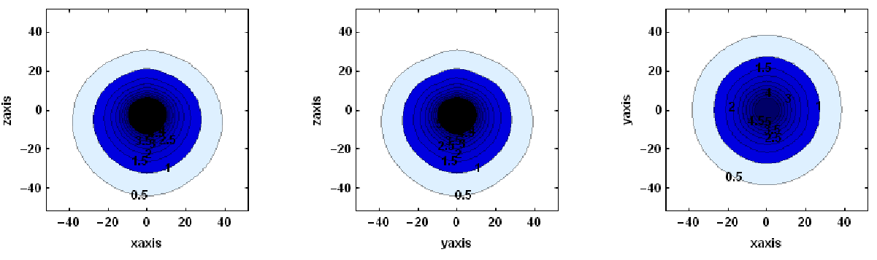
Light detection fields
ANTARES
MultiPMT

Slide 6
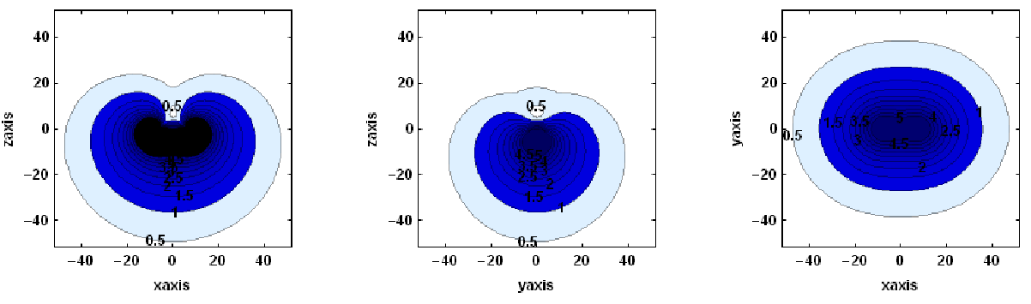
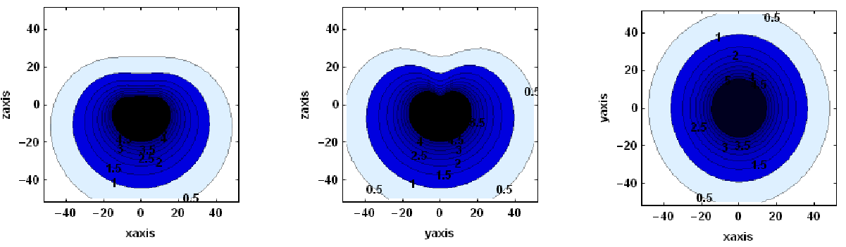
Light detection fields
NEMO
NuOne

Slide 7
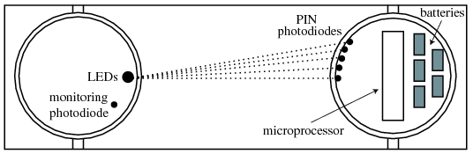
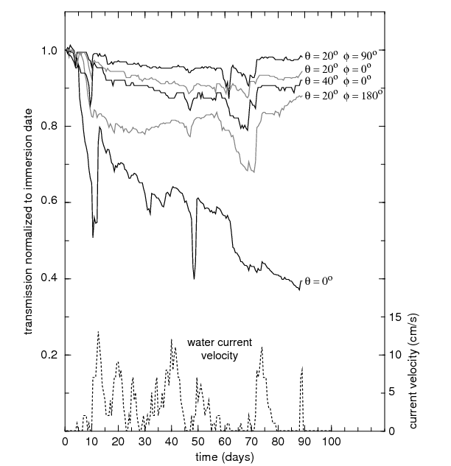
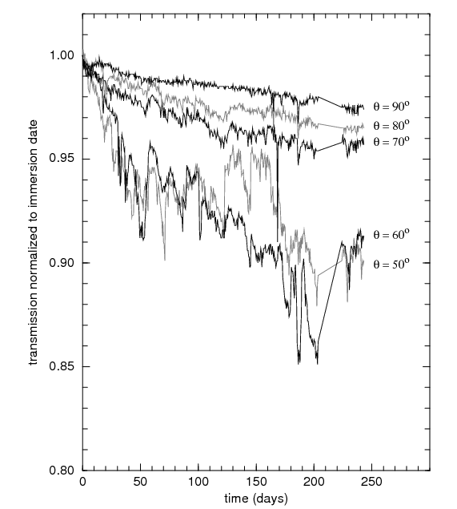
Biofouling /Sedimentation
ANTARES Site Exploration results
Angle of surface to horizontal | 0° | 30° | 70° | 90°
Transmission coefficient | 0.00 | 0.90 | 0.94 | 0.99

Slide 8
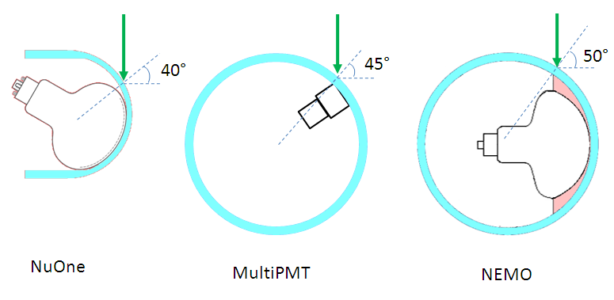
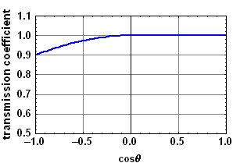
Simulation of light loss
Worst case light incidence
Apply 10% transmission
loss for vertical tracks

Slide 9
Simulation
NESSY : ANTARES-SOFT-2007-011
Cherenkov + EM Showers
Generate isotropic tracks in can height=30m, radius =55m below one storey
Default energy for plots 10 TeV unless otherwise indicated

Slide 10
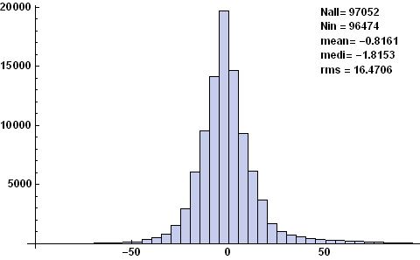
Time differences in storey
Time difference all hits in storey relative to mean (only geometry)
ANTARES
MultiPMT
-50 0 50 Δt (ns)
-50 0 50 Δt (ns)
NuOne
NEMO
-50 0 50 Δt (ns)
-50 0 50 Δt (ns)

Slide 11
Angular efficiency
Efficiency
for coincidence
of at least 2 PMTs
in storey

Slide 12
NuOne efficiency
Energy dependence

Slide 13
OM orientation

Slide 14
Comparison of four configurations
Efficiency for two photons in storey
−0.5<cosθ<1.0

Slide 15
Comparison
 |  |  | NuOne | NEMO | multiPMT | ANTARES
total effective photocathode area (m²) |  |  | 0.067 | 0.044 | 0.057 | 0.033
Efficiency | one photon |  | 0.68 | 0.59 | 0.53 | 0.51
 | two photon |  | 0.45 | 0.36 | 0.30 | 0.29
 | coincidence |  | 0.41 | 0.31 | 0.30 | 0.24
Efficiency relative | one photon |  | 1.3 | 1.2 | 1.0 | 1
to ANTARES | two photon |  | 1.5 | 1.2 | 1.0 | 1
 | coincidence |  | 1.7 | 1.3 | 1.3 | 1
Efficiency per area | one photon |  | 0.33 | 0.44 | 0.30 | 0.51
0,033 m² | two photon |  | 0.22 | 0.27 | 0.17 | 0.29
 | coincidence |  | 0.20 | 0.23 | 0.17 | 0.24
Efficiency ratio | two/one photon |  | 0.66 | 0.61 | 0.58 | 0.58
 | coincidence/two photon |  | 0.92 | 0.84 | 0.98 | 0.81
Efficiency / m² NuOne/ANTARES= 0.83
Statistical errors < 0.003

Slide 16
Cost Model of Stéphan Beurthey
How does detection unit with 40 storeys each 3 OM
compare with 20 storeys each 6 OM ?
Number of PM | 3 | 6
Floor size(m) | 2,5 | 2,5 | m
Number of container | 0 | 0
Electric connection | 3 | 6
Number of floor | 40 | 20
Distance between floor (m) | 15 | 30 | m
Number data cable | 1 | 1
Number mechanical cable | 1 | 1
Number of wet connector | 1 | 1
IL length (m) | 300 | 300 | m
Total cost | 1026394 | 786394 | €/line
Indicative cost 20 Storeys/40 Storeys = 0.77

Slide 17
Conclusions so far
All configuration symmetric in azimuth
Coincidences ≈ two photons for NuOne
Configurations similar per effective area
Only complete cost estimations can objectively decide
Full simulations needed,
but simplified can reduce parameter space

