Slide 1

Brief Introduction of CNIC
September , 2017
中国科学院计算机网络信息中心
Computer Network Information Center,
Chinese Academy of Sciences

Slide 2

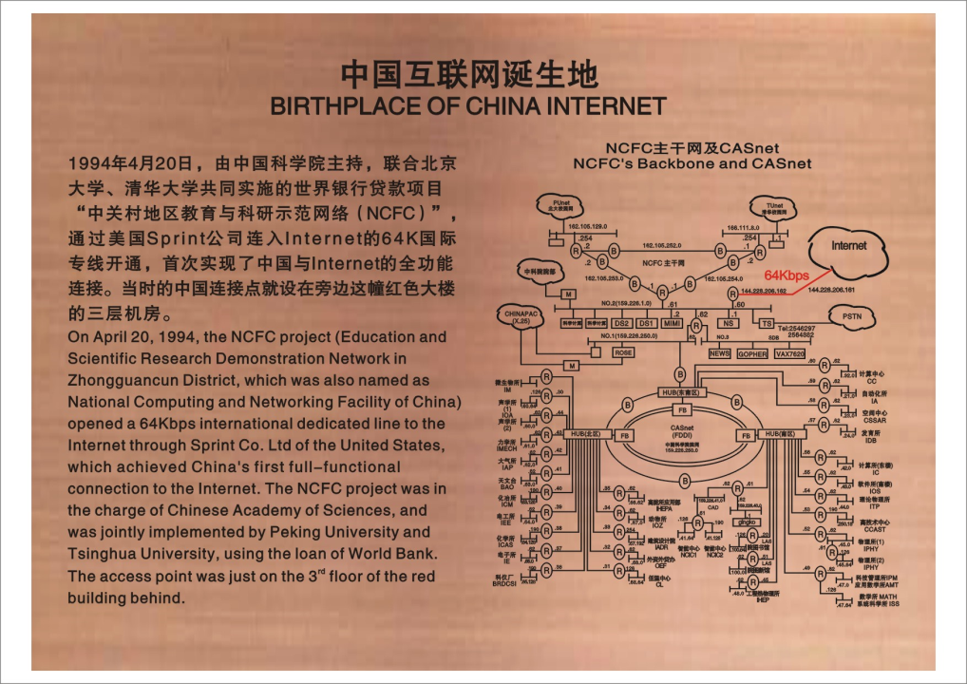
Backgroud
中国科学院
计算机网络信息中心
Computer Network Information Center
Chinese Academy of Sciences
Founded in April 1995, Computer Network Information Center (CNIC) is supporting institute involved in constructing and operating IT infrastructure and providing IT-related services. In addition, it serves as an R&D and demonstration base for IT technology applications.
Notes:
national computing and networking facility of China

Slide 3
PAST
PRESENT
FUTURE

Slide 4




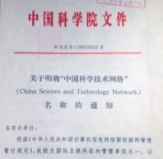
History 1977-1999
First router developed in China
China's first .cn domain name server
Naming of CSTNET
First supercomputer of CNIC: SGI Power Challenge XL（6GFLOPs）
First version of Sicence Popularizing Website
CAS Computing Center founded.
State Planning Commission
approved initiation of Scientific Database Project.
NCFC achieved full-functional connection to the Internet.
.CN Domain Name Server began to provide registration service.
State Science and Technology Commission approved the founding of CNIC.
CAS Internet based on NCFC was officially named as CSTNET.
CNIC started the earliest scientific computing service in China.
CNIC was authorized to operate and manage CNNIC.
CNIC becomes responsible for Sicence Popularizing
1977
1986 1994.4 1994.5 1995.3 1996.5 1996.8 1997.6 1999

Slide 5
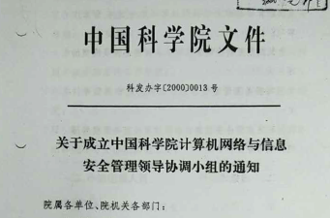


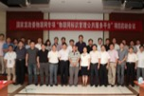
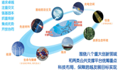
History 2000-2016
Responsibilities in network and information security were identified.
Academia Resource Planning system was officially opened.
China Internet of Things Name Service Platform was officially initiated.
CAS website system was officially opened.
8+2 strategy of CAS
CNIC becomes responsible for network and information security of CSTNET.
CNIC becomes responsible for the operation and management of ARP.
CAS website system was formally released.
NDRC approved the initiation of China Internet of Things Name Management Service Platform.
CNNIC was transferred to the State Internet Information Office.
CNIC led the planning of data and computing platform under CAS 8+2 strategy.
2000 2002 2009.10 2013.7 2014.7 2016
Notes:
National Development and Reform Commission

Slide 6
PAST
PRESENT
FUTURE

Slide 7
Organization
450 regular employees · 188 graduate students
2 CAS Hundred Talent Project professors · 4 CAS distinguished professors
R&D Depart.
Strategic Advisory Committee
Director: Prof. Wu Hequan
Deputy Director: Prof. Sun Jiulin, Prof. Sun Jiachang
Science and Technology Cloud Department
High Performance Computing Department
Big Data Department
Management Informatization Department
New Media Department
Cyberspace Security Department
Interent of Things Laboratory
E-science Laboratory
Future Network Laboratory
Advaned Interactive Technology Laboratory
MGI Informatics Research Laboratory
Resource Promotion and Service Department
Strategy and Evaluation Center
CAS non-legal Entity
CNIC Leadership
Science News Center, CAS
Center of Scientific Computing Applications &
Research, CAS
Administrative Division
Division of General Affairs
Division of R&D Management
Division of Human Resources and Education
Division of Finance
Division of Property Management
Science and Technology Committee
Academic Degree Evaluation Committee

Slide 8








Academic Exchange and Cooperation
International
CODATA (EC memeber, secretariat office and Vice President unit of CODATA-China)
GLORIAD (founding member)
PRAGMA (founding member)
APAN (member)
LoRa Alliance (member)
Domestic
Supercomputing Innovation Alliance (leading organization, secretariat office)
China Computer Society：HPC (founding member)/security (Deptuty Director)/expert committee on big data
Internet Society of China (Vice President unit)
China Information Association (Standing Board Member Unit)
Beijing Innovation Alliance for Materials Genome Project (Standing Board Member Unit)
Smart City Innovation and Industrialization Alliance of CAS University (member)
Alliance of Industrial Internet (member)
Strategic Alliance for Image and Video Big Data Industrial Technology Innovation (Standing Board Member Unit)
Notes:
CODATA is the Committee on Data of the International Council for Science (ICSU).IT’S FULL NAME IS Committee on Data for Science and Technology
PRAGMA（Pacific Rim Application and Grid Middleware Assembly, http://www.pragma-grid.net/ ）
是目前国际上网格计算及高速网络应用领域著名的学术组织之一。PRAGMA得到了美国自然基金会（NSF）的支持，由美国加州大学圣地亚哥分校发起，致力于在太平洋周边地区重要学术机构之间建立起持续的合作，并积极推进网格技术及高速互联网络在学科中的应用。
2002年3月，PRAGMA正式成立，主席为美国加州大学圣地亚哥分校Peter Arzberger博士。目前，PRAGMA已有正式成员单位与合作伙伴35个。
PRAGMA的主要工作包括：引导和推动联合项目进行网格中间件的开发，促进网格应用；共享资源以建立测试床；解决跨机构和国际性的资源调度和分配问题。PRAGMA的主要活动是研讨会，通常每年举行2次。

Slide 9
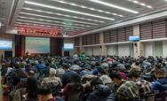
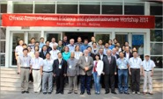
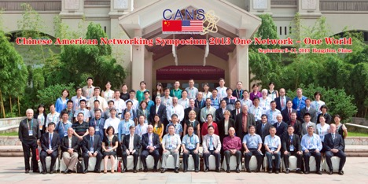
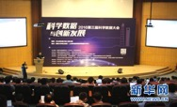
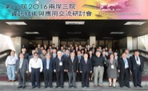
Academic Conferences
China E-science Development Symposium (One of the Forums of World Internet Conference 2017 Nov/Dec)
China Scientific Data Conference
International Conference on Theoretical and High Performance Computational Chemistry
Chinese-American Networking Sympoiusm (CANS)
CHinese-AmericaN German E-Science and cyberinfrastructure Workshop (CHANGES)
Cross-strait Symposium on Information Science and Technology

Slide 10
Construct and operate key information system
China Science and Technology Network (CSTNET)
China National Grid (CNGrid)
National Data Sharing Service Platform for Basic Science
Virtual Science Museums of China for science outreach
China Internet of Things Name Service Platform
Eduroam CN Wireless Networking Roaming Center
CAS Supercomputing Grid CAS Data Cloud
CAS Data Storage Environment CAS Instrument and Equipment Sharing Management Platform
CAS Large Research Infrastructure Sharing Service Platform
CAS Cybersecurity Service Platform CAS Portal for Continued Education
CAS Website System Academia Resource Planning System of CAS
CAS Email System CAS International Conference Service Platform
CAS Video Conferencing System Passport of China Science and Technology Cloud
national-level（6）
CAS-level（13）

Slide 11
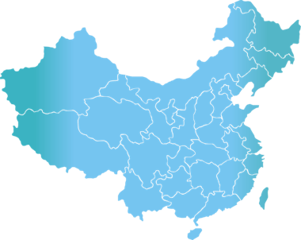
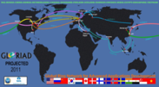
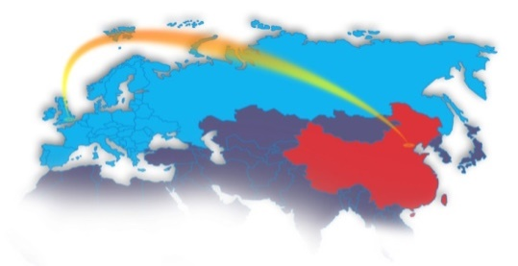
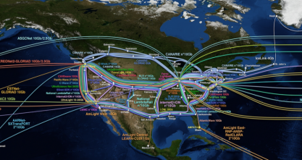
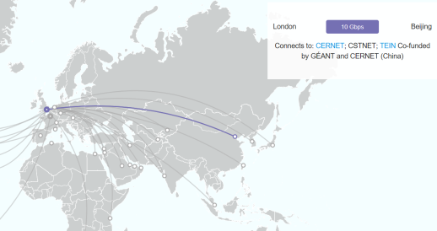
National Information System：CSTNET
Usability of international connection, domestic connection and backbone network has reached 99.99%
299 connected institutions, approx. 1 million users
International Bandwidth 52G
GLORIAD with U.S.: 10G
GEANT with EU : 10G
Hongkong Exchange Point: 32G
Domestic Bandwidth 109.5G
Corenetwork：100G
Backbone Network：8 of 2.5G，4 of 1G，2 of 155M, 4 of 4over6
哈尔滨
乌鲁木齐
沈阳
长春
乌鲁木齐南山
北京
石家庄
烟台
大连
西宁
山西
青岛
兰州
西安
南京
上海
羊八井
武汉
合肥
拉萨
成都
宁波
2.5G
长沙
福州
台北
1G
昆明
贵阳
厦门
155M
西双版纳
广州
深圳
lower than 155M
香港
IPv4/IPv6 connections

Slide 12
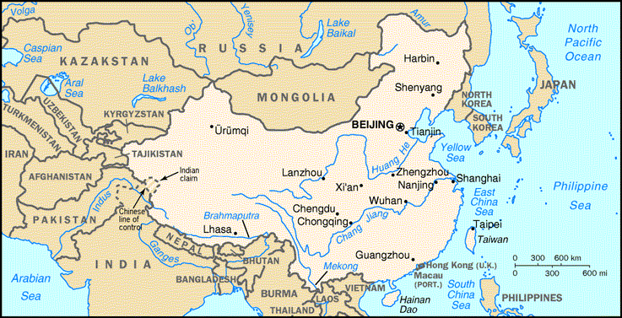
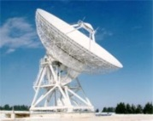
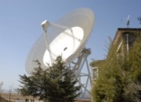
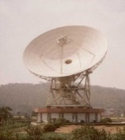
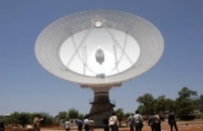
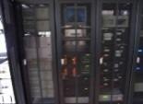
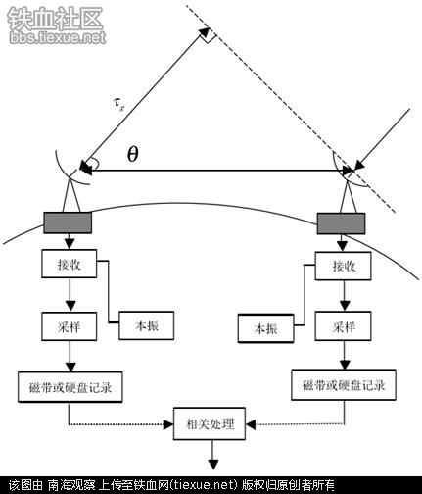
R&D via CSTNET
  In the China Chang'e lunar exploration mission, CSTNET established a VLBI virtual private network. There are 5 observations widely distributed in China. In the mission, the real-time measurement of observed data are transferred to a processing center simultaneously to achieve high-precision orbit measurement.
  Very-long-baseline interferometry (VLBI) is a type of astronomical interferometry used in radio astronomy. In VLBI a signal from an astronomical radio source, is collected at multiple radio telescopes on Earth. This allows observations of an object that are made simultaneously by many radio telescopes to be combined, emulating a telescope with a size equal to the maximum separation between the telescopes.
Notes:
一个案例一页

Slide 13
National Information System：CNGrid
Resources including 5 National Supercomputing Center
- computing capacity exceeding 60PFlops
- storage capacity exceeding 50PB
- usability>99%
- 900+ users, 0.97 million+ tasks, 0.14billion+work-hours
Support 14 supercomputing service platform
  ATLAS Experiment Monte Carlo Simulation Platform
Industrial Product Design Community
New Medicine Discovery Community
Digital Media and Cultural Creation Community
OPUS Operation Supporting Platform
Computing Chemistry Service Community
GridMol molecule visualization software
Cold Environment Monitoring Research Cloud
Stem Cell and Biomedicine Cloud
Materials Science Integration Platform
Microgravity Effect Simulation Platform
Large-scale parellel hydrological processing platform
Combustion Dynamics Center of Sichuan University
Beijing Fingerprint Comparison Platform
2016 16 nodes
  Tsinghua University Shenzhen Institute of Advanced Technology, CAS
  National Supercomputing Center in Shenzhen
  Beijing Institute of Applied Physics and Computing Mathematics
  Huazhong S&T University Shanghai Supercomputing Center
  National Supercomputing Center in Guangzhou
  Gansu Computing Center
2014 4 nodes
2015 8 nodes
  Hongkong University
  National Supercomputing Center in Tianjin
  National Supercomputing Center in Jinan
  CNIC, CAS
  China S&T University
  Shandong University
  Xian Jiaotong University
  National Supercomputing Center in Changsha

Slide 14
R&D in Supercomputing
Center of Scientific Computing Application & Research
Chinese Academy of Sciences (COSCAR)
Computational Science
Algorithm Optimization &Implementation
Heterogeneous Platforms
Software Production Line
Academy of Mathematics & Systems Science
National Astronomical Observatories
Institute of Atmospheric Physics
Institute of Modem Physics
Institute of Modem Physics
Institute of Modem Physics
Computer Network Information Center of CAS
Office of General Affairs of CAS

Slide 15
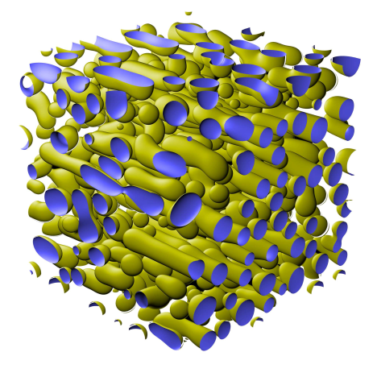
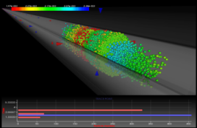
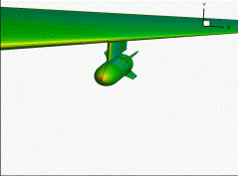
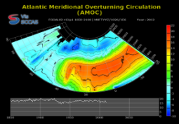
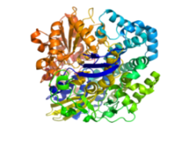

R&D in Supercomputing
Nomination for 2016 Gordon Bell Prize:
Self-developed software ‘ScETD-PF’ to achieve the world's largest parallel computing (9 million core)
Actual performance is 39.678 PFLOPs double precision.
Parallel efficiency of the software is 40% vs common software 5%
It breaks through the difficulty of large-scale simulation of titanium alloy microstructure.
Phase field simulation of
phase separation process
C-ADS visulazation
multi-body separation simulation
Ocean circulation simulation
High precision simulations of protein folding
Atmosphere circulation simulation
40+ supercomputing software and 140+ supercomputing applications
Notes:
9M-CORE CPU simulation of microstructure of alloy.
Nomination for 2016 Gordon Bell Prize

Slide 16
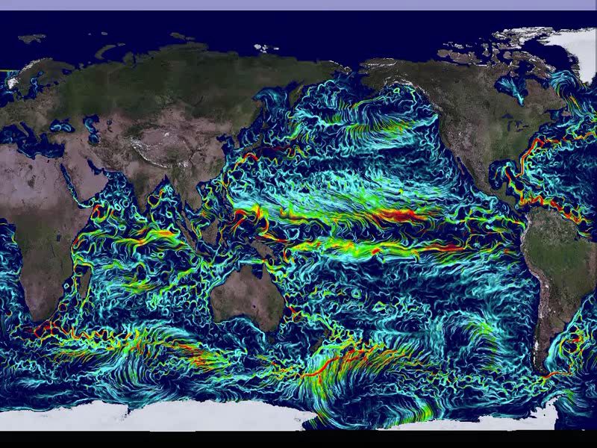
Participant the research of Earth Numerical Simulator. The self-developed visualization algorithm have been applied in large-scale ocean flow field simulation, with an adaptive level of high precision detail visualization.
Notes:
大规模海洋流场模拟数据可视化，提出自适应的多层次细节可视化，解决全局与局部可视化的矛盾，在不断放大过程中始终保持特征流场的高精度显示，漩涡状的结构，是科学家最关心的。

Slide 17
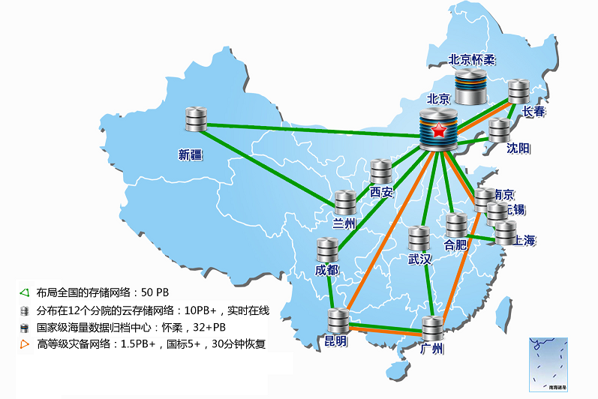


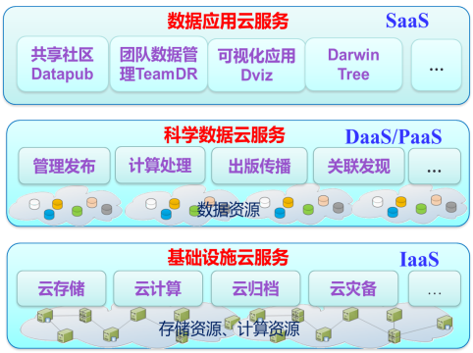
Infrastructure and Resources in Scientific Data
Develop and run Cloud Storage distributed in 12 cities, total storage is 52PB.
Construct and manage the Scientific Databases of CAS, which launches the historical beginning of China scientific data management and applications. 1340 databases and 688TB data.
Establish the National & Local Joint Engineering Laboratory for Big-Data Analysis Computing Technology

Slide 18
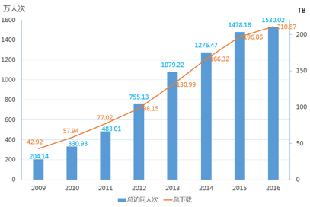
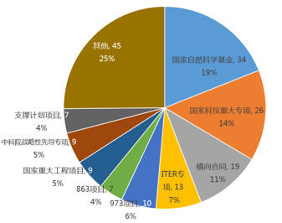
National Information System：
National Data Sharing Service Platform for Basic Science
  Since the project passed the evaluation in 2013, the amount of data resources has increased from 130.67TB to 420.86TB
  Servicing key R&D activities and engineering endeavors of the nation with more than 180 typical applications
Visits and Downloads have increased since 2009
distribution of service types

Slide 19






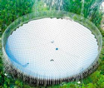










R&D in life-cycle management of Scientific Data
Database management system for Scientific big Data
To solve very large scale (100 billions lines) relational database management
To solve large scale (10 billions edges) graph database management
To solve super large scale (1 trillion objects) semistructured database management
Data acquisition and pre-processing
Data publishing and sharing
Further analysis
查询
引擎
立方体
Scientific facilities/ Observation stations
预测模型
关联
整合
原始库
可视化
检索
分析
索引
metadata
models
Data Flow
接入
Data storage and analysis
Data archiving and preservation

Slide 20
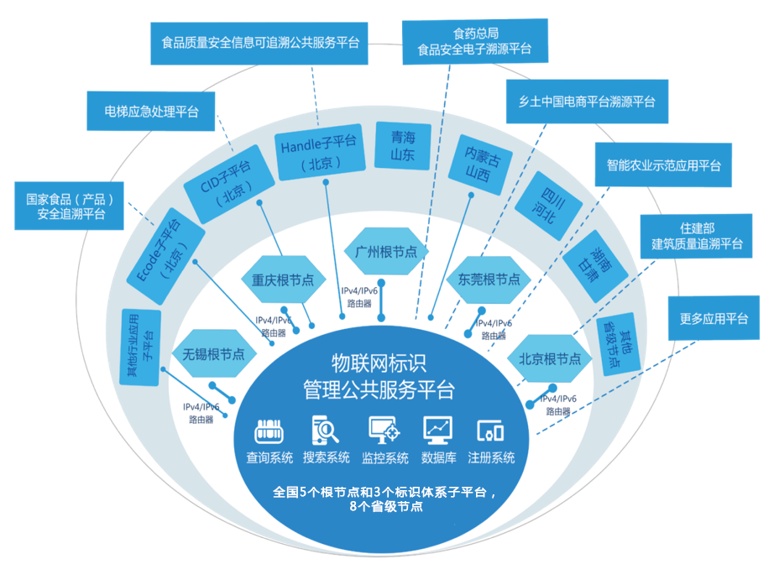
National Information System：
Internet of Things Name Management Service Platform
Initiated in 2012 under the Internet of Things Research and Industrialization Project of National Development and Reform Commission.
Leading Organization
CNIC, CAS
Participating Organizations
GS1 China
No. 1 Institute of Electronics of MIIT
Academy of Telecoms of MIIT
Registered names：10.8 billion
Daily analysis amout：5 million
Total analysis amout：0.82 billion

Slide 21

Platforms and R&D in science outreach
CAS’Science Outreach Cloud supports the content creation and distribution of more than 250 teams with annual average PVs of more than 200 million and total resource amount of 1TＢ.
Outstanding science outreach website (www.kepu.cn ) of China in 2016.
1
Collaborative Content Creation CNIC as a bridge for connecting content creation endeavors
SELF Forum 15 sessions of public science lectures, 5000+ audience, 100 million＋views
Science Video 200+ original videos, various ministerial level prizes, 4D science movie formally released
Big Family of Science: CAS official Wechat account for science outreach
nearly 200 active scientists responding to hot issues, 50 thousand + fans
Demonstration Base and Camp for Science Explorer more than 30 partner schools across the country
2
3
4
5

Slide 22
R&D Programs
State's Key Project of Research and Development Plan:
  Research on service mechanism and supporting system of national high performance computing environment
  Biomedical application service community based on national high performance computing environment
  Database management system for Scientific big Data
National Key Engineering Project for big data:
  Scientific data public service platform and innovation demonstrations
National Natural Science Foundation of China’s Key Program:
  Research on basic algorithm library for domestic 100PF computers
China Association for Science and Technology’s program:
  Science popularization, major topic selection, fusion, creation and dissemination
CAS’s Informatization Project:
  China Science and Technology Cloud
  Smart CAS
  Scientific big data
  E-science applications
  Cyberspace Security

Slide 23
PAST
PRESENT
FUTURE

Slide 24
135 Planning of CNIC (2016-2020)
1 Mission: CNIC aims to be the first-rate information center for cyberinfrastructure construction, system integration, operation management and service performance through concrete actions to fully harness the strength of IT to support scientific innovations and management activities, promote the R&D of information technology and application demonstrations, integrate e-science and e-management resources, enhance research paradigm shift and the spread of scientific ideas, and cultivate leading imformatization professionals across disciplinary boundaries.

Slide 25
135 Planning of CNIC (2016-2020)
3 Breakthroughs
Breakthrough 1： build China Science and Technology Cloud, making great progress in infrastructure integration and service capacity
Integrated infrastructure, resource scheduling and sharing
High performance computing supporting
PB scale data-intensive processing
Rich information and software resource pool
Breakthrough 2：support Smart CAS, making great progress in next-generation Academia Resource Planning System, science communication and continued education
E-management for CAS, science outreach,
Data sharing between different information systems
Breakthrough 3：support data-intensive research, making great progress in scientific big data technology and data service capacity
Extensible platform for big data research
Big data management, processing tools
Big data Mechanisms and standards.
Notes:
通过高速网络的基础设施能力和服务水平的提升，全面连接国家科技创新活动要素，实现网络资源的动态调度和按需定制；通过云计算技术深度整合院内外的信息化基础设施（IaaS）、平台（PaaS）及软件（SaaS）等各类科技基础资源与服务，建立面向科技工作者、全面支持异构信息化公共资源透明调度、用户自助使用服务等功能的中国科技云资源管理与自助服务云环境。
构建中国科技云资源整合系统，实现整合资源的共享应用、实时监控、动态调度。
建立和部署基于WiFi的科研网络泛在接入服务体系。
为国家战略新兴产业、基础科学研究、重大工程等提供高质量的计算支持。
构建适应中国科学大数据发展需求的基础设施，满足院“十三五”规划要求的云计算公共服务能力与PB级数据密集型处理环境。
推进院信息资源平台、关联搜索等信息资源池与软件资源池建设。

Slide 26
135 Planning of CNIC (2016-2020)
5 Priorities
Priority 1：future network research and testbed
Priority 2：cybersecurity for mobile network and cloud environment
Priority 3：self-developed high performance computing platform software
Priority 4：self-developed data platform software
Priority 5：application of cyber physical system (name service) technologies

Slide 27
Looking forward to future collaboration

