Slide 1

L/O/G/O
Informatization of CAS:
For Better Innovation
Dr. Mingqi CHEN
8 September 2017

Slide 2
OUTLINE
Overview of CAS
Current status of Informatization
The future planning

Slide 3

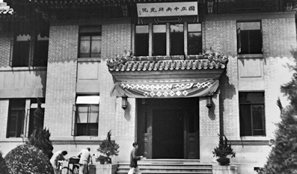






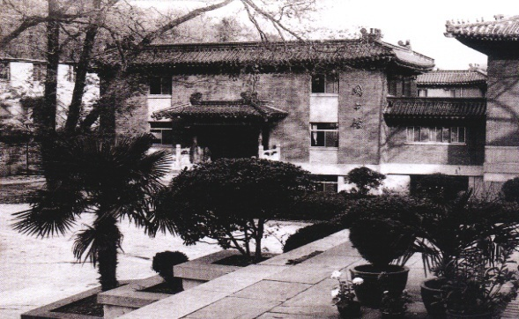
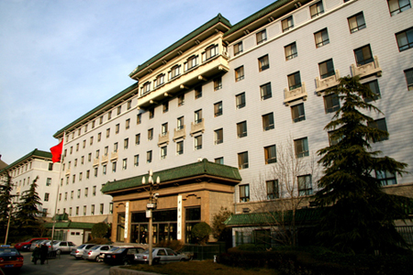
CAS: Cradle of Science and Innovation in China
Founded in Nov. 1949
Based on Academia Sinica and Beiping Academy
Home to the largest number of best talents
A powerhouse of knowledge and innovation
1949 - 1978
Guo Moruo
1979 - 1981
Fang Yi
1981 - 1987
Lu Jiaxi
1987 - 1997
Zhou Guangzhao
1997 - 2011
Lu Yongxiang
2011-
Bai
Chunli
Academia Sinica (1928-1949)
CAS headquarters (1949-1979)
CAS headquarters (1979-)
3
Notes:
3

Slide 4




Mission, Structure and Strategy
Scientific
Excellence
High-caliber
Talent
Trusted
Ideas
Mission
Universities
Academy
Institutes
Structure
Strategy
Democracy
Talent
Openness
Structure
Mission
Three integrated elements: a large number of institutes, a merit-based academy and higher education institutions
Development Strategy: to run it with democracy, flourish it with openness and boost it with talent
Committed to excellent S&amp;T, high-caliber talent and offering strategic advice to decision-makers
4

Slide 5
Vital Statistics:
Institutes | 104
Branches | 12
Universities | 3
Mega-Science Facilities | 14 in operation and 7 under construction
Employees | 68,700 | 2014
Academic Members | 724 and 70 FM | 2014
Budgets | 46B RMB | 2014

Slide 6
Most recent Highlights:
Contribution of 90% effective payloads on Chinese manned space missions
Supply of critical technology to the Chinese submersible reach 7000-metre deep ocean
Major breakthroughs on quantum communication technology
Discovery of a new kind of neutrino transformation
Single-molecule Raman imaging reaching unprecedented sub-nanometer scale
Discovery of the oldest-known primate skeleton fossil
Breakthrough research on origin of H7N9 avian influenza virus and mechanisms of H5N1 avian influenza virus interspecies transmission
Development of a pilot unit for dimethyl methanol to olefins technology

Slide 7
Organizational Structure
Adhoc Committees
Committee for Education; Committee for Strategic Studies;
Committee for Academic Affairs;
Committee for Development Strategy
President
( Chairman of the Presidium of the Academy)
Presidium of the Academy
Vice Presidents
Secretary-General
Deputy Secretary-Generals
Executive Committee
of the Presidium
Bureau of Frontier Sciences and Education
Bureau of Major R&D Programs
Bureau of S&T for Development
Office of General Affairs
Bureau of Academic Divisions
Bureau of Development Planning
Bureau of Infrastructure, Logistics & Finance
Bureau of Personnel
Bureau of International Cooperation
Bureau of Science Communication
Bureau of Supervision and Auditing
Division of Mathematics and Physics
Division of Chemistry
Division of Life Sciences and Medicine
Division of Earth Sciences
Division of Information Technology Sciences
Division of Technological Sciences
Research Institutes
Educational Institutions
Supporting Organizations
CAS Holdings

Slide 8
OUTLINE
Overview of CAS
Current status of Infromatization
The future planning

Slide 9

Organization Chart
The Leader Group of Cyberspace Affairs，CAS
Strategic level: The Leader Group of Cyberspace Affairs(12 members)
Consultation & evaluation Level: The expert advisor committee(23members)
Plan&Coordination level:the office of The leader Group of Cyberspace Affairs（9members）
Execution level:
The Division of network and Informatization, General Office of CAS, （ 4 staffs ）
Supporting & service level: CNIC and other many institutes
The expert Advisor Committee
Office
Division of network and informatization,GO of CAS
Institute…
Institute…
Institute…
9

Slide 10
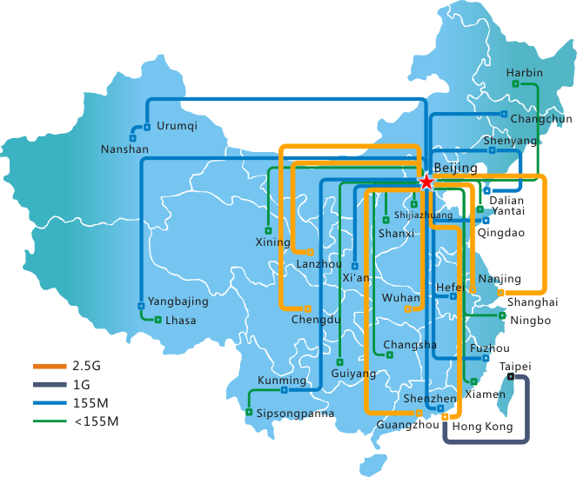
Cyber Infrastructure in CAS: Network
Coverage
30+ Provinces
Operation
1 Core Center
12 Regional Branch Centers
Users
370+ Institutions
1,000,000 End Users
China Science and Technology Network (CSTNet) is one of the earliest internet networks in China
Notes:
Network topology map :Tree-like structure
Backbone carriers :China Telecom ;China Mobile Chine Unicom; tele-grade network operaters.

Slide 11
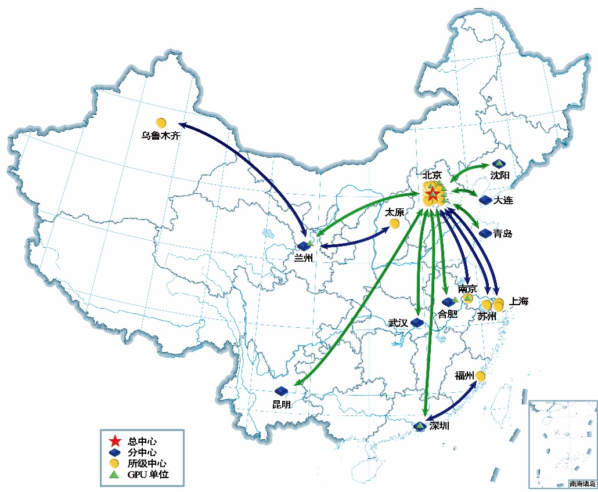
Cyber Infrastructure in CAS: Supercomputing
Three-tier grid
  1 head center(Eea，2.36 Petaflops)
  12regional centers
  18 institution centers, 11 GPU centers
Applications
  Computational Chemistry, Physics, Material science, Life science, CFD, Industrial computing
  Operation and maintenance of the Supercomputing Environment of CAS (CSCGrid);Common HPC service provider;Play Important Roles in the national HPC infrastructure of China.
  Supercomputing Innovation Alliance（2013）;CAS Computational Science
Application Research Center（2015）

Slide 12
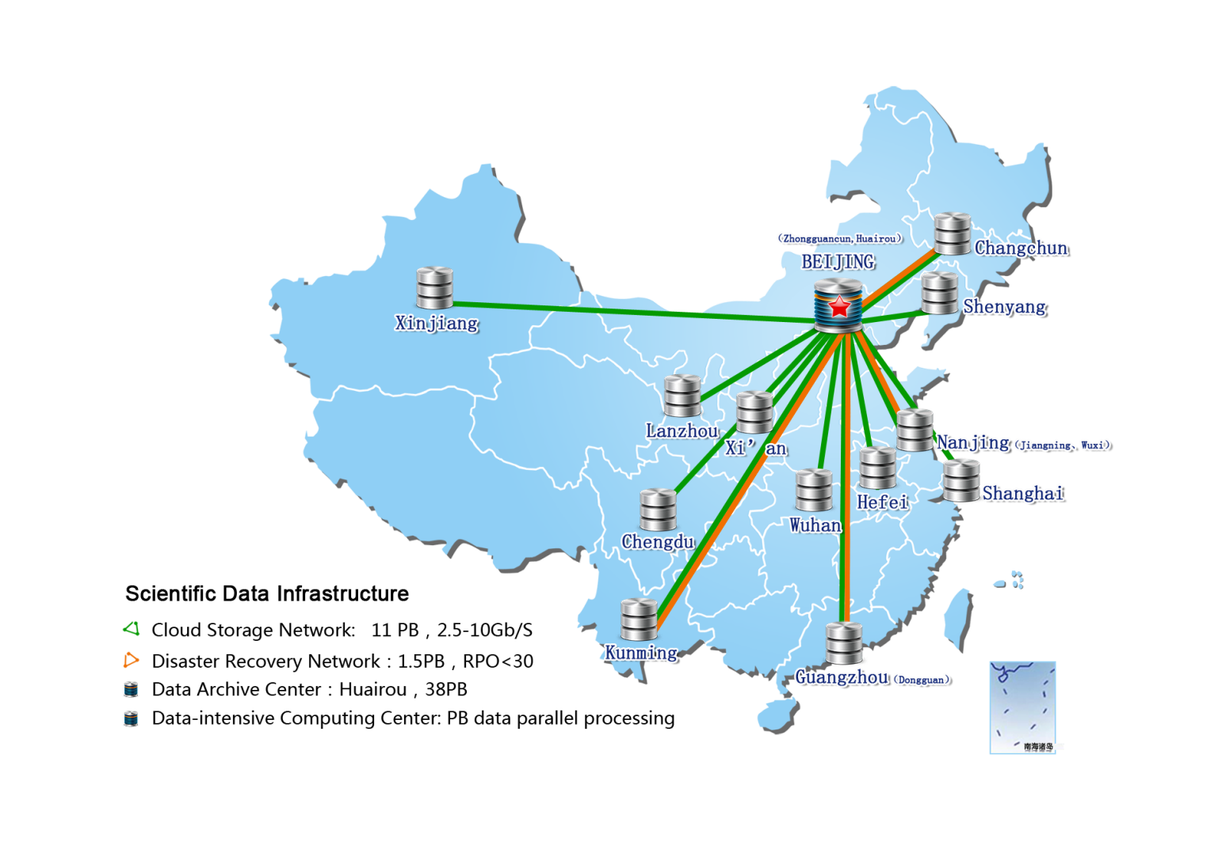
Cyber Infrastructure in CAS: Scientific Data
A Long-term mission started in 1986 which funded by CAS
  many institutes involved
  long-term, large-scale collaboration
  data from research, for research
Collecting multi-discipline research data and promoting data sharing
  More than 350 research databases and 500 datasets by 61 institutes
  Over 200TB data available to open access and download

Slide 13
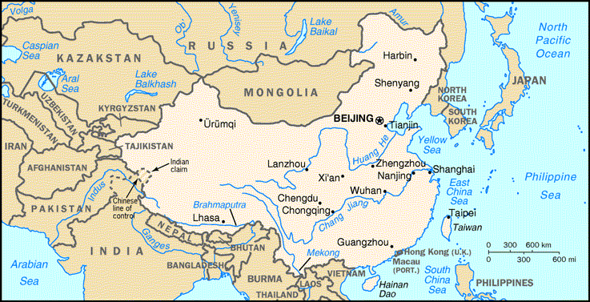










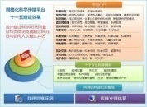
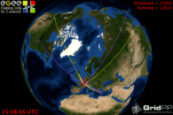
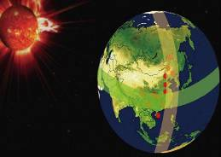
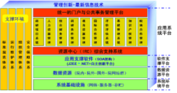
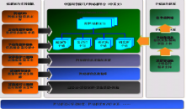
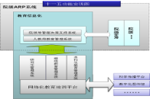
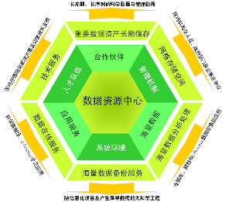
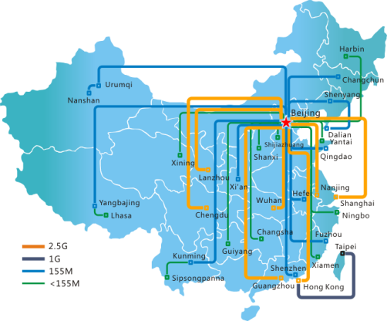
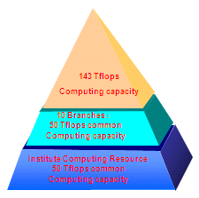


CAS Informatization Progress
（2006-2010）
Organization
e-Science Applications
Standard & Regulation
Application Platform
Cyberinfrastructure
Xinjiang
★Beijing
Shenyang
Dalian
Lanzhou
Qingdao
Wuhan
Hefei
Shanghai
Chengdu
上海
Kunming
Network
Supercomputing
Data
Shenzhen
Security
13

Slide 14

Result of 12th five years planning（2011-2015）
Education Cloud
Management Cloud
Science Cloud
e-Science Application Promotion Project
Scientific Data Resource Integration and Sharing Project
Cyberinfrastructure
Management and Strategic Decision Support Project
Science Communication Service based on Internet
Continuation Education, Science and Education Integration Project
Network Security Guarantee and Service Project
14

Slide 15
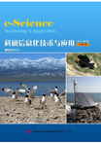
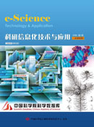
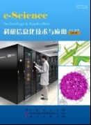
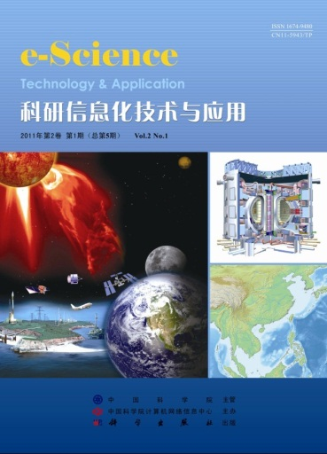
Magazine
e-Science Technology & Application, created in 2008, published bimonthly in Chinese with abstracts in English (now)
Publication number:
CN 11-5943/TP ISSN 1674-9480
Authority: CAS
Organizer: CNIC,CAS
Science Press Co.,Ltd.
Publisher: Science Press Co., Ltd.
Notes:
e-Science Technology & Application: The First magazine focus on eScience
The first issue of the Chinese Journal was published in 2008, printed by Science Press.
e-Science Technology & Application is oriented in the publication of PERSPECTIVE/ TECHNOLOGY /APPLICATION/ EXPERIENCE /NEWS & VIEWS related to eScience.
========
本刊是我国唯一一份以科研信息化（e-Science）为主题的综合性、学术性刊物，强调“学术性与应用性相结合”的办刊方针。旨在通过深入报道世界范围内的e-Science技术与应用的最新进展以及我国e-Science发展战略与政策研究，为广大科研工作者提供一个开放的交流平台和前沿信息交流渠道。

Slide 16

Magazine
http://www.csdata.org
China Scientific Data: created in 2016.The journal is dedicated to promoting the sharing and citation of scientific data, and to making them findable, accessible, intelligible and reusable. Data papers describing (but not limited to) :Datasets or data products generated from major scientific activities; Derived datasets or data products refined from raw data;Datasets linked to existing publications
Publication number:
CN11-6035/N,ISSN 2096-2223
Authority: CAS, CODATA China National Committee
Organizer: CNIC,CAS
Science Press Co.,Ltd.
Publisher: Science Press Co., Ltd.
Notes:
*Open data as an important component of scientific policies . Data publishing as an effective strategy to promote data openness
* China Scientific Data does NOT publish new research findings, or techniques, methods and cases concerning data quality researches and data applications
The jurnal is a bilingual open-access journal publishing data papers of multisisciplinary fileds in English and Chinese quarterly and is indexed by Chinese Science Citation Database (2017-2018).

Slide 17
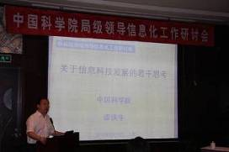
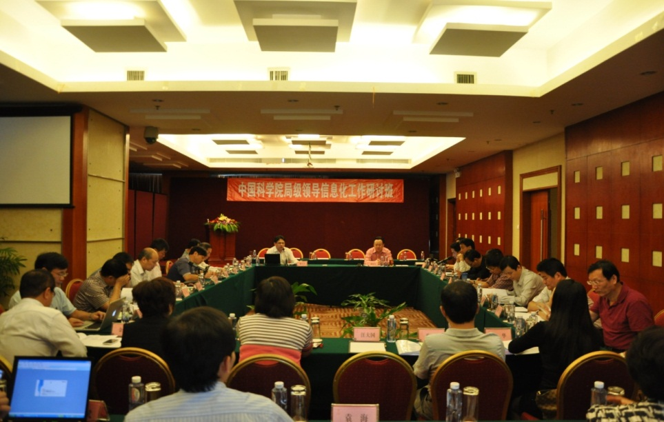
Annual Training Program
Training
CIO Training Program: Started in 2010
Objective: Let trainees to understand and value the eScience and promote eScience applications in their Institutes
Attendance: Directors of the institutes of CAS(CIOs), 300+ person-time totally.
Notes:
attendees

Slide 18
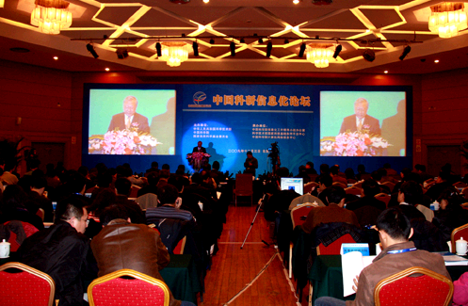
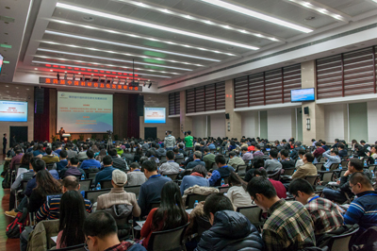
China e-Science Forum
-1st Forum, 3 December 2009
  Co-organized by CAS, Ministry of Science and Technology of China (MOST), National Natural Science Foundation of China (NSFC)
  Hosted by CAS Informatization Leading Group Office, National S&T Infrastructure Center, CNIC
-2ndForum,15-16 Dec.2011, Beijing
  -3thForum,21-22 Oct.2013,Beijing
  -4th Forum, 8-9 Dec.2015, Beijing
  8 government departments: CAS/CAC
  （Cyberspace Administration of China）/MOE/MOST/MIIT/CASS/CAE/NSFC
200~ Attendance
450~ Attendance
18
Notes:
Cyberspace Administration of China
Office of the Central Leading Group for Cyberspace Affairs

Slide 19
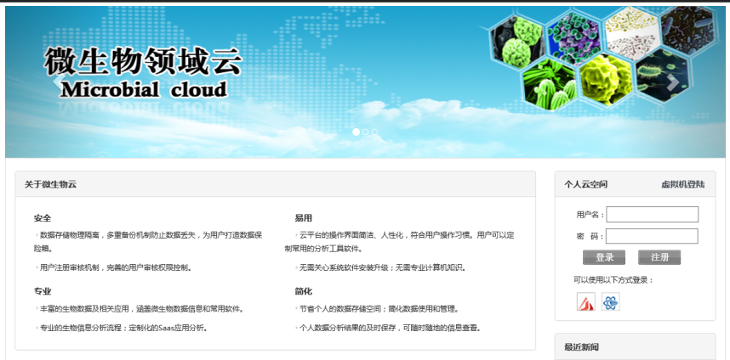
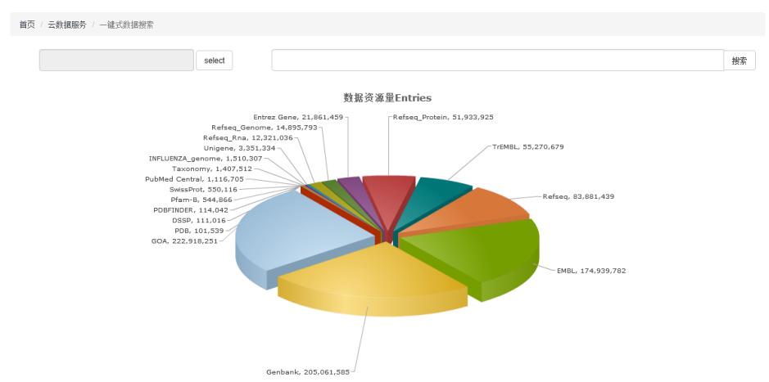
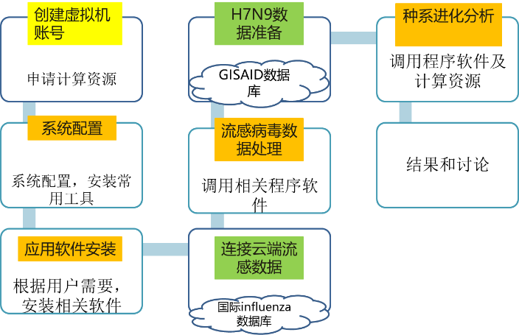
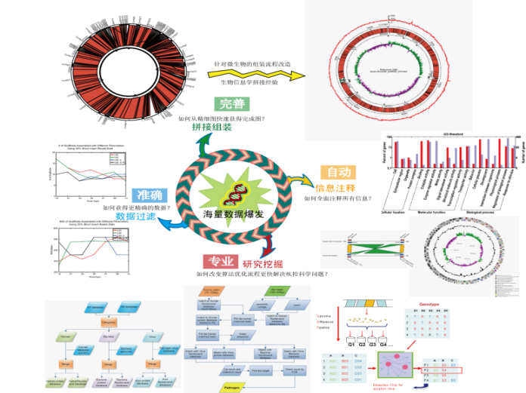
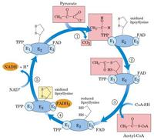
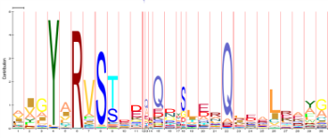
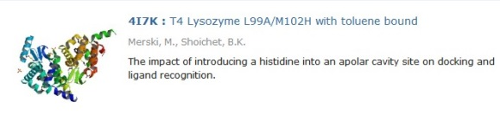
e-Science Applications Case:
Microbial Big Data Platform
Apps
One-stop data search engine
Automatic resources allocation
Data
Computing
Pfam
PDB
Massive
Distributed
Heterogeneous
Data analysis pipeline for gene annotation, visualization and functional analysis
Notes:
Institute of Microbiology, Based on cloud environment

Slide 20
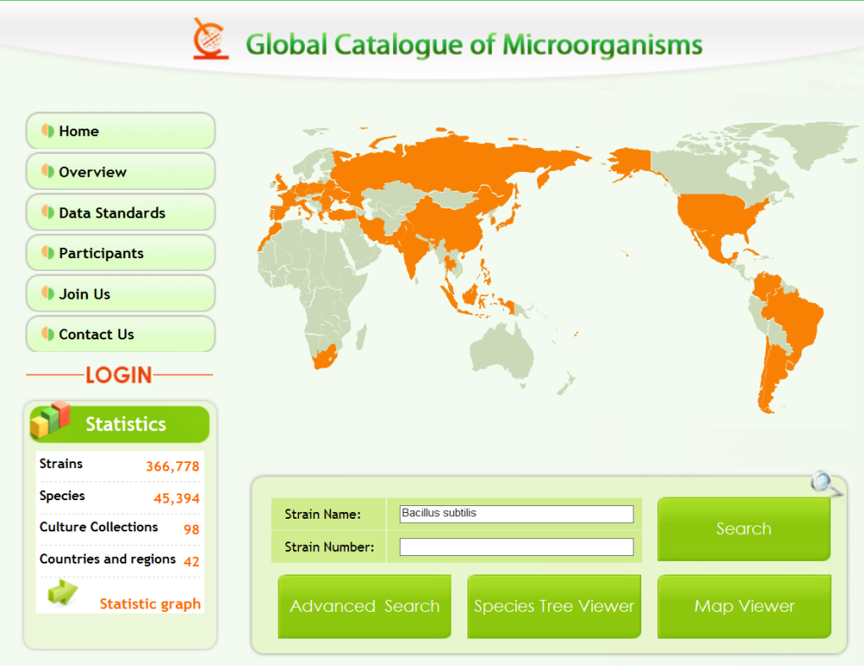

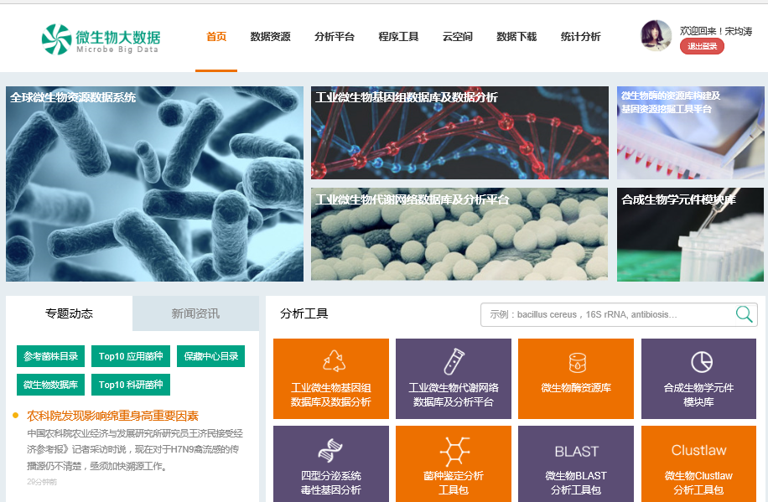
e-Science Applications Case:
Microbial Big Data Platform
Propose the first ISO standards in the field of microbial resources information
ISO / PWI 21710 biotechnology-Data Management and publication in microbial biological resource centers.
Global Catalogue of Microorganisms
98 bio-resources centers from 42 countries sharing data through the platform
largest international cooperation project in the field of microbiology
Microbial Big Data Portal for
Chinese National data project (863 project)
Notes:
Constructing world-leading data platforms

Slide 21
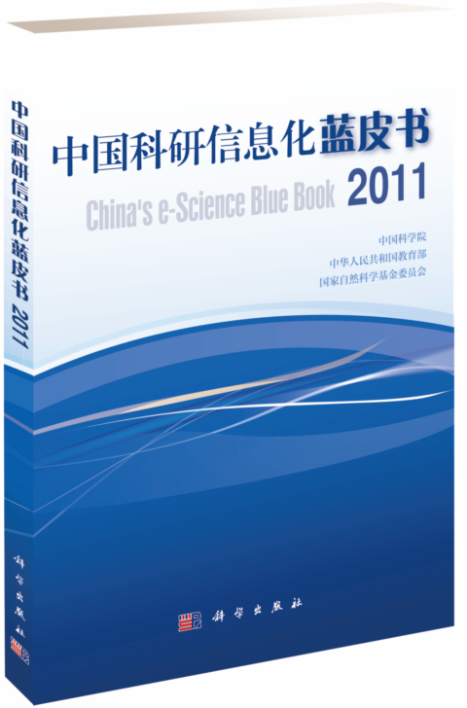
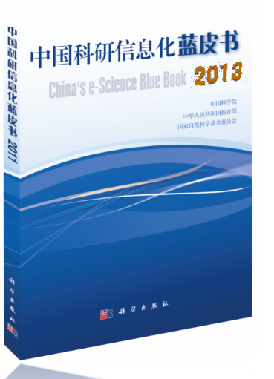
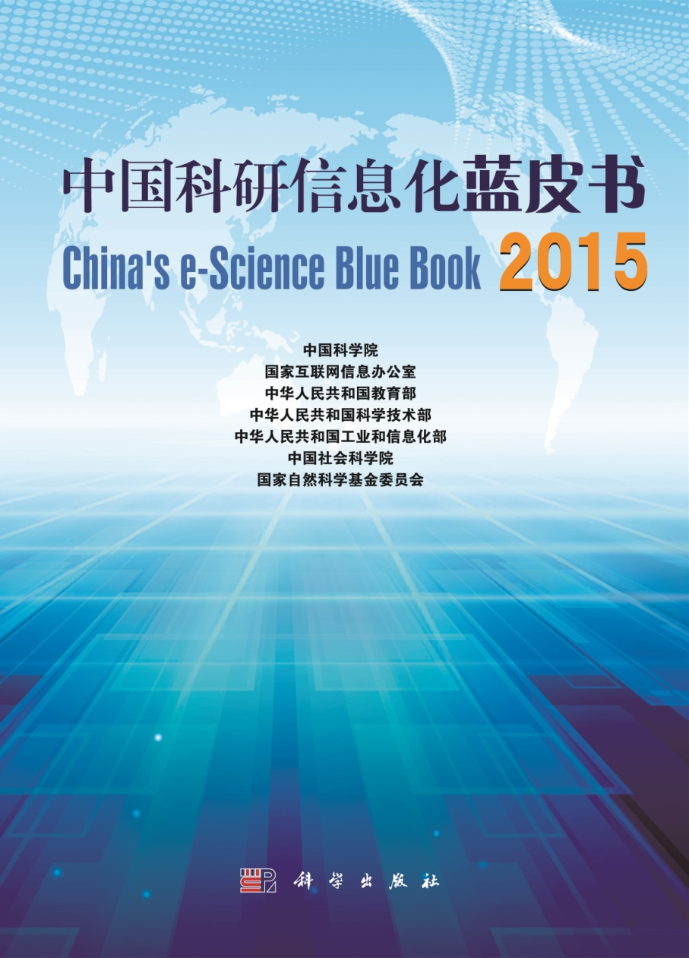
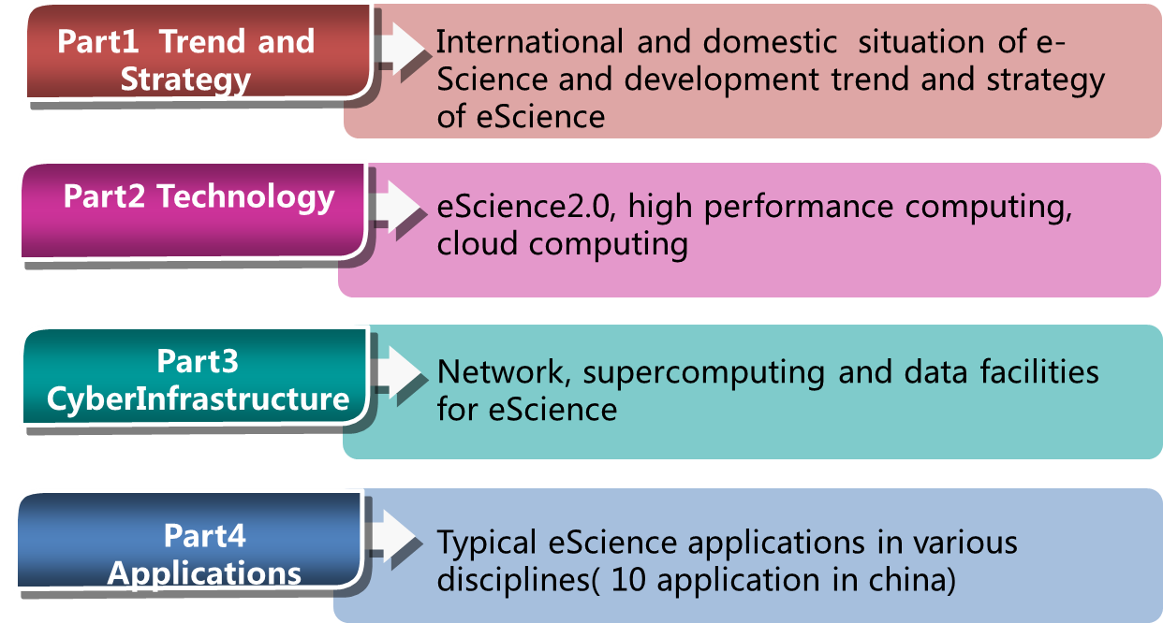
China’s e-Science Blue Book Series
First Blue Book in china
CAS
Ministry of Education
NSF of China
21
Notes:
"China's e-Science Blue Book 2011" the first time compiled to ensure the authority and comprehensiveness of the Blue Book, Blue Book, invited domestic and foreign research field of information technology experts, academics, entrepreneurs, involved in the network environment for e-Science, the supercomputing environment, the status of the data environment, and research of technology development and application of practices and trends in the objective described in-depth analysis and for scientific research and information technology strategic situation, and strive to promote technological innovation and innovative paradigm shift for the China's future scientific and technological innovation to provide overall strategic reference, to show the whole picture and cutting-edge results of research and information technology to domestic and foreign readers.
---
Escience 2.0 : form building services for science to Science as a services//Guoyike form Imperial College London

Slide 22
OUTLINE
Overview of CAS
Current status of Informatization
The future planning

Slide 23
The 13th Plan（2016-2020） for Network Security and Informatization
Five main Projects
The Project of China science and technology Cloud
The Project of Intelligent CAS
The Project of Scientific Big Data
The Project of e-Science Applications
The Project of Network Security

Slide 24








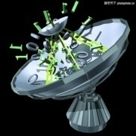
Thank you!
Q&A
mqchen@cashq.ac.cn

