Slide 1
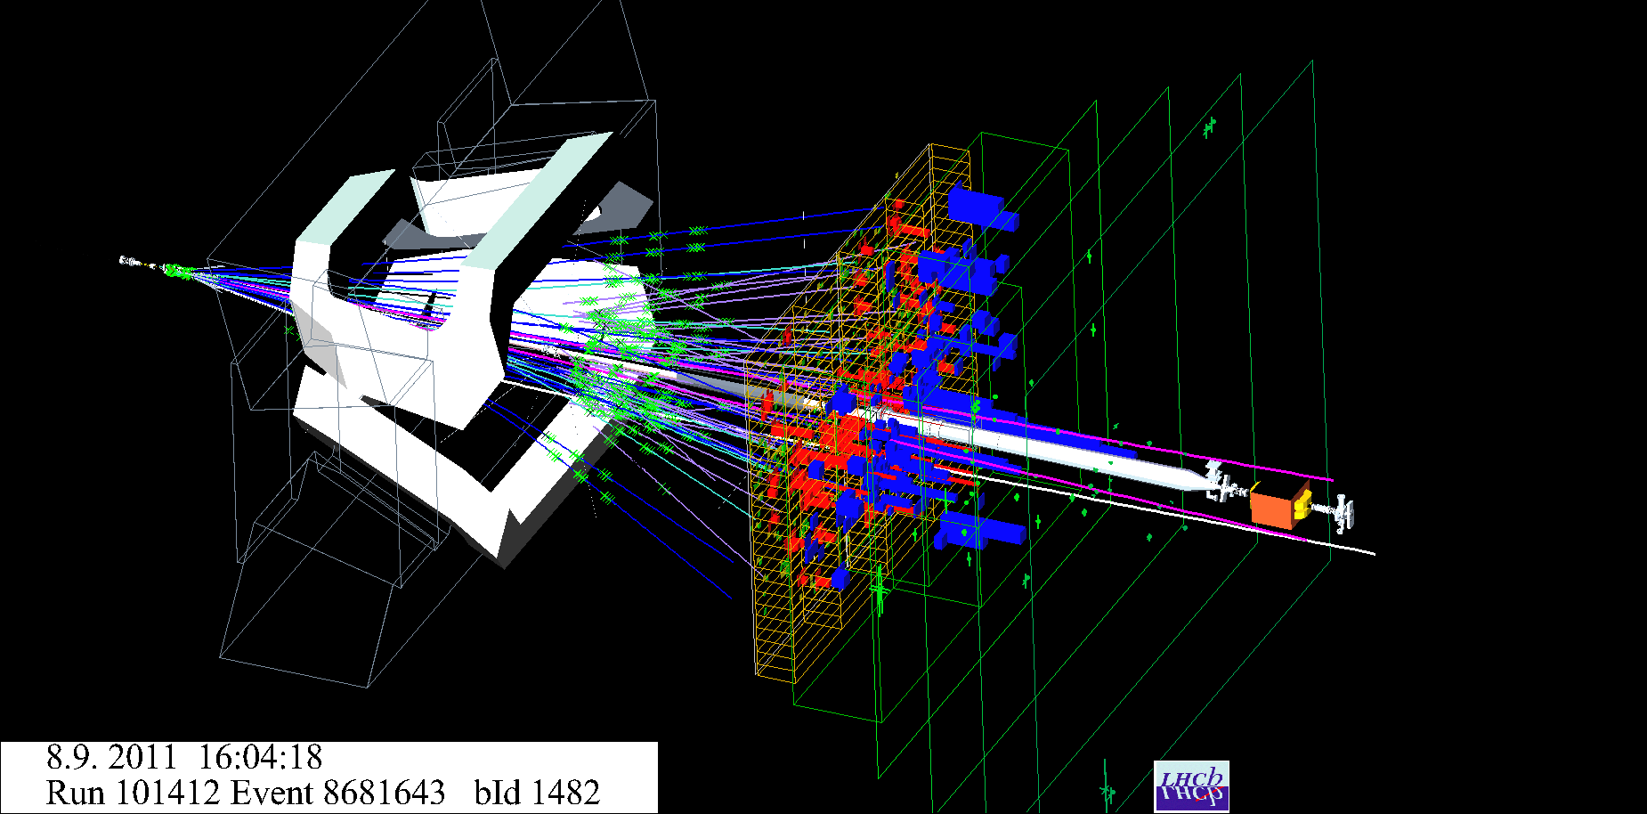
CP violation measurement in two body B decays with the LHCb detector

Slide 2
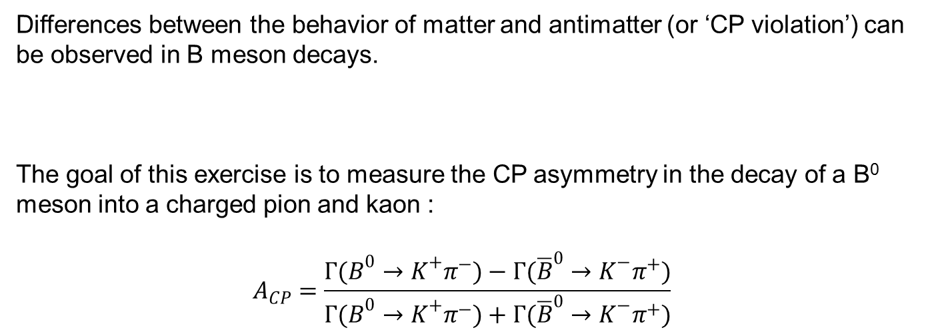
Differences between the behavior of matter and antimatter (or ‘CP violation’) can be observed in B meson decays.
The goal of this exercise is to measure the CP asymmetry in the decay of a B⁰ meson into a charged pion and kaon :
$$A_{CP}=\frac{{Γ(B}^{0}→K^{+}π^{−})−{Γ(\overline{B}}^{0}→K^{−}π^{+})}{{Γ(B}^{0}→K^{+}π^{−})+{Γ(\overline{B}}^{0}→K^{−}π^{+})}$$

Slide 3
Difficulty: separate the different signal components!
Exercise:
First step using simulated data:
Define a selection based on particle identification to find your signal
Second step on real LHCb data:
Apply the selection and perform fits of the invariant mass
Compute the CP asymmetry and compare with the published result

