Slide 1
$t\overline{t}$ Phenomenology
SUMMER SCHOOL PROJECT
MC Sample Generation & Reconstruction in ttHbb
on ATLAS
Director: Steve MUANZA
Member: YANG Xiao
NIAN Guoen

Slide 2
Outline
Motivation
Physical Process
Method
Result & Conclusion
Improvement

Slide 3
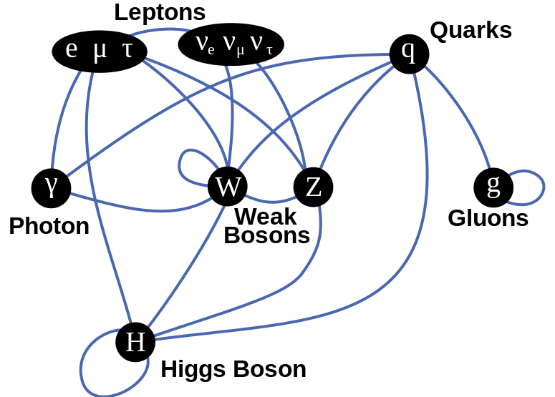
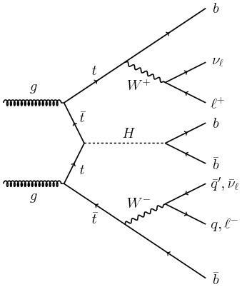
ttH production and bb-decay
Most sensitive to Yukawa coupling(high mass)
bb decay large BR
Not find yet.
(┬＿┬)
Background High(tt-production,QCD-bkg)

Slide 4
Process of Project
PYTHIA
Event generator
HepMC
Standard format
DELPHES
Fast detector simulation
ROOT
Reconstruction

Slide 5
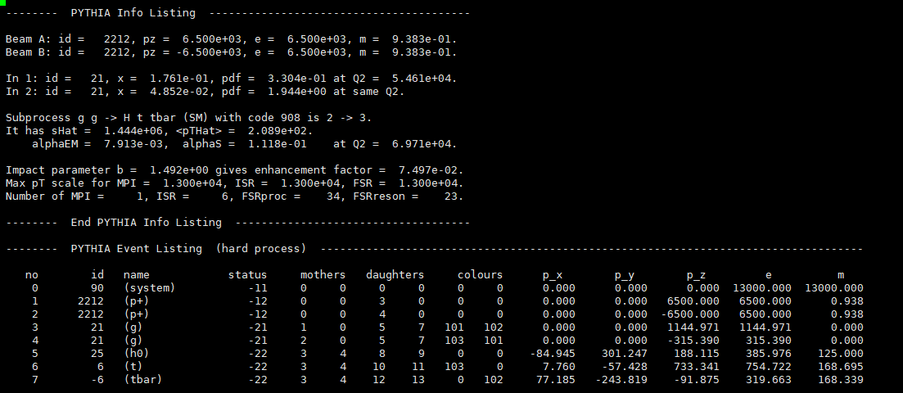
Process in PYTHIA
We simulate pp collision in 13TeV. Partons gg interact as the Feynman diagram.
We generate 5,000 events of this Feynman diagram by PYTHIA8.2.

Slide 6
Process of Project
PYTHIA
Event generator
HepMC
Standard format
DELPHES
Fast detector simulation
ROOT
Reconstruction

Slide 7
Process in DELPHES
To simulate detector and its resolution, we use software DELPHES to disperse in Gaussian distribution (ATLAS).
With DELPHES, we cut background, input reconstruction process and output a ROOT file to reconstruct Higgs boson finally.

Slide 8
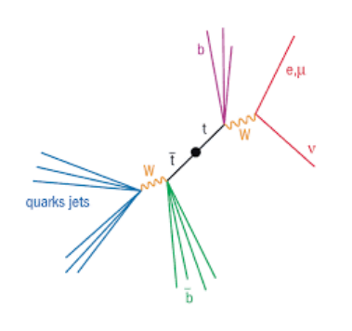
Background (tt_production)
Other interactions also produce top quarks and top quarks decay to leptons and jets. This process produces background.

Slide 9
Reconstruction (1-lep)
From masses of final state particles, we can reconstruction Higgs boson steps by steps.
Leptonic W reconstruction
Hadronic W reconstruction
Top quarks reconstruction
Higgs boson reconstruction

Slide 10
Momentum of neutrinos
Only p_T can dectected(MET). Need p_z
$m_{W}^{2}={\left(p^{ν}+p^{l}\right)}^{2}, m_{ν}≈0$

Slide 11
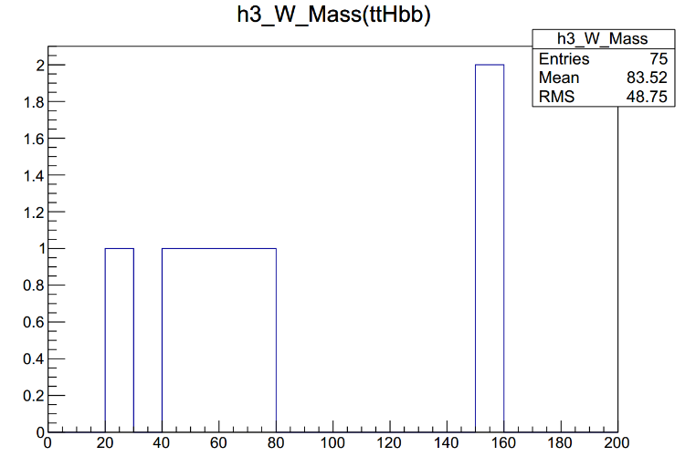
Cut-based Analysis
Need 6 jet (4b-tagged)
Leptonic W reconstruction – Force lνmass to the W mass – Solve 2nd degree equation to get pz_nu
Hadronic W reconstruction
After requesting 4 b-tag jets,
Sum all light jets
top by W+b
Remove |m(jj) – m(W)| > 25
Combination minimizing χ 2 , based on the top mass
Higgs
2 remaining b jets
$$χ^{2}={\left(\frac{m_{lνb}−m_{t}}{19GeV}\right)}^{2}+{\left(\frac{m_{jjb}−m_{t}}{13GeV}\right)}^{2}$$

Slide 12
Top reconstruction
t (Had. W)
t (lep. W)

Slide 13
Higgs reconstruction

Slide 14
ZHbb reconstruction(check)

Slide 15
Conclusion
Generate MC sample ourselves
(PYTHIA , HepMC, DELPHES)
5000evts
ttHbb(also tt-production)
Reconstruction W,top ,Higgs (1lep)
Slove P_z_nu with some trick
Based on W,top mass
Build Cut-flow for ttHbb (1lep)
~300 lines c++ code

Slide 16
Improvement
MORE EVENTS SAMPLE! 5000 evts,~1Gb,Quota….
More small channel/region
Background compare(nomalizition skill)
Multi-Variable Analysis(BDT)
Selection Eff. & Sys&Stat. Uncentainty

Slide 17
Thanks for your attention!
Refrence:
[1] ATLAS-CONF-2016-080
[2] Steggemann-TOP2008,http://wwwo.physik.rwth-aachen.de/fileadmin/user_upload/www_physik/Personen/erdmann/Steggemann-TOP2008.pdf
[3] Marie Reinecke , Bachelor’s Thesis, Neutrino Reconstruction with KLFitter(p23)

Slide 18
Backup

Slide 19
Backup
t (Had. W)
t (lep. W)

Slide 20
Backup

Slide 21
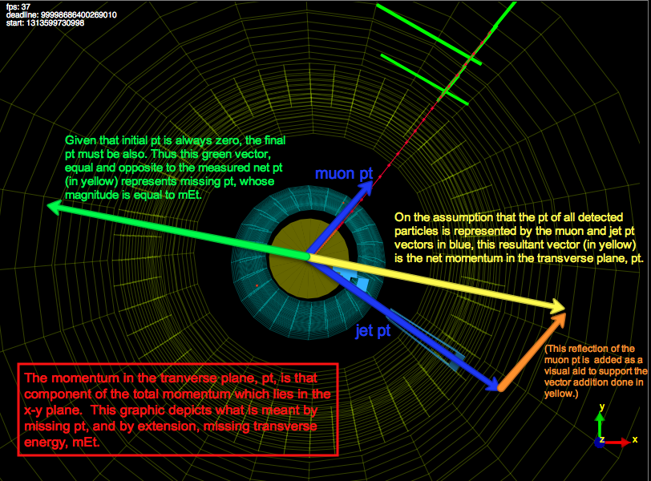
Backup

Slide 22
Backup

Slide 23
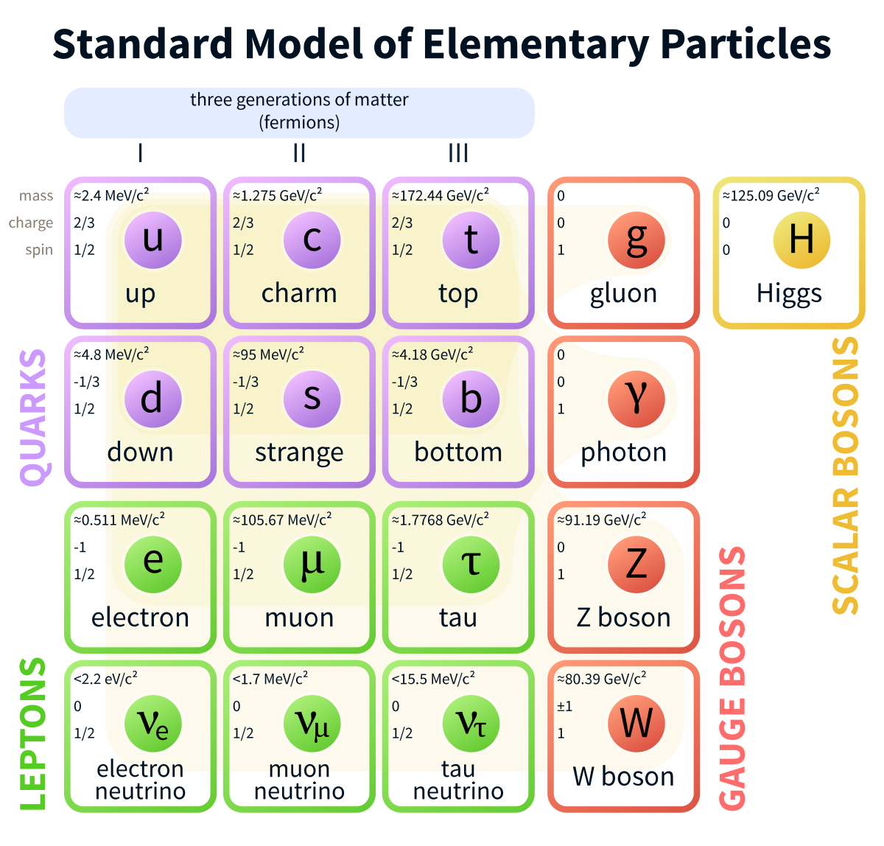
Backup

