Slide 1
Z boson identification and mass measurement from ATLAS experiment data
Qianqian Su,
Yifan Zheng
France-China summer school
2017/07/21

Slide 2
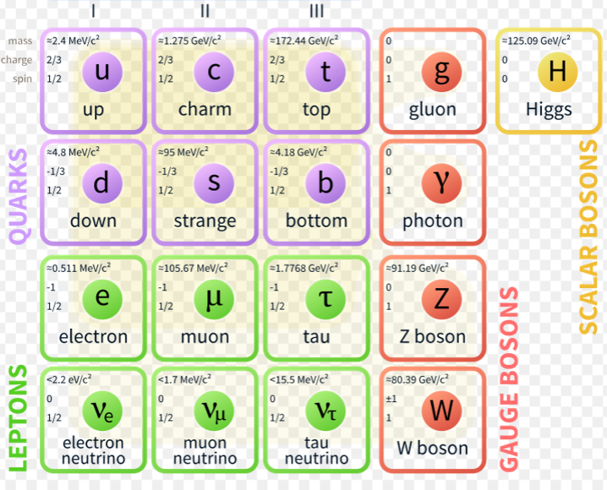
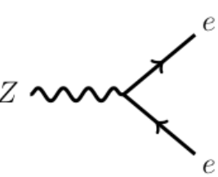
Standard model
The charged W⁺, W⁻ and the neutral Z mediate the weak interaction
Decay of Z bosons: 24 decay possibilities
70% quark-antiquark pair
20% neutrino-antineutrino
10% lepton-antilepton pairs, $e^{−}e^{+}, u^{−}u^{+}, τ^{−}τ^{+}$
http://atlas.physicsmasterclasses.org/en/zpath.htm

Slide 3
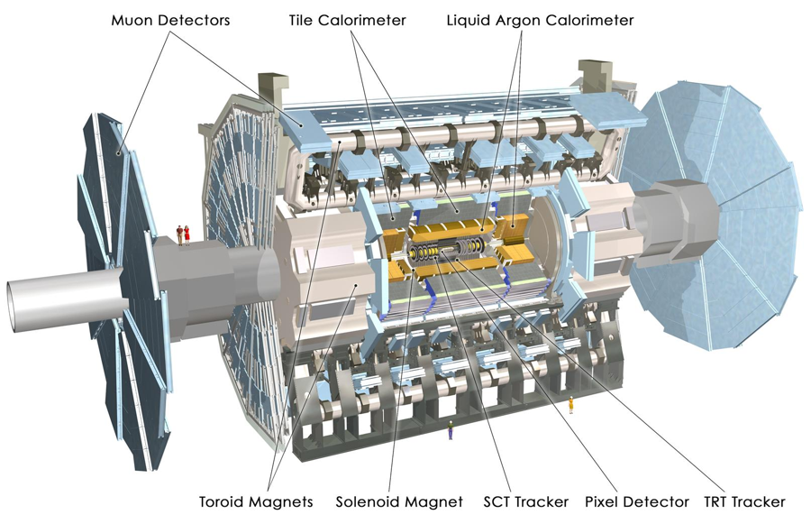
ATLAS detector
http://atlas.cern/

Slide 4
ATLAS detector – identify events

Slide 5
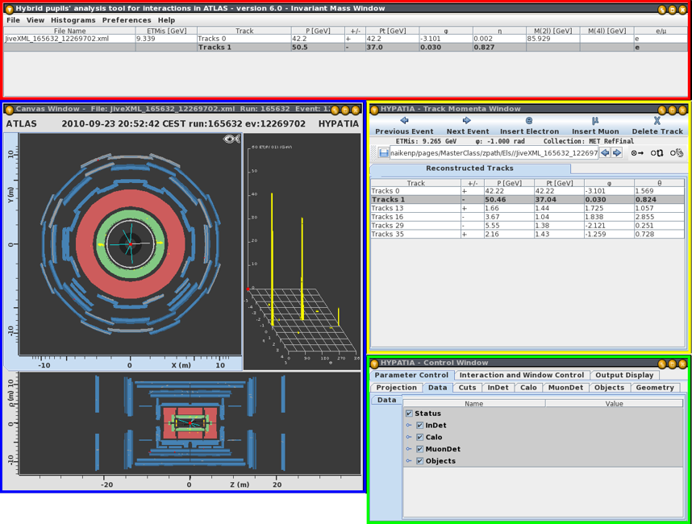
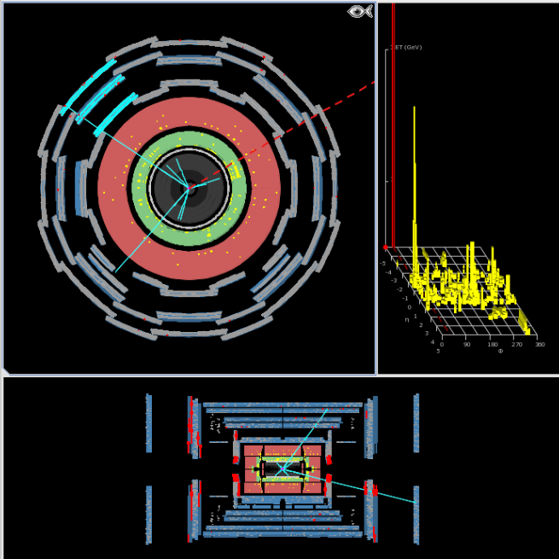
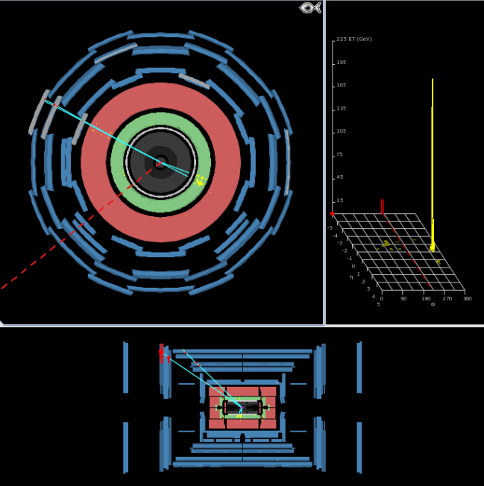
Event identification
Event display program – HYPATIA
2*50 events in total
Invariant mass: around 90 GeV
uu decay event
uu + ee decay events
γγ decay event

Slide 6
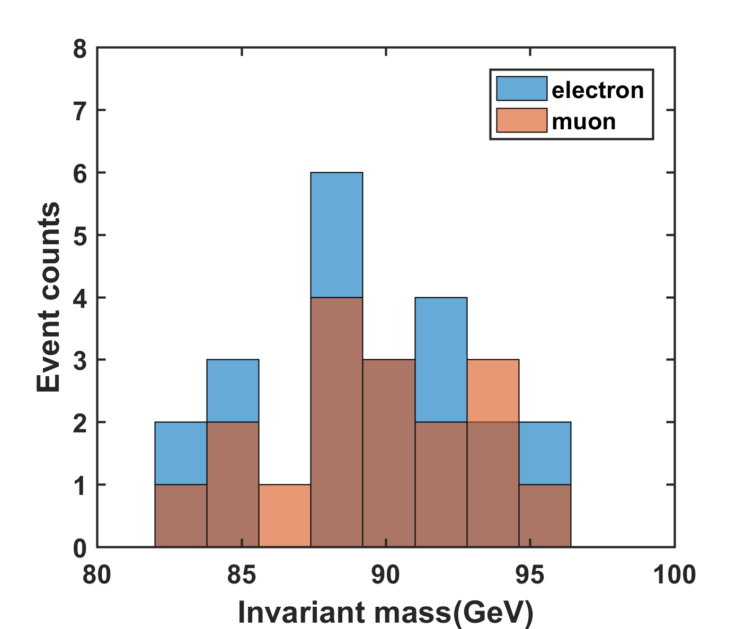
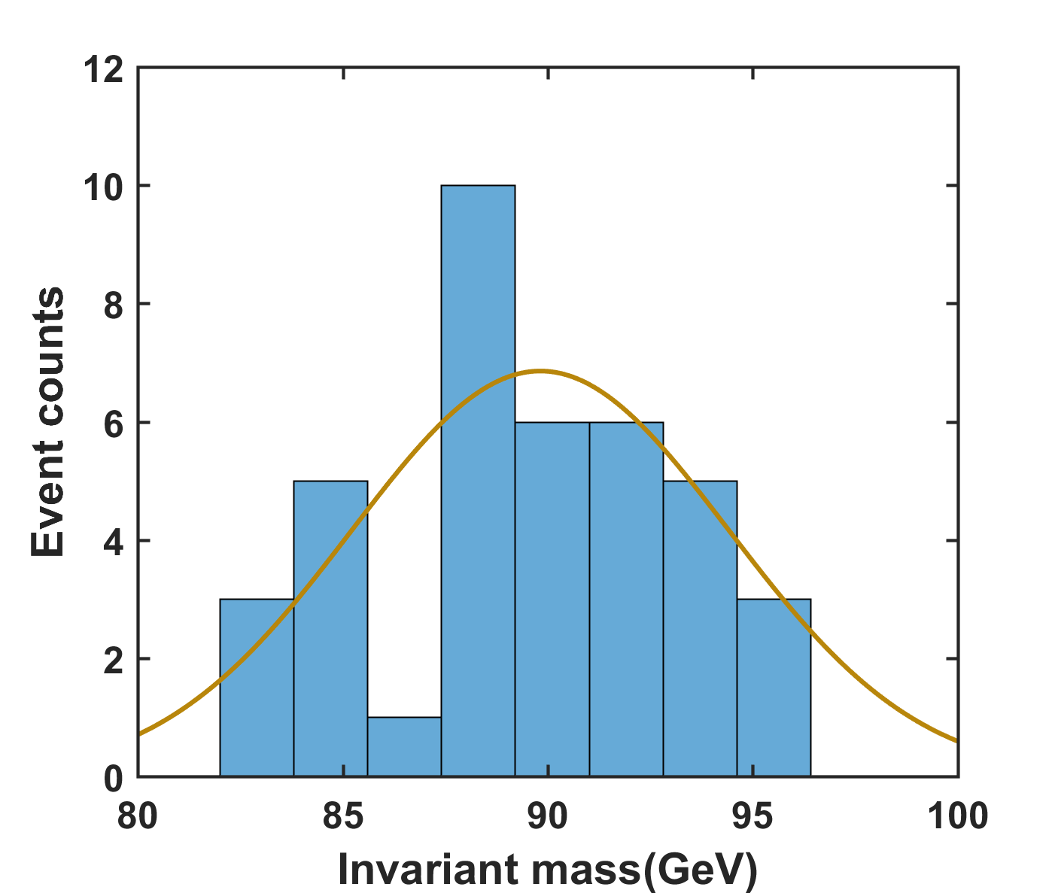
Results
Combine ee and uu decay, we fit the data and finally get the z boson invariant mass : 88.8 ± 4.6 $GeV/c^{2}$
Compared with the standard measurement: 91.1876±0.0021 GeV/c²
 | Events | mean | std
$$m_{uu}$$ | 17 | 89.58 | 3.8
$$m_{ee}$$ | 22 | 89.47 | 3.8
J. Beringer; et al. (2012). "2012 Review of Particle Physics - Gauge and Higgs Bosons" (PDF). Physical Review D. 86: 1.

Slide 7
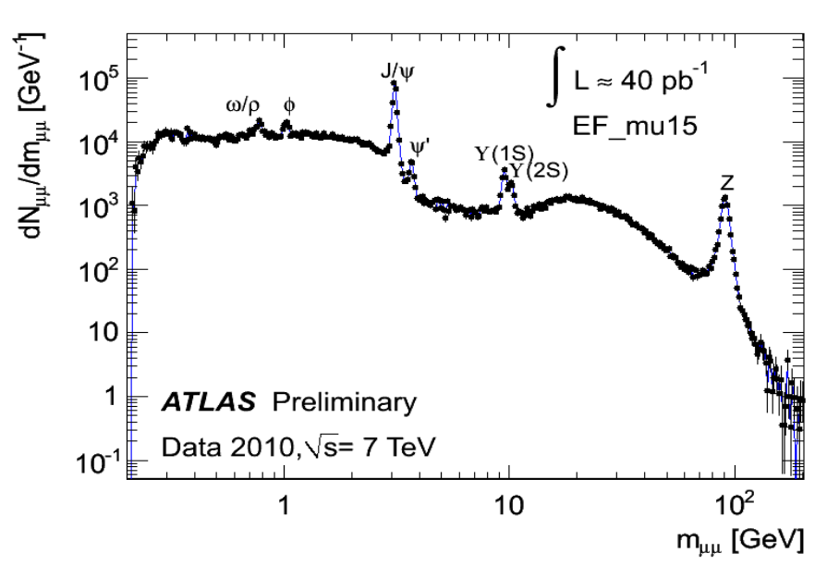
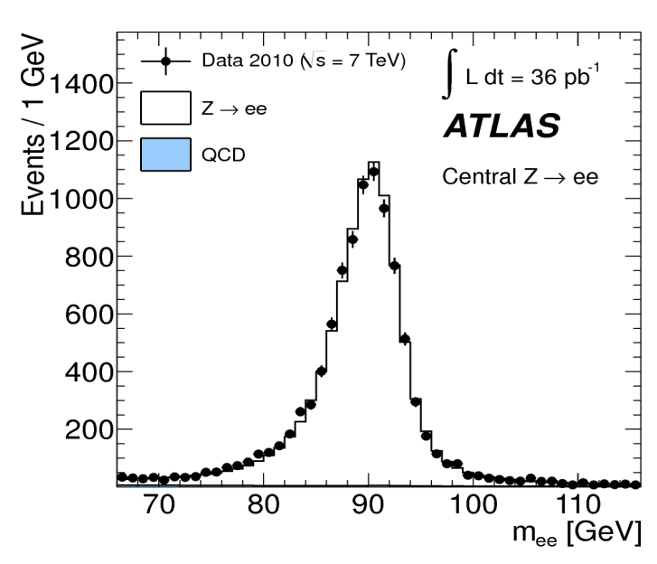
Discussion
Limited number of events
Gaussian fitting: background is not considered
Z boson analysis in ATLAS

Slide 8
Thanks!

