Slide 1
Cosmic Ray Angular Distribution and Muon Live Time Experiment
ZHENG Taifan, LI Yongwei

Slide 2
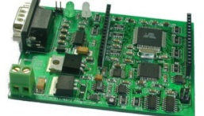
Particle Detector Description
DAQ
Scintillator
PMT
Scintillator: When muons pass through the scintillator, it could emit photons. The scintillator could be either plastic or liquid.
Photomultiplier(PMT): It captures photons emitted in the scintillator，convert them into photoelectron and amplifies the signal by dynode.
Data acquisition board(DAQ): Convert the analog signal from the PMT into a digital signal. Also acts as a filter against low signal.

Slide 3
Cosmic Ray Angular Distribution
Random coincidence events:
The photomultiplier can generate fake signals from random thermal noise. Moreover, the environmental radioactivity can also create signal in the detector and both signals have higher frequency than the muon signals.
Thus we need 2 or more detectors so that the muon will pass through all at once and we can identify the muon by the coincidence signals from all the detectors.
But occasionally, random background signals might all happen at once in all the detectors, which is identified as a muon signal in the machine. These are called random coincidence events. In the case of two detectors, it can be computed with the following formula
$Γ=n$1n2T
ni is the background event rate of the detector i and T is the coincident time window.

Slide 4
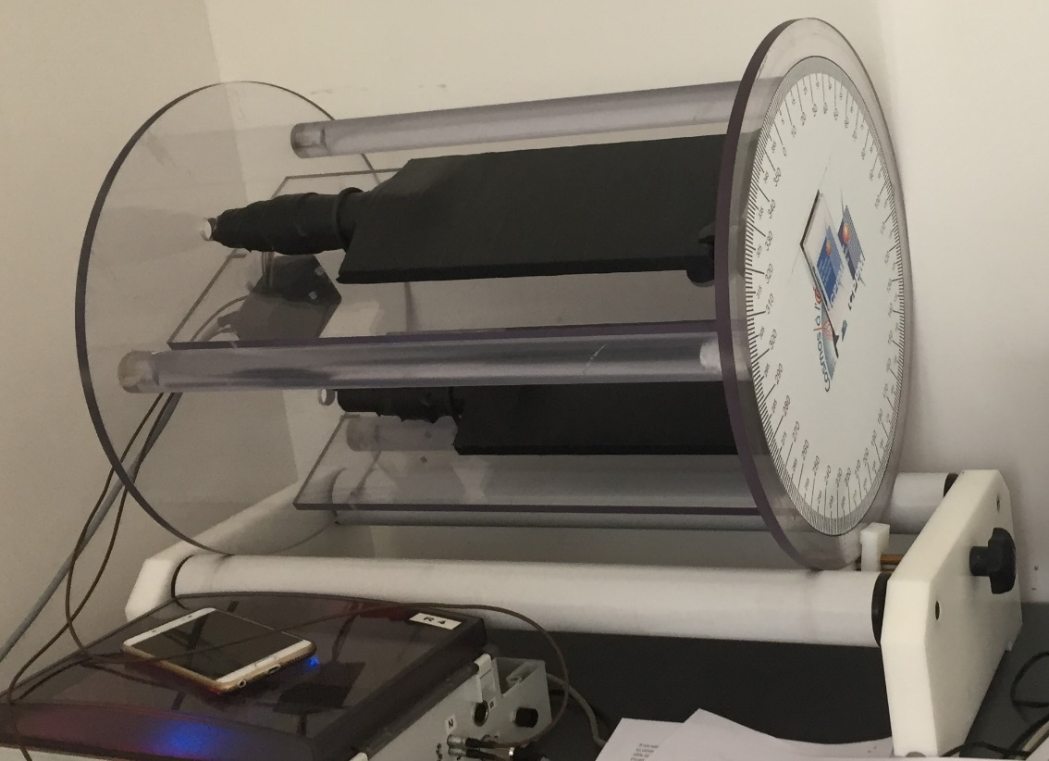
Cosmic Ray Angular Distribution
Set up
Scintillators

Slide 5
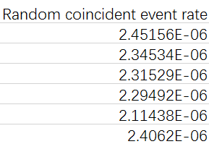
Cosmic Ray Angular Distribution
Measurements and results
Event rate does not approach 0

Slide 6
Cosmic Ray Angular Distribution
The muon passing through the first detector won’t always pass through the
second for it comes from all direction, so there is an efficiency less than
100%.
Rate(Ω)=F(θ)×η(θ,ψ)×S
Method 1：
rand(x₀,y₀,0) (θ,ψ)
Thus x₁=x₀-htanθcosψ
y₁=y₀-htanθsinψ
z
η(θ,ψ)=(a-htanθcosψ)(b-htanθcosψ)
dΩ=sinθdθdψ F(θ)=Fcos²θ
Rate=∫F(θ)×η(θ,ψ)×SdΩ
Method 2：
By code：
n=0，count=0
①Generate lots of random numbers
rand(x₀,y₀,0) (θ,ψ) and calculate x_{1，} y₁
②Judge if –a/2<x₁<a/2,-b/2< y₁<b/2
Yes，count=+1，n=+1；No，n=+1；
③Approximate the η value，η=count/n
y
(a/2,b/2,0)
h
(a/2,b/2,-h)
x

Slide 7
Muon Live Time Experiment
Muon Property: Mass: 105.66MeV Mean lifetime: 2.2μs
Decay mode:
The objective of the experiment is to measure the mean lifetime of the muon by ourselves.
When particles decay, the number of the particles follows N₀e^{-λt}. N₀ is the initial number of the particles., τ =1/λ is the mean lifetime.

Slide 8
Muon Live Time Experiment
Set up
Dark container
Scintillator
PMT1
P
M
T
2
μ⁻
_
υ_{μ}
υ_{e}
e⁻
Liquid scintillator tank

Slide 9
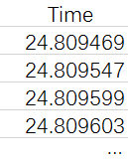
Muon Live Time Experiment
We are looking for the time difference of two signals: the signal of muon and electron, whose distribution is the distribution of muon lifetime and forms a muon decay curve. From which we can extract muon mean lifetime.

Slide 10
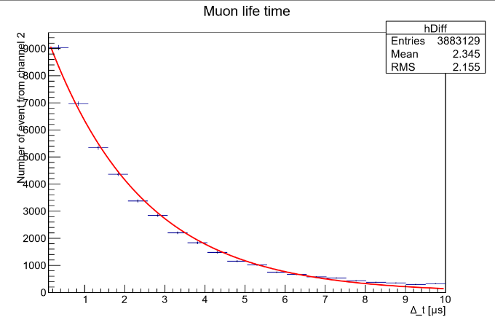
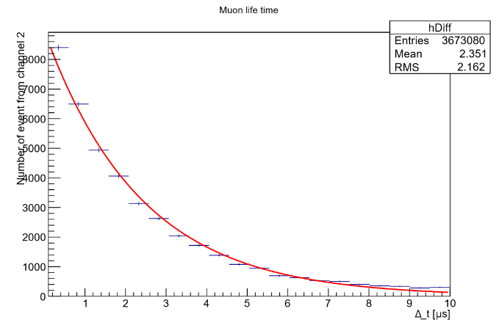
Muon Live Time Experiment
After the exponential fitting, we get
Using only PMT2:
λ=0.4205$±$0.0027 , τ=2.3781±0.0153
Using both PMT1 and PMT2: λ=0.4219±0.0026 , τ=2.3702±0.0146
Δt distribution only using PMT2
To compute by hand…
$N=N$₀e^{-λt}
Take the logarithm of both sides
$lnN=lnN$₀-λt
Then take the logarithm of all of the data points and fit it into a straight line using least square method
$y=$-λt+b
Δt distribution using PMT1 and PMT2

Slide 11
Muon Live Time Experiment
Alternative way of computing:
Again take the logarithm and –λ is the slope of the graph. We can compute λ using each successive two data points and thus get 19 λ values and take the average.
Then we get:
Using only PMT2:
λ=0.3841±0.0054 , τ=2.6034±0.0008
Using both PMT1 and PMT2:
λ=0.3806±0.0055 , τ=2.6276±0.0008

Slide 12
Muon Live Time Experiment
Thank You !

