Slide 1
DOM Assembly SUBATECH
status
H. Carduner, Bari June 12-15

Slide 2
Rooms
First idea proposed by the lab
Assembly: 30m2 Proposed by the lab, September 1st
Storage: 50m2 Proposed by the lab, September 1st
near the assembly room
DOM/VEOC: 40m2 Mechanical workshop, free zone
Crane and truck access

Slide 3
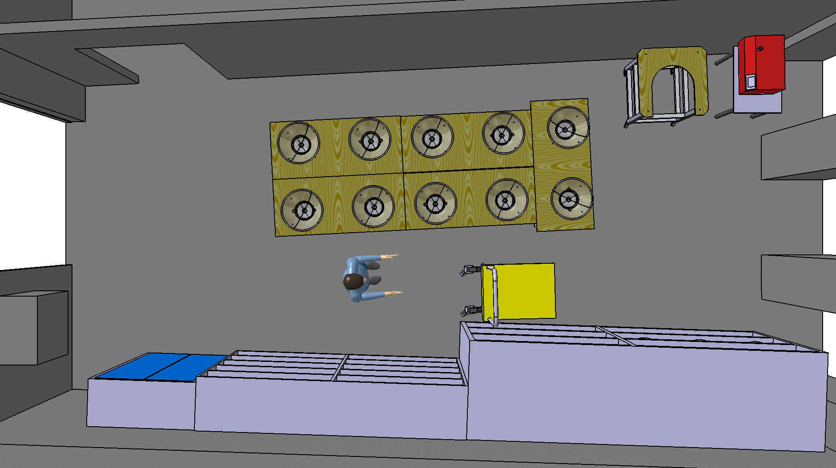
Assembly room
Leak detector
DOM integration table
DOM closing table
30m²
DOM rack

Slide 4
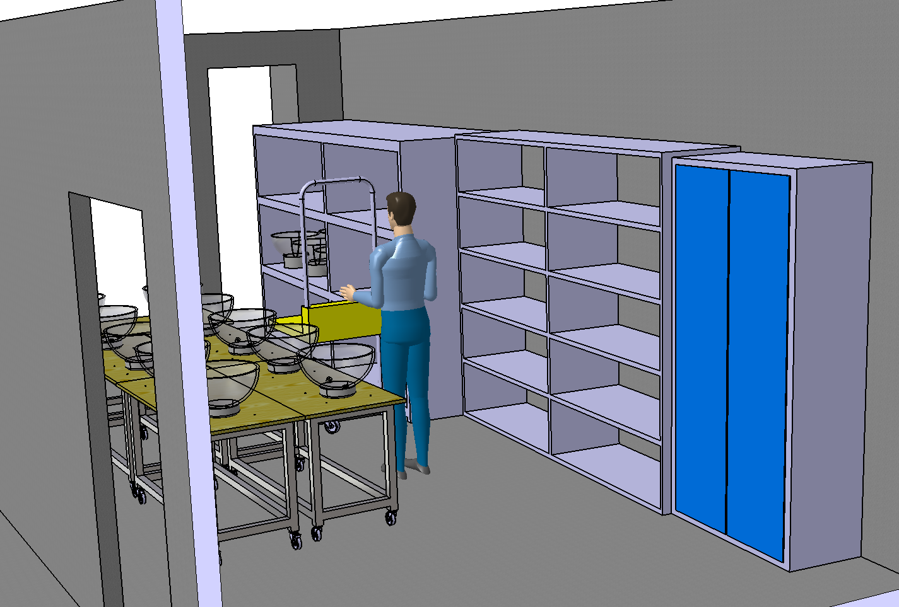
Assembly room

Slide 5
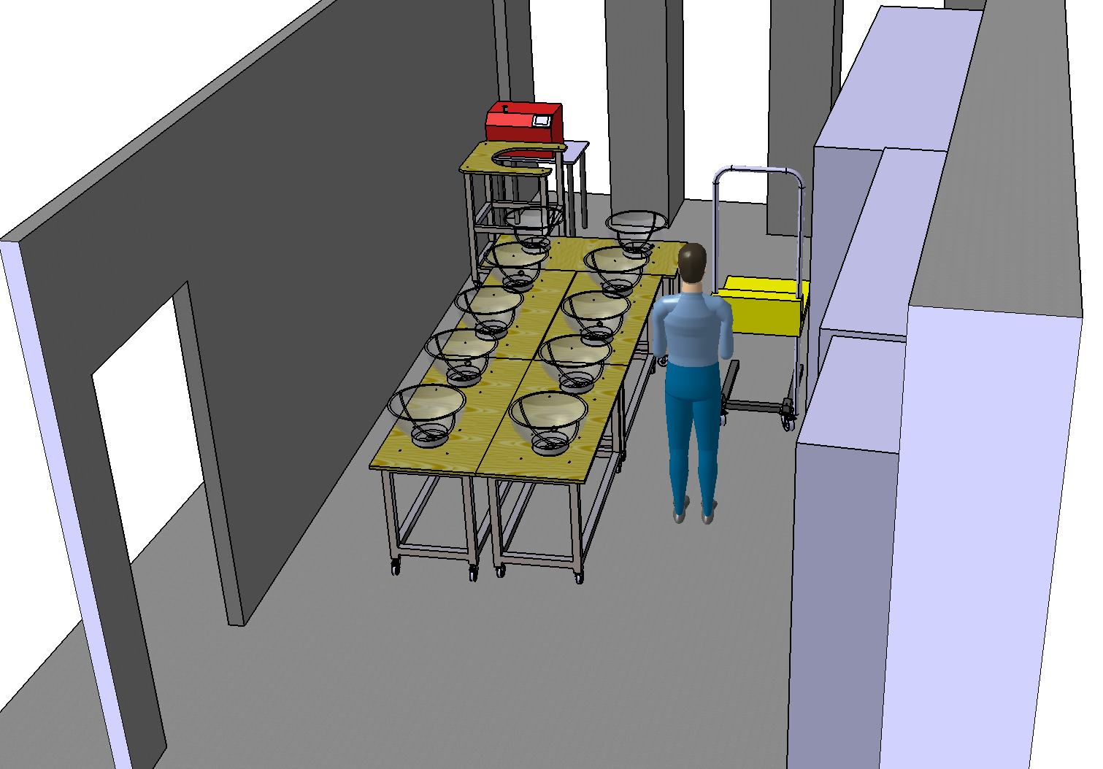
Assembly room

Slide 6
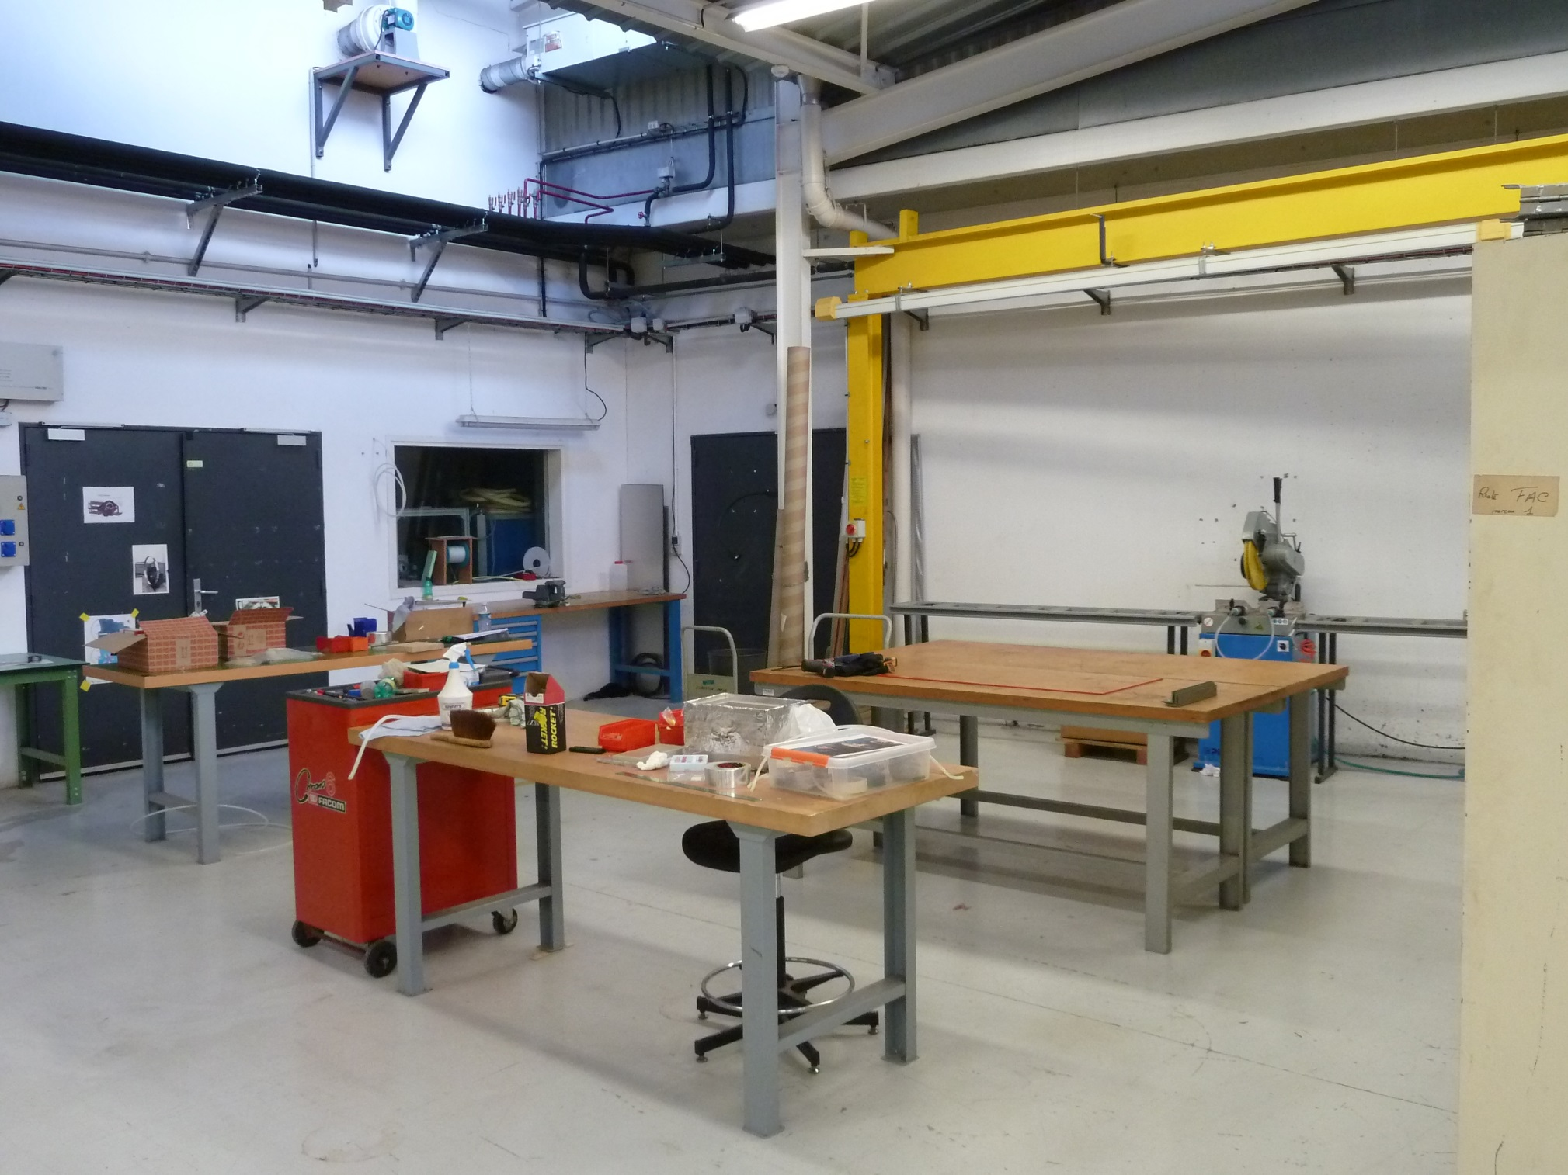
DOM/VEOC

Slide 7
TOOLS & HR
Tools and equipment's:
Orders have started (CPPM, IPHC, SUBATECH)
Tools: Quotations are ready, some will be done in our workshops (IPHC, SUBATECH)
Human resources:
Assembly: 2 technicians are assigned but half time each, and one in fixed-term contract
is expected for early 2018.
LQS: No one now but discussion in progress.
To really begin it would be nice to have components for one or two DOM in October.

Slide 8
DOM Assembly IPHC - Strasbourg
status
Safia Kihel, Bari June 12-15

Slide 9
Human resources
People involved :
Christian Weber (100%) and Safia Kihel (ISR – 80 %) are going to build the DOM.
Stella Suzanne-Ochsenbein (20 %) is the LQS.
We are asking for one fixed-term technician contract. We don't know yet if we will get it or not.
DOMs on VEOC ?
We are thinking also about doing the integration of DOMs on VEOC.
For the moment, there are only discussions, no decision has been made yet.

Slide 10
Room equipped with LED light No windows - Crane (max 500 kg) – Total area ~ 200 m² - Truck access

Slide 11
Materials
Tools :
Part of the tools are home-made at Strasbourg and Nantes. The other part is outsourced.
The tools should be available on September (except for the "Suction cup", the "DOM closing table" and the "DOM transportation". It will depend on when a decision will be taken)
Equipments :
We are in the process of purchasing the basic equipments (we have to deal with many administrative rules). Most of them should be available on September.
Components :
We are looking for the components for at least 1 or 2 DOMs .
Get them before the training courses ? To get familiar with them and quality reception procedure.

Slide 12
Training courses
Quality courses
Stella and Safia should participate to the quality courses organized by Giorgos in September.
DOM integration training
Christian and Safia are looking for the KM3NeT DOM integration training
Collaboration meeting in the beginning of October
Training in middle of October ?

