Slide 1
An Introduction to hidropic physics
HADRONIC
Hadronic physics is not a serious illness!
Laure Massacrier
Institut de Physique Nucléaire d’Orsay
JRJC 2017, Maine et Loire, 26 Nov. au 2 déc. 2017

Slide 2
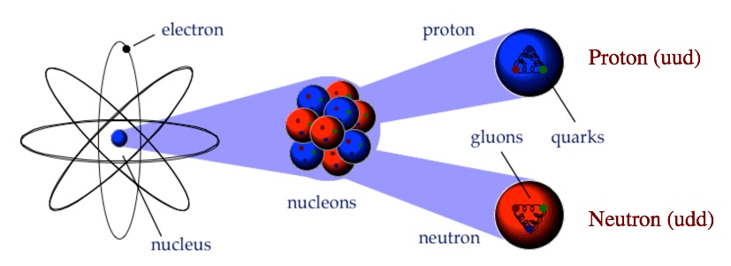
Quarks and gluons : the heart of matter
The structure of matter :
Inside the atom : the nucleus is made up of nucleons (protons, neutrons) which are made up of quarks and gluons
Only few percent of the proton mass comes from the mass of its constituents. The remaining mass comes from interactions.
We are not stardust, we are (virtual) gluons!

Slide 3
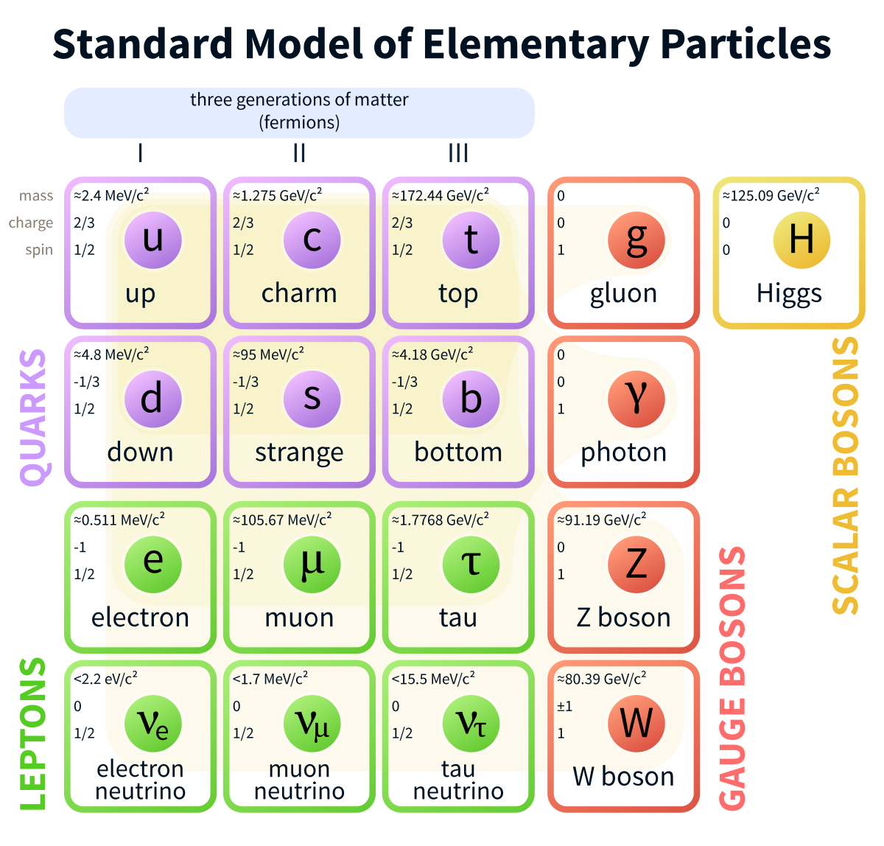
The elementary building blocks of matter
Fermions (spin ½)
Divided into three generations of:
- quarks
- leptons
First generation : lightest and most stable particles → the constituents of all stable matter in the
universe
Gauge Bosons (spin 1) → the force carriers
Higgs boson (spin 0)→ gives mass to elementary particles of the standard model
Antiparticles : same mass as particle but opposite charge
Hadrons are built from the elementary blocks of matters:
Mesons : 1 quark + antiquark (eg. pion)
Baryons : 3 quarks (eg. proton, neutron)
Notes:
Le spin est, en physique quantique, une des propriétés des particules, au même titre que la masse ou la charge électrique. Comme d'autres observables quantiques, sa mesure donne des valeurs discrètes et est soumise au principe d'incertitude. C'est la seule observable quantique qui ne présente pas d'équivalent classique¹, contrairement, par exemple, à la position, l'impulsion ou l'énergie d'une particule. Il est toutefois souvent assimilé au moment cinétique (cf paragraphe 2 de cet article, ou Précession de Thomas), ou à la rotation d'un astre sur lui-même, comme dans l'expression « résonance spin-orbite ». Enfin, le moment cinétique intrinsèque (de spin) et le moment magnétique intrinsèque (de spin) sont tous deux confondus sous le terme de « spin ».

Slide 4
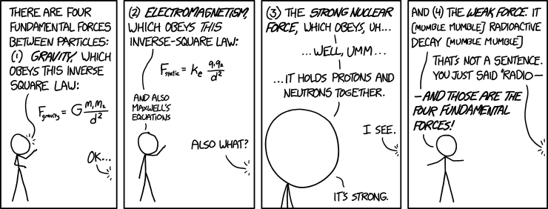
The four fundamental forces and their carriers
Gravitational interaction
Acts on | Mass-Energy
Particles experiencing | All
Particles mediating | Graviton (not yet observed)
Strenght at ~ 10⁻¹⁷m | 10⁻⁴¹
Electromagnetic interaction
Acts on | Electric charge
Particles experiencing | Electrically charged
Particles mediating | Photon
Strenght at ~ 10⁻¹⁷m | 1
Weak interaction
Acts on | flavours
Particles experiencing | Quarks, leptons
Particles mediating | W^{+ / -} , Z
Strenght at ~ 10⁻¹⁷m | 10⁻⁴
Strong interaction
Acts on | Color charge
Particles experiencing | Quarks, gluons
Particles mediating | Gluons (8)
Strenght at ~ 10⁻¹⁷m | 60

Slide 5
HADRONIC physics: From quarks to hadrons
Hadronic physics studies the structure, the properties and the interactions of the hadrons in terms of quarks and gluons
The underlying theory is Quantum ChromoDynamics (QCD) : the theory of strong interaction between quarks and gluons
The goal is to use our understanding of QCD to qualitatively describe a wide array of hadronic phenomena, ranging from terrestrial nuclear physics to the behaviour of matter in the early universe
A (non exhaustive) list of few key open issues in hadronic physics :
How does the proton mass arise from its constituents?
How does the proton spin arise from its constituents ?
What is our degree of understanding of QCD?
Can we determine precisely the parameters of QCD? (Λ_{QCD}, QCD vaccuum parameter, mass of quarks)
What is the origin and dynamics of confinement?
What is the origin and dynamics of chiral symmetry breaking?
What are the roles of quarks and gluons in nuclei and matter under extreme condition?
→ From the modification of the quark gluon structure of a nucleon when it is immersed in a nuclear medium within a nucleus to the novel phases and behavior of matter in neutron stars or the early universe
More generally, understand the quark and gluon structure of hadrons based on QCD
Notes:
In common study of strong interaction at different regime.
Experimentally: QGP, nucleon structure, hadron spectroscopy
Theortically: lattice QCD, perturbative QCD, effective theory

Slide 6
A wise student said
QCD means nasty properties
Let’s have a look then!

Slide 7
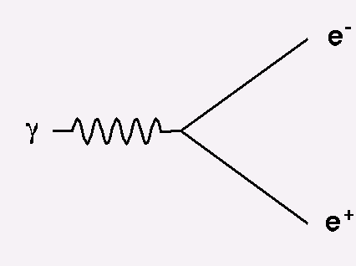
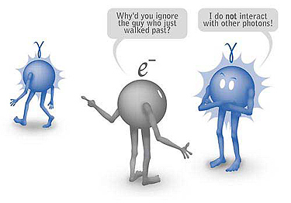
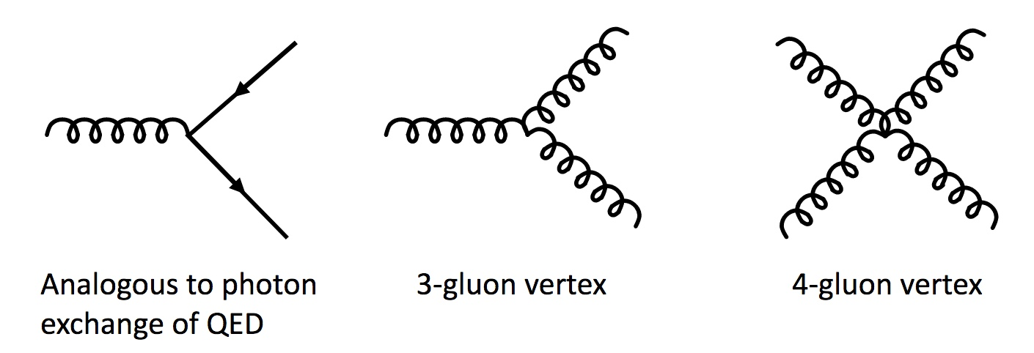
The basics of Quantum chromodynamics (QCD)
QCD is a quantum field theory with similarity and differences with respect to Quantum ElecroDynamics (QED) describing the electromagnetism interaction
QED
versus
QCD
Charge types +, -
Mediator properties photon, massless, neutral
Charge types 3 color charges (red, green, blue)
Mediator properties 8 gluons , massless, color charged
Interaction with electrically charged objects
Interaction with color charged objects (quarks, gluons)
Range and strenght of interaction
weaker and infinite range
Range and strenght of interaction
stronger and short range
Fundamental vertices
Fundamental vertices
g
q
g
g
g
g
g
g
g
q
Coupling constant α = e²/4π = 1/137
Strong consequences on the theory
α_{s} = g_{s}²/4π ~ 1
Notes:
Wuth 3- and 4-gluon vertices we generated all is needed to guarantee gauge invariance. In other words, no extra 5- or more gluon vertices have to be introduced to achieve the gauge invariance of higher order amplitudes
n theoretical physics, quantum field theory (QFT) is the theoretical framework for constructing quantum mechanical models of subatomic particles in particle physics and quasiparticles in condensed matter physics. It is a set of notions and mathematical tools that combines classical fields, special relativity, and quantum mechanics

Slide 8
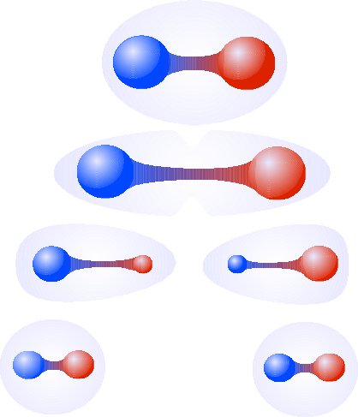
IMPORTANT FEATURES of QCD
What is color?
The fundamental « charge » of QCD
A conserved quantum number
Three colors r, g, b (and three anti-colors r, g, b)
Gluons carry color charges (naively expect 9 gluons → but 8 realised by nature (coulor octet + singlet))
Leptons and other gauge bosons (γ, W, Z) → no color charge → don’t participate to strong interaction
Emission/Absorption of gluons by quarks changes color of quarks : q_{i} → g_{ij} + q_{j}
Color blindness and confinement
Experimental evidence :
We don’t observe free quarks in nature
Quarks are confined within hadrons (color neutral objects)
What happens if you try to separate a qq pair?
Gluon tube between quarks elongates
Strong force get stronger with the distance
As soon as there is enough energy in the system a new quark-antiquark pair
will be created
Direct consequence of gluon self-interaction

Slide 9
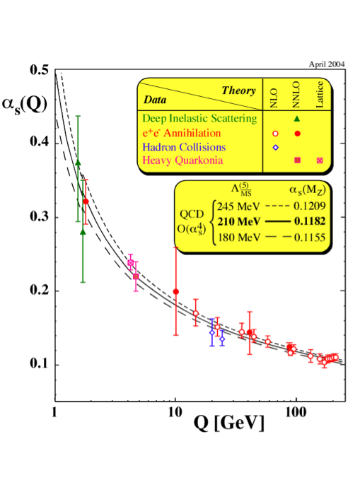
Important features of qcd
Confinement and asymptotic freedom
Confinement :
For Q² < 1 GeV
For Distance ~ 1fm (typical size of hadrons)
Particle we observe in nature are in the regime of non-perturbative QCD
Coupling constant
confinement
Asymptotic freedom :
At short distances the effective coupling between quarks decreases logarithmically
Under such conditions quarks and gluons appear to be quasi-free
Perturbative QCD regime Q² >> 1 GeV
Asymptotic freedom
Energy scale
Distance
Large distance
Short distance
Notes:
In physics, a coupling constant or gauge coupling parameter is a number that determines the strength of the force exerted in an interaction

Slide 10
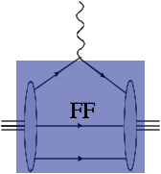
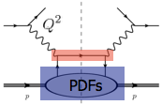
Elements of QCD : theoretical tools
Perturbative QCD (pQCD)
In the high-energy (high momentum transfer) regime, perturbative approach is applicable to QCD
→ good predicting power for yields, cross sections, kinematic distributions
Order by order expansion in α_{s} with α_{s} << 1, observable f can be written:
$f=f_{1}α_{s}+ f_{2}α_{s}^{2}$ + $f_{3}α_{s}^{3}+ …$
Where only the first, two or three terms are calculated and the others are assumed to be negligible
The f factors are calculated via Feynman diagrams
Factorisation theorem and pQCD
Factorisation of a process : hard part ⊗ soft part
hard part = calculable with perturbative QCD
Soft part = « universal » distributions (FF, PDF, GPD…)
Examples for the proton case
Elastic diffusion
ep → e’p’
Deep Inelastic Scattering
ep → e’X
Importance of precise experimental measurements
of the universal distributions
Ex: determine PDFs in lepton-proton collisions and
use them to compute proton-proton cross
sections at LHC
Form factor
Parton distributions
Notes:
Diffusion profondément inélastiqueep → e’X

Slide 11
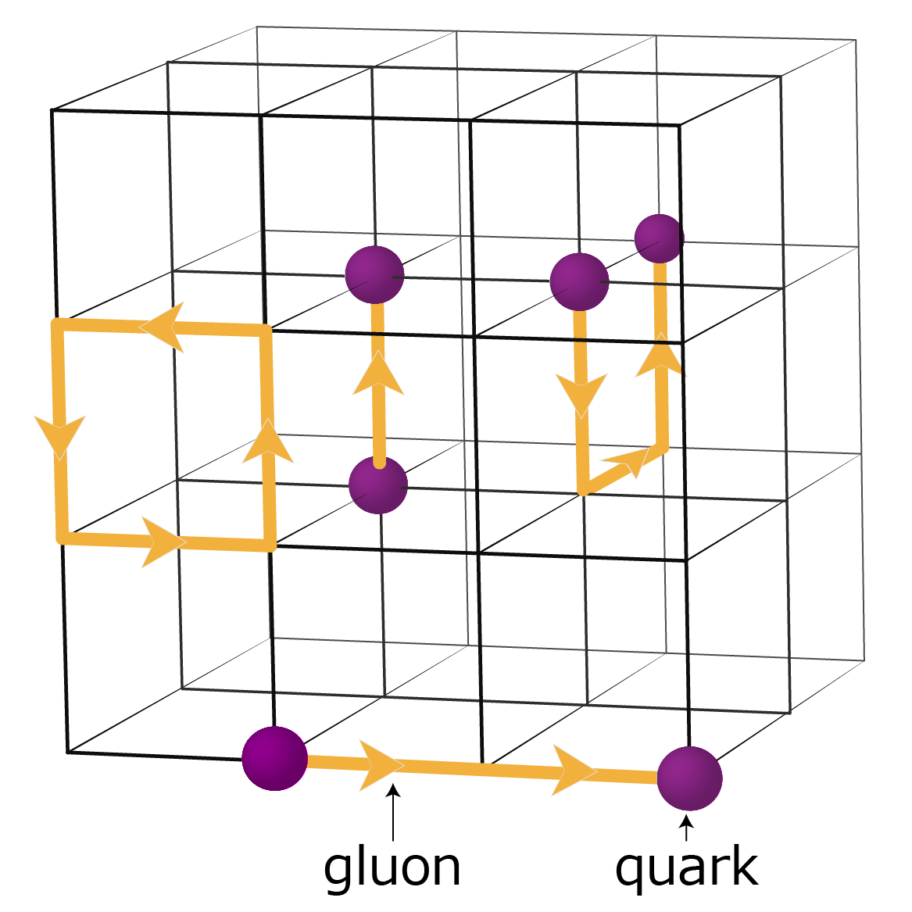
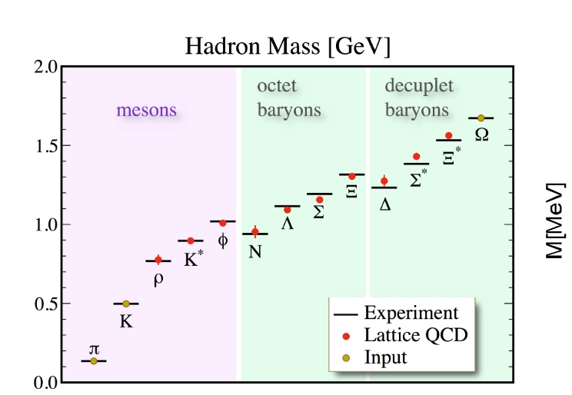
Elements of QCD : theoretical tools
In the low-energy (low momentum transfer) regime, various approaches to non-perturbative QCD are possible
Lattice QCD
Quarks and gluons are studied on a discrete space-time lattice
Fields representing quarks are defined at lattice sites, while gluon fields are links connecting sites
Only nearest neighbour interactions considered
For infinitely large lattice and infinitesimally sites close to each other → QCD vacuum recovered
Great predictive power: hadron masses, temperature of deconfinement, …
Effective theories
Phys. Rev. D79 034504 (2008)
Approximation to an underlying physical theory at a chosen energy scale. Use of effective Lagrangians equivalent to QCD one.
Ex : Chiral perturbation theory : interaction of hadrons with pions and kaons (Goldstone bosons of spontaneous chiral
symmetry breaking)

Slide 12
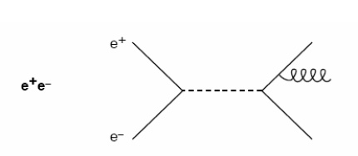
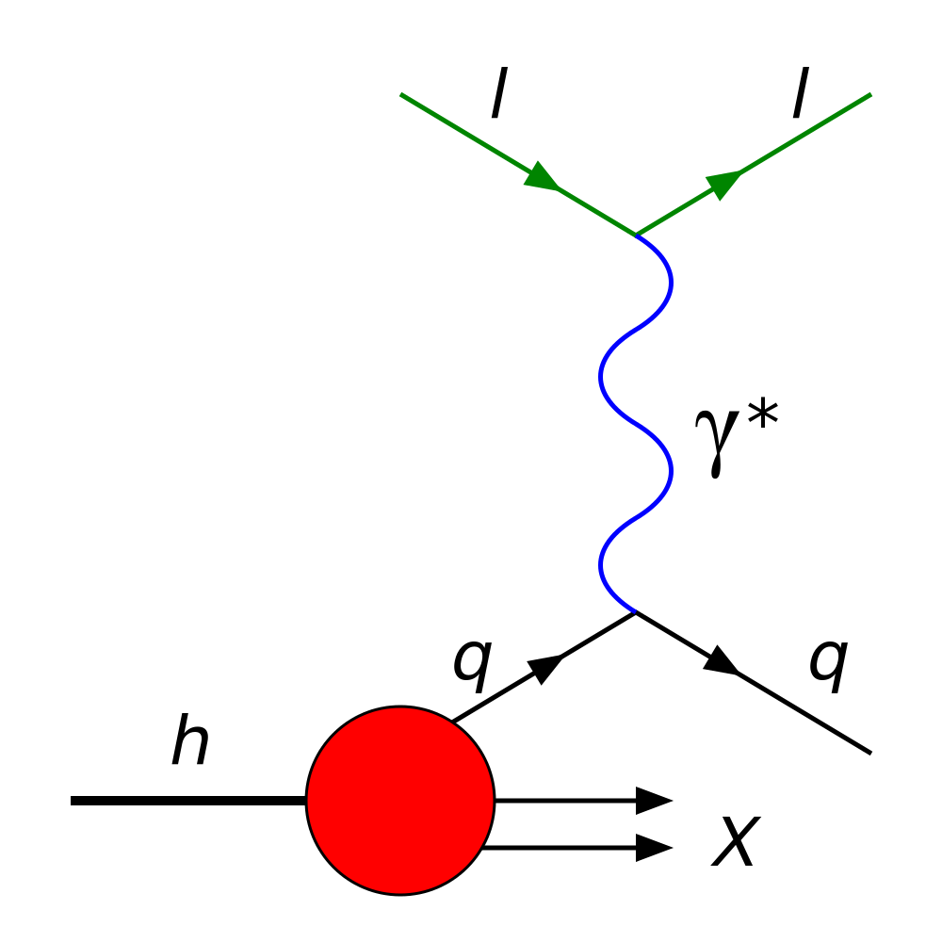
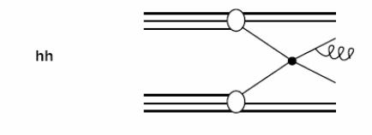
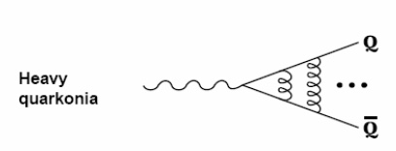
Elements of QCD : EXPERIMENTAL tools
Test of QCD can be done with different processes:
Electron-Positron annihilation :
No hadrons in initial state
Production of multi-jets → discovery of the gluon, gluon self-coupling
Deep inelastic scattering :
Probe the insides of hadrons using electrons, muons and neutrinos
One hadron in the initial state
First convincing evidence of the existence of quarks
Hadron-Hadron collisions :
Two hadrons in initial state
Rich variety of quantum states available for particle production → spectroscopy of hadrons, hadron properties
Heavy quarkonia : ratios of hadronic over radiative decay proportional to α_{s}

Slide 13
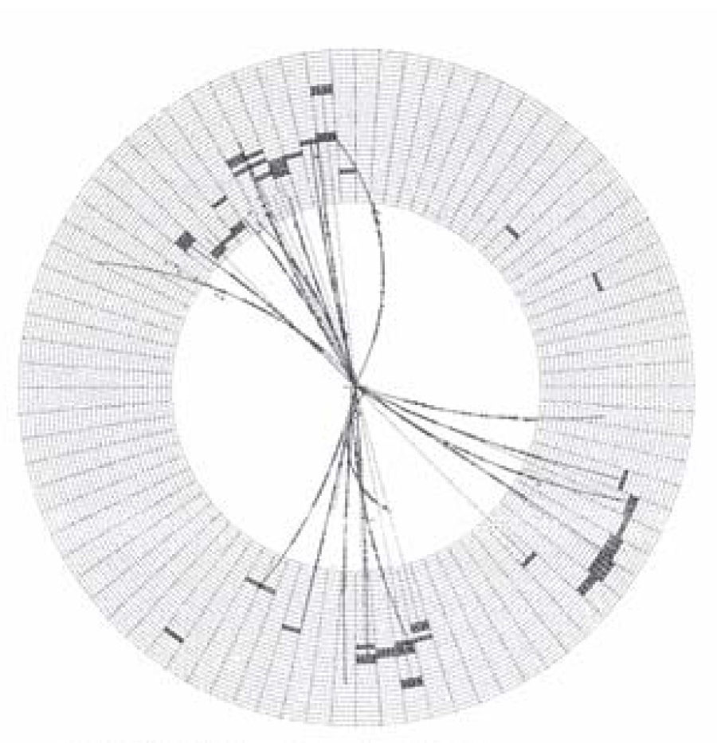
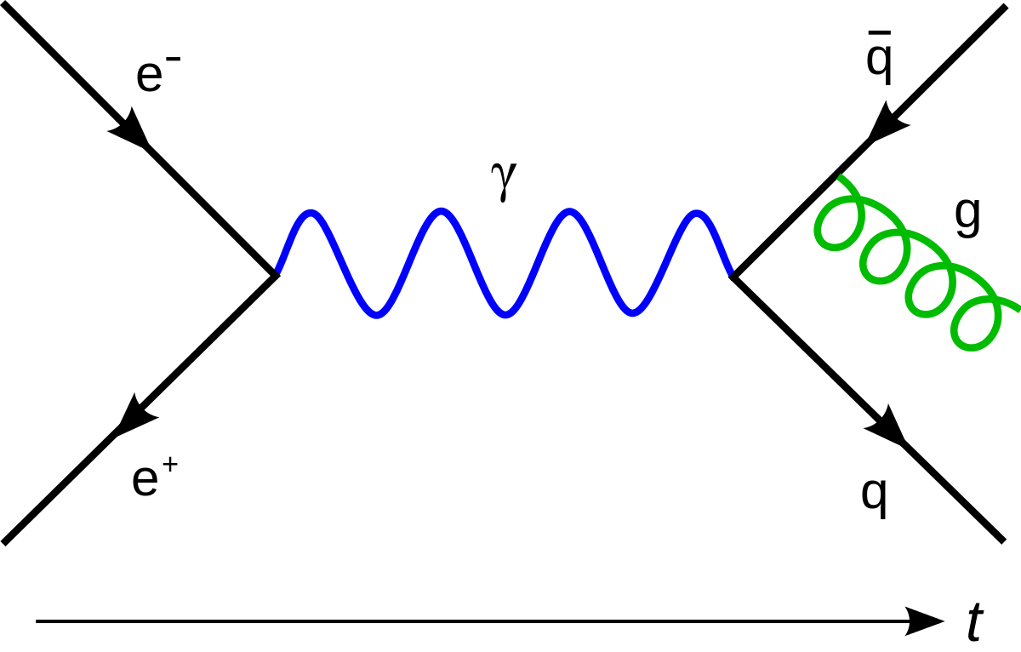
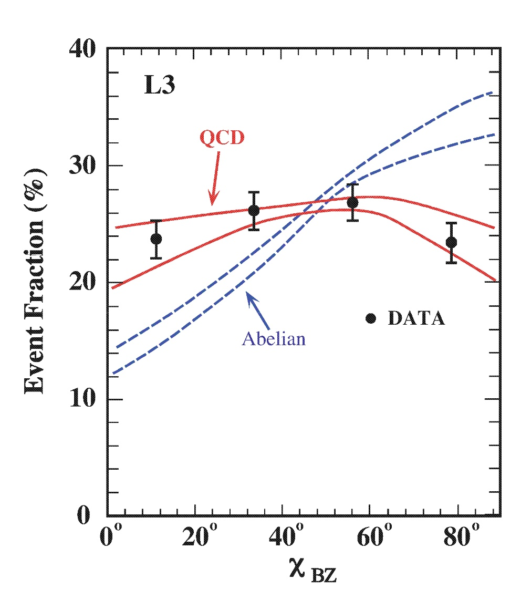
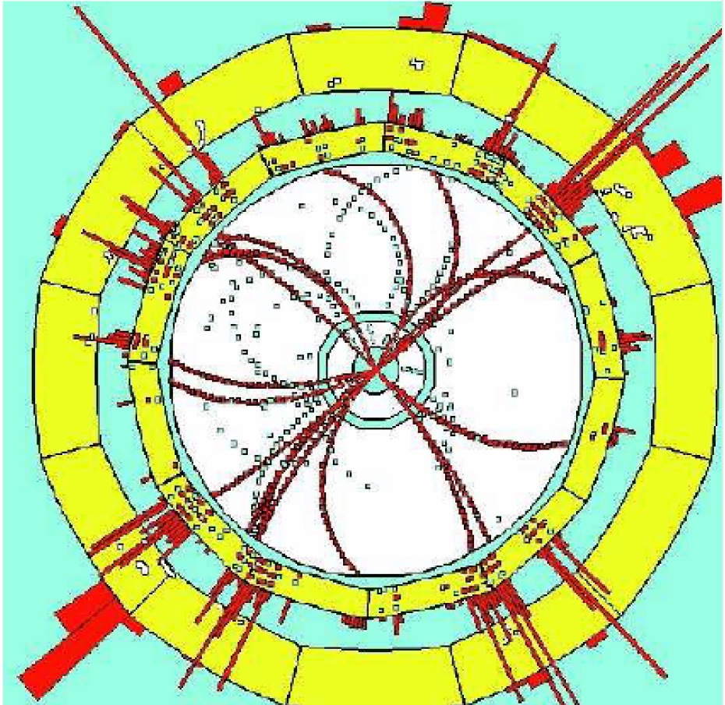
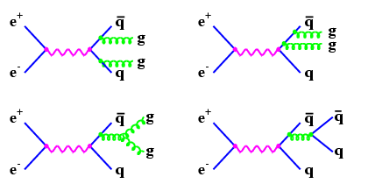
Experimental validations of qcd: evidence for GLUONS and gluon self-coupling
e⁺e⁻ collider, √s = 12-47 GeV
3-jet event, JADE detector at PETRA, DESY (1977)
With Electron-Positron annihilation
Quarks radiate gluons
Because of confinement, fragments hadronises into jets
Leading order correction to the process e⁺e⁻ → qq (two-jet final state)
Experimental signature: 3-jets in the final state
e⁺e⁻ collider, √s → 200 GeV
4-jet event, ALEPH detector at LEP-I
4-jet events allow to test the existence of gluon self coupling
Notes:
or in
stance, the so-called Bengtson-Zerwas angle,
χ
BZ
[53], measuring the angle between the planes defined by the tw
o highest and the two lowest energy
jets, is rather sensitive to the difference of a gluon-jet spl
itting into two gluons, which in QCD is the
dominant source of 4-jet final states, and a gluon splitting t
o a quark-antiquark pair, which is the
dominant process in an abelian vector theory where gluons ca
rry no colour charge.

Slide 14
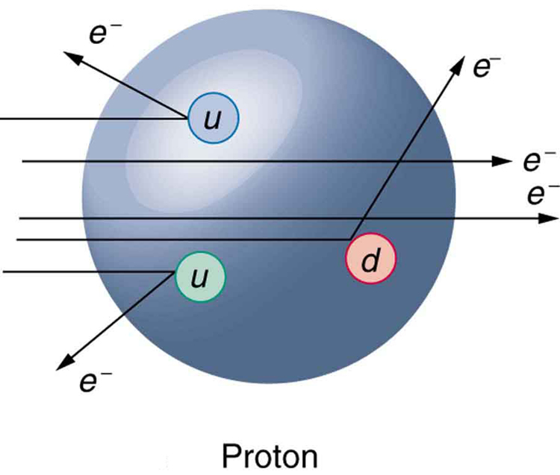
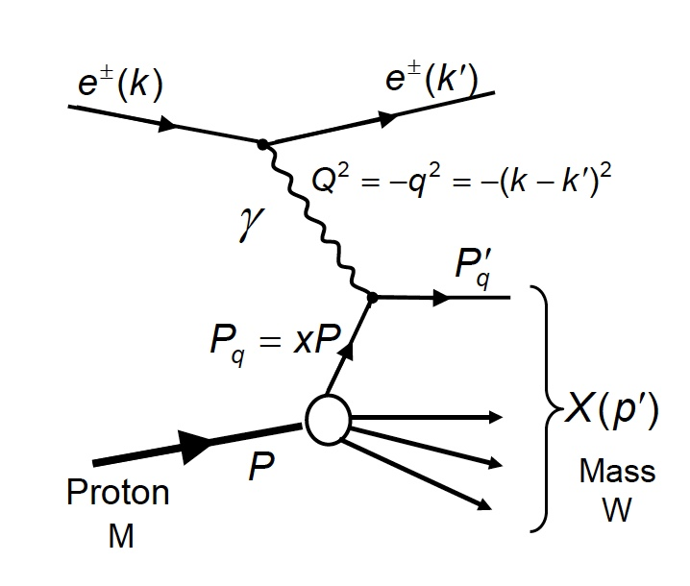
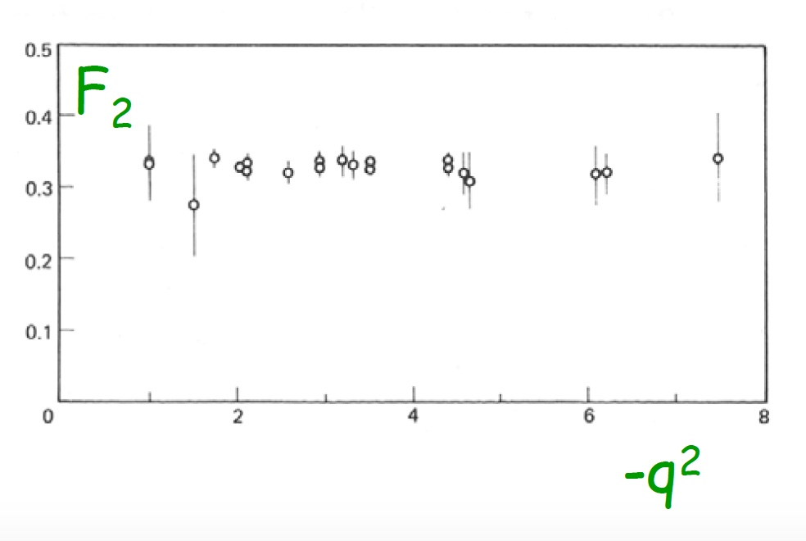
Experimental validations of qcd: evidence for quarks
proton breaks up
With Deep Inelastic Scattering:
high Q²
Simple idea : look inside the proton using an electron « microscope »
SLAC, 1972
Scattering described by two independent variables (x, Q²)
F₂ → proton structure function gives the probability of finding a quark carrying fraction x of proton momentum (weighted by electric charge of quark)
F₂(x) depends on x but not on q² → scale invariance
→ indicates evidence for point like particles inside proton

Slide 15
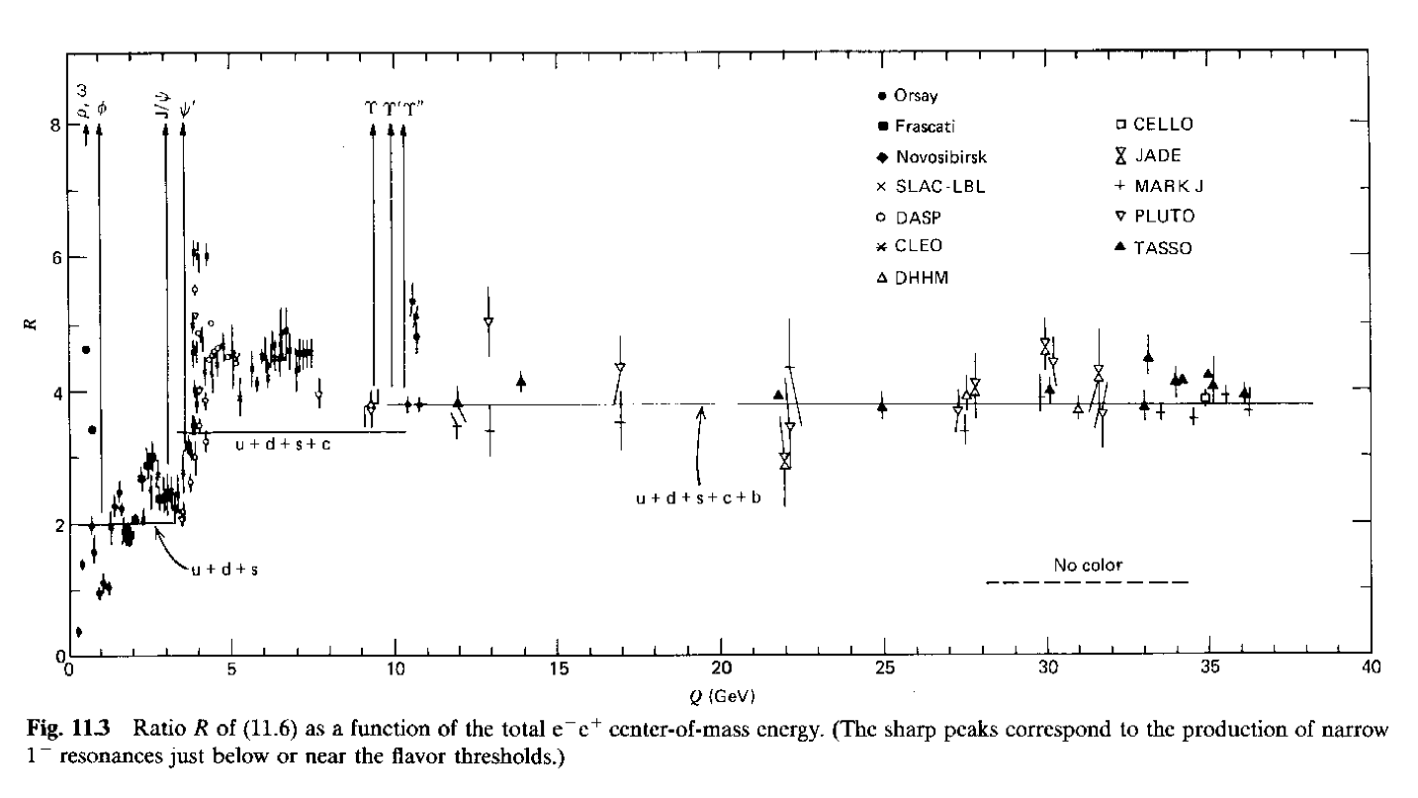
Experimental validations of qcd: evidence for COLOR
With Electron-Positron annihilation
For a single quark flavour
μ⁺
No color
With 3 colors
μ⁻
But, we measure e⁺e⁻ → hadrons not e⁺e⁻ → qq
Sum over all quarks flavours (accessible at a given √s)
Notes:
Et Delta++ baryon (3 quarks u) violerait principe de Pauli
Decay de Pi0 to gamma gamma proportionnel a Nombre de couleurs au carré = 3

Slide 16
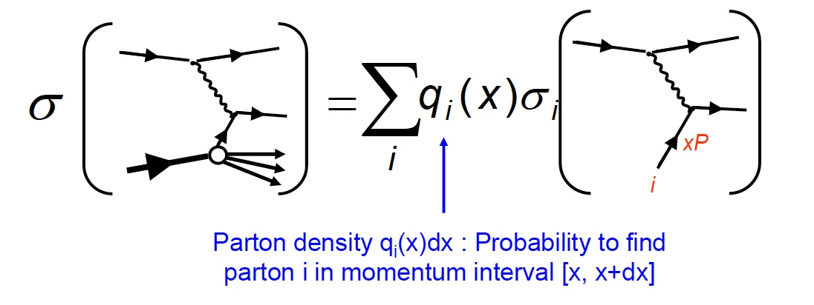
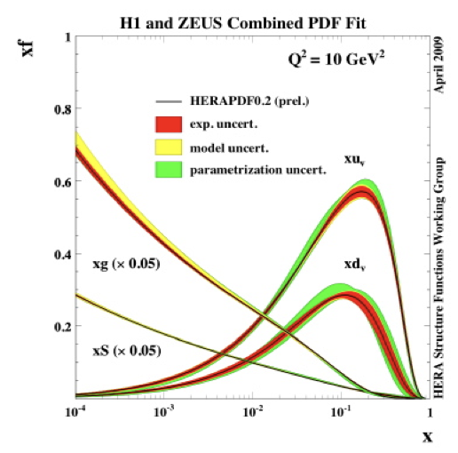
Measuring « universal » distributions
Example : Measure pdf with Deep Inelastic Scattering:
Factorisation hypothesis
15 years of measurements at HERA (DESY)
Good precisions for u, d quarks, gluons
But still many unknown:
- parton distributions at very low x
- modification of pdf in nuclear matter
- generalised descriptions (GPDs, TMDs)
Small x
Gluons, sea quarks
Large x
Valence quarks
Notes:
ep 920 GeV

Slide 17
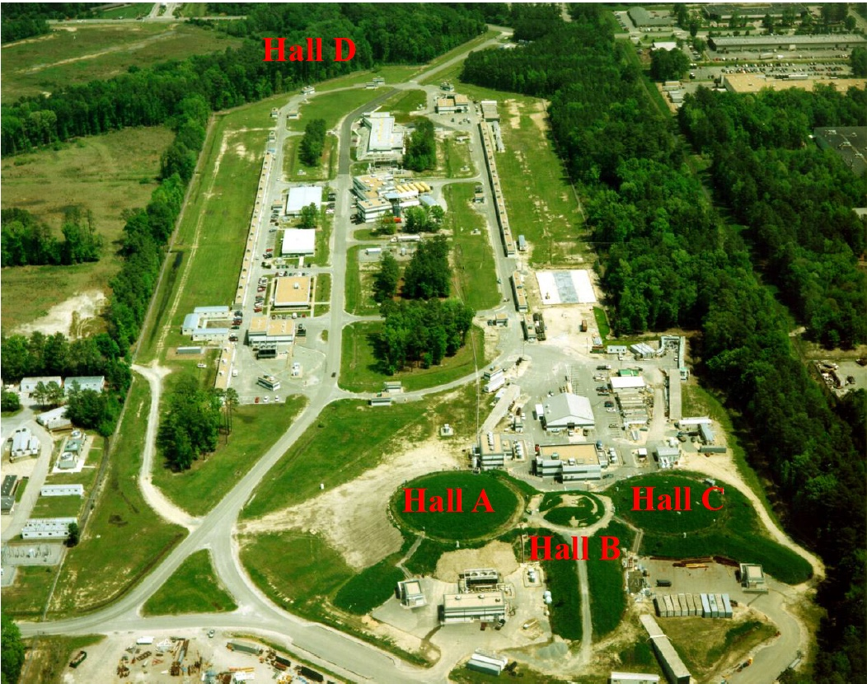
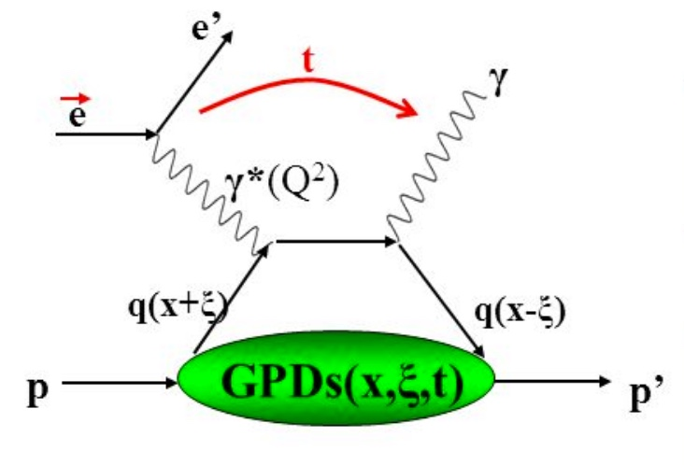
Deeper in the understanding of the Nucleon structure
The example of the experiments conducted at Jefferson Lab (USA)
e⁻ beam at 12 GeV (4 experimental hall A, B, C, D)
3D spatial maps of the nucleons :
With Generalised parton distributions (GPDs)
Accessed through Deeply Virtual Compton Scattering (DVCS) : ep → e’p’γ
Hard part: photon-quark interaction and re-emission of real photon
Soft part: GPDs

Slide 18
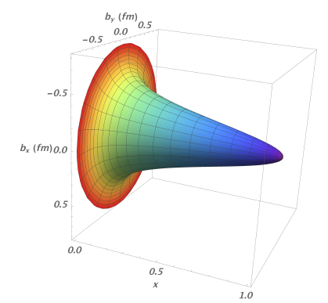
3D Spatial Maps of the nucleons: the GPDs
ep a e’p’γ
Proton tomography
(DVCS)
Faster quarks (valence) at the core of the nucleon.
Slower quarks (sea) at its periphery
Transverse position
ep a ep
ep a e’X
(elastic)
(DIS)
Quark longitudinal momentum
→ Frédéric Georges « Diffusion Compton profondément virtuelle au Jefferson Lab »
Notes:
we have been able to derive a functional mapping of the density and transverse size of the proton charge as a function of the quark’s longitudinal momentum.

Slide 19
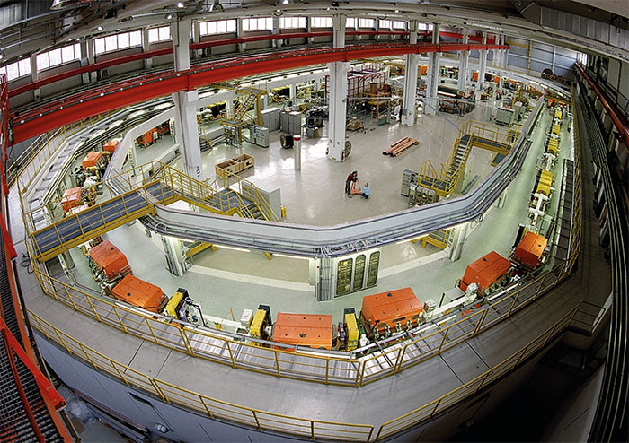
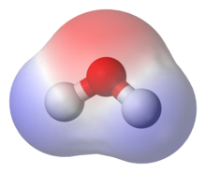
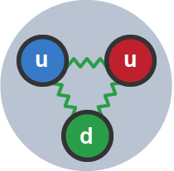
Investigating the electric dipole Moment of hadrons
The example of the proposal from the JEDI (Julich Electric Dipole moment Investigations) Collaboration
EDM is a measure of the separation of positive and negative electrical charges within a system, i.e. a measure of the system overall polarity
Goal of the new experiment : set most precise limits on the EDM of hadrons
Cosy storage ring, Julich
Water molecule
proton
analogy
EDMs violate both parity (P) and time reversal (T)
Assuming CPT symmetry valid → CP violated
Strong constrain on the scale of CP-violation (SUSY range)
→ Julien Michaud « Anneau de stockage pour la mesure de moment électrique dipolaire»
Notes:
Un exemple courant de composé polaire est l'eau (H₂O). Les électrons des atomes d'hydrogène de l'eau sont fortement attirés par l'atome d'oxygène et sont en réalité plus proche du noyau de l'oxygène que de ceux de l'hydrogène. C'est pourquoi l'eau a une charge négative en son centre (teinte rouge) et une charge positive à ses extrémités (teinte bleue).

Slide 20
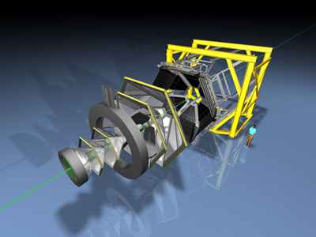
Hadron spectroscopy with the hades detector
The example of the HADES experiment at SIS accelerator (GSI)
Study of in-medium properties of light vector mesons in very dense and hot nuclear matter
Low energy Heavy Ion beams on fixed target and detection of lepton pairs
Study electromagnetic decay of hadrons/mesons in elementary reactions
High Acceptance Di-Electron Spectrometer
HADES has intensively studied resonance production in several light colliding systems (p+p, d+p) to build a solid basis for the understanding of hadron properties in heavier collision system
Role of baryonic resonances (Δ, N*,..) production was investigated in several works in elementary reactions at different beam kinetic energies. An objective was the extraction of the individual contributions of the resonances to the total production cross section, as well as their production and decay properties (angular distributions)
→ Amel Belounnas « Study of baryonic resonances in the reaction pp→ppπ+π− at 3.5 GeV with HADES »

Slide 21
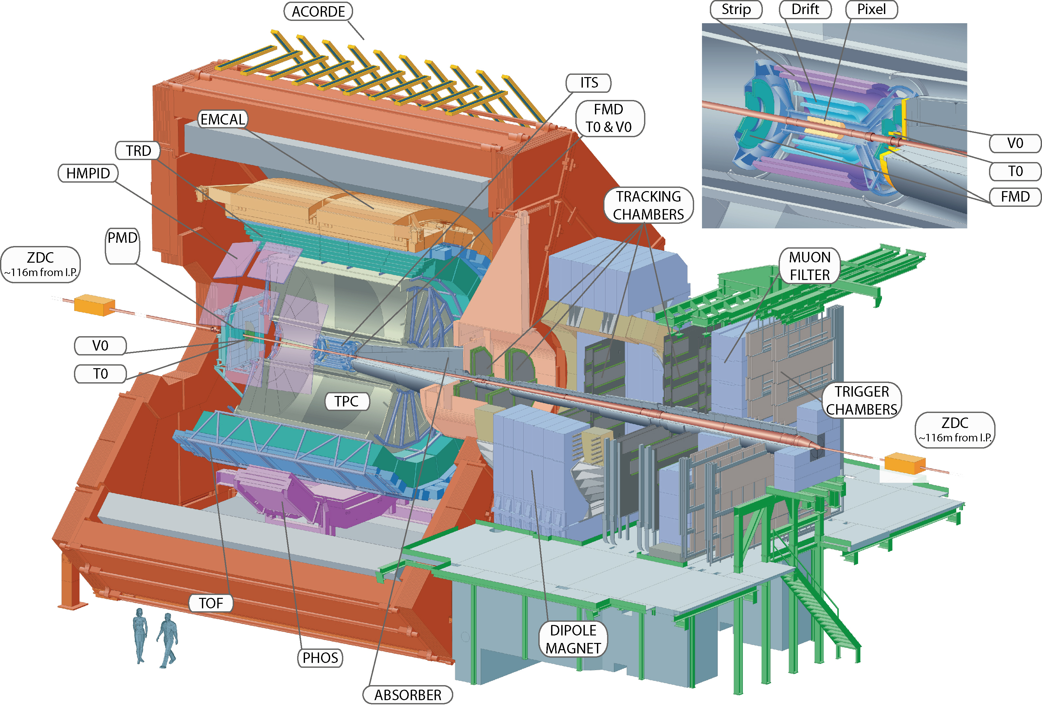
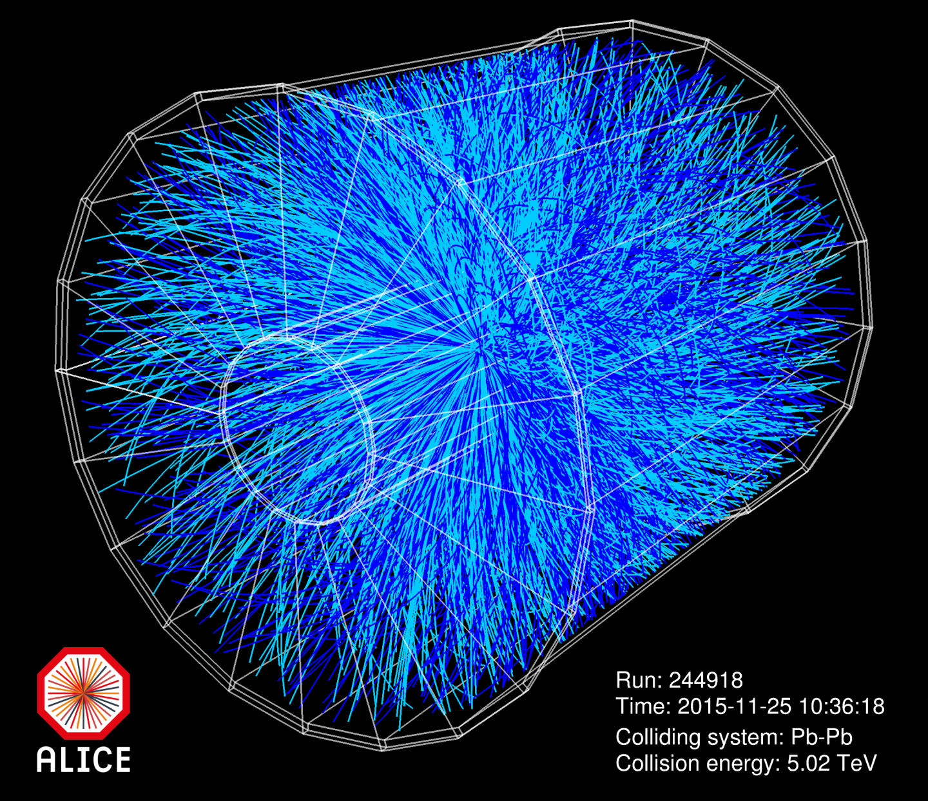
Study QCD under extreme conditions with ultra-relativistic heavy ion collisions
The example of the ALICE experiment at CERN
Study of the Quark Gluon Plasma (GQP) in Pb-Pb collisions
QGP : Deconfined state of nuclear matter → quarks and gluons evolve freely during a
short amount of time
High temperature and pressure needed!
Conditions similar to the early universe

Slide 22
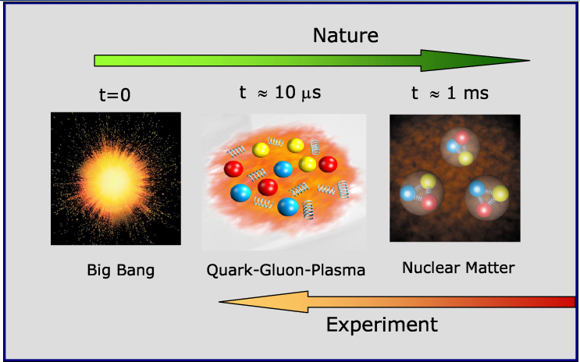
Ultra-relativistic HI collisions to recreate the conditions of the early universe
In the early stages of the Universe (few μs after Big Bang), quarks and gluons were evolving freely due to the large temperature and energy density
As the universe cooled down, they were confined inside the hadrons
To study confinement → recreate this stage of matter in the lab
From lattice QCD → T_{c} ~ 170 MeV (10⁵ times t° inside sun)
→ ε_{c} ~ 1 GeV/fm³ (5 times ordinary matter)
How to reach those conditions in lab?
Collisions of High-Energy Ultra-Relativistic Heavy Nuclei
Vary type of nuclei and energy to explore different regions of the
phase diagramme of nuclear matter

Slide 23
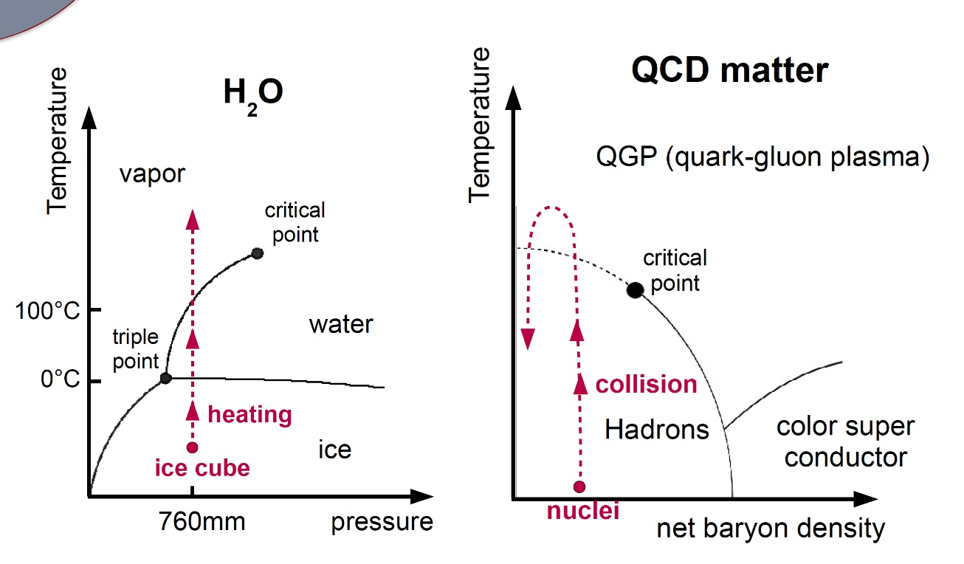
The phase diagramme of nuclear matter
What is the state of QCD matter under specific conditions of temperature and baryon density?
What is the nature of the phase transition? Is there a critical point?
Can we write down the EoS of nuclear matter? → interesting for astrophysics

Slide 24
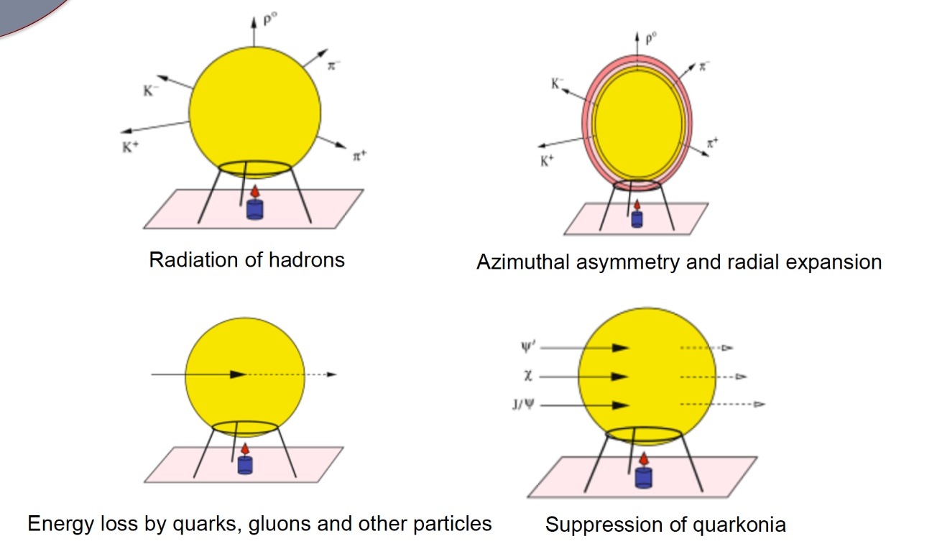
How to characterise the qgp experimentally?
QGP not « directly » accessible to observation (last only few fm/c!)
Need a combination of several probes and a good reference system (without QGP formation)
Also need probes unaffected by the QGP to serve as reference for other probes (Z, Drell-Yan)
The example of quarkonia (cc,bb)
Heavy quarks created early in the collision (before the QGP is formed)
While going through the QGP (depending on its temperature) the less bound quarkonia will be suppressed by color screening
If quarkonium yields in PbPb collisions are suppressed with respect to the «scaled» yield from pp collisions
→ evidence for QGP formation
Important to well understand quarkonium formation in pp collisions (not so simple!)
→ Tasnuva Chowdhury « Upsilon production rate as a function of charged particle multiplicity in pp collisions at √s = 13 TeV in ALICE experiment »

Slide 25
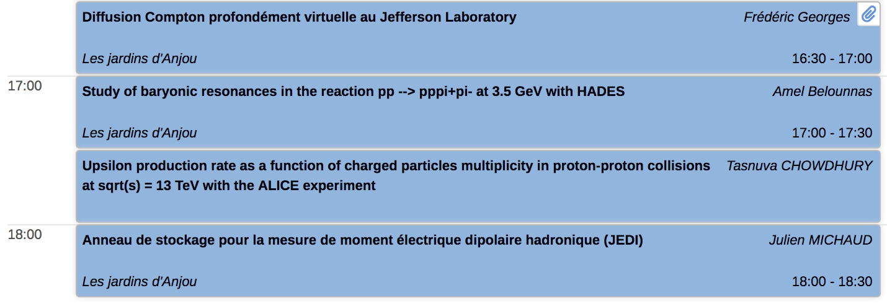
Conclusions
I leave the room to students
Reward at the end of session

