Slide 1
Characterization of detectors for the inner tracking system of the ALICE experiment on the LHC
00
Natalia Emriskova, M2 PSA
Master thesis supervised by Felix Reidt and Boris Hippolyte | June 13, 2017

Slide 2
outline
ALICE ITS upgrade
ALICE collaboration
Current detector and ITS
Upgrade motivations
ITS upgrade layout
ALPIDE pixel chip
Test beam framework
Test beam setup
One telescope plane
Analysis software
3. Analysis steps
Efficiency profile
Multiple scattering
Pixel response from data
Pixel response model
4. Pixel matrix edge
5. Dead double column
Conclusion & outlooks

Slide 3
1 ALICE ITS upgrade
1.1 ALICE collaboration
ALICE = A Large Ion Collider Experiment
International collaboration
1800 members – 174 institutes – 42 countries
Studying Quantum Chromodynamics (QCD) and Quark-Gluon Plasma (QGP)
Experiment at the Large Hadron Collider (LHC) at CERN
Notes:
QGP = state of matter with extreme temperature and energy density

Slide 4
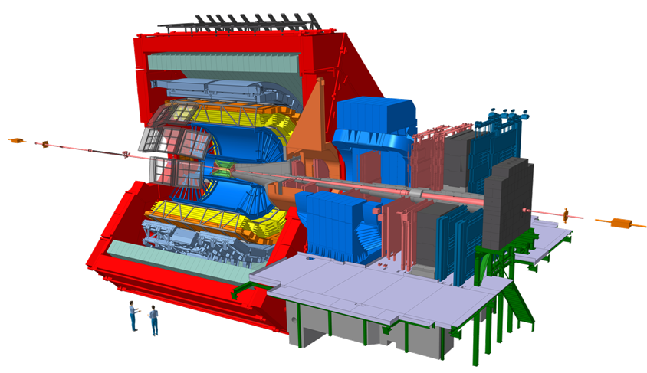
1 ALICE ITS upgrade
1.2 Current Inner Tracking System
Strip
Drift
Pixel
Inner Tracking System (ITS)

Slide 5
1 ALICE ITS upgrade
1.3 Upgrade motivations
ALICE physics program:
Thermalization and hadronization of charm and beauty in QGP
In-medium (QGP) parton energy loss
Quarkonia dissociation
ITS upgrade goals:
Highly efficient tracking with special emphasis on very low momenta.
Very precise reconstruction of secondary vertices from decaying charm and beauty hadrons.

Slide 6
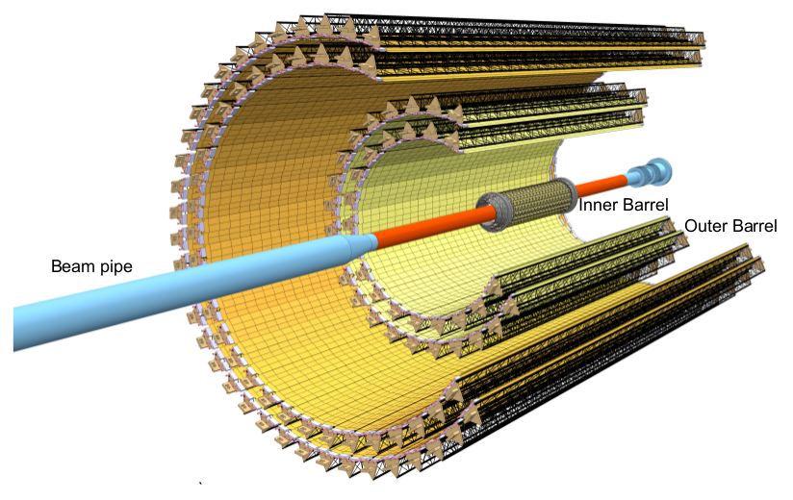
1 ALICE ITS upgrade
1.4 ITS upgrade layout
Beam pipe diameter
29.8 mm → 19.2 mm
First detection layer
39 mm → 22 mm
Number of layers
6 → 7
Silicon pixel sensors
resolution: 5 µm
Read out rate
1kHz → 50 kHz (Pb-Pb)
200 kHz (p-p)
Low material budget

Slide 7
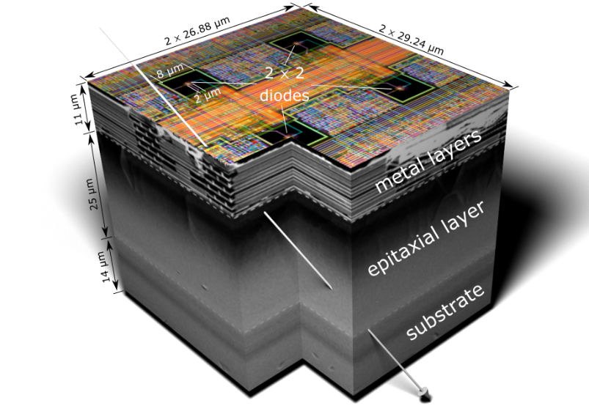
1 ALICE ITS upgrade
1.5 ALPIDE pixel chip
Notes:
Analog electronics in pixels, digital signal is propagated to the periphery which is a small inactive region at the bottom
The ALPIDE chip does in-pixel amplification and discrimination. Furthermore, in-pixel hit-buffers can store the hits. The chip is readout using in-matrix data-sparsification based on a priority encoder. Only the addresses of hit pixels arrive at the small periphery, which contains biasing and off chip communication.

Slide 8
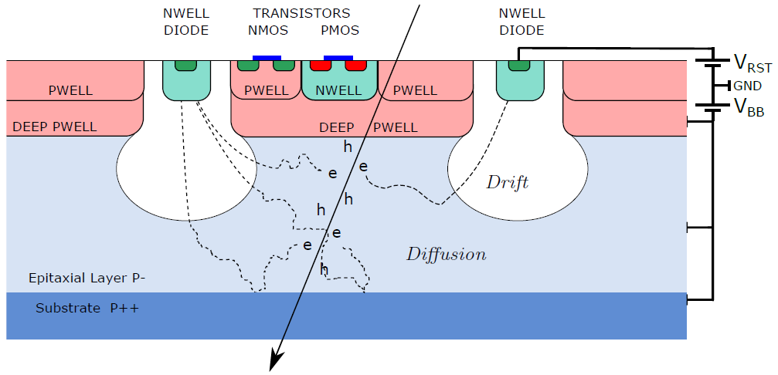
1 ALICE ITS upgrade
1.5 ALPIDE pixel chip – detection principle
Notes:
Charge sharing

Slide 9
1 ALICE ITS upgrade
1.5 ALPIDE pixel chip – two important features
1. Guard ring
2. Double columns
Guard ring
ALPIDE
Pixel Matrix
Periphery circuit

Slide 10
2 Test beam Framework
2.1 Test beam telescope
Device Under Test
(DUT)
3
Side view:
Y
0
1
2
4
5
6
Pion beam
of 6 GeV/c
Z
Top view:
X
Z

Slide 11
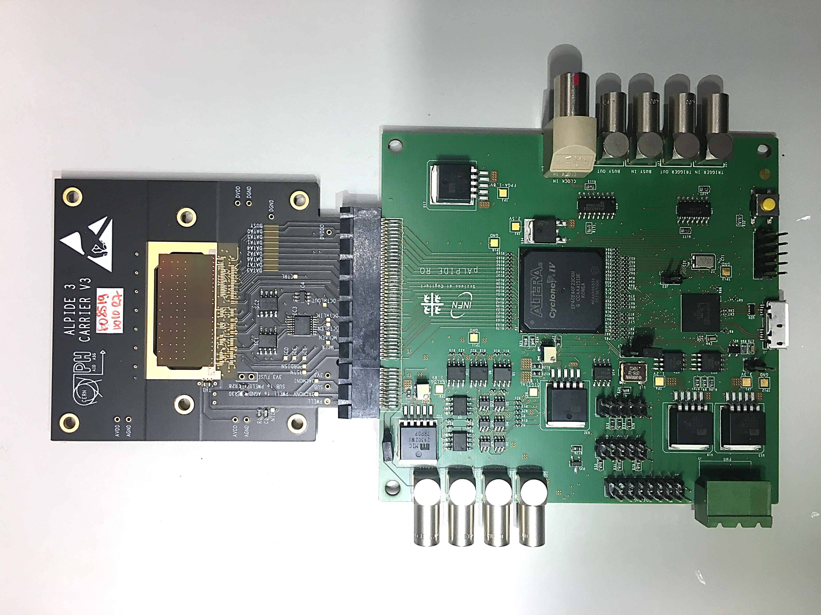
2 Test beam Framework
2.2 One telescope plane
Y
ALPIDE chip
Periphery circuit
Active Matrix
0
X

Slide 12
2 Test beam Framework
2.3 Analysis software
EUTelescope modifications
Analysis Processor:
Include the borders
Y
DUT ALPIDE chip
100 μm
0
X
cut borders
edge
column 1023

Slide 13
2 Test beam Framework
2.3 Analysis software
EUTelescope modifications
Analysis Processor:
Include the borders
Converter:
Create an artificial edge
Y
DUT ALPIDE chip
Active
Matrix
0
X
cut
column 850
edge
column 1023

Slide 14
2 Test beam Framework
2.3 Analysis software
EUTelescope modifications
Analysis Processor:
Include the borders
Converter:
Create an artificial edge
Dead-double-column Finder: 0 ≤ X ≤ 850 off
Y
DUT ALPIDE chip
Dead double
columns
Active
Matrix
0
X
cut
column 850
edge
column 1023

Slide 15
2 Test beam Framework
2.3 Analysis software
EUTelescope modifications
Analysis Processor:
Include the borders
Converter:
Create an artificial edge
Dead-double-column Finder: 0 < X < 851 off
Analysis Processor:
Set 10 bins / pixel on X
Y
DUT ALPIDE chip
Active
Matrix
Cut region
0
X
+ development of post-processing macros
cut
column 850
edge
column 1023

Slide 16
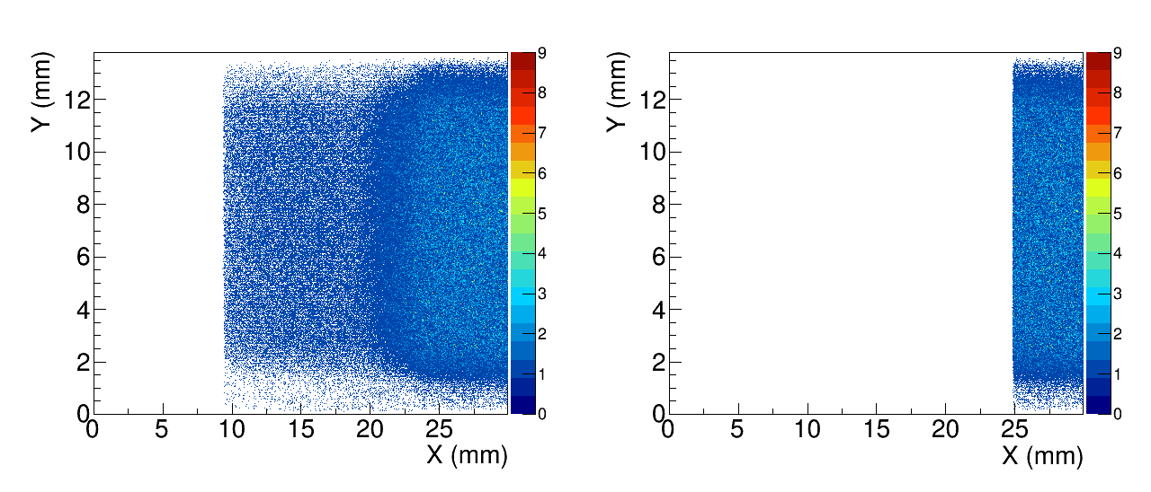
3 analysis
3.1 Efficiency profile
n
k
$ε= \frac{number of tracks with hit in the DUT}{total number of tracks}= \frac{k}{n}$

Slide 17
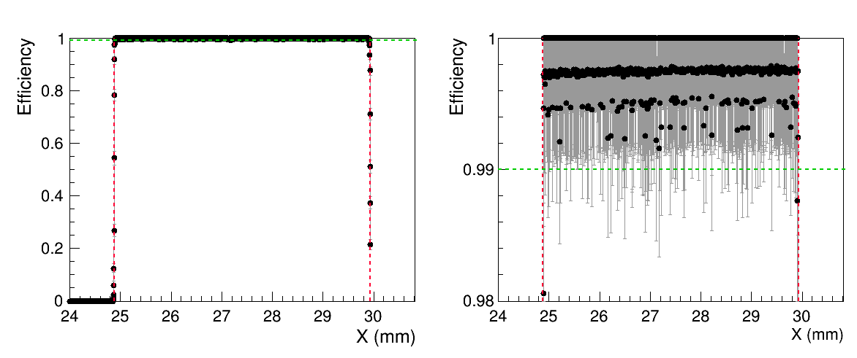
3 analysis
3.1 Efficiency profile
Artificial edge
Matrix edge

Slide 18
3 analysis
3.1 Efficiency profile

Slide 19
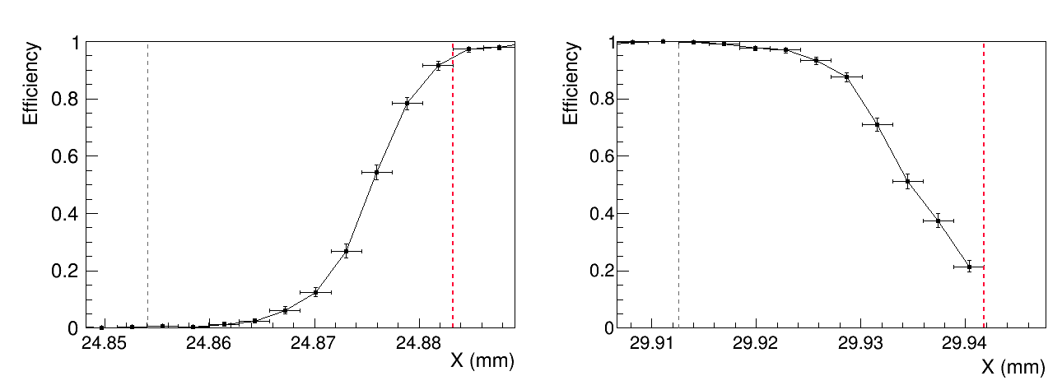
3 analysis
3.1 Efficiency profile
Cut
Edge
one pixel
one pixel
Artificial edge
Physical edge

Slide 20
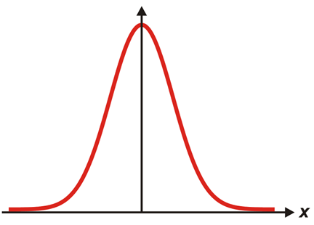
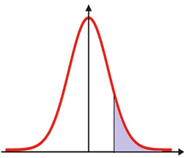
3 analysis
3.2 Multiple scattering model
ε
ε
ε
Erfc(x)
µ
x
cut
x
x
$$𝒩\left( μ, σ_{tr}=2.8 μm\right)$$
Step function
Error function

Slide 21
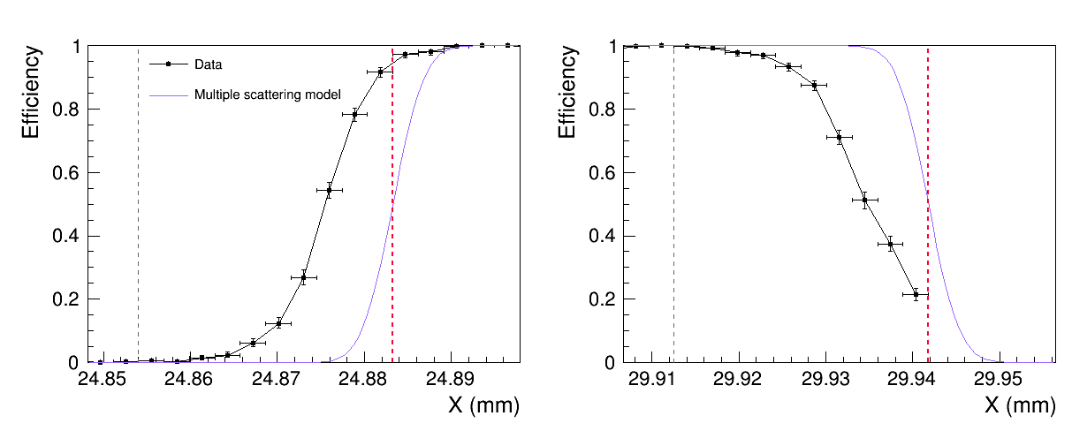
3 analysis
3.2 Multiple scattering model
one pixel
one pixel
Artificial edge
Physical edge

Slide 22
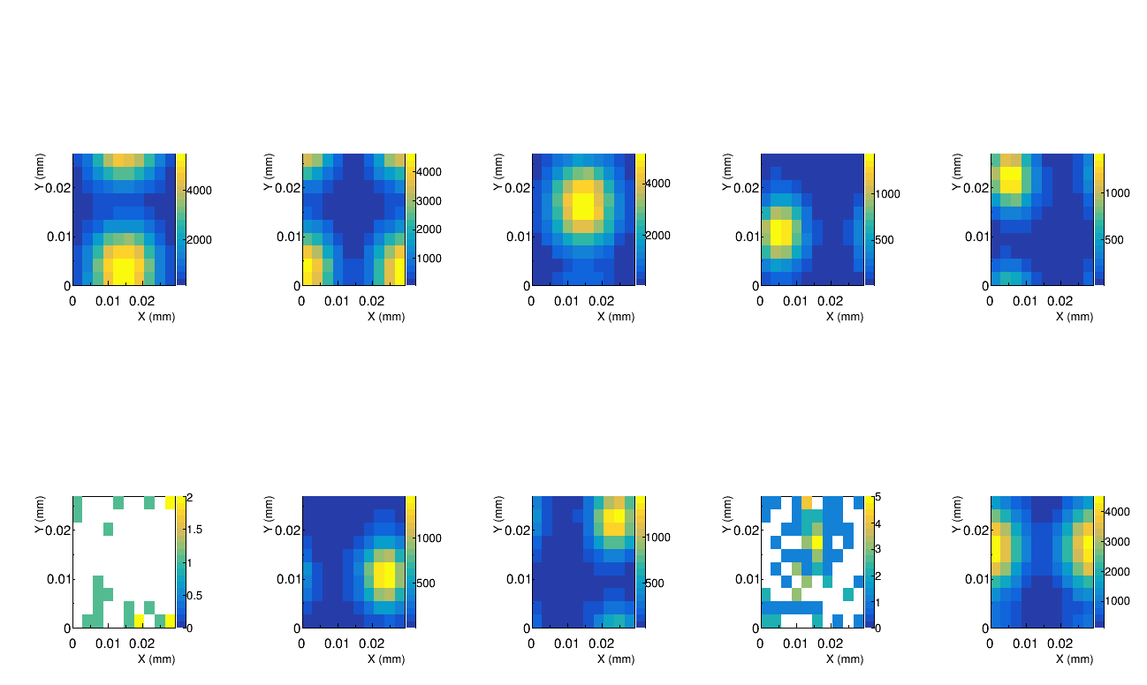
3 analysis
3.3 Cluster shapes
Notes:
Impinging point inside one pixel

Slide 23
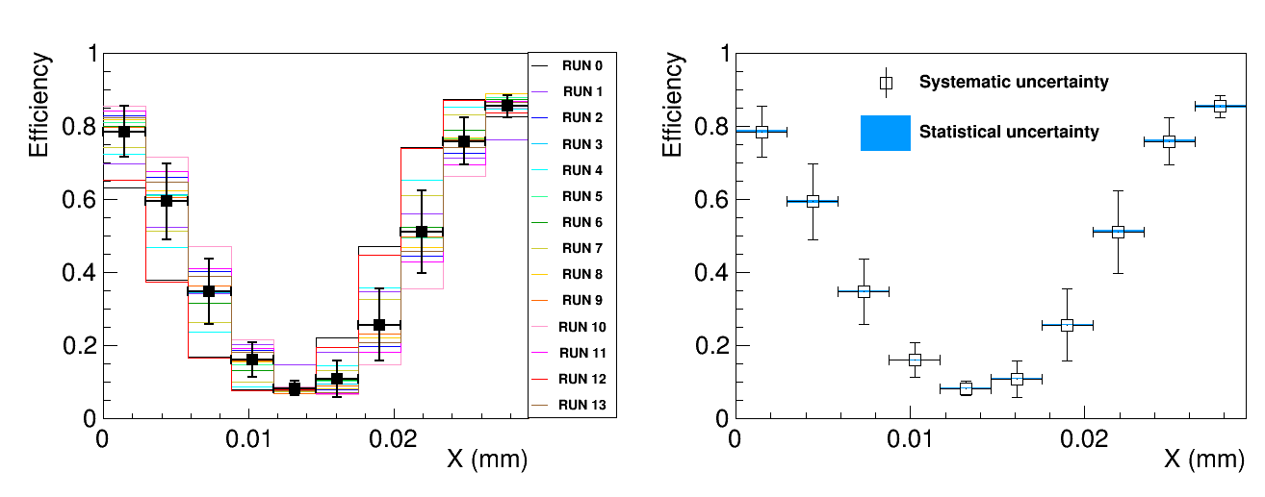
3 analysis
3.4 Pixel response from cluster shapes
Systematic uncertainty dominating
Residual misalignment of the data

Slide 24
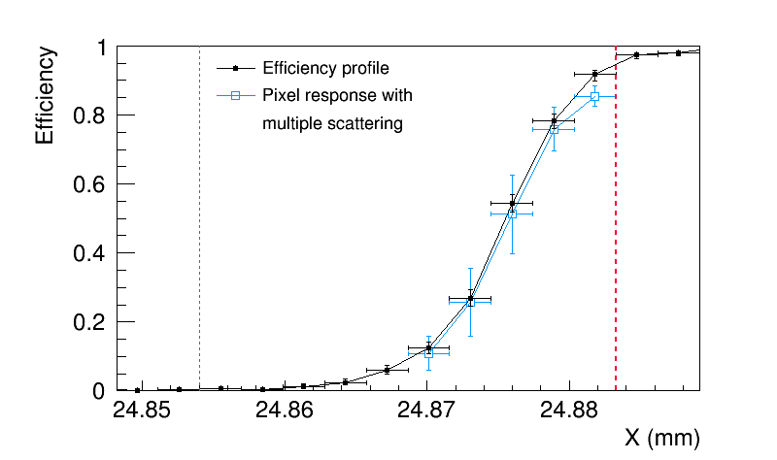
3 analysis
3.4 Pixel response from cluster shapes
$$\frac{χ^{2}}{ndf}=\frac{3.62}{5}=0.724$$
last rejected pixel
Notes:
Don’t comment the chi2
Explicite which ic compared and in which range

Slide 25
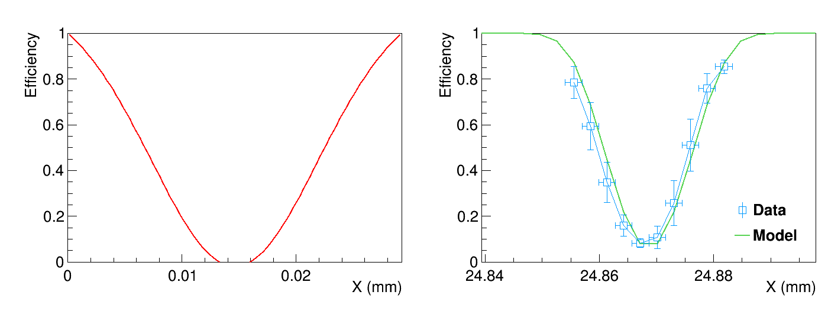
3 analysis
3.5 Pixel response model
$$\frac{χ^{2}}{ndf}=\frac{7.59}{10}=0.759$$
Before convolution
After convolution

Slide 26
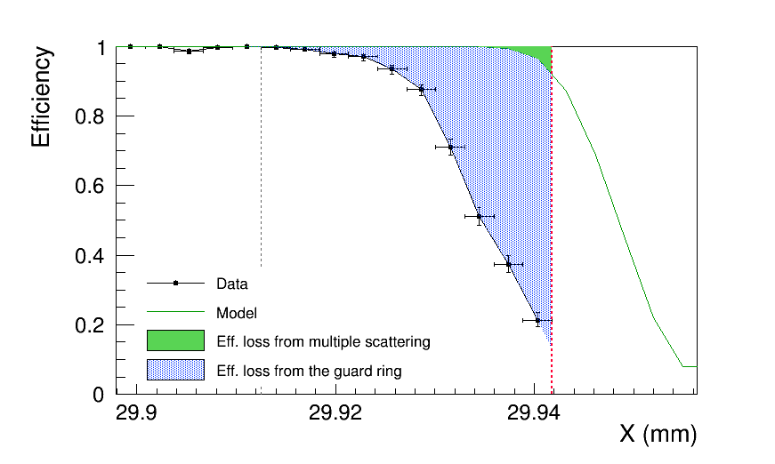
4 Pixel matrix edge
$${( 24.1 }_{− 1.3}^{+ 1.6} ) \%$$
last pixel
Notes:
Compare to the 100 micron gap

Slide 27
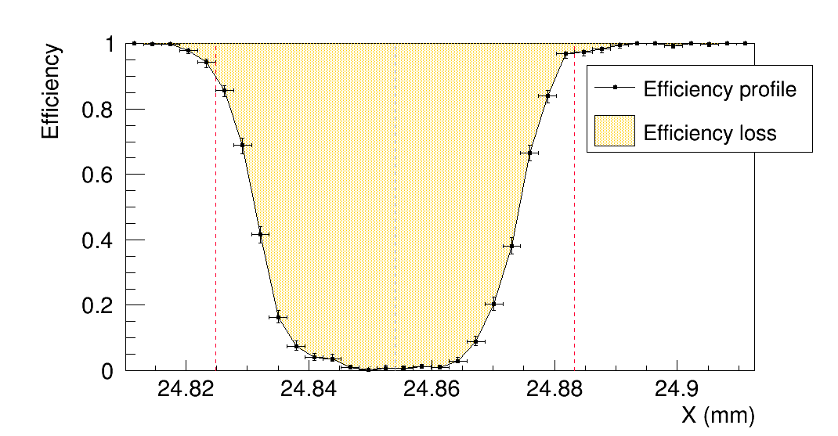
5 Dead double column
$${( 73.4 }_{− 1.7}^{+ 2.1} ) \%$$
2 pixel columns

Slide 28
Conclusion
In-pixel response study of the ALPIDE chip using test beam data
The sensor edge:
Multiple scattering – minor effect
Pixel response dominant
Efficiency loss du to the guard ring ~ 24 %
Only in the last pixel column
Dead double column:
Efficiency loss ~ 73 %
Charge sharing can recover ~ 27 %

Slide 29
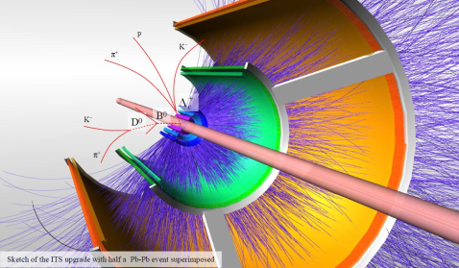
Thank you

Slide 30
Back ups

Slide 31
Runs used in the analysis
Run number | Number of events
3180 | 15 251
3181 | 65 017
3182 | 169 399
3183 | 40 107
3184 | 40 440
3185 | 40 149
3186 | 35 873
3187 | 40 140
3189 | 39 838
3190 | 39 767
3191 | 39 172
3192 | 39 956
3193 | 40 159
3195 | 40 297
TOTAL | 685 562

Slide 32
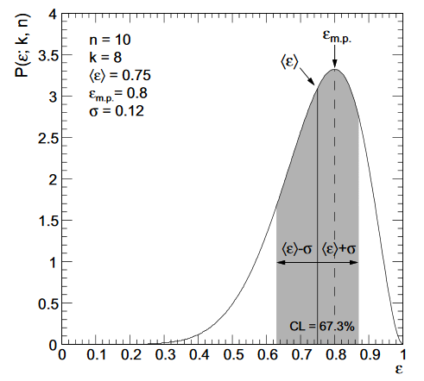
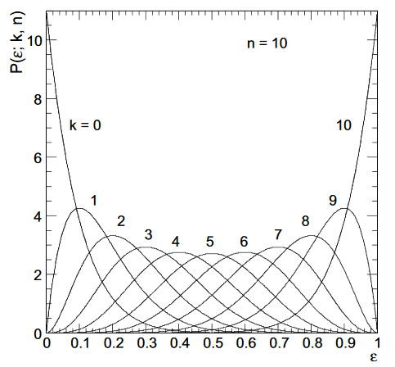
Efficiency error calculation
$ε= \frac{k}{n}$
$\left\langle ε\right\rangle = \frac{k+1}{n+2}$
$$σ= \frac{(k+1)(k+2)}{(n+2)(n+3)}−{\left\langle ε\right\rangle }^{2}$$

Slide 33
Calculation of sigma tr
$$σ_{tr}^{2}= σ_{res}^{2}−σ_{pos}^{2}$$
Track resolution
residual
Single point resolution
2.833 μm
6.009 μm
5.229 μm

Slide 34
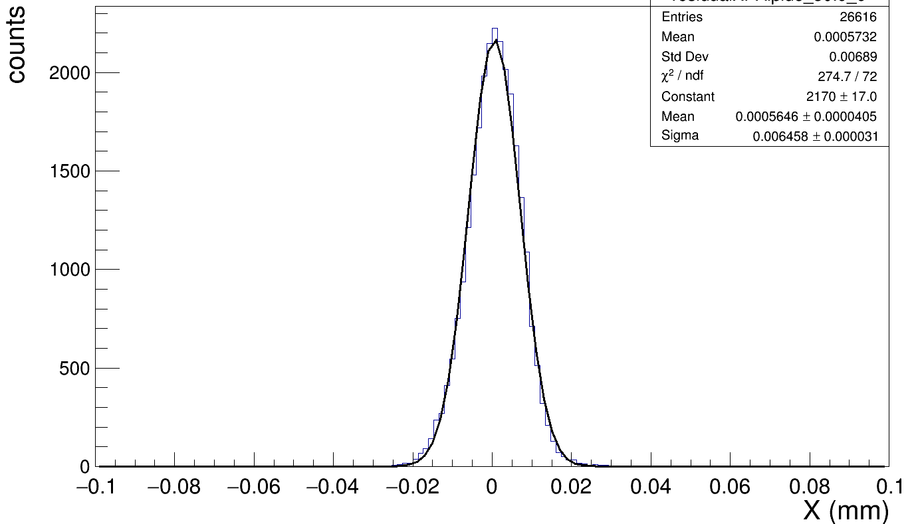
Residual Gaussian fit

Slide 35
3 analysis
3.3 Cluster shapes
cut
active

Slide 36
Chi² calculations
Data vs. pixel response from cluster shapes
$$χ^{2}= \sum_{k=1}^{5}{\frac{{\left(ε_{data}\left(k\right)− ε_{pix}(k)\right)}^{2}}{σ_{data}^{2}\left(k\right)+σ_{pix}^{2}\left(k\right)}}$$
Pixel response from cluster shapes vs. model
$$χ^{2}= \sum_{k=1}^{10}{\frac{{\left(ε_{pix}\left(k\right)− ε_{model}(k)\right)}^{2}}{σ_{pix}^{2}\left(k\right)}}$$

Slide 37
Efficiency loss calculations
Pixel matrix edge
Effect | Integral (µm) | Efficiency loss (%)
Total | $${7.20 }_{− 0.39}^{+ 0.46}$$ | $${24.6 }_{− 1.3}^{+ 1.6}$$
Multiple scattering | $$0.15$$ | $0.5$
Guard ring | $${7.05 }_{− 0.39}^{+ 0.46}$$ | $${24.1 }_{− 1.7}^{+ 2.0}$$
Dead double column
Effect | Integral (µm) | Efficiency loss (%)
Dead double column | $${42.9 }_{− 1.0}^{+ 1.2}$$ | $${73.4 }_{− 1.7}^{+ 2.0}$$

Slide 38
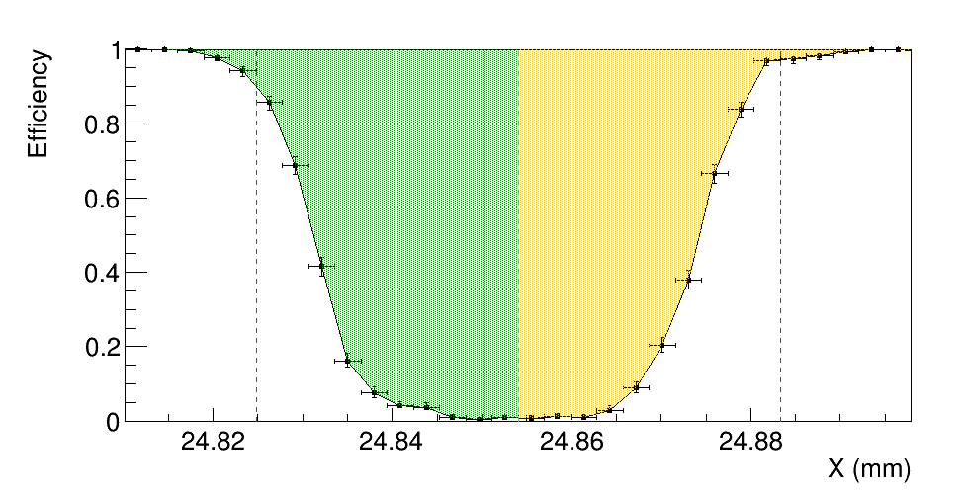
Dead Double column asymmetry
22.8 μm
20.1 μm

Slide 39
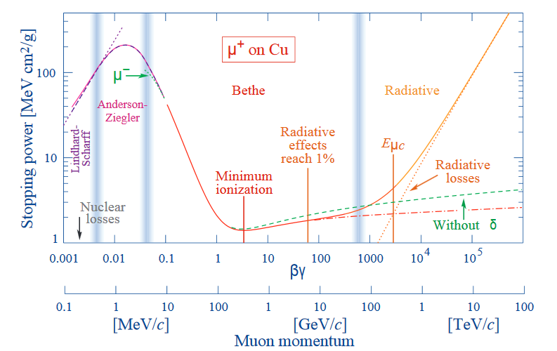
Bethe-bloch formula

