Slide 1
Project Status
A.Tsaregorodtsev,
CPPM-IN2P3-CNRS, Marseille,
LUPM, Montpellier, 17 July 2017

Slide 2
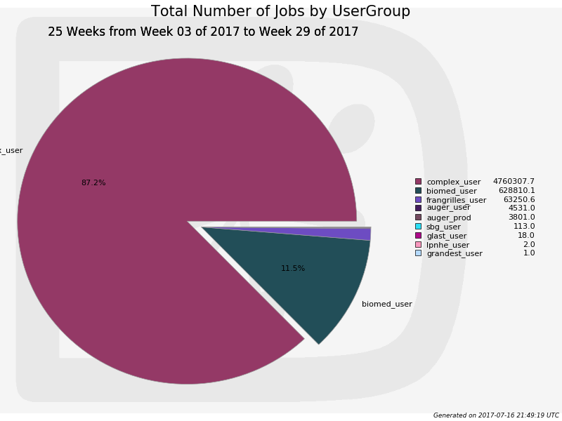
FG-DIRAC
Smooth running
> 5M jobs in 2017
New VO’s
vo.hess-experiment.eu
Requested, to be set up
FG-DIRAC
VOMS certificates
Affecting pilot submission
cctbdirac01.in2p3.fr testbed
Functional, will be used for the v6r19 certification
Tested with the MariaDB
Preliminary OK

Slide 3
DIRAC4EGI
DIRAC4EGI
CPPM together with UB and Cyfronet offered to maintain the service
The EGI answer is positive
Part of the Eosc-Hub H’2020 proposal
Submitted, results in early autumn
If OK, 1FTE will be allocated for 3 years starting from Jan 2018
Current status
Smooth running
Mostly WeNMR activities, but also West Life, compchem, etc.
OLA for the period until the end of 2017 is prepared
The user data security annex is being finalized

Slide 4
DIRAC4EGI
An engineer hired for 2 months (july, august) to work on the service administrations
DIRAC services monitoring integrated into the EGI infrastructure
GOCDB, Nagios probes
Setting up user notifications
Concentrate on the Eiscat 3D case
Data management, custom file catalog
Job submission to cloud resources

Slide 5
Eiscat 3D case
Data management
Custom SE in front of their file server
Customization of the File Catalog
Specific data access policies depending on the user roles, data age, etc
Job submission to cloud resources
No grid resources negotiated
Forced to use FedCloud resources
Pushes us to have a smooth operation of the VMDIRAC package

Slide 6
Releases
Release v6r18 is retracted
Client/server backward incompatibilities in the Resource Status System
V6r19-pre serious have started
Fixed problems of v6r18
New Externals version v6r6p2
Updated versions of third party libraries
e.g. openssl with recent security fixes
Do not install v6r18
FG-DIRAC will be upgraded to v6r19 as soon as it is out

Slide 7
Current development areas
Multi-core (IHEP, PNNL)
Using multi-core resources
Configuration
Scheduling policies
VMDIRAC (see Luisa’s slides)
Using RSS for Computing Elements
Still finalized in v6r19
To be extended to Queues also
Logging using native Python module
Towards centralized logging

Slide 8
Test server
cctbdirac01.in2p3.fr testbed
Functional, will be used for the v6r19 certification
Tested with the MariaDB
Preliminary OK

Slide 9
Consortium
New partner approved
PNNL
The Accession document for the University of Montpellier is finalized
Have to start the signing procedure
UB membership suspended
Need to finalize this officially
Should be done before the PNNL and UM signing starts

