Slide 1
Bridging nuclear ab-initio and energy-density-functional theories
2-6 October 2017, IPN Orsay
Marcella Grasso
From dilute matter to the equilibrium point in the energy-density-functional theory
P2I
Physique des deux infinis

Slide 2
Present collaborators along this research line:
ENSAR2, JRA TheoS (Theoretical Support for Nuclear Facilities in Europe), Task: Development of suitable effective interactions in mean-field and BMF theories
Laboratoire Internationale LIA COLL-AGAIN
J. Bonnard, A. Boulet,,U. van Kolck, D. Lacroix, O. Vasseur, J. Yang (IPN Orsay)
G. Colò, X. Roca-Maza (Univ. of Milano)

Slide 3
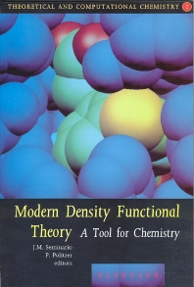
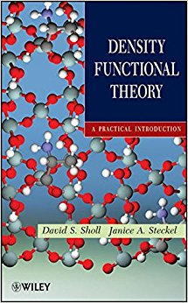
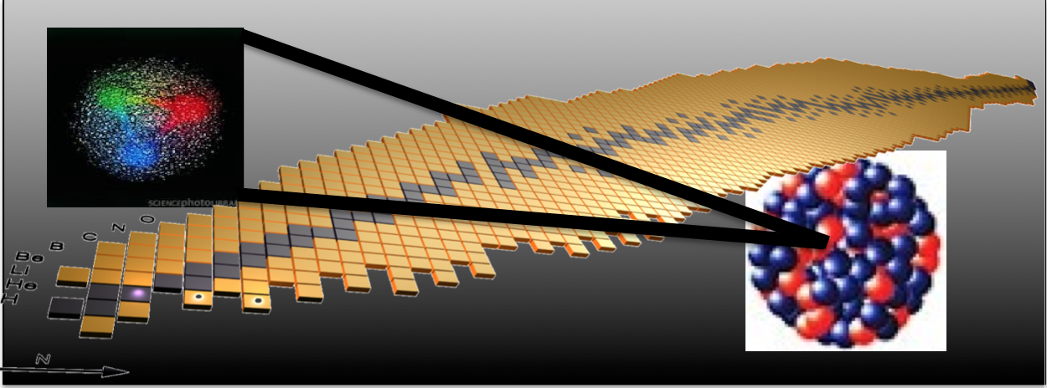
Density Functional Theory in chemistry and solid state physics
Mean-field models and beyond
Nuclear many-body problem with effective interactions
Double counting …
Work on EDF designed for beyond-mean-field models Nuclear matter
Bridging with EFT/ ab initio
Energy Density Functional
(EDF) theory (functionals derived in most cases from effective phenomenological interactions)
… since several decades

Slide 4
Some specific solutions exist, for example a subtraction procedure in particle-vibration coupling or second random-phase approximation: Tselyaev, Phys. Rev. C 88, 054301 (2013) Gambacurta, Grasso, Engel, PRC 92, 034303 (2015)
EDF: models currently employ Skyrme and Gogny phenomenological forces adjusted at the mean-field level
Within the EDF: designing interactions adapted for beyond mean-field models (cancellation of double counting, regularization of divergences, …)

Slide 5
Response function in RPA and SRPA
RPA
SRPA
Σ(E) -> energy-dependent self-energy
Case of density-independent interaction

Slide 6
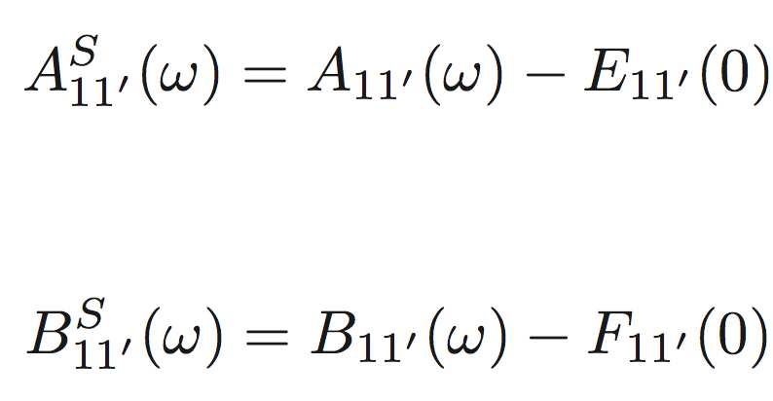
The zero-energy self-energy is subtracted
Subtraction:
This leads to a rescaling of the single-particle spectrum -> beyond mean-field effect on the effective mass
Talks of yesterday
Small effective mass without 3-body
Important effect at second order on m*

Slide 7
OUTLINE
Perturbative many-body problem (beyond mean field)
Work on EDF designed for beyond-mean-field models
Divergences, instabilities, double counting -> bridging with EFT -> regularization procedures and parameters adjustment (around the saturation density)
◆ Introduction of new functionals: very low-density nuclear matter ->
New functionals designed to correctly reproduce ALSO the low-density behavior, bridging with EFT/ ab initio
YGLO functional (resumed formula from EFT)
Lee-Yang inspired functional (density-dependent scattering length)
Resumed formula for the unitary limit
… Towards a power counting in EDF theories

Slide 8
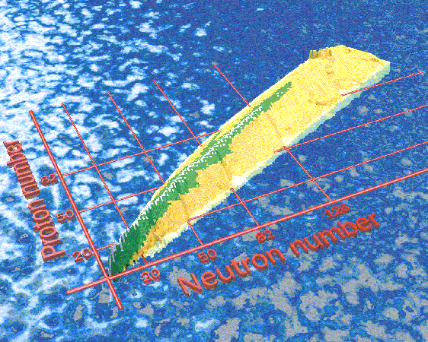
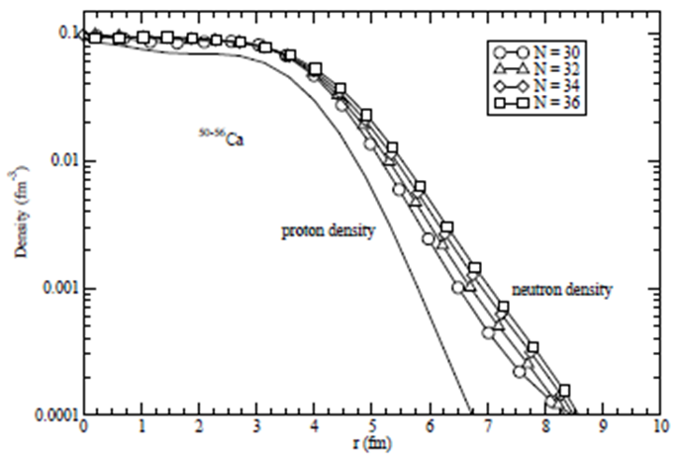
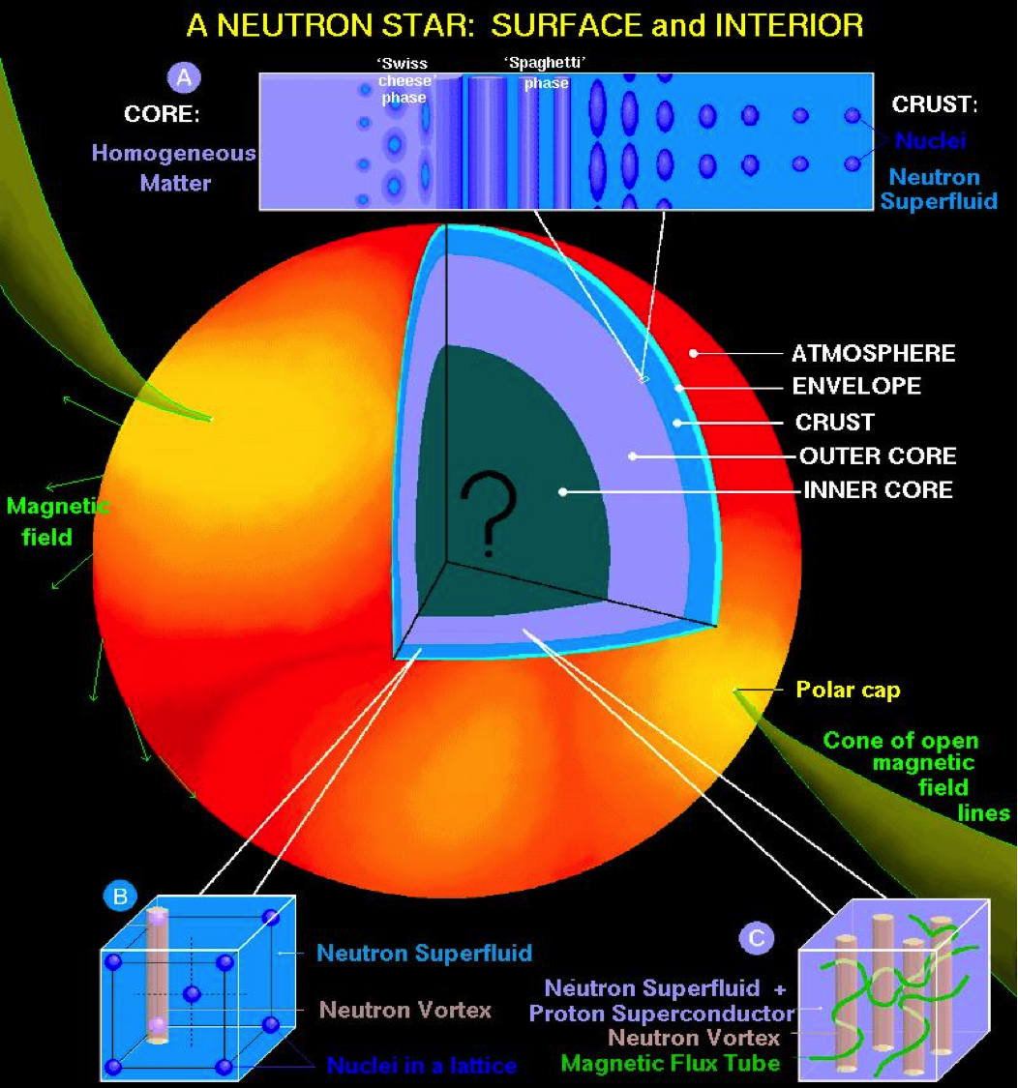
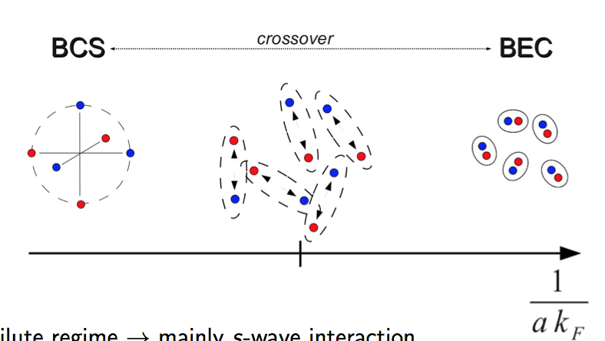
Properties of matter: relevant for constraining energy density functionals
Neutron-rich matter and pure neutron matter -> physics of isospin asymmetric systems
Very low-density neutron matter
Surface properties of neutron-rich nuclei with a diffuse density.
Outer crust of neutron stars
Analogy with ultracold atomic gases at unitarity (large scattering length)

Slide 9
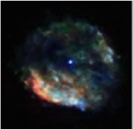
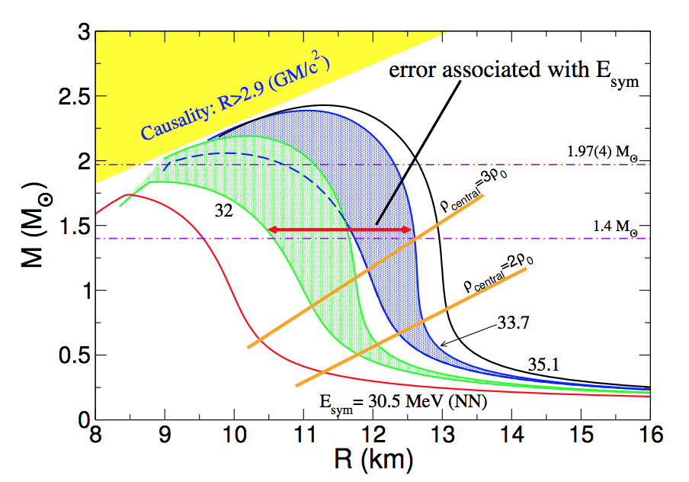
Properties of matter: relevant for constraining energy density functionals
Around the saturation point and beyond.
The structure of neutron stars may be calculated by solving the Tolmann-Oppenheimer-Volkoff equations.
Pressure (first derivative of the EOS) enters in such equations. The total radius is provided by the point where the pressure vanishes:
neutron star mass/radius,
symmetry energy and its density dependence

Slide 10
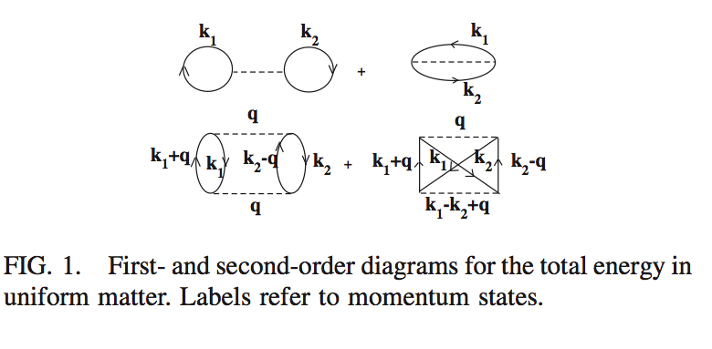
Moghrabi, Grasso, Colo’, Van Giai, PRL 105, 262501 (2010)
First application to finite nuclei: Brenna et al. PRC 90, 044316 (2014)
⬥ Yang, Grasso, Roca-Maza, et al., PRC 94, 034311 (2016)
⬥ Grasso, Lacroix, van Kolck, Invited Comment, Phys. Scr. 91, 063005 (2016)
Equation of state of nuclear matter with a Skyrme-type interaction.
The perturbative many-body problem:
First order
Second order
k_{F} = (3/2 π² ρ) ^{1/3} SM
k_{F} = k_{N} = (3π² ρ) ^{1/3} NM
k_{F} -> Fermi momentum
This second-order contribution diverges ->
For ex. the square of the Skyrme t₀ term has a k_{F}⁴ dependence and is the sum of a finite part plus a term linearly dependent on the cutoff (on the transferred momentum q) -> REGULARIZATION

Slide 11
Skyrme interaction for matter (no spin orbit at the mean-field level)
Spin-exchange operator

Slide 12
Asymptotic behavior:

Slide 13
Combinations of Skyrme parameters

Slide 14
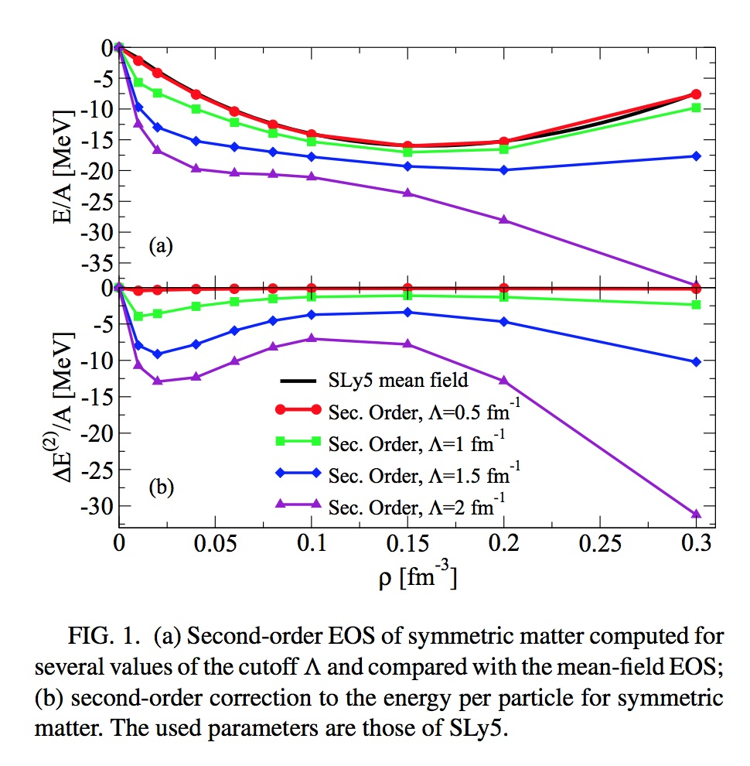
Double counting and ultraviolet divergence (equation of state of symmetric matter)
Second-order equation of state compared with SLy5 mean-field
Second-order correction
Yang, Grasso, Roca-Maza, et al, PRC 94, 034311 (2016)

Slide 15
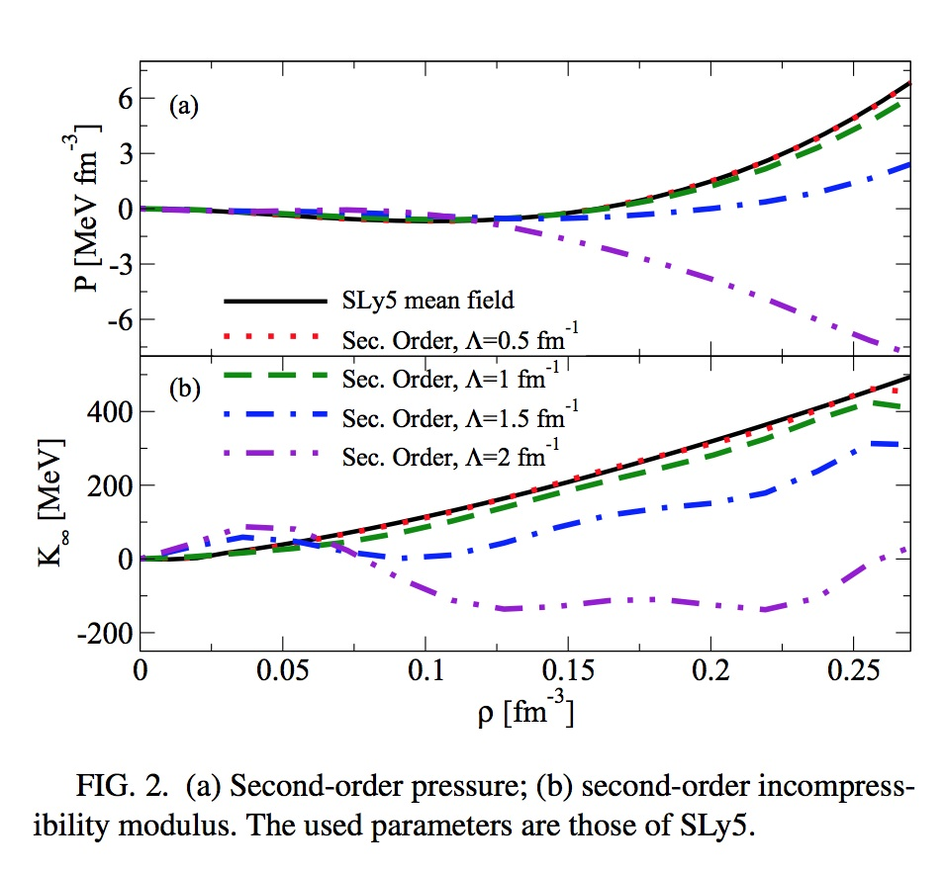
Double counting and ultraviolet divergence (pressure and incompressibility)
PRESSURE
INCOMPR.
Yang, Grasso, Roca-Maza, et al, PRC 94, 034311 (2016)

Slide 16
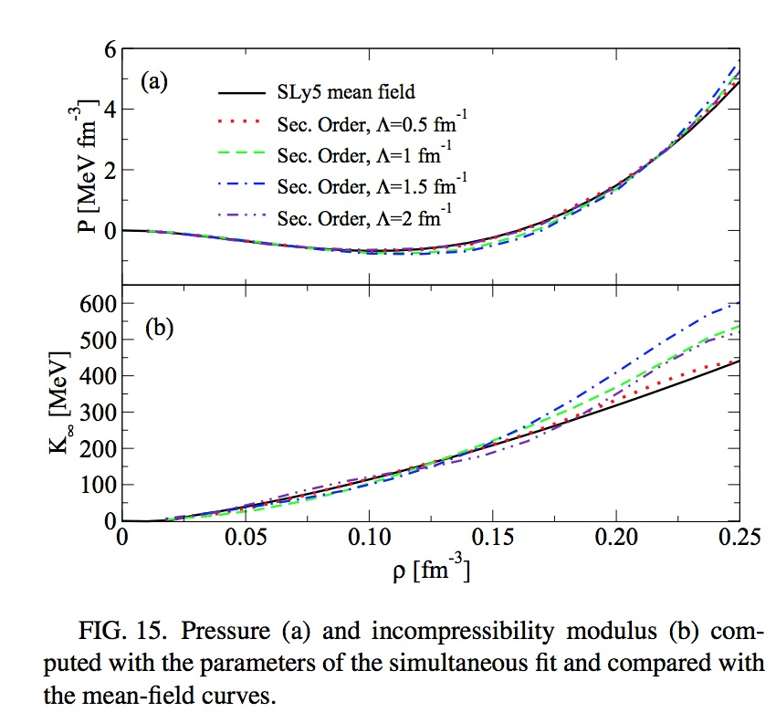
Pressure and incompressibility (not entering in the fit)
PRESSURE
INCOMPRESSIBILITY:
BENCHMARK: 229.9 MeV
Max deviation: 25 MeV
Yang, Grasso, Roca-Maza, et al, PRC 94, 034311 (2016)

Slide 17
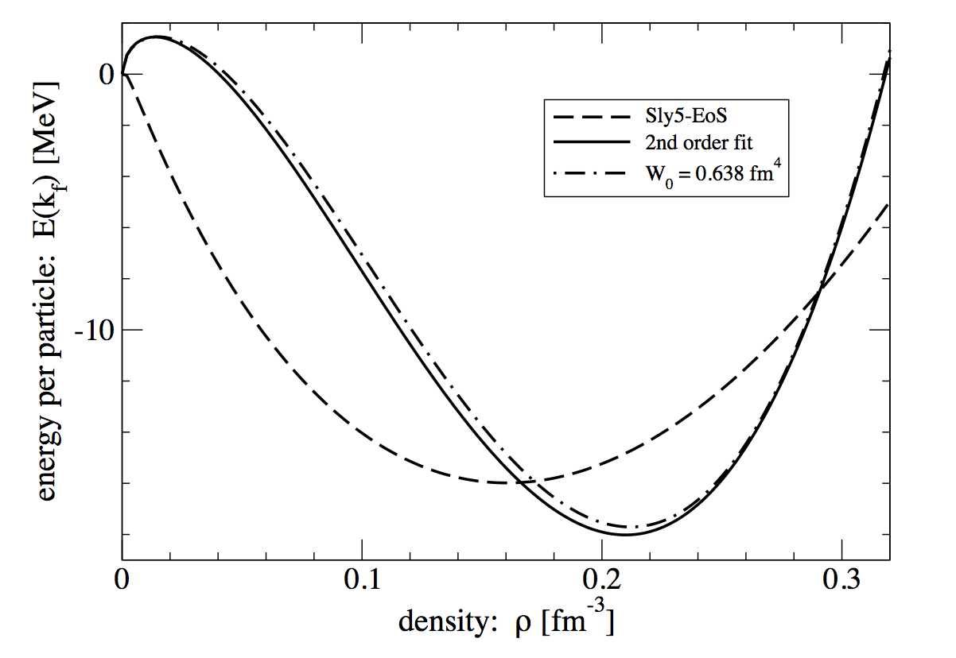
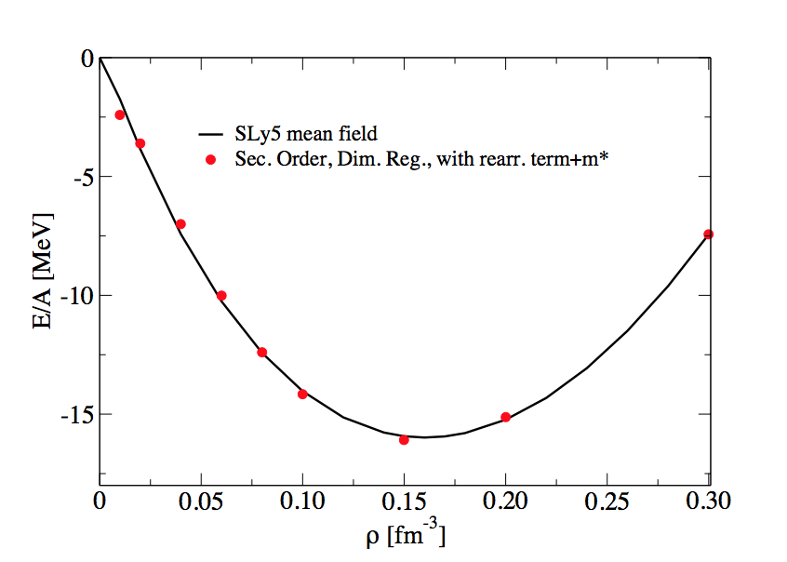
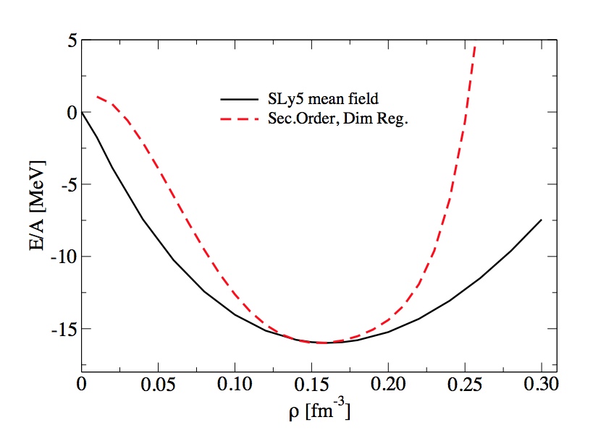
IMPORTANCE OF THE DENSITY DEPENDENCE AND OF THE REARRANGEMENT TERMS (in second-order perturbation theory: related to B RPA matrix elements: Carlsson, et al. PRC87, 054303 (2013).
SYMM. MATTER (dim. reg.)
No density dependence
With also rearr. terms
Density dependence. No rearr. terms
Equilibrium point + compressibility (250 MeV)
Kaiser, J. Phys. G: Nucl. and Part. Phys. 42, 095111 (2015)
Yang, Grasso, Roca-Maza, et al, , PRC 94, 034311 (2016)

Slide 18
Low-density for neutron matter (EFT satisfies this regime -> Hammer, Furnstahl, NPA 678, 277 (2000)) Lee-Yang expansion in (ak_{N}). Low-density EOS
Lee and Yang, Phys. Rev. 105, 1119 (1957)
a -> neutron-neutron scattering length, -18.9 fm
k_{N} -> neutron Fermi momentum = (3π² ρ)^{1/3}
α = 1/3
What about the mean-field Skyrme EOS?
Skyrme term | kN dependence in the EOS
t ₀ | k_{N}³
t ₃ | k_{N}^{3α+3}
t ₁ and t ₂ | k_{N}⁵

Slide 19
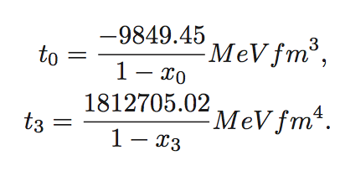
We have to constrain the parameters in the following way:

Slide 20
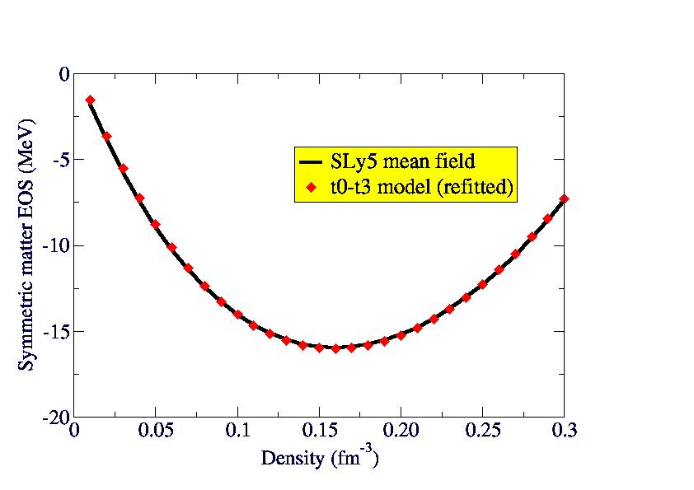
It is possible to constrain the low-density behavior of neutron matter, with α=1/3, and to adjust x0 and x3 for reproducing a reasonable EOS for symmetric matter (at ordinary densities)
But the EOS of neutron matter is completely wrong at ordinary scales of densities
Yang, Grasso, Lacroix, PRC 94 , 031301(R) (2016)

Slide 21
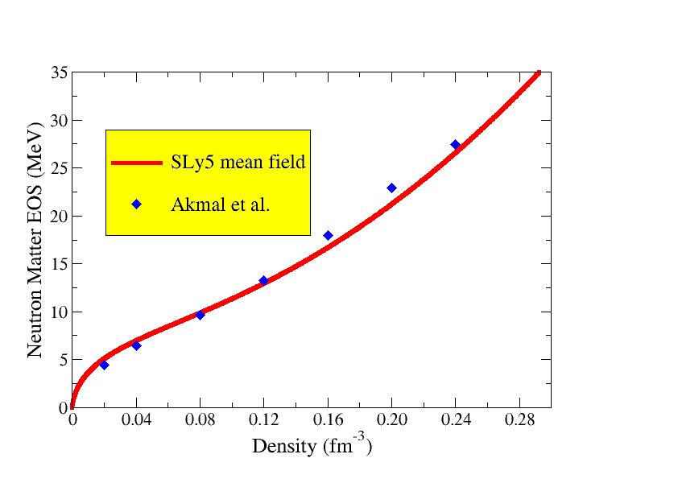
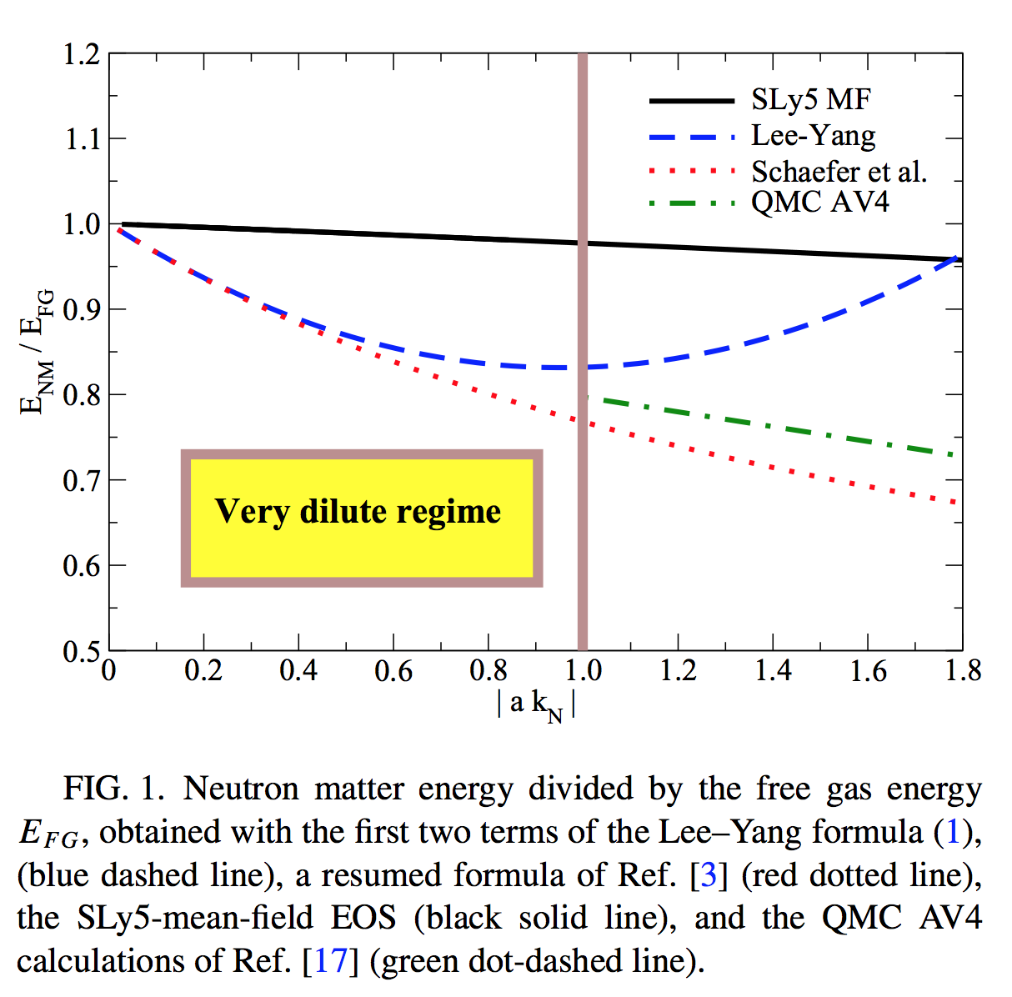
Neutron matter at ‘usual’ density scales. Example of Lyon-Saclay forces adjusted on the neutron EOS
Low-density regime
SLy5 -> Chabanat et al. NPA 627, 710 (1997); 635, 231 (1998), 643, 441 (1998)
Akmal et al. -> PRC 58, 1804 (1998)
Neutron matter energy divided by the free gas energy

Slide 22
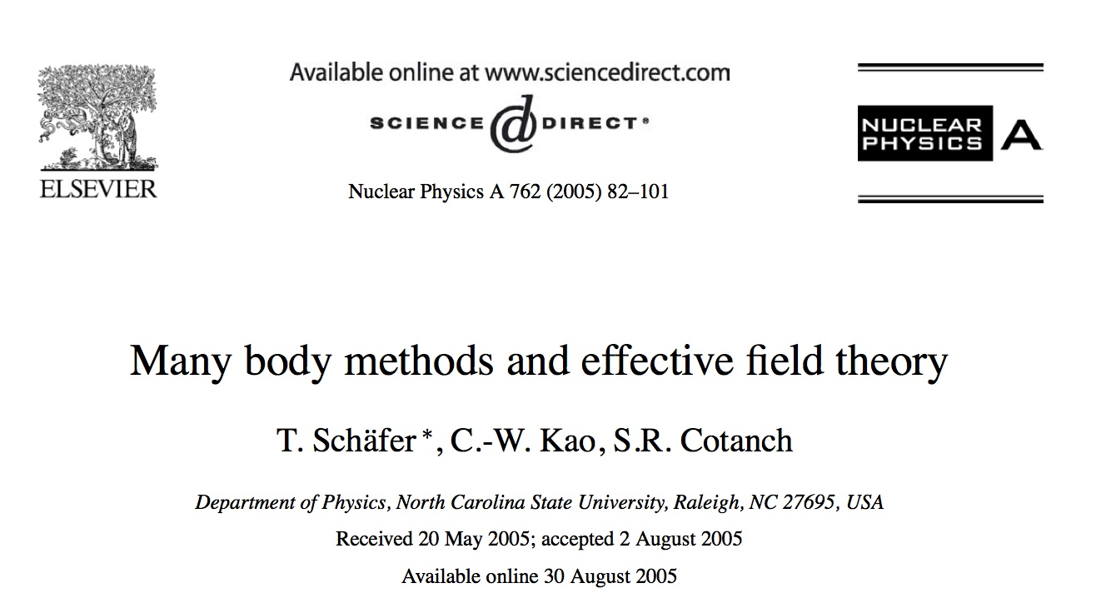
The second-order contribution has the required k_{F}⁴ term
… but only second order is not enough (if one wants to keep the correct value of the scattering length)
Resummation techniques
Steele, arXiv: nucl-th/0010066v2
Kaiser, NPA 860, 41 (2011)
Schaefer, NPA 762, 82 (2005)
Effective field theories capable of describing systems with anomalously large scattering lengths require summing an infinite number of Feynman diagrams at leading order …

Slide 23
Guided by:
The fact that the second-order t₀ contribution leads to the correct dependence on the Fermi momentum in neutron matter;
The resumed formulae;
Good properties of Skyrme functionals
A hybrid functional, YGLO (Yang, Grasso, Lacroix, Orsay):
Matching the low-density limit with the Lee-Yang expansion of the energy
Beta = 1 - > symmetric matter
Beta =0 -> neutron matter

Slide 24
YGLO functional: Inspired by resumed expressions (resumed functional) (EFT)
EOS for symmetric and neutron matter:
Constrained by the first two terms of Lee Yang formula (scattering length)
Mimic velocity- and density-dependent terms
Resumed expression
Other parameters adjusted on QMC results at extremely low densities and on Friedman et al. or Akmal et al. EOSs at higher densities
Yang, Grasso, Lacroix, PRC 94 , 031301(R) (2016)

Slide 25
B and R are fixed by imposing to recover the Lee-Yang formula (the analog for symmetric matter may be found in Fetter-Walecka book)

Slide 26
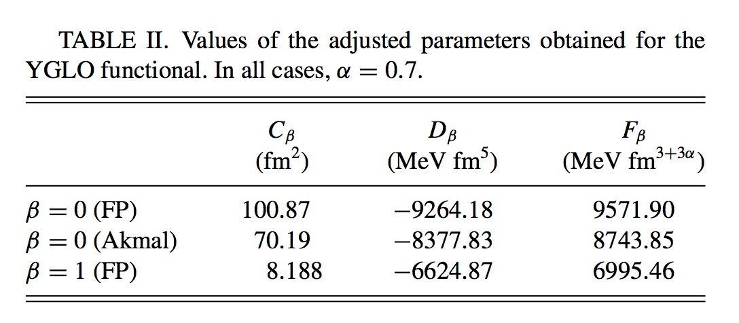
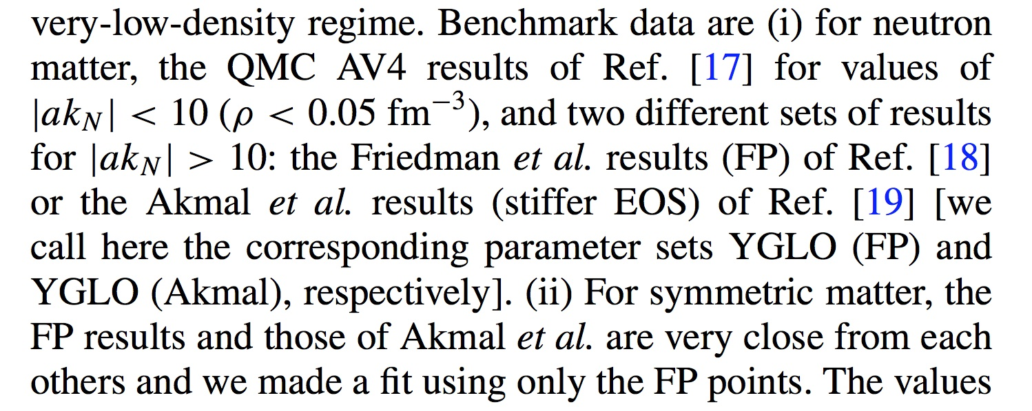
The other adjusted parameters

Slide 27
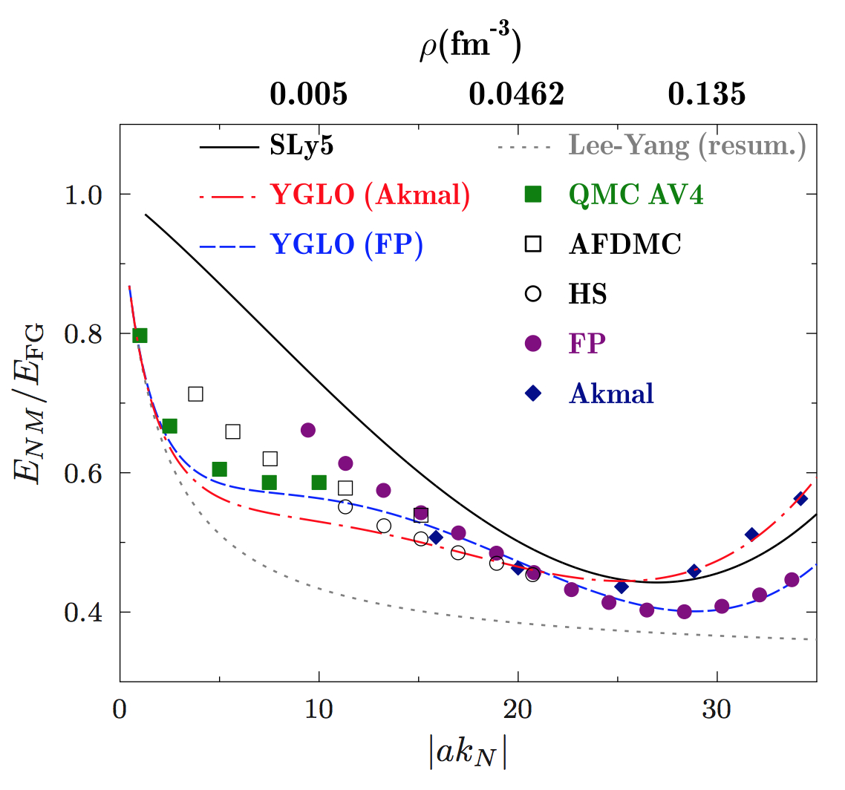
YGLO. Very low-density behavior of neutron matter
Energy divided by the free gas energy
Yang, Grasso, Lacroix, PRC 94, 031301(R) (2016)

Slide 28
Asymmetric matter
Parabolic approximation
Neutron
density
Proton
density

Slide 29
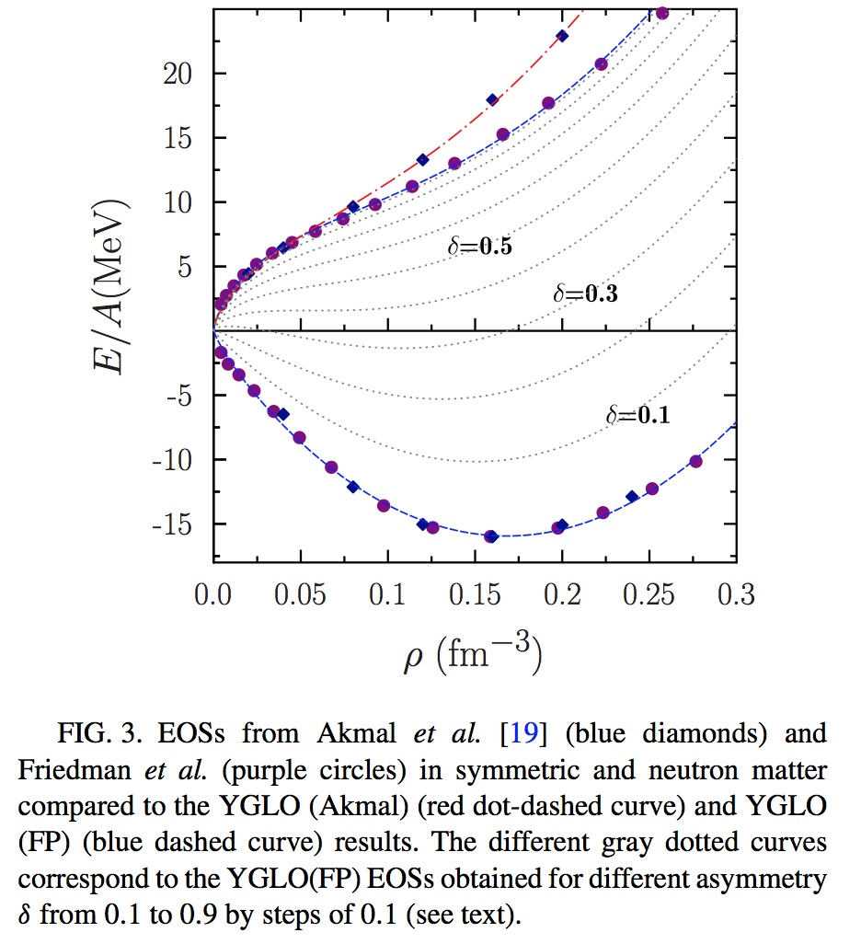
Asymmetric matter

Slide 30
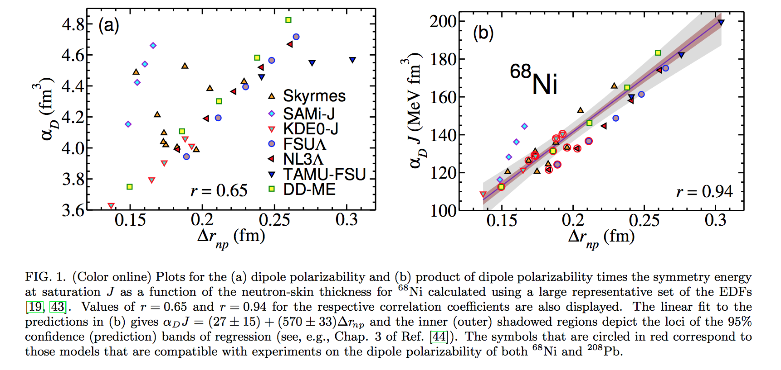
Neutron skin thickness (difference between rms radii of neutrons and protons)
Dipole polarizability times symmetry energy versus neutron skin thickness
Dipole polarizability versus neutron skin thickness
Roca-Maza et al, PRC 92, 064304 (2015)

Slide 31
Symmetry energy and its slope L=3ρ₀ (dS/dρ)_{ρ=ρ0}
Strong correlation observed between the neutron skin thickness and the slope L of the symmetry energy ( see for instance: Warda et al. PRC 80, 024316 (2009), Centelles et al. PRL 102, 122502 (2009) ->
This correlation is thus expected to exist between the electric dipole polarizability times the symmetry energy and the slope of the symmetry energy
Recent experimental determinations of the electric dipole polarizability:
²⁰⁸Pb (polarized proton inelastic scattering at forward angles, RCNP) (Tamii et al. PRL107, 062502 (2011)). Combining all available data: α_{D}=20.1 ± 0.6 fm³
- ¹²⁰Sn (polarized proton inelastic scattering at forward angles, RCNP) (Hashimoto et al. PRC 92, 031305 (2015)). Combining all available data: α_{D}=8.93 ± 0.36 fm³
⁶⁸Ni (Coulomb excitation in inverse kinematics and invariant mass in one- and two-neutron decay channels, GSI) (Wieland et al, PRL 102, 092502 (2009); Rossi et al. PRL 111, 242503 (2013)). α_{D}=3.40 ± 0.23 fm³

Slide 32
Using the experimental values of the electric dipole polarizability in the three nuclei
²⁰⁸Pb -> J=(24.5 ± 0.8)+(0.168 ± 0.007) L
⁶⁸Ni -> J=(24.9 ± 2.0)+(0.19 ± 0.02) L
¹²⁰Sn -> J=(25.4 ± 1.1)+(0.17 ± 0.01) L
Roca-Maza et al, PRC 92, 064304 (2015)

Slide 33
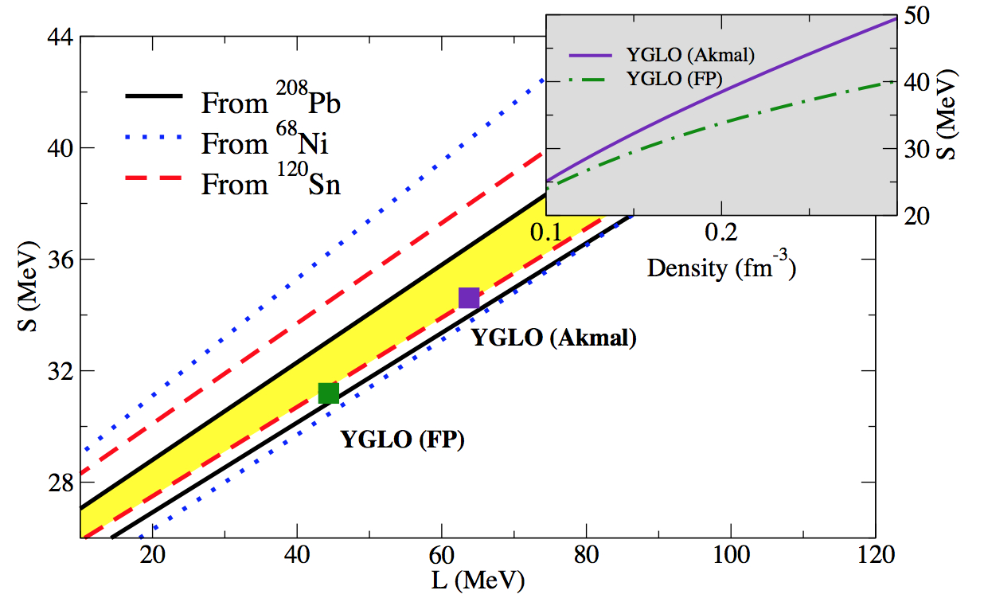
Symmetry energy and its slope
Lines delimit the phenomenological areas constrained by the exp. determination of the electric dipole polarizability
Yang, Grasso, Lacroix, PRC 94, 031301(R) (2016)

Slide 34
… Without resummation, how to handle the different density scales ?
… A Lee-Yang type expression for the EOS of neutron matter-> if the low-density regime is always satisfied
s-wave scattering length
Associated effective range
We choose to keep terms containing only the s-wave scattering length. The next term in the Lee-Yang expansion contains the p-wave scattering length
Grasso, Lacroix, Yang,Phys. Rev. C 95, 054327 (2017)

Slide 35
Scattering length and effective range. Expansion describing the small k behavior of the phase shift a enters at the leading order and the effective range r_{e} enters at the next-to-leading order
k cot δ = -1/a +1/2 r_{s} k² + O(k⁴)

Slide 36
Neutron-neutron scattering length.
Low-density regime:
We impose a low-density constraint: - a k_{F}=1 ->
a =-18.9 fm up to a max momentum so that 18.9 k_{F}=1.
Beyond this value, we tune the scattering length so that –a = 1/k_{F}

Slide 37
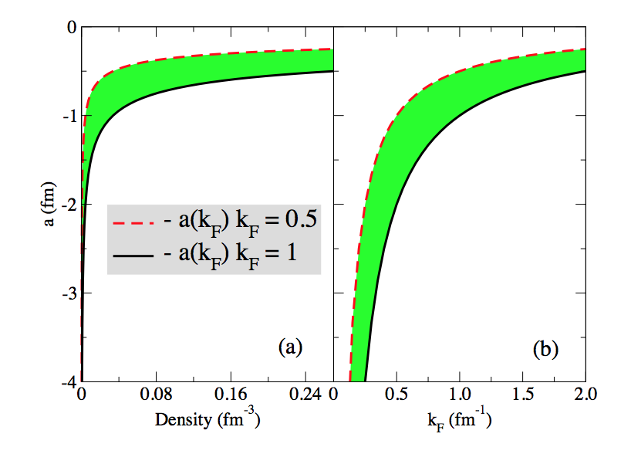
Neutron-neutron scattering length
Grasso, Lacroix, Yang, PRC 95, 054327 (2017).

Slide 38
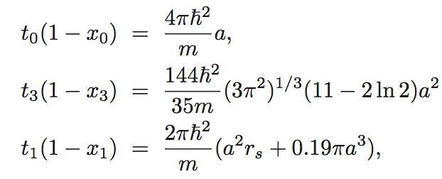
We introduce a Skyrme-type functional containing only s-wave terms and leading, at the mean-field level, to a neutron matter EOS given by the LY expression, with the relations :
The power of the density-dependent term is chosen equal to 1/3
Grasso, Lacroix, Yang, PRC 95, 054327 (2017).

Slide 39
We require that:
The functional correctly describes neutron matter at all density scales
The functional leads to a reasonable EOS for symmetric matter around the equilibrium point
This may be obtained by imposing a low-density regime everywhere (with a density-dependent neutron-neutron scattering length)

Slide 40
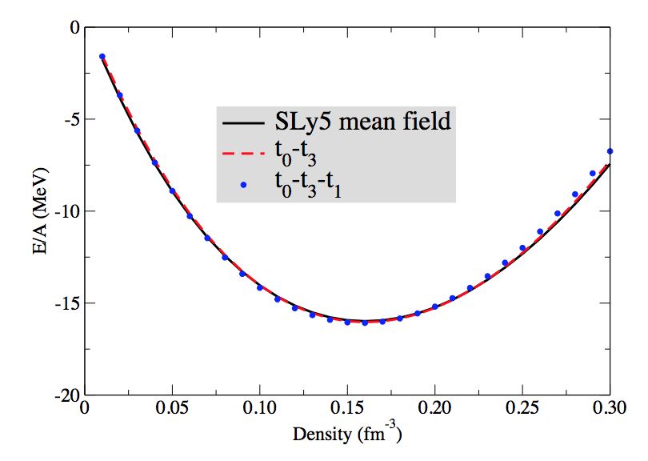
The parameters x_{i} do not enter in the EOS of symmetric matter.
We may thus adjust the parameters t_{i} to have a reasonable EOS of symmetric matter and tune the neutron-neutron scattering length by imposing, at each density scale, a low-density constraint
Symmetric matter, two cases
t₀-t₃
t₀-t₃-t₁
Grasso, Lacroix, Yang,Phys. Rev. C 95, 054327 (2017)

Slide 41
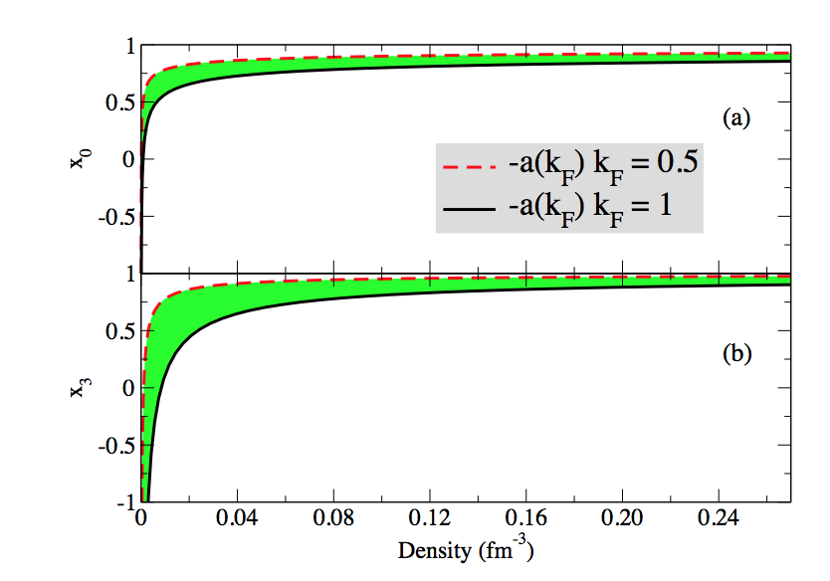
Density dependence of the parameters x₀ and x₃
Typical Skyrme values at densities around the saturation point
Grasso, Lacroix, Yang,Phys. Rev. C 95, 054327 (2017)

Slide 42
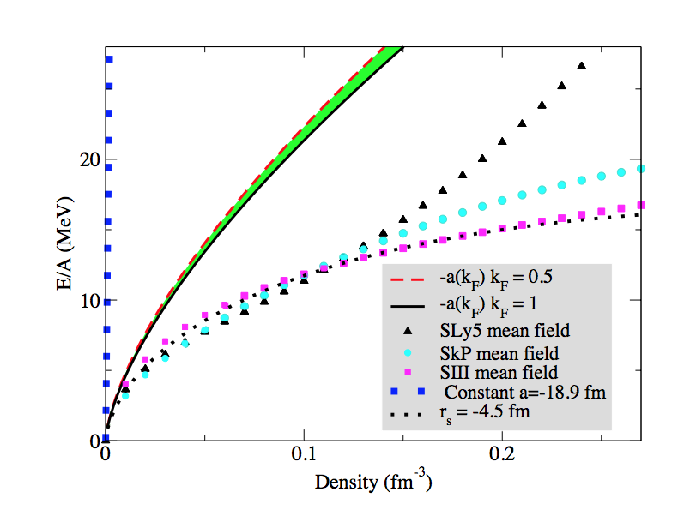
First two terms of the Lee-Yang expansion. EOS of neutron matter
LY with -18.9 fm
First two terms
SLy5 mean field
SkP mean field
Huge discrepancy
SIII mean field
Grasso, Lacroix, Yang,Phys. Rev. C 95, 054327 (2017)

Slide 43
Including the s-wave k_{F}⁵ terms and adjusting the effective range
Grasso, Lacroix, Yang, PRC 95, 054327 (2017).

Slide 44
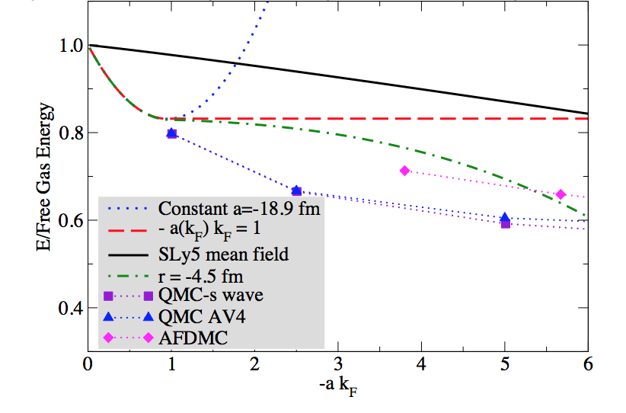
Low-density behavior
Grasso, Lacroix, Yang,Phys. Rev. C 95, 054327 (2017)

Slide 45
Conclusions
Beyond-mean-field tailored interactions -> second-order calculations for matter
New functionals valid at all density scales for neutron matter and at densities around saturation for symmetric matter
-> YGLO (resummation from EFT and good properties of Skyrme forces : a hybrid functional)
-> without resummation -> density-dependent neutron-neutron scattering length

Slide 46
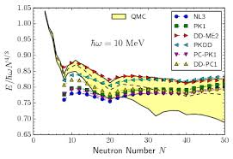
Brainstorming/Discussions
Perspectives. Bridging infinite systems with finite systems -> finite nuclei …. First, neutron drops
How it works as a function of the density ? -> changing the frequency of the trapping harmonic potential to produce different densities for the confined neutrons
Want about the effective mass ?
Should we introduce a resumed expression?

Slide 47
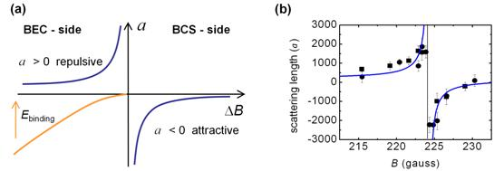
Brainstorming/Discussions
To deeply analyze the analogy with atomic gases close to Feshbach energy in the case of a density-dependent scattering length?
1/k
1/B

Slide 48
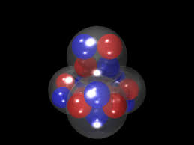
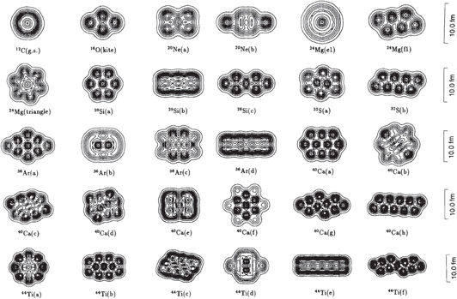
Brainstorming/Discussions
Wrong symmetric matter at low densities -> clustering is missing
And what about pairing?

Slide 49
Brainstorming/Discussions
Resumed terms in YGLO … only the first two terms of the Lee Yang expansion are recovered by construction. What about requiring to recover the following terms?

