Slide 1
Studies on detector and commissioning CALICE Technical meeting
J. NANNI
LLR - 24/05/17

Slide 2
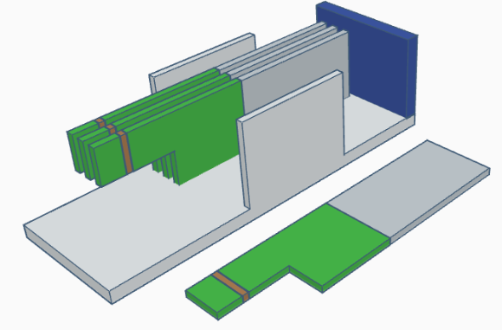
Studies on detector 2100 BCID problem
Detector mecanic struture disassemble:
Bottom plate,
Side plate,
Back plate
New mecanic elements (on hold):
Front panel,
Cable hole,
Cover
3 SLABs in structure:
16, 22, 18
1 SLAB out:
15

Slide 3
Studies on detector 2100 BCID problem
SLAB 16
SLAB 22
SLAB 18
SLAB 15

Slide 4
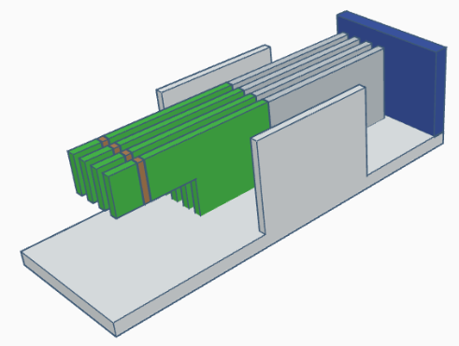
Studies on detector 2100 BCID problem
→ Move SLAB 15 in the structure
SLAB 16
SLAB 22
SLAB 18
SLAB 15
Disconnection of power supply connector from patch panel and move SLAB 15 inside the structure reduce the problem

Slide 5
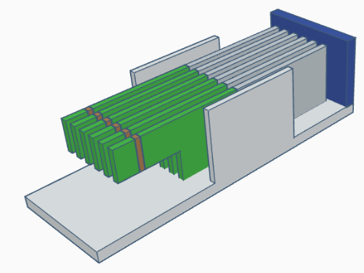
Studies on detector 2100 BCID problem
Add 2 more SLABS 19, 21
SLAB 16
SLAB 22
SLAB 18
SLAB 15
SLAB 21
SLAB 19
2100 BCID problem come back …

Slide 6
Studies on detector 2100 BCID problem
CONCLUSION:
2100 BCID not understand,
Conductor effect in mechanical structure,
Maybe also in power supply patch panel
IDEAS to solve this problem:
Put capton on the bottom plate,
Put capton on the SLAB cover plate (face of electronics),
Add more mechanical element in plastic matter,

Slide 7
SLAB Commissioning Without power supply
Contact between gnd, HV on bottom face of PCB
Contact of resistor and DVdd,
SlowControl S4 and S16,
Readout return S9 and S21,
Shortcut between Avdd, DVdd and gnd,

Slide 8
SLAB Commissioning Low voltage ON
DIF:
Green led DS1 on DIF (ON→OFF),
Blue LED blinking,
1.2V and 2.5V on J3 and J4,
SMB and FEV:
3.45V and 3.27V on AVdd and DVdd
Configure:
Red light on DIF (OFF➔ON➔OFF),
Blue led stay ON

Slide 9
SLAB Commissioning Acquisition (High voltage OFF➔ON)
SLAB open (no cover):
1st acquisition, 3min, all chips answered
Cover SLAB:
2nd acquisition, 3min, all chips answered
High voltage ON:
Wait few minutes
3rd acquisition, 3min, all chips answered
Place copper:
4th acquisition, 3min, all chips answered

Slide 10
SLAB Commissioning Final commissioning
Find Noisy:
Goal 230, step 5, ratio ≤1%
Cut noisy chanel
Scurves by 64
Range 170-270, step 5, acq_t 3min
Find threshold by chip
Cosmic run
No BCID problem
Cosmic particul detected

