Slide 1
Probing new physics with atomic spectroscopy
CD, Frugiuele, Fuchs, Soreq, 1709.02817
Berengut, Budker, CD, Flambaum, Frugiuele,
Fuchs, Grojean, Harnik, Ozeri, Perez, Soreq, 1704.05068
CD, Ozeri, Perez, Soreq, 1601.05087
Cédric Delaunay
LAPTh-Annecy
IPHC Strasbourg
22 September 2017

Slide 2
Outline
Motivations – BSM, precision frontier
Atomic forces in/beyond the SM
Probes in atoms with few electrons – helium, hydrogen/deuterium, positronium
Isotope-shift probes in heavy atoms – King linearity
Interpretation in known models – dark photon, B-L gauge boson
Conclusion

Slide 3
Motivations
Physics Beyond the Standard Model?
Importance of the precision frontier

Slide 4
The Standard Model
The SM is trementous success – It describes well* all (non-gravitational) phenomena up to ~1TeV energies!
It provides a good parameterization of:
electroweak symmetry breaking, close to the Higgs mechanism (Л>few TeV)
flavor- and CP-violating, close to the CKM picture (Л>10⁴⁻⁵ TeV)
With a 125GeV Higgs boson, the SM is a consistent theory, potentially up to the Planck scale ~10¹⁹GeV
* modulo few persisting anomalies: muon g-2, b→sμμ …

Slide 5
The Standard Model
Yet, the Standard Model is an incomplete theory, which has several important shortcomings:
No neutrino oscillations
No (cold) dark matter candidate
Insufficient baryon asymmetry
Besides the SM suffers from several theoretical issues:
The Higgs mass is unstable under high-scale quantum corrections (naturalness problem)
The neutron EDM is not suppressed (strong CP problem)
Its flavor parameters are very small and hierarchical (flavor puzzle)
Any of the above requires physics beyond the SM
None of the above unquestionably* points to a given scale: Л?
* naturalness favors Л~TeV, yet with known exceptions (relaxion) and increasing pressure from the LHC

Slide 6
New-physics searches
Energy frontier
discover new massive particles
with few events at high energies
(take close-up pictures)
BSM Physics
Intensity frontier
find deviations
in low-energy observables
with large statistics
(increase luminosity/contrast)
Precision frontier
find deviations
in low-energy observables
measured with high precision
(increase sharpness)

Slide 7
Precision frontier in atoms
With the advent of modern optics and cooling technologies the atom has become a golden field for physics at very high precision.
Precision atomic physics offered ultra sensitive probes of exotic phenomena beyond the SM which breaks QED symmetries:
Parity-violation (eg. Cesium: Л>few TeV)
CP violation (eg. Tallium: Л>few PeV)

Slide 8
Precision atomic spectroscopy
The frequency comb technique opened the way towards precision measurements of atomic transition frequencies in the optical range (Nobel in Physics 2005)
Thanks to their higher stability, narrow optical transitions are now the most accurately measured
eg. Octupole transition (E3) in Ytterbium ion
Significant improvement is expected:
eg. uncertainty of E3 in Yb+ is reaching
Godun+ PRL 113, 210801 (2014)
Huntermann+ PRL 113, 210802 (2014)
accuracy
Huntermann+ PRL 116, 063001 (2016)

Slide 9
Precision atomic spectroscopy
In terms of length, this would correspond to measure the distance to the nearest stars (~10 ly) with meter-precision!
In principle, these measurements could thus be sensitive to new forces weaker than QED by 18 orders of magnitude!
This level of precision makes atomic spectroscopy a sensational probe of BSM physics complementary to the energy/intensity frontiers.

Slide 10
Atomic forces in/beyond the Standard Model
Generic Spin-independent forces
The HigGs force

Slide 11
Atomic potentials
Consider a new boson with parity-even couplings to electrons and nucleons: and
At low energies it gives rise to a short-range, spin-independent force between atomic nuclei and their bound electrons described by:
mediator mass
mediator spin
electronic
coupling
nuclear
coupling

Slide 12
Atomic potentials
Inevitably, if the new boson couples to electrons, there is also a similar force acting on pairs of bound electrons:
Both electron-nucleus and electron-electron new interactions above will correct the transition frequencies whose values are approximately set by the Coulomb potential:
is the distance between two electrons

Slide 13
Energy level shifts
Consider a transition i between two energy levels a,b ( ) in a given atom
Relaxing from b to a, the atom emits a photon of frequency ( ):
In the presence of the new force, energy levels are shifted in a state-dependent way, so that:
b
a
Energy

Slide 14
Energy level shifts
Taking , the energy-level shift due to can be described in QM by (time-independent) perturbation theory.
Schematically:
first-order energy
correction
electron wavefunction in the absence of new physics
(ie. from only)

Slide 15
Energy level shifts
In an atom with electrons, this yields :
where X,Y are overlap integrals of the Yukawa potentials with the electron wavefunctions
For hydrogen and helium we use known non-relativistic (hydrogenoid or Hylleraas) wave functions
In heavy atoms, we simulate the atomic structure using relativistic many-body perturbation theory
Hylleraas (1928)
Berengut+ PRA 73 (2006)

Slide 16
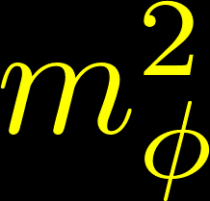
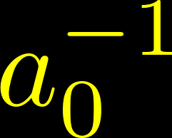
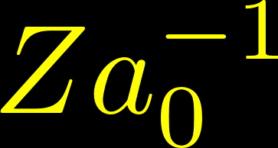
Typical atomic bound
X,Y integrals are difficult to guestimate but they admit simple limits:
For the Yukawa potential is Coulomb-like ( ) leading to constant bound
For the potential is point-like ( ) and the bound weakens like (or faster if cancelations)
In between, new physics contributions for the two states are comparable in size and may cancel
coupling
mass

Slide 17
The atomic Higgs force
The exchange of the Higgs boson between a nucleus and its bound electron gives rise to force of the type above with and
In the SM, the couplings of the Higgs boson are proportional to the fermion mass : with a universal proportionality factor being the VEV of the Higgs field
As a result, the (SM) Higgs force is very suppressed:
Shifman+ PLB 78, 443 (1978)
CD+ arXiv:1601.05087

Slide 18
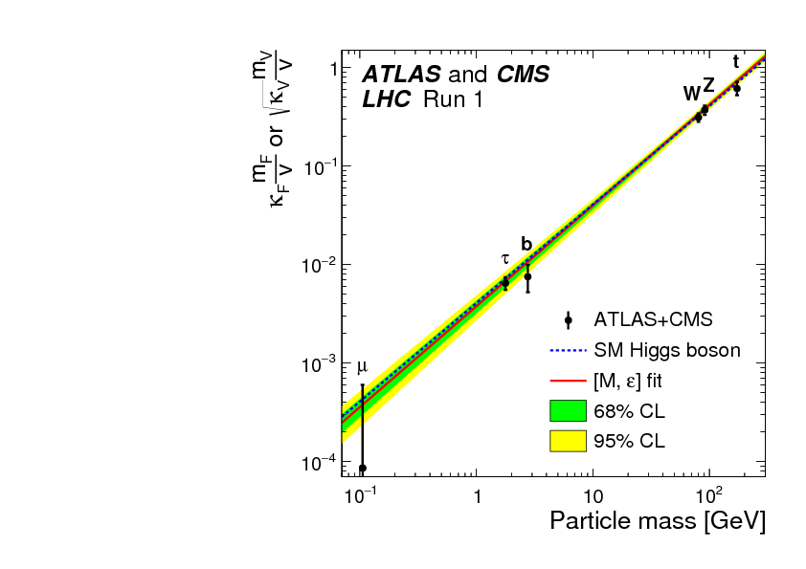
Higgs couplings from data
Yet, little is known experimentally about how the Higgs boson couples to fermions, especially the electron and the up and down quarks.
Model independent bounds from LHC give:
Hence, the Higgs force could be stronger than the SM prediction by ~6 orders of magnitude!
Perez+ PRD 93, 013001 (2015)
Altmannshofer+ JHEP 1505, 125 (2015)
down
up
electron

Slide 19
Frenquency shifts from the Higgs force
Since the Higgs mass is much larger than any other scale in the atom, the Higgs force is well described by a point-like interaction:
As a result, the energy level shifts are controlled by the electron density near the nucleus:
electron density at the origin
(in units of )
CD+ arXiv:1601.05087

Slide 20
Frenquency shifts from the Higgs force
For states with (P,D,…-waves), the density at the nucleus is very suppressed due to angular momentum conservation (up to spin-orbit coupling).
For states (S-waves), the density at the nucleus can be extracted from hyperfine splitting (HFS) measurements. Moreover, for atoms with a single valence electron, it is well approximated by the formula:
Budker+ Atomic Physics
ionization #
linear in the
nuclear charge
due to screening
of core electrons
principal quantum #
« quantum defect »
Sobelman Atomic Spectra and Radiative Transitions

Slide 21
Frenquency shifts from the Higgs force
Consider optical transitions in Ca, Sr and Yb ions, which involve a ground-state:
Assume saturated LHC bound on the Higgs couplings:
Then, the frequency shift due to the Higgs force in these transitions could reach:
Such transitions are typically measured with Hz accuracy. Hence, these atomic observables are more sensitive than the LHC by a factor of ~1000
CD+ arXiv:1601.05087

Slide 22
Probing BSM with atomic spectroscopy
As we saw experimental sensitivity is very good
But to make up probes of these measurements one needs either :
Very precise theoretical (QED) calculations
available only for atoms with few (1,2) electrons
eg. Helium frequencies knwon to surpassing experimental accuracy
To construct observables largely insensitive to theory uncertainties
King linearity of isotope shifts

Slide 23
Probing BSM in atoms with few electrons
Hydrogen, Helium, Positronium
Isotope shifts

Slide 24
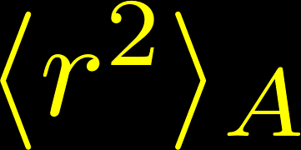
Transition frequencies – Theory
The theory prediction for a transition i in a given atom A is:
Higher-order effects in the nuclear finite size are not resolvable by current experimental precision.
Leading finite nuclear size contribution:
is the rms charge
radius squared,
is a (calculable) electronic constant
dominant contribution
calculated in the point-nucleus limit
to high-order in
(incl. nuclear spin and polarizability effects)
possible new physics contribution

Slide 25
Nuclear charge radius
While and can be calculated with sufficient accuracy, the theory prediction is generally limited by a poorer knowledge of the nuclear charge radius.
The charge radius is determined by independent measurements in:
electron scattering off of nuclei (~1%)
muonic spectroscopy (<0.1%)
The proton charge radius is still a big puzzle:
muonic hydrogen spectroscopy disagrees with electronic measurements (CODATA) by ~7σ
Pohl+ Nature 466, 213 (2010)
Antognini+ Science 353, 669 (2013)

Slide 26
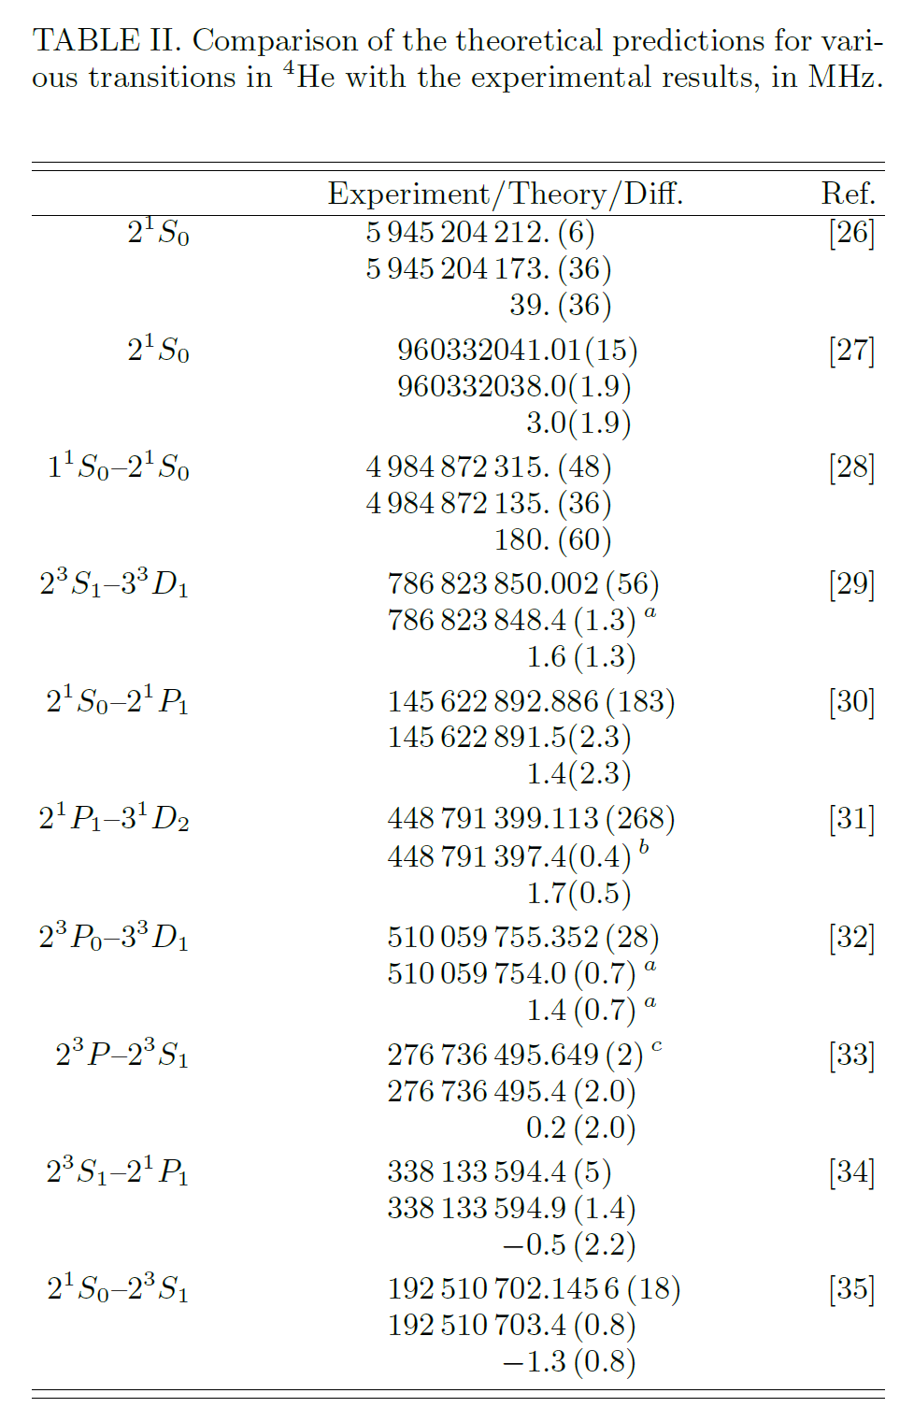
Precisely measured transitions in Helium
Pachucki+ arXiv:1704.06920
Transitions between singly- excited states are very well measured:
Helium 4 data agrees with theory up to ~few kHz
orbital
momentum
total spin
S=0,1
nL
Energy
1s
Total angular
momentum
J=L+S
orbital # of
excited electron

Slide 27
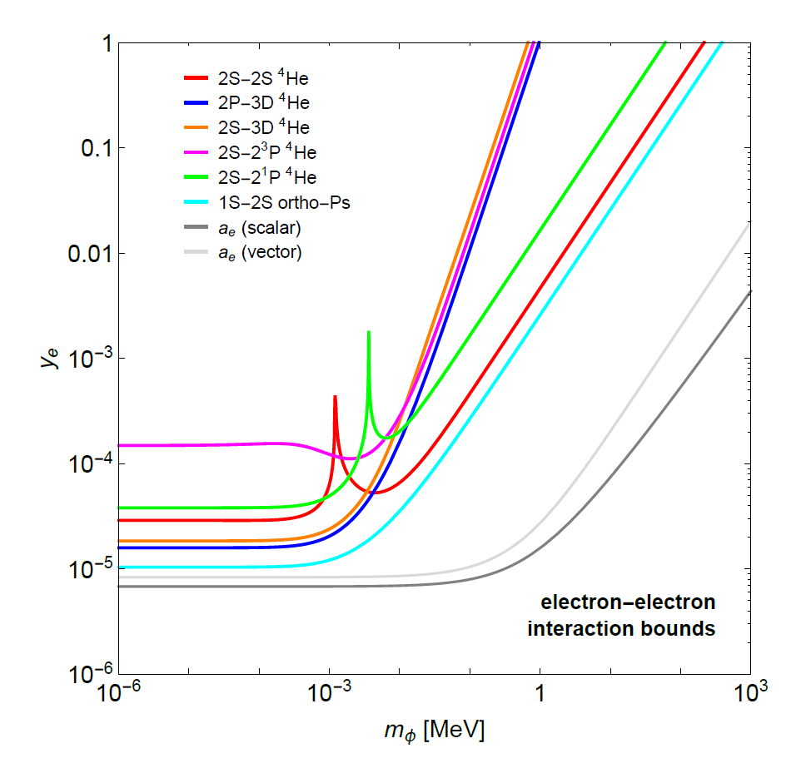
Bound on electro-philic forces
Consider new physics couples only to electrons
Bounds from helium spectroscopy are roughly comparable to positronium and electron g-2 below 1keV
CD+ arXiv:1709.02817

Slide 28
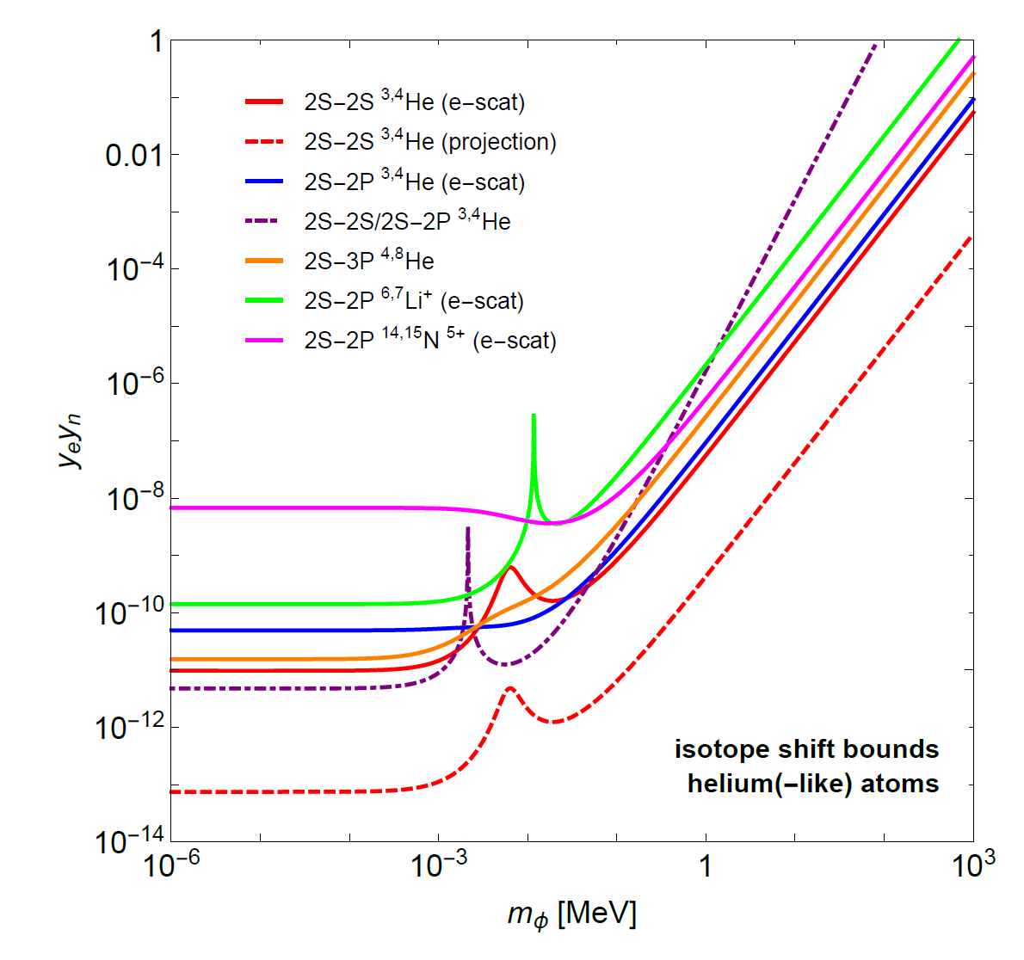
Helium Isotope shifts
Frequency shifts between helium 3,4 isotopes are measured and predicted from theory with 2 orders of magnitude higher accuracy (systematics cancel out)
This gives strong bounds on electron-neutron interactions
A factor ~100 improvement is expected with He charge radii extracted from muonic spectroscopy
Antognini+ Can. J. Phys. 89, 47 (2011)
CD+ arXiv:1709.02817

Slide 29
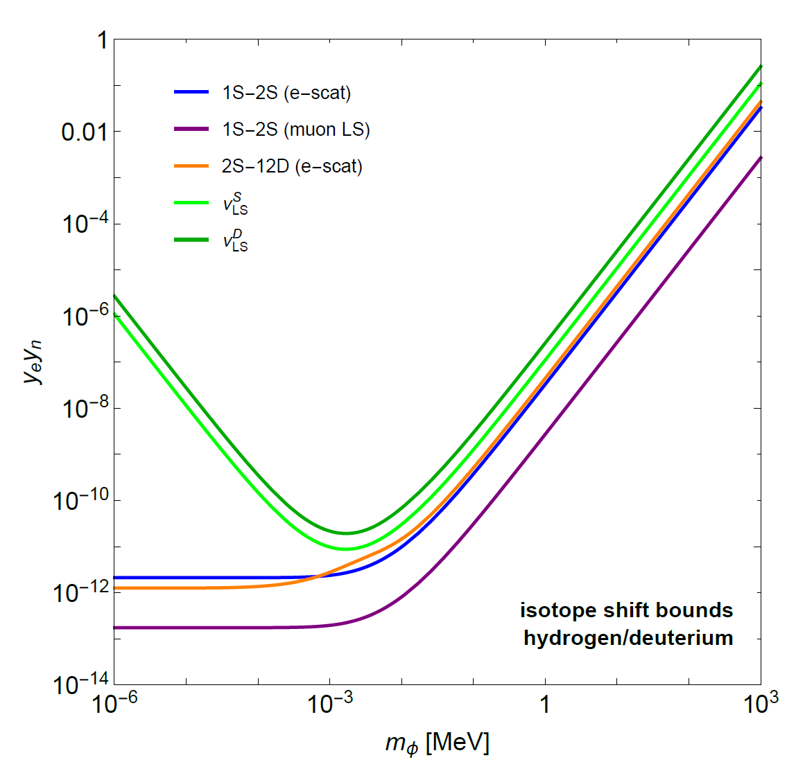
HD isotope shifts
Despite the proton size puzzle, electronic and muonic measurements of the difference of hydrogen and deuterium charge radii are consistent within uncertainties
Strongest bounds from
1S-2S, 2S-12D transition
Lamb shift corrections:
Pohl+ Science 353, 669 (2016)
Weitz+ PRA 52, 2664 (1995)
CD+ arXiv:1709.02817

Slide 30
Probing BSM with « clock » transitions in heavy atoms
Isotope Shifts
King Linearity

Slide 31
Optical clock transitions
Narrow optical (« clock ») transitions in heavy elements are measured with better (~1Hz) accuracy
Yet, they have too many electrons which greatly limits the precision of the theory calculation.
Many-body simulations predict the transition frequencies with ~1% accuracy at best.
Direct comparison between theory and experiment is therefore not possible

Slide 32
Basic idea
For point-like ( ) and static ( ) nuclei, two (zero-spin) isotopes A and A’ have the exact same spectrum within QED:
On the other hand, since the new physics contribution is only mildly suppressed by
New physics leads to isotope shift:

Slide 33
Isotope shifts from nuclear physics
In the real world, nuclei have isotope-dependent finite mass and finite (charge) radius:
Given their nuclear nature IS are small, typically GHz,
But they are also hardly predictable from theory.
While masses are measured with ~10⁻¹⁰ uncertainty, charge radii are determined from scattering experiment with insufficient (~0.1%) precision.
mass shift (MS)
field shift (FS)

Slide 34
King linearity
We need an observable sensitive to new physics and only limited by the precision of IS measurements
Such an observable was discovered long ago: King linearity
The idea is to use IS measurements in another transition with the same isotopes to get rid of
Provided is valid, a linear relation between IS of the two transitions follows
King J. Opt. Soc. Am. 53, 638 (1963)

Slide 35
King linearity
This linearity is independent of the value of the F,K constants and the charge radius differences
It is the mere result of the factorization of electronic and nuclear parameters:
Establising linearity is thus only limited by the precision of IS an nuclear mass measurements
independent of A,A’

Slide 36
King linearity violation from new physics
In the presence of new physics forces, the theory prediction for IS becomes:
New physics then implies King linearity violation:
Vector notation:

Slide 37
King linearity violation from new physics
Caveat – new physics sensitivity is suppressed in either of the following cases:
eg. for short-range forces with as in this case
or constant of AA’
only for very exotic
forces with

Slide 38
Bounding new physics
In order to test linearity 2 transitions and 4 isotopes (at least) are needed.
If data is consistent with linearity within experimental uncertainty, a bound can be put on new physics coupling vs. mass:
area of the triangle formed by the 3 points on the King plot
the only theoretical inputs (depend on )

Slide 39
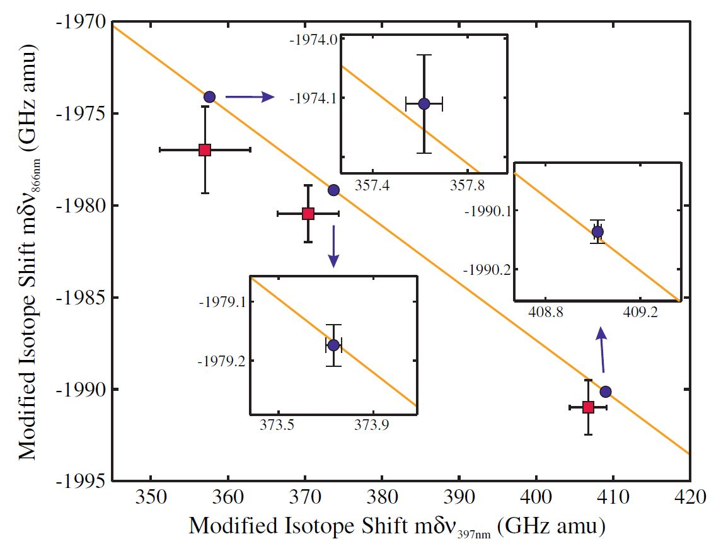
King Linearity in Ca⁺ data
4p_{3/2}
4p_{1/2}
3d_{5/2}
3d_{3/2}
4s
1s
core electrons
closed shells
A=40
A’=42,44,48
Gebert+ PRL 115 (2015)
precision ~ 100kHz

Slide 40
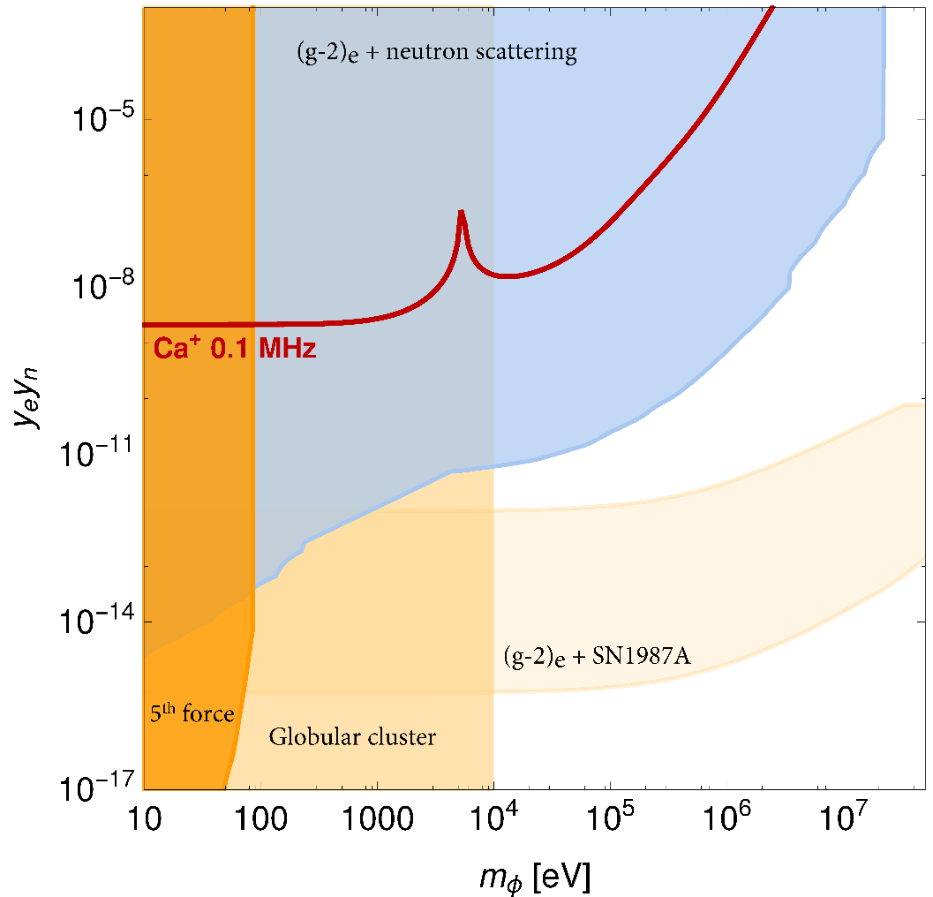
Ca⁺ bound
Combined bound from neutron scattering off of Pb nuclei and electron g-2
Astrophysical bound
from energy losses
galaxy cluster
Combined bound from supernova cooling and electron g-2
Searches for gravity-like forces
with torque balance
Berengut+ arXiv:1704.05068

Slide 41
Clock transitions
The Ca⁺ bound is based on broad dipole-allowed transitions (S→P, D→P) with ~10MHz width, thus limiting the precision to ~100kHz
IS measurements in very narrow transitions with sub-Hz width could improve sensitivity by 5 orders of magnitude
There is a unique candidate with 2 clock transitions and 4+ stable (spin-zero) isotopes: Yb⁺
Also, several elements have a clock transition for the ion and the neutral atom: Ca, Sr, Ba, Yb

Slide 42
Sensitivity estimates
Assume linearity is established within a precision Δ
Then, factorization holds within uncertainties:
And a best-case estimate of the resulting bound is:
suppression factor
for short-range forces
calculated
from MBPT
alignment with MS
Berengut+ PRA 73 (2006)

Slide 43
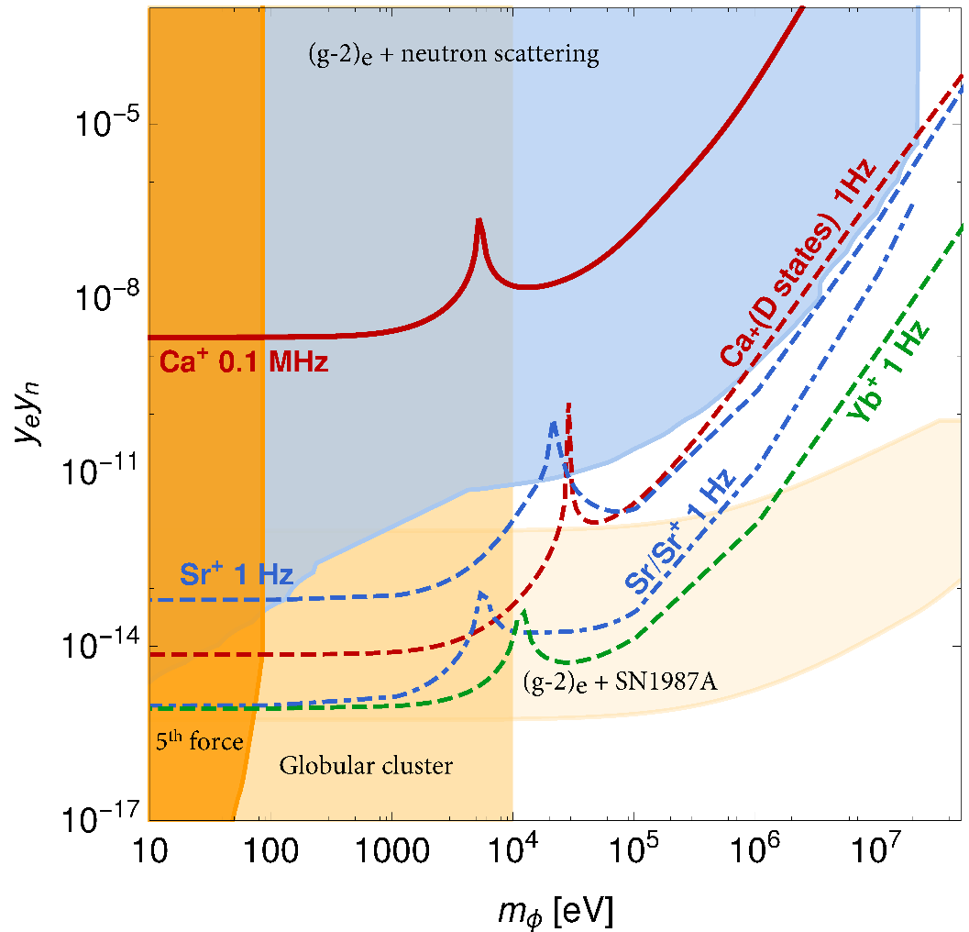
Projections
Assume state-of-the-art accuracy of 1Hz in all IS measurements
Assume linearity is established to that level.
Recent many-body estimates show that this is realistic for Sr⁺
Flambaum+ arXiv:1709.00600
Berengut+ arXiv:1704.05068

Slide 44
Interpretation in known BSM models
Higgs and Higgs-like forces,
Dark photon, U(1)_{B-L} Z’

Slide 45
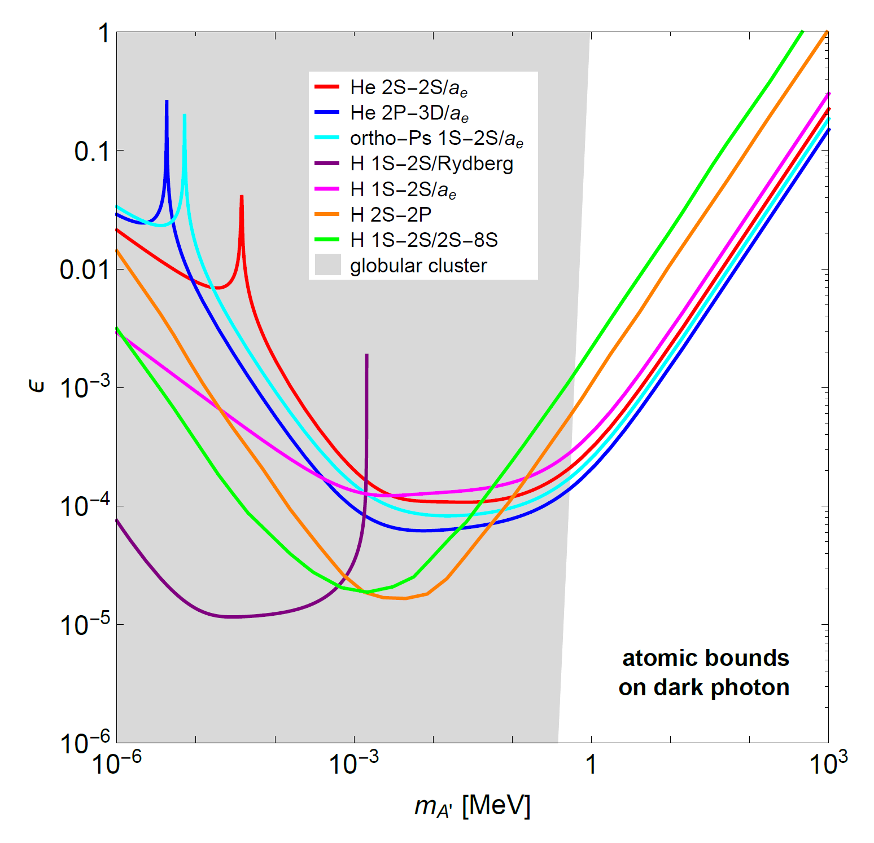
Dark photon
Consider a new massive U(1) gauge boson A’ kinetically mixed with the photon.
Its couplings are rescaled from QED couplings by a universal mixing angle , thus ,
Helium (combined with g-2) is the best indirect bound from laboratory experiments above 100keV
CD+ arXiv:1709.02817

Slide 46
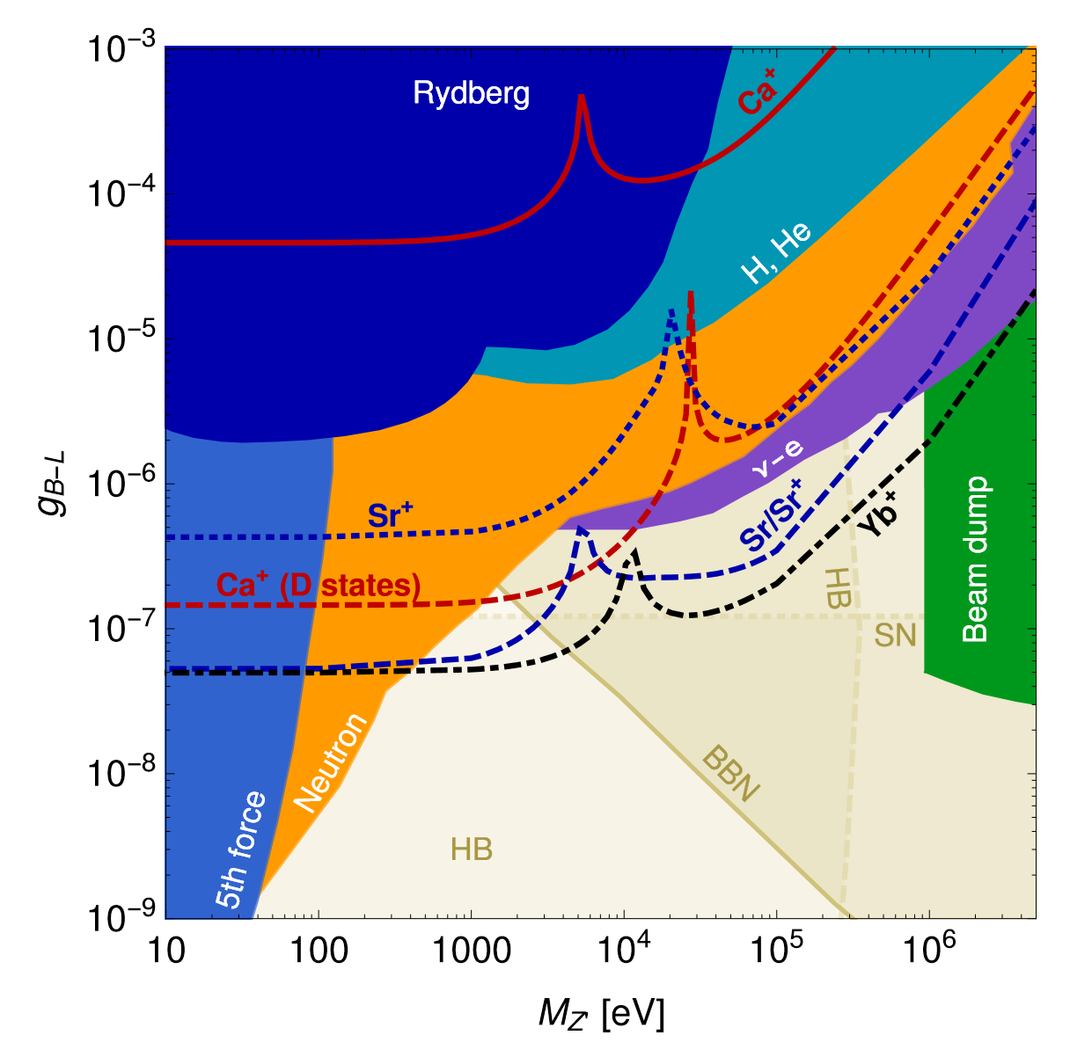
B-L gauge boson
Consider a new massive U(1) gauge boson Z’ coupled to B-L current,
Projected IS sensitivity in Sr+ and Yb+ will extend the reach of laboratory experiments in the mass range [300eV,1MeV]
Frugiuele+ PRD 96, 015011 (2017)

Slide 47
Conclusions
The precision frontier in atoms offer sensitive probes to new physics complementary to high-energy colliders
Light bosons below the GeV can be efficiently probed through precision spectroscopic measurements in helium, positronium, hydrogen/deuterium
In heavy atoms, despite the lack of accurate theoretical calculations, isotope shift in precisely measured/measurable optical clock transition could provide very strong bounds from King linearity violation

