Slide 1

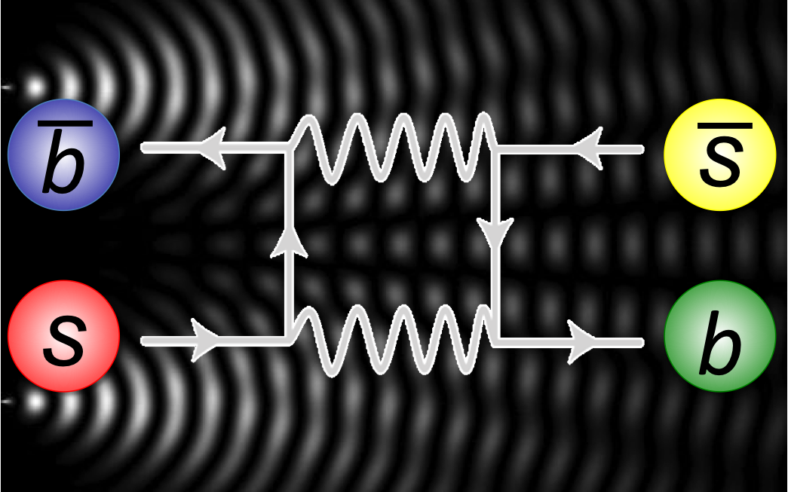
Violation of CPT and Lorentz symmetry in neutral mesons
Séminaire de Physique des Hautes Energies
IPHC Strasbourg
Jeroen van Tilburg
Notes:
Introduction. My project: SL decays at LHCb. Side project for master students. CP eigenmodes. Paper.
Admit LHCb bias.

Slide 2
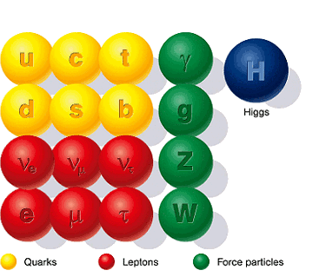
Standard Model
Notes:
SM: successful. u,d, e form building blocks of all known matter.
3 generations of quarks and leptons. This talk: mainly quarks.
Gauge bosons: forces. Gravity missing.
Higgs, discovered very recently (2012).

Slide 3
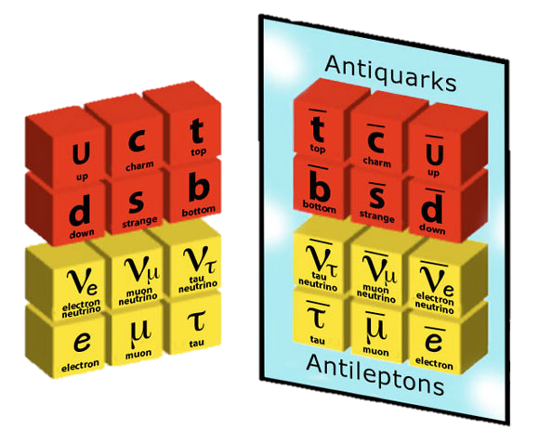
Antiparticles
Quarks
Leptons
Notes:
Since the marriage of relativity and QM we know that antiparticles must exist.
Same mass, same lifetime. Different charge. Denoted with bar.

Slide 4
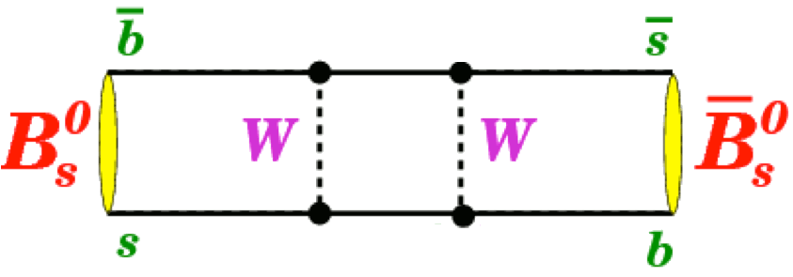
Strong interaction
_
Quarks form baryons (qqq) or mesons (qq)
The quantum play-ground: Neutral mesons
Neutral meson can oscillate into its own anti-particle!
Notes:
Quarks always form bound state in (anti-)mesons or (anti-)baryons. Nowadays, we know that more exotic states exists as well (penta- and tetraquarks).
But in this zoo, neutral mesons take a special place. Why they are special I can best show with the example of a Bs meson. Consists of a b and anti-s quark. I draw here the box diagram, then the b and s quark exchange a W boson twice and lo-and-behold, the Bs has become an anti-Bs: this particle can oscillate into its own anti-particle.
Two-state QM system: Neutral mesons mix before they decay.

Slide 5
Neutral meson systems
s
d
K⁰
c
u
D⁰
b
d
B⁰
b
s
B⁰
_{s}
And their anti-partners

Slide 6
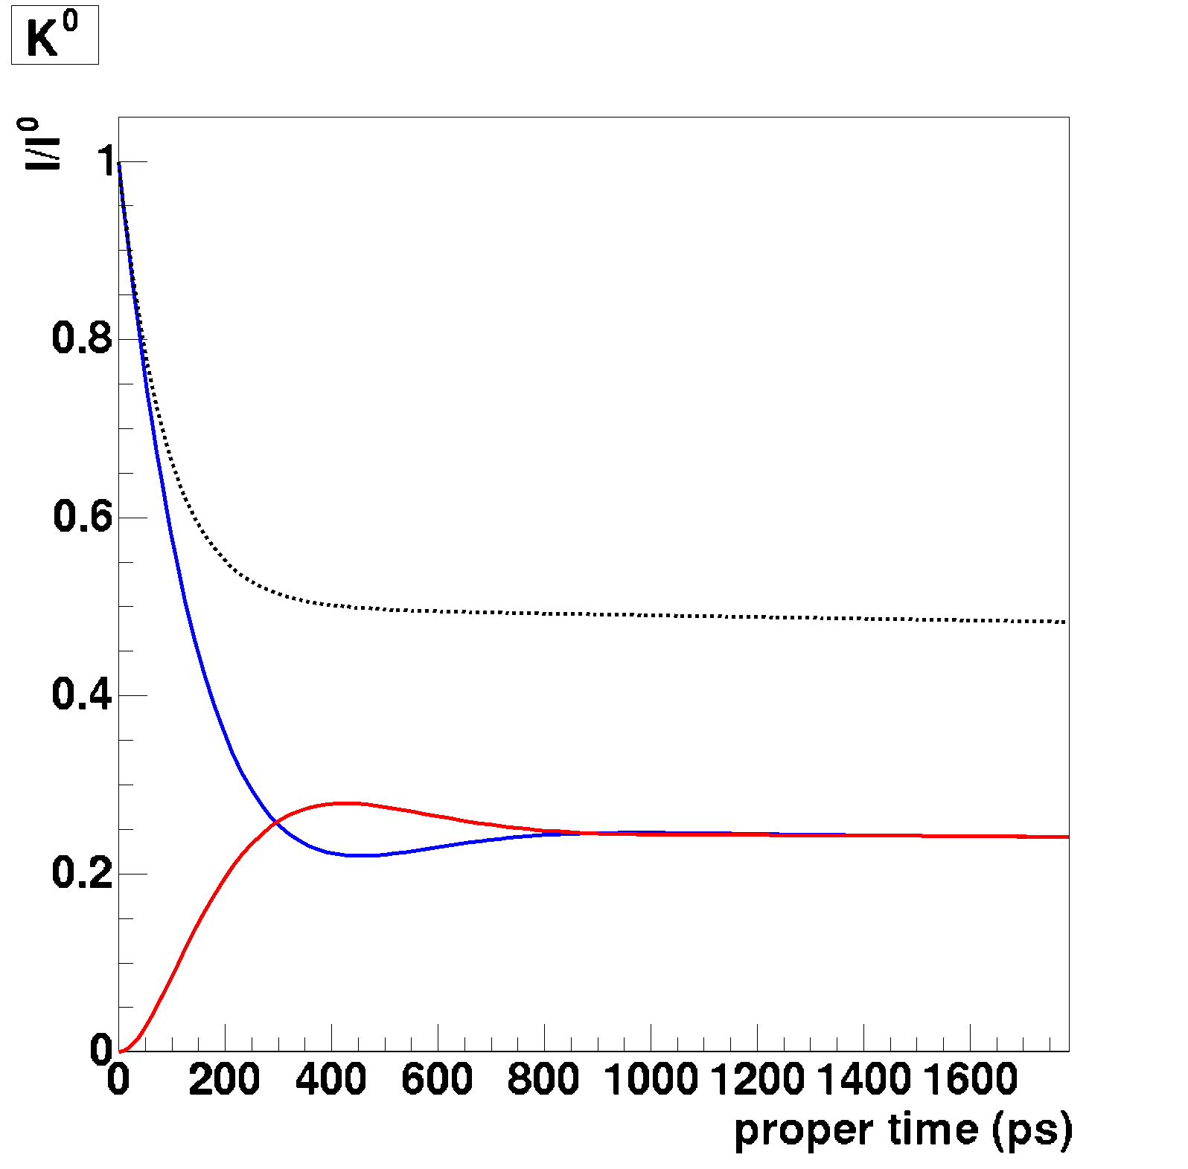
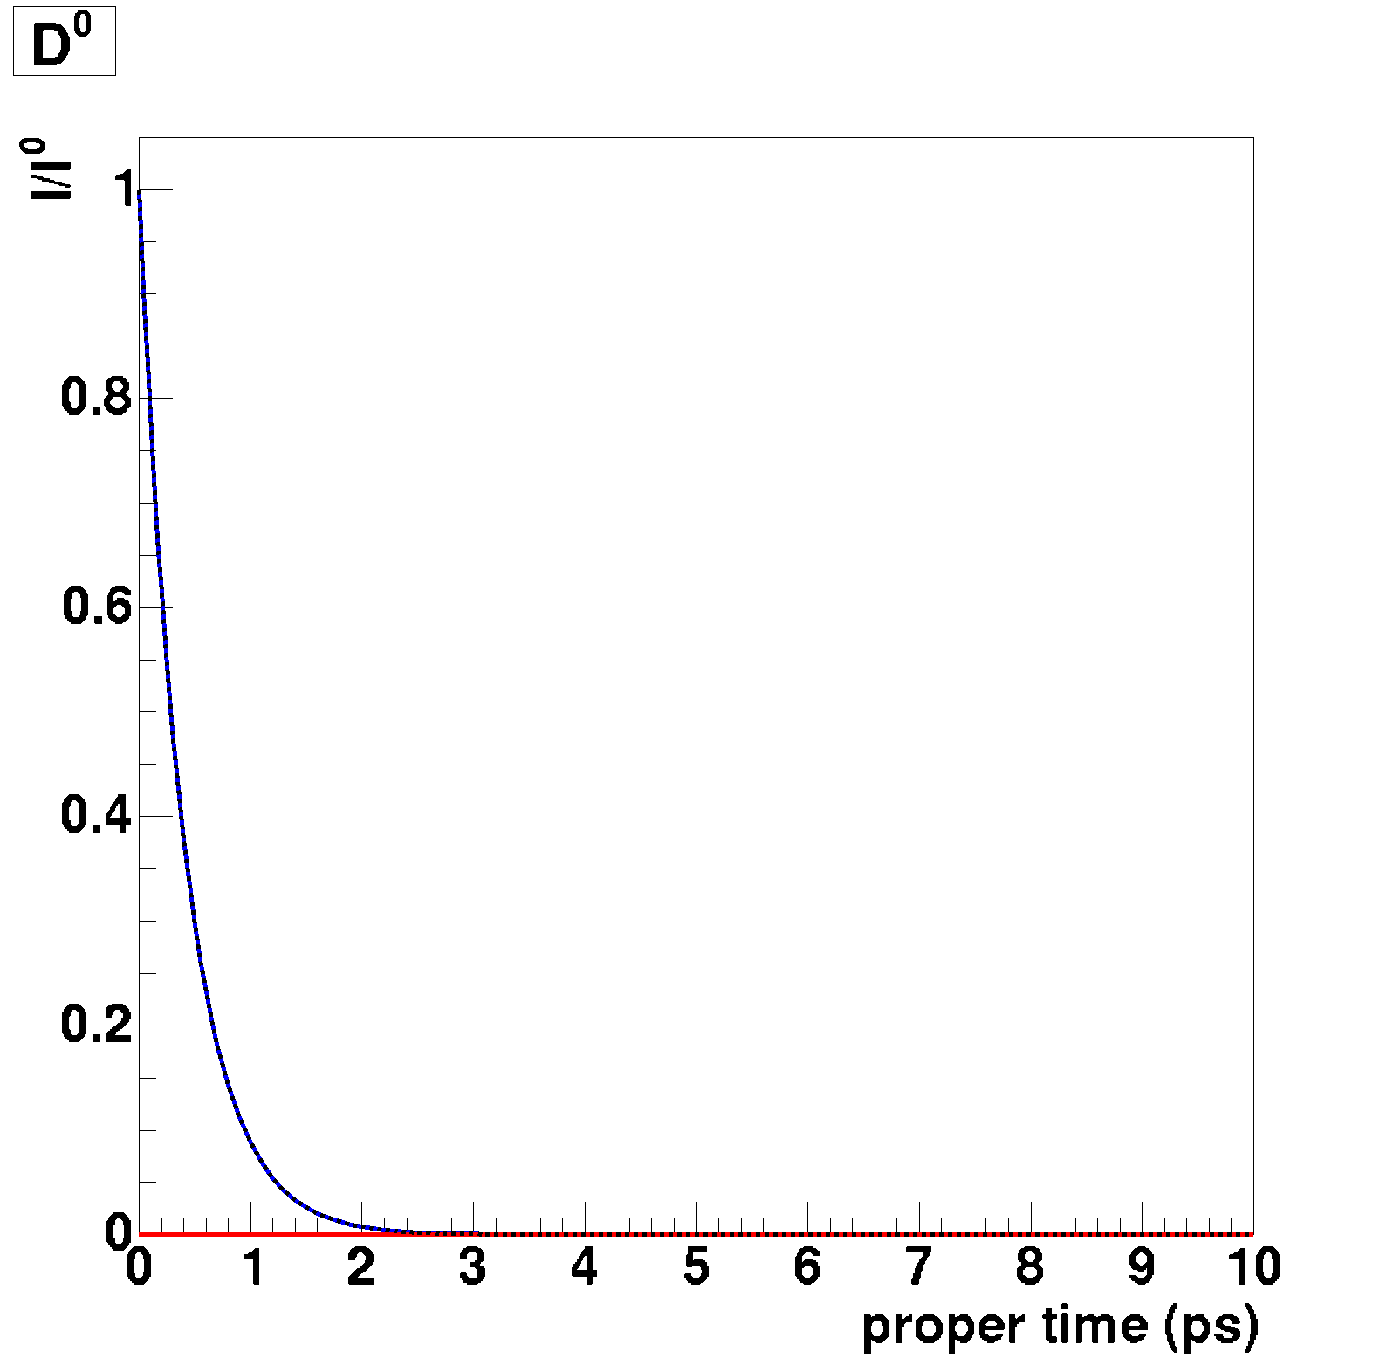
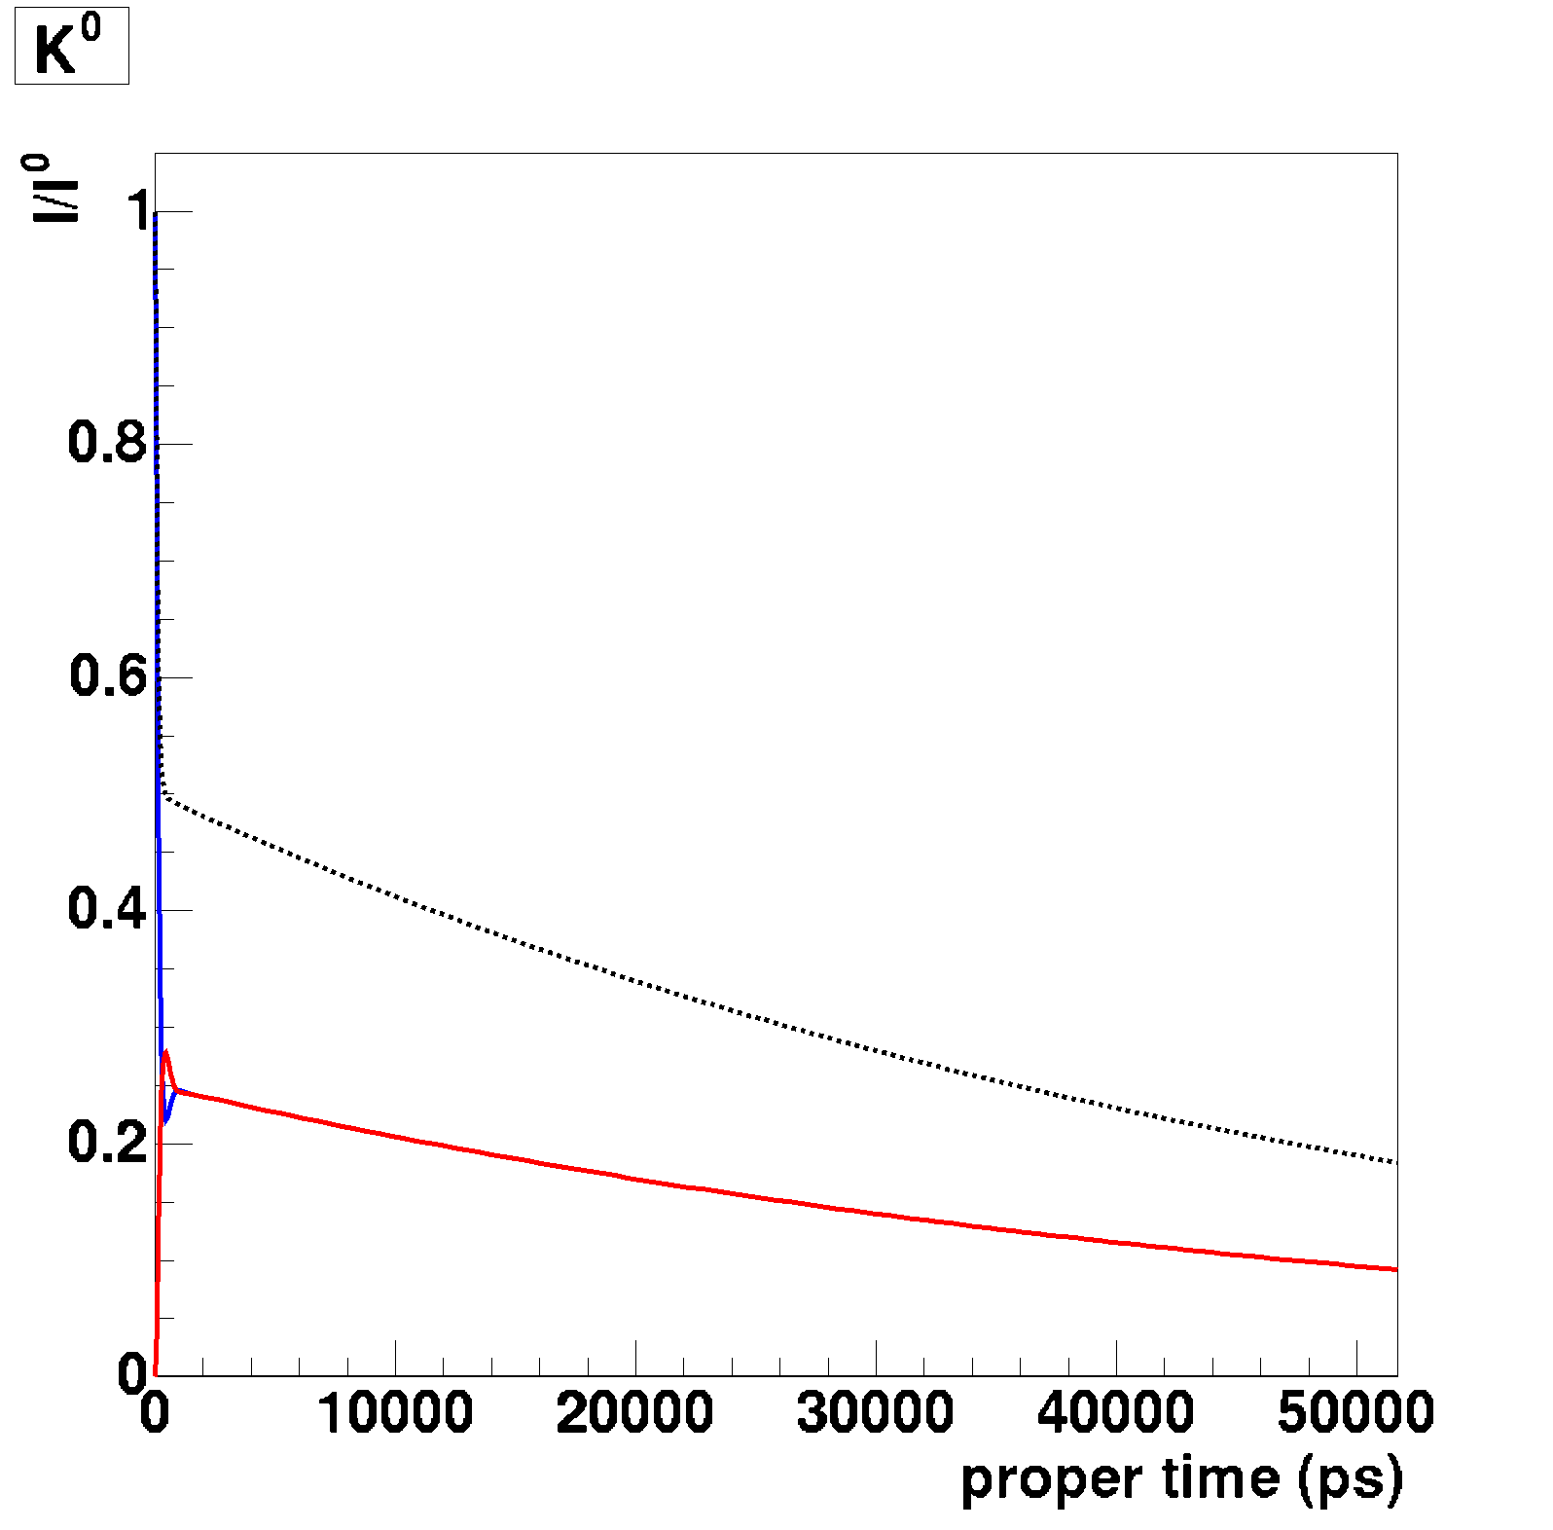
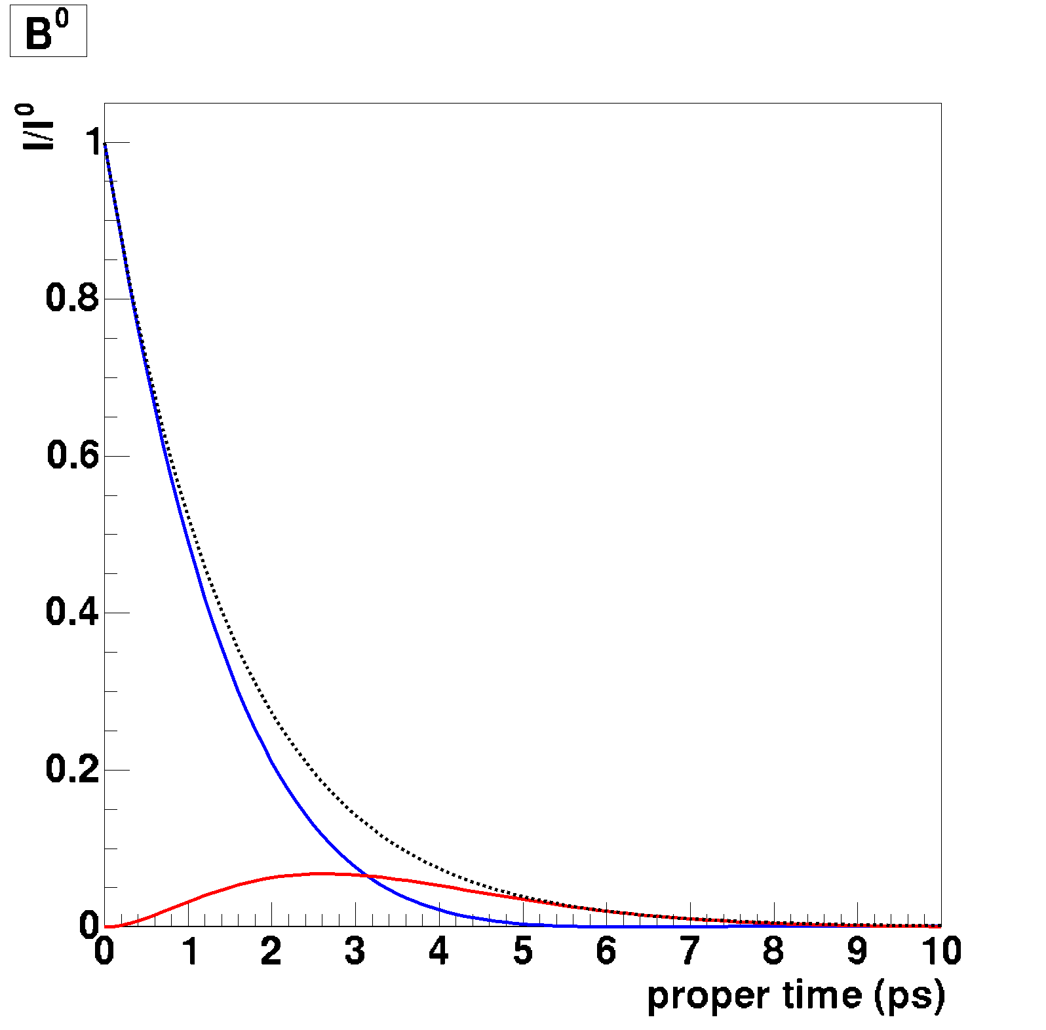
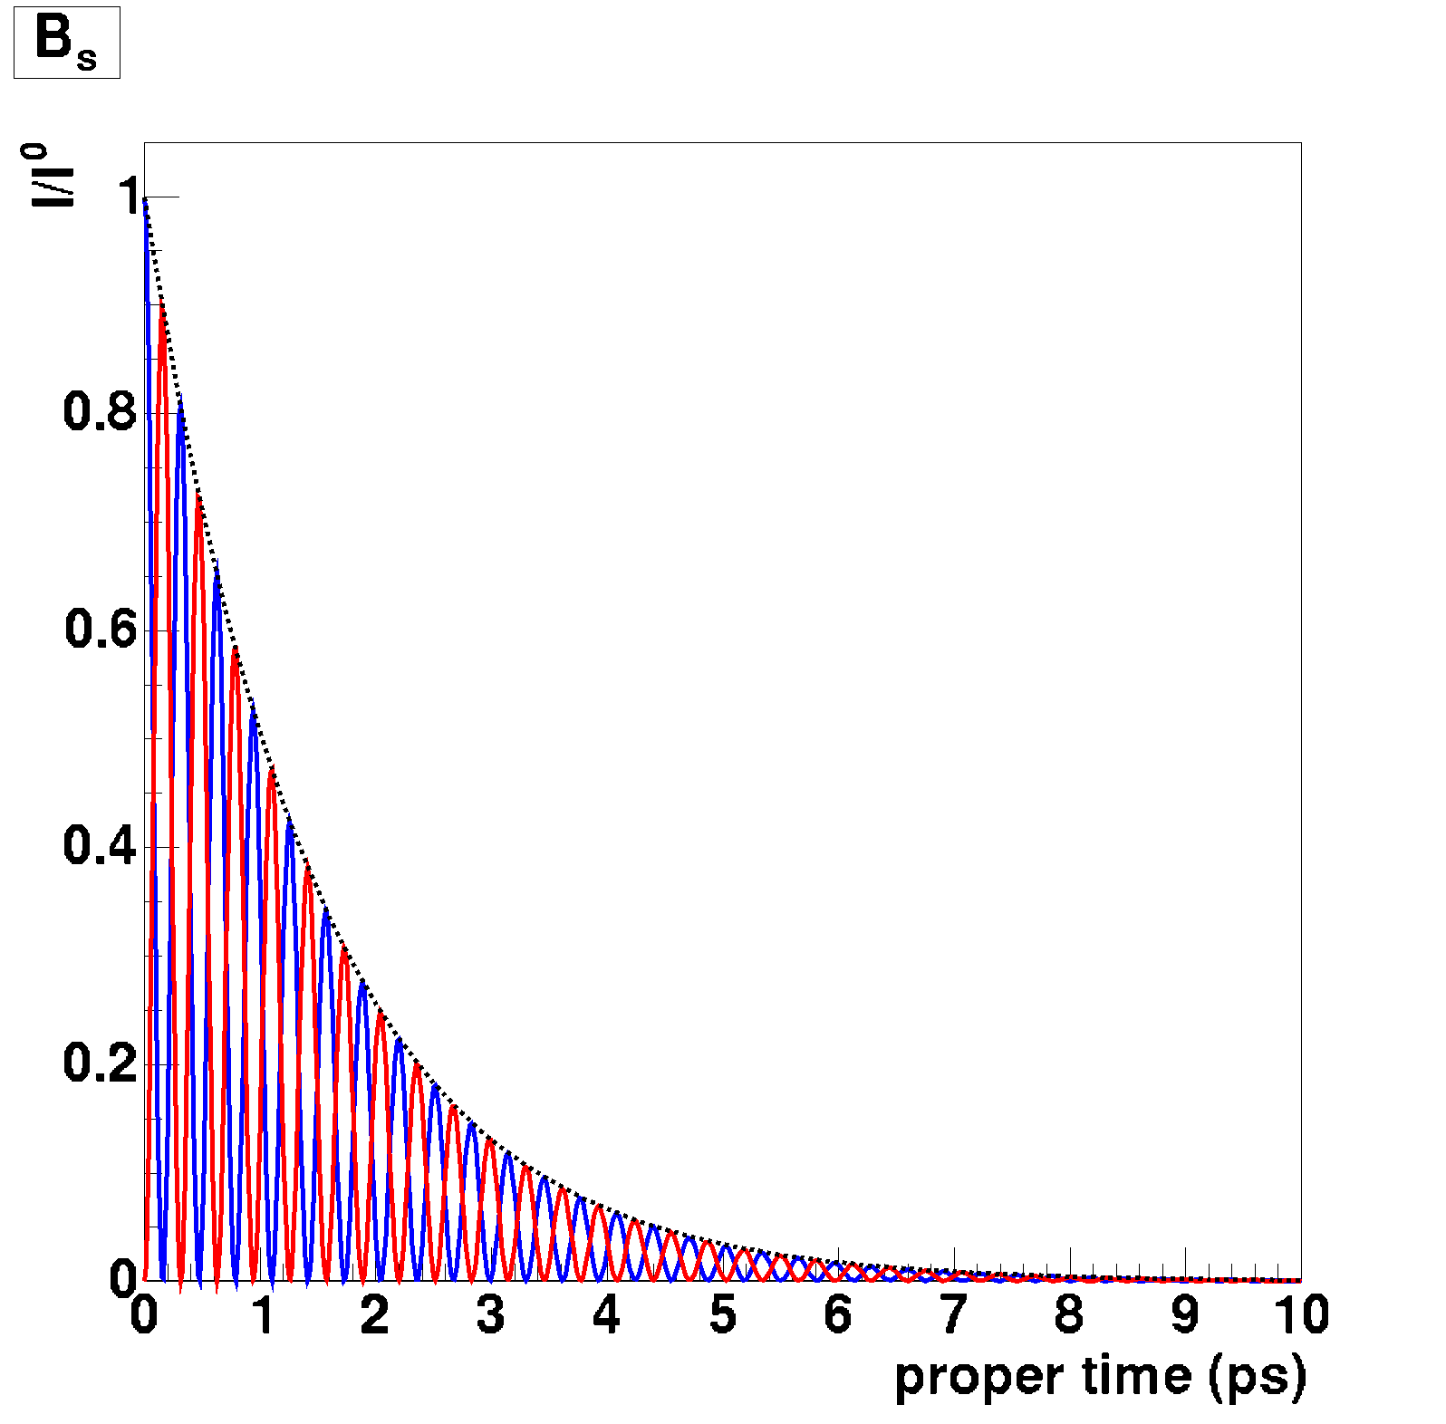
Time evolution
of P⁰ and P⁰ state (produced as P⁰)
K⁰
sd
D⁰
cu
Probability
Probability
B⁰
bd
B_{s}
bs
Probability
Probability
Notes:
Two-state QM system: two eigenstates.
Dm is the mass difference between the two eigenstates of the 2-state system.
DG is the decay width difference between the two eigenstates.

Slide 7
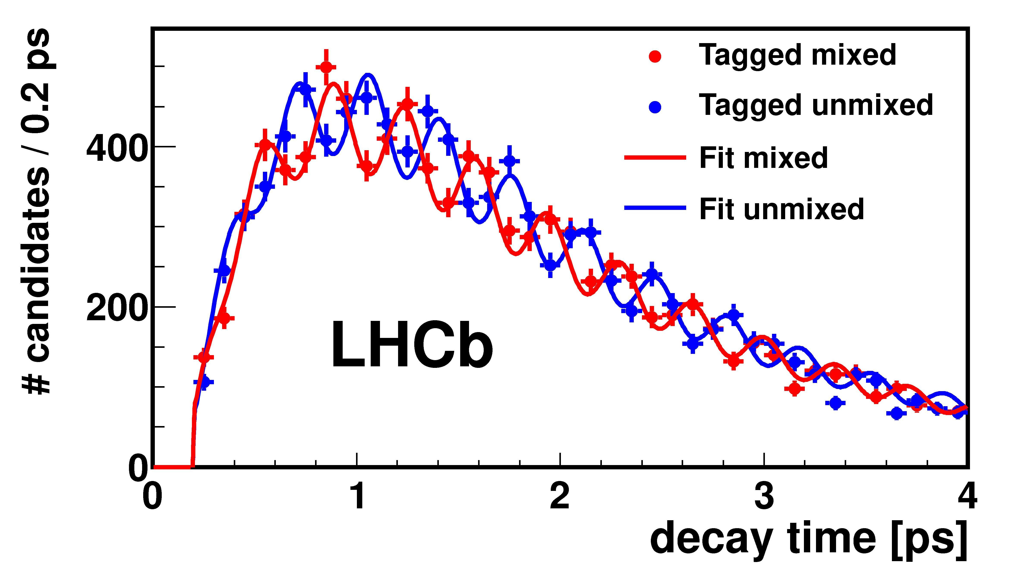
Measurement of B_{s} oscillations

Slide 8

Antiparticles
Quarks
Leptons
Notes:
Why does the universe has chosen to exist of matter (and not antimatter).

Slide 9
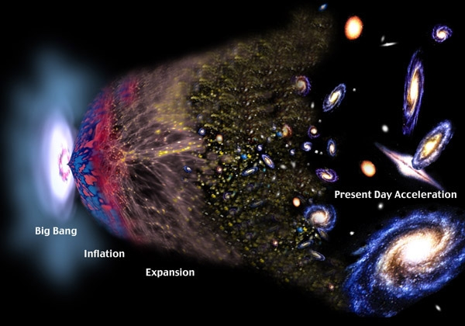

Big Bang
Quarks
Leptons
50.00000001%
49.99999999%
Notes:
More matter than antimatter created: CP violation.
1 of 3 conditions from Sacharov: non-equilibrium, CV + CPV, baryon number violation.
Matter and antimatter annihilated.

Slide 10
Three discrete symmetries
CPT theorem
All interactions are invariant under combined C, P and T
Implies particle and anti-particle have equal masses and lifetimes
One of the most important theorems in Lorentz-invariant quantum field theories.
Notes:
Most important concept in physics: symmetry.

Slide 11
C, P and CP in weak interactions
Weak interaction violates C and P maximally.
But CP was thought to be a good symmetry, until 1964.
Notes:
Example: tau decay to pion-neutrino.

Slide 12
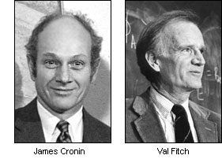
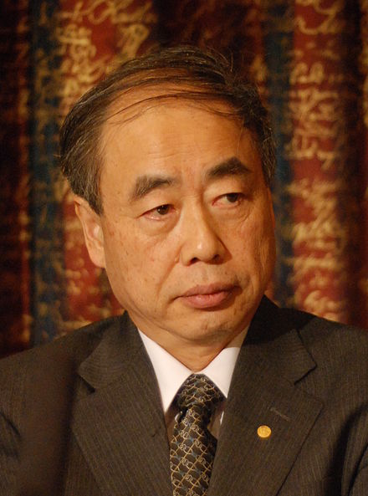
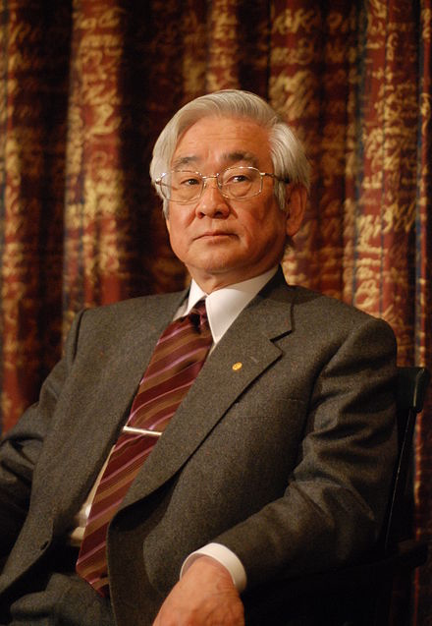
CP violation
In 1964, also CP violation found in kaon decays
  Nobel prize in 1980.
CP violation requires 3rd generation
  Nobel prize in 2008
... but effect way too small to explain
matter dominance in universe
Kobayashi
Maskawa
Notes:
3rd gen predicted in 1972 by KM. Observed in 1977.
10 orders missing to explain BAU.

Slide 13
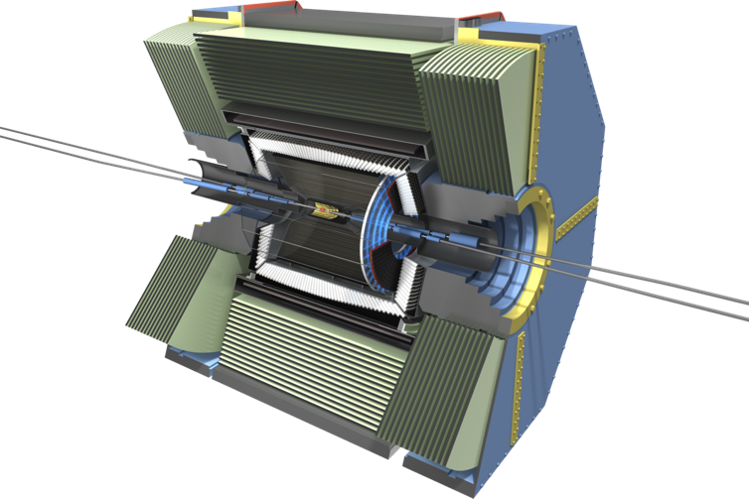
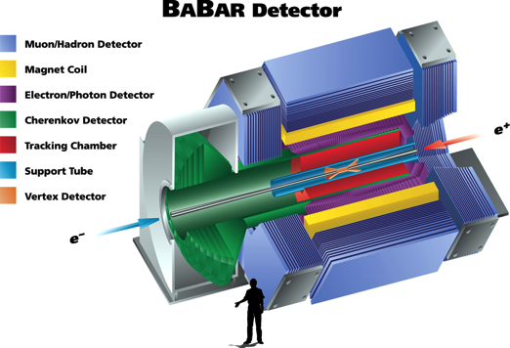
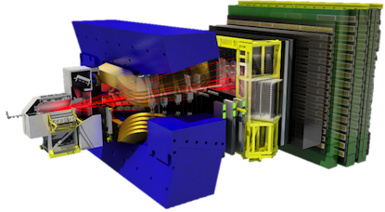
New physics?
Searches may reveal new sources of CP violation beyond the SM.
  Window to SUSY.
  Dedicated new experiments:
What about CPT violation?
  Window to quantum gravity?

Slide 14

CPT violation in mixing
CPT symmetry implies equal mass & lifetime of meson and antimeson
Mass eigenstates:
  CP violation (assuming CPT symmetry) → |q/p|≠1
  CPT violation (and CP violation) → z ≠ 0
Non-zero z modifies the decay rates.
Notes:
Complex parameter. Interferometic system sensitive to CPTV due to small Dm and DG.

Slide 15
Historical context
Since discovery of P and CP violation, CPT also questioned.
  Neutral mesons ideal test system (interference).
Many experimental searches for CPT violation in mesons
  KLOE, KTeV, CPLEAR, NA48, E773, FOCUS, BaBar, Belle
  Mostly in neutral kaon system
Most searches assume z to be constant of nature
(classical approach)
But…
  … CPT violation implies Lorentz-
  invariance breaking
[Greenberg, PRL 89 (2002)]

Slide 16
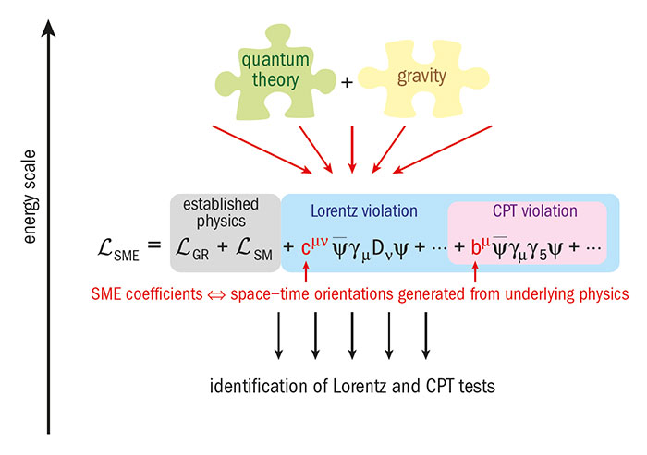
Standard Model Extension
Effective field theory
[Kostelecky, PRD55 (1997) 6760]
Low-energy relics from Planck-scale physics
E.g. spontaneous symmetry breaking of string theory operators
Notes:
In an interacting local QFT.
CPTV terms also LIV. But there are LIV terms that are CPT even.
SME adds all possible Lorentz-violating (and CPT-violating) terms to SM Lagrangian.
Underlying theory could be CPT and Lorentz invariant. Possible in string theory. (Weakly) broken at low energies.
CPT violation depends on particle direction and boost.

Slide 17
Standard Model Extension
[Kostelecky, PRD55 (1997) 6760]
Many terms. Example of SME term (quark sector, d=3)
Expected to be suppressed by m²/M_{Planck}
  M_{Planck}=2x10¹⁹ GeV
Many tests for LIV:
  Clock comparisons, Penning traps, spin-torsion balance, βdecay, neutrinos, cosmic rays, GW, etc.
Interferometry in neutral meson mixing sensitive to a_{μ}.
Notes:
In an interacting local QFT.
CPTV terms also LIV. But there are LIV terms that are CPT even.
Underlying theory could be CPT and Lorentz invariant. Possible in string theory. (Weakly) broken at low energies.
CPT violation depends on particle direction and boost.
D<=4 is mSME

Slide 18
Variation of z
In the SME, mass difference is not anymore constant:
Therefore z is not constant:
Experimental opportunity: measure SME coefficients
SME parameter
Real 4-vector vacuum expectation value.
Valence quarks have opposite a_{μ}
Four-velocity
z depends on momentum and direction in space!
Remember:
Notes:
- Four velocity is absolute in space
- Damu is vacuum expectation value. Measure Re(z)

Slide 19
SME coefficient
Δa_{μ} is the SME coefficient for neutral mesons
  Real-valued mass term and includes possible effects from quark binding.
A priori, Δa_{μ} can be different for each neutral meson (K⁰,D⁰,B_{d},B_{s}).
High sensitivity due to interferometry (small Δm and ΔΓ).
  E.g. in B_{s} system
Notes:
In an interacting local QFT.
Four velocity is absolute in space
Damu is vacuum expectation value. Measure Re(z)
For kaons Dm ~ 3e-15 GeV

Slide 20
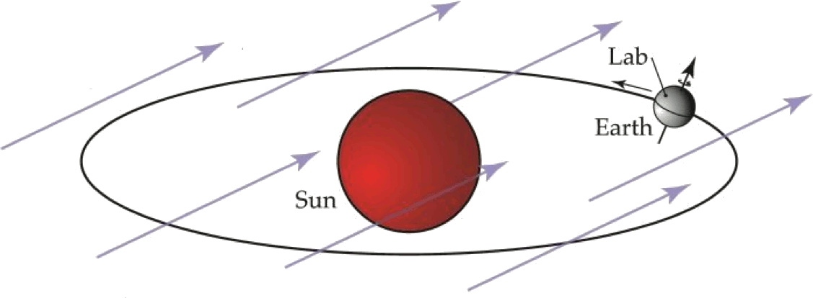
Background field
Δa_{μ}
If lab is fixed → sidereal dependence

Slide 21
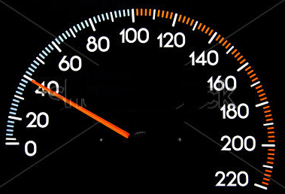
Sensitivity
CPT reach depends on orientation and boost of mesons.
High boost increases sensitivity
  BaBar: βγ = 0.55
  LHCb: <βγ> ≈ 20. → LHCb 40x more sensitive.

Slide 22
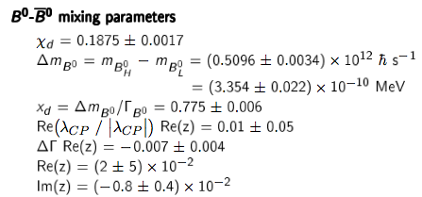
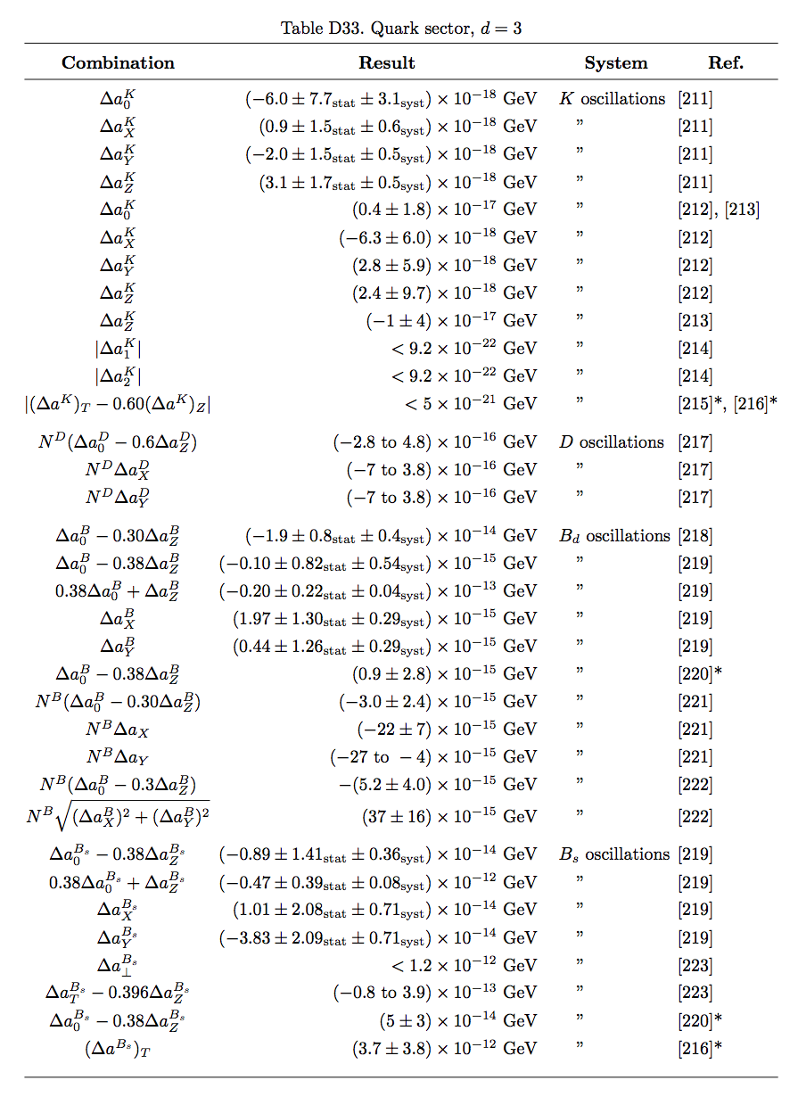
Data tables
PDG, [Chin. Phys. C40 (2016) 100001]
Kostelecky, Russel [Rev.Mod.Phys.83 (2011) 11]

Slide 23
Neutral kaons
K⁰ meson
PDG review (KLOE, KTeV, CPLEAR, NA48 data)
  Re(z)=(2.4±2.3)x10^{–4}, Im(z)=(–0.7±1.4)x10^{–5}
KLOE, [PLB 730 (2014) 89]
  Low boost (γ=0.015)
  Uncertainty on Δa_{μ}~2x10^{–18} GeV
E773, Kostelecky, [PRL 80 (1998) 1818] and [PRD 82 (2010) 101702(R)]
  High boost γ≈100
  Time-independent part |Δa_{T}–0.6Δa_{Z}| ≤ 5x10^{–21}GeV
KTeV, H. Nguyen, [CPT’01 proceedings]
  High boost γ=100
  Δa_{x,y}<9.2x10^{–22} GeV @ 90% CL (stat error)
Difficult to compete for LHCb
Notes:
Lower boost than KTeV (guess γ~40)
Bad lifetime acceptance (only about ~1 lifetime for downstream K_{s}).
Probably worse statistics…? Need to know origin from K_{s} (e.g from D⁰ or from φ)

Slide 24
Neutral charm
FOCUS, [PLB 556 (2003) 7]
  Uses D⁰→Kπ (35k events)
  Re(z)y – Im(z)x = (0.83±0.77)%
  SME analysis. High boost γ≈39
  Uncertainty Δa_{μ}~3x10^{–13} GeV
Prospects for LHCb:
  Similar boost (γ≈30), higher stats (50M events)
  Should be able to improve bounds by factor ~40
D⁰ meson

Slide 25
Neutral B⁰ mesons
PDG review and JvT & v.Veghel [PLB 742 (2015) 236]
  Based on BaBar, Belle data
  Ignoring direct CPV and CPTV for Re(z)
  Re(z)=(0.7±2.4)%, Im(z)=(–0.8±0.4)%
BaBar, [PRL 100 (2008) 131802]
  SME analysis on dilepton events
  Uncertainty on Δa_{μ}~(3–13)x10^{–13} GeV (SM value for ΔΓ/Δm)
BaBar, [PRD94 (2016) 011101] based on data [PRL 109 (2012) 211801]
  Direct CPTV included in fit
  Re(z)=(–6.5±3.1)%, Im(z)=(1.0±3.3)%
  Uncertainty on Δa_{μ}~1x10^{–14} GeV (from CPT’16 proceedings)
B⁰ meson
Notes:
New BaBar result measures KL and KS. And positive and “negative” decay times.

Slide 26
Neutral B_{s} mesons
D0 collaboration
  Dimuons, Kostelecky, v.Kooten [PRD 82 (2010) 101702(R)]
  Semileptonic D_{s} μ, D0 [PRL 115 (2015) 161601]
  Uncertainties on Δa_{μ}~O(10^{–13}) GeV
B_{s} meson

Slide 27
Overview limits on Δa_{μ}
10⁻²¹
10⁻²⁰
10⁻¹⁹
10⁻¹⁸
10⁻¹⁷
10⁻¹⁶
10⁻¹⁵
10⁻¹⁴
10⁻¹³
10⁻¹²
GeV
K⁰
D⁰
B⁰
B_{s}⁰

Slide 28
Recent LHCb paper

Slide 29
Flavour specific vs
CP eigenmodes
CPT-violating parameter:
SME constraint: Δa_{μ} is real
  ΔΓ small for B mesons: Re(z) ~400 larger than Im(z)

Slide 30
Flavour specific vs
CP eigenmodes
CPT-violating parameter:
SME constraint: Δa_{μ} is real
  ΔΓ small for B mesons: Re(z) ~400 larger than Im(z)
B-meson decays to flavour-specific states
  Sensitive to Im(z)
  E.g., semileptonic decays B_{d}→D⁻μ⁺ν
B-meson decays to CP eigenstates
  More sensitive to Re(z)
  E.g., B_{d}→J/ψ K_{S}, B_{s}→J/ψ φ

Slide 31
Decay rates
B_{d} system: B_{d}→J/ψ K_{S}
  B_{s} system: B_{s}→J/ψ φ
  More complicated
  See next slide…
B⁰ meson
B_{s} meson

Slide 32
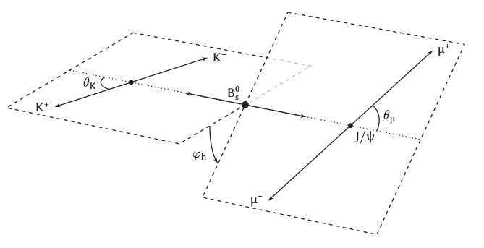

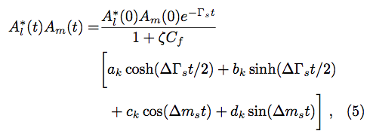
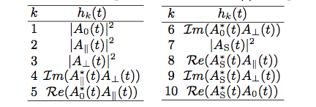
B_{s} decay rates
CP eigenvalue of final state
depends on decay angles.
Four “helicity” states → ten terms (including interferences)
Coefficients a_{k},b_{k},c_{k},d_{k} given in
[PRL 116 (2016) 241601]

Slide 33
Sun-centred frame
  Need to know flight direction of mesons in reference frame.
  Z-axis directed North, following rotation axis of Earth.
  X-axis points away from Sun towards vernal equinox.
  Y-axis complement RHS.

Slide 34
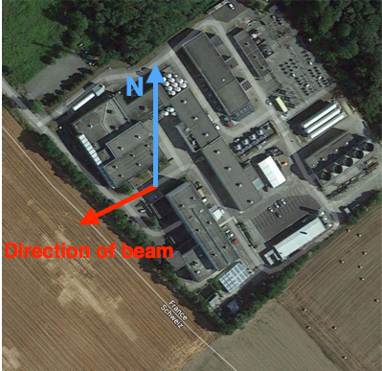
Location of LHCb
CERN survey used e.g. by Google maps
  LHCb located at IP8.
  Uses WGS84 reference frame
GPS coordinates
  Latitude (λ): 46’14’’29’’’
  Longitude: 6’5’’47’’’
    Uncertainty ~1.5 m (from ref frame)
Direction of beam
  Azimuth θ = 236’17’’44’’’
  Beam points upwards by 3.6 mrad
Angle beam w/ Earth rotational axis:
  cosχ≈ −0.38
Notes:
Sidereal dependence largest when experiment oriented East-West and/or when closer to the North Pole.
Sidereal dependence for LHCb close to maximal (sinX = 0.923)

Slide 35
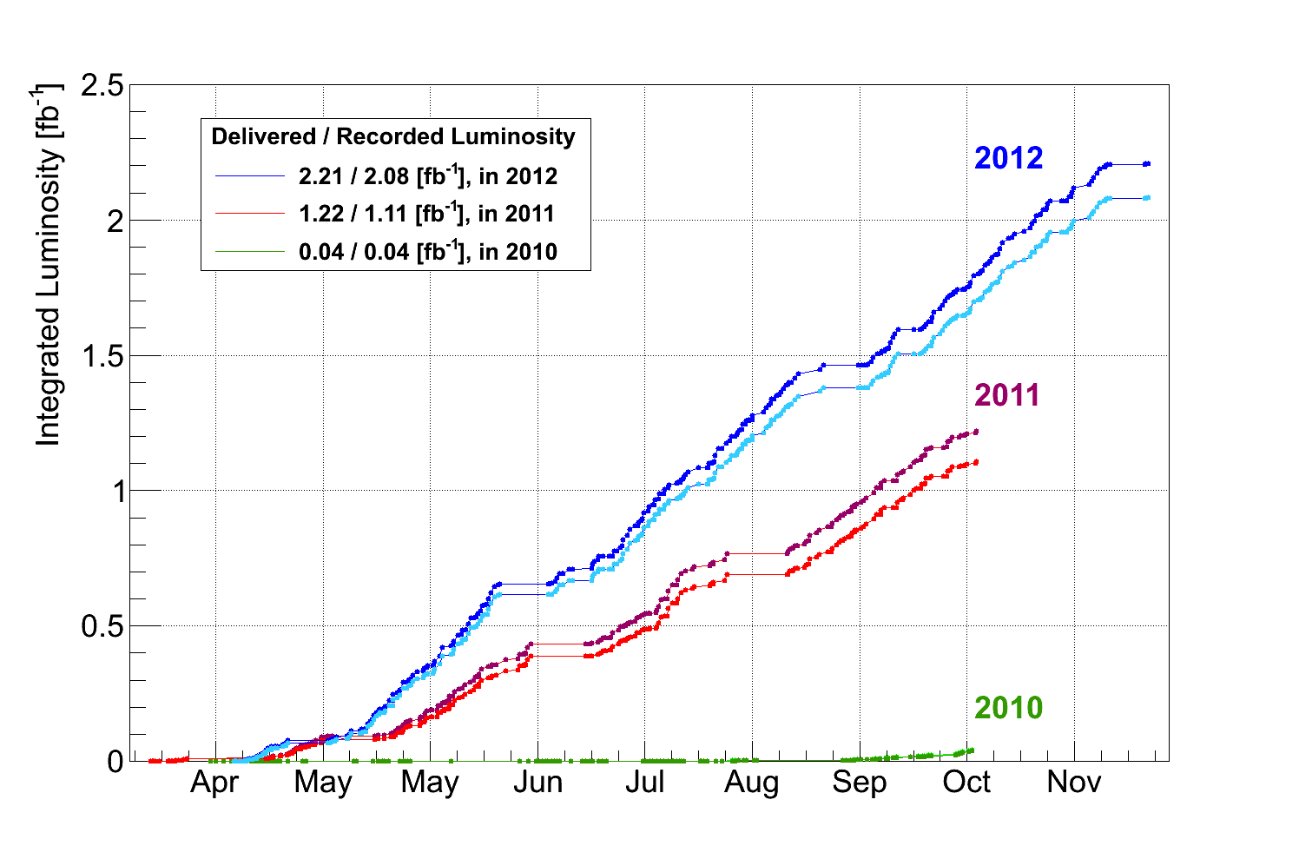
Data taking periods
→ Data well spread over 2 years
Notes:
A bit more data taken during the night, compared to day time → at night the LHC experts are sleeping.
No real effect on sensitivity.

Slide 36
Sidereal dependence
→
Notes:
No sidereal variation.

Slide 37
Sidereal dependence
→
High sensitivity from small Δm and B meson boost:
Angle of B meson with Earth rotational axis. B mesons mostly along beam:
cos(χ) ≈ −0.38
Sidereal frequency
Notes:
No sidereal variation.

Slide 38
Sidereal dependence
→
High sensitivity from small Δm and B meson boost.
Angle of B meson with Earth rotational axis. B mesons mostly along beam:
cos(χ) ≈ −0.38
Sidereal frequency
Main decay modes to CP eigenstates:
Full angular analysis!
Notes:
No sidereal variation.

Slide 39
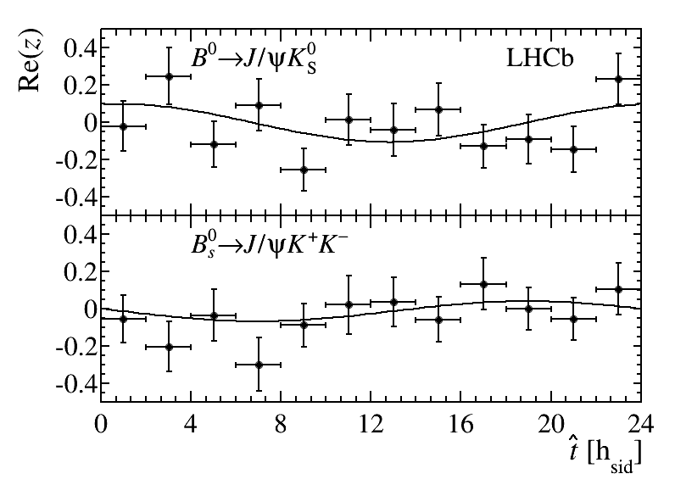
Sidereal dependence
→
[PRL 116 (2016) 241601]
High sensitivity from small Δm and B meson boost.
Angle of B meson with Earth rotational axis. B mesons mostly along beam:
cos(χ) ≈ −0.38
Sidereal frequency
Re(z) as function of sidereal phase
Main decay modes to CP eigenstates:
Full angular analysis!
Notes:
No sidereal variation.

Slide 40
Numerical results
B_{d} system (SME):
B_{s} system (SME):
B_{s} system: (no assumption on Lorentz breaking)
[PRL 116 (2016) 241601]
First measurement of z in B_{s} system
Consistent with CPT and Lorentz symmetry
Notes:
Mass difference below 1E-6 eV !

Slide 41
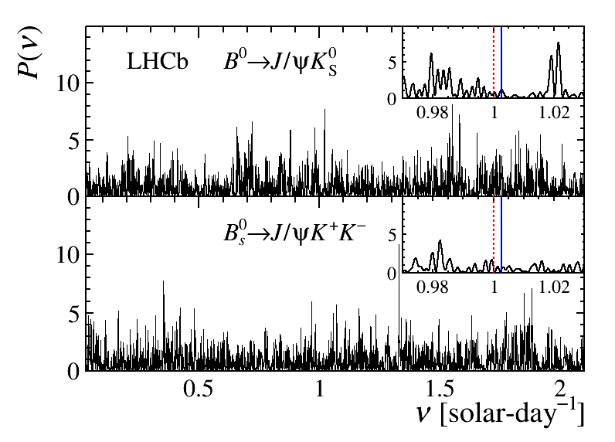
Periodogram test
[PRL 116 (2016) 241601]
Scan large frequency range (not only sidereal):
→ No significant peaks found at p-values of 0.57 and 0.06
Notes:
No sidereal dependence in CPT signal found: What if periodic behaviour is not sidereal?

Slide 42
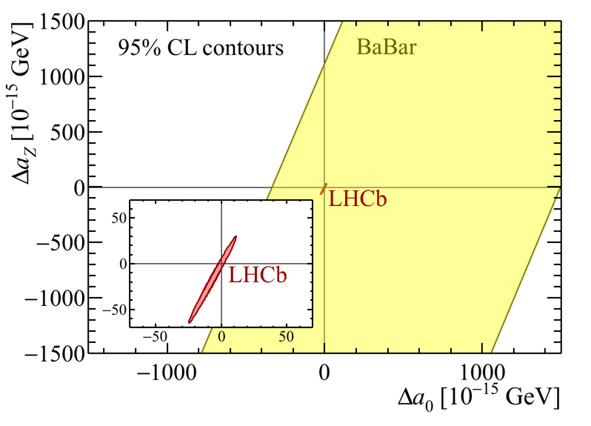
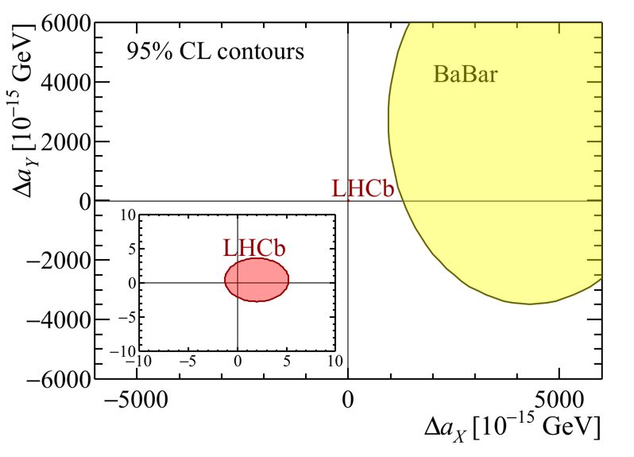
Comparison with BaBar
[PRL 100 (2008) 131802]
Boost BaBar: βγ = 0.5 (Cf. LHCb: 20)
BaBar used inclusive dilepton B decays
Used ΔΓ_{d} = 0.00261 (SM prediction) [arXiv:1511.09466]
Corresponds to Re(z) of O(2); |z|² terms cannot be ignored
LHCb O(10³) times more precise

Slide 43
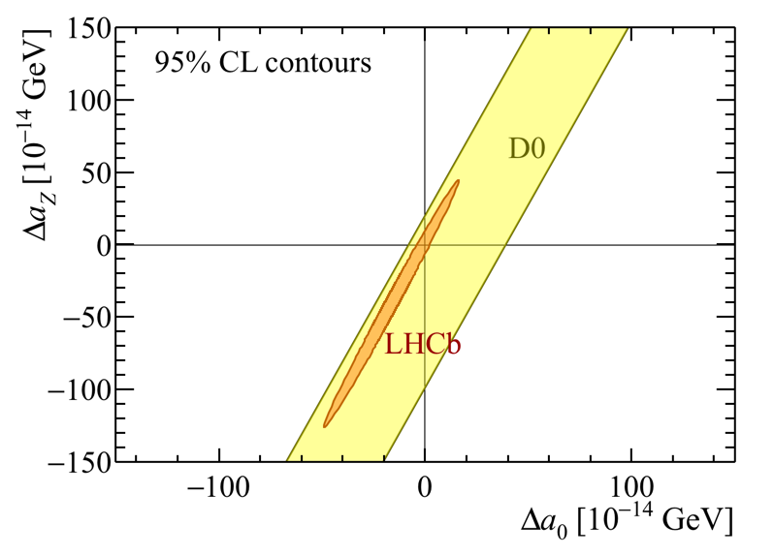
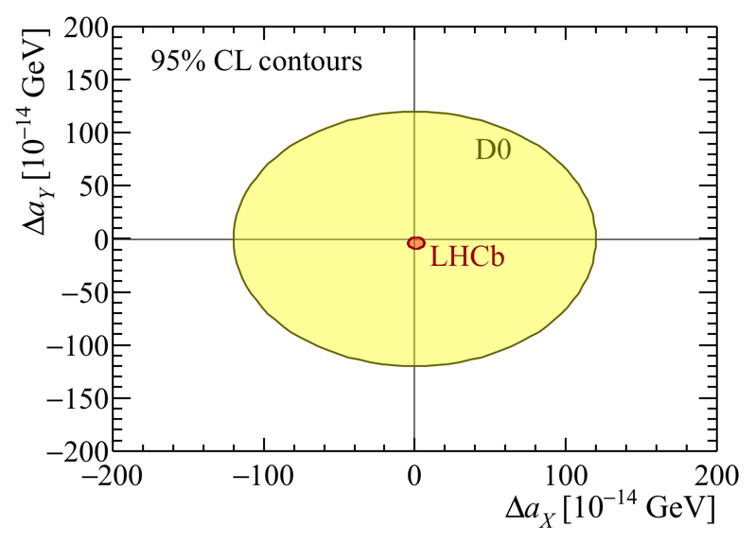
Comparison with D0
[PRL 115 (2015) 161601]
Boost at D0: βγ = 4.7 (Cf. LHCb: 20)
D0 used semileptonic B decays
LHCb O(10) times more precise

Slide 44
Overview
Before
10⁻²¹
10⁻²⁰
10⁻¹⁹
10⁻¹⁸
10⁻¹⁷
10⁻¹⁶
10⁻¹⁵
10⁻¹⁴
10⁻¹³
10⁻¹²
GeV
K⁰
D⁰
B⁰
B_{s}⁰

Slide 45
Overview
After LHCb measurements
10⁻²¹
10⁻²⁰
10⁻¹⁹
10⁻¹⁸
10⁻¹⁷
10⁻¹⁶
10⁻¹⁵
10⁻¹⁴
10⁻¹³
10⁻¹²
GeV
K⁰
D⁰
B⁰
B_{s}⁰

Slide 46
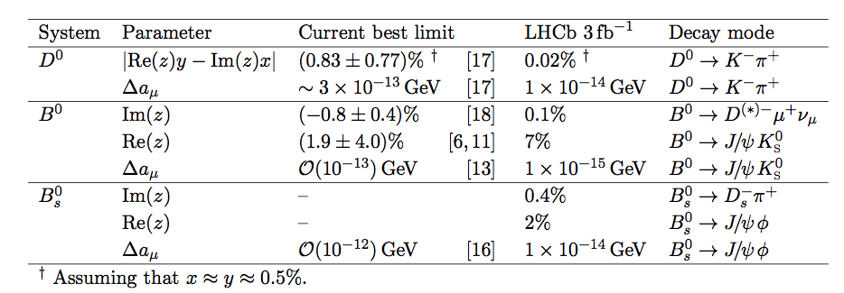
Outlook
Table from JvT & v.Veghel [PLB 742 (2015) 236]
Expected statistical sensitivities for LHCb Run 1 (3 fb⁻¹)

Slide 47
Outlook
Table from JvT & v.Veghel [PLB 742 (2015) 236]
Expected statistical sensitivities for LHCb Run 1 (3 fb⁻¹)
Covered by this measurement

Slide 48
Outlook
Table from JvT & v.Veghel [PLB 742 (2015) 236]
Expected statistical sensitivities for LHCb Run 1 (3 fb⁻¹)
Future measure-ments possible for LHCb & Belle II
Covered by this measurement

Slide 49
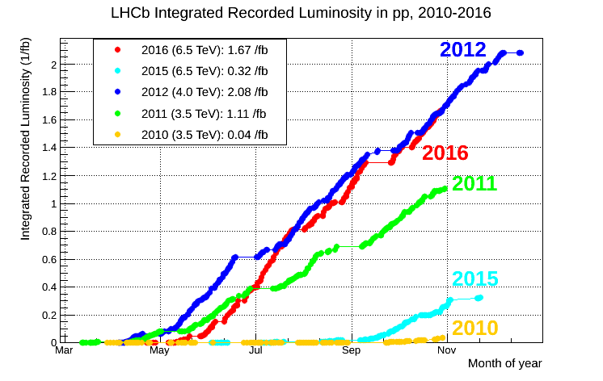
Outlook
Run 2 has just started
  Increase data sample by factor ~4
Higher collision energy in Run 2
(8 → 13 TeV)
→ Larger cross sections
→ Larger boost (+30%)
Upgrade (> 2019)
  Increase statistics by another factor 10

Slide 50
Other exotics that I did not talk about
Quantum decoherence at φ and Ψ(4S) resonances
Quantum decoherence for 1-particle states
Lorentz invariance in production of quarks (e.g. tt)
SME limits for beta decay.
And a lot more...
_

Slide 51
Conclusions
Interferometry with neutral mesons sensitive to CPT violation
  Strongest bounds in K⁰ system…
  … but effects may be enhanced in heavier systems
First LHCb results on CPT & Lorentz violation
  Improved limits SME parameters in B_{d} and B_{s} systems
  First measurements of z in B_{s} system
Future improvements
  Classical and SME analysis in D⁰ system
  Im(z) in B_{d} and B_{s} systems
  More data from LHCb and Belle II
[PRL 116 (2016) 241601]

Slide 52
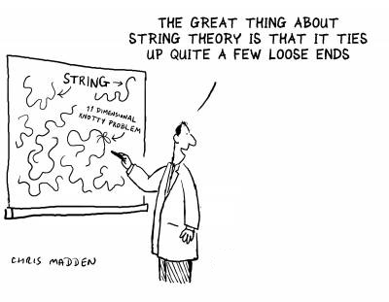
Backup slides

Slide 53
CPT and Lorentz symmetry
CPT violation implies Lorentz invariance breaking.
SME: EFT framework with CPT- & Lorentz-violating terms.
Experimental opportunity: measure SME parameters.
z depends on four-velocity
  i.e. on momentum and
  on direction in space
Δa_{μ} is real 4-vector vacuum
expectation value → z mostly real
[Greenberg, PRL 89 (2002)]
[Kostelecky, PRD55 (1997) 6760]
SME coefficient for neutral mesons
Δa_{μ}
Notes:
In an interacting local QFT.
Four velocity is absolute in space
Damu is vacuum expectation value. Measure Re(z)

Slide 54
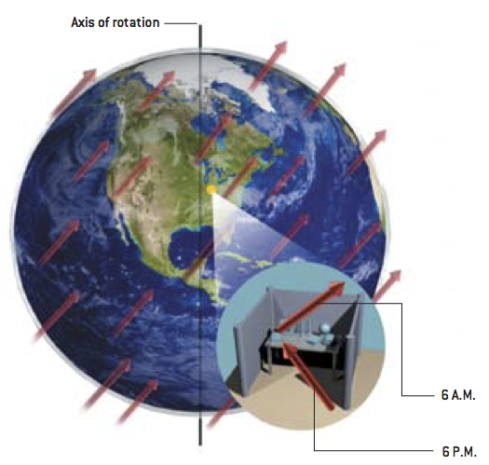
Background field

Slide 55
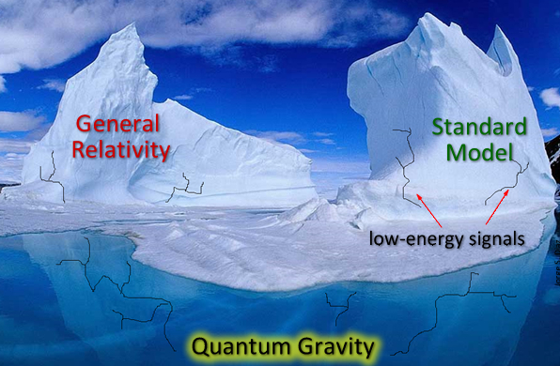
SME

