Slide 1

Report from
Collider & Particle Physics
Work-Package
Tetiana Berger-Hryn’ova
ENIGMASS Meeting
20/07/2017

Slide 2


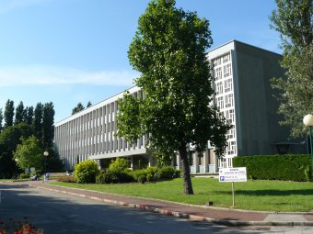

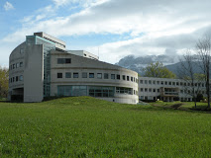

Main Axes
Theory:
Precision calculations
for SM and new physics
processes, model building,
development of tools for
interpretation of the
LHC results, new ideas
for searches &
experiments.
nEDM
*
LPSC
LAPTh
LAPP
*New for the ENIGMASS renewal

Slide 3
Highlights 2012-2017

Slide 4

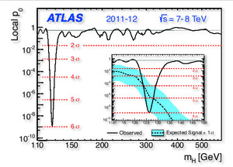
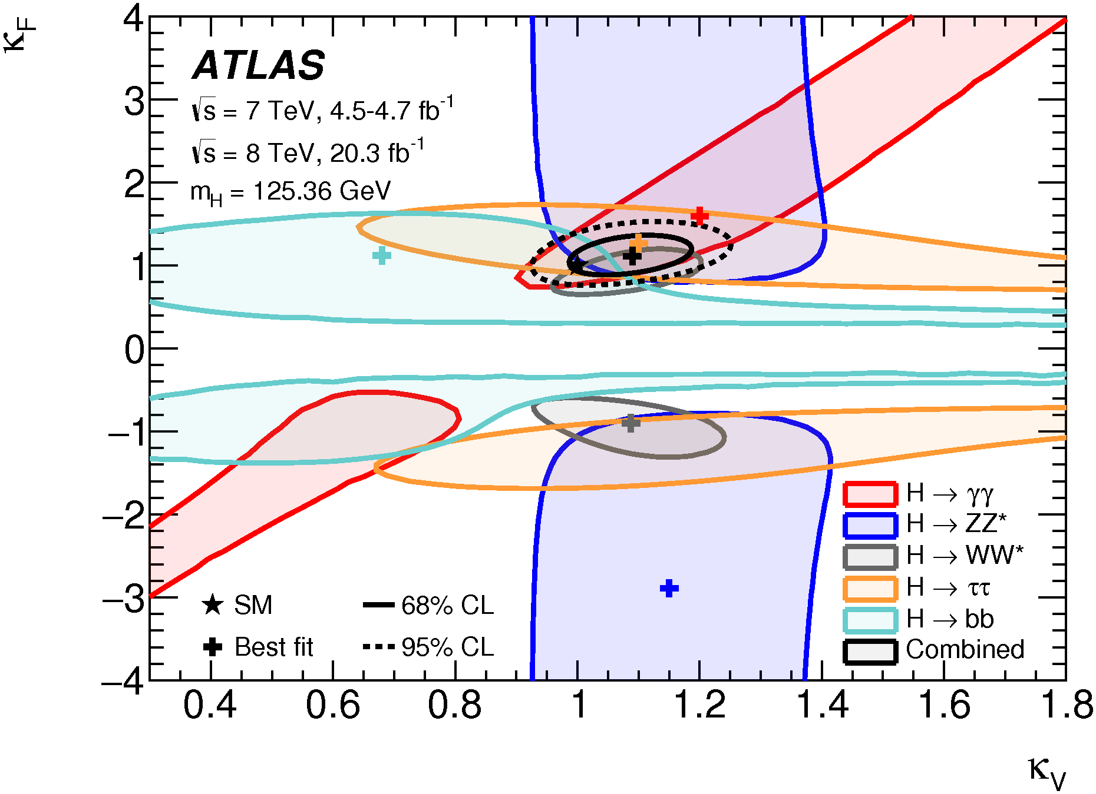
Higgs Discovery 2012 and beyond
Nobel Prize
(Physics) 2012
Eur. Phys. J. C76 (2016) 6

Slide 5
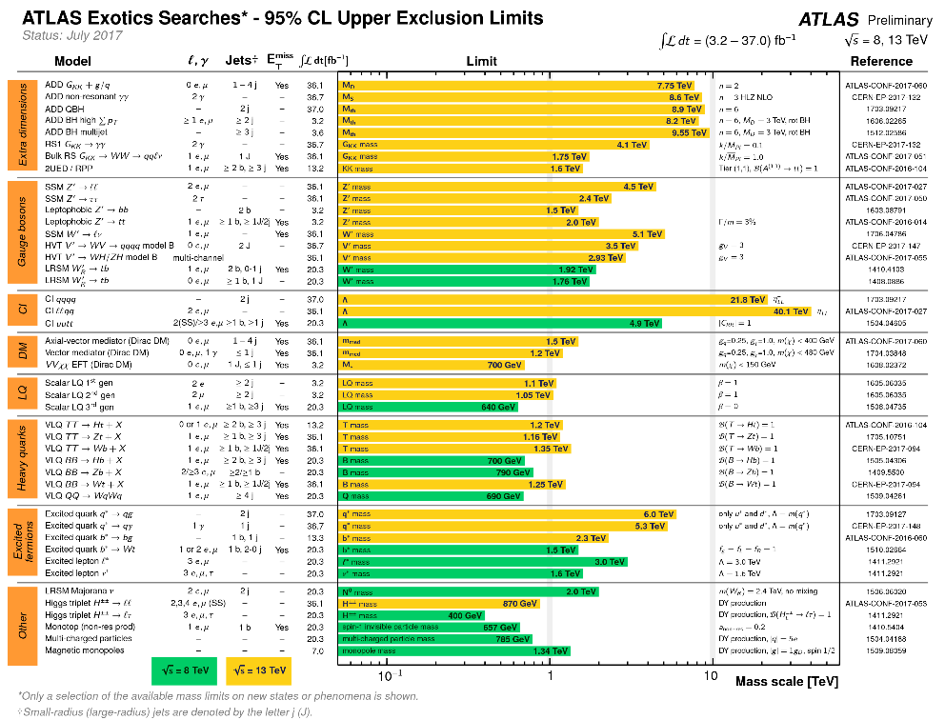
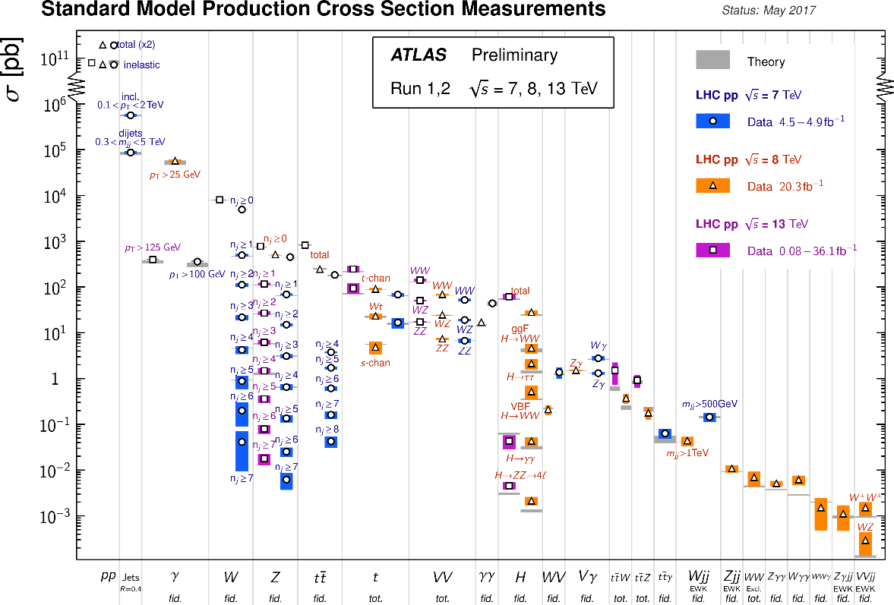
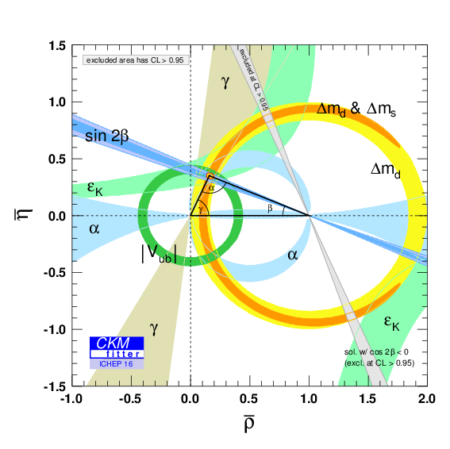
No New Physics @ LHC yet
Our searches:
γγ, γ+MET,
ll, tb, tt, etc...
Measurements:
WZ production,
top polarization,
Higgs
properties
CKM angles
(β, γ, φ_{s}); B→K*γ
etc..

Slide 6
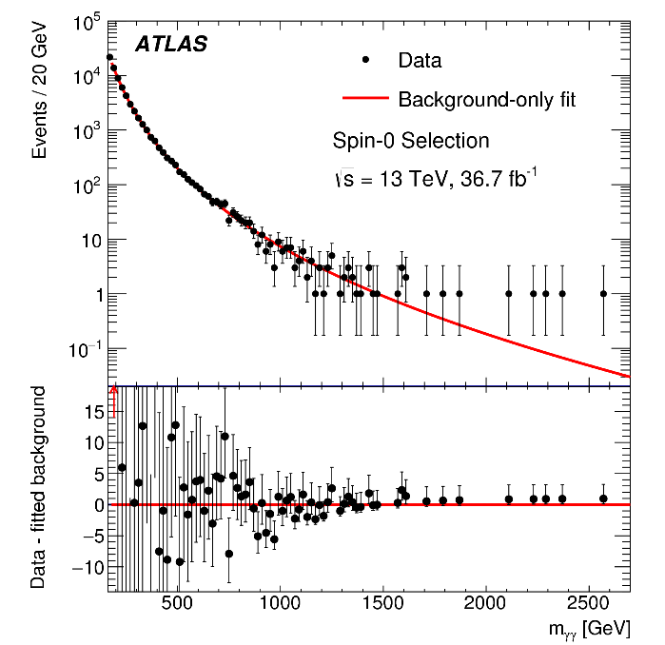
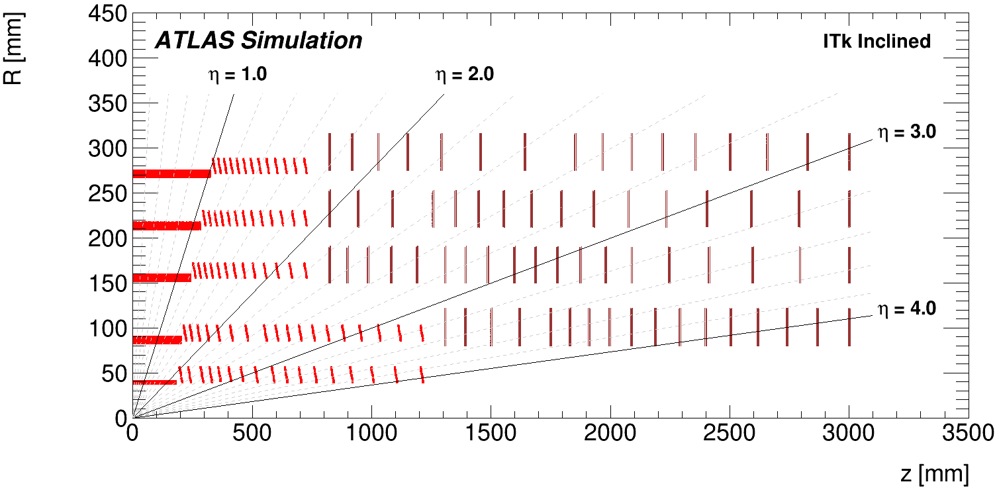
ENIGMASS Highlights Experiment
SM WZ
γγ: Higgs &
Exotics
PD:
E. Yatsenko
PhD:
Burger,
O. Dartsi
PD:O. Kivernyk
PhD:
K. Grevtsov,
Z. Barnovska
ATLAS Tracking Upgrade: Inclinded
Radiative B_{d,s} decays
PD: A. Bethami, B. Smart, N. Readioff,
A. Rummler + hardware
PhD: L. Beaucourt

Slide 7
ENIGMASS Highlights Theory
Constrain NP from measurements
Recasting Tools
Tools:
SmodelS
MadAnalysis5
Forums:
Interpretation
of the LHC results
for BSM studies
PhD: U. Laa
New Tool:
Lilith
PhD: J. Bernon
Higher Order Computations
New models: e.g. Composite Higgs
PD: C. Delaunay
PhD:
J. Proudom
Sgluon production @ LHC

Slide 8
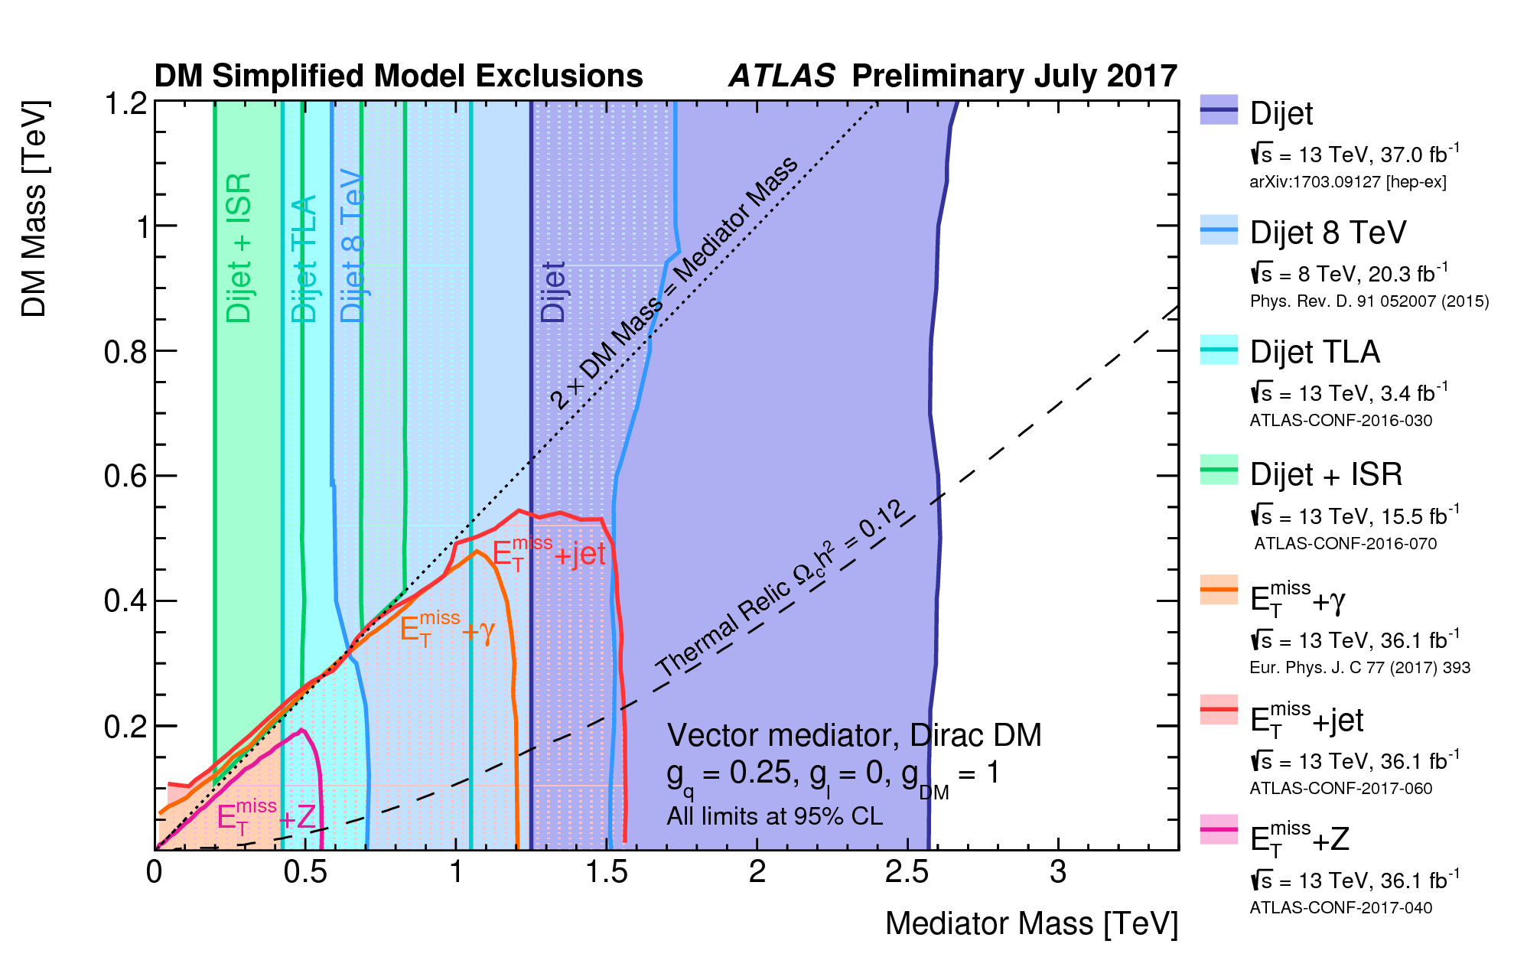
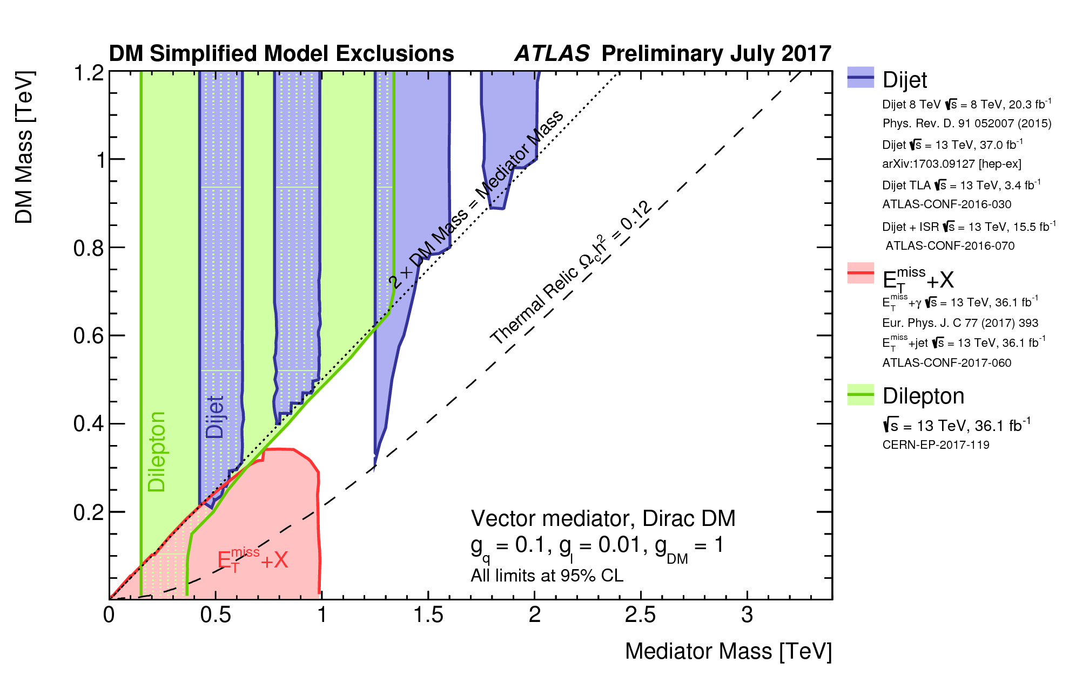
Theory-Experiment Example
Proposal in Dark Matter Working group (Sept 2016) by B. Zaldivar (PD ENIGMASS):
Dileptons
PD: P. Mastandrea
PhD: P. Falke
arXiv:1401.0221

Slide 9


Next 10 years
Search for any deviations from Standard Model predictions
Direct
observation:
In-direct
observation:
Our searches: γγ, γ+MET,
ll, tb, tt, etc.
Diboson measurements (VBS),
Double Higgs production,
Measurements of CKM angles,
Flavour anomalies,
Precision QCD...
LHC
Theory
Recasting of existing searches,
New theories, search proposals
Higher Precision Calculations,
EFT extensions of SM
Measurrement of neutron electric dipole moment,
Measurement of magnetic resonant transitions between neutron quantum
states in the gravity field, etc… Future collider experiments.
Non-LHC

Slide 10
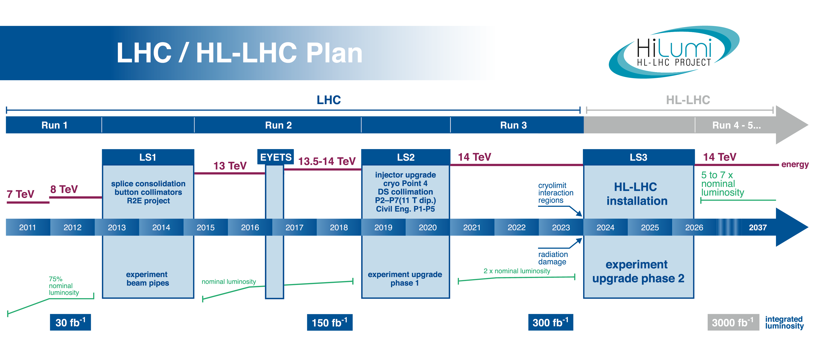
LHC Timeline
Upgrades:
ALICE Inner Tracking
ATLAS LAr Electronics
LHCb DAQ
Upgrades:
ATLAS LAr Electronics
& Inner Tracker
? LHCb Calorimeter ?
To Do

Slide 11
LHC Timeline
Upgrades:
ALICE Inner Tracking
ATLAS LAr Electronics
LHCb DAQ
Upgrades:
ATLAS LAr Electronics
& Inner Tracker
? LHCb Calorimeter ?
To Do
Operational Responsibilities: Calorimeters & related performance studies, Computing, etc.

Slide 12
LHC Timeline
 | ATLAS | LHCb | ALICE (HI)
2017 | 40fb⁻¹ | 5fb⁻¹ | 1nb⁻¹
2019 | 150fb⁻¹ | 8fb⁻¹
2024 | 300fb⁻¹ | 28fb⁻¹
2028 | 1000fb⁻¹ | 42fb⁻¹ | 10nb⁻¹

Slide 13
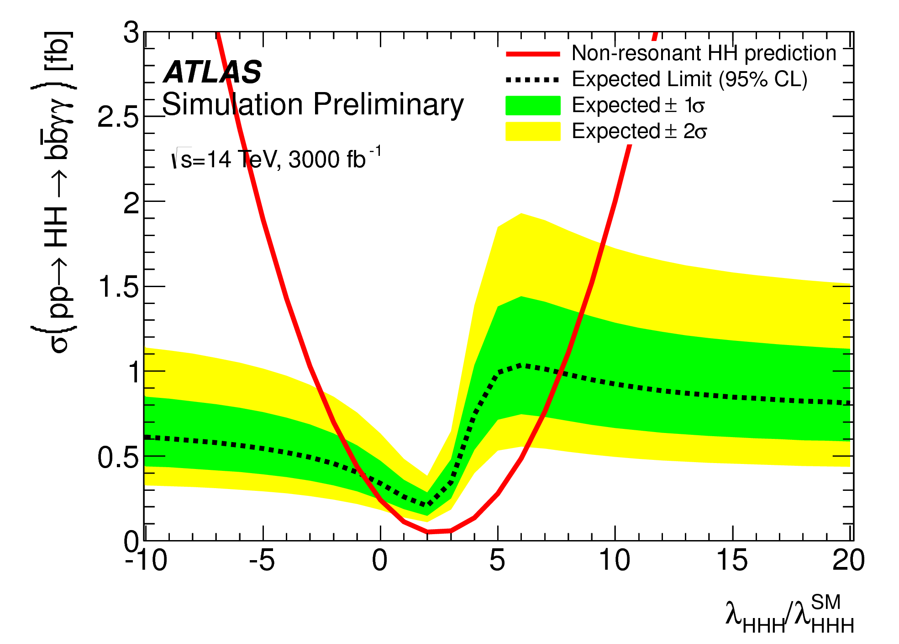
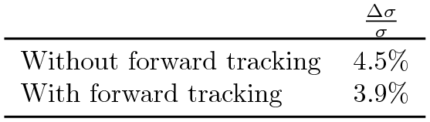
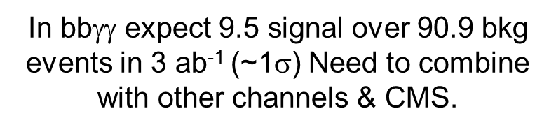
Probing Nature of EWSB: New@HL-LHC
VBS cross-section in longitudinal mode is sensitive to new physics. Crucial to check consistency
with SM predictions.
Double Higgs production: probes the shape of the scalar Higgs potential
Negative interference between HH
production with and w/o HHH vertex.
ATL-PHYS-PUB-2017-001
CERN-LHCC-2017-005
In bbγγ expect 9.5 signal over 90.9 bkg events in 3 ab⁻¹ (~1$$) Need to combine with other channels & CMS.

Slide 14
SM Effective Field Theory (EFT)
To Do
SM scale ~ v = 246 GeV, no BSM physics seen below Λ ~ 1 TeV
⇒parameterize the BSM using an EFT extension of the SM
Usually(*) leading effect from interference of d=6 and SM ~(v/Λ)² and can neglect d≥8 and |c^{(d=6)}|².
⇒ Report experimental constraints on the c_{i}, compare to model predictions
Straightforward to extend to higher orders in SM couplings
Many operators: 2499 for n_{gen}=3
  Higgs operators
  Other EW operators (TGCs)
  4-fermion operators (flavour measurements)
Measu-
rements
planned
Theory
predictions
are crucial.

Slide 15
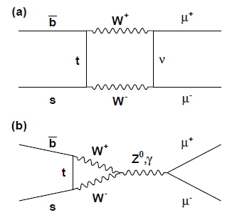
Flavour Anomalies
BR_{obs}(B_{s}→μμ)/BR_{SM}(B_{s}→μμ)=0.76^{+0.20}_{-0.17}
⇒ More precise measurement needed.
BR(B_{s}→μμγ) ~5 BR(B_{s}→μμ), not seen yet.
Also interesting to see B_{s}→eμγ.
LHCb reported 2-3 sigma anomalies in various
b→sll measurements (BRs, angular observables, ...) and in b→cτυ. FCNC sensitive to BSM contributions through the loops.
To Do
arXiv:1610.00629
Sign of New Physics? Stat Fluctuations?
QCD effects not fully accounted for?

Slide 16
Probing QCD with Quark Gluon Plasma (QGP)
  Study of QGP in Pb-Pb: new constraints on strong interaction
  Study of pp collisions: baseline for the QGP study and for comparisons with QCD calculations;
  p-Pb collisions: cold nuclear effect
  ALICE @ LPSC:
  Inclusive jets, jet-jet and photon-hadron/jet correlations measurements
  parton fragmentation related observables
  in-medium modification of parton energy loss and energy redistribution at ~ low p_{T}
  New b-tagging methods for heavy flavour identification in jets:
  → use to study quark flavor dependence of energy loss in QGP: test dead cone effect prediction
To Do
Notes:
16
Groupe Evaluation AERES 13-14 janvier 2011

Slide 17
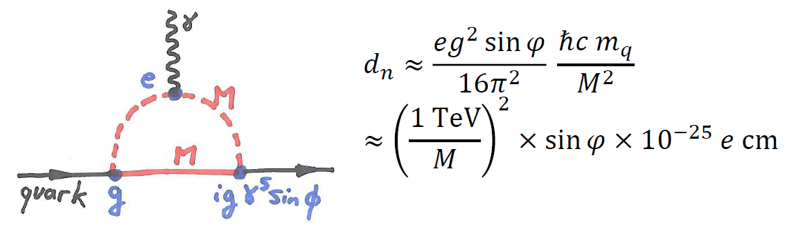

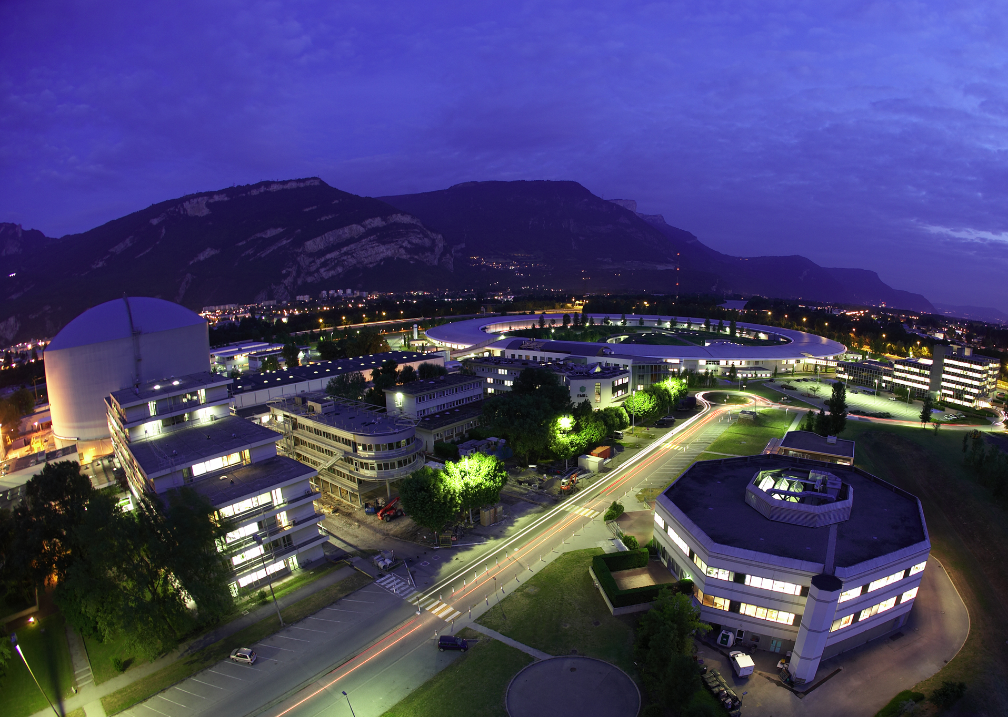
Beside LHC
GRANIT: Testing Gravity using neutron quantum bouncer
nEDM: Search for BSM CP violation mechanism
Unique test of weak equivalent principle
→ independent measurements of inertial and gravitational masses
Test of modified gravity and new short range interactions:
cosmological chameleon, symmetron...
Collaboration LPSC-ILL
Possible contribution from new physics: multi-TeV BSM sensitivity
→
Test of electroweak baryogenesis (requires also BSM scalar sector)
Timeline :
  2018 : publication slightly improved result / RAL-Sussex result : dn < 3. 10-26 e cm
  2017 – 2020: design/construction n2EDM spectrometer
  2020-2025: Data taking with n2EDM at the PSI UCN source → sdn ~ 10-27 e cm
LPSC contribution (ANR and ERC grants): Hg magnetometry, B mapping, UCN switch

Slide 18
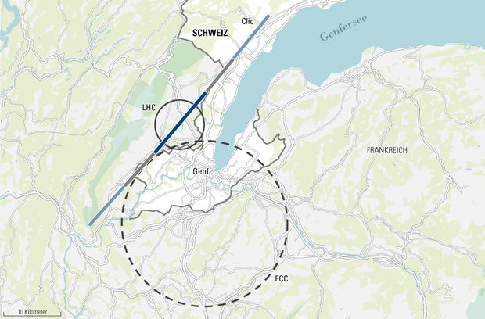
Beyond LHC: new colliders
Small ILC
groups @
LAPP & LPSC
Following
developments
on FCC,
CLIC and
ILC.

Slide 19
Overview of Research Teams
 | ALICE LPSC | ATLAS LAPP | ATLAS LPSC | ILC LAPP | ILC LPSC | nEDM/ GRANIT | LAPTh PP | LHCb LAPP | LPSC Theory
PERM PHYS | 5 | 13 | 11 | 2& | 1& | 3 | 9 | 8& | 4
PD | 0 | 6(4) | 1(1) | 0 | 0 | 1 | 2(1) | 1 | 2
PhD | 4 | 7(4) | 5 | 0 | 0 | 2 | 3^{x}*(1^{x}) | 1* | 4^{x} (1^{x})
& Not full time
x One shared LAPTh-LPSC
* One shared LAPTh-LHCb
() Currently funded by ENIGMASS

Slide 20
Backup

Slide 21
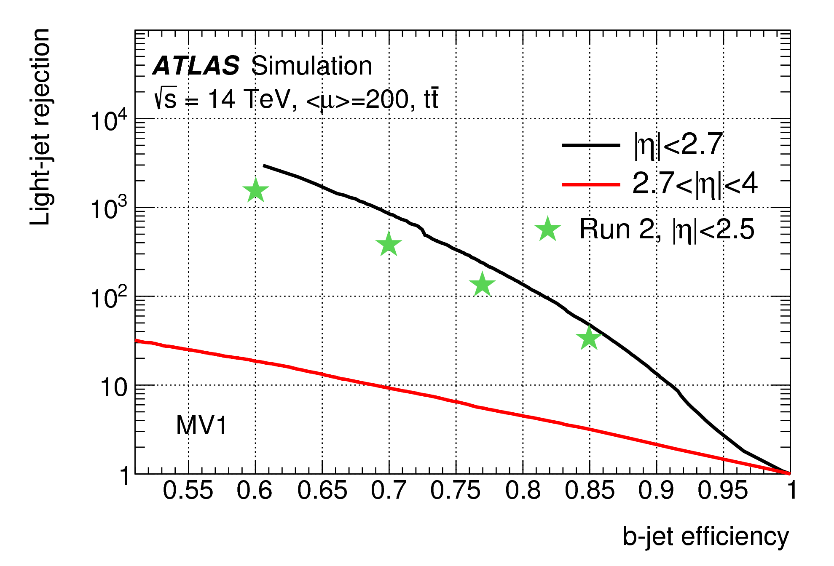
ATLAS Tracking Upgrade (2024-25)
Goals: improved tracking performance in higher pile-up & radiation environment
Inclined Layout
Idea initiated at LAPP:
less material, less silicone
LAPP & LPSC: Layout Simulation, Thermal & Mechanical tests, Electronics (Services),.. Future construction

Slide 22
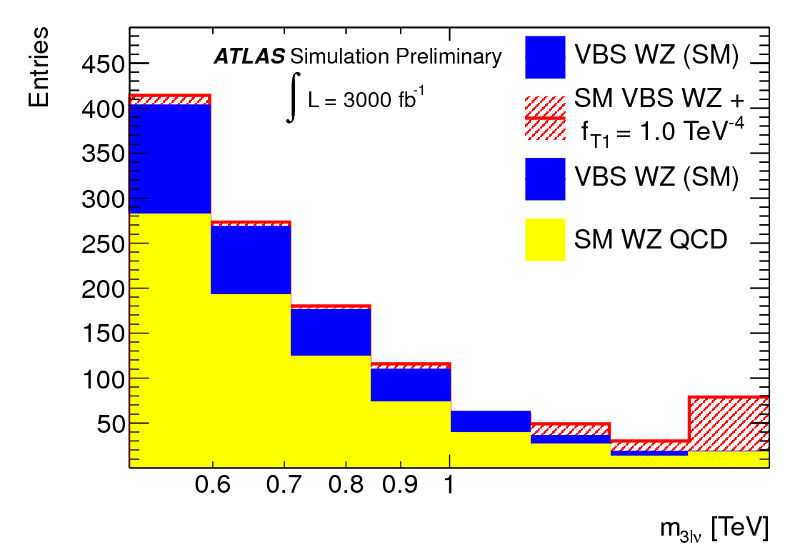
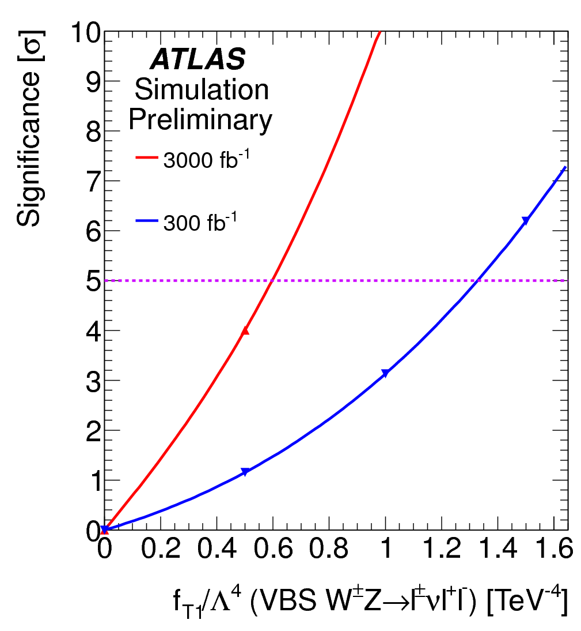
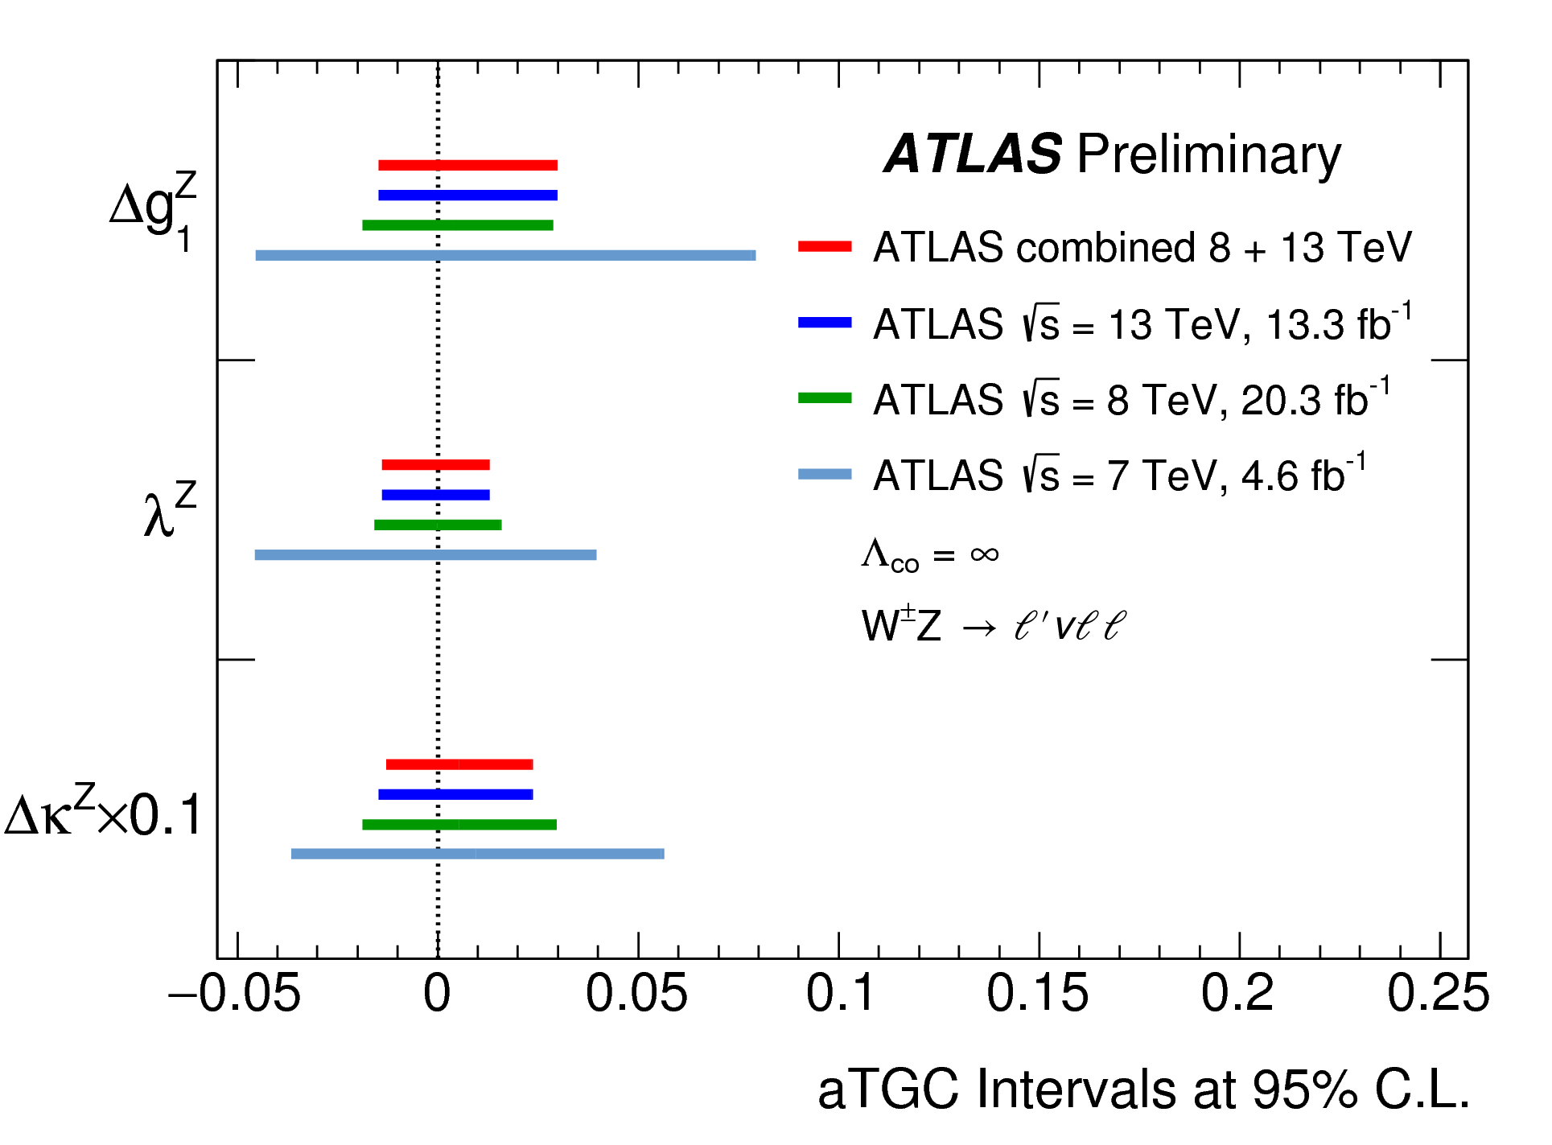
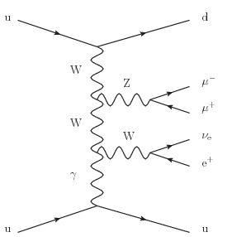
Dibosons to VBS
ATL-PHYS-PUB-2013-006
To Do
ATLAS-CONF-2016-043

Slide 23
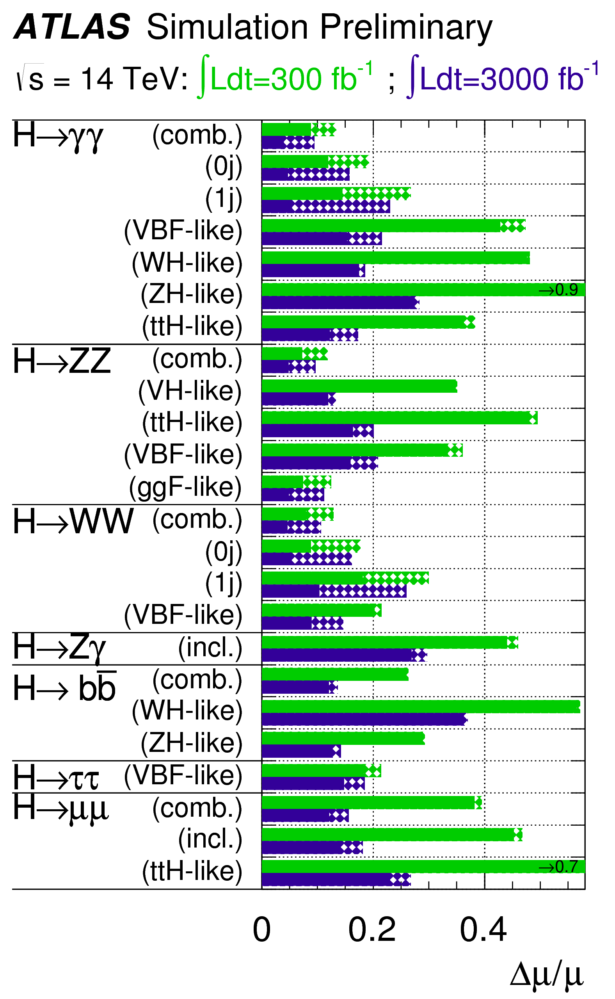
H→γγ couplings
ATLAS-CONF-2016-067
ATL-PHYS-PUB-2014-016
New ggF N3LO calculation
+3% change in σSM_{ggF}
QCD pert. uncert. 7.8% → 3.8%
PDF+α_{s} uncert.: ~7% → 3.2%
Experimental precision needs
to catch up with theory!
JHEP(2016)058
To Do
Old extrapolation.
Analyses improved.
Sizable theory uncertainties!
From N. Berger @ Dissecting the LHC results 2017

Slide 24
CKM angles
arXiv:1612.07233
To Do
Now (CKMFitter):
sin2β=0.691±0.017
γ =(72.2^{+5.3}_{-5.8})°
φ_{s}=-0.015±0.035rad
 | LHCb Uncertainty End of Run 4
β | 0.031°
γ | 0.9°
φ_{s} | 0.009 rad
Testing SM
predictions
Dalitz time-dependent
analysis for Run 2
Also B_{s}→J/ψη’(ρ⁰γ,ηπ⁺π⁻)

Slide 25
LHCb DAQ Upgrade (2019-20)
Goal: Remove Hardware Trigger
LAPP coordinates
firmware
development for
Prototype Readout
Board Used for
Event Building
Potential participation in the LHCb Calorimeter upgrade 2024-2025

Slide 26
ATLAS LAr Calorimeter Upgrade (2019-20)
Goal: increase calorimeter
hardware trigger
granularity and to do
digitisation at 40 MHz
LAPP developed a fast and dense processing
unit (E_{T} calculation, LHC
bunch crossing identification etc.)
LAPP coordinates firmware development
Coordination of
tests at CERN
ATLAS LAr Electronics upgrade 2024-2025: back-end & calibration card

Slide 27
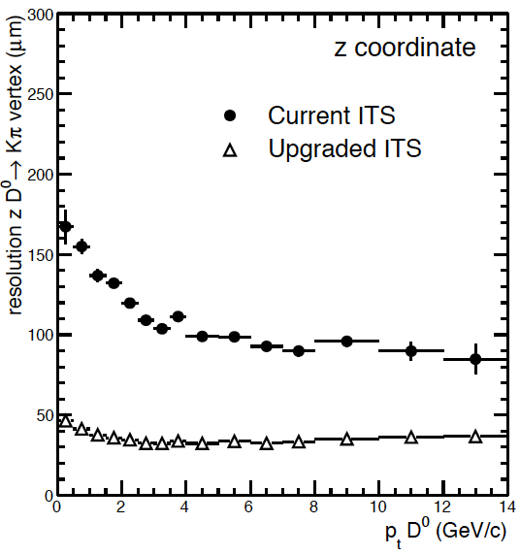
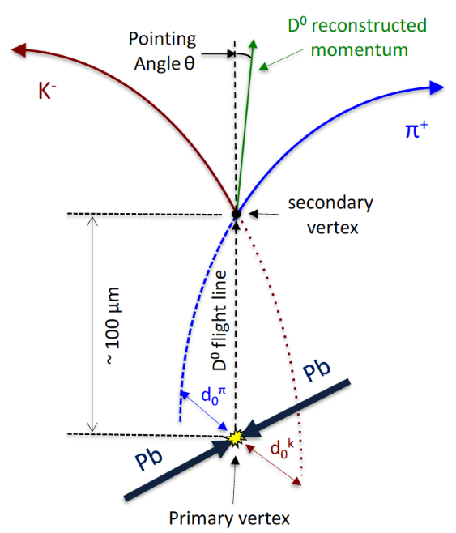
ALICE Tracking Upgrade (2019-20)
Goals: improve tracking performance
LPSC: Construction of manufacturing molds for staves.
Design and production of the Middle Barrel staves assembly tool.
Potential Synergy with ATLAS Tracking Upgrade in LPSC

Slide 28
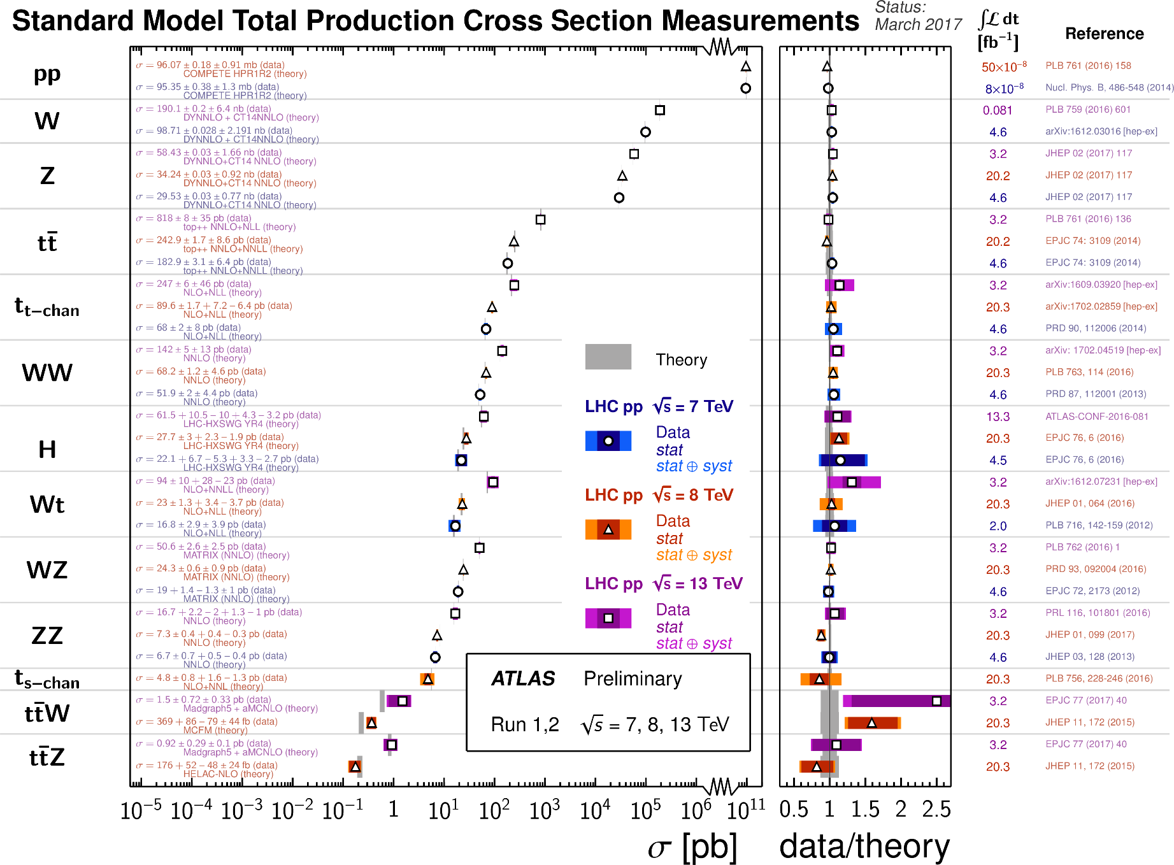
Indirect Searches = Measurements

Slide 29
LHCb anomalies (1)

Slide 30
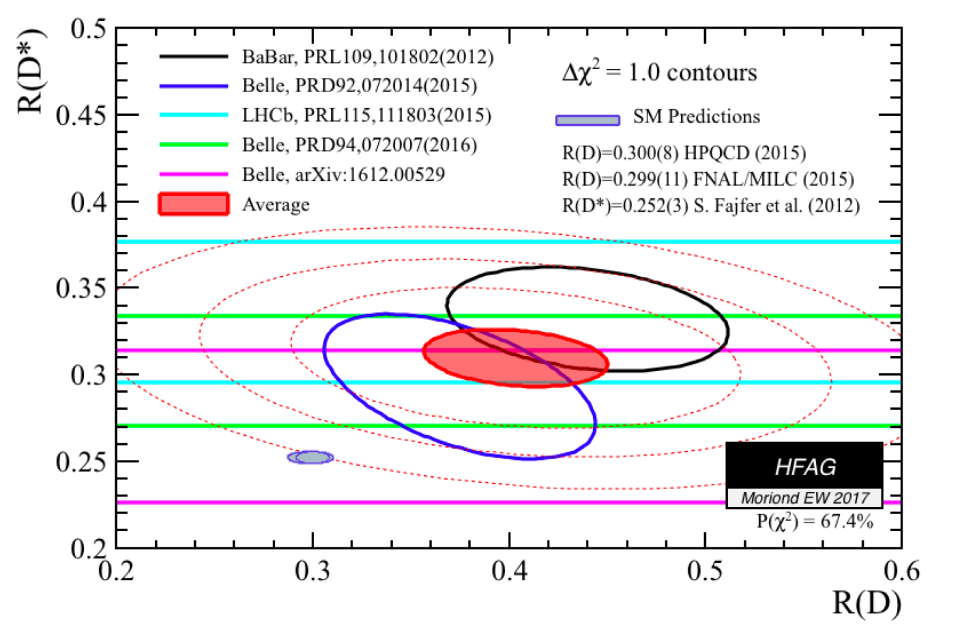
LHCb anomalies (2)

Slide 31
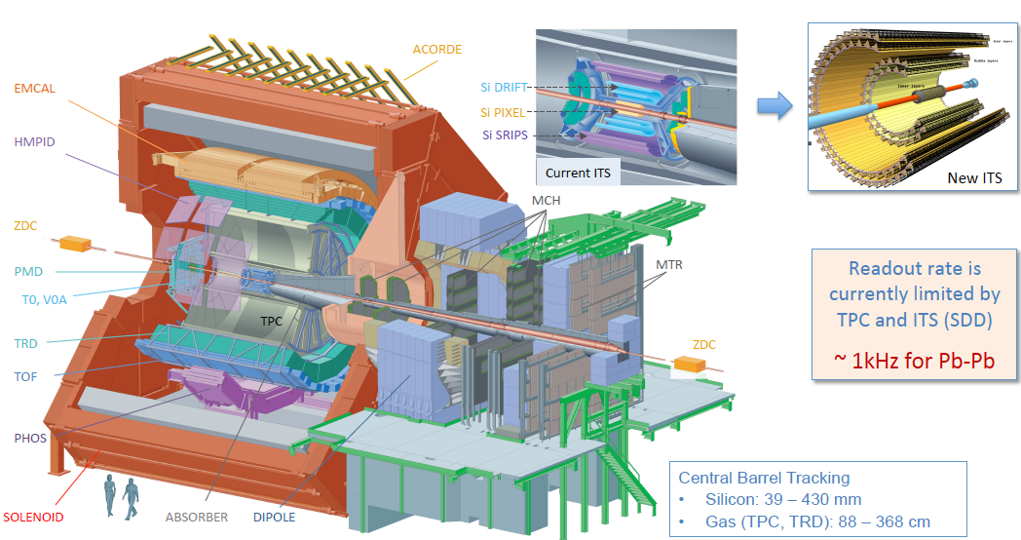
Upgrade d’ALICE run 3&4
  New electronics (TPC, TOF, TRD, Muon spectro…) + New DAQ & HLT (50 kHz Pb-Pb, O2 project)
  New detectors: Internal Tracking System and MFT (Muon Forward tracking)
Notes:
31
Groupe Evaluation AERES 13-14 janvier 2011

Slide 32
Quark Gluon Plasma & ALICE experiment
LPSC team:
  5 permanents : G. Conesa-Balbastre (CR), J. Faivre (MdC), C. Furget (PR), R. Guernane (CR), C. Silvestre (CR)
  4 PhD: A. Vauthier (UGA), H. Yokoyama (Tsukuba/UGA), R. Hosokawa (Tsukuba/UGA), H. Hassan (Liban/UGA)
Physics goals:
  Study of high density deconfined matter like QGP produced in Pb-Pb collision at LHC provides new constraints on strong interaction at the partonic level (95% of the nucleon mass).
  Study p-p collisions as a baseline for the QGP study and for comparisons with QCD calculations; study cold nuclear effect study in p-Pb collisions
  Favoured topics: study of parton energy loss in QGP through jets production and photon-hadron correlations
Technical involvement:
  Electromagnetic calorimeter: assembly, energy calibration, Level 1 trigger, reconstruction+analysis
Projects for run 3&4:
  ALICE upgrade during LS2: improve the tracking performance and increase the statistics by 10
  New jet observables, study of in-medium energy loss for heavy flavours and precise measurements of the parton energy loss through jet-jet and photon-hadron/jet correlations
Notes:
32
Groupe Evaluation AERES 13-14 janvier 2011

