Slide 1


Ultra-Scalable
Full SQL Full ACID
Operational & Analytical Database
Ricardo Jimenez-Peris
LeanXcale
CEO & Founder

Slide 2
LeanXcale
New database vendor
Result of leading edge research in:
Scalable transactional management
Scalable data management
Storage management
Elasticity
High availability
Currently working with several big companies in the following verticals:
Banking
Telecommunications
Retail
Travel technology

Slide 3
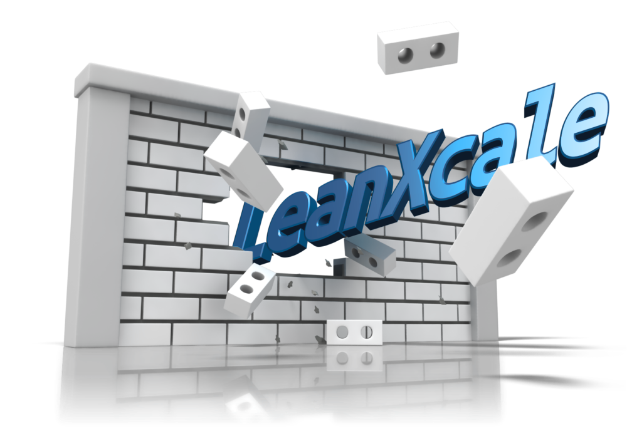
Ultra-Scalable Transactions
Solved how to scale transactions to large scale (i.e. 100 million update transactions per second) in a fully seamless way
Breakthrough result of
15+ years of research
by a tenacious team
Notes:
What is unique about our offering?
We have solved a core problem in cloud data management: how to scale full ACID transactions.
We have achieved this scalability in a totally seamless and transparent way to applications.
We can scale to a million update transactions per second.
Result of a our whole scientific careers devoted to this topic and yes, being lucky.

Slide 4
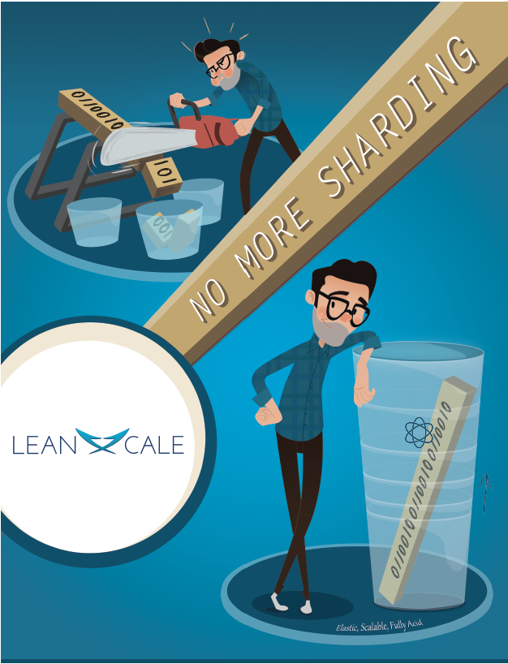
Problem: Lack of Scalable SQL Databases
Mainframe → expensive licensing/HW
Alternatives:
Mainframe → expensive licensing/HW
Sharding → expensive development
---------------------------------------------------------
Solution: Ultra-Scalable SQL
New generation database:
Ultra-Scalable → to 100s of nodes
Full SQL → simplicity
Full ACID → transactional consistency
No Sharding → fully transparent to the applications
Can replace mainframes

Slide 5
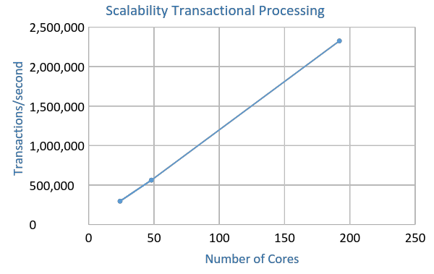
Scalability
2.35 Million
transactions
per second
Evaluation without data manager/logging to see
how much throughput can attain
the transactional processing

Slide 6
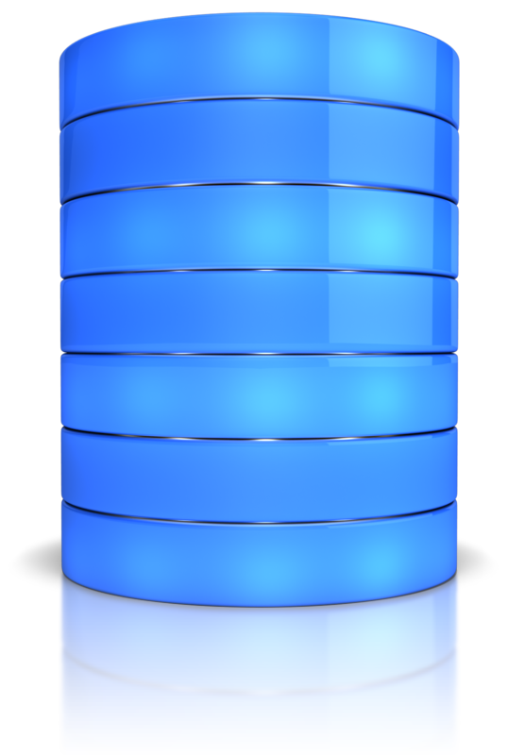
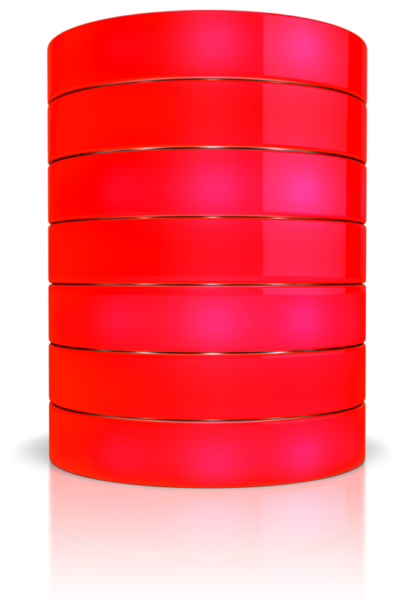
Operational DB
Data Warehouse
Copy Process (ETL)
Costs of ETLs represent 75% of business analytics
Analytical queries on obsolete data

Slide 7

Blending OLTP & OLAP
Making Decisions at the Right Time
Analytical Queries
on Operational Data
OLTP
OLAP
Operational Database
Data Warehouse
OLTP + OLAP
Cutting costs of business analytics by 75%
Real-time Analytical Queries
No more ETLs

Slide 8
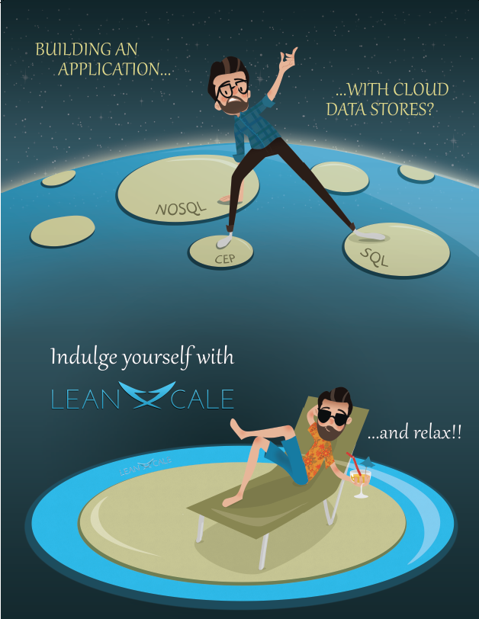
Problem: Polyglot World
Lack of queries and transactions across data stores
Lack of consistency guarantees within NoSQL data stores
---------------------------------------------------------
Solution: Transactional NoSQL & Global Transactions
Queries across data stores → SQL, Neo4J, MongoDB, HBase
Full ACID HBase
Full ACID Neo4J (prototype with MVCC)
Full ACID MongoDB (prototype)

Slide 9

Problem: Cost of Hadoop
Programmatic queries (MR) or subsets of SQL (Hive, Impala)
Queries do not observe operational data
ETLs required every time
---------------------------------------------------------
Solution: Operational Data Lake
Supporting queries across Hadoop data lake and customer operational data

Slide 10
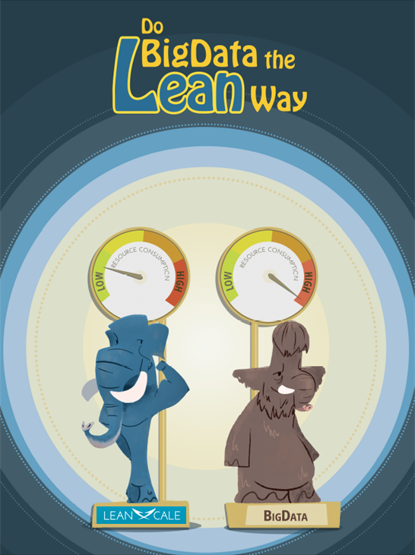
LeanXcale’s
KiVi Storage Engine
KiVi is a new storage engine from LeanXcale that is:
Multi-Workload.
Vectorial.
Ultra-efficient.
Columnar.
Fully elastic
Dual SQL and KV interface over relational data.
Online aggregation.
Inexpensive replication.
Efficient distributed indexing.
Efficient multi-versioning.
Notes:
Another pain in current enterprise is that despite they use scalable technologies (such as map-reduce) the footprint is very big. An example is Google spanner that scales but it requires more than 1 core per tps. LeanXcale is able to do 10-20 times more efficiently!!

Slide 11

Architecture
OLTP & OLAP
Query Engine
SQL Engine
Ultra-Scalable
Transactions
Transaction Mng
KiVi Key-Value Data Store
Storage

Slide 12

What is LeanXcale?
Ultra-Scalable OLTP
OLAP over
Operational Data
Full SQL Full ACID DB
Real-Time Big Data
Polyglot
Elastic & Ultra-Efficient
Queries across SQL, HBase, MongoDB, Neo4J & Hadoop files
Integration with Data Streaming
Non-disruptive data migration, continuous load balancing and
An Ultra-Scalable SQL Database for Any Size and Any Workload
Notes:
LeanXcale is the medicine for most common pains enterprises face today to manage DBs.
It has four active components: OLTP, OLAP, polyglot integration, and Elasticity and Ultra-Efficiency.
All with ultra-scalability vitamins.

Slide 13



What is the Magic?

Slide 14




Transactional Processing
The transactional management provides ultra-scalability
+
Fully transparent:
No sharding.
No required a priori knowledge about rows to be accessed.
Syntactically: no changes required in the application.
Semantically: equivalent behavior to a centralized system.
+
Provides Snapshot Isolation
(the isolation level provided by Oracle when set to “Serializable” isolation).

Slide 15





Ultra-Scalable Transactions
LeanXcale
Process &
commits
transactions
in parallel
Traditional systems
have a single-node bottleneck
Provides a consistent
view
vs
Time
Time
Traditional
transactional DB
Notes:
Traditional and current solutions at some point they do some part of the transactional processing one per one txn basis, resulting in a single node bottleneck.
LeanXcale processes and commits txns fully in parallel. We regulate the visibility of updated data to provide a consistent view.
We are like the Iguazu falls, 3.5 km of falls.

Slide 16
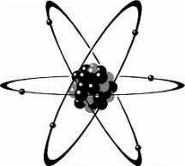
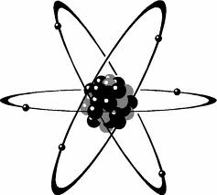
Snapshot Isolation vs. Serializability
Serializability provides a fully atomic view of a transaction, reads and writes happen atomically at a single point in time
Reads & Writes
Snapshot isolation splits atomicity in two points one at the beginning of the transaction where all reads happen and one at the end of the transaction where all writes happen
Reads
Writes
Start
End

Slide 17
Traditional Approach
Centralized Transaction Manager
Atomicity
Isolation
Central TM
Consistency
Durability
Single-node bottleneck

Slide 18
Traditional Approach
Centralized Transaction Manager
Atomicity
Isolation
Writes
Central TM
Isolation
Reads
Durability
Single-node bottleneck

Slide 19
Scaling ACID Properties
Atomicity
Isolation
Writes
Atomicity
Atomicity
Isolation
Reads
Durability

Slide 20






Scaling ACID Properties
Local
TMs
Conflict
Managers
Atomicity
Isolation
Writes
Isolation
Reads
Durability
Snapshot Server
Commit Sequencer
Loggers

Slide 21




Main Principles
Separation of commit from the visibility of committed data
Proactive pre-assignment of commit timestamps to committing transactions
Detection and resolution of conflicts before commit
Transactions can commit in parallel due to:
They do not conflict
They have their commit timestamp already assigned that will determine its serialization order
Visibility is regulated separately to guarantee the reading of fully consistent states

Slide 22



Transactional Life Cycle: Start
Current consistent
snapshot
Snapshot
Server
The local txn mng gets the “start TS” from the snapshot server.
Get start TS
Local Txn
Manager

Slide 23

Transactional Life Cycle: Execution
The transaction will read the state as of “start TS”.
Write-write conflicts are detected by conflict managers on the fly.
Conflict
Manager
Run on start TS snapshot
Get start TS
Local Txn
Manager

Slide 24
Transactional Life Cycle: Commit
The local transaction manager orchestrates the commit.
Commit
Run on start TS snapshot
Get start TS
Local Txn
Manager

Slide 25



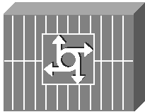
Transactional Life Cycle: Commit
Local Txn
Manager
Get Commit TS
Log
Public Updates
Report
Snaps Serv
writeset
Commit TS
writeset
Commit TS
Snapshot
Server
Data Store
Logger
Commit
Sequencer

Slide 26
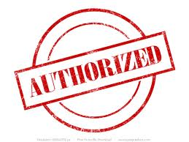
Transactional Life Cycle: Commit
Sequence of timestamps received by the Snapshot Server
TIMESTAMP 11
TIMESTAMP 15
TIMESTAMP 12
TIMESTAMP 14
TIMESTAMP 13
11
15
12
14
13
Time
Evolution of the current snapshot at the Snapshot Server
TIMESTAMP 11
TIMESTAMP 11
TIMESTAMP 12
TIMESTAMP 12
TIMESTAMP 15
11
11
12
12
15

Slide 27
Conclusions
Transactional management not a bottleneck anymore. We can scale to many million of transactions per second.
Combining multiple capabilities in a single database system, such as OLTP and OLAP, is what we believe it is the future of database management.
We are working in this direction.

Slide 28
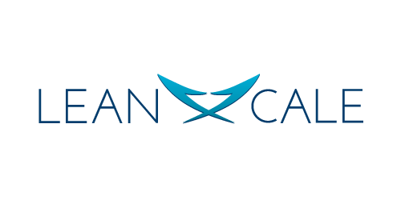

Ricardo Jimenez-Peris
LeanXcale CEO & Co-Founder
rjimenez@leanxcale.com
www.LeanXcale.com
@LeanXcale

