Slide 1
CMOS Pixel Sensors
Applications - imaging devices
Maciej Kachel
9 May 2017 - FJPPL satellite meeting
Motivation
Depletion in MAPS
Examples of applications at IPHC
Problems to overcome and future plans

Slide 2
Motivation – MAPS for Imaging Devices
CCD
Monolithic Sensor
(ex: MAPS)
Hybrid Pixel Sensor
Detector
Readout &
Processing Cell
Sensitive Volume
Pixel detector
Small pixel pitch
Wide energy range
Low noise (cooling)
No single particle image
Limited counting rate
Single particle counting
Small pixel pitch
  Low noise
Low cost
Moderate counting rate
Single particle counting
High counting rate
Noise impacted by detector connection
High cost
  Bonding
  detector
Notes:
particles= photon, proton, electron, alpha..
Single particle counting – provides more information – augmented imaging – filterout energy improve resolution – filter-out the noise !! Especially

Slide 3
Depletion in MAPS
Principle
Undepleted MAPS
Depleted MAPS
Pros:
Collecting diode DC coupled (~1.0V)
Simple readout architecture (3T possible)
Cons:
Small depletion volume
Charge collection by drift and diffusion
Pros:
AC coupled diode -> HV possible
Depletion: Charge collection by drift
(fast, small clusters)
Cons:
Biasing from top -> diode reset difficult
Motivation for having depleted sensors:
Larger depleted volume -> Increased signal
Drift -> Faster charge collection -> less prone to radiation damage
  -> Small clusters -> Larger pixels possible (but within spatial resol. spect)

Slide 4
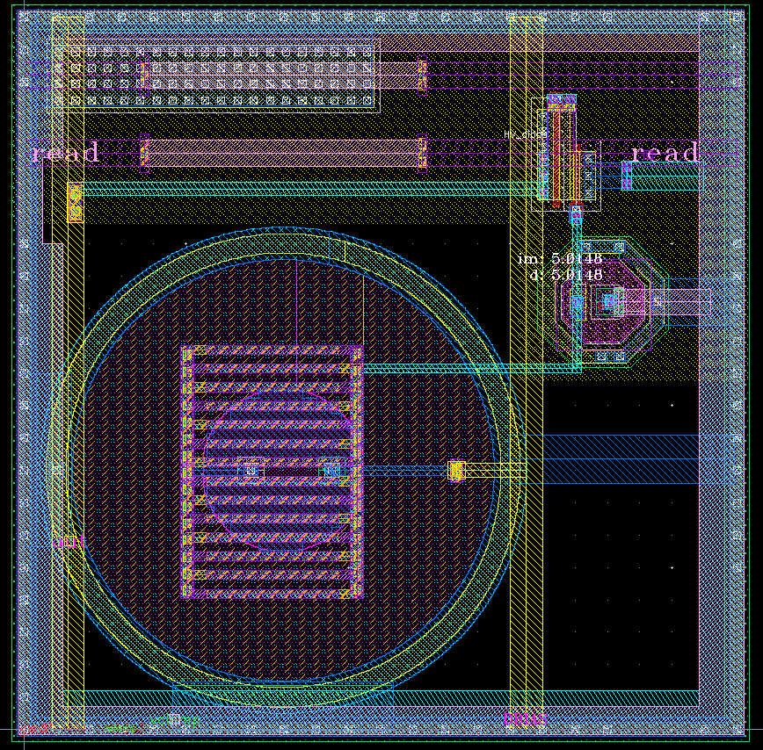
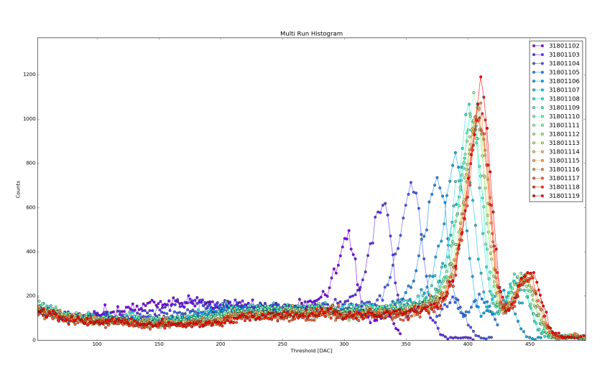
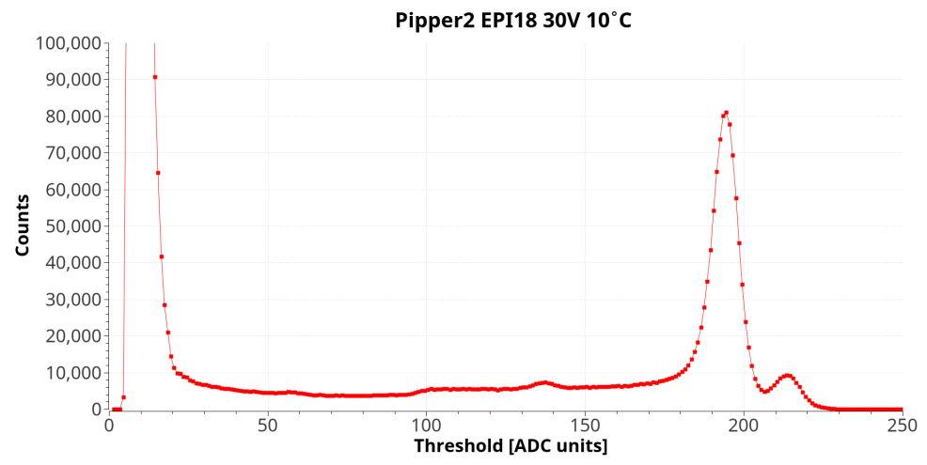
Examples of Applications at IPHC
Example 1 : Spectroscopy – Pipper sensor
Prorotype chip 32x128 pixels
Analog outputs
Pixel size 22x22
AC coupled collecting diode
Produced on two substrates:
  Epitaxial layer 18µm
  Czochralski substrate
22fF
Laboratory measurements with ⁵⁵Fe in function of diode bias (1-19V)
Single pixel events spectrum
(90% charge in single pixel)
Epitaxial layer 18 um
In function of Vdiode (2V : 20V)
σ at (Mg Kα) = 35 e⁻ => FWHM ≈ 300 eV

Slide 5
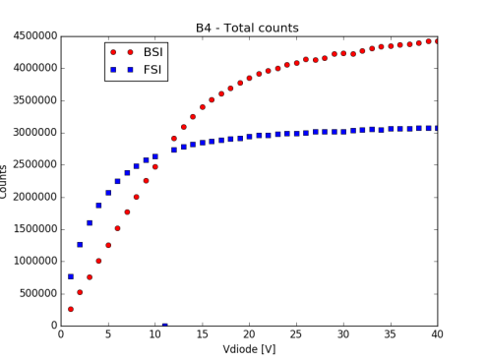

Back Side Processing
Goal: Fully depleted sensor
col. diode
col. diode
Depleted zone
Thinning
Ion implant
Annealing
p+ layer
Preliminary studies of FSI/BSI with ⁵⁵Fe
Detailed studies at Soleil Synchrotron next month
[J. HEYMES]
Post processing done in Jan 2017

Slide 6

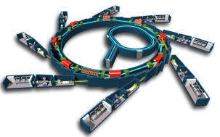
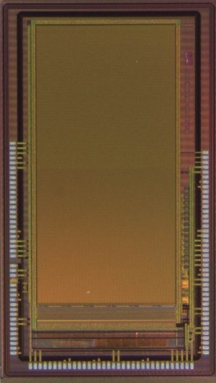
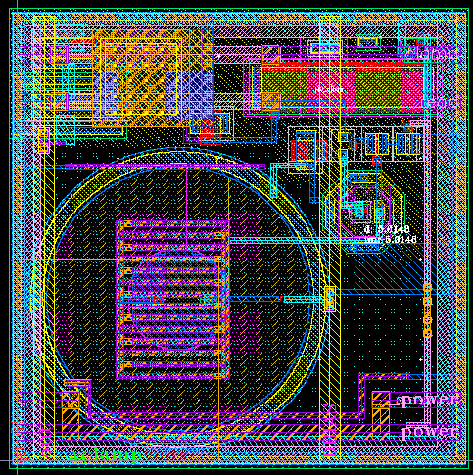
Examples of Applications at IPHC
Example 2 : Counting – Low energy X-ray - Mimosa 22SX
Requirements:
X-Ray Energy Range [few 100 eV – 5 keV] with 100% QE
Counting Dynamic [1-10⁷] ph/pix/s
High Spatial Resolution (pixel pitch ~ 20 µm)
Mimosa 22SX
First prototype specs
Tower Jazz 180 nm CIS
128 x 256 pixels with 22µm pixel pitch
Collecting diode AC coupled to the amplifier
Discriminator with 2 thresholds -> energy window
Binary outputs
16 mm² of active area
Strategy for counting:
Small pixels – amplification only
Rolling shutter readout
Column Discriminator
Serialization and readout
Counting outside of the pixels

Slide 7

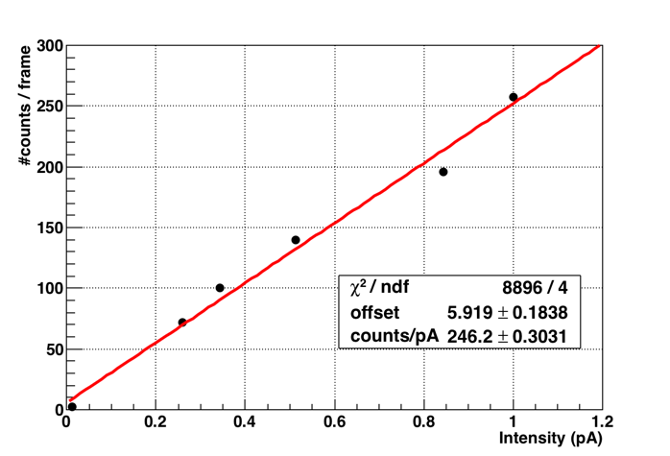
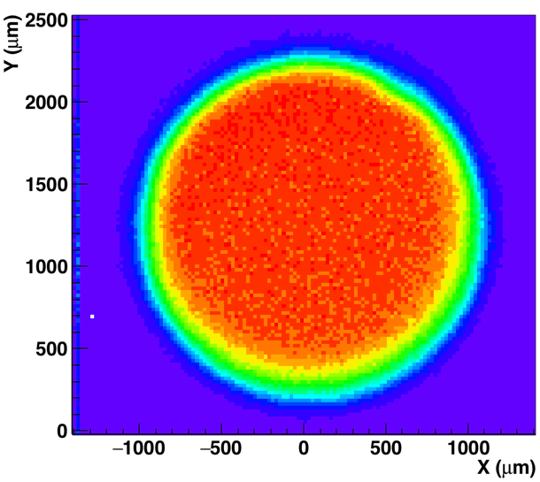
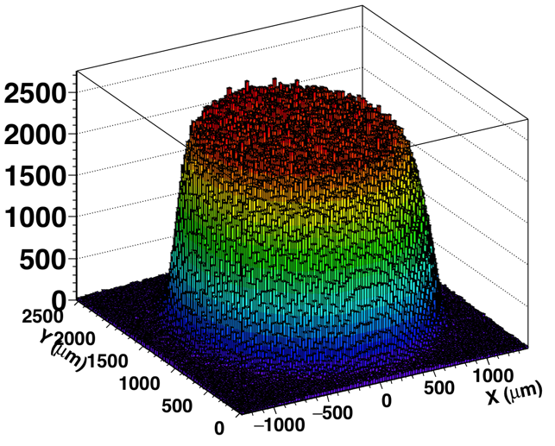
A spin-off application for M22SX
Example 3 : Counting – Dose Monitoring
CYRCé Cyclotron at IPHC:
24 MeV protons
Milimeter beam size
Motivation:
Monitor dose for small beam size (problematic with current detector)
First tests with Mimosa 22SX
Linear behaviour in the measured fluence range
At least 1000 protons/pix/s possible

Slide 8
Future full scale sensor
Synaps 2D
  Based on Mimosa 22SX but 8x larger -> active area 1x1 cm²
  3 side buttable for building multisensor modules
  Will be used as a multiproject platform
    Binary outputs-> counting applications
    Analog outputs -> spectroscopy

Slide 9
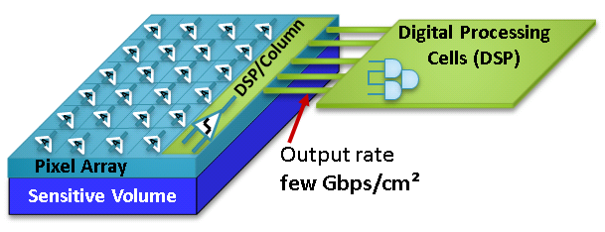
Limitations of current approach
2D Sensor
Reading all data (high flux)
  Massive parallel readout
  Frame rate limited
Off chip processing needed -> FPGA
Diode reset problematic with HV
  Rework biasing approach?

Slide 10
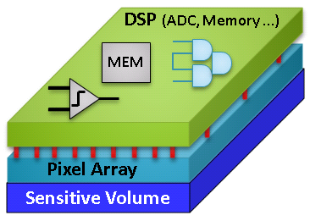
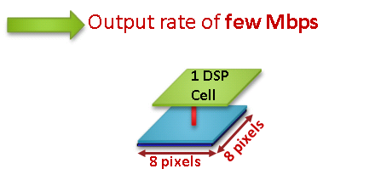
3D approach to Overcome the limitations
3D Sensor
Digital processing chip on top of the MAPS detector
  Pixel pitch ~ 8x larger -> 100x100 – > 150x150
  Functionality ? -> counting, memory, on-chip histogramming
  Output data rate decrease -> easier to build bigger systems
Local rolling shutter (8x8 pixels)
-> integration time ~ 1µs -> 10⁷ photons/pix·s

Slide 11
Summary
Depletion in MAPS
  => imaging applications
High rate single particle counting
    1000 particles /pixel/s proven on small scale
    Large scale
    Beyond 1000
Validation
  Mimosa22SX will be tested in June at SOLEIL synchrotron
  Interested in other places for validation
  Spectroscopy
  Low energy X-ray counting
  Proton counting
Need development

Slide 12
Thank you for your attention

