Slide 1
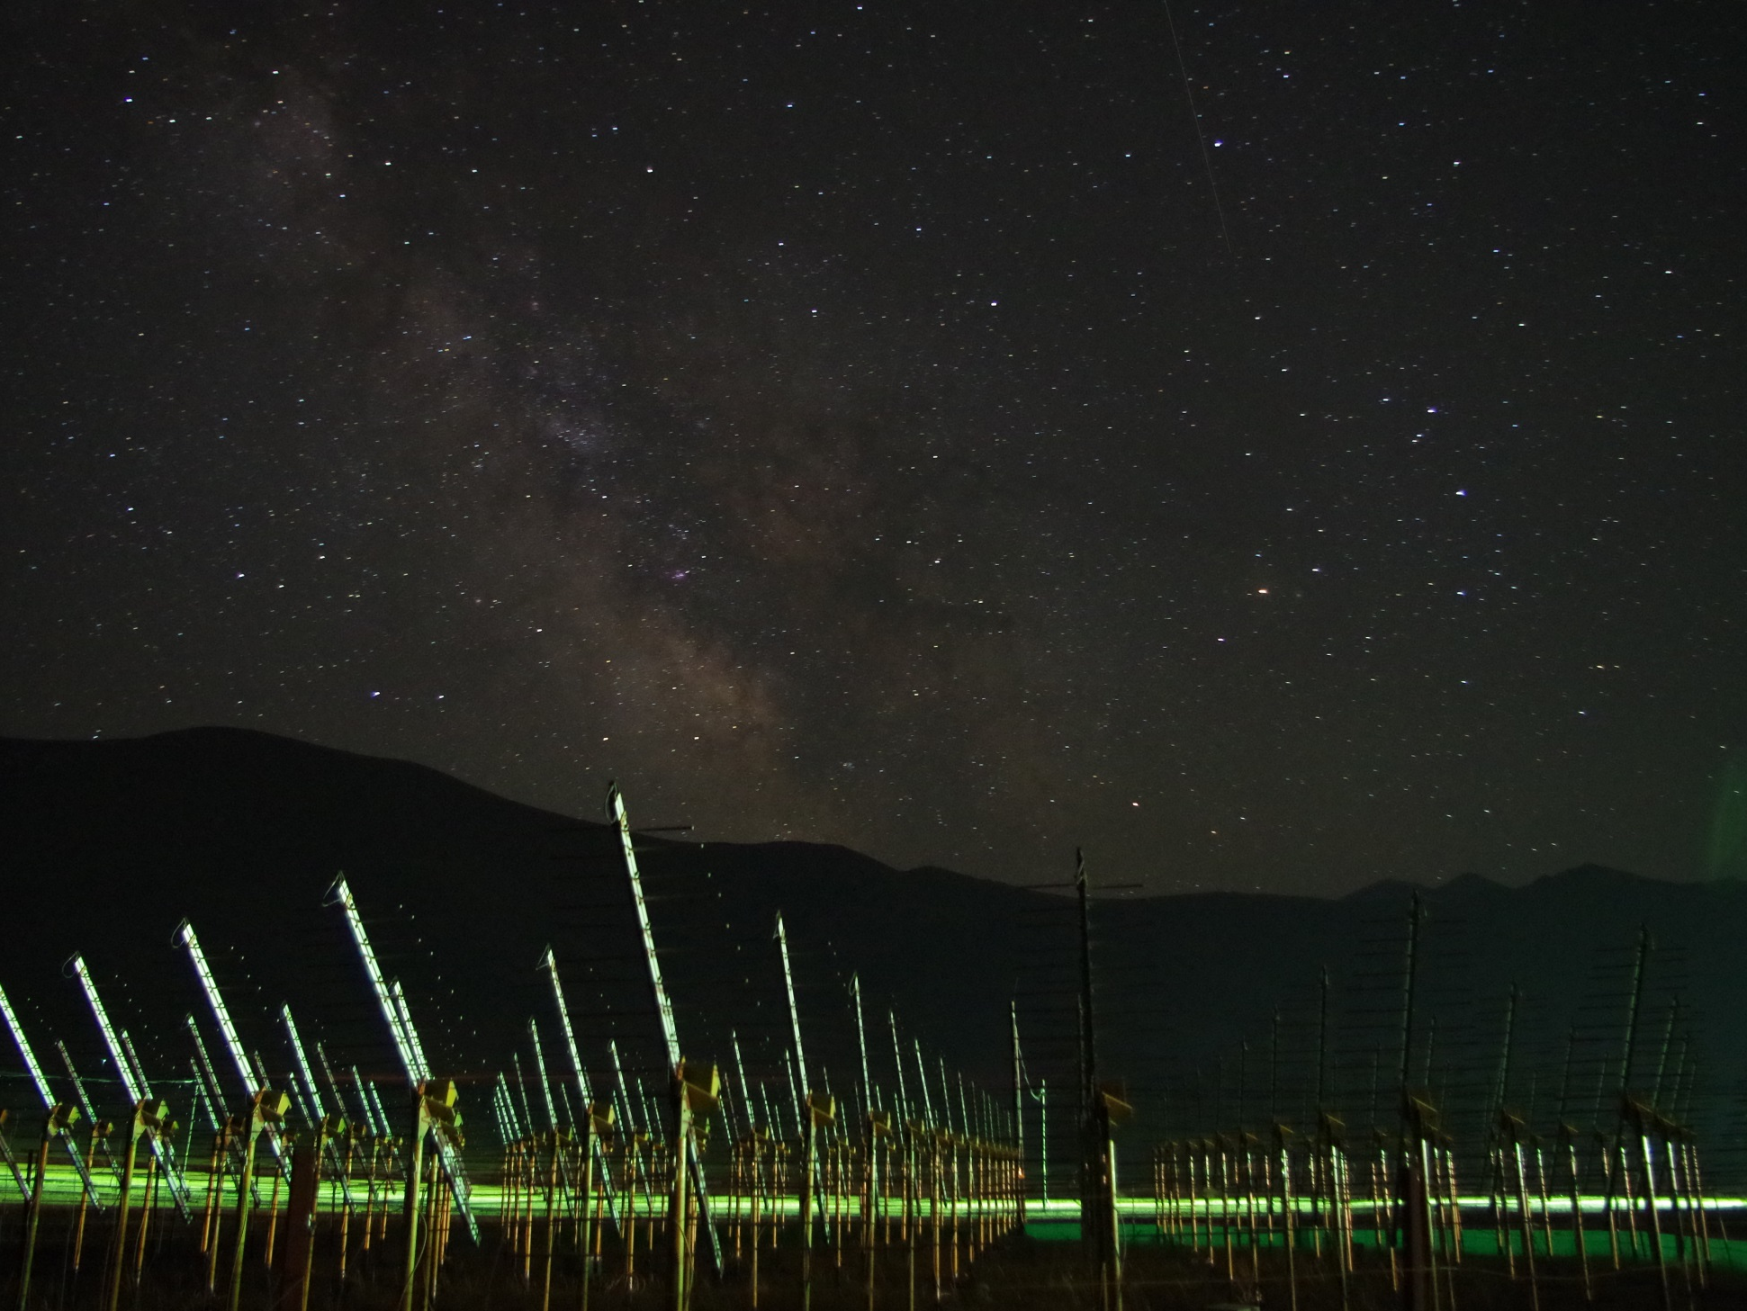
The Giant Radio Array for Neutrino Detection
Project status
Olivier Martineau
GRAND White Paper workshop
IAP Paris, May 16, 2017
the 21CM array
site of the GRANDproto setup (picture: Gu Junhua)

Slide 2
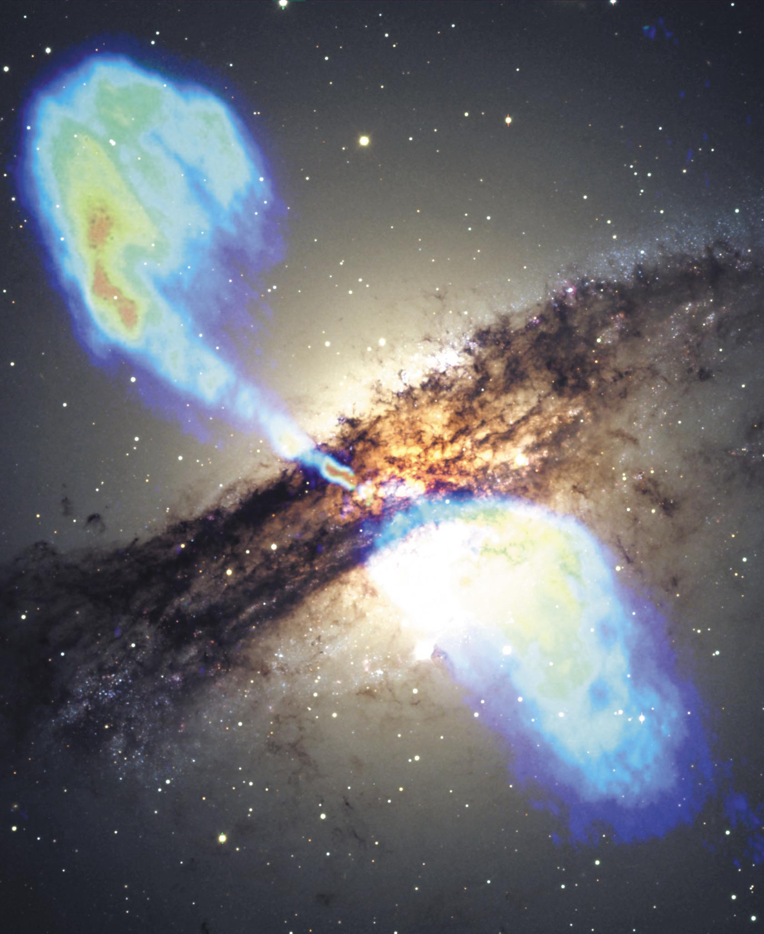
UHE neutrinos
as initial driver for the GRAND project
UHE neutrinos as very clean probes of the violent Universe
Produced by UHE hadron interactions with matter or photon fields (@ source or during propagation)
➔ Guaranteed existence
Unambiguous hadronic origin
Not deflected
➔ Point back to source
Not attenuated
Probe up to cosmological distances
A timely proposal:
Dawn of UHE neutrino astronomy (IceCube)
Multi-messenger approach (UHECRs, γ and GW) opens bright perspectives for the field.
Hear more at Ke+Kohta’s talk (2pm) + Science case session!
Centaurus A

Slide 3
Cosmogenic neutrinos fluxes
All flavors
Present experiments above most optimistic predictions (detector size).
Larger radio projects aim at ~10x improved sensitivity (ARA, ARIANNA)
Large fractions of (E, φ_{ν}) space parameter still not covered.
GZK « reasonnable » models
Kotera
GZK pure Fe, low Emax
Kotera

Slide 4
Antarctica projects

Slide 5
Antarctica projects Angular resolution
Angular resolution ~1° scale

Slide 6
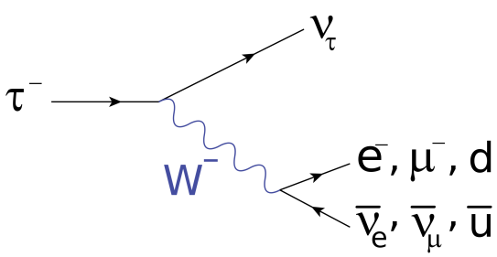
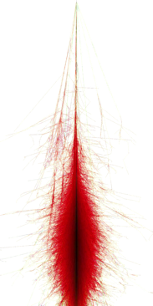
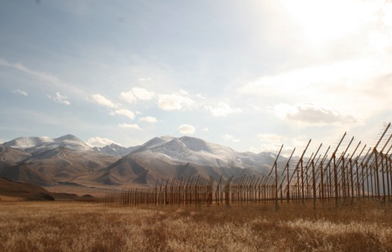
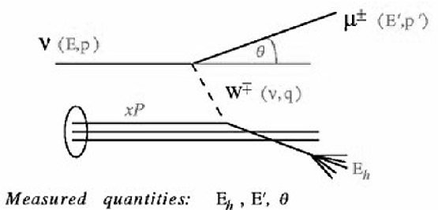
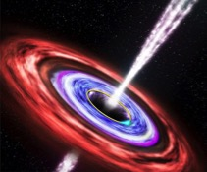
Earth-skimming neutrino detection
τ±
τ
ν_{τ}
Goal: search for cosmic neutrinos
Detection principle:
ν-induced tau decays in atmosphere generate ~horizontal extensive air showers.
[Fargion astro-ph/99066450, Bertou astro-ph/0104452]
Issues:
VERY seldom events
Earth-skimming trajectories (m.f.p._{ν} <1000km)

Slide 7
Radio & inclined showers
Beaming of EAS radio emission finaly an advantage?
Vertical shower
Earth skimming ν-induced shower
X_{max}
θ_{c} ~1°
~10km
>30km
~400m

Slide 8
(Very) inclined EAS radio emission
max (Efield)
[µV/m]
ZHAireS Efield computation
30-80MHz
2.4 10¹⁷eV tau decay @ origin
Subsequent shower:
E = 2 10¹⁷ eV
θ = 89.5°
Tau
decay
Shower axis
Longitudinal distance [km]
Lateral distance [km]

Slide 9
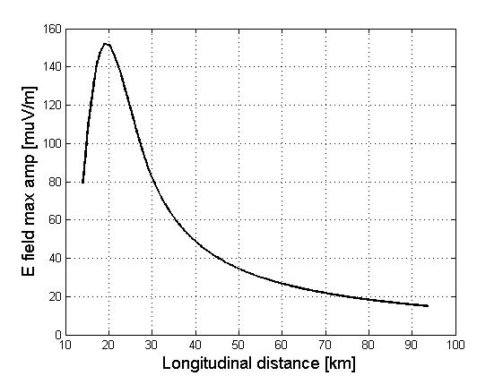
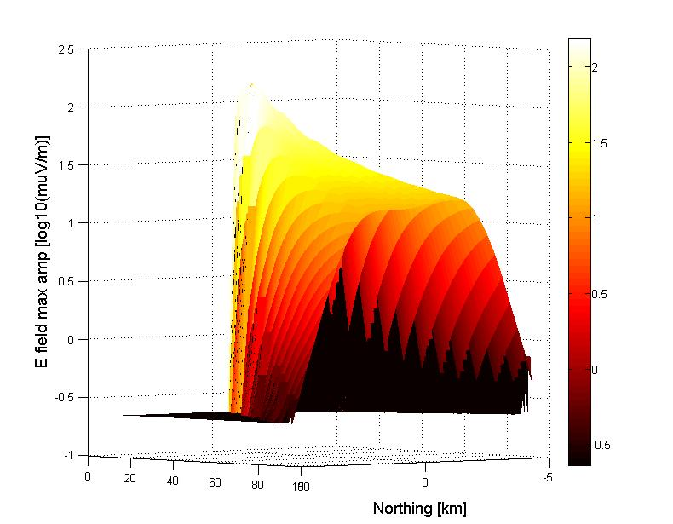
ZHAireS shower profile
E_{sh} = 2.4 10¹⁷eV
d_{decay} = 18km
36km
54km
73km
91km
E_{sh} = 2.4 10¹⁷eV
TREND bckgd noise
TREND bckgd noise
Earth-skimming trajectories definitly favorable for radio detection ☺

Slide 10
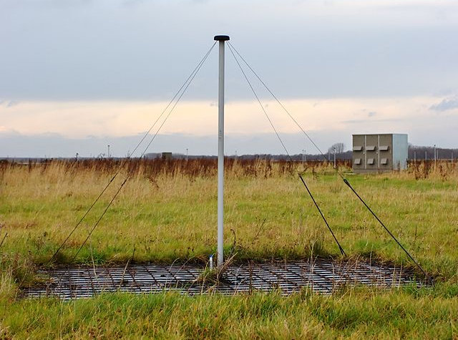
Radio antenna are probably the most basic HE particle detectors you can think of…
Cheap + robust + easy to deploy & maintain
Perfect for giant arrays
LOFAR

Slide 11
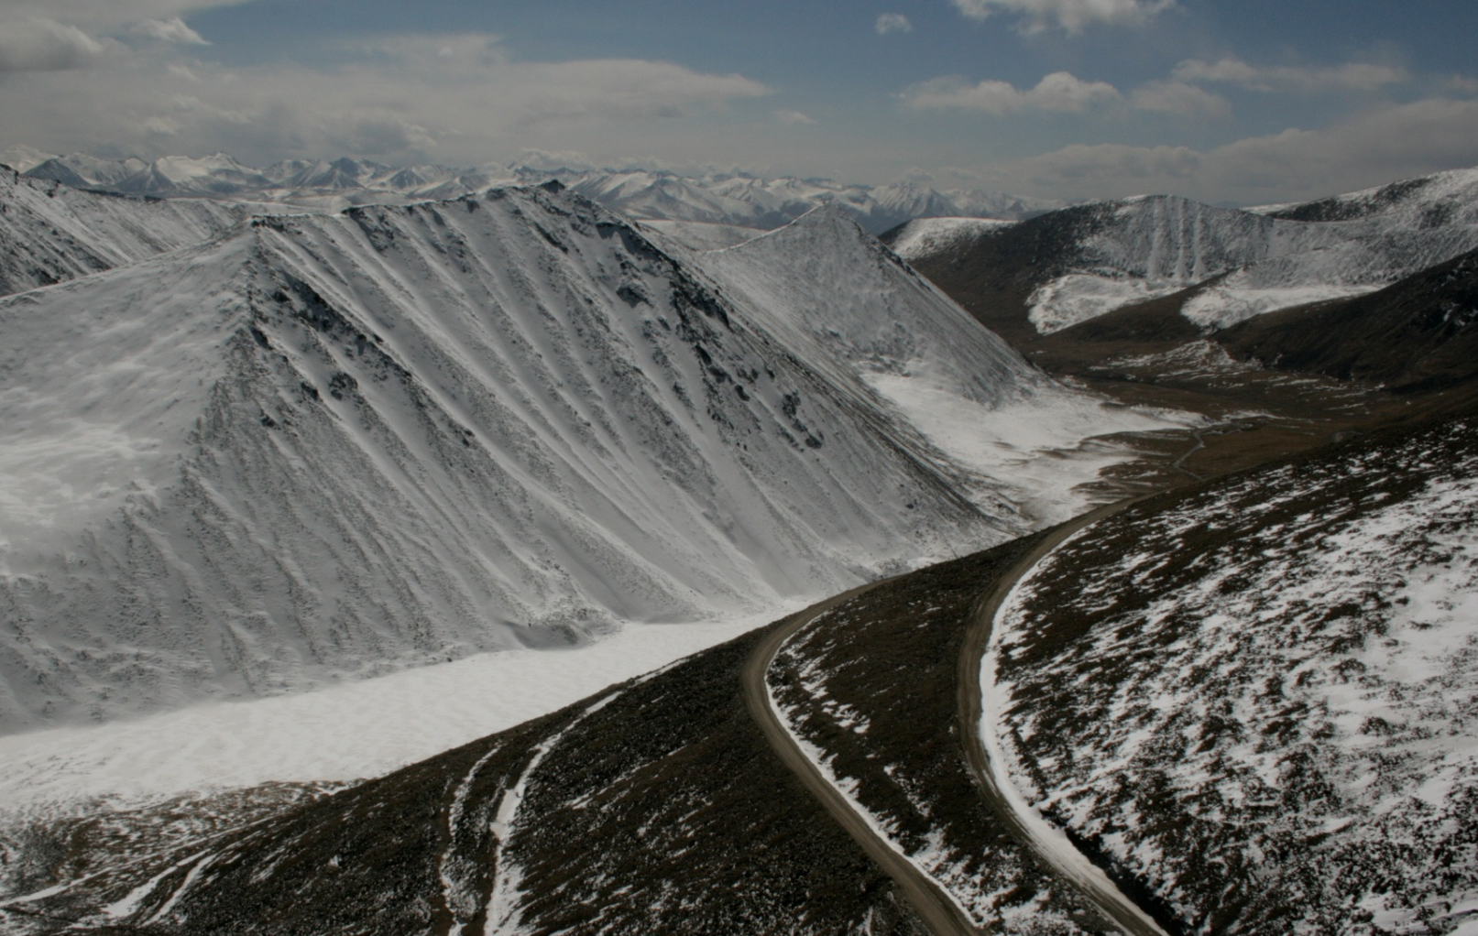
The GRAND project
Size of the neutrino detector is a key parameter.
>10000 km²?
- technical capacity?
- topology?
Ulastai

Slide 12
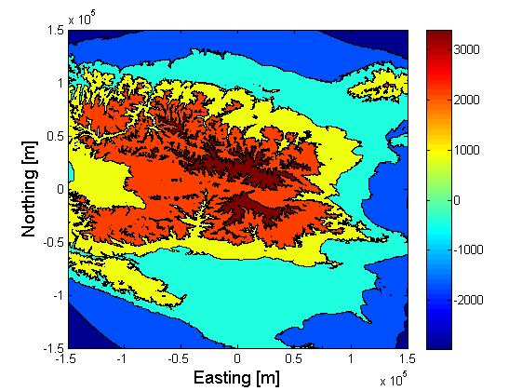
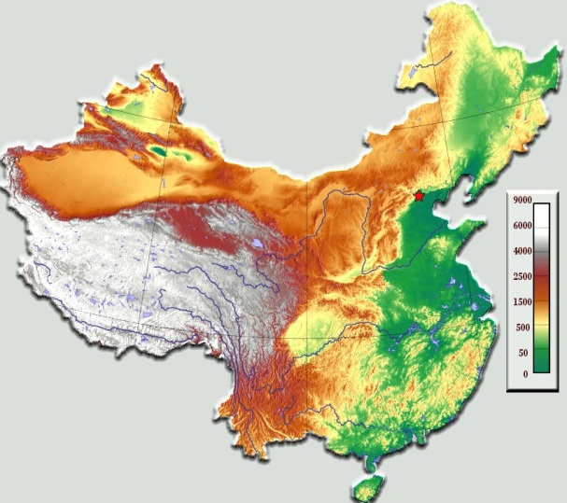
GRAND ν sensitivity study - Setup
Simulation layout of 90’000 antennas over 60’000km² in the TianShan mountains (800m step size square grid)
MC down to τ decay (E_{ν} in 10¹⁷ - 10²¹ eV, θ in [85-95°])
1D trajectories
No atmosphere
Parametric tau energy losses
Shower radio emission:
Preliminar study with radio
signal parametrization
No antenna response simulation
Northing [km]
+150
+100
+50
0
-50
-100
-150
Urumqi
Ulastai
-150 -100 -50 0 +50 +100 +150
Easting [km]

Slide 13
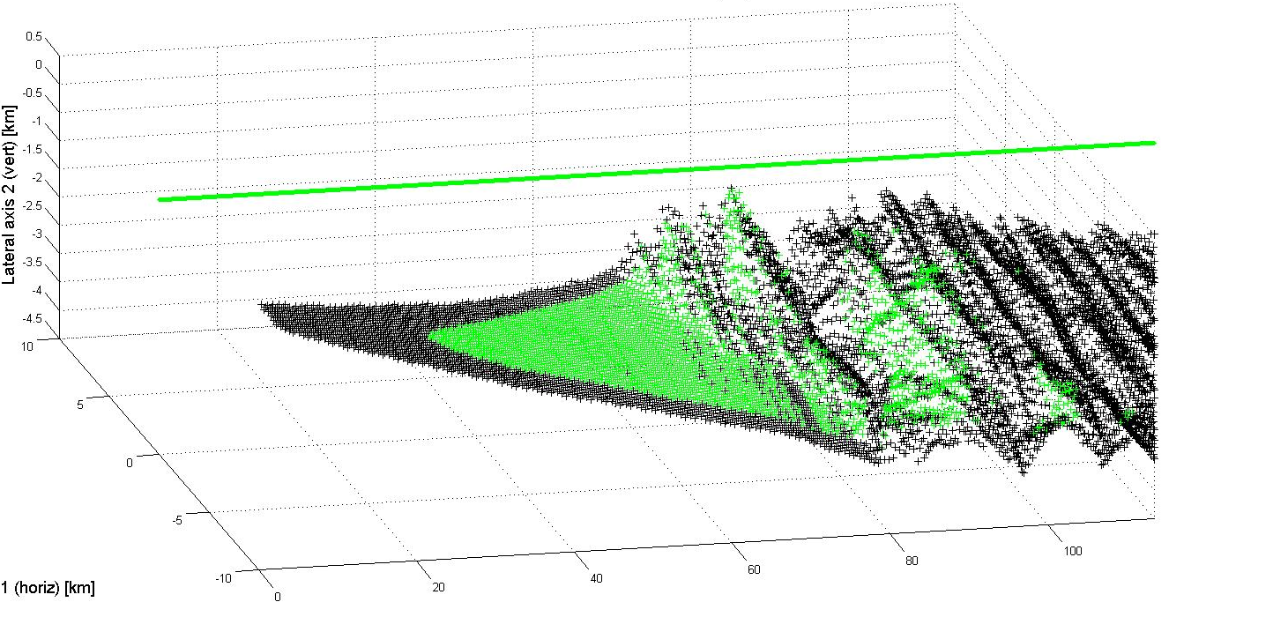
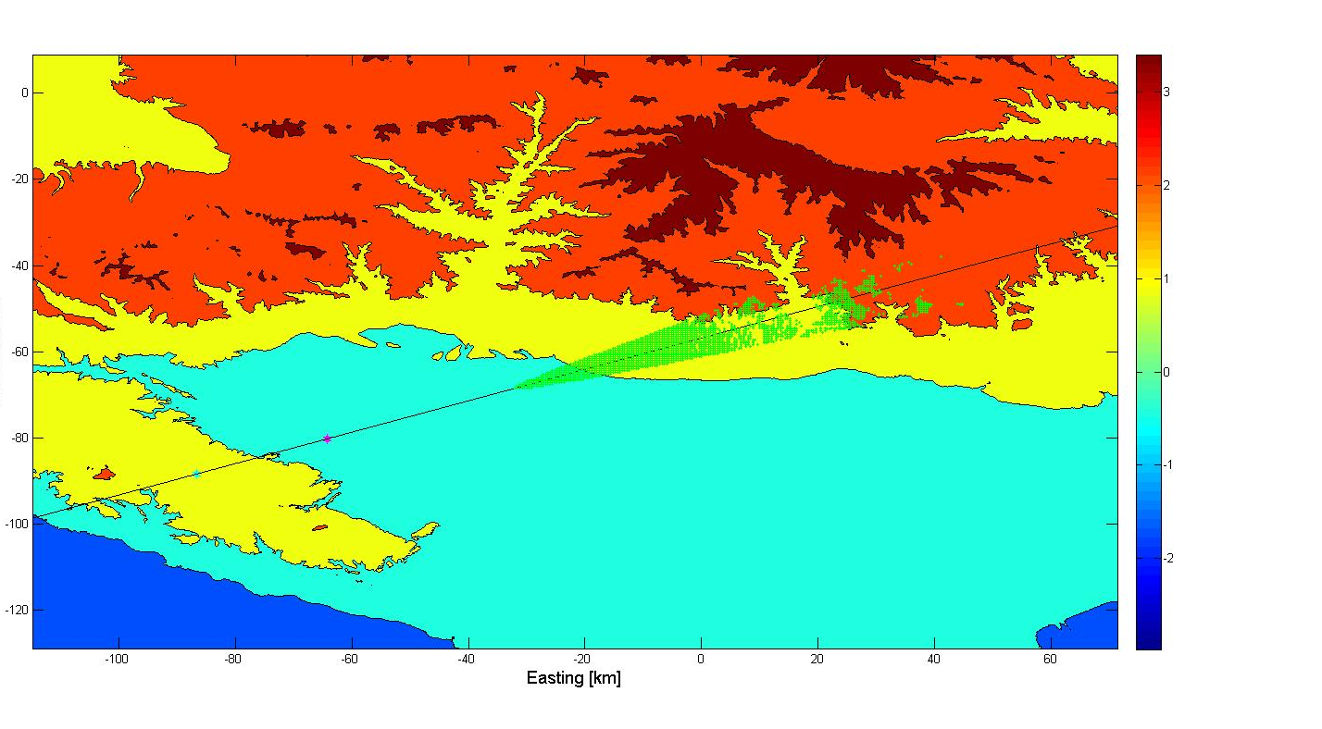
-4
3 10²⁰eV neutrino
2.4 10²⁰eV shower
θ = 88°
2114 antennas
triggered
Cut view (Earth referential)
Tau decay
Shower axis
Neutrino interaction
3D view (shower referential)
Radio emission cone
(4.5° for E>30µV/m @ E_{sh} = 2.4 10²⁰ eV)
Shower axis
Vertical axis (km)
Antenna field
(trig’d antennas)
Lateral axis (km)
Longitudinal axis (km)
Top view (Earth referential)
Shower radio track
Shower tagged as « detected » if a cluster of 8+ antennas is inside the radio detection cone.
Northing [km]
Tau decay
Neutrino interaction
Easting [km]

Slide 14
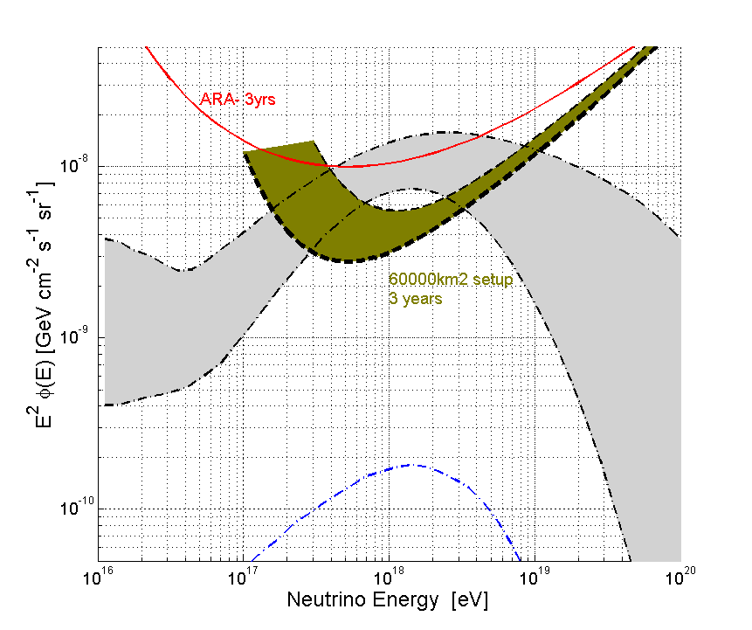
GRAND ν sensitivity study Preliminary results
Agressive
3.10²⁰eV
Sensitivities > 0 for zenith values = ±4° around horizontal ⇨ Earth-skimming trajectories only.
Mountains are sizable tragets (~40% of total).
Earth becomes opaque at higher energies
3.10¹⁹eV
3.10¹⁸ eV
3.10¹⁷ eV
All flavors
Upward
Going
(Earth)
Downward
Going
(mountains)
- 60’000km² simulation setup
- All flavor flux φ(E)= φ₀E⁻²
- no candidate in 3 years
⇨ 90% CL integral limit:
φ₀ < 2-4 10⁻⁹ Gev/cm²/sr/s
… not good enough!
Preliminary

Slide 15
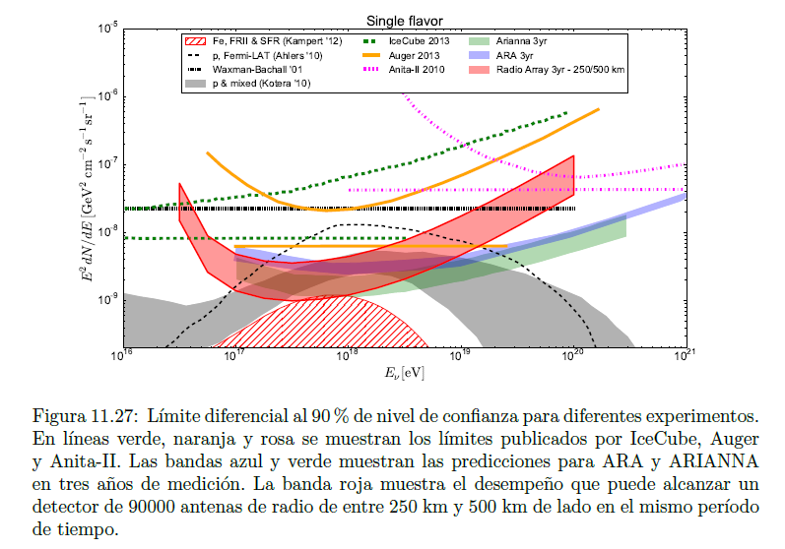
P. Pieroni PhD (Buenos Aires & Santiago):
Upper line of red region ⬄ area = 62500km² on flat area
Best differential limit: ~10⁻⁸ GeV/cm²/s/sr (@3 10¹⁷eV) (all flavors)
GRAND 60000km² simulation area:
Best differential limit: 2 – 4 10⁻⁹ GeV/cm²/s/sr (@5 10¹⁷eV) (all flavors)
~factor 2-5 better, compatible with mountain effect.

Slide 16
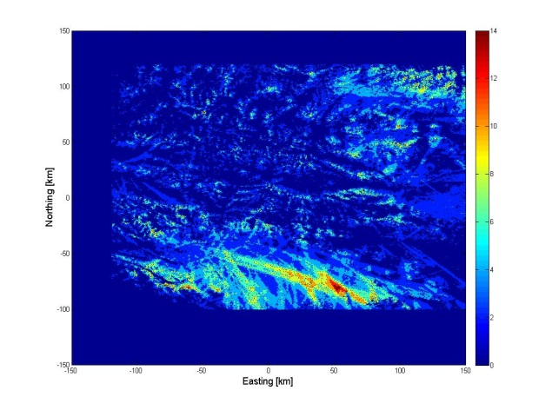
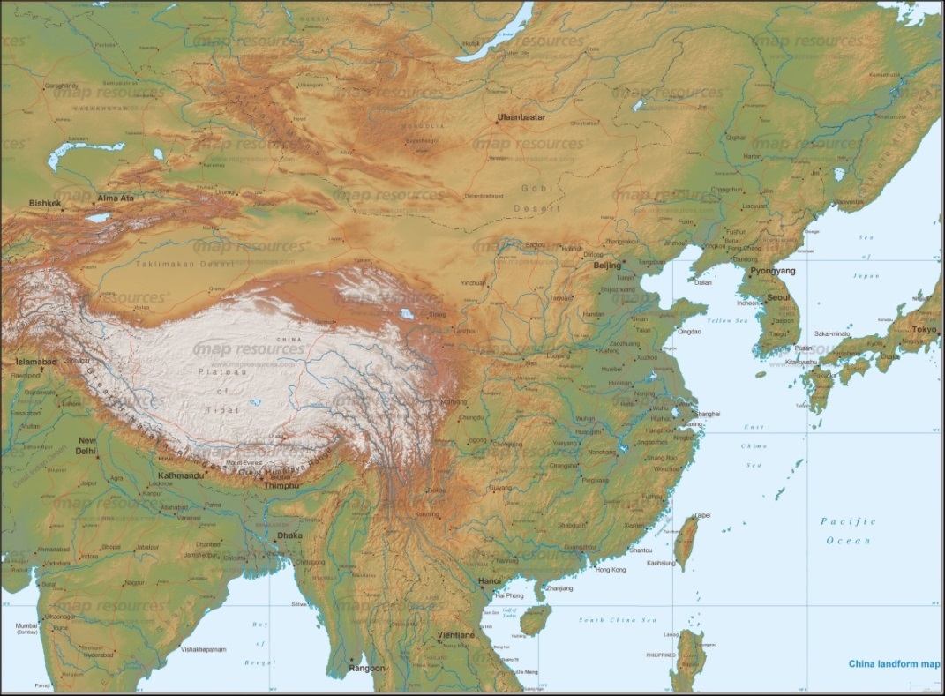
GRAND ν sensitivity study
Target sensitivity: φ₀ = 1.5 10⁻¹¹ GeV/cm²/sr/s
(~10 times better than 60000km² simu result)
Driver: go for hotspots! Then 200’000km² may be enough to reach target sensitivity
Giant simulation area (1’000’000 antennas over 1’000’000 km²? Full Earth?) to identify hotspots.
Hotspot with favorable topology
enhanced detection rate!
x 10 in sensitivity for x 3 in surface(?)

Slide 17
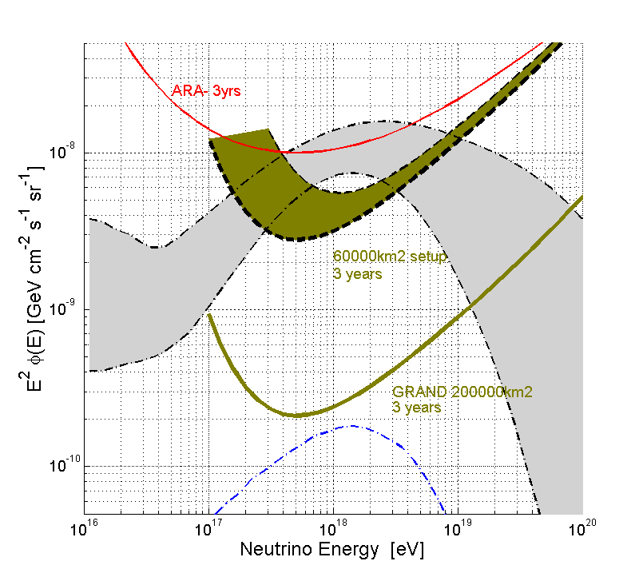
GRAND neutrino sensitivity
All flavors
Target sensitivity
φ₀ = 1.5 10⁻¹⁰ GeV/cm²/sr/s
integral limit
reachable for 200’000 km² array
[0.5 – 50 cosmogenic events/year ]
VERY preliminary

Slide 18
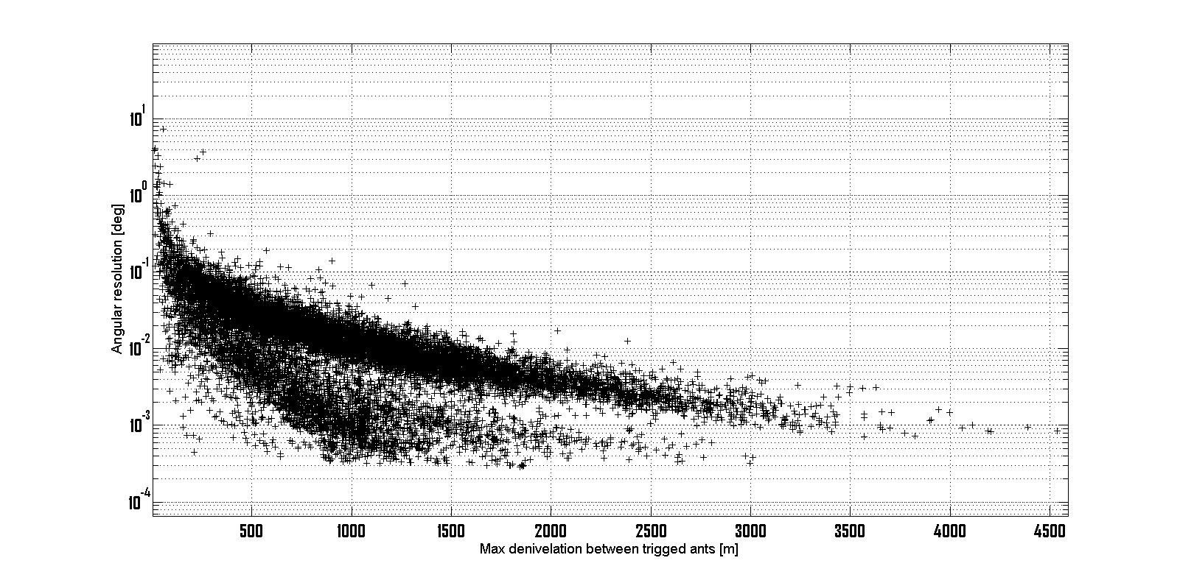
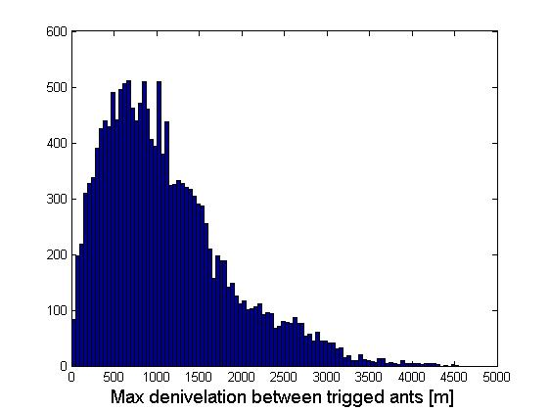
GRAND angular resolution
δθ ~ cδt/L┴_{max}
cδt
θ
L┴_{max}
δt = 3ns nominal
L┴_{max} = 1000m (vertical denivelation)
δθ ~ 0.05°
Complete analytical computation using trigged antenna position (Ardouin et al., Astropart Phys 34 2011) gives compatible results.
This is excellent but corresponds to an ideal case.
Reachable? See ‘reconstruction’ slide.

Slide 19
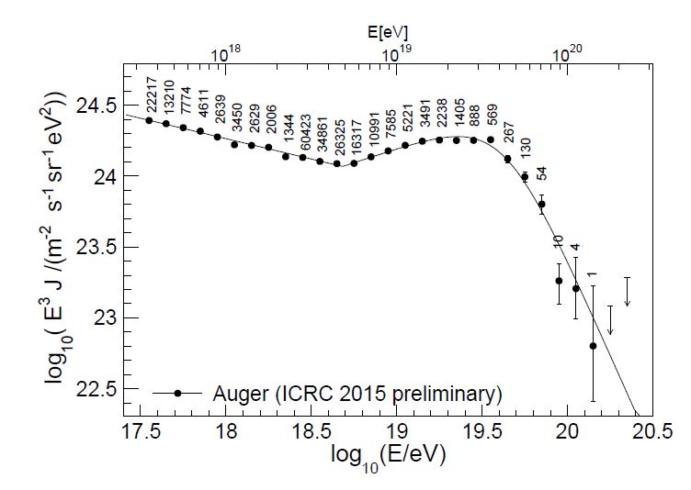
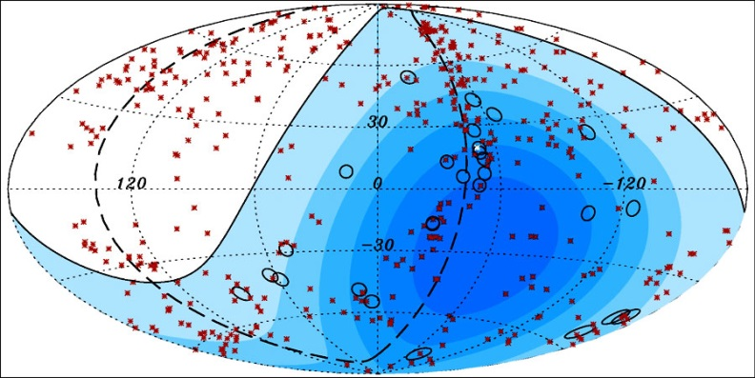
Trans-GZK UHECRs
AUGER: very limited stat beyond 10^{19.5} eV. Hints for mixed composition. Better primary determination expected with AUGERPrime.
GRAND:
Exposure ~x20 AUGER or more (2 weeks ⬄ 1 year of AUGER!) with inclined events.
Primary nature determination?

Slide 20
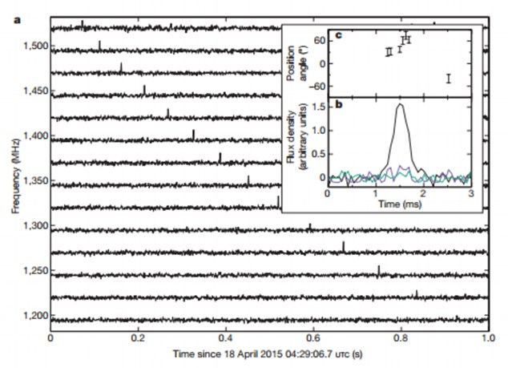
Fast Radio Bursts
Serendipitous discovery of ~20 HE bursts (0.1 – 30Jy) in the 0.7-2GHz band in data archive.
1/f² delay variation due to propagation ➔ extragalactic origin
30Jy + flat spectrum FRBs should be detectable by GRAND (incoherent sum of 200’000 antenna pulses in 100-300MHz) (P. Zarka)
GRAND sale argument: good sensitivity, unexplorer frequency band, large field of view (= single antenna FoV thanks to incoherent summing) opening possibilities for HUGE stats…
Antennas BW?
DAQ?
➔ Parallel session

Slide 21
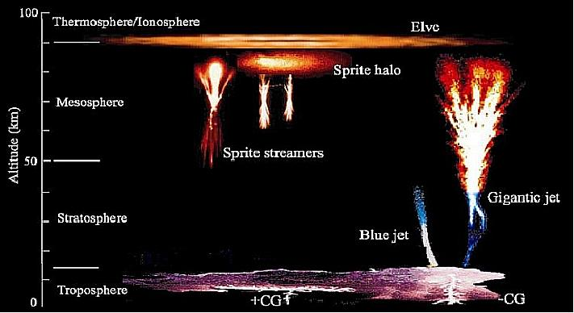
GRAND science case – a summary
VHE phenomena in the Universe
Cosmogenic neutrinos
Neutrino astronomy
Trans-GZK UHECRs & gammas
Radio astronomy
Fast Radio Bursts + Giant Pulses
Epoch of Reionization
Fundamenal physics
Fundamental physics tests: neutrino flavor, LIV
Glashow resonnance(?)
EAS physics
Others
Extreme electromagnetic atmosphere events (Elfs, Sprites, etc.)

Slide 22
GRAND status
Preliminary study of GRAND neutrino sensitivity was completed late 2015. It is consistant with other studies.
It indicates that a 200’000km² array would guarantee neutrino detection, even under the most pessimistic scenario for cosmogenic fluxes. Excellent angular resolution should be achievable.
Giant array size opens exciting perspectives for a large scientific scope (UHECRs, FRBs, EoR…)
To Do (before white paper release):
Confirm sensitivity expectations with robust simulations
Determine (estimate?) performances achievable on EAS source reconstruction (direction, energy and nature of primary)
Identify experimental challenges towards GRAND & define roadmap to solve them.

Slide 23
GRAND
ToDo list
Neutrino sensitivity robust estimation
EAS primary info reconstruction
Experimental roadmap definition
Items to be discussed during this workshop,
as well as how far we go in White Paper.

Slide 24
1. GRAND neutrino simulation
Bckgd
End-to-end simulation chain
τ
ν_{τ}
shower
DAQ
V(t)
Topography along track
CC & NC ν_{τ} interactions
τ energy losses
τ decay
DANTON
(V. Niess)
Shower development
Radio emission
ZHaireS + EVA
(K. de Vries, OM, C. Medina, M. Tueros, A. Zilles)
Antenna response
Antenna trigger (background noise sim)
NEC
(D. Charrier, S. Le Coz, OM)
Antenna design?
Array layout?
See « GRANDsimu » talk, Wed 3pm
Parallel session Wed PM + Thu AM

Slide 25
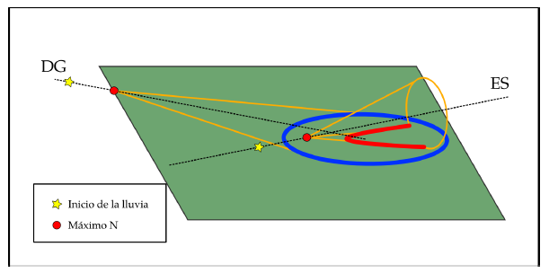
1. Radio simulation
P. Pieronni PhD thesis
Flat detector: all ground position are equivalent
➔ ~ ok to re-use same (E, θ, ϕ) shower for ≠ x_{core}.
Not true if antenna deployed in mountain area
3D radio simulation now needed!
Much larger CPU request

Slide 26
1. «Morphing» of radio emission
A very fast way to compute Efield at any position for any shower. Under study since July 2016 (W. Carvalho, K. de Vries, OM, C. Medina, M. Tueros, A. Zilles)
Input:
E^{A}(t,x_{i}’), Efield time trace generated at (arbitrary) antennas locations x_{i}’ by generic shower A (E_{A}, θ_{A}, ϕ_{A},h_{A}).
Shower B (E_{B}, θ_{B}, ϕ_{B},h_{B}),output of DANTON
GRAND antenna positions x_{i} in direct view of B.
IF we can determine a scaling factor k_{AB} = f(E_{A}, θ_{A}, ϕ_{A}, h_{A}, E_{B}, θ_{B}, ϕ_{B}, h_{B}) so that E^{B}(t,x_{i}’) = k_{AB} E^{A}(t,x_{i}’) THEN
We can easily compute E^{B}(t,x_{i}’)
We can easily compute E^{B}(t,x_{i}) by interpolation of E^{B}(t,x_{i}’)
Status to be detailed this afternoon
Will be tested on a « toy model » topography
More @ 3pm + parallel session Wed PM!

Slide 27
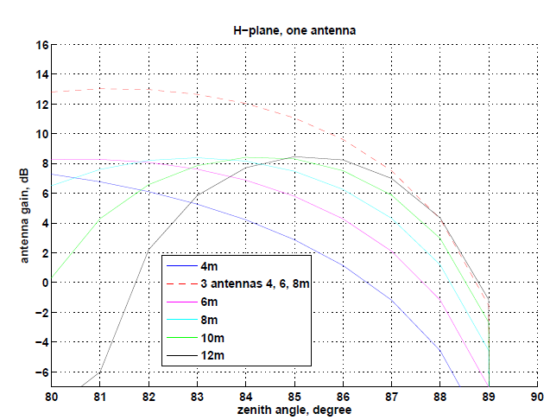
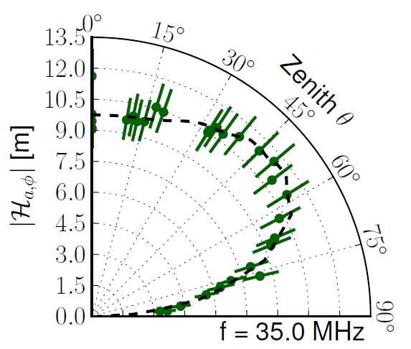
1. GRAND antennas
8m
Perfectly conducting ground: σ = +∞
➔ E_{plane} = 0 for θ = 90°
For h = 2m:
G_{max} = max(P_{rad})/(P_{in} /4π)= 7.6dB
G(87°)=-6.9dB
For h = 4+6+8m (phased antennas):
G(87°)=7.5dB
Noise /sqrt(3)
Still to be optimized + other designs under study (Didier)
Antenna Efield response being included in chain
100µV/m threshold is a realistic target!
GRANDproto300
See parallel session Thu PM
Aab, astro-ph/1209.3840

Slide 28
1. GRAND simulation timeline
If all goes well:
Radio morphing + antenna response valid in June
Test on ToyModel during summer
DANTON fully ready before september (backward MC + topography modules)
Full scale simu during autumn
First sensitivity results not before end 2017 ☹
But there would still be work ahead after that:
Layout optimisation (array shape, subarrays)
Reconstruction

Slide 29
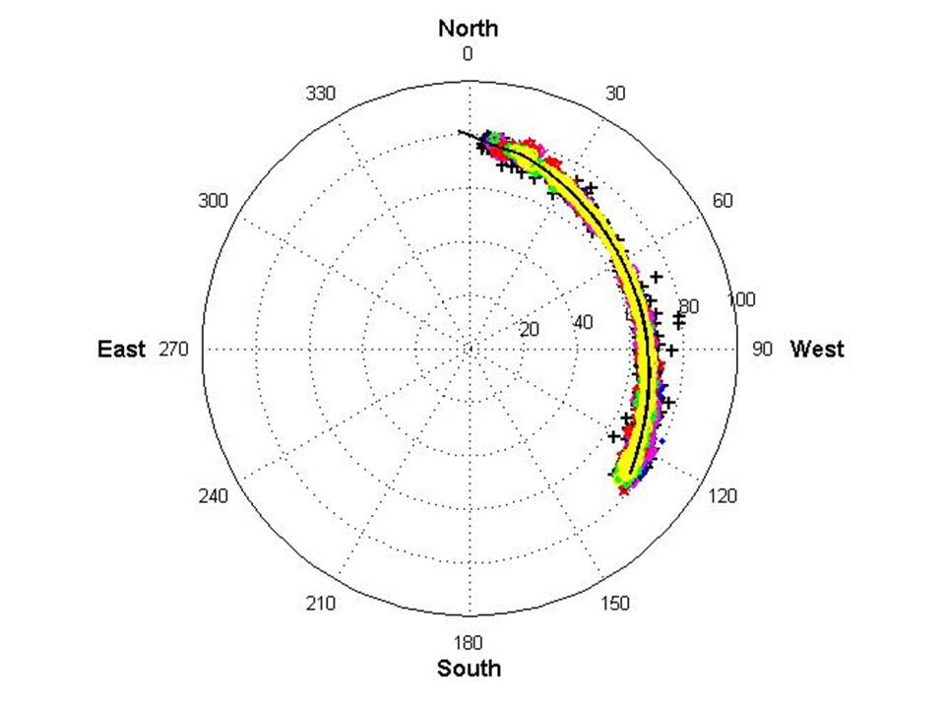
2. EAS primary reconstruction
Great results achieved by AUGER&LOFAR (direction, E, X_{max}) but very inclined trajectories + radio-only data makes reconstruction very different for GRAND:
Far-from-axis signal characteristics?
Ground reflection effects?
Radio-only geometry reconstruction?
Angular resolution
Critical for neutrino anaylsis
Method to be defined: wavefront shape? Frequency band used?
Requires rigourous treatment using simulated events (+ validation with TREND / AERA data?)
PhD proposal (Kumiko+Olivier)
TREND plane track detection

Slide 30
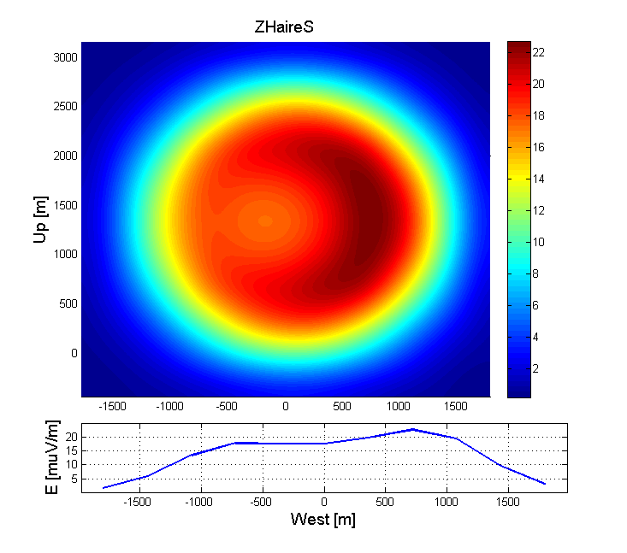
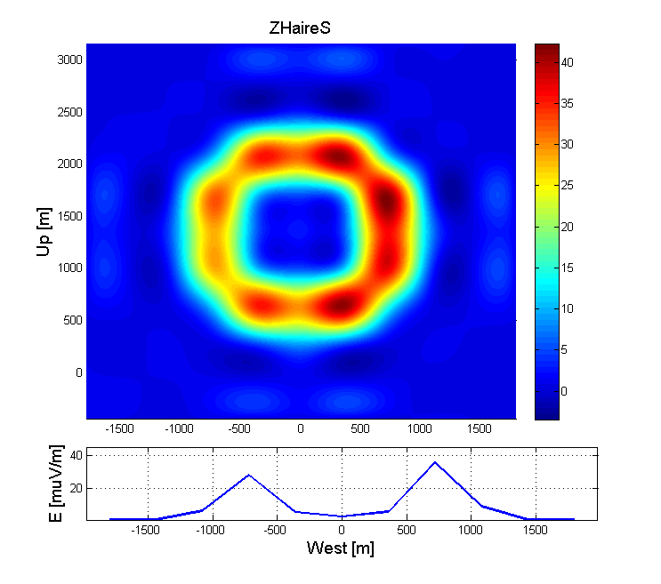
2. EAS primary reconstruction
Energy & X_{max}: key for UHECRs physics
Both depend highly on geometry, hard to constrain from 30-100MHz radio data only (AERA input?).
High-frequency band as a solution?
Cerenkov ring may provide good measurement of shower axis + distance to emission point.
E = 9.6 10¹⁶eV shower,
θ = 90.5°.
Max Efield amplitude distrib on plane ┴ to shower axis @ d = 34km away from X_{max}
30-100MHz
200-300MHz

Slide 31
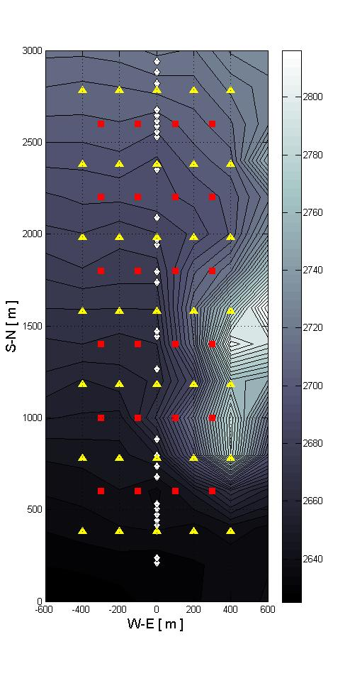
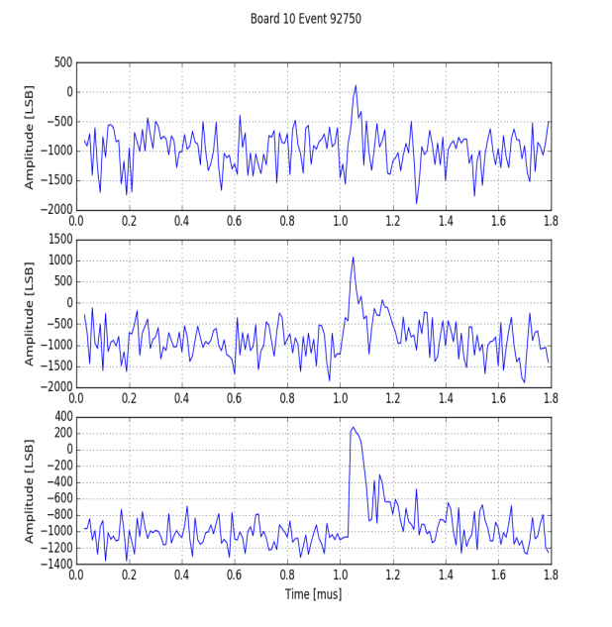
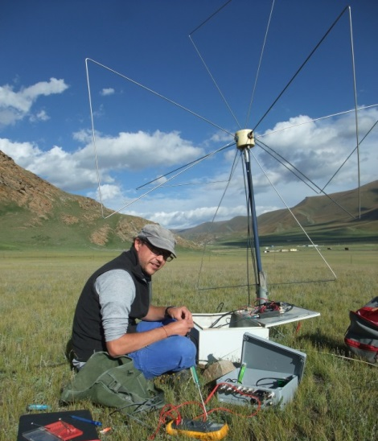
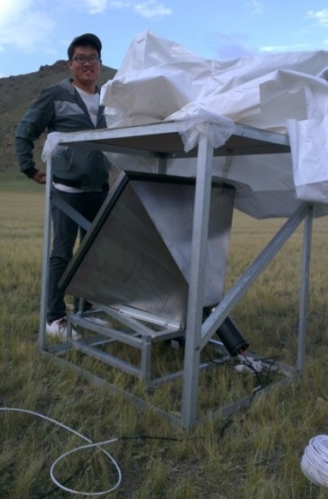
3. Roadmap to GRAND
GRANDproto35 (2018-2020)
Goal: demonstrate that EAS can be detected on standalone radio array with high efficiency & very good background rejection.
Setup:
35 3-arms antennas + high duty cycle DAQ
21 scintillators for offline radio EAS candidate nature validation.
Budget: 160kE, fully funded by NAOC+IHEP, deployment fall 2017 @ Ulastai.
GRANDproto on-site tests, 10/12/2016
EW-channel
NS-channel
Vert-channel

Slide 32
3. Roadmap to GRAND
GRANDproto300 (to be deployed in 2019)
Goal: establish detection & identification by standalone radio array of very inclined showers (θ>70°) induced by high energy cosmic rays (>10¹⁸eV). Includes bckgd rejection, EAS reconstruction, etc…
Setup:
300 HorizonAntennas over 300 (?) km² (Bandwidth?)
Fast DAQ (AERA+GRANDproto35 analog stage for HF)
Solar pannels (day use) + WiFi data transfer (T0 trigs)
Also a testbench for trigger+DAQ development for latter stages.
Budget: 1.3M€
Location?
Parallel session Thu PM+Fri AM

Slide 33
3. Roadmap to GRAND
GRAND10k (2025)
Goal: first GRAND subarray, sensitivity comparable to ARA/ARIANNA on similar time scale, allowing 1st discovery of cosmogenic neutrinos (if lucky).
DAQ with discrete elements, but mature design.
for trigger, data transfer, consumption.
Budget: 1500€ / detection unit ? (3500€ for GRANDproto300)

Slide 34
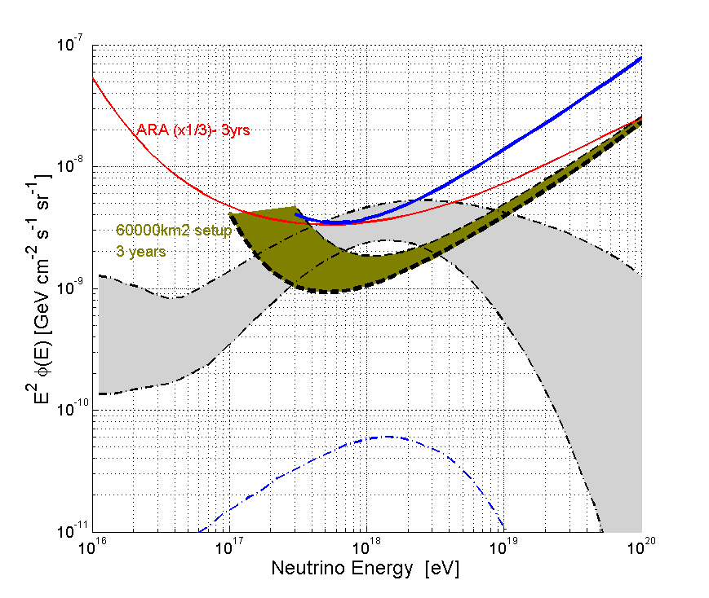
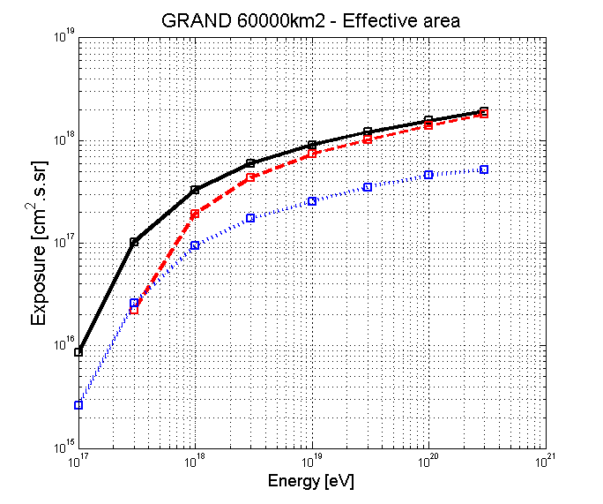
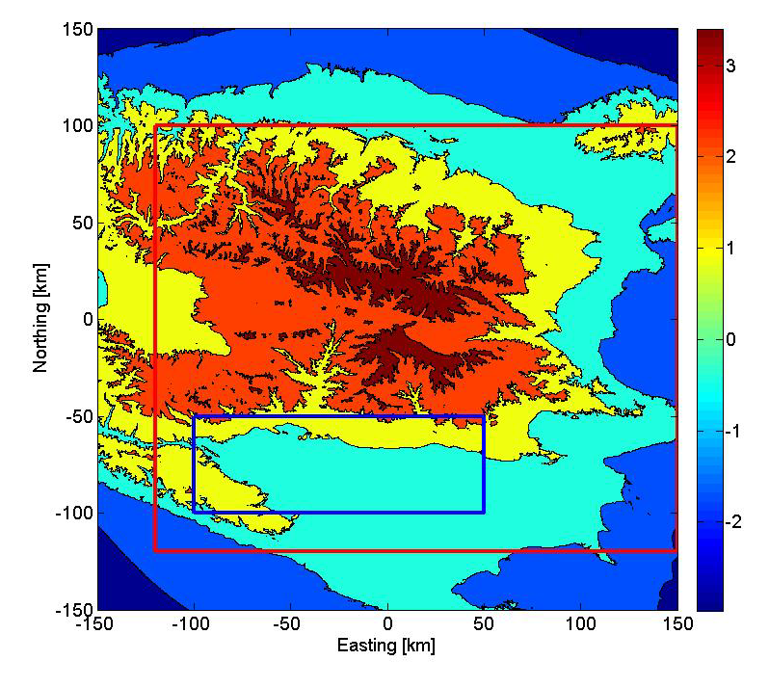
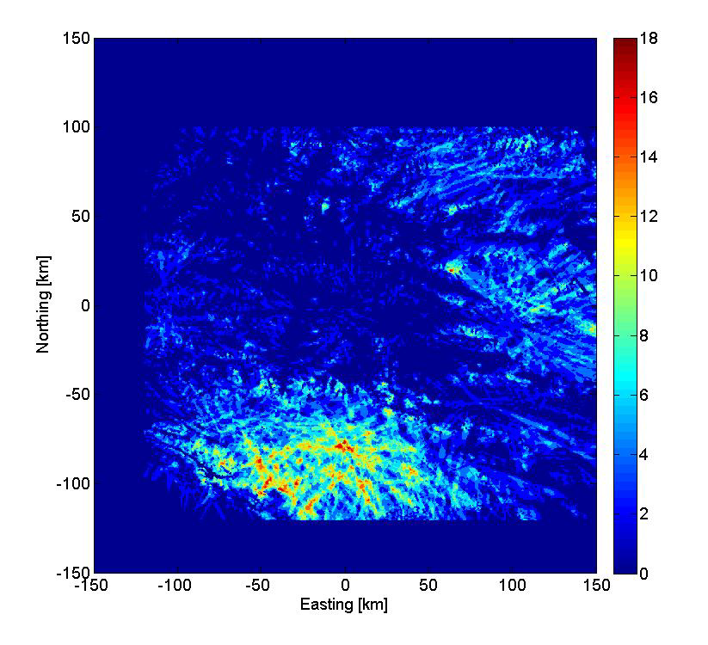
GRAND10k size?
GRAND
7500km² hotspot
Preliminary sensitivity study: hotspot of 7500km² (12% of 60’000km²) corresponds to ~30% of 60’000km² effective area.
a ~10’000km² array deployed over hotspot may have comparable/better sensitivity than full ARA/ARIANNA.
Disclaimer: to be confirmed by full end-to-end simulation.
60000km² effective area (agressive)
60000km² effective area (conservative)
7500km² effective area (agressive)
Simulated antenna triggers map
60’000km²
7’500km²

Slide 35
3. Roadmap to GRAND
GRAND10k (to be deployed in 2025)
Goal: first GRAND subarray, neutrino sensitivity comparable to ARA/ARIANNA on similar time scale, allowing 1st discovery of cosmogenic neutrinos if large rate.
DAQ with discrete elements, but mature design.
for trigger, data transfer, consumption.
Budget: 1500€ / detection unit ? (3500€ for GRANDproto300)➔15 (10kAnts) -30 (20kAnts) M€
Parallel session Thu PM+Fri AM

Slide 36
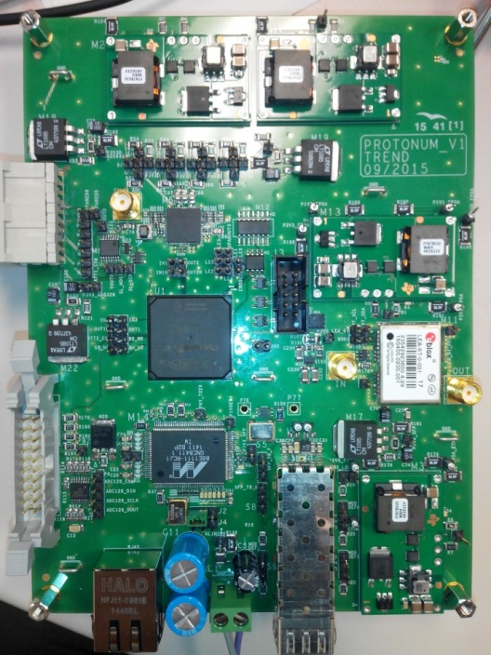
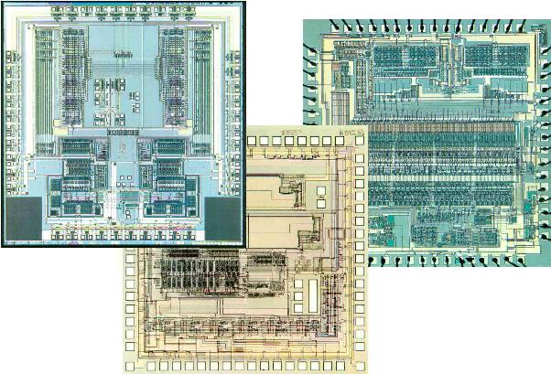
3. Roadmap to GRAND
GRAND200k (203x)
Industrial scale allows to cut costs down: 500€/unit ➔ 120k€ in total.
GRANDproto digital board
ASIC
(Application-specific integrated circuit)
Cost ~ 10M$ ➔ few 10$ /board
Consomption < 1W
Reliability ☺
PCB + discrete componants: amplifier, ADC, FPGA, comm.
cost~1000 € /board
consomption~ 5W
Reliability?

Slide 37
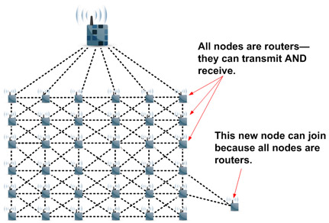
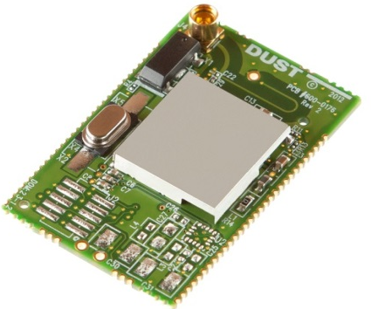
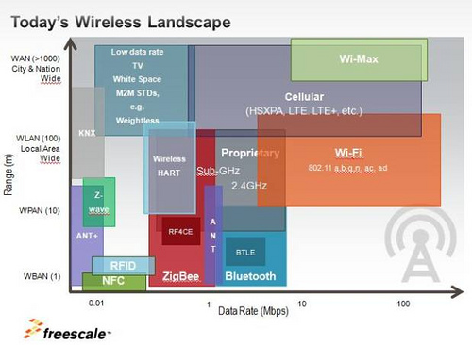
GRAND data format & transfer
SmartMesh (DustTechnologies)
2.4GHz band.
400By/s on the shelf, 4kBy/s in R&D stage
1Hz total acquisition rate:
➔1kBy/s
➔1GBy/day
is very comfortable
If more data flux is needed (FRBs):
WiMax?
Solutions in 10 years from now?
Industrials WILL be interested to look for solution.
~10$/unit
C. Timmermans @ GRAND workshop

