Slide 1
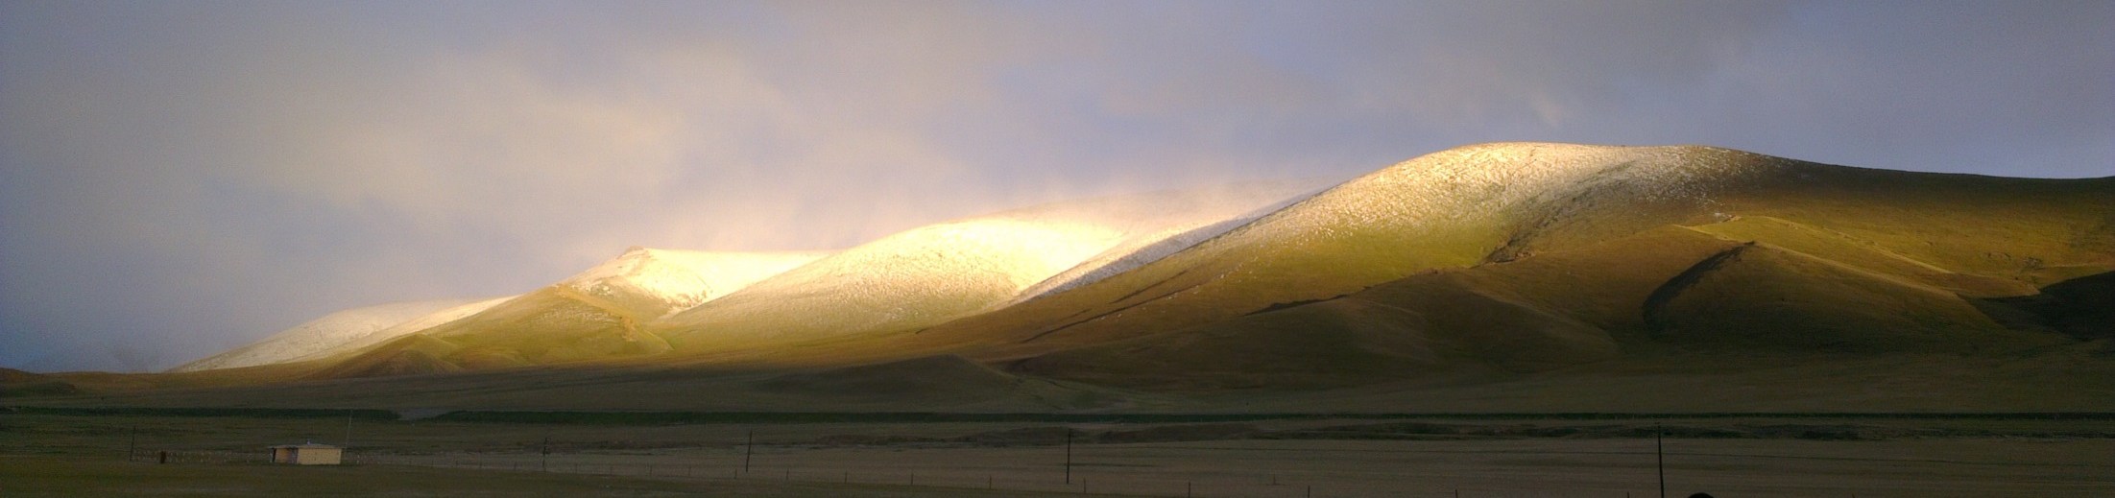
GRANDproto
Principle & Status
GRAND WhitePaper workshop
IAP, May 16, 2017
Olivier Martineau for the GRANDproto crew:
Wu XiangPing, Sandra Le Coz, Gu Junhua, Valentin Niess, David Martin, Jacques David, Charles Timmermans, René Habraken, Sijbrand de Jong, Didier Charrier, Gou QuanBu, Wang Zhen, Hu HongBo and local staff @ Ulastai

Slide 2
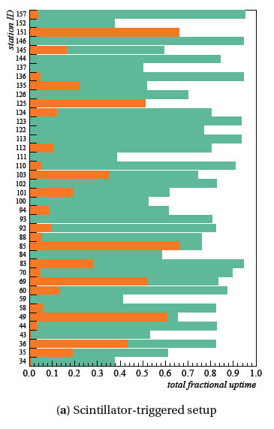
GRANDproto rationale
AERA live time
Context: autonomous radio-detection of EAS is a key step for GRAND project.
So far autonomous radio detection is performed with limited efficiency only:
  AERA self triggering
  ~10% for TREND (see Sandra’s talk).
Causes:
  Detector stability (TREND: ~25%)
  Large background rate kills DAQ live time (TREND & AERA).
  Air showers selection cuts strongly affect detection efficiency (TREND: ~50%)
These can be cured!!!
➔ GRANDproto: dedicated set-up for air shower autonomous radiodetection with high efficiency + high purity
S. Jensen PhD, Nijmegen, April 2016

Slide 3
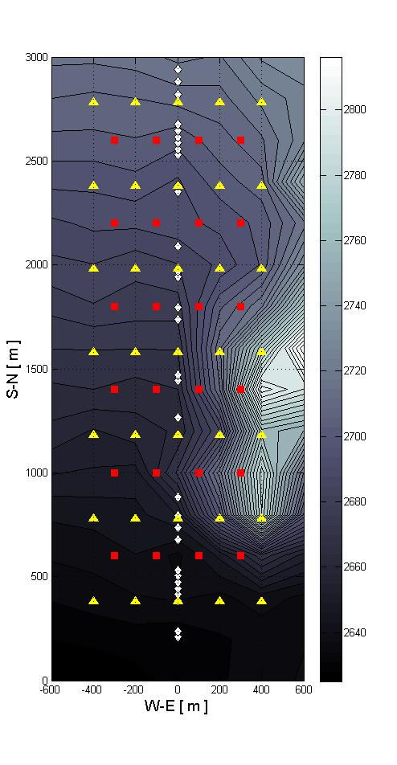
GRANDproto layout
Antennas
Scintillators
Radio-array of 35 antennas with 3 arms and dedicated DAQ with 100% duty cycle up to 1kHz trigger rate.
Array of 24 scintillators on the radio array site, running independently.
Layout designed for optimal detection efficiency for showers coming from North & 30<θ<70°
Scintillator array to be used as an EAS-pure detector for offline cross-check allowing quantitative determination of radio detection efficiency and background rejection performances.
Goal: establish radio-detection as a valid tool for autonomous detection of EAS (i.e. detection efficiency + background rejection)

Slide 4
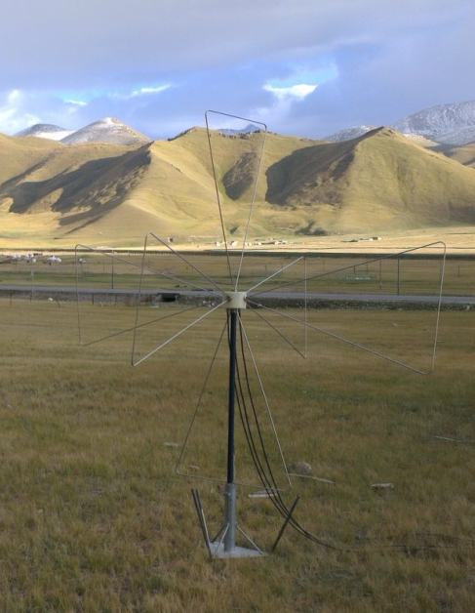
GRANDproto radio array
3D antennas (SUBATECH design, Xi’An prod)
  Reconstruction of full polarization info
  ➔ signature for EAS/background rejection (ε?)
Antennas running on site since Summer 2014. All produced, waiting for shipping.
E ┴ v
E ┴ B
E

Slide 5
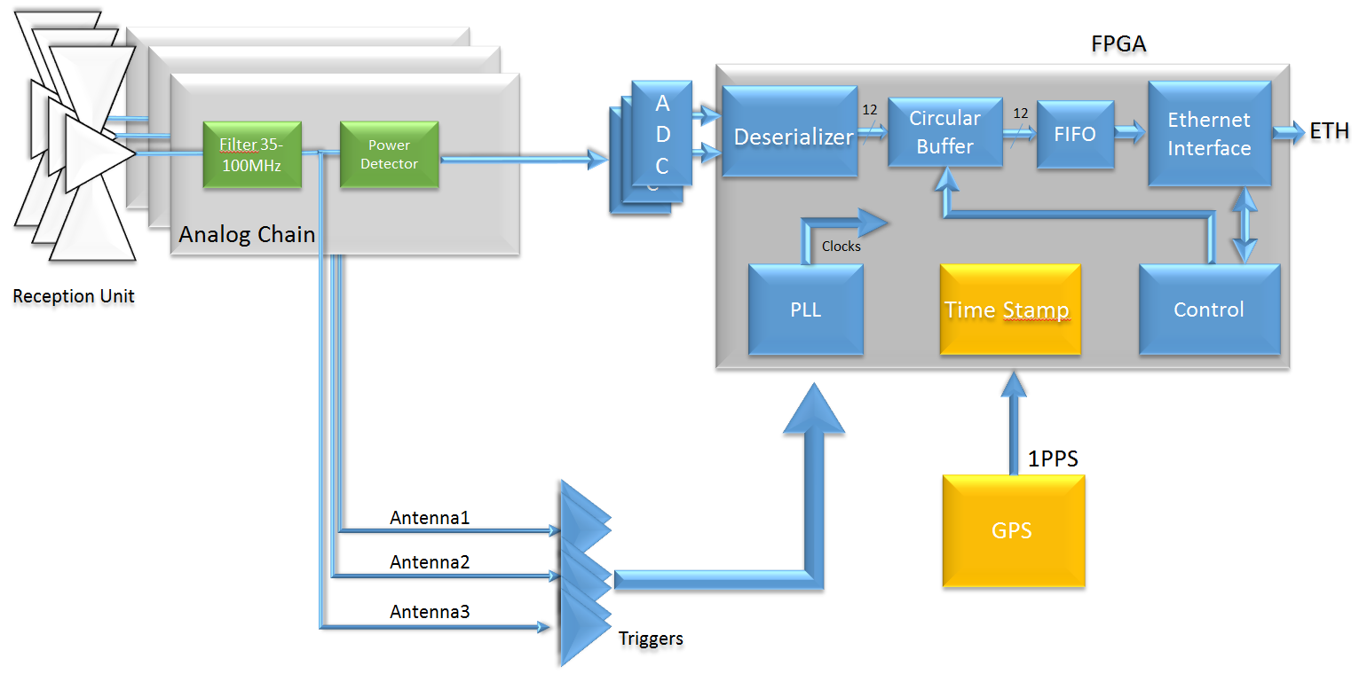
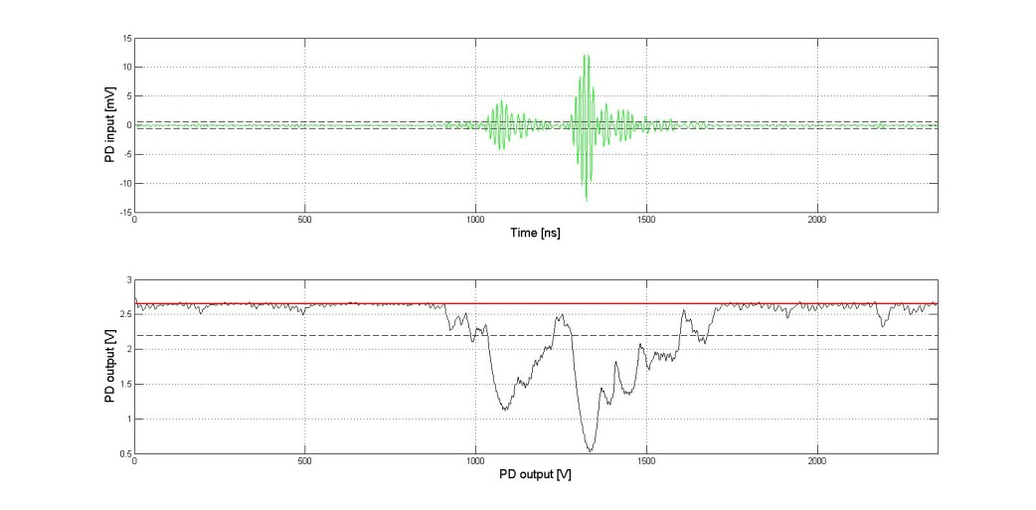
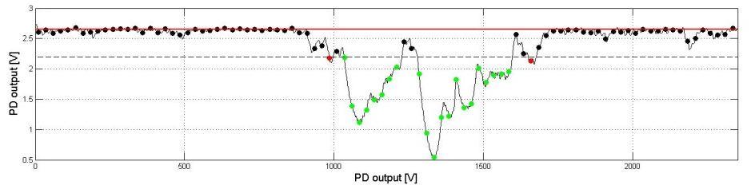
GRANDproto radio array
Short waves
DAQ system (LPNHE design & proto, French company prod)
  Trigger on 30-100MHz analog signal
  Enveloppe detection
  Front end digitization
  GPS timing
  100% duty cycle up to ~1kHz
  Internal calibration system
Data transfer through 21CMA optical fiber to DAQ room (<10km)
Simulated signal at filter output
Simulated signal at
power detector output
Simulated signal at
ADC output (60MS/s)

Slide 6
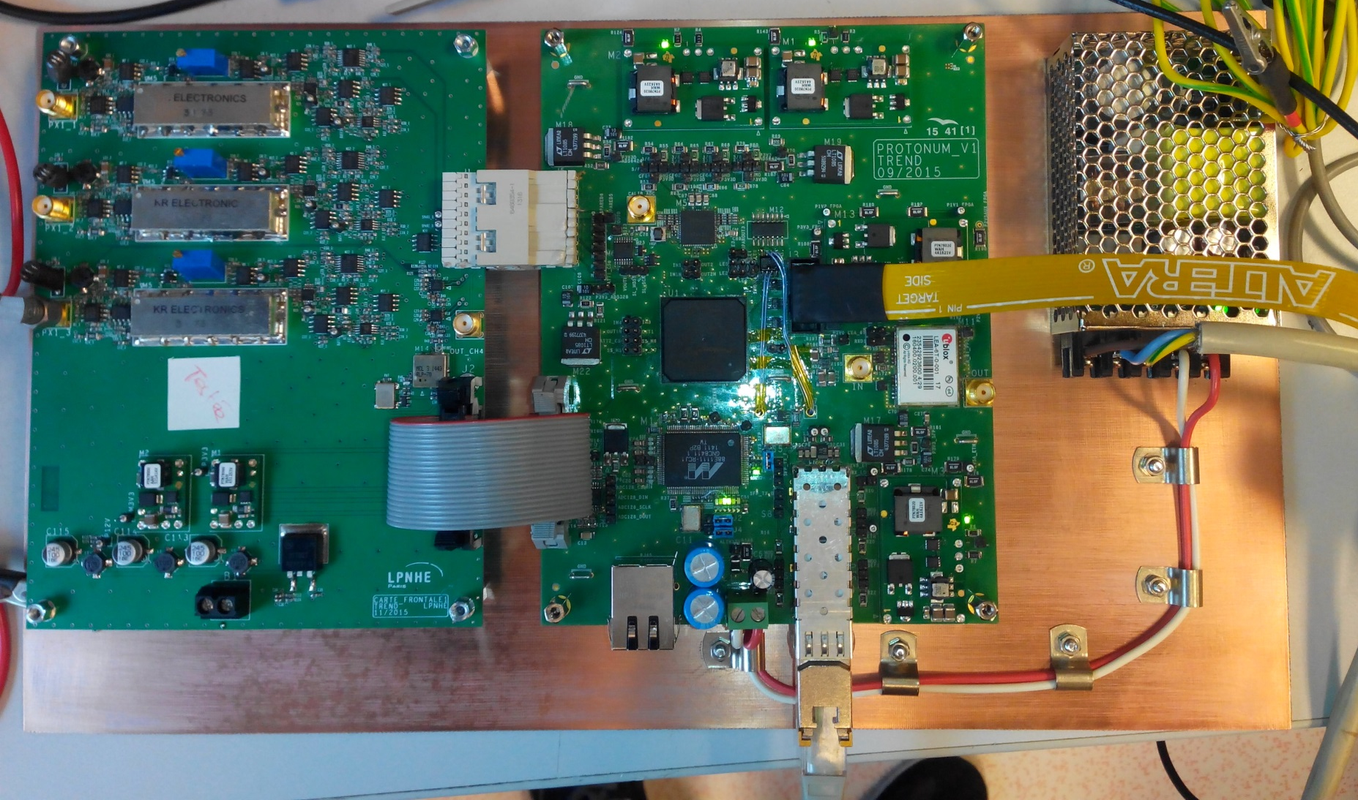
GRANDproto DAQ
ANALOG CARD
DIGITAL CARD
Input:
3 channels
x, y, z
d’une antenne
ADC 4 channels
(100MS/s + 12 bits)
FPGA
Filters
35-100MHz
Power detectors
(envelop detection+ log amplification)
GPS
(trigger time stamp)
Trigger on filtered signal
Optical transceiver
Prototype cards ready November 2015. Final validation December 2016.

Slide 7
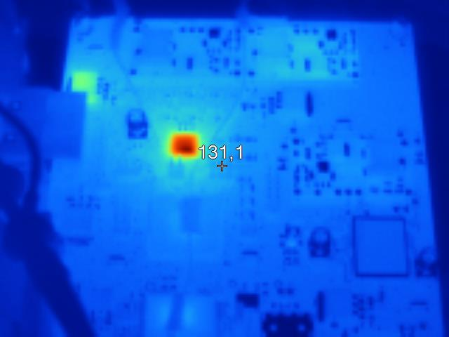
Hardware can be harsh sometimes
Inverted implantation mask for ADC in IN2P3 componant library
Bad temperature dissipation
Heratic componant behavior
3 months to figure this bug out and fix it.
Infrared picture

Slide 8
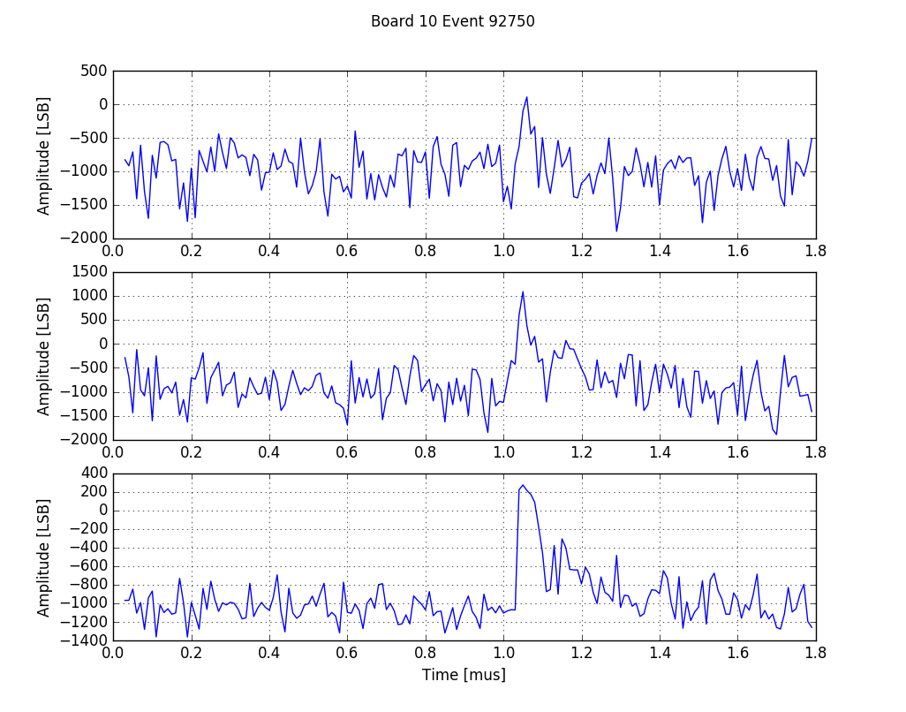
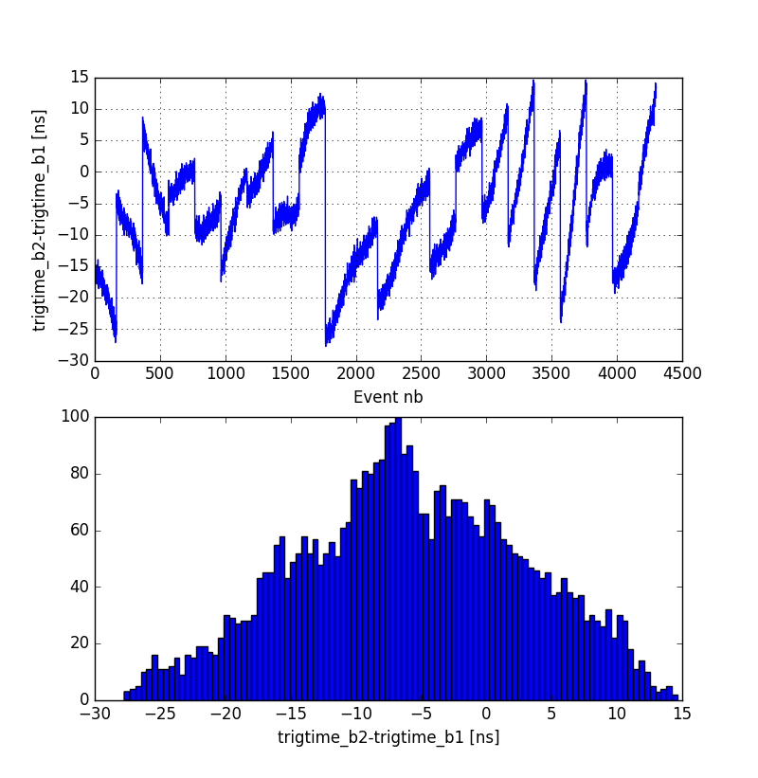
GRANDproto DAQ status
DAQ tested on-site May+August+December 2016. Now all good!
DAQ software (Gu Junhua) now 90% developped. ~20 machines dedicated to DAQ now waiting in Ulastai.
Ulastai, 10/12/2016
EW-channel
NS-channel
Vert-channel
Relative GPS timing: σ ~8ns
(coincident pulse on 2 cards)
Clean signals

Slide 9
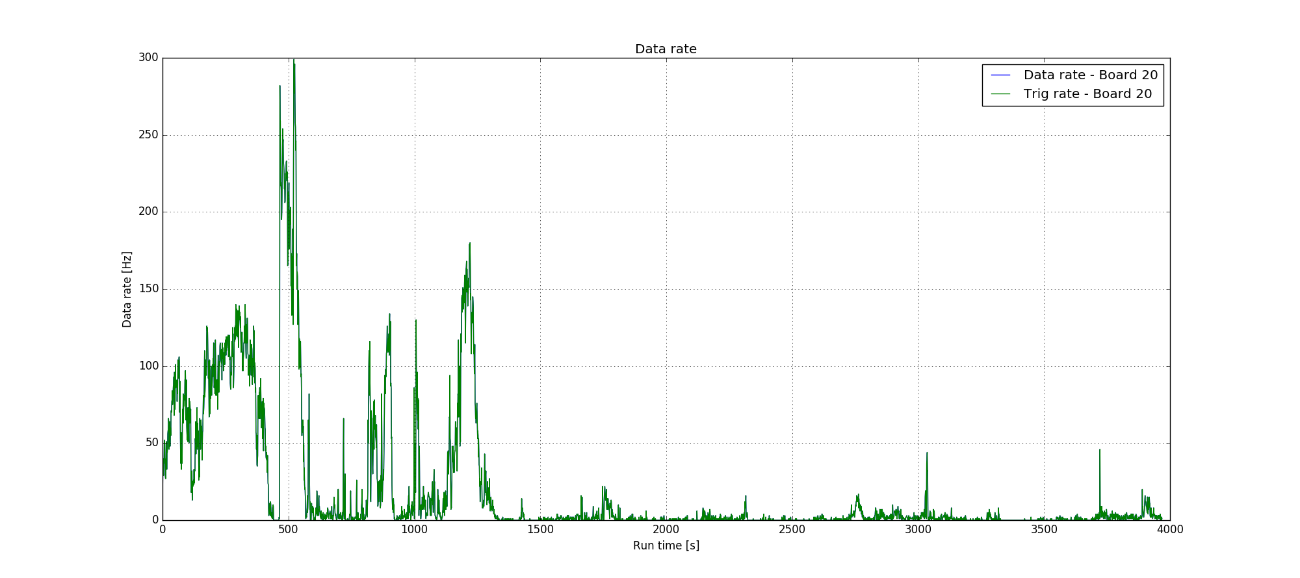
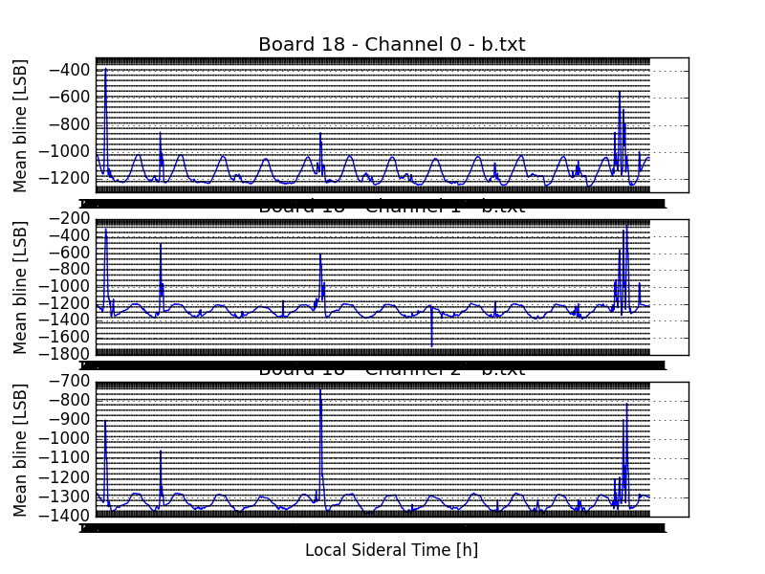
GRANDproto DAQ status
100% efficiency up to few kHz ☺
Long term monitoring: running since ~15 days @ Ulastai
Clear 24h-periodic fluctuation of baseline ➔ galactic noise.
Few episodes of noise (correleted on each channels)
Stable response ☺

Slide 10
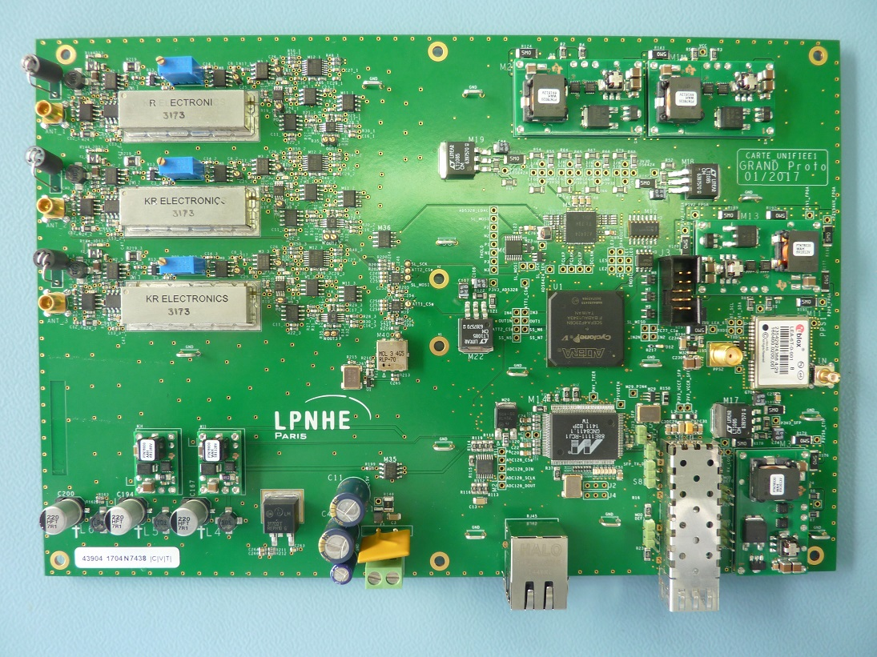
GRANDproto DAQ status
Improved design fro production: now digitial + analog stages merged on one single board.
2 samples arrive at LPNHE today for validation
Production of 33 more units before end of June ➔ instalation this fall.
STAE picture, May 12, 2017

Slide 11
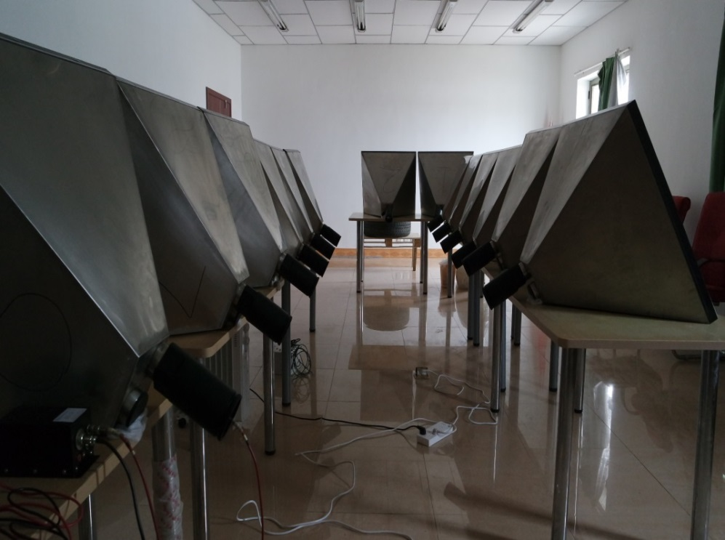
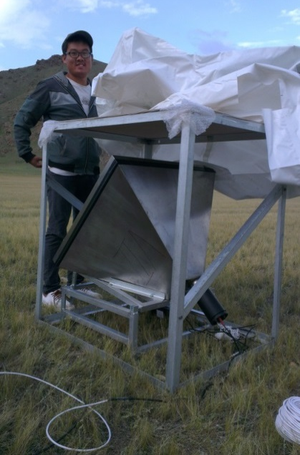
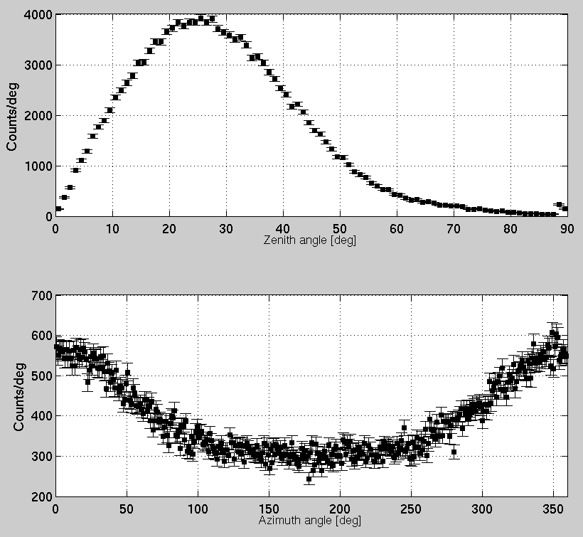
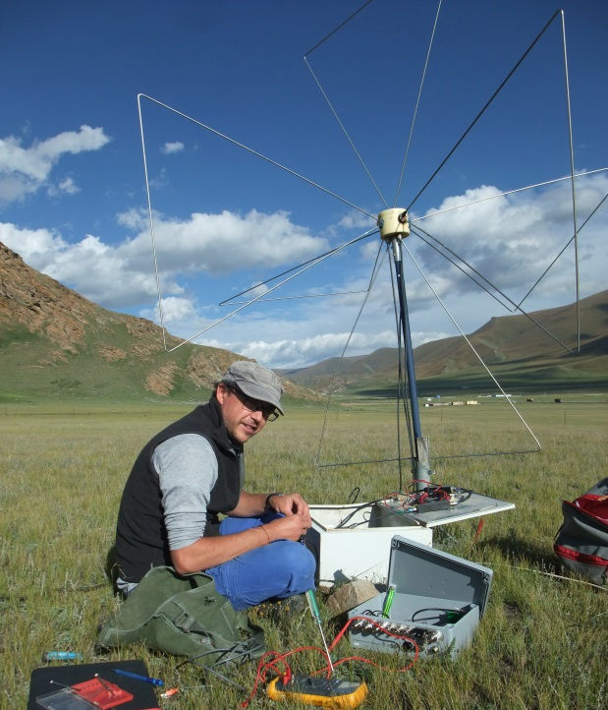
GRANDproto status
6 scintillators deployed summer 2015 for tests (Gou Quanbu, IHEP).
Tilted orientation for improved sensitivity to inclined CR showers.
Reconstruction consistant with expectation for CR events.
All scints delivered in Ulastai waiting for deployment.
Zenith distrib
Azim distrib
3 units of AUGER-AERA DAQ deployed summer 2016; Will be integrated to GRANDproto « standard » acquisition (August 2017).
GREAT tool for DAQ efficiency cross-checks, cross calibration…
Especially important in the perspective of GRANDproto300 (AERA DAQ)

Slide 12
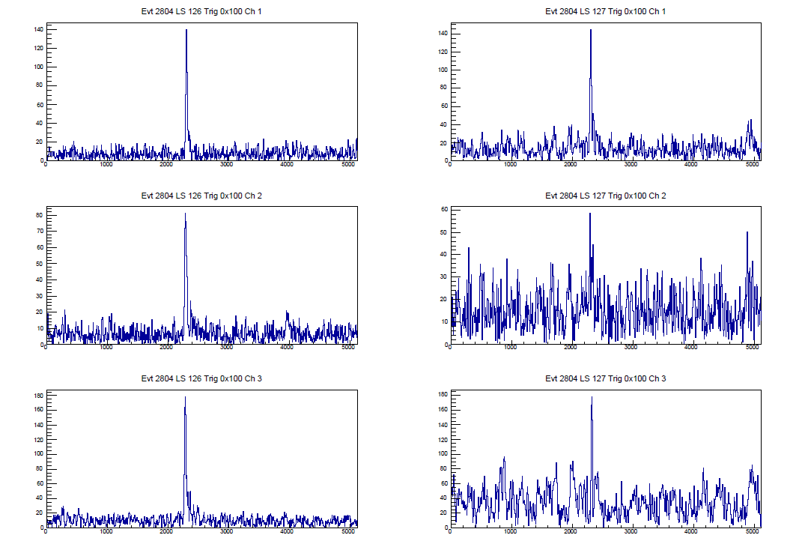
AERA DAQ results
Exemple of a coincident event between 2 AERA antennas

Slide 13
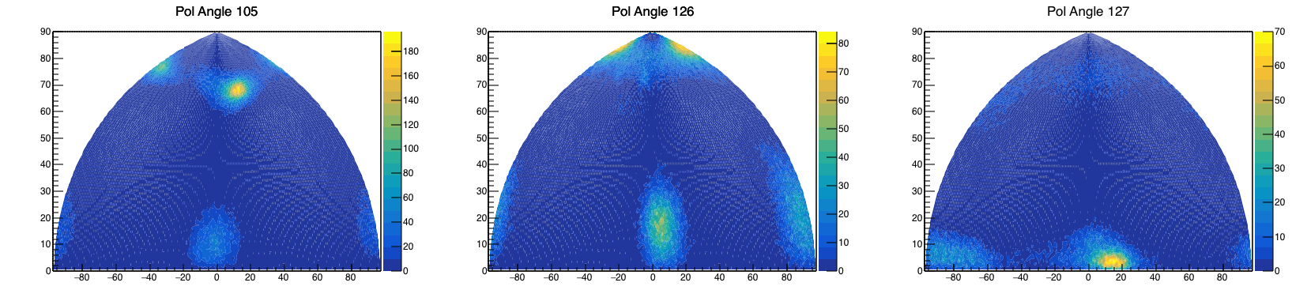
AERA DAQ results
Clear clustering of polarization vector direction
  Good amplitude/polarization resolution
  Efficient tool for background rejection ☺

Slide 14
Conclusion
GRANDproto as a tool to establish the possibility to perform efficient EAS detection+identification with high efficiency.
Tool: 3D antennas + fast DAQ.
3 AERA front-end units will be included in GRANDproto35 DAQ (in preparation for GRANDproto300).
Now all looks in good shape. Fingers crossed for production. Timeline targets start in December 2017.

