Slide 1
Experimental Hints on BSM physics from run II
Dissecting LHC Results
Paris
April 20, 2017
Dirk Zerwas
LAL Orsay
Introduction
The anomalous SM
Exotics
Supersymmetric models
Conclusions

Slide 2
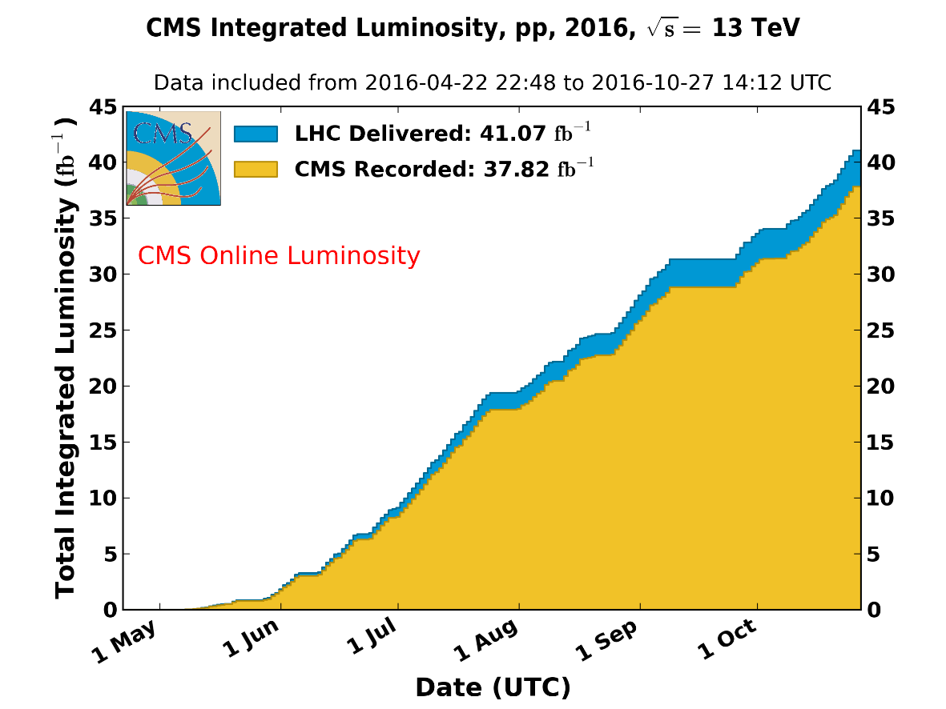
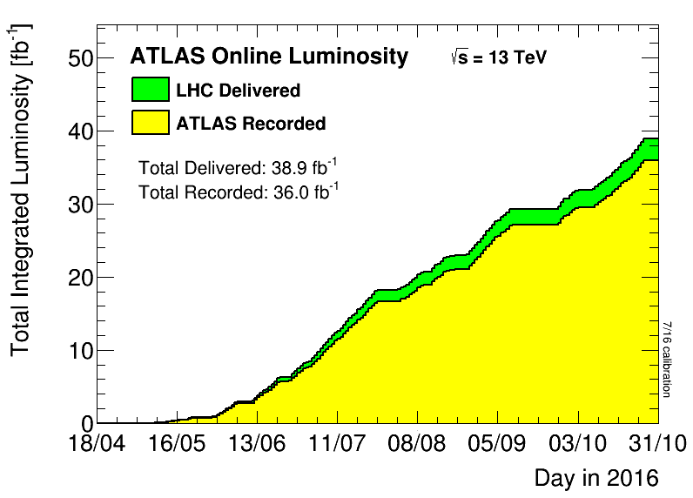
The LHC
2016:
Proton-proton
13TeV
40fb⁻¹
Order of (2030): 3000fb⁻¹ with 200 pileup events

Slide 3
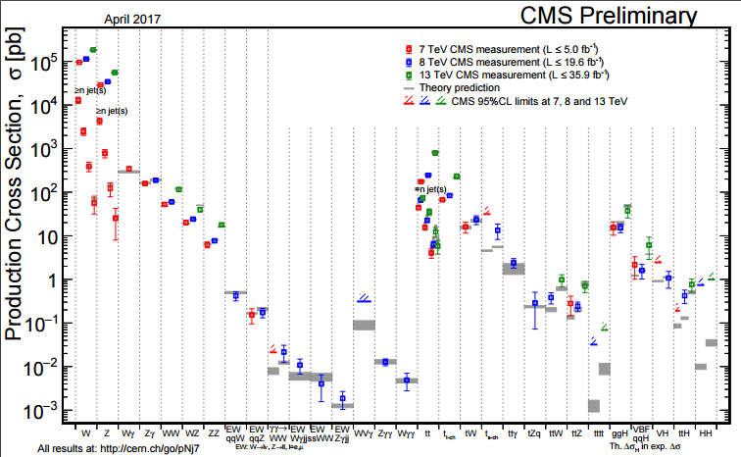
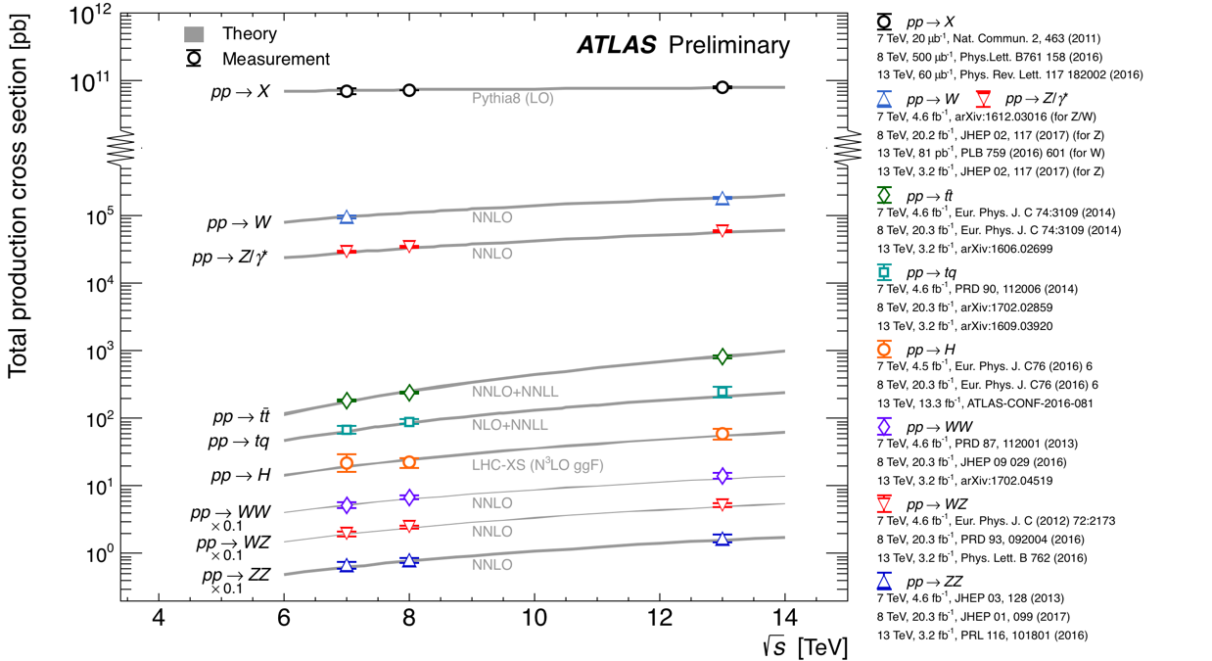
The SM cross sections
Cross sections measured over many orders of magnitude all in agreement with prediction
and as function of the CM energy

Slide 4
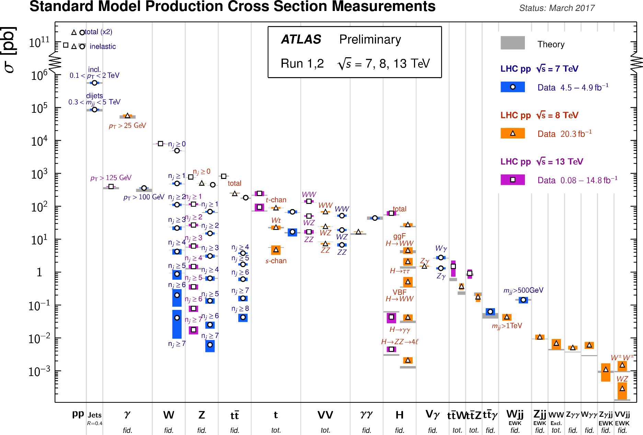
The SM cross sections: look closer?
Fiducial cross sections: no exciting deviations (glass half-full or half-empty?)

Slide 5
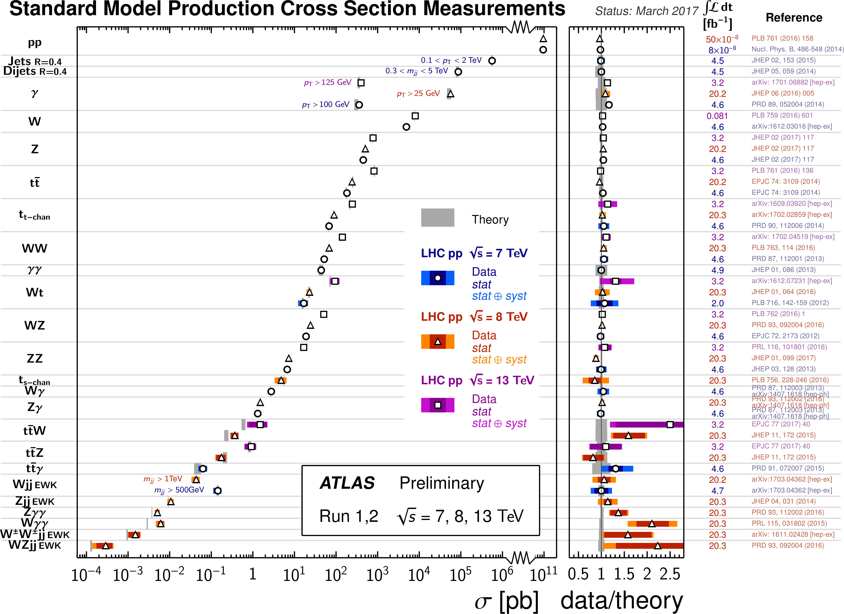
The SM cross sections
Fiducial cross sections: Zγγ and Wγγ, but the errors….
And Zγγ and Wγγ in CMS is as Standard as possible

Slide 6
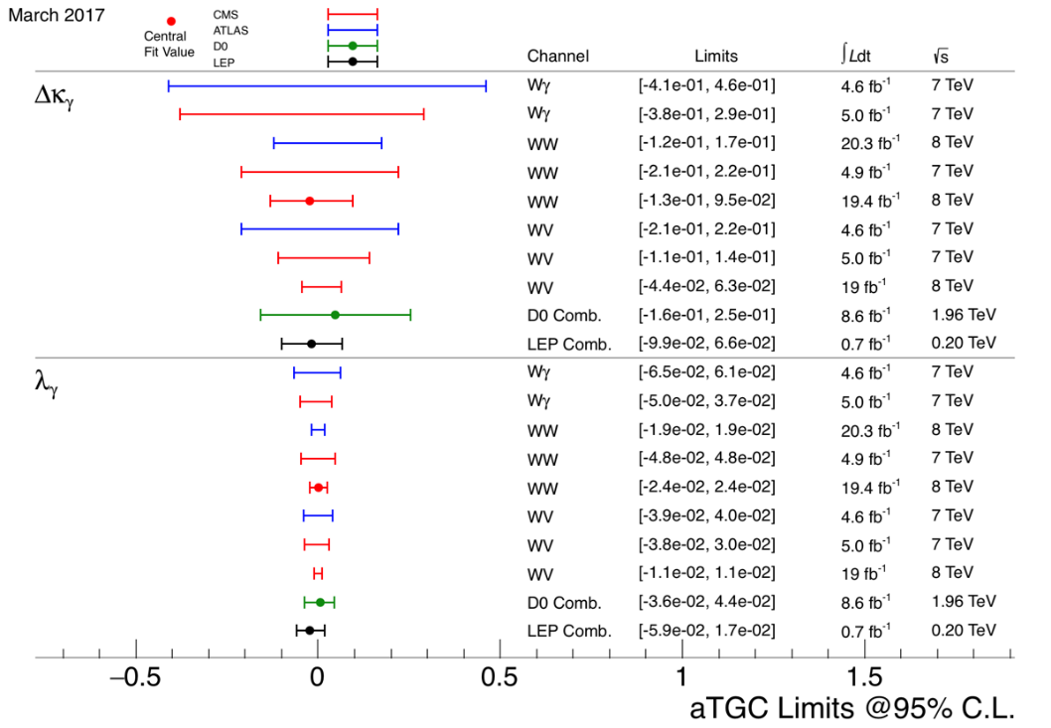
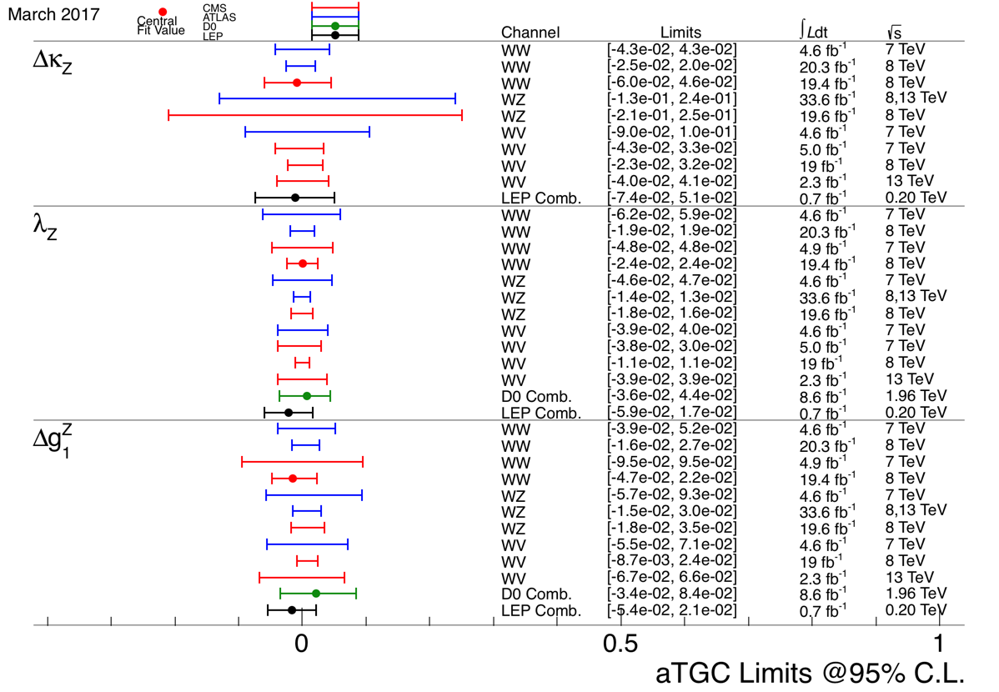
TGV anomalous W couplings?
Not equivalent to SM cross section measurement, eg deviations can be at high pT etc
WWγ frighteningly standard
Starting to be as good as LEP….
WWZ more of the same

Slide 7
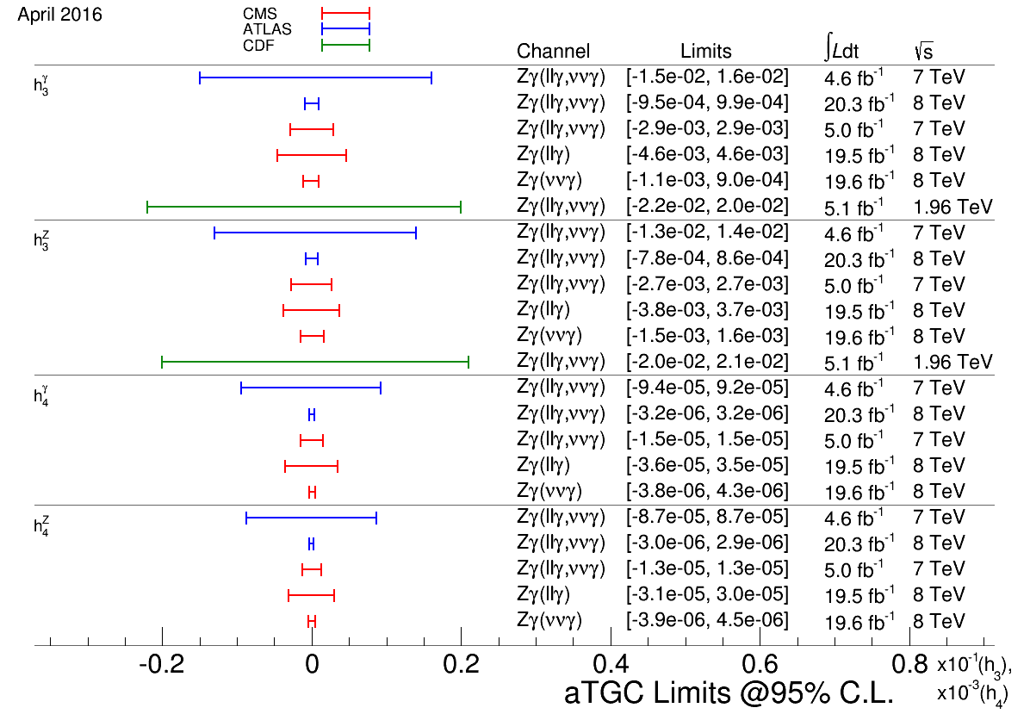
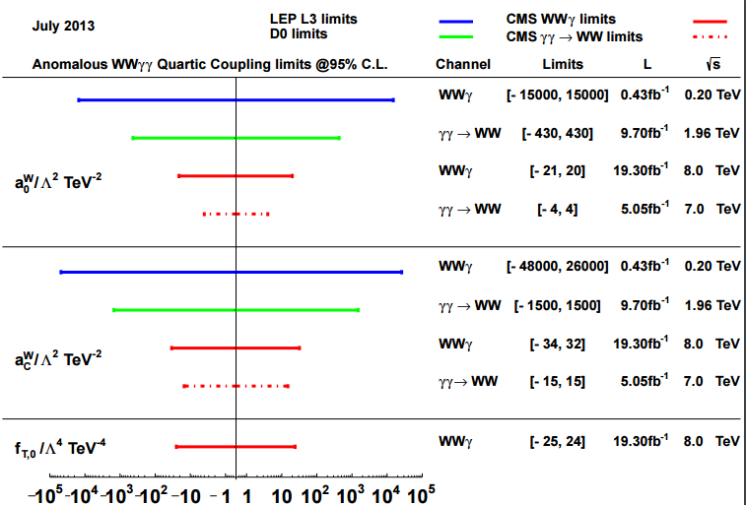
TGV anomalous Z couplings or QGCs for W?
Zγγ and ZZγ frighteningly standard: interval includes SM value
Quartic coupings: all ok

Slide 8
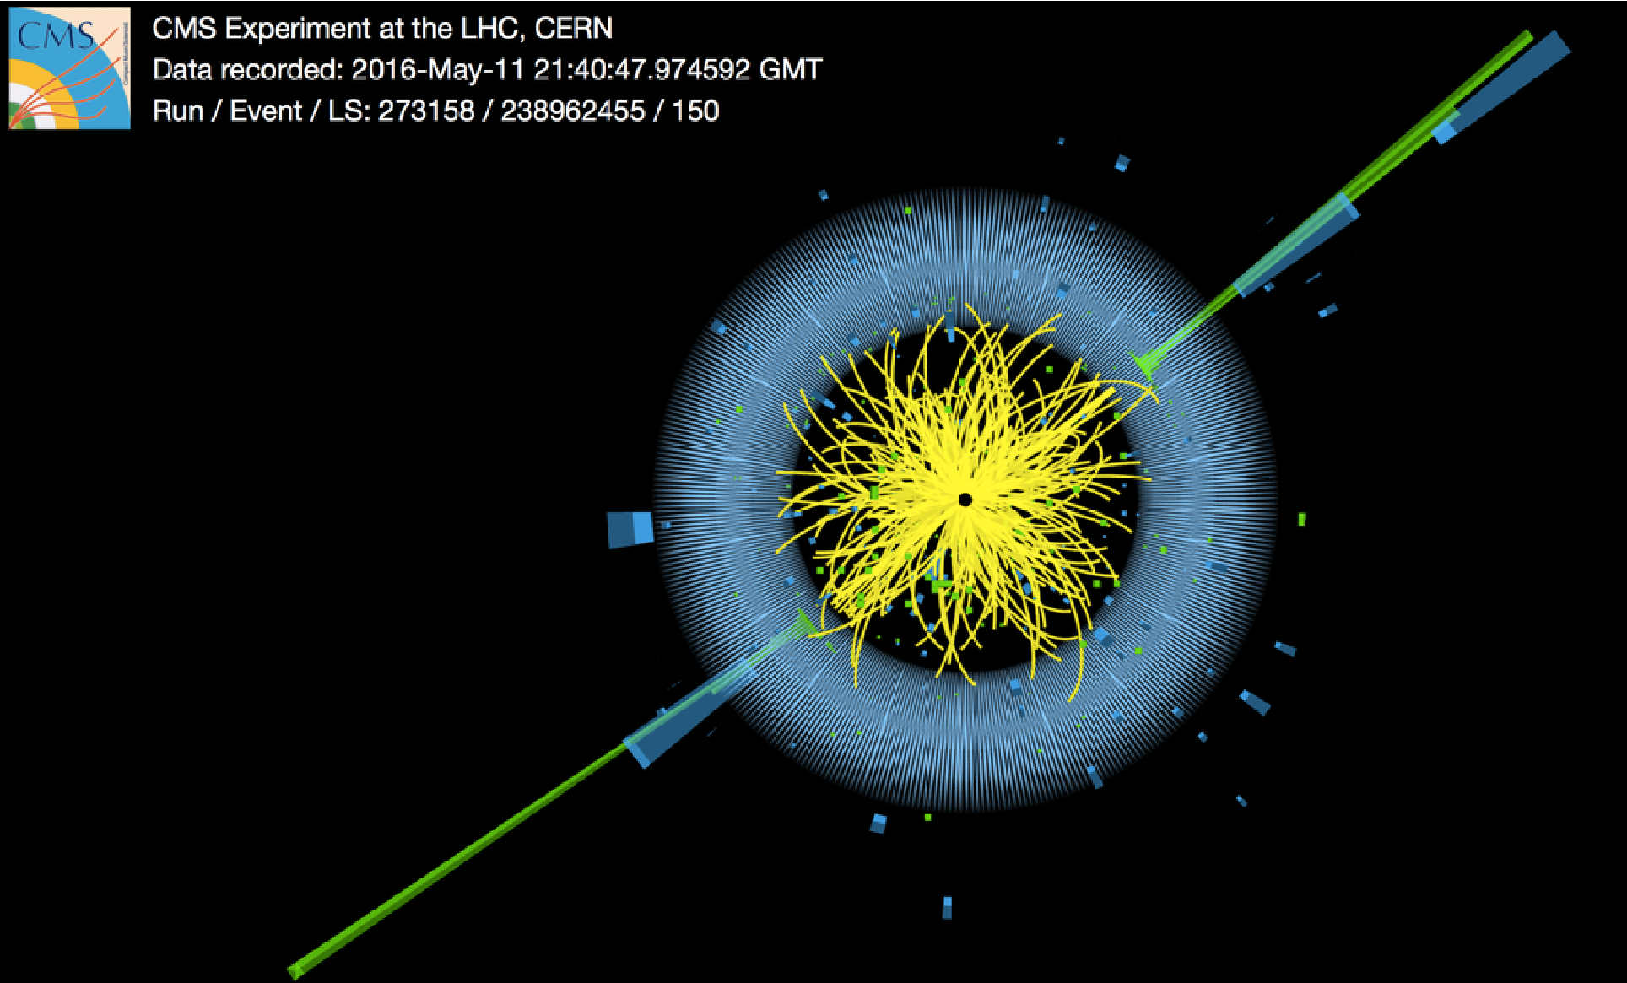
7.7 TeV dijet

Slide 9
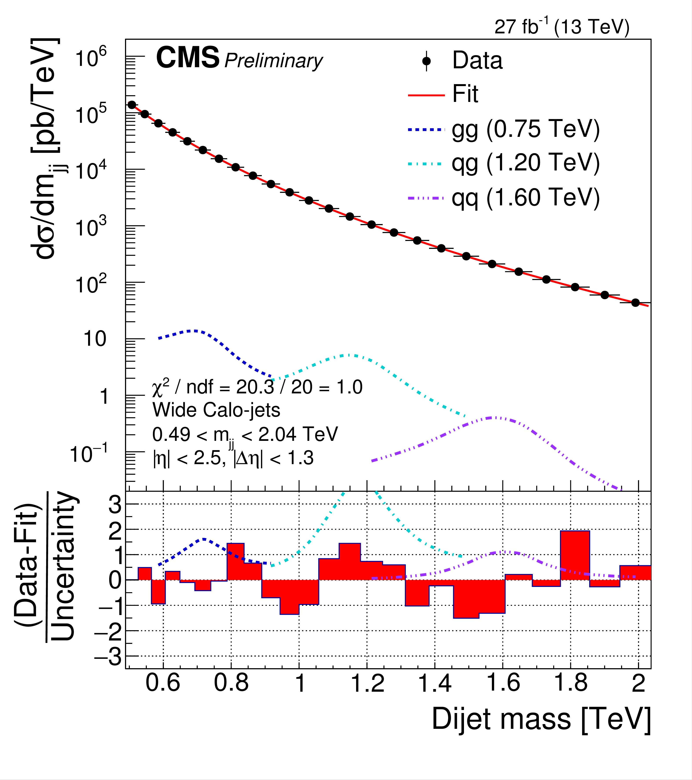
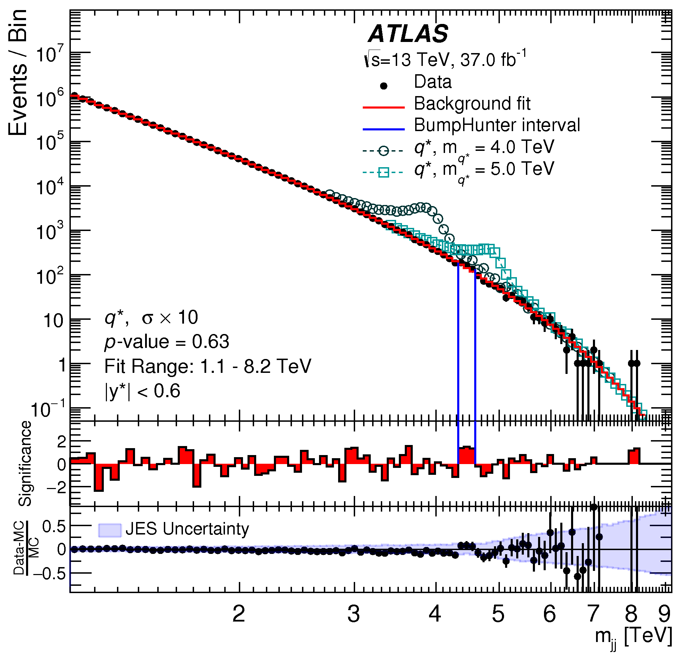
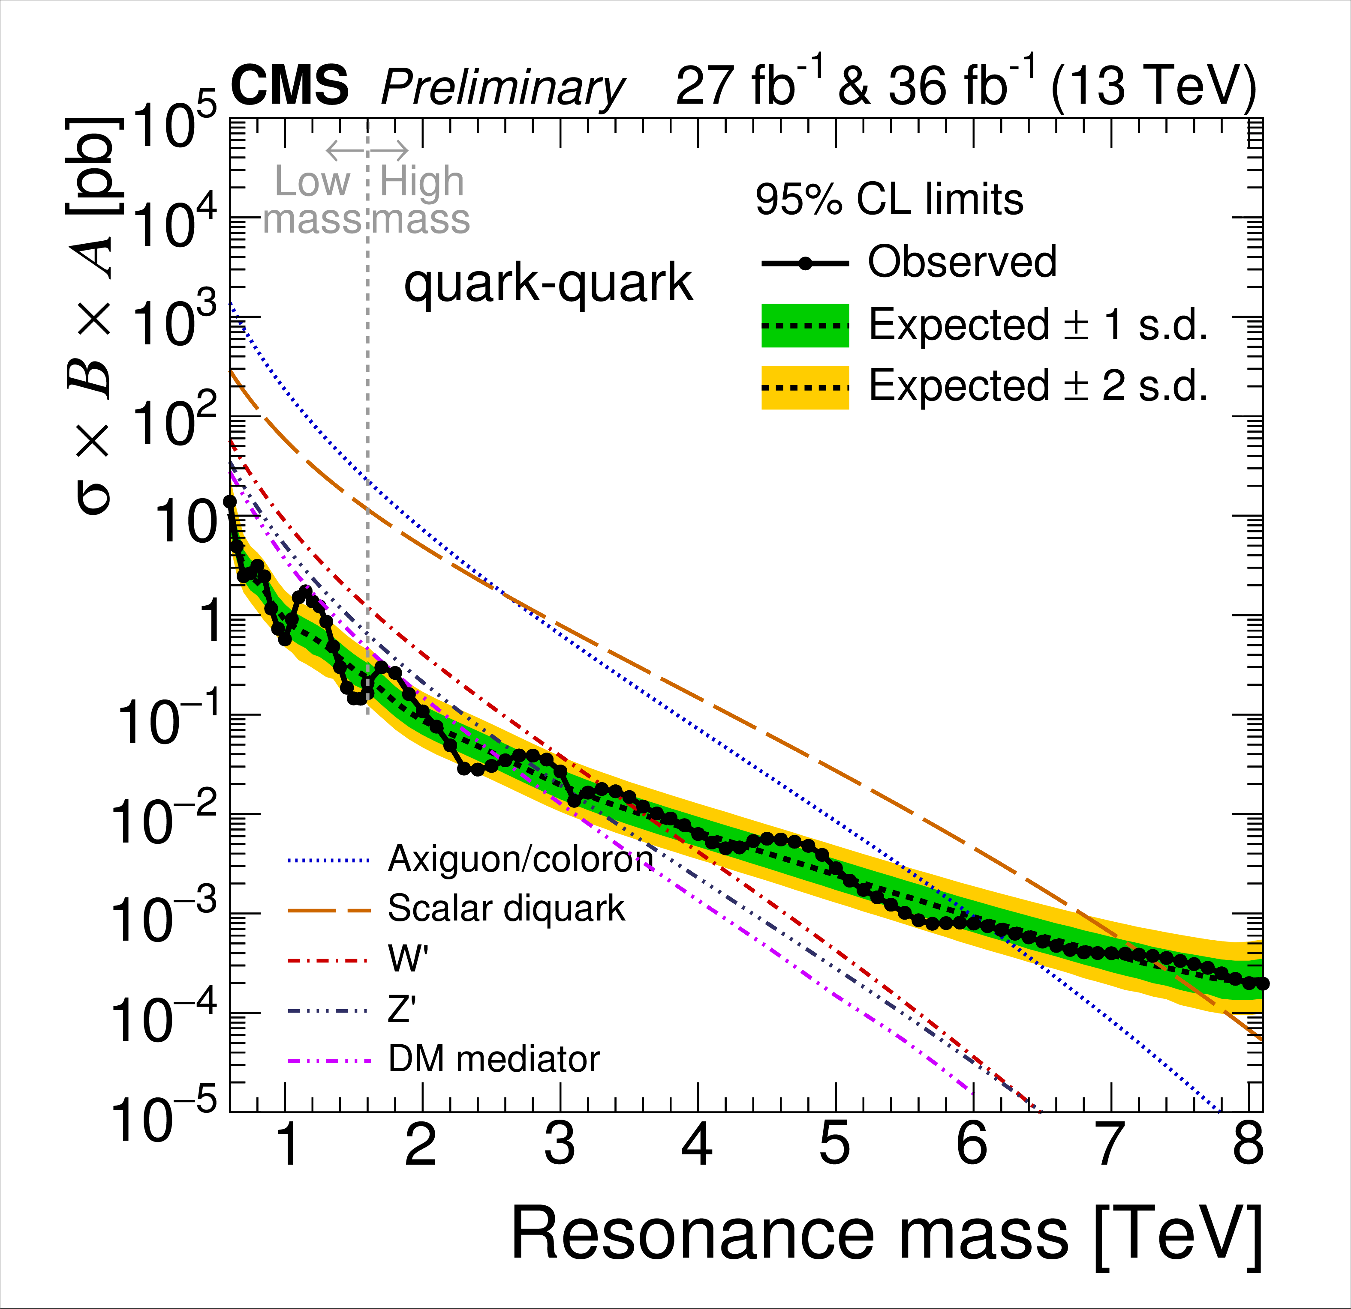
Dijet resonances
Di-jet searches:
Bump hunting
No bump observed
Can be applied to many different models
Depends on final stats q/g
Limits in the n-TeV mass range

Slide 10
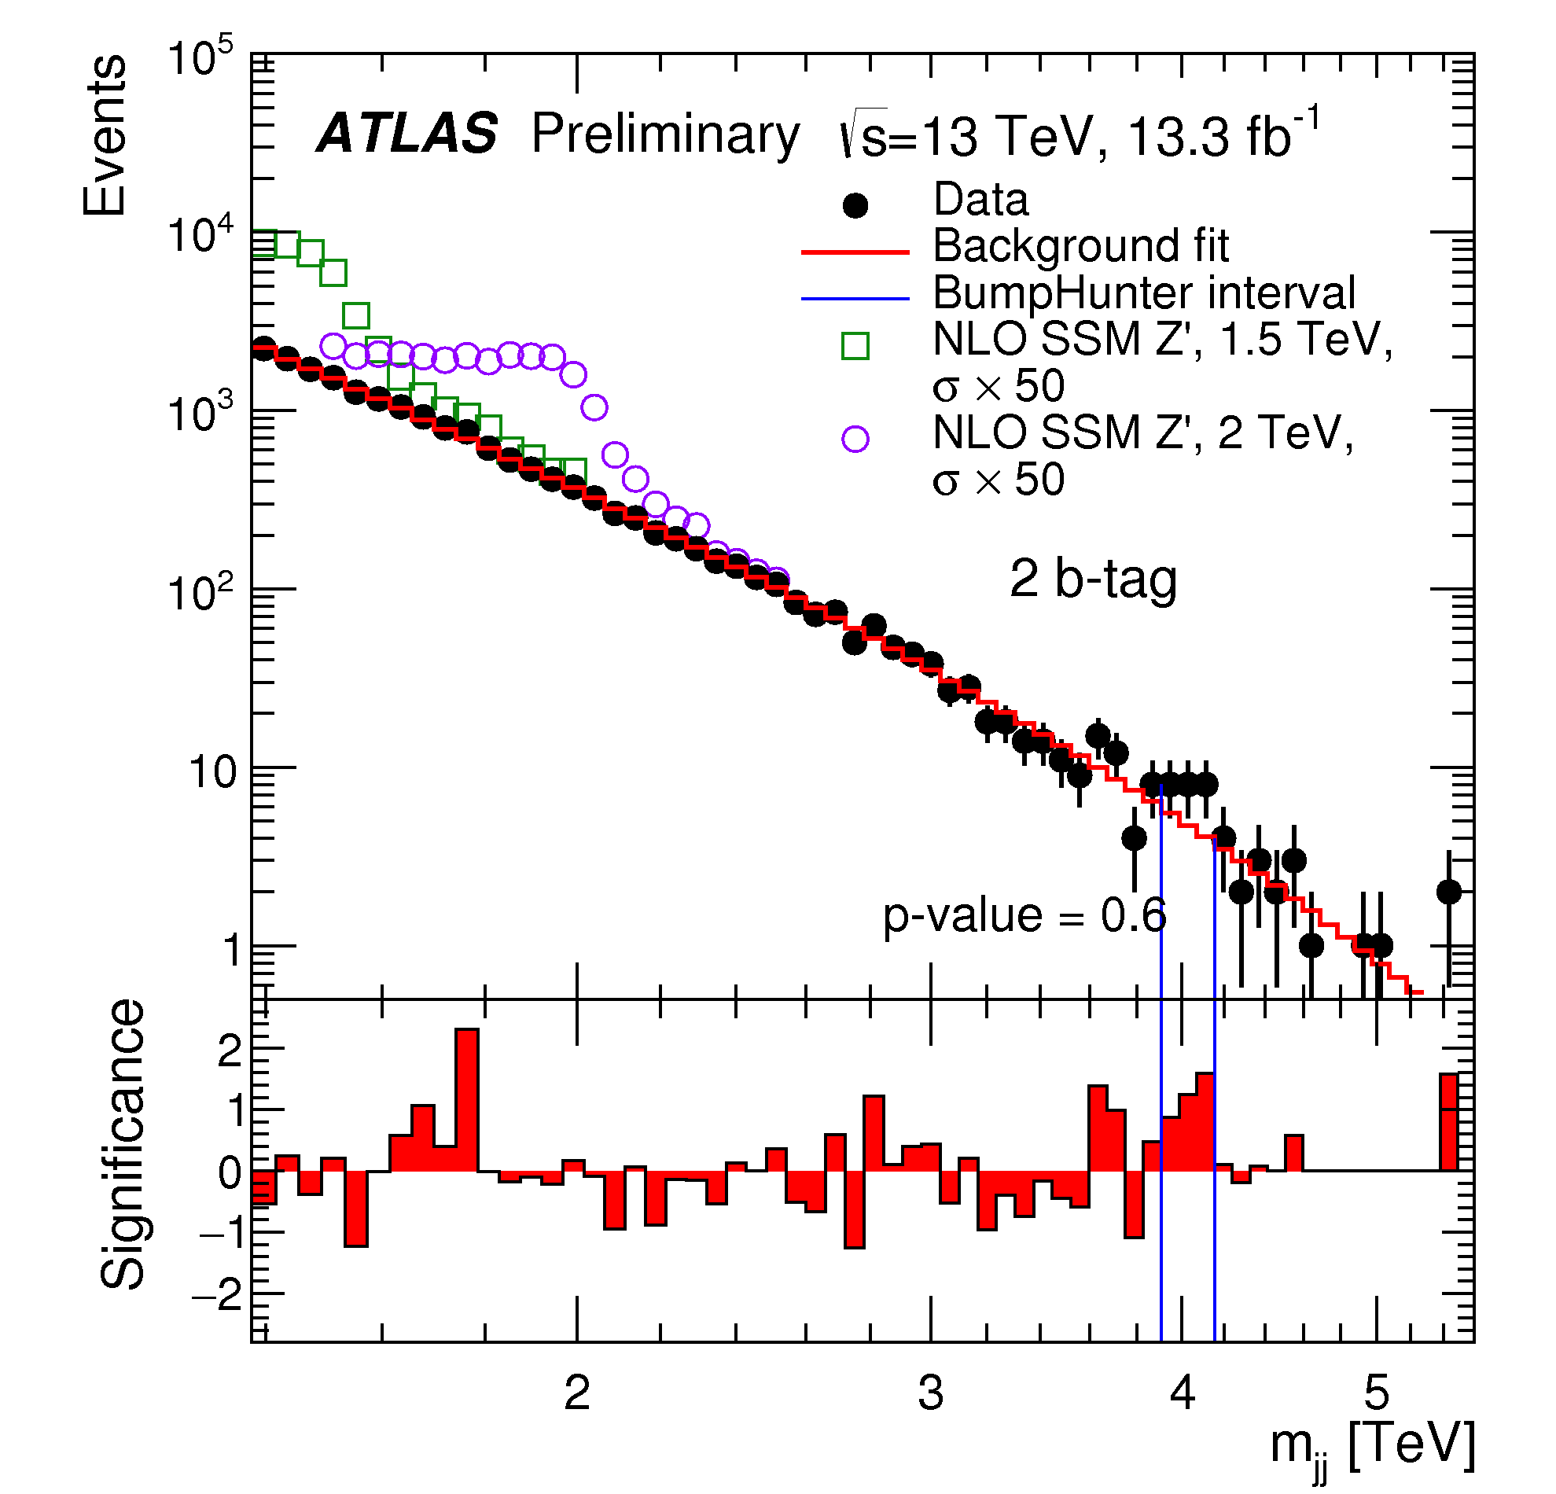
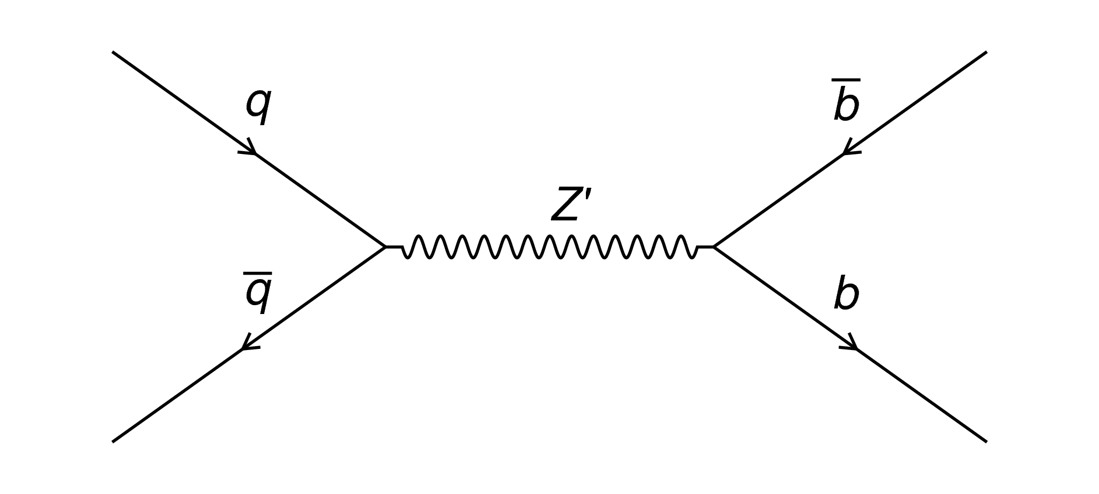
Dijet resonances with bjets
Di-jet searches:
Bump hunting
2 btags
Some interesting bins
Full stat to come

Slide 11
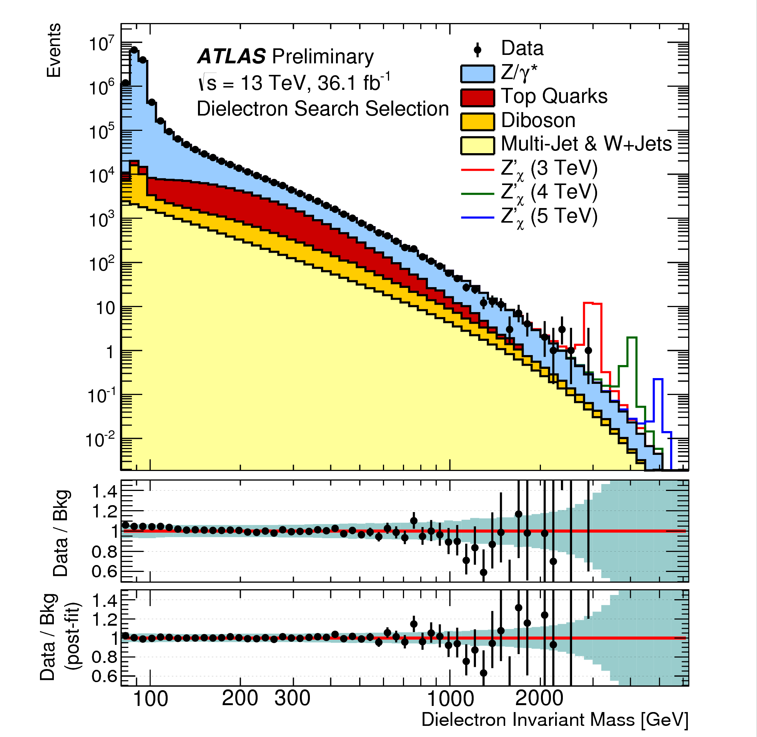
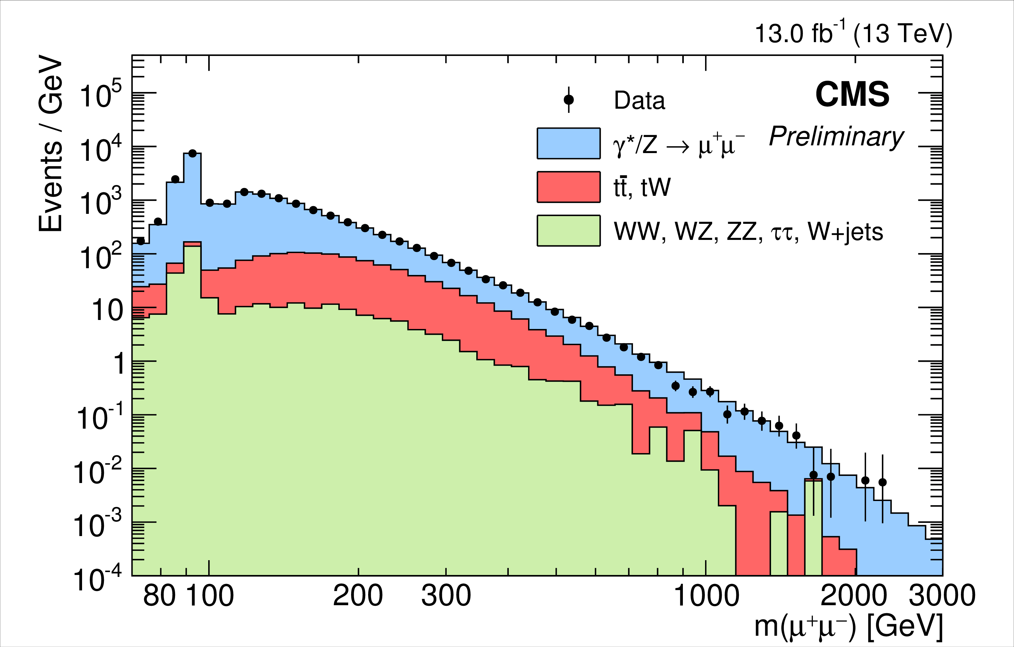
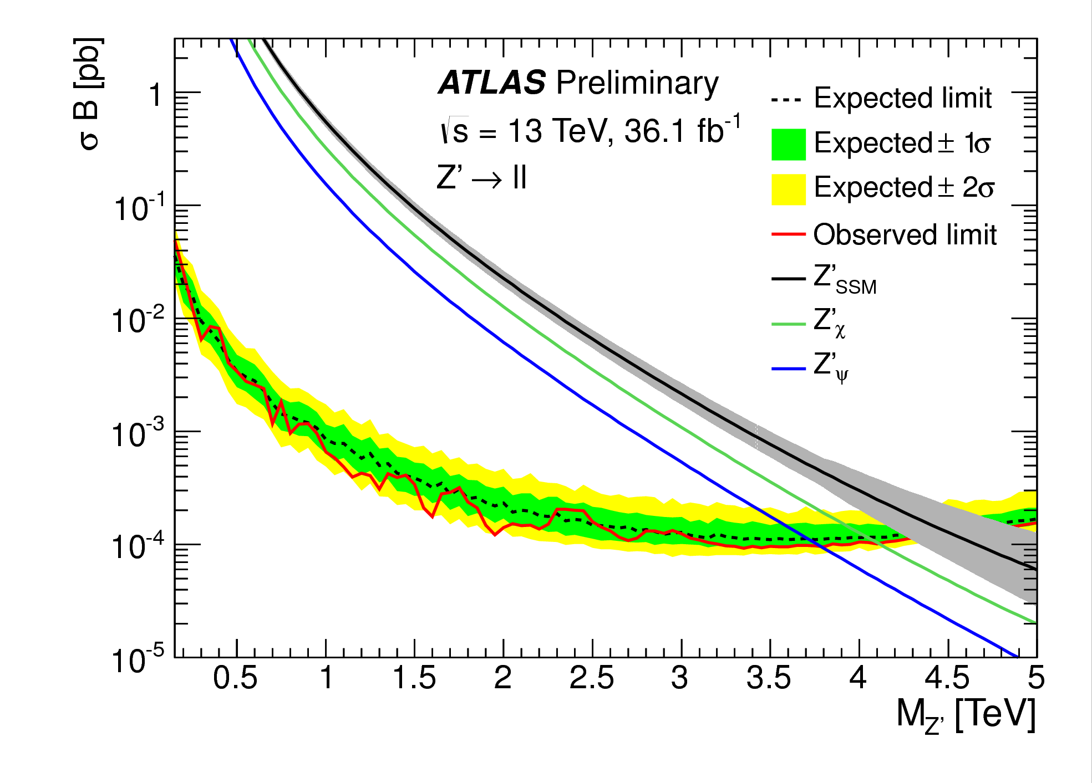
Di-lepton resonances
Di-lepton searches:
Bump hunting
Single bin deviations (also deficits)
No bump observed
Can be applied to many different models
Limits in the n-TeV mass range

Slide 12
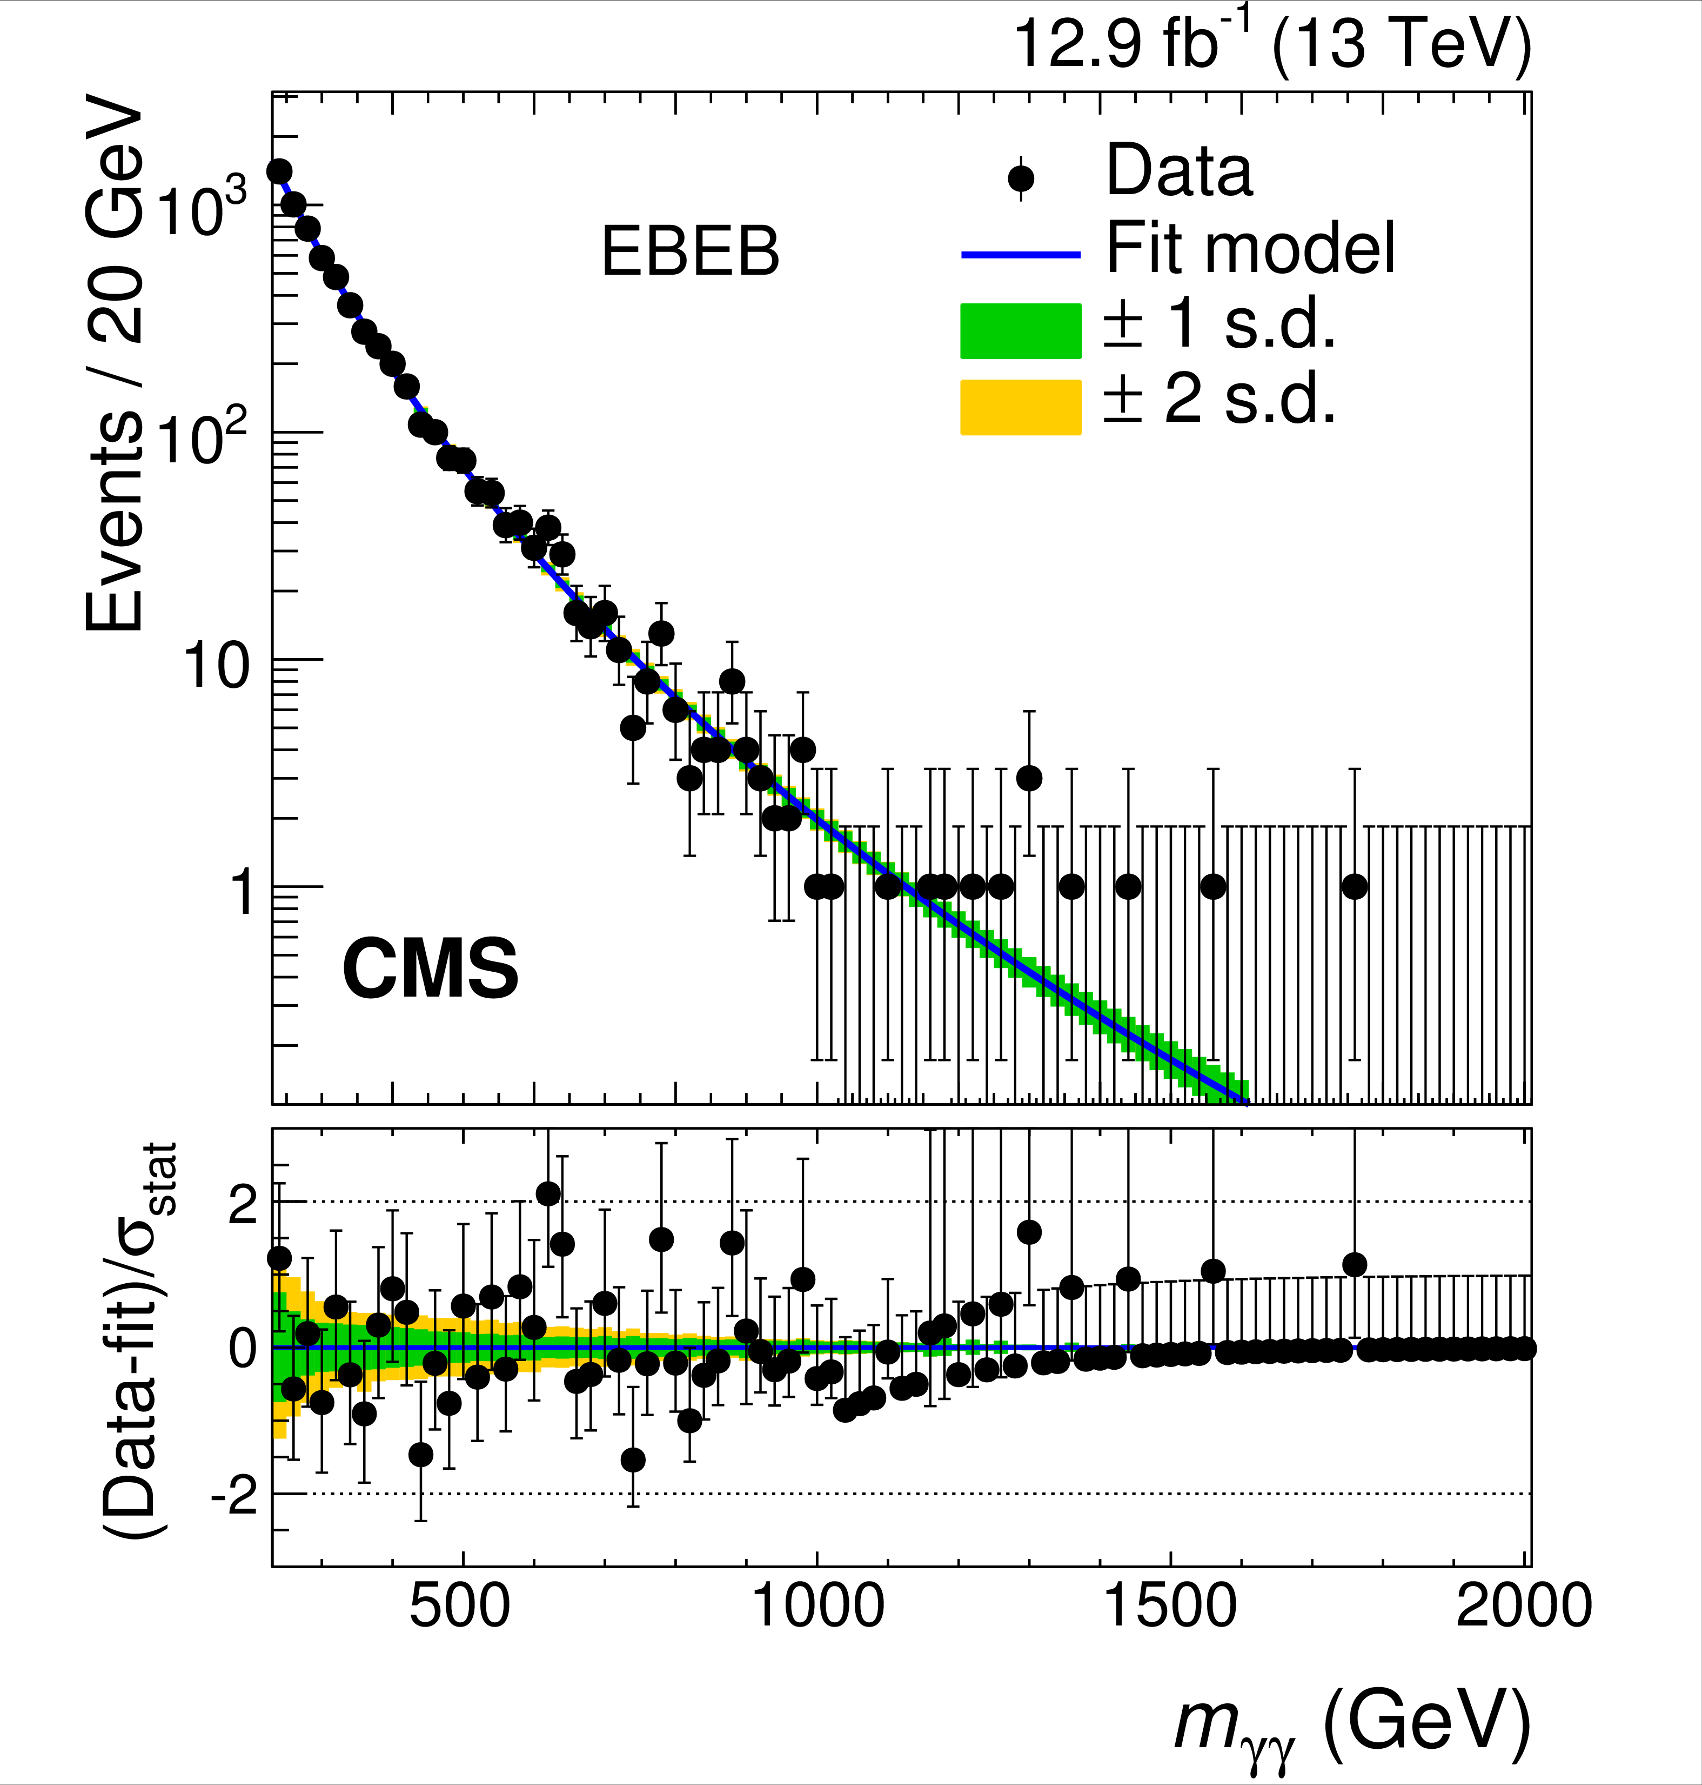
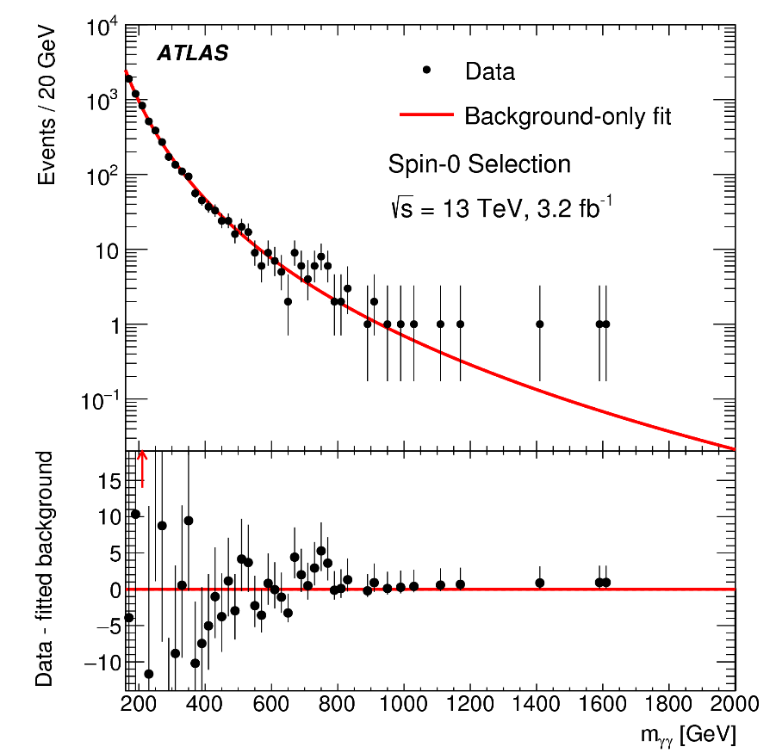
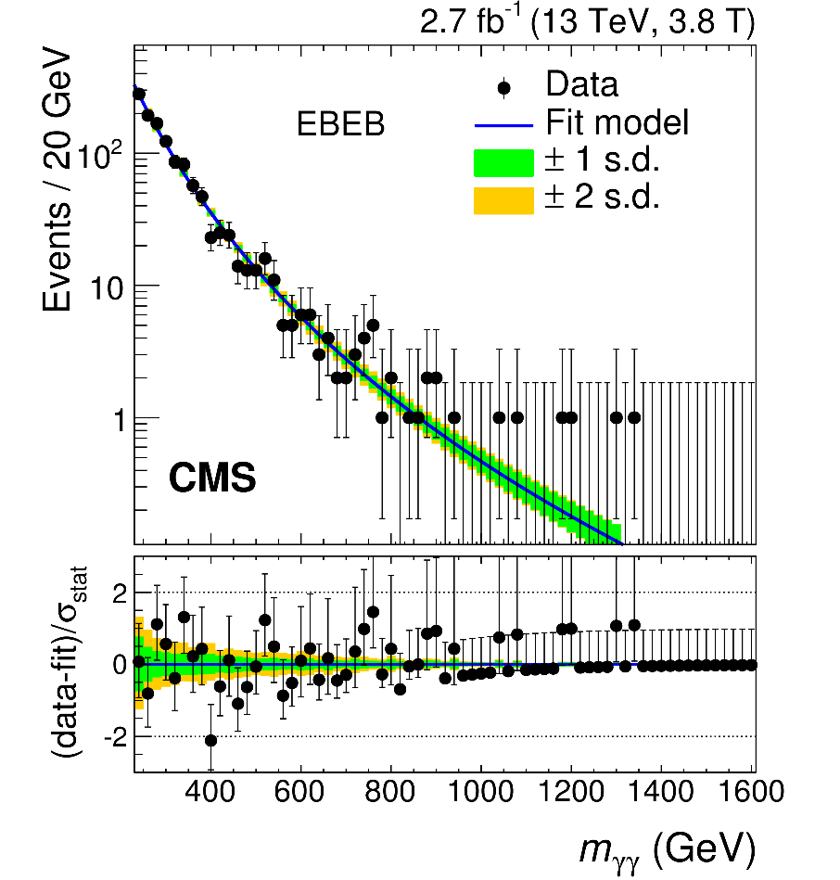
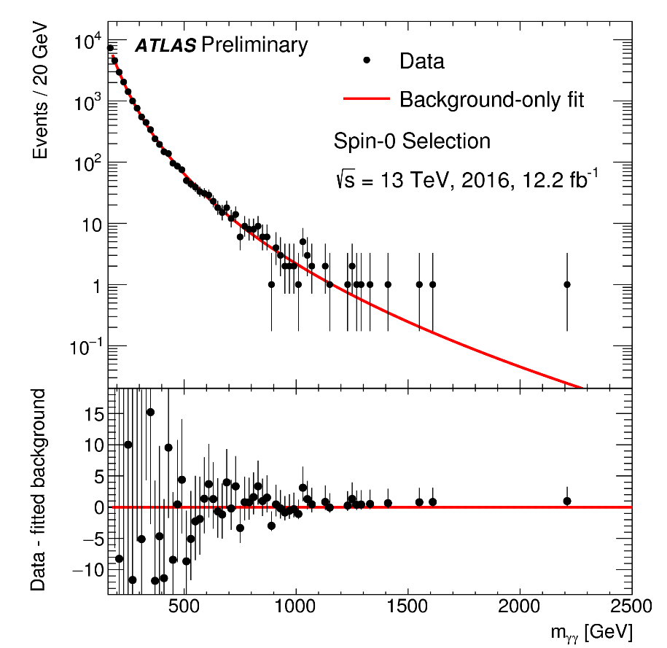
A di-photon hint

Slide 13
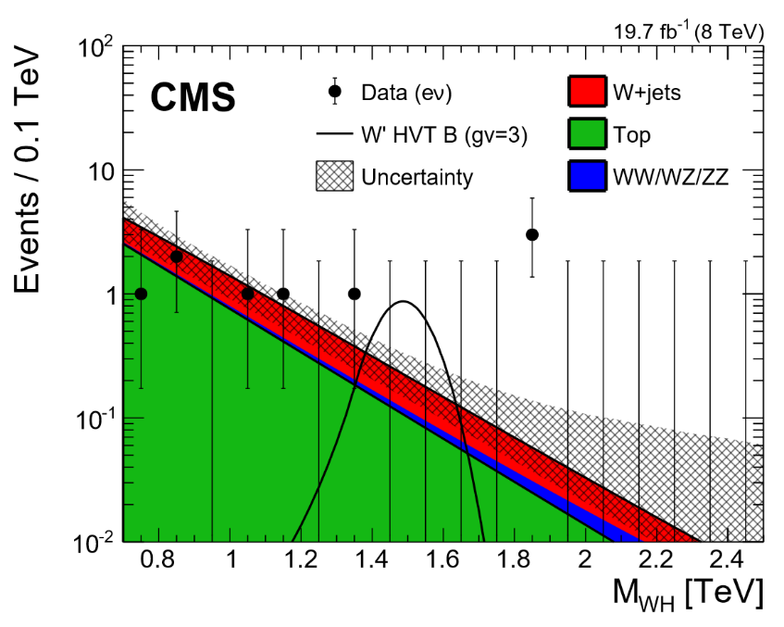
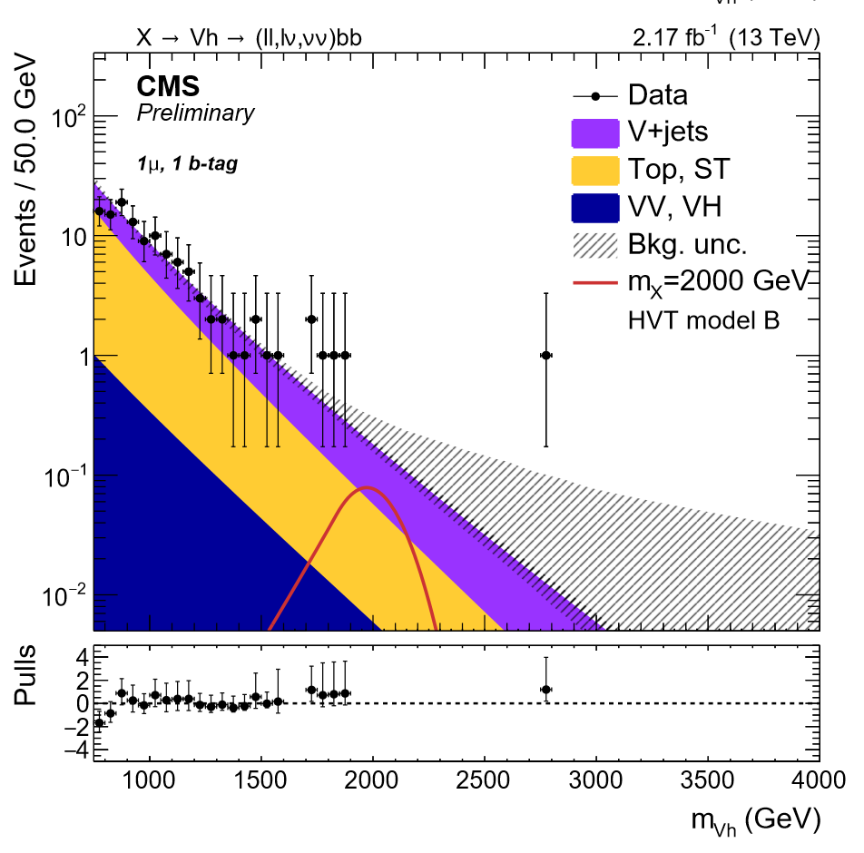
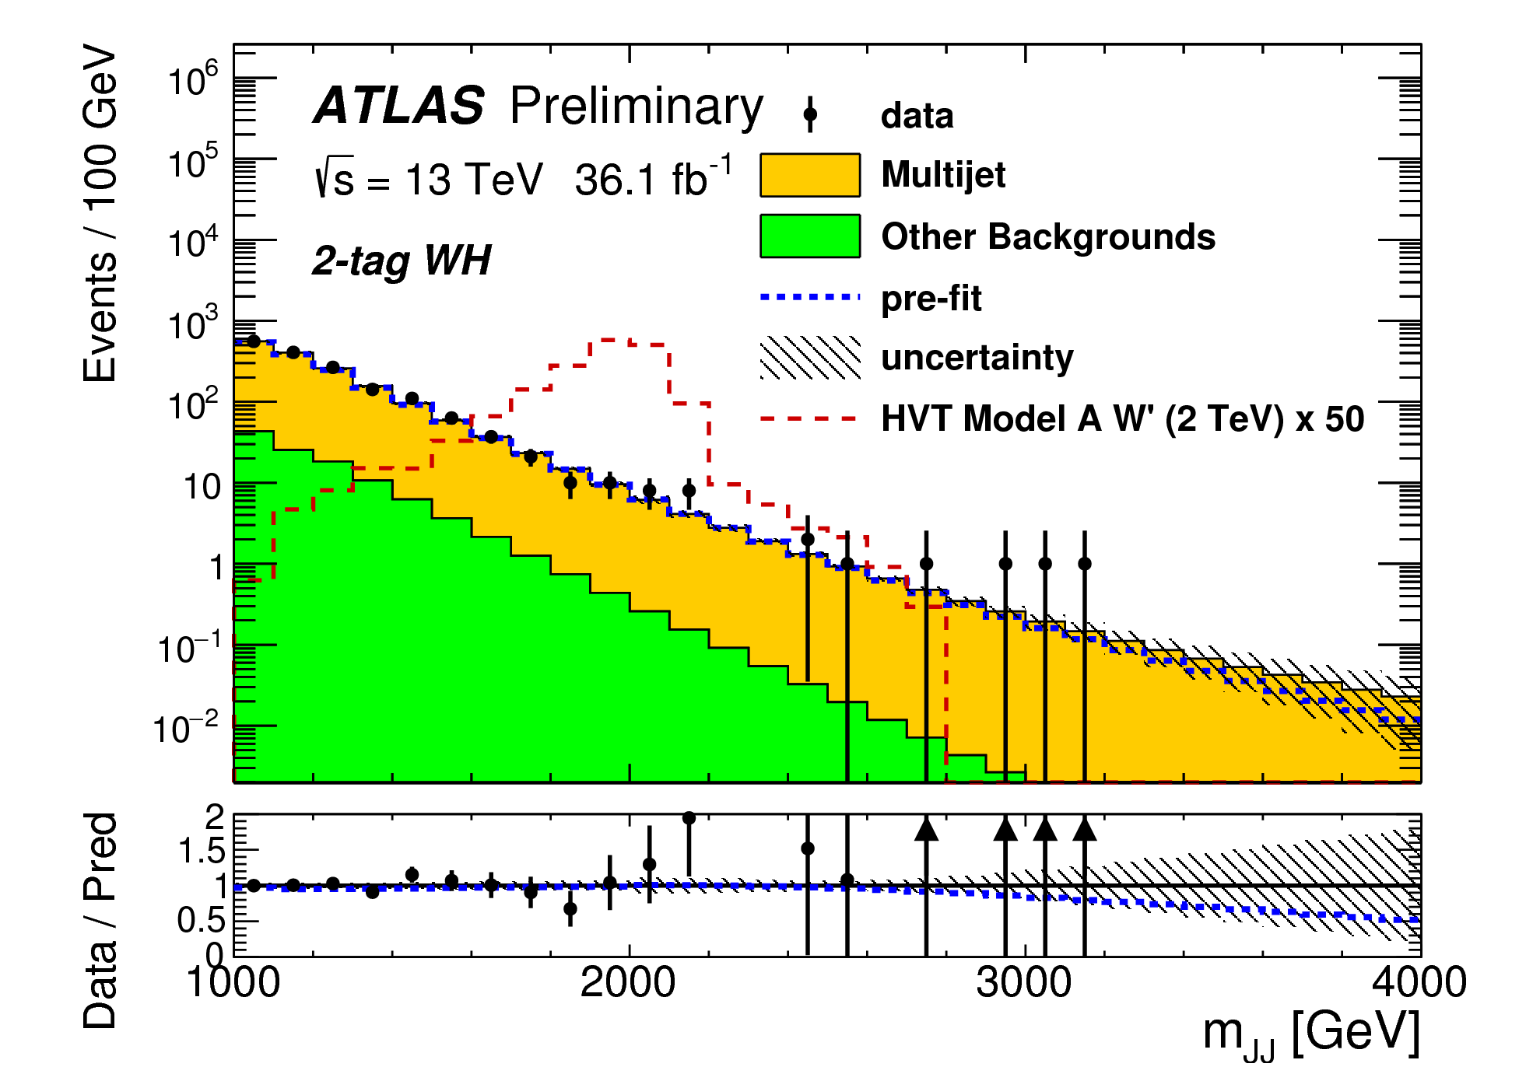
A W/Z+Something hints?
WH:
lν bbar
bbar as single jet
M_{HW}>1.8TeV
3 observed
0.3 expected
electron channel (not muon)
CMS 13TeV:
1.8TeV: very standard
ATLAS 13TeV:
1.8TeV: very standard (hadronic W)

Slide 14
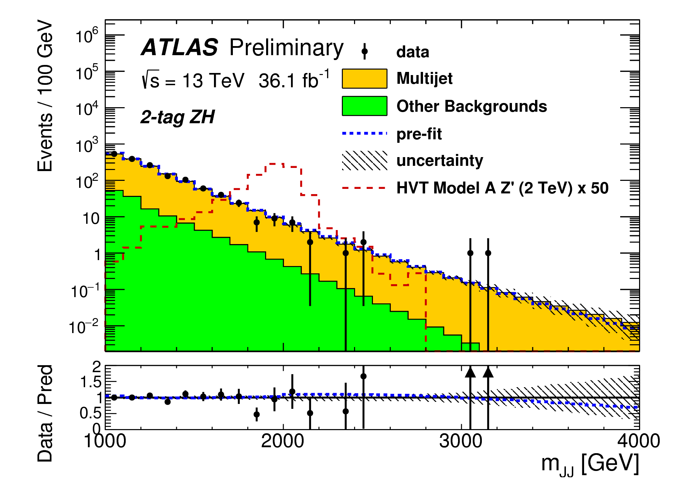
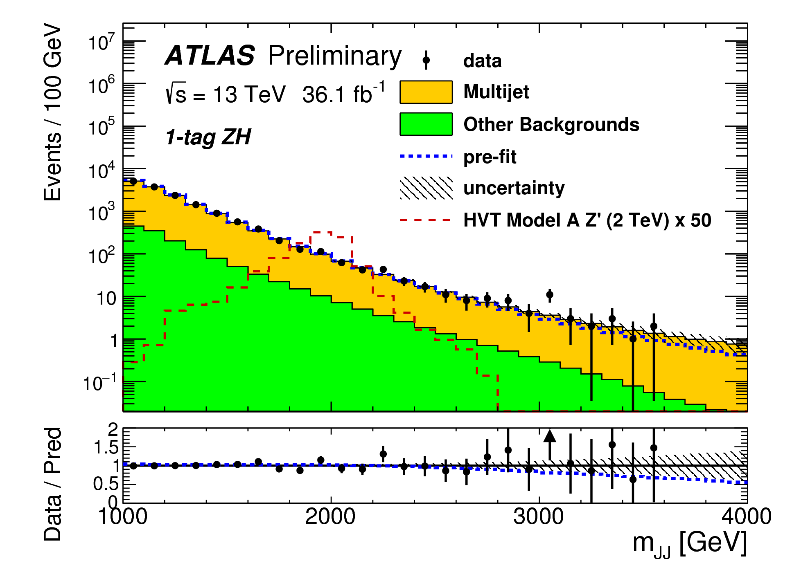
A W/Z+Something hints?
ATLAS W/Z+H:
Hadronic final state
Large overlap: 60%
ATLAS 13TeV:
WH 3TeV very standard
ATLAS 13TeV:
ZH 3TeV
Combined fit of 1 and 2 btag (Higgs)
3sigma local, 2sigma global at 3TeV

Slide 15
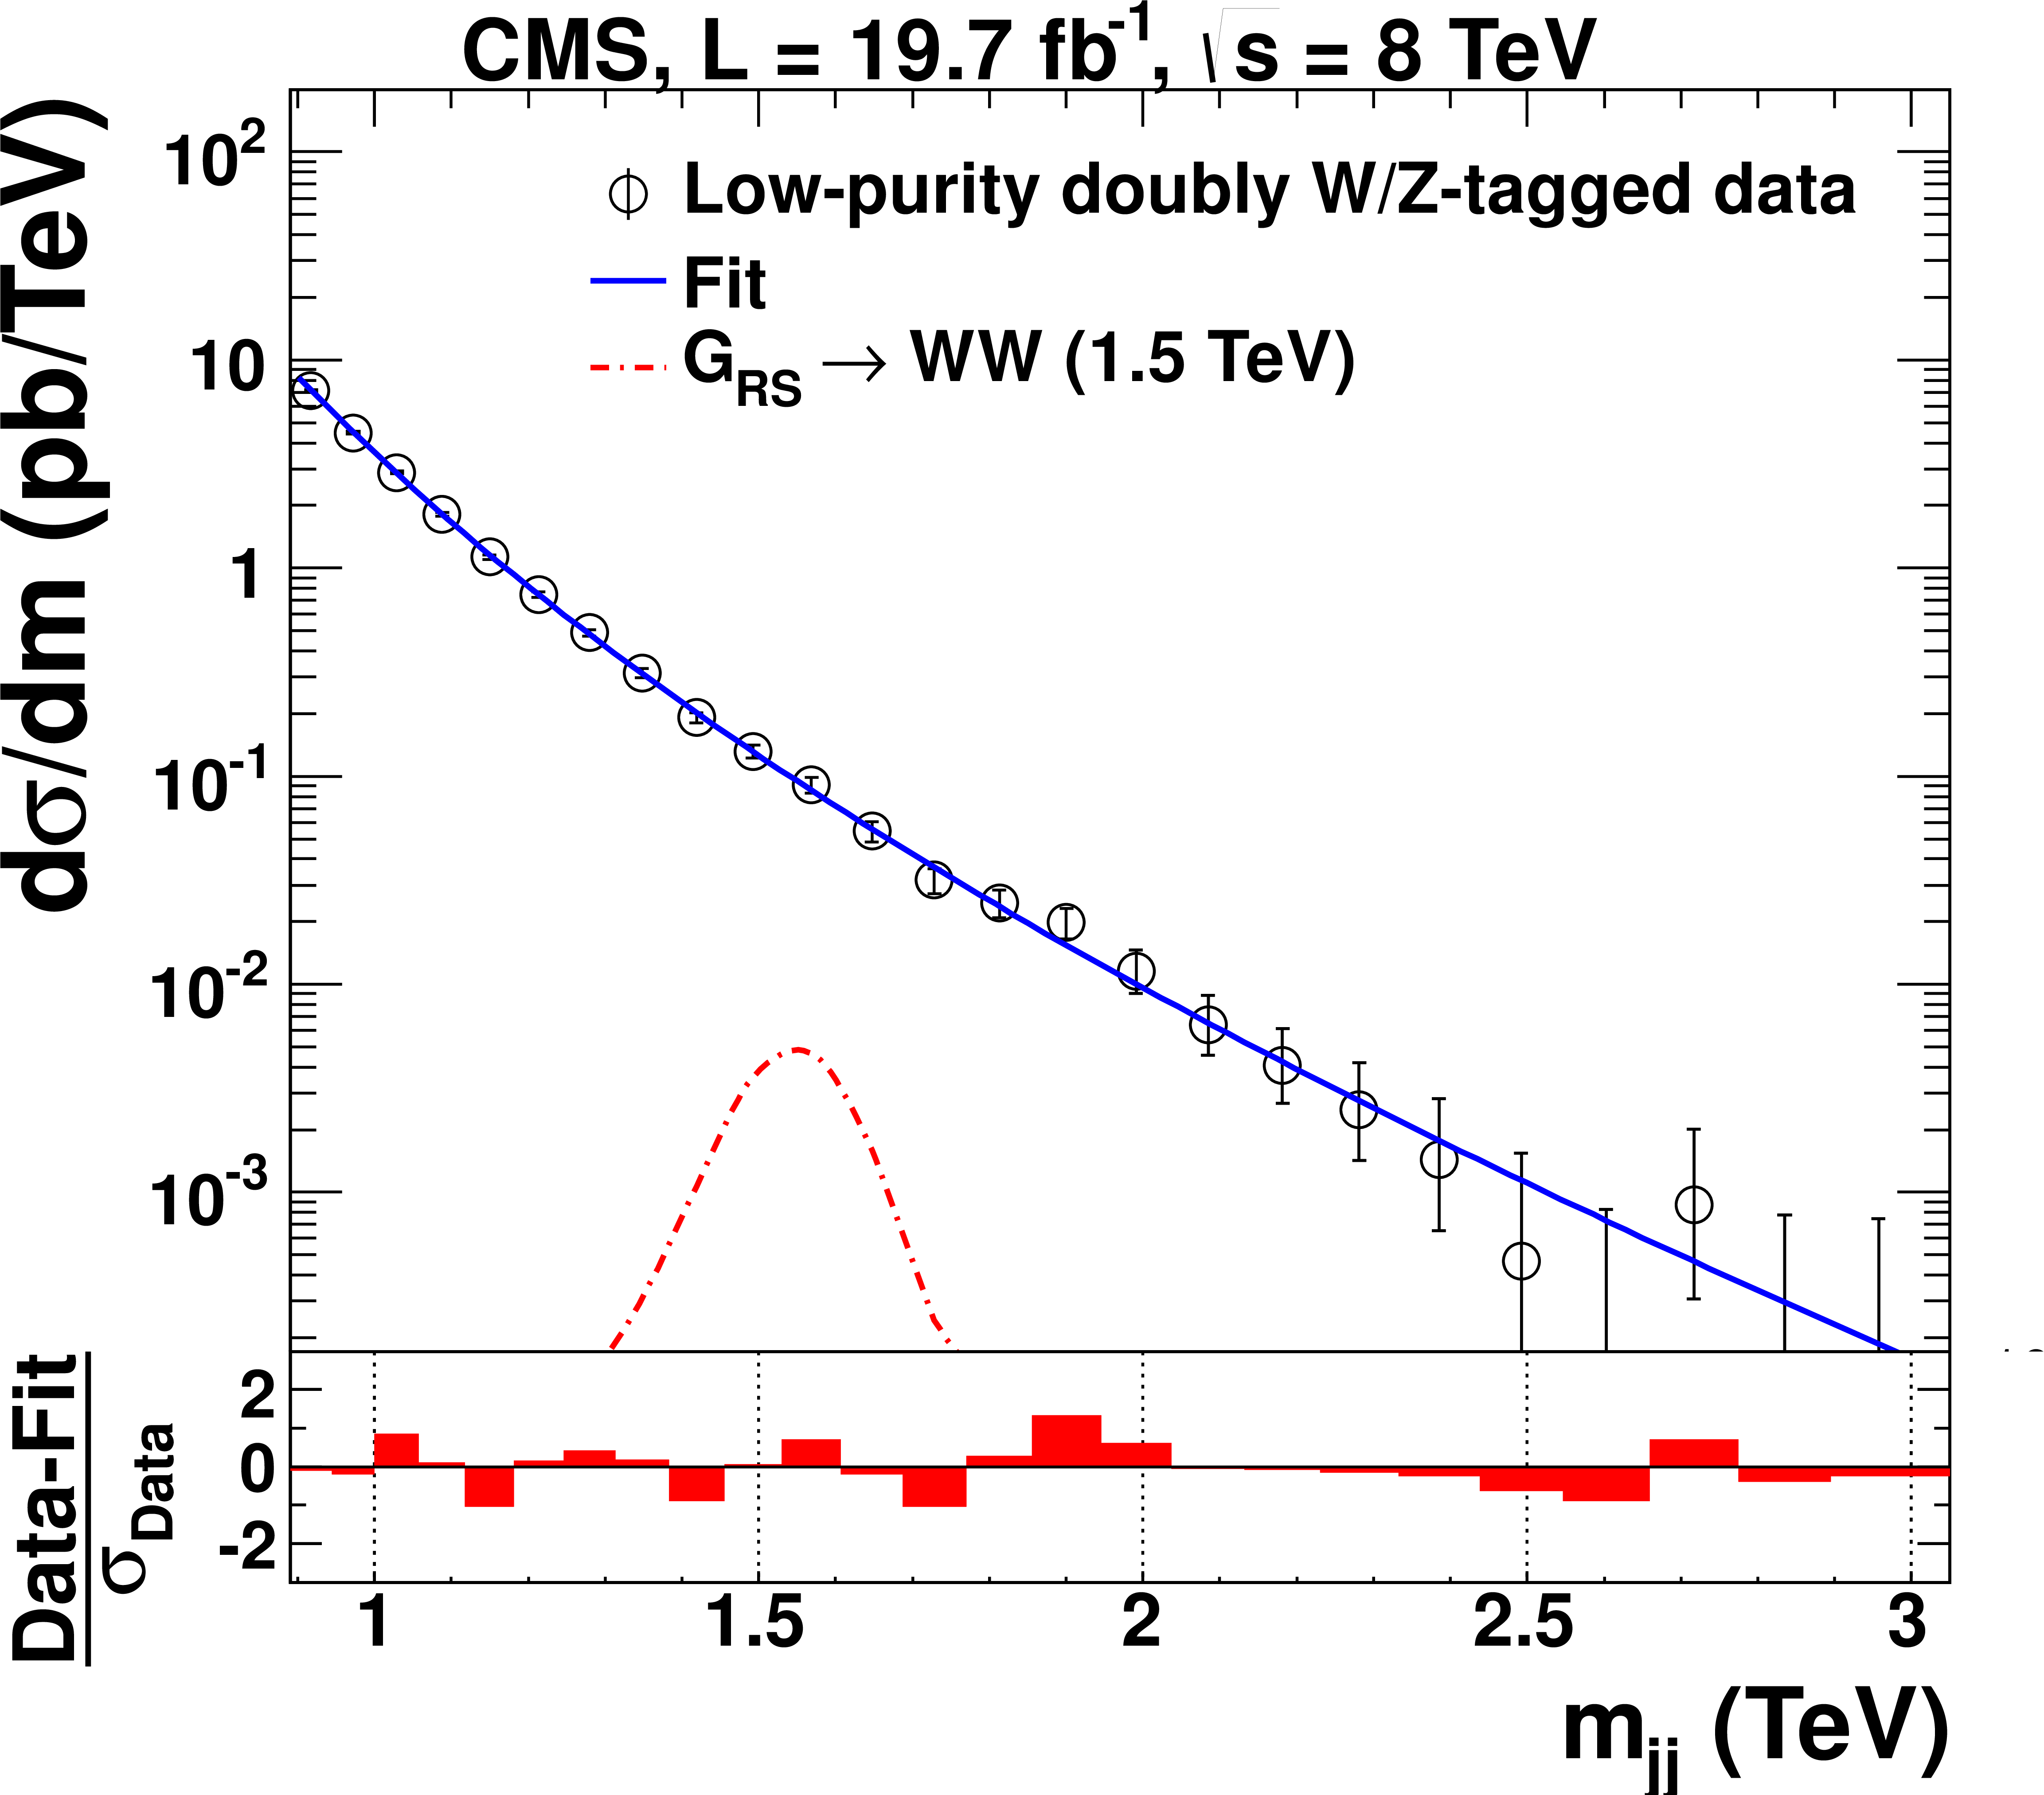
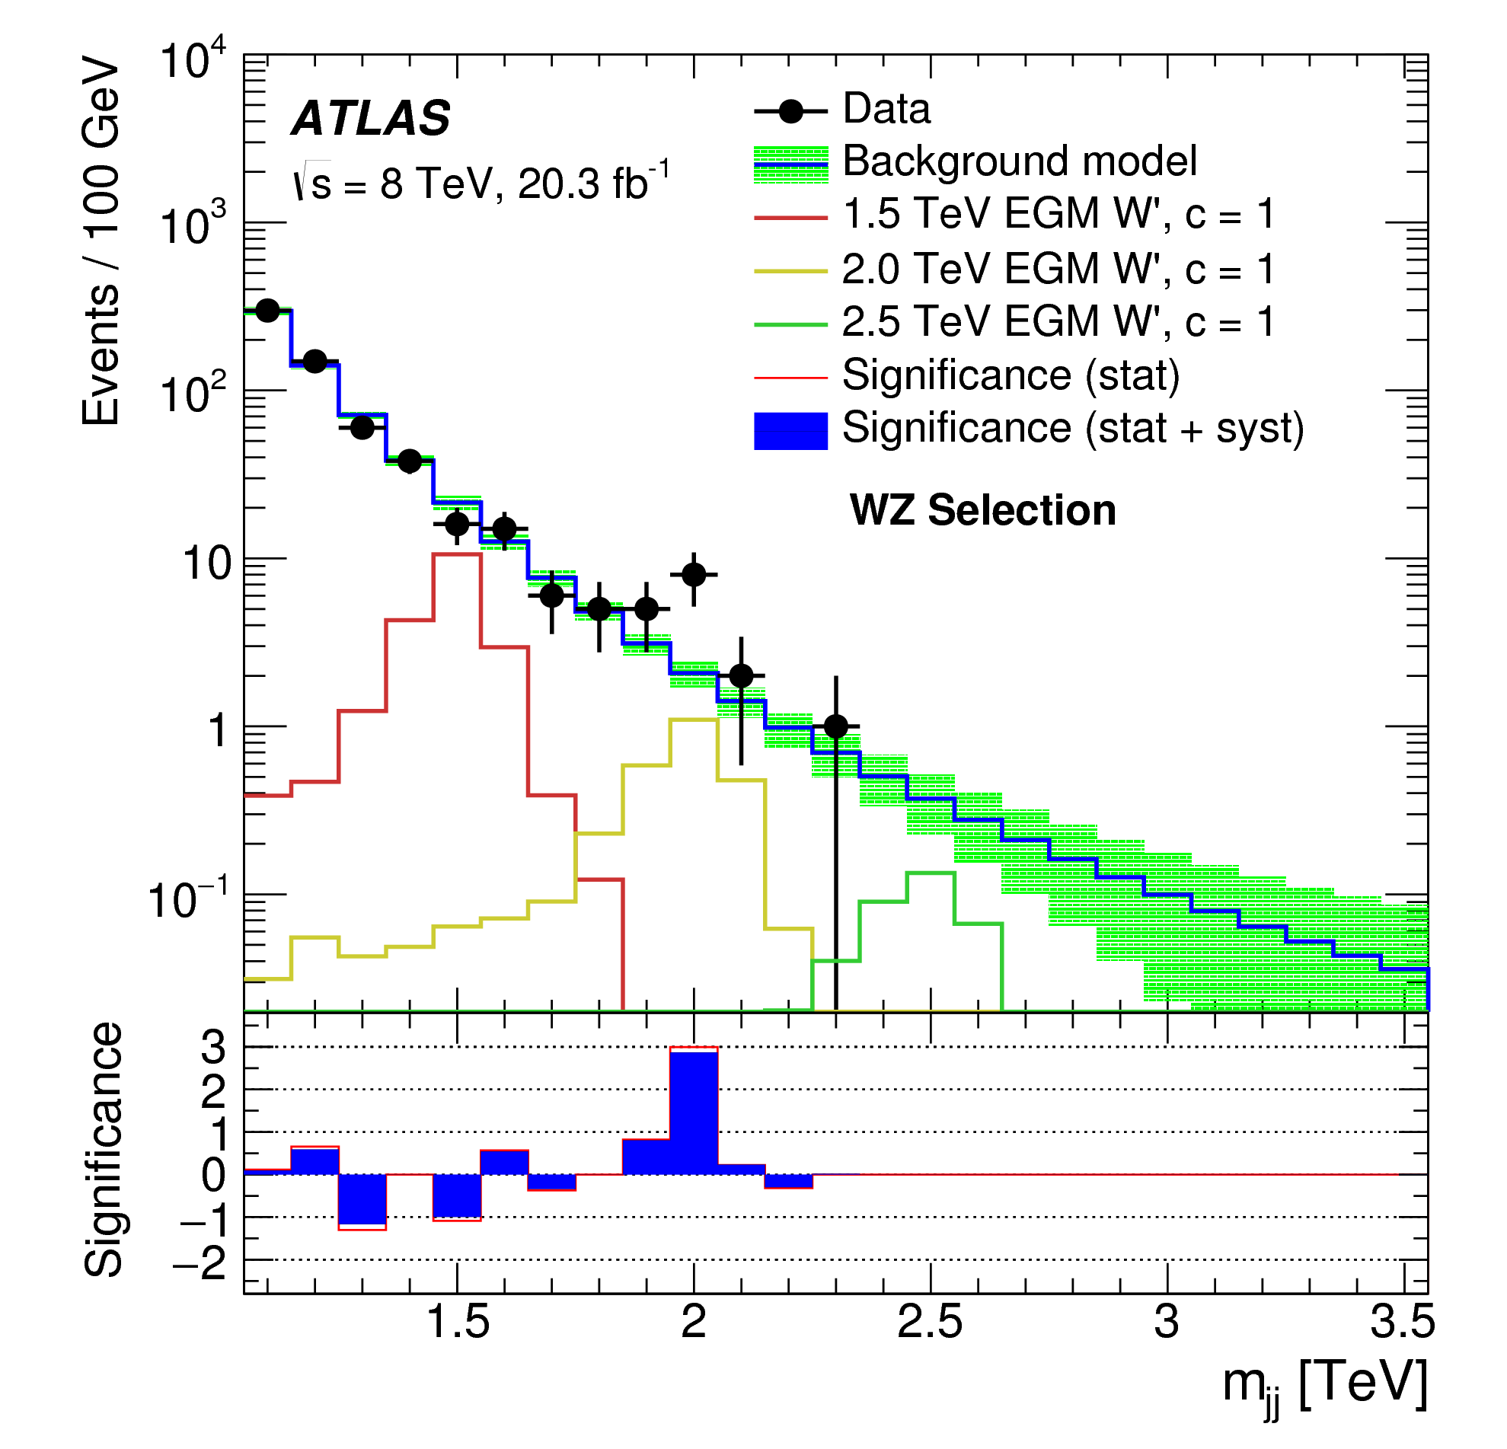
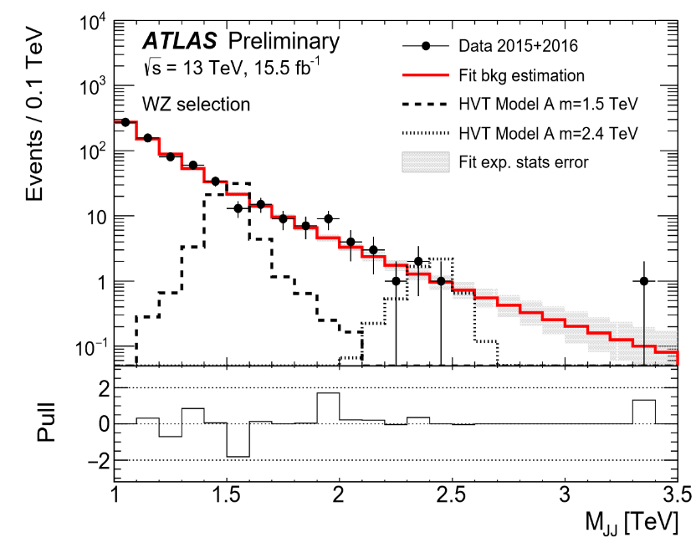
A WZ resonance hint?
WZ:
boosted W, Z
Reconstructed as di-jets
Substructure (jet mass etc)
WZ 8TeV ATLAS:
3.4sigma local
2.5sigma global
WZ 8TeV CMS:
Less than 2sigma
WZ 13TeV:
8TeV: 1.9sigma

Slide 16
Supersymmetry
fermion ↔boson
has “no” problems with radiative corrections (quadrat. div.)
has a light Higgs Boson (<140GeV)
interesting pheno at the TeV scale
3 (or more) neutral Higgs bosons: h, A, H
1 (or more) charged Higgs boson(s): H±
and supersymmetric particles
Many different models:
mSUGRA, MSSM
Supersplit SUSY
GMSB
AMB
Additional (s)particles:
NMSSM
MRSSM/N=1/N=2 hybrid
and many more
spin-0 | spin-1/2 | spin-1
squarks: q_{R}, q_{L} | q
 | gluino: g | g
sleptons: ℓ_{R}, ℓ_{L} | ℓ
h,H,A | neutralino χ_{i=1-4} | Z, γ
H± | charginos: χ±_{i=1-2} | W±
~
~
~
~
~
R-parity
production of SUSY particles in pairs
(Cascade-) decays to the lightest SUSY particle
LSP stable, neutral and weakly interacting: neutralino (χ₁)
experimental signature: missing E_{T}
First discovery: partner of the neutralinos (R=1) (see talk by Yves)

Slide 17
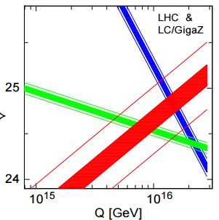
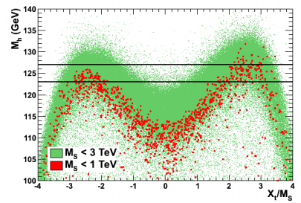
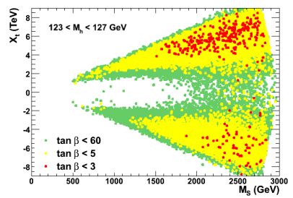
Supersymmetry: Motivation
Unification of coupling constants?
Allanach et al, hep-ph/0403133
SUSY impact:
Threshold of new sparticles passed
Beta functions (running) changes
ES-Skala 10²GeV
GUT 10¹⁶GeV
Djouadi, Eur.Phys.J. C74 (2014) 2704
SUSY impact:
Higgs mass limited to 140GeV (but tough to get there)→ a stop could be light

Slide 18
Eg SUSPECT2/3
Michael Ughetto, Gilbert Moultaka
And the SUSY breaking parameters?
pMSSM low scale (most parameters defined at EW scale):
Many parameters (order 20 up to 120)
Gauginos: M1, M2, M3, μ
Sfermion mass parameters: left and right for each generation, 2 for leptons, 3 for quarks
Trilinear parameters
Ratio of Higgs vevs: tanβ
pMSSM high scale:
Same number as pMSSM low scale
pMSSM high scale is a subset of pMSSM low scale!
(3 scale models: GUT, EW, MZ):
mSUGRA:
M1, M2, M3 → m_{1/2}
Sfermion mass parameters → m₀
Trilinear couplings → A₀
tanβ
Sign of μ
AMB:
Leads to μ < Mi
LSP almost degenerate with other gauginos
GMSB/GGM (4 scales: GUT, Messenger, EW, MZ):
LSP = Gravitino
Classical GMSB: frequently photonic decay
GGM: anything goes for NLSP to LSP=Gravitino

Slide 19
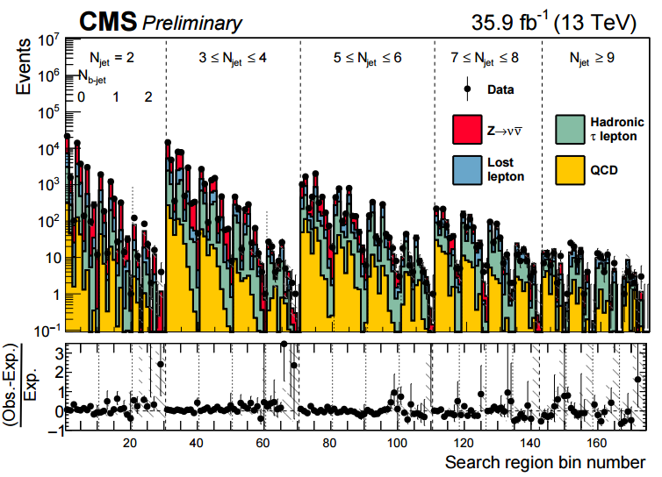
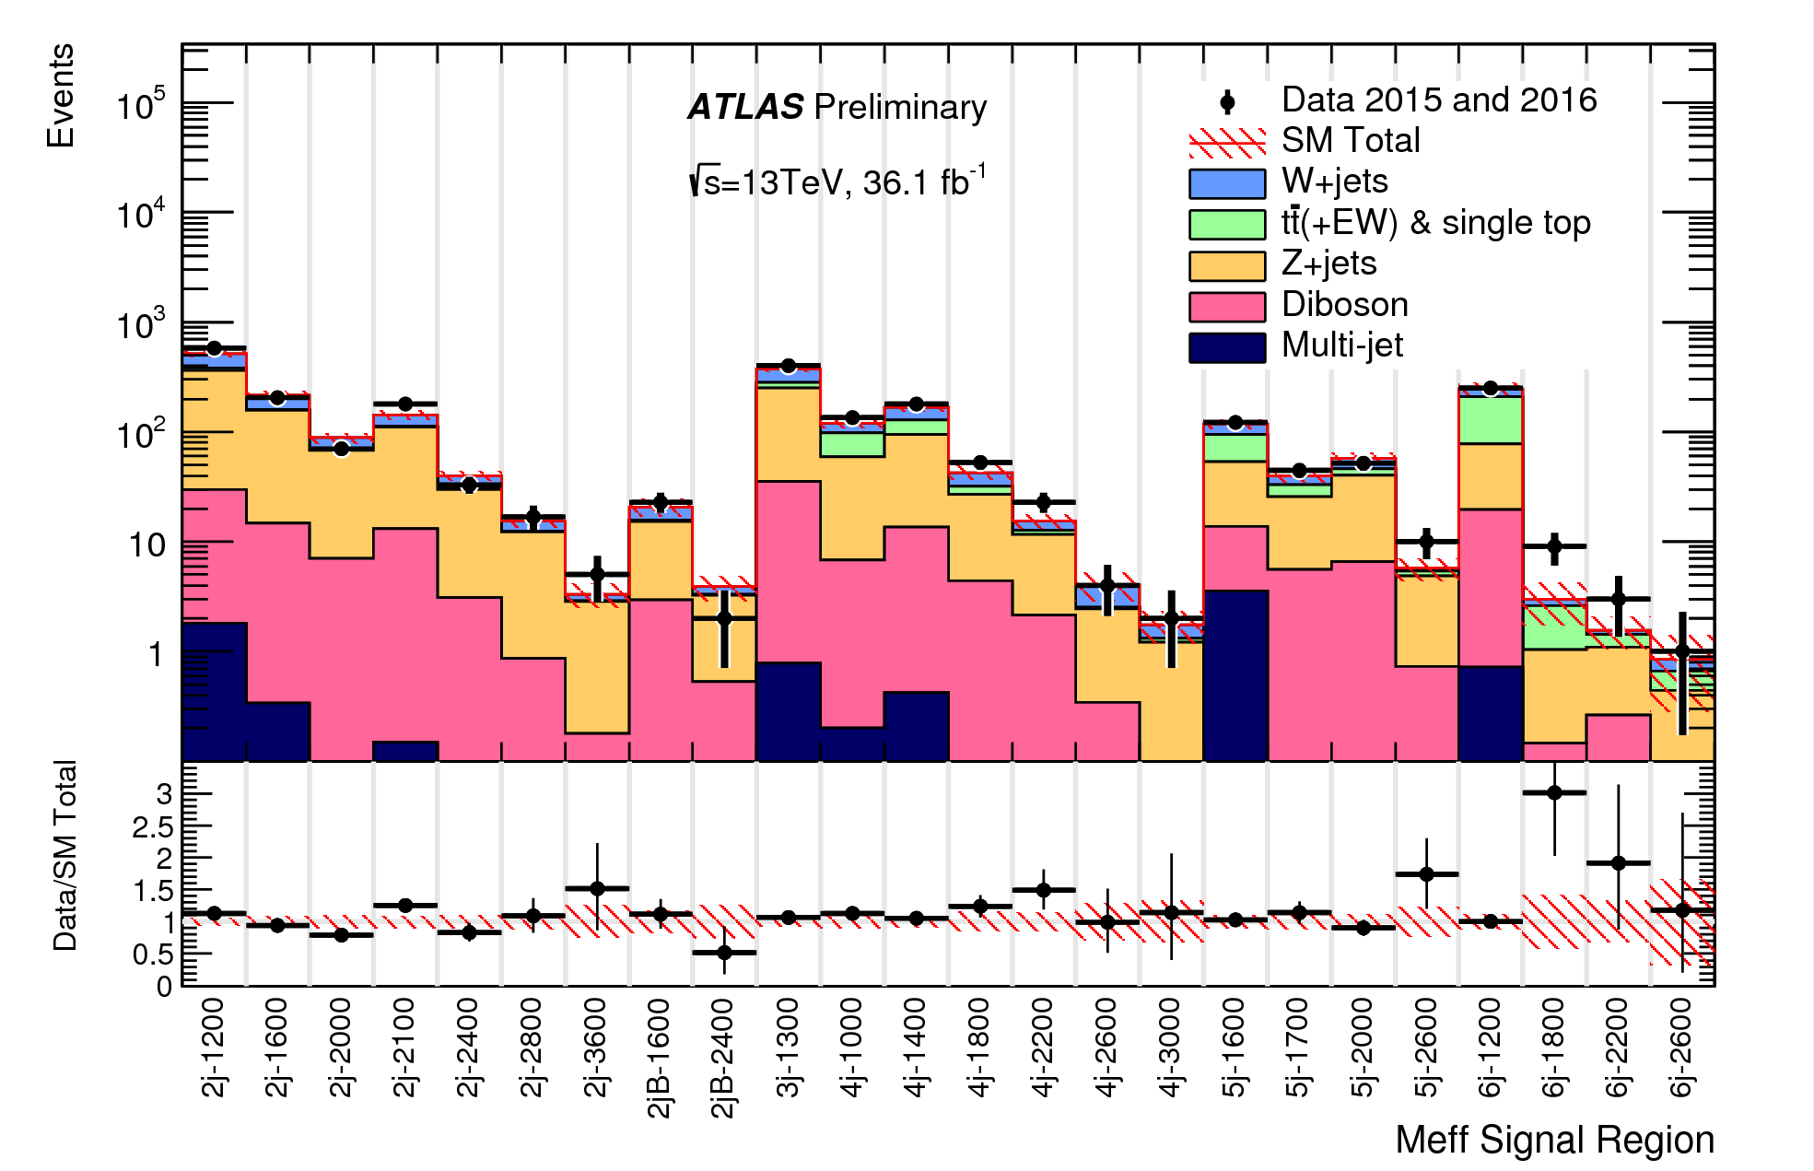
Search for Supersymmetry: gluinos and squarks
Signature:
colored particles → large (pb) cross sections
many high transverse momentum jets
large missing ET
Measure background from data (CRs)/
Extrapolate sensitive variable
many cross checks possible
no exciting deviations ☹
Single bin deviations up to 2, but the errors are large

Slide 20
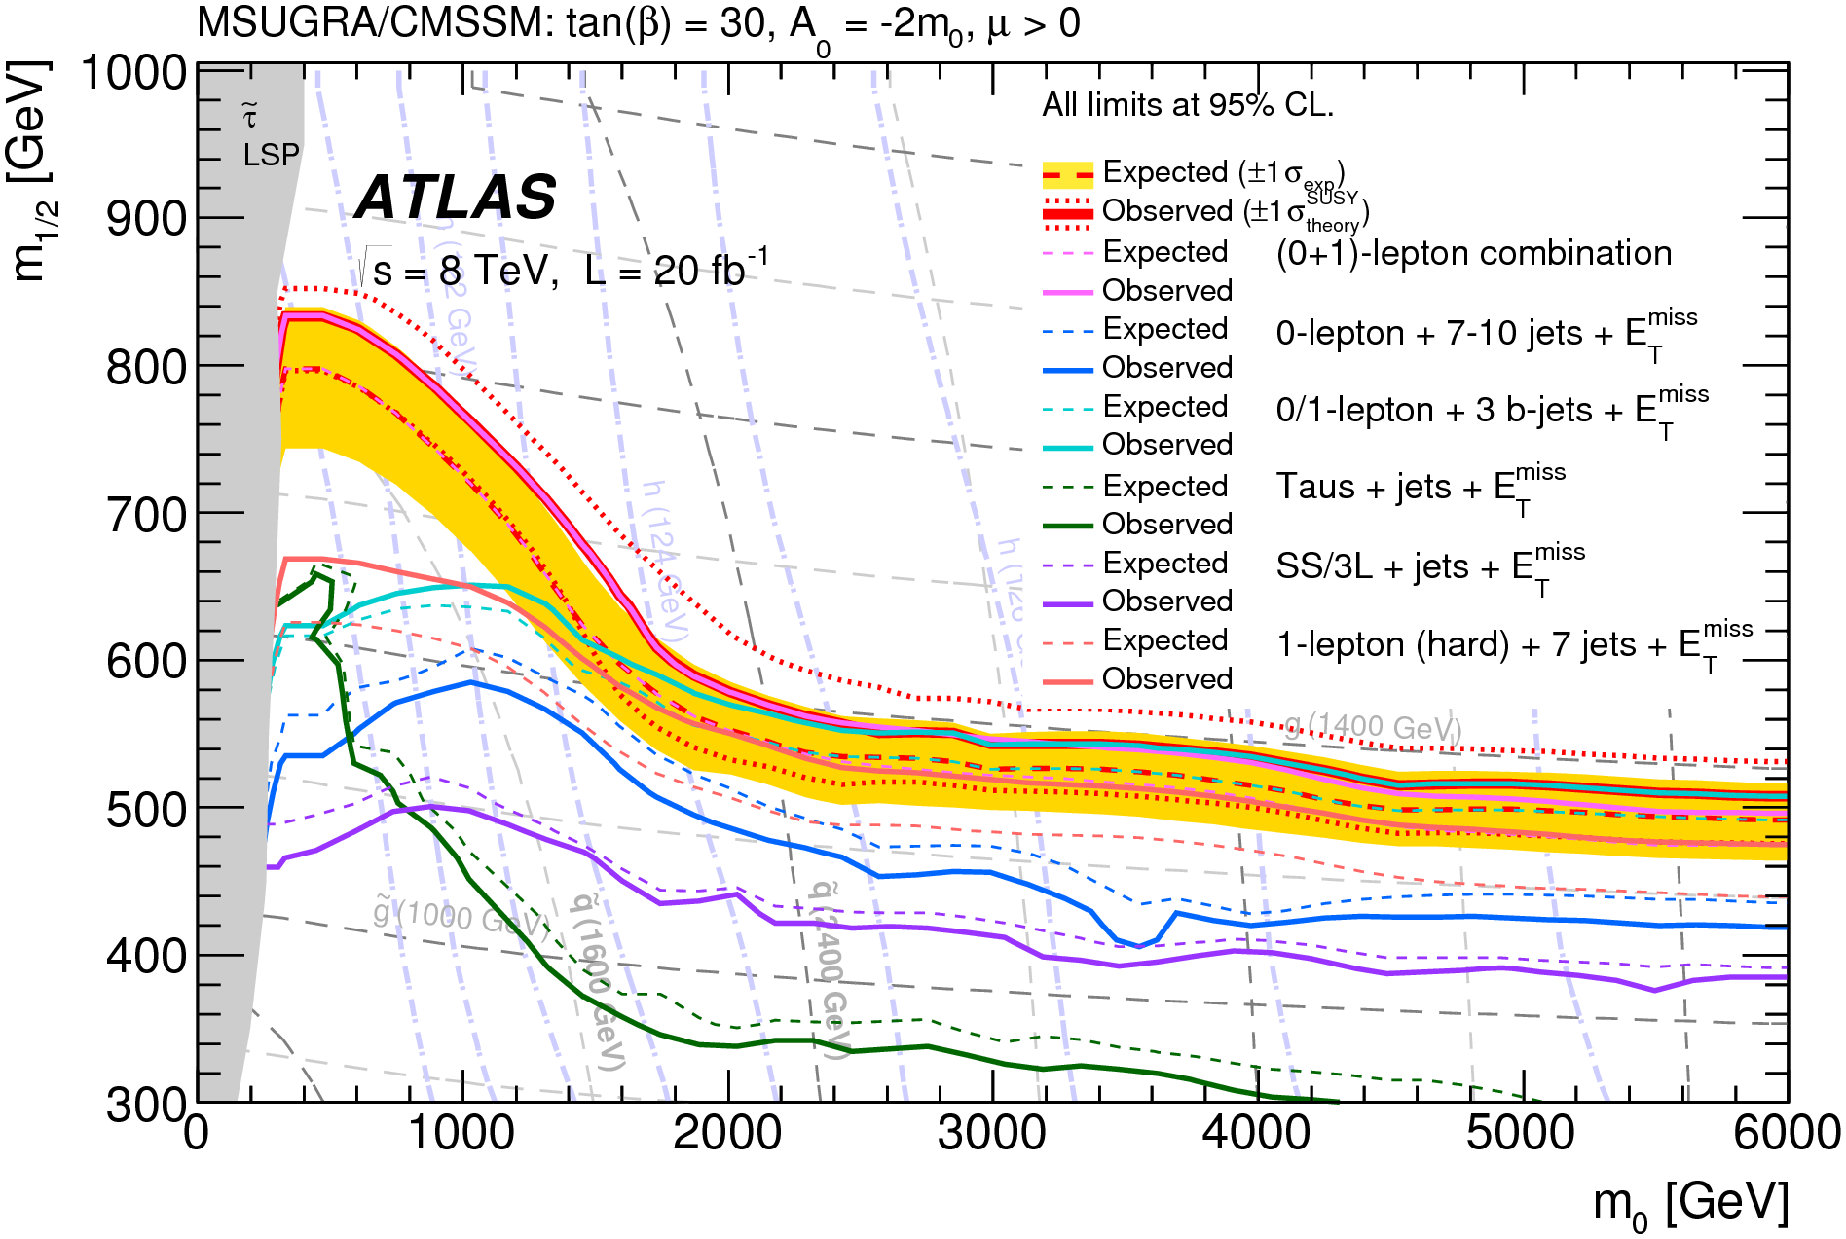
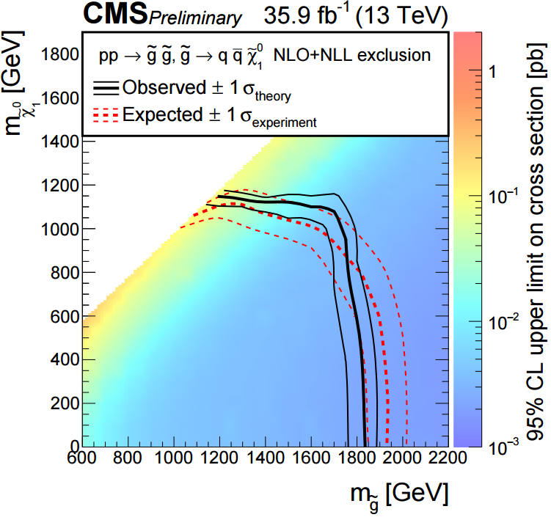
Search for Supersymmetry: gluinos and squarks
Signature:
colored particles → large (pb) cross sections
many high transverse momentum jets
large missing ET
Measure background from data (CRs)/
Extrapolate sensitive variable
many cross checks possible
no exciting deviations ☹
8 TeV mSUGRA limit:
1.4TeV gluinos
Problematic: dependence of limits on the cascade decays
13 TeV simplified scenario limit:
1.8TeV gluinos

Slide 21
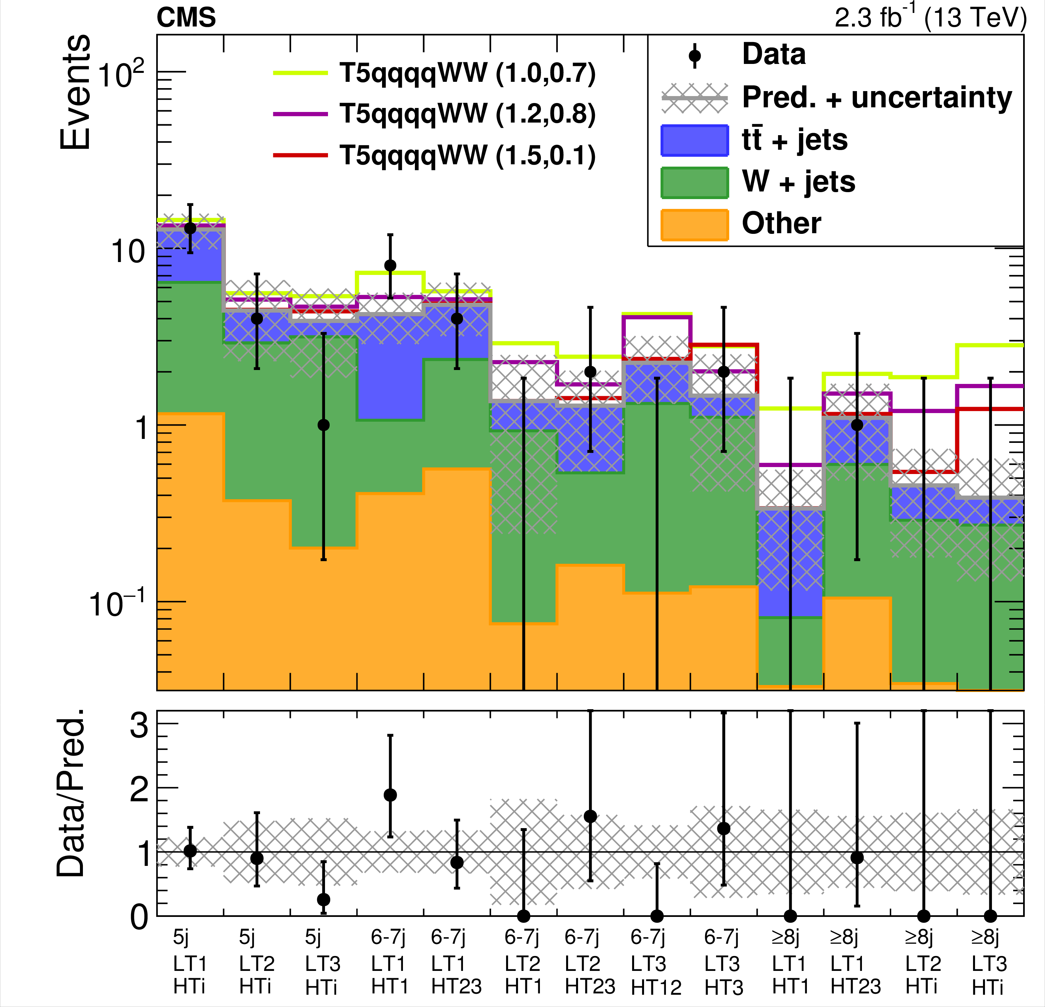
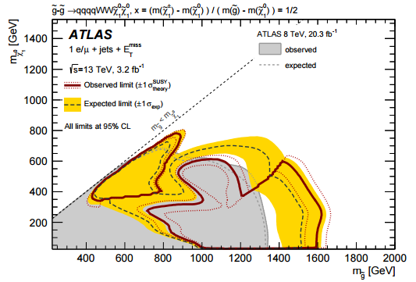
Search for Supersymmetry: 1lepton channel
1-lepton signature:
colored particles → large (pb) cross sections
many high transverse momentum jets
an isolated lepton
large missing ET
Calculate limits in simplified scenarios
Sensitivity order 1.6TeV

Slide 22
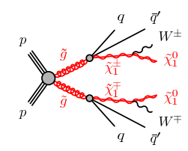
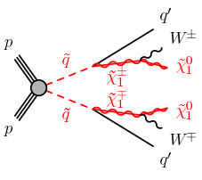
1lepton channel: digression
Simplified model depends on
Masses of on-shell sparticles
Squark 1-step scenario:
Chargino decay drives its field content (Wino)
M1 < M2
M(chargino1) = M(neutralino2)
Same coupling strength
Effective BR:
BR(SquarkL → q chargino) <=1/2
Direct decay to LSP: g1 !=0
100% difficult, 10% maybe
Gluino 1 step scenario:
Branching ratio fixed
All other masses set to high values
Chargino decay drives its field content (Wino)
Gluino → chargino q qbar’ ???
Gluino → Squark quark
Squark → quark chargino
Supersymmetric version of q→ W q’
Need assumption on “off shell sparticles”:
M(SquarkL) < M(SquarkR)
Unless you want a direct decay ☹
Mass limits to be taken with a grain of salt

Slide 23
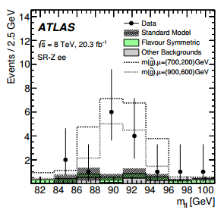
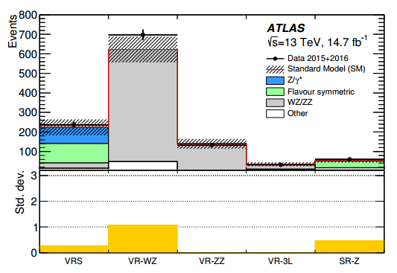
Di-lepton SUSY excitement
ATLAS:
Require 2 leptons
Z search
Systematic errors non-negligeable
ATLAS 8TeV:
3 sigma in ee
1.7 sigma in muons
ATLAS 13TeV:
Standard…

Slide 24
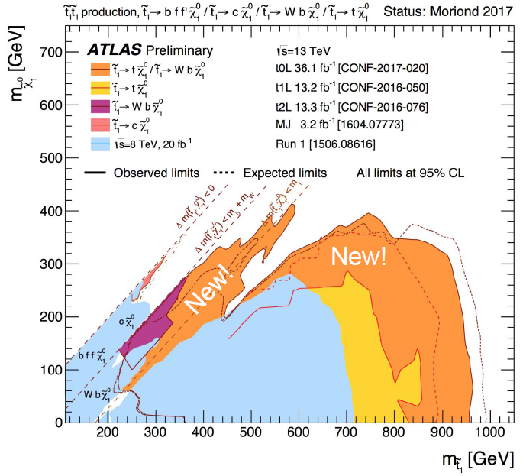
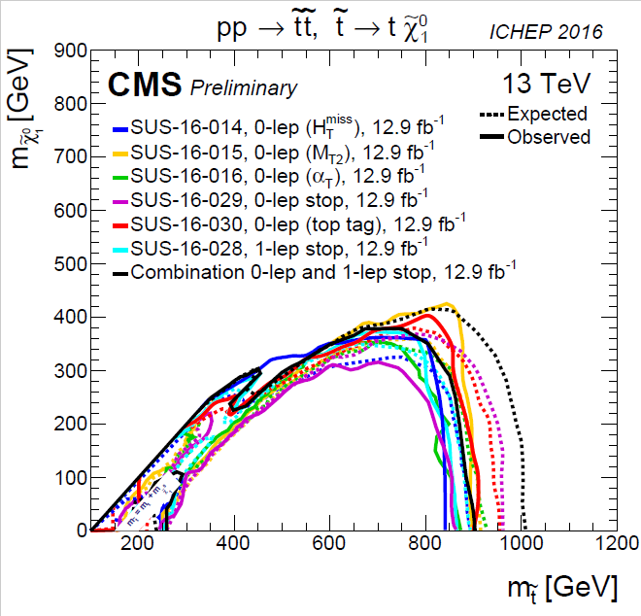
Search for Supersymmetry: stops
Direct stop pair production (right to left):
top + neutralino
Δ(mStop; χ) < mtop
Δ(mStop; χ) < mb + mW (charm, 4body)
Δ(mStop; χ) < 0
different channels in the same figure as overlay: not a combination due to different assumptions

Slide 25
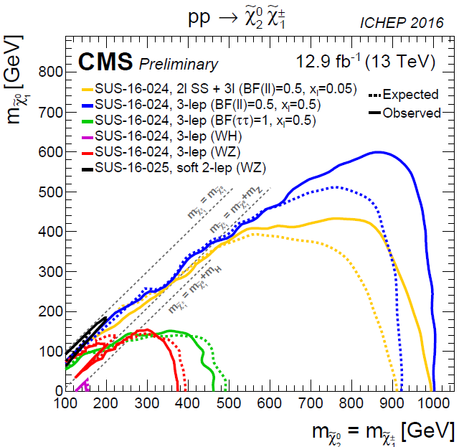
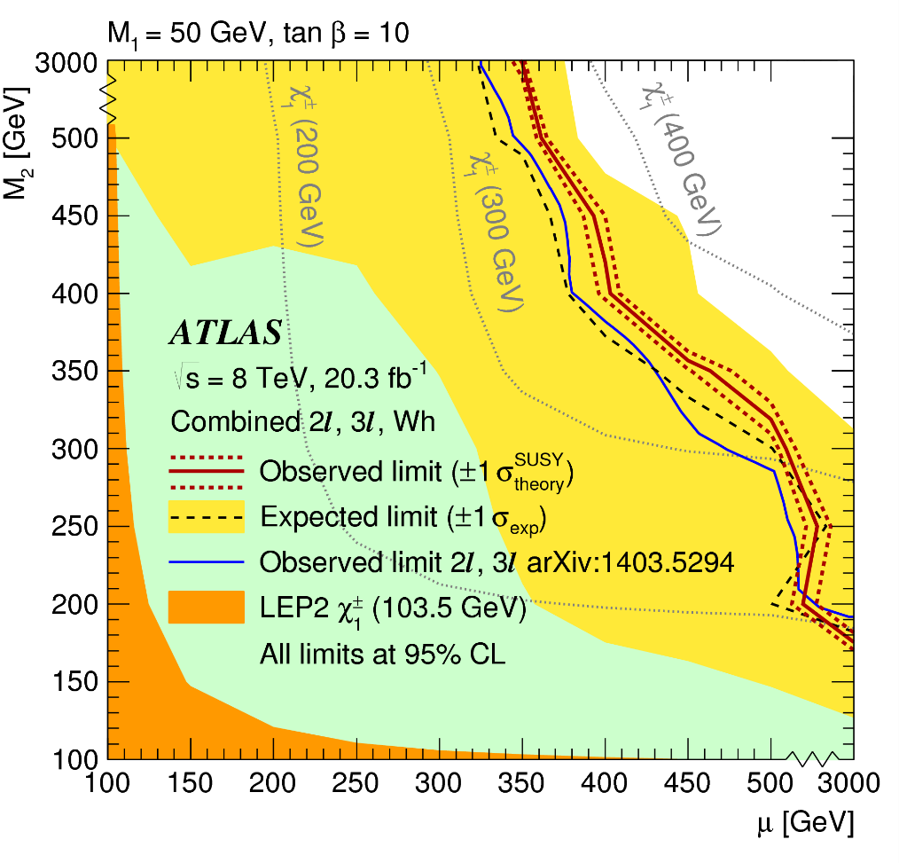
Search for Supersymmetry: Electroweak Sector
Signature:
associated production of charginos and neutralinos
supersymmetric version of WZ (difficult)
leptonic decays → 3(and more) leptons (muons,e)
MSSM limits:
improve on LEP
1000 GeV (BF(ll)=0.5)
350 GeV pMSSM (M1=5GeV)

Slide 26
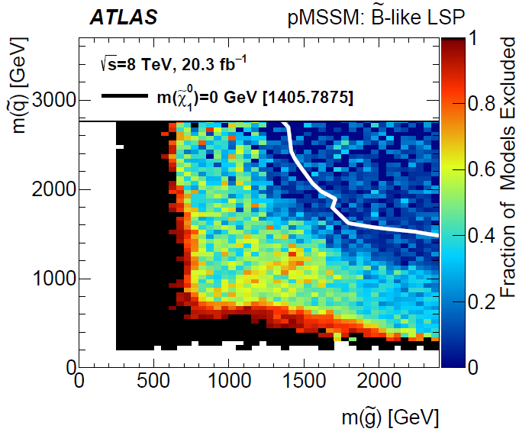
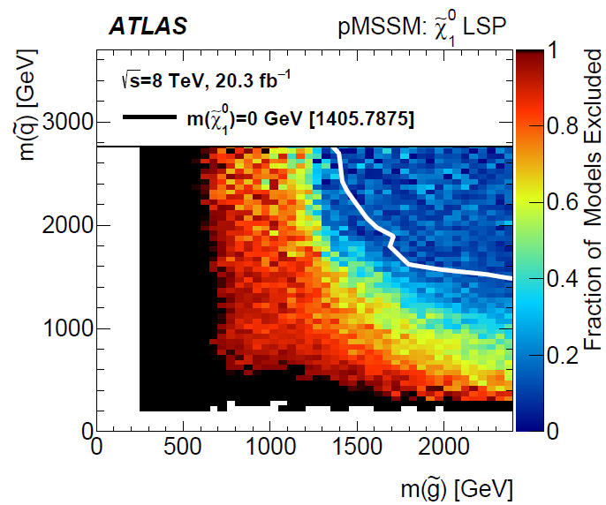
pMSSM
Vocabulary:
LEP: slepton to lepton + neutralino1 defined as exclusive signature
LHC: simplified model → BR=1 (even for cascade decays)
pMSSM limits:
Good coverage of pMSSM
depence on LSP nature (via signatures)

Slide 27
And dark Matter?
Dark matter:
Search for DM+DM+X, eg X=H→γγ
Limits in particular models
Translation to direct detection experiments
LHC provides competitive limits under model assumptions
Talk by Renjie Wang tomorrow

Slide 28
Putting it all together
Sophie Henrot-Versillé et al, Phys.Rev. D89 (2014) 055017
Anja Butter et al, Phys.Rev. D93 (2016) 015011
Ingredients:
Relic density
Higgs boson mass
g-2 muon
B physics observables
EW precision data
Top quark mass
Models:
mSUGRA
13 param MSSM
NMSSM
MSSM:
Not all hope is lost ☺
NMSSM
GCE + invisible Higgs link
(fun physics)
Categorisation:
DM process (h, A funnel, co-annihilation,…)

Slide 29
Long lived sparticles
Signature:
GMSB: stau as NLSP
Long lifetime
slepton as heavy muon
AMSB: chargino and LSP degenerate winos
Decay to pion

Slide 30
RPV stops or scalar partners of gluinos
Signature:
Pair produced resonances
Jet pairing combinatorics
Background (multi-jets)
no hint

Slide 31
The dream: measure the unification of SUSY breaking parameters
SFitter: Lafaye, Plehn, Rauch, D.Z. and friends
Eur.Phys.J. C54 (2008) 617-644, Eur.Phys.J. C71 (2011) 1520
LHC:
5% level mass measurement
HL-LHC:
improve to 1%
ILC:
electroweak sector measurements
precision 0.1%
LHC:
12fold ambiguity
ILC:
solves ambiguities
LHC
LHC:
hint on Parameter unification
HL-LHC:
increases precision
HL-LHC + ILC
Dark matter (deduced):
LHC:
% level with ambiguities
Postpone all that fun a bit

Slide 32
BSM Conclusions
Supersplit SUSY cross sections ☺
Room left for higher masses ☺
Non-SUSY searches turned up empty ☺
Obviously SUSY is just around the corner…….

