Slide 1




Electron Ion Collider:
The next QCD frontier
Understanding the Glue that Binds Us All
Why the EIC? ➔ “Gluon Imaging”
To understand the role of gluons in binding
quarks & gluons into Nucleons and Nuclei
RECOMMENDATION:
We recommend a high-energy high-luminosity polarized EIC as the highest priority for new facility construction following the completion of FRIB.
Abhay Deshpande

Slide 2
QCD: The Holy Grail of Quantum Field Theories
QCD : “nearly perfect” theory that explains nature’s strong interactions, is a fundamental quantum theory of quarks and gluon fields
QCD is rich with symmetries
Chiral, Axial, Scale & P&T symmetries broken by quantum effects: Most of the visible matter in the Universe emerges as a result
Inherent in QCD are the deepest aspects of relativistic quantum field theories: (confinement, asymptotic freedom, anomalies, spontaneous breaking of chiral symmetry) ➔ all depend on non-linear dynamics in QCD
(1) (2) (3)
Gauge “color” symmetry : unbroken but confined
Global “chiral” flavor symmetry: exact for massless quarks
Baryon number and axial charge (massless quarks) conservation
Scale invariance for massless quarks and gluon fields
Discrete C, P & T symmetries

Slide 3
Non-linear Structure of QCD: Fundamental Consequences
Quark (Color) confinement:
  Consequence of nonlinear gluon self-interactions
  Unique property of the strong interaction
Strong Quark-Gluon Interactions:
  Confined motion of quarks and gluons – Transverse Momentum Dependent Parton Distributions (TMDs)
  Confined spatial correlations of quark and gluon distributions – Generalized Parton Distributions (GPDs)
Ultra-dense color (gluon) fields:
  Is there a universal many-body structure due to ultra-dense color fields at the core of all hadrons and nuclei?
All expected to be under the “femtoscope” called the EIC

Slide 4
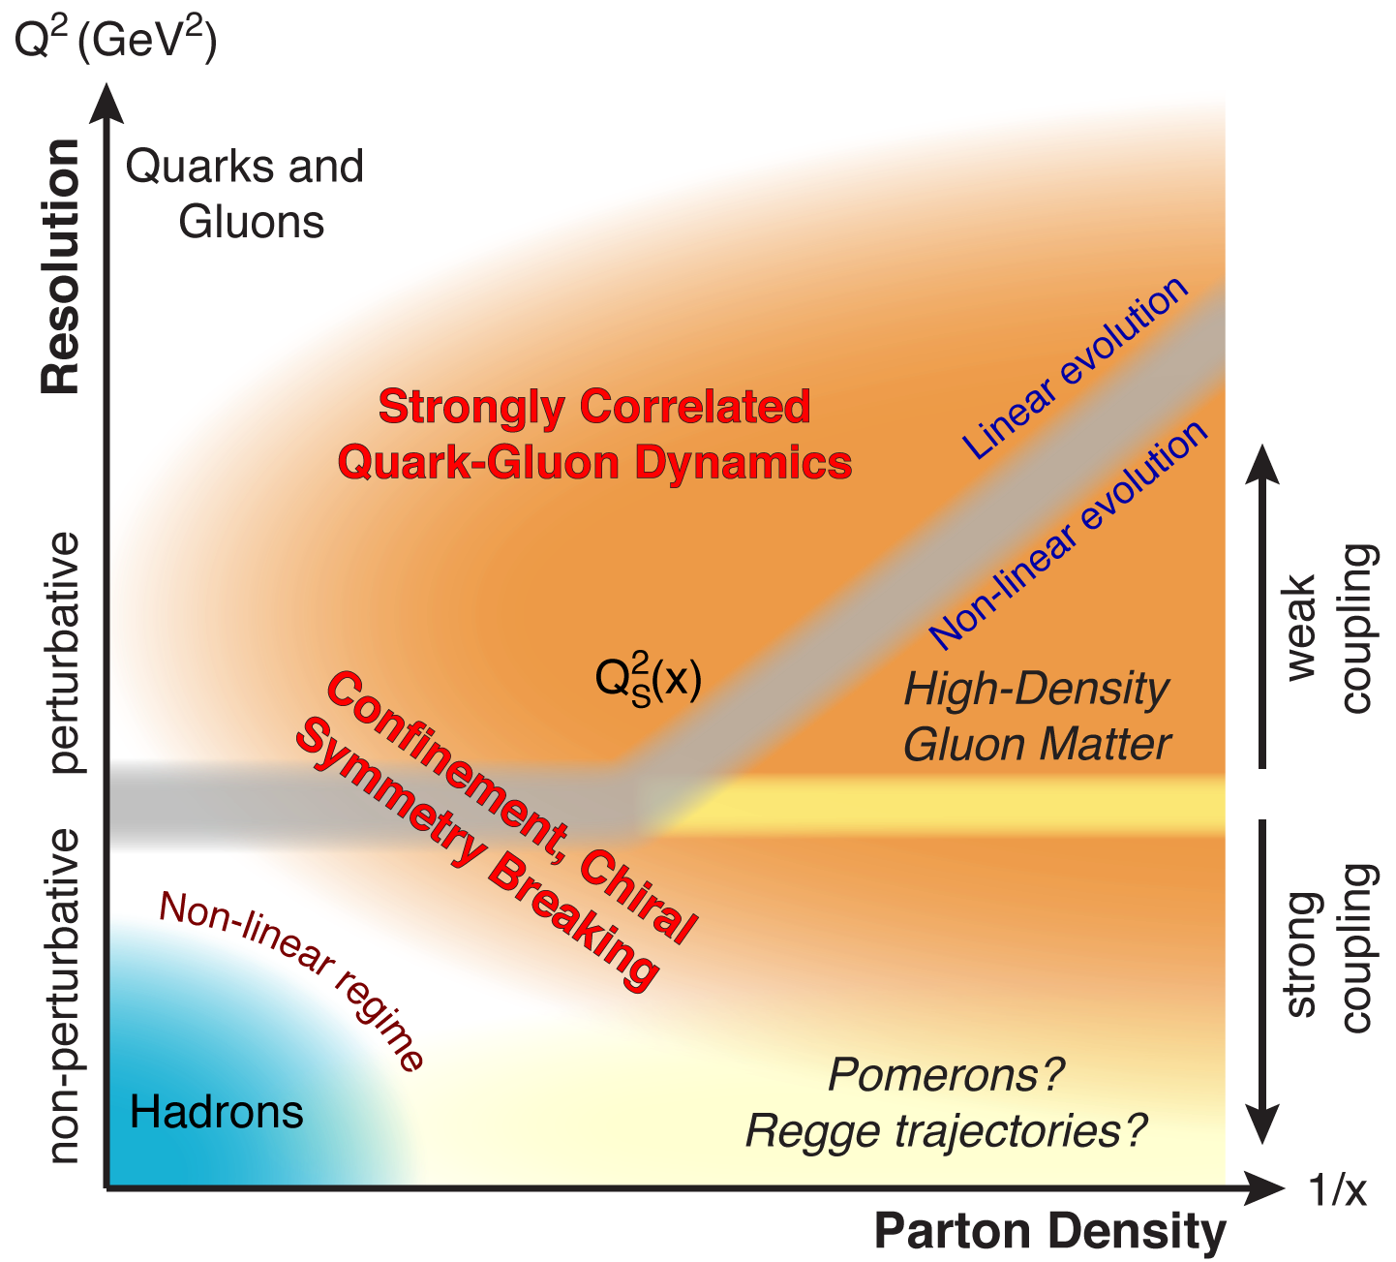
QCD Landscape to be explored by EIC
QCD at high resolution (Q²) —weakly correlated quarks and gluons are well-described
Strong QCD dynamics creates
many-body correlations between
quarks and gluons
→ hadron structure emerges
EIC will systematically explore
correlations in this region.
An exciting opportunity: Observation by EIC of a new regime in QCD of weakly coupled high density matter

Slide 5
Emergent Dynamics in QCD
Without gluons, there would be no nucleons,
no atomic nuclei… no visible world!
Massless gluons & almost massless quarks, through their interactions, generate most of the mass of the nucleons
Gluons carry ~50% of the proton’s momentum, a significant fraction of the nucleon’s spin, and are essential for the dynamics of confined partons
Properties of hadrons are emergent phenomena resulting not only from the equation of motion but are also inextricably tied to the properties of the QCD vacuum. Striking examples besides confinement are spontaneous symmetry breaking and anomalies
The nucleon-nucleon forces emerge from quark-gluon interactions: how this happens remains a mystery
Experimental insight and guidance crucial for complete understanding of how hadrons & nuclei emerge from quarks and gluons

Slide 6
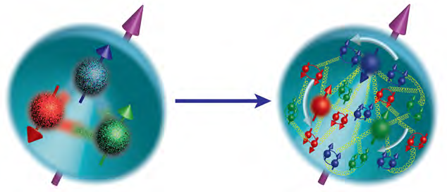
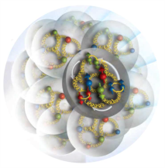
A new facility is needed to investigate, with precision, the dynamics of gluons & sea quarks and their role in the structure of visible matter
How are the sea quarks and gluons, and their spins, distributed in space and momentum inside the nucleon?
How do the nucleon properties emerge from them and their interactions?
How do color-charged quarks and gluons, and colorless jets, interact with a nuclear medium?
How do the confined hadronic states emerge from these quarks and gluons?
How do the quark-gluon interactions create nuclear binding?
How does a dense nuclear environment affect the quarks and gluons, their correlations, and their interactions?
What happens to the gluon density in nuclei? Does it saturate at high energy, giving rise to a gluonic matter with universal properties in all nuclei, even the proton?
gluon
emission
gluon recombination
?
=

Slide 7
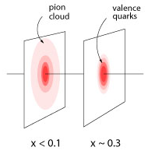
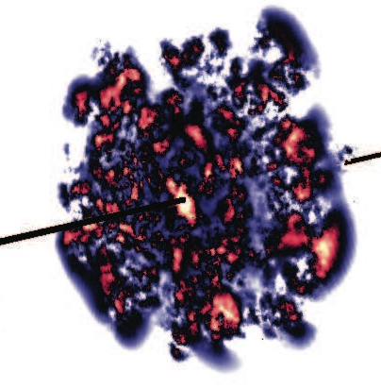
What does a proton look like with increasing energy?
One of several possible scenarios: a pion cloud model
A parton core in the proton gets increasingly surrounded
by a meson cloud with decreasing x
large impact on gluon and sea-quark observables
What do we expect to see:
pairs (sea quarks) generated at small(ish)-x are predicted to be unpolarized
gluons generated from sea quarks are unpolarized
needed:
  high precision measurement of flavor separated polarized quark and gluon
distributions as functions of x
  high precision spatial imaging: Gluon radius ~ sea-quark radius ?
What happens in the gluon dominated small-x regime?
  possible scenario: lumpy glue
EIC needs to and will explore the dynamical spatial structure of hadrons

Slide 8
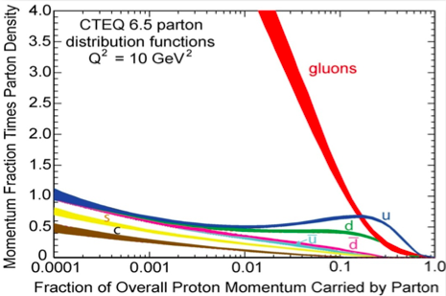
Gluon and the consequences of its interesting properties:
QCD
Terra-incognita!
High Potential for Discovery
Gluons carry color charge ➔ Can interact with other gluons!
Apparent “indefinite rise” in gluon distribution in proton!
What could limit this indefinite rise? → saturation of soft gluon densities via gg→g recombination must be responsible.
recombination
Where? No one has unambiguously seen this before!
If true, effective theory of this →“Color Glass Condensate”
Notes:
Significant modification and simplification of this slide… may convert in to two….

Slide 9
Proton as a laboratory for QCD
3D structure of hadrons in momentum and position space….

Slide 10
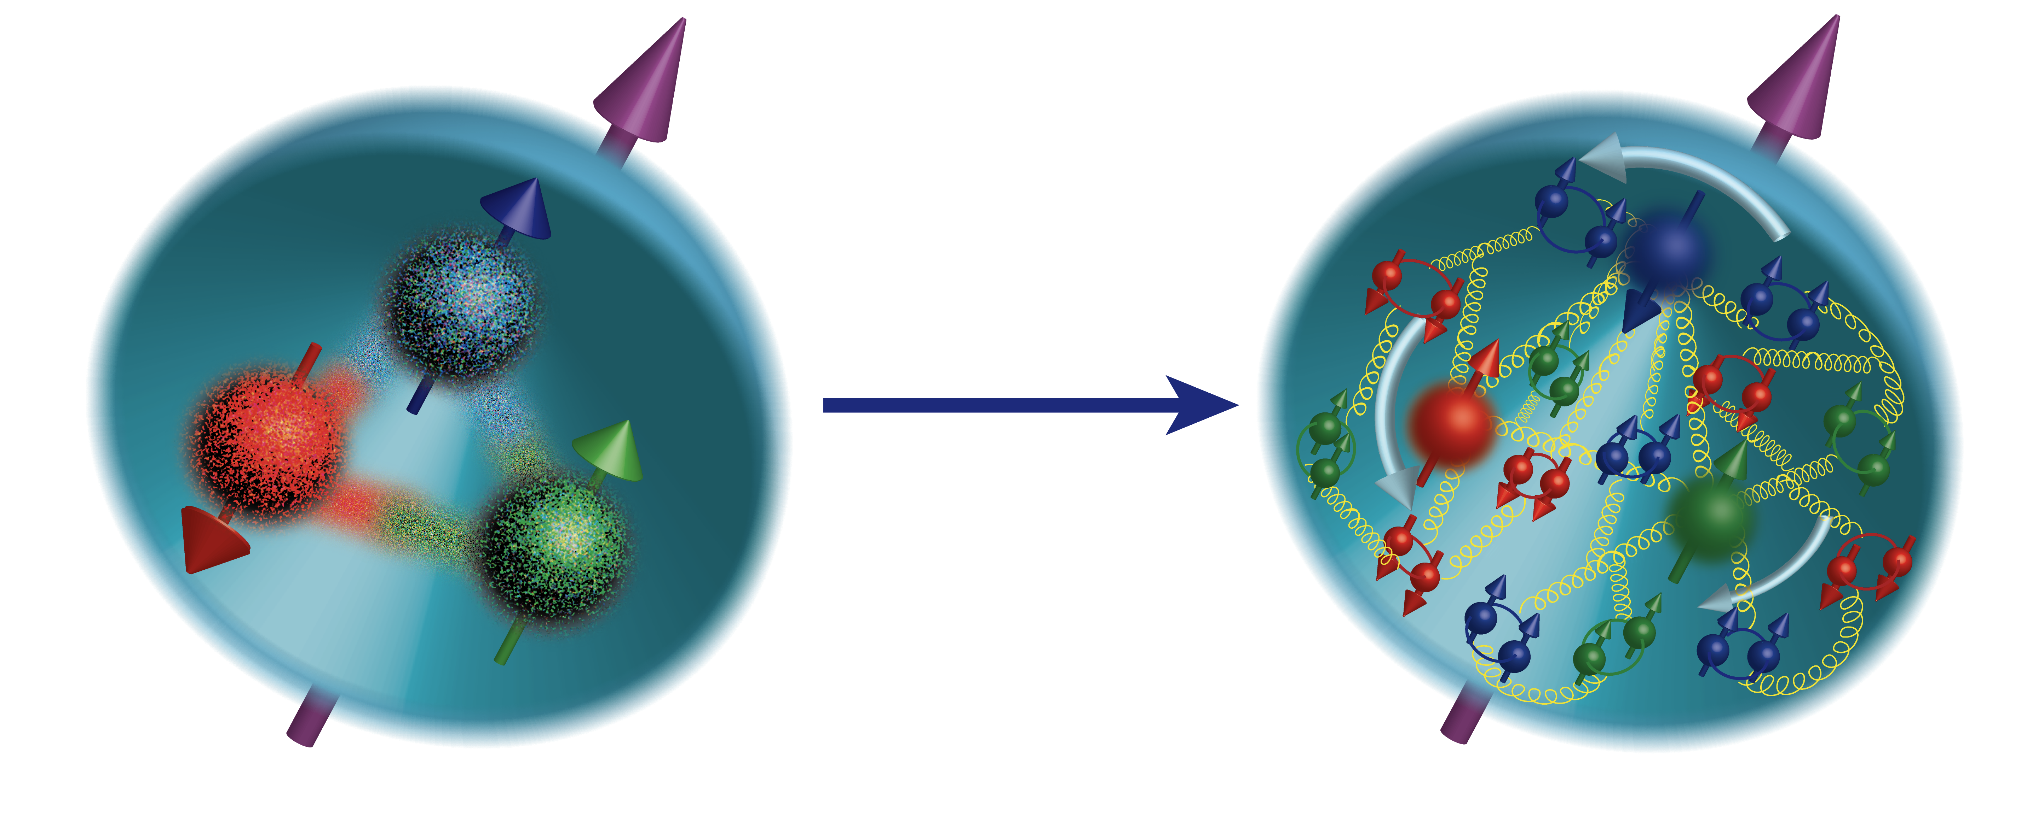
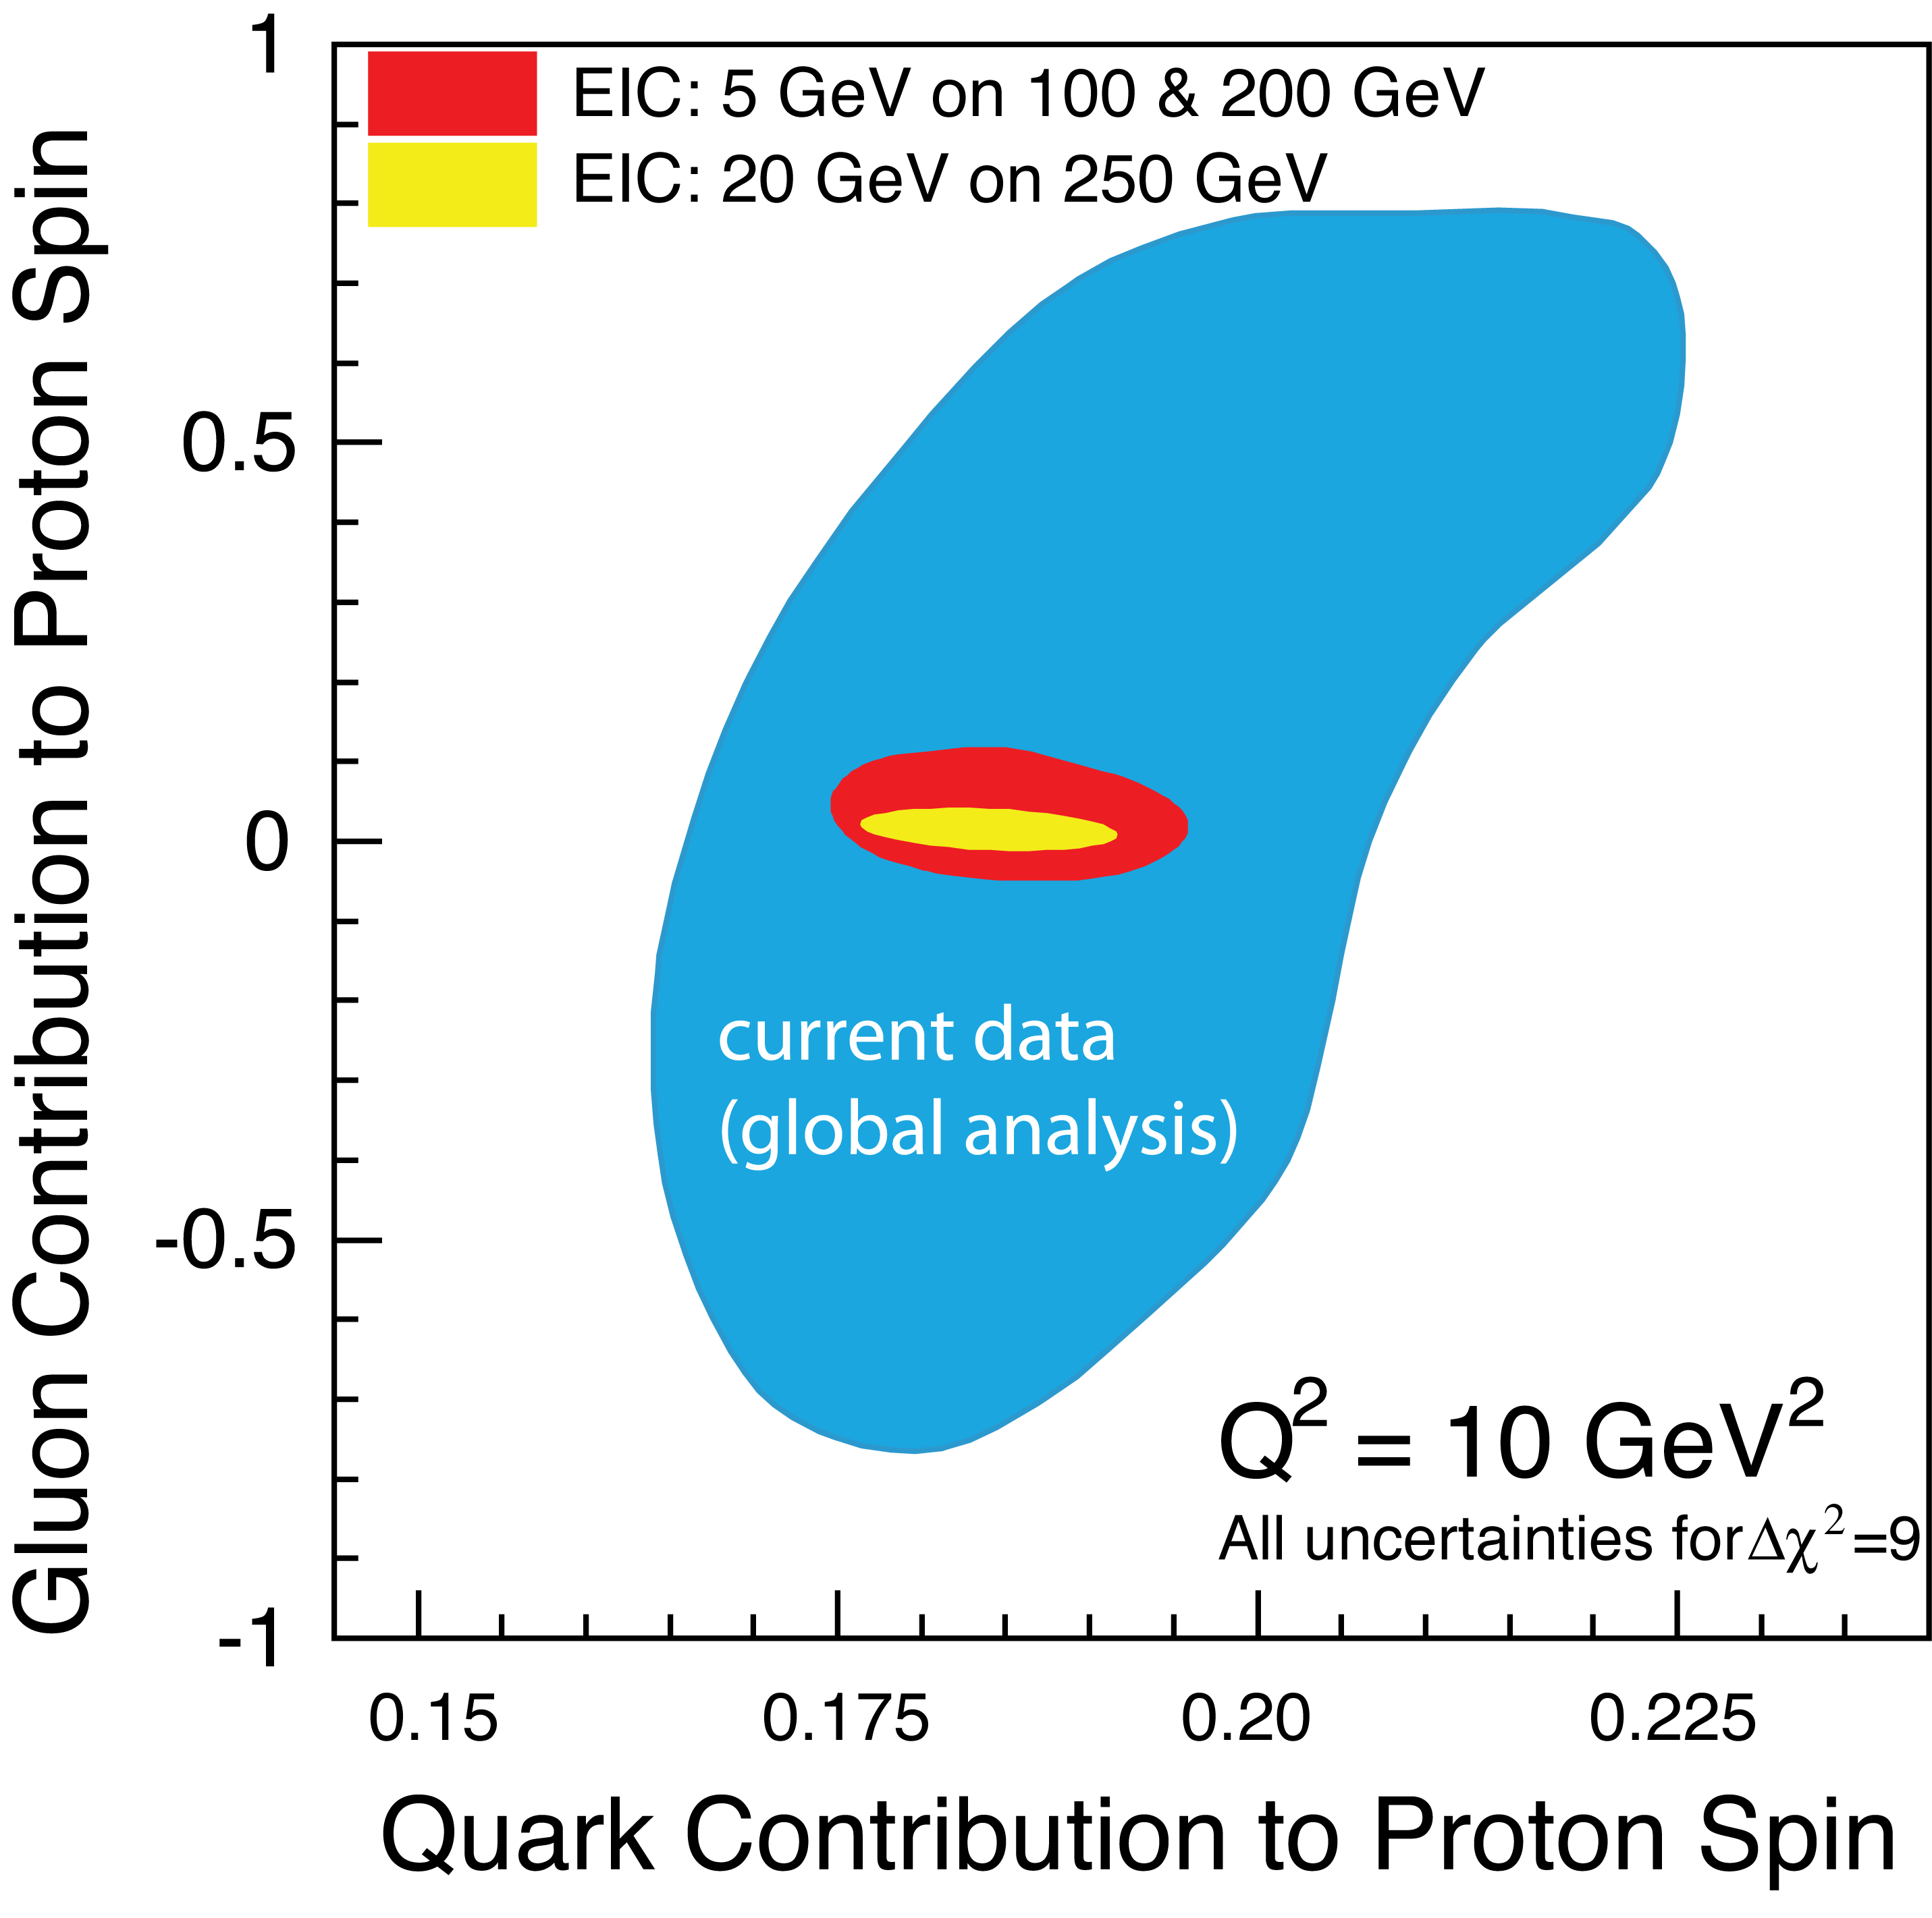
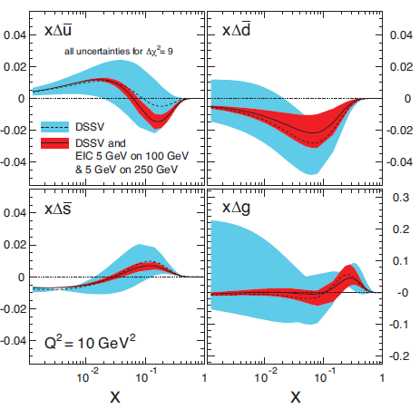
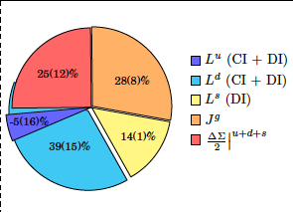
Understanding Nucleon Spin
“Helicity sum rule”
EIC projected measurements:
precise determination of polarized PDFs of quark sea and gluons ➔ precision ΔG and ΔΣ
A clear idea of the magnitude of ∑L_{q}+L_{g}
gluon
contribution
orbital angular
momentum
quark
contribution
Q²=10 GeV²
Spin and Lattice: Recent Activities
Gluon’s spin contribution on Lattice: S_{G} = 0.5(0.1)
Yi-Bo Yang et al. PRL 118, 102001 (2017)
J_{q} calculated on Lattice QCD:
𝛘QCD Collaboration, PRD91, 014505, 2015
Notes:
Emergent Phenomena
added some physics motivation why Delta G is relevant in general, and a more modern plot based on DSSV-154 how well we can measure the helicity sum rule. Better plot from the lattice paper showing the Ls
Axial Anomaly affects behavior of Δg(x) as function of Q²
Recent theoretical work: Shows how to constrain in
Helicity sum rule (NEED TO FIND THE REFERENCE)

Slide 11
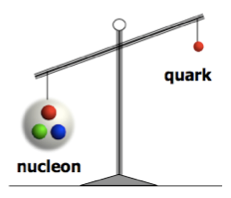
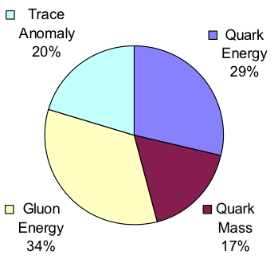
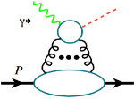
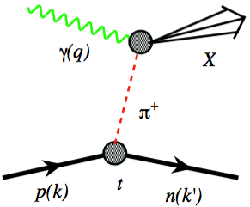
Understanding Nucleon Mass
Relativistic motion
χ Symmetry Breaking
Quantum fluctuation
MeV
GeV
Quark Energy
Gluon Energy
Quark Mass
Trace Anomaly
“… The vast majority of the nucleon’s mass is due to quantum fluctuations of quark-antiquark pairs, the gluons, and the energy associated with quarks moving around at close to the speed of light. …”
The 2015 Long Range Plan for Nuclear Science
Preliminary Lattice QCD results:
EIC’s expected contribution in:
Trace anomaly:
J/Ψ, Υ, …
Upsilon production
near the threshold
Quark-gluon energy:
quark-gluon momentum fractions
In nucleon with
DIS and SIDIS
In pions and kaons with Sullivan process
Notes:
Emergent Phenomena like the Spin

Slide 12
3-Dimensional Imaging Quarks and Gluons
Wigner functions W(x,b_{T},k_{T})
offer unprecedented insight into confinement and chiral symmetry breaking.
W(x,b_{T},k_{T})
∫d²b_{T}
∫ d²k_{T}
Momentum
space
Coordinate
space
f(x,k_{T})
f(x,b_{T})
Spin-dependent 2D coordinate space (transverse) + 1D (longitudinal momentum)
images from exclusive scattering
→ GPDs
Spin-dependent 3D momentum space
images from semi-inclusive scattering
→ TMDs
Position and momentum → Orbital motion of quarks and gluons
Recent theoretical work indicates possible direct access to gluon Wigner function through diffractive di-jet measurements at an EIC
Notes:
added why wigner fcts. are important. and added reference statement that diffraction allows access to gluon wigner functions
Y. Hatta, Bo-Wen Xiao & F. Yuan, PRL 116, 022301 (2016)
10.1103/PhysRevLett.116.202301
Angular correlation between the nucleon’s recoil momentum and the di-jet transverse momentum carry non-trivial information about the phase space of the Wigner distribution.

Slide 13

Spatial Imaging of quarks & gluons
Generalized Parton Distributions
Historically, investigations of nucleon structure and dynamics involved breaking the nucleon…. (exploration of internal structure!)
To get to the orbital motion of quarks and gluons we need non-violent collisions
Quarks
Motion
Gluons:
Only @
Collider
Deeply Virtual Compton Scattering
Measure all three final states
e + p → e’+ p’+ γ
Fourier transform of momentum transferred=(p-p’) → Spatial distribution
Exclusive measurements ➔ measure “everything”

Slide 14
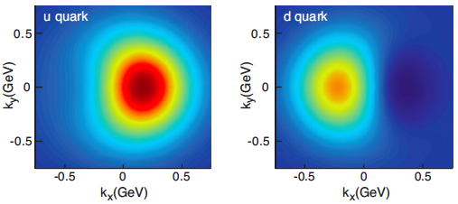
2+1 D partonic image of the proton with the EIC
Spin-dependent 3D momentum space
images from semi-inclusive scattering
Spin-dependent 2D coordinate space (transverse) + 1D (longitudinal momentum)
images from exclusive scattering
Transverse Momentum Distributions
Transverse Position Distributions
u-Quark
sea-quarks
unpolarized polarized
Gluons

Slide 15
Use of Nuclei as a Laboratory for QCD :
“Imaging” of nucleus
Diffraction is an exclusive process…
Study of saturation is the aim, however “imaging” is the tool….

Slide 16
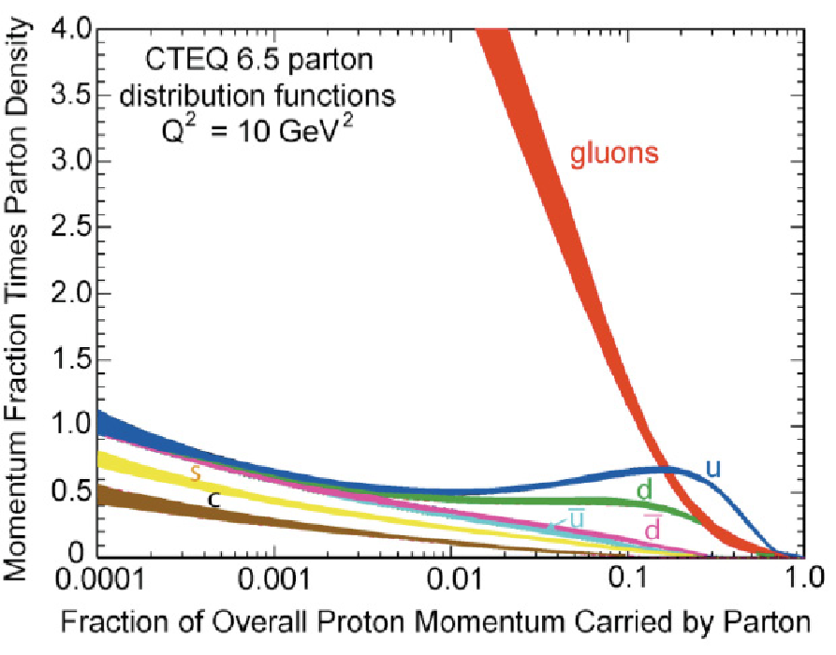
What do we learn from low-x studies?
What tames the low-x rise?
New evolution eqn.s @ low x & moderate Q²
Saturation Scale Q_{S}(x) where gluon emission and recombination comparable
gluon
emission
gluon recombination
Resolution
=
At Q_{S}
1/Energy
First observation of gluon recombination effects in nuclei:
➔leading to a collective gluonic system!
First observation of g-g recombination in different nuclei
Is this a universal property?
Is the Color Glass Condensate the correct effective theory?
Notes:
Color Glass Condensate mentioned for the first time here!

Slide 17
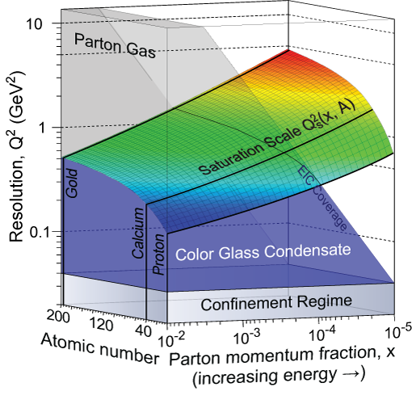
How to explore/study this new phase of matter?
(multi-TeV) e-p collider OR a (multi-10s GeV) e-A collider
Advantage of nucleus →
Teaney, Kowalski
Kovchegov et al.
Enhancement of Q_{S} with A:
Saturation regime reached at significantly lower energy (read: “cost”) in nuclei
Notes:
Interest in mapping the transition from dilute gas to CGC region systematically, by varying nuclei and varying energy.

Slide 18
Transverse imaging of the gluons nuclei
Diffractive vector meson production in e-Au
,γ
d
Diff. MC: “Sartre”
➔Does low x dynamics (Saturation) modify the transverse gluon distribution?
Experimental challenges being
Studied.
Simulation study by Toll & Ullrich

Slide 19
Saturation/CGC: What to measure?
Many ways to get to gluon distribution in nuclei, but diffraction most sensitive:
At HERA
  ep: 10-15% diffractive
At EIC eA, if Saturation/CGC
  eA: 25-30% diffractive
Notes:
Amazing events: in the rest frame a 1 TeV e-beam on Nucleus (~binding energy of 10s MeV) and nothing happens to the nucleus 1/3 of time. The gluon matter is so “DISK” like that even when probed with high resolution probe acts like a “solid” Dark object, creating diffractive patters. Nuclei have a lot more gluons than protons, so the object is DARKER, and hence the diffractive part of the cross section RISES above 1 in ratio. If there is no saturation, then the nucleus may break more often, and hence the ratio of diffraction in nuclei to proton actually decreases.

Slide 20
Realization….
Support for Accelerator R&D
User group formation ➔ leading to future collaborations
Early experimental design concepts
Support for detector pre-conception design R&D
The National Academy of Science (NAS- NRC) Review

Slide 21
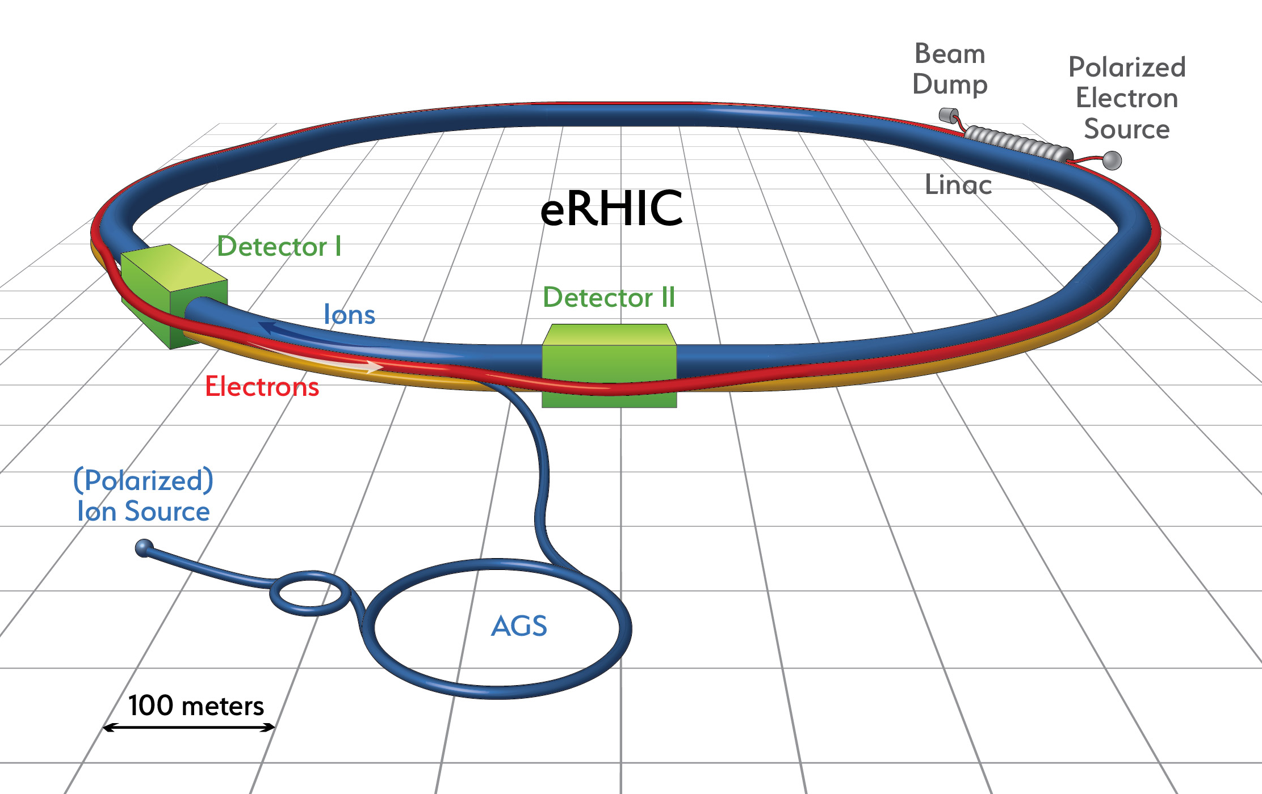
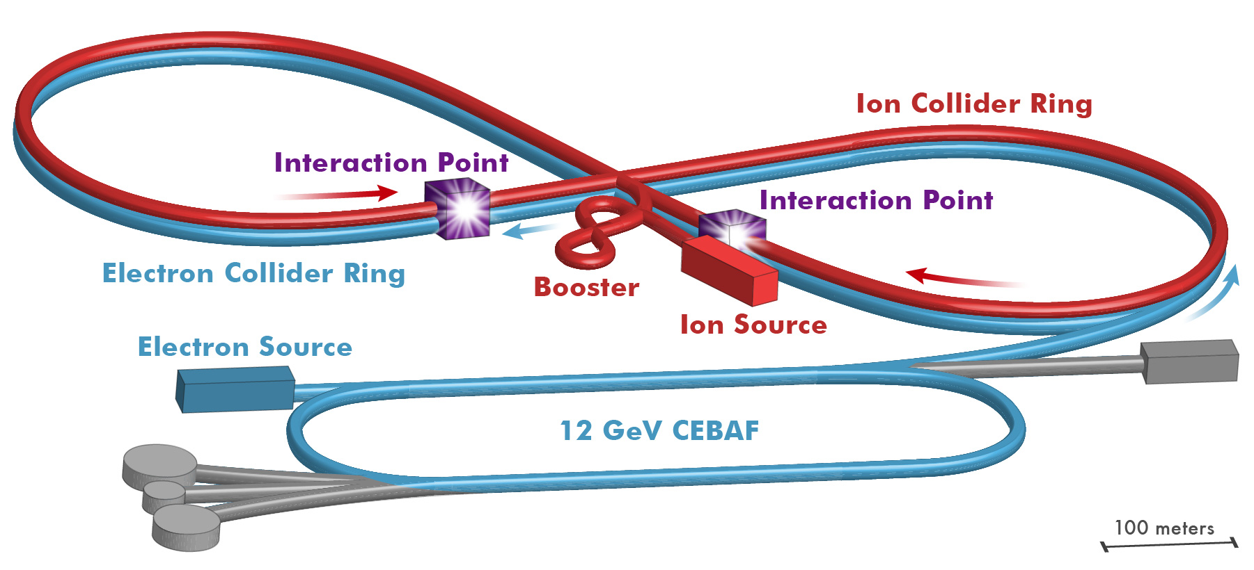
The Electron Ion Collider
Two options of realization!
For e-N collisions at the EIC:
Polarized beams: e, p, d/³He
e beam 5-10(20) GeV
Luminosity L_{ep} ~ 10³³⁻³⁴ cm⁻²sec⁻¹
  100-1000 times HERA
20-100 (140) GeV Variable CoM
For e-A collisions at the EIC:
Wide range in nuclei
Luminosity per nucleon same as e-p
Variable center of mass energy
Not to scale
Ring-Ring
World’s first
Polarized electron-proton/light ion
and electron-Nucleus collider
Both designs use DOE’s significant investments in infrastructure
1212.1701.v3
A. Accardi et al Eur. Phy. J. A, 52 9(2016)
Ed. A. Deshpande, Z.-E. Meziani, J.-W. Qiu
Notes:
Contrast with HERA could be made more explicit. Table/column presentation.

Slide 22

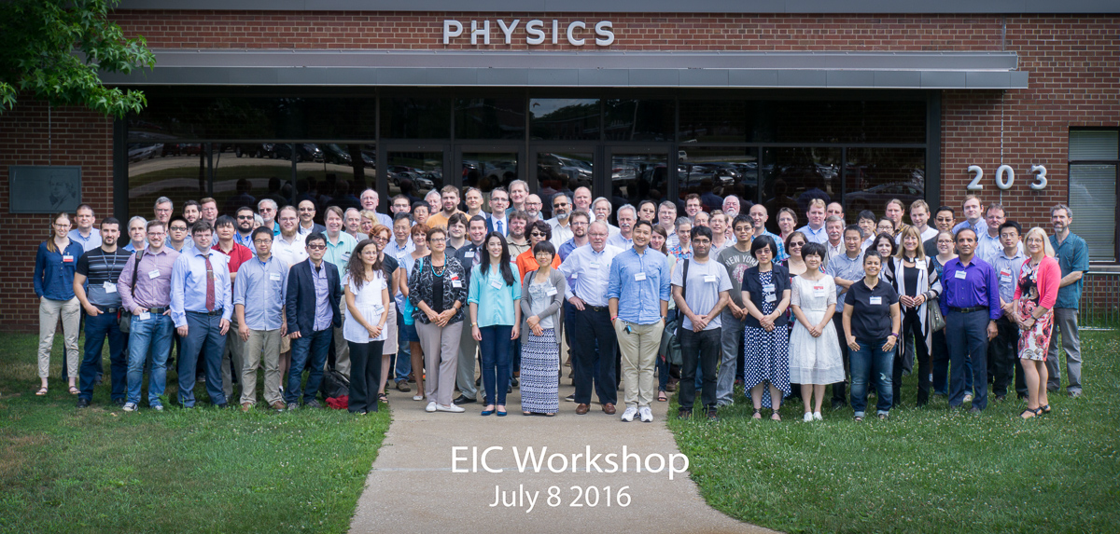
Community/Collaboration building:
EIC User Group → eicug.org (contact me!)
The EIC Users Meeting at Stony Brook, June 2014:
  http://skipper.physics.sunysb.edu/~eicug/meeting1/SBU.html
The EIC UG Meeting at University of Berkeley, January 6-9, 2016
  http://skipper.physics.sunysb.edu/~eicug/meeting2/UCB2016.html
EICUG Argonne National Laboratory July 7-10, 2016
  http://eic2016.phy.anl.gov
EICUG on BlueJeans (Electronic/Remote) meeting March 2017
Next in person meetings:
July 18-22, 2017 Trieste, Italy
Ample opportunities for contributions & participation!

Slide 23
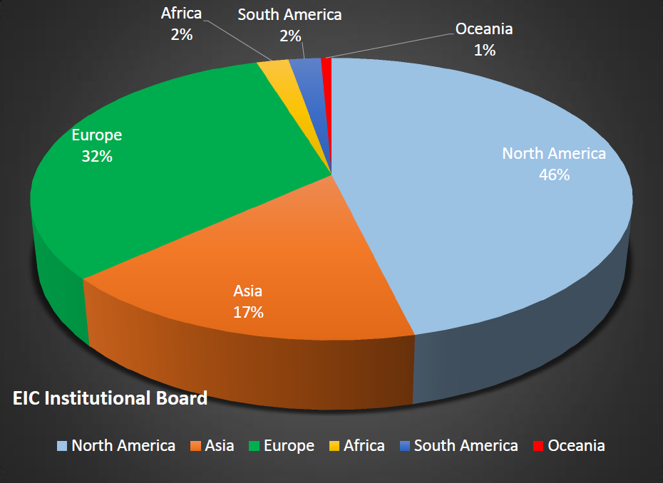
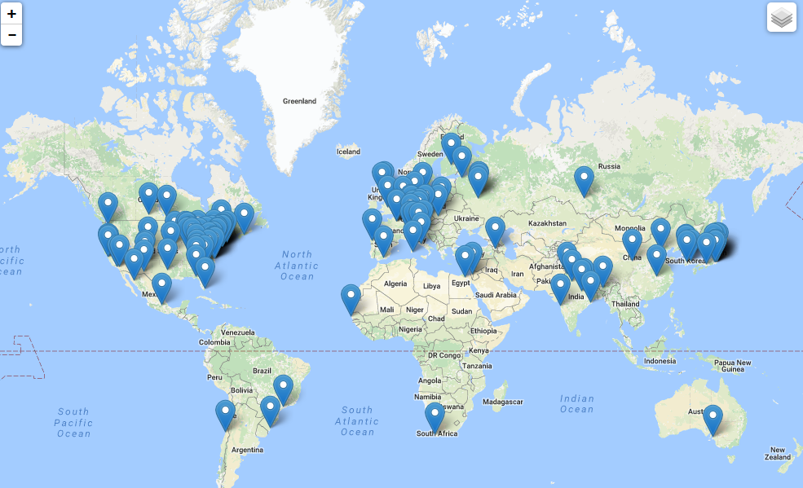
The EIC Users Group: EICUG.ORG
(no students included as of yet)
670 collaborators, 28 countries, 150 institutions... (December, 2016)
Map of institution’s locations

Slide 24
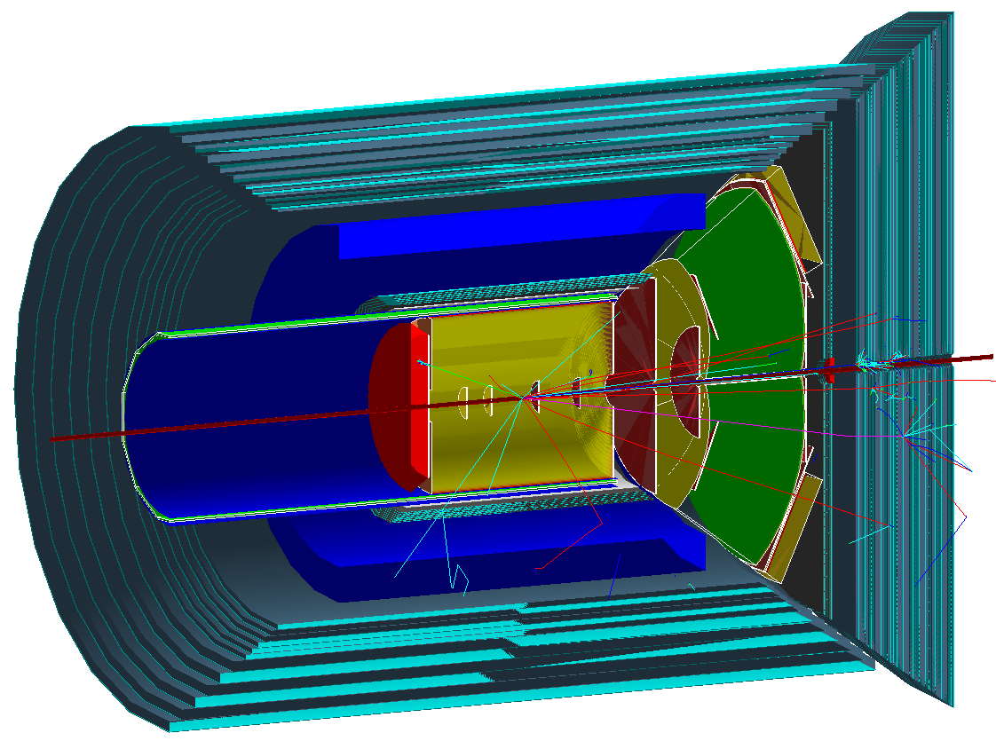
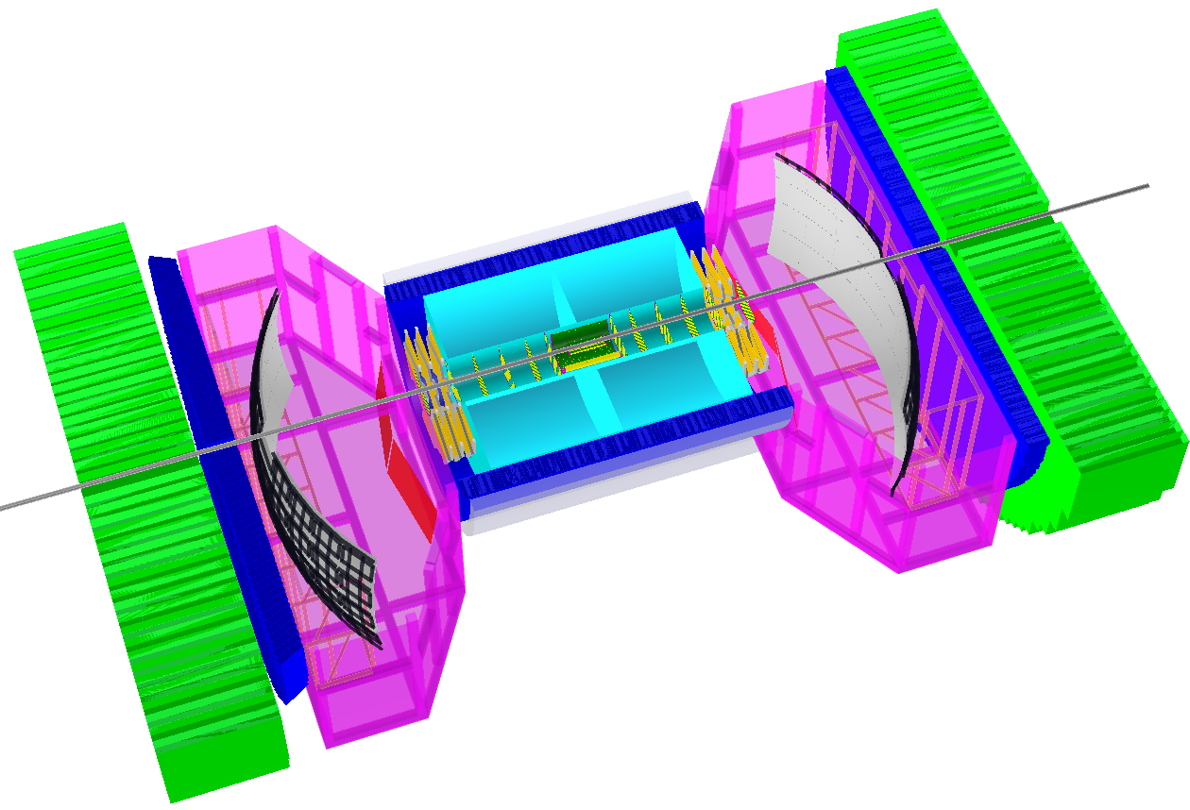
EIC Detector Concepts
“ePHENIX”
“BEAST”
JLEIC Det
Other ideas from the Users Group
are welcome! (essential!)
Curtesey of Thomas Ullrich

Slide 25
Path forward for the EIC:
Science Review by National Academy of Science (& Engineering & Arts) (National Research Council)
  Committee being formed now, expect report by Early 2018
Positive NAS review will trigger the DOE’s CD process
  CD0 (acceptance of the critical need for science by DOE) FY19
  EIC-Proposal’s Technical & Cost review → FY20 (site selection)
  CD2 requires site selection
  Major Construction funds (“CD3”) by 2022/23”
    Assuming 1.6% sustained increase over inflation of the next several years (Long Range Plan)
    Consistent with the past 10 years of NP funding increases in the US

Slide 26
Connections to other areas of physics
Explorations of the stringy dynamics of hadrons led to the string theory of Gravity. A weakly coupled regime of 10-d gravity is conjectured to be dual to strongly coupled 4-d QCD-like theory. Further profound connections may emerge from deeper investigations of the QCD landscape.
The dynamics of strongly coupled cold atom gases and QCD (non-Abelian gauge fields but also strong nuclear fields) show strikingly common features. Cold atom scientists are actively engaged in engineering cold atoms simulators of gauge field mechanism.
Strong connections have emerged between studies of strongly correlated condensed matter systems and QCD: topological effects arising from chiral anomaly
Strong field QED explores the breakdown of the QED vacuum and its nonlinear optical response in e⁺e⁻ pair creation. Reaching this regime is a major goal in developing high powered lasers.
Notes:
Strong coupling resulting in non-linear interactions and emergent phenomena
QCD provides these conditions very naturally because of the self-interactions inherent in its structure and dynamics.

Slide 27
Summary:
The EIC (with its precision and control) will profoundly impact our understanding of the many body structure of nucleons and nuclei in terms of sea quarks & gluons → The bridge between sea quark/gluons to Nuclei
The EIC will enable IMAGES of yet unexplored regions of phase spaces in QCD with its high luminosity/energy, nuclei & beam polarization → High potential for discovery
Outstanding questions raised by world wide experiments at CERN, BNL and Jeff Lab, have naturally led us to the science and design parameters of the EIC: World wide interest and opportunity in collaborating on the EIC
Accelerator scientists at RHIC, Jlab in collaboration with many outside accelerator experts will provide the intellectual and technical leadership to realize the EIC -- a frontier accelerator facility.
Future QCD studies, particularly for Gluons, demands an Electron Ion Collider
NSAC agrees and we are moving forward!

Slide 28

Thanks to many of my EIC Collaborators and Enthusiasts who led many of the studies presented in this talk
See: arXiv:1108.1713, D. Boer et al.
Without the EIC White Paper Writing Group the EIC White Paper would not have existed.
Special thanks to Dr. Jianwei Qiu and Prof. Zein-Eddine Meziani, my Co-Editors for the EIC White Paper
See: arXiv:1212.1701.v3 , A. Accardi et al.
Eur. Phy. J. A 52, 9 (2016)
THANK YOU
The eRHIC and JLEIC machine design teams
Also gratefully acknowledge recent input from: M. Diefenthaler, R. Ent, R. Milner, R. Yoshida

Slide 29
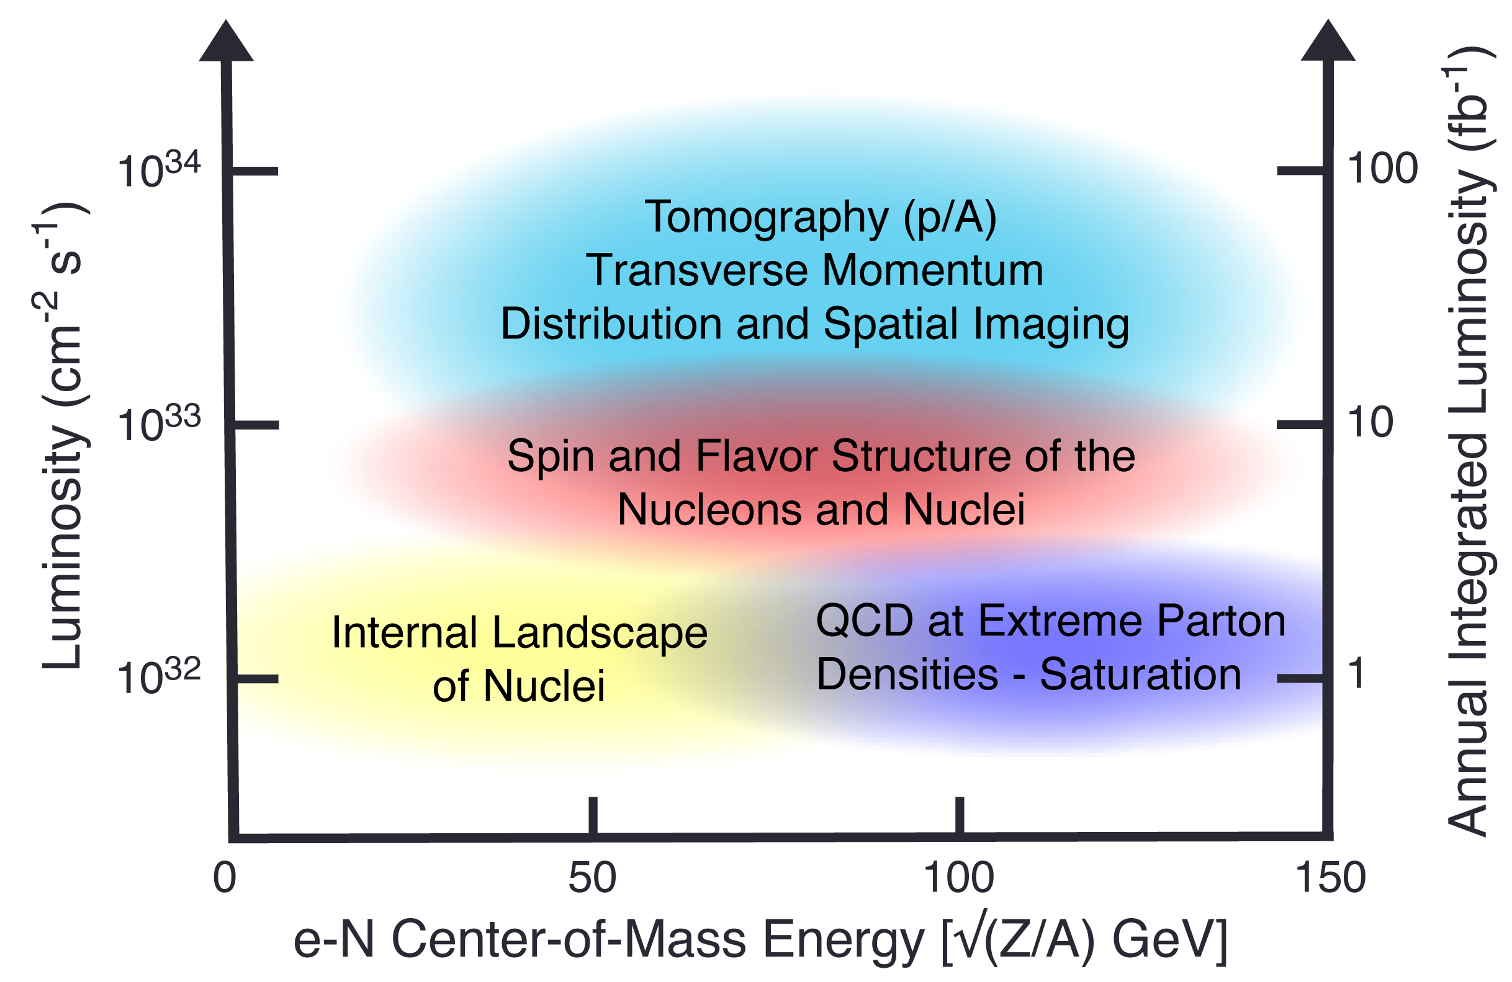
Uniqueness of EIC among all DIS Facilities
All DIS facilities in the world.
However,
if we ask for:
high luminosity & wide reach in √s
polarized lepton & hadron beams
nuclear beams
EIC stands out as
unique facility …

Slide 30
EIC: impact on the knowledge of nPDFs
Ratio of Parton Distribution Functions of Pb over Proton:
Without EIC, large uncertainties in nuclear sea quarks and gluons
With EIC significantly reduces uncertainties
Impossible for current and future pA data at RHIC & LHC data to achieve
Notes:
Box around sea quarks and gluons rihght two figures.

Slide 31
Emergence of Hadrons from Partons
Nucleus as a Femtometer sized filter
Unprecedented ν, the virtual photon energy range @ EIC : precision & control
Energy loss by light vs. heavy quarks:
Control of ν by selecting kinematics;
Also under control the nuclear size.
Colored quark emerges as color neutral hadron ➔ What is nature telling us about confinement?
Identify π vs. D^{0 (charm)} mesons in e-A collisions: Understand energy loss of light vs. heavy quarks traversing the cold nuclear matter:
Connect to energy loss in Hot QCD
Need the collider energy of EIC and its control on parton kinematics
Notes:
Large nu measurements, Q2 large, so Shadowing effects are absent

Slide 32
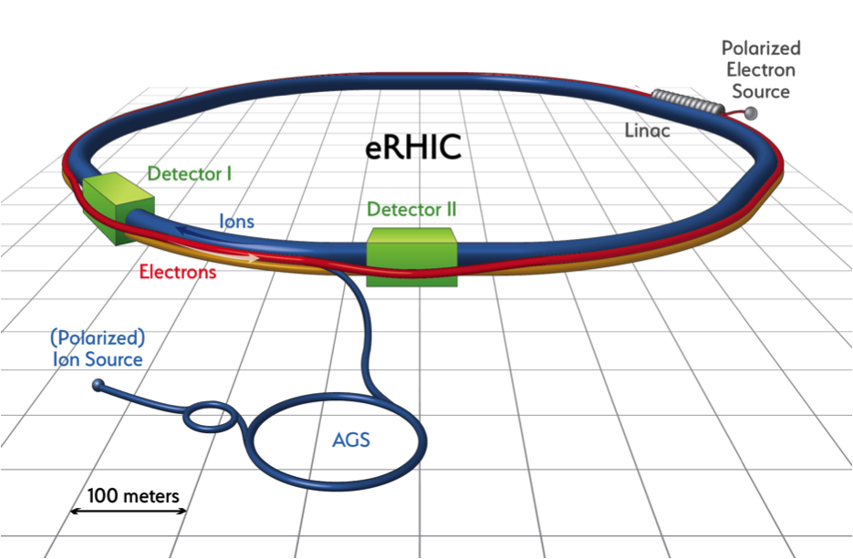
eRHIC at BNL
Upton, NY
Use existing RHIC
  Up to 275 GeV protons
  Existing: tunnel, detector halls & hadron injector complex
Add 18 GeV electron accelerator in the same tunnel
  Use either high intensity Electron Storage Ring or Energy Recovery Linac
Achieve high luminosity, high energy e-p/A collisions with full acceptance detector
Luminosity and/or energy staging possible

Slide 33
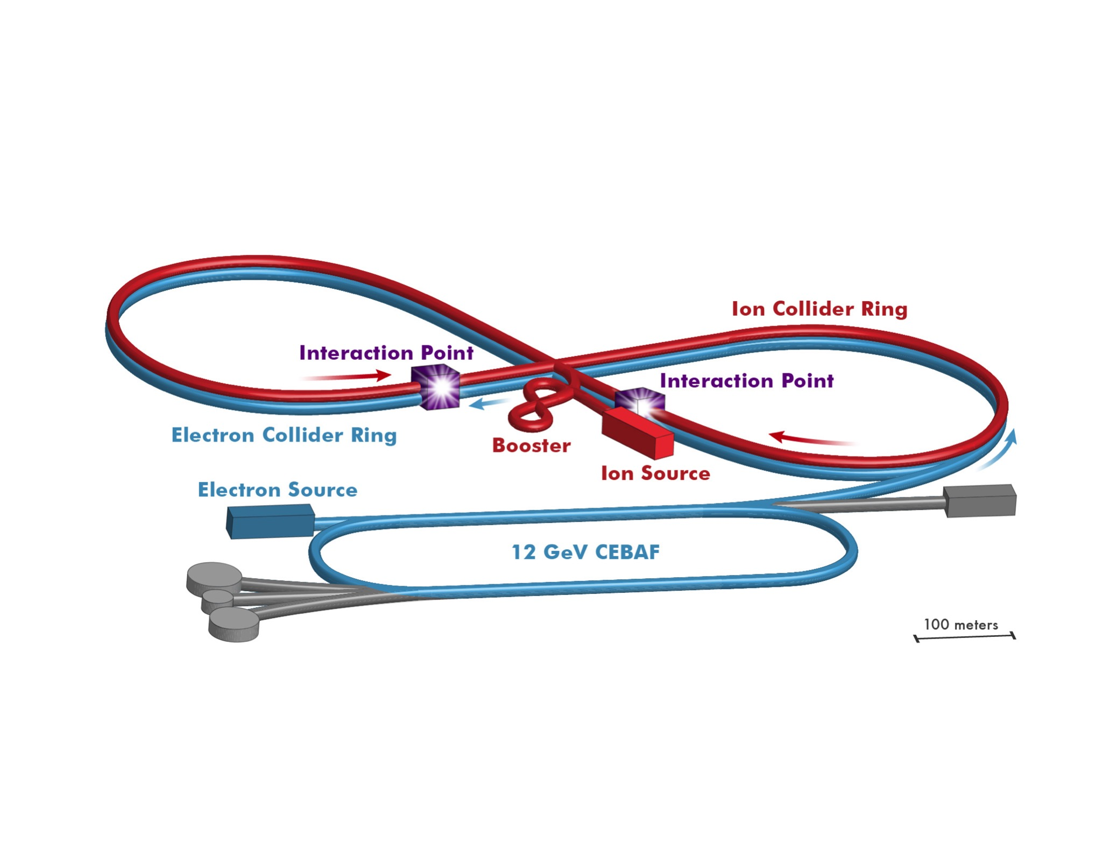
JLEIC at Jefferson Laboratory (Newport News, VA)
Use existing CEBAF for polarized electron injector
Figure 8 Layout: Optimized for high ion beam polarization  polarized deuterons
Energy Range: √s : 20 to 65 - 140 GeV (magnet technology choice)
Fully integrated detector/IR
JLEIC achieves initial high luminosity, with technology choice determining initial and upgraded energy reach

