Slide 1
HNSciCloud and VMDIRAC
Luisa Arrabito
Johan Bregeon
DIRAC@IN2P3 Call 09/03/2017

Slide 2
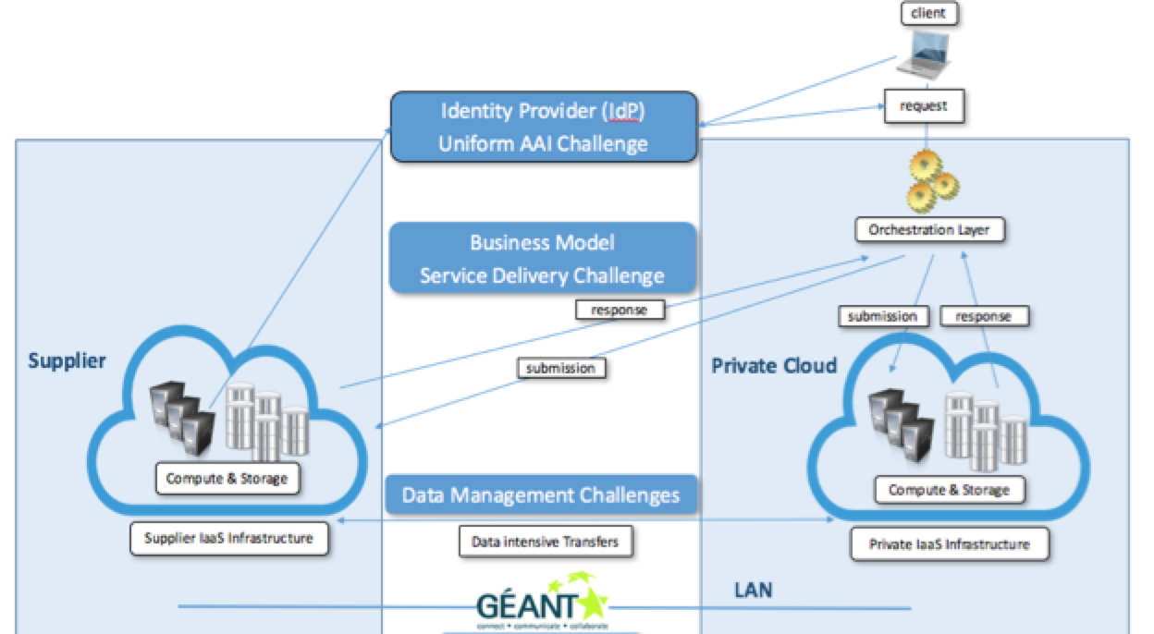
HNSciCloud Highlights
HNSciCloud Objective
Create a common hybrid science cloud platform for the European research community

Slide 3
Main Challenges
Compute & Storage
CPU process with intensive data access
Efficient large-scale data management
Transparent data access
Network Connectivity and Federated Identity
Tenders needs to be connected to GEANT
Single Sign-on and authentication services to end-users supporting eduGAIN
Service Payment Models
Determine the most appropriate purchasing option for the scientific application workload

Slide 4
Current activities
Solution prototyping
From Oct 18th to Jan 17th
Objective: to assess the designs produced by the selected contractors according to the project needs
Pilot deployment
From Jan 17th to March 20th
3 designs selected
Objective: the contractors build their prototypes and make them accessible to the buyers group (CERN, CC-IN2P3, PIC, CNAF…)

Slide 5
Current activities
Prototype Phase
From April to June 2017
3 companies will deploy their proposed solutions for the hybrid Cloud
Test phase
From June to December 2017
CTA is one of the Use Cases
Work with PIC (ranked 1)
Selected companies: Tsystems, RHEA, IBM

Slide 6
CTA Use case
Use VMDIRAC to access hybrid cloud resources
The output should be useful to other users communities
Work also to integrate the Data Management part in DIRAC (e.g. OneData)

Slide 7
Testing VMDIRAC
Tests with 1 cloud provider until now (Tsystems, based on OpenStack)
VMDIRAC debugging needed to take into account OpenStack evolutions (e.g. new connection parameters)
Found 2 bugs also in python libcloud
Access to the endpoint
Retrieve floating ips

Slide 8
Testing VMDIRAC
Run the contextualization script manually for debugging
Minor modifications needed to make it running (e.g. mounting ephemeral disk, cvmfs installation)
Job agent correctly running and matching jobs

Slide 9
Next (near future) steps
Check that the VM contextualization works well also when launched by the CloudDirector
Write documentation for VMDIRAC installation, configuration and usage
All this will be useful also to access FG Cloud resources (I’m already testing LUPM-Cloud in parallel)

