Slide 1
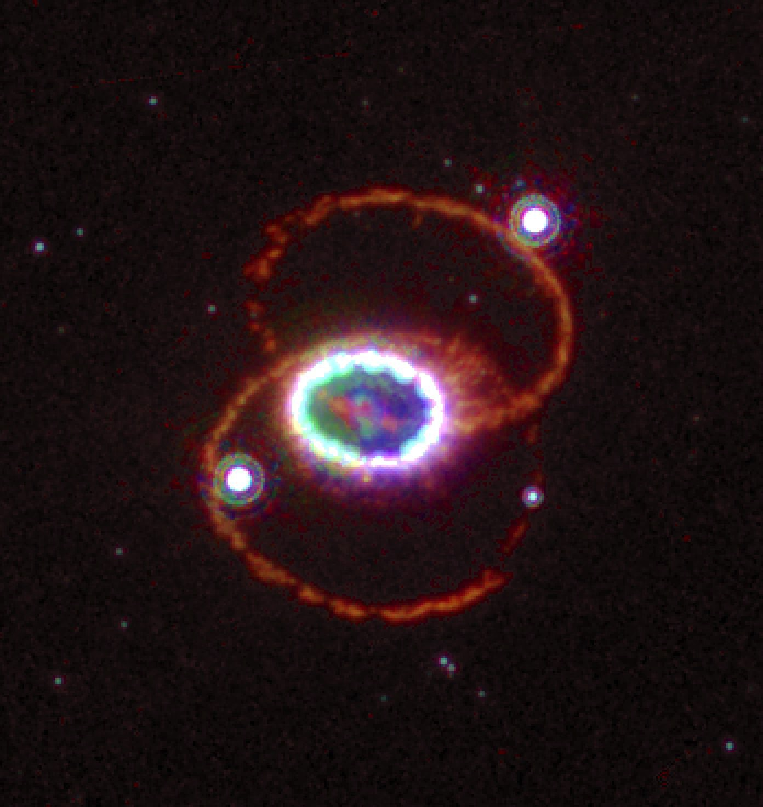
SN 1987A: The Supernova of a Lifetime
Robert P. Kirshner
Clowes Research Professor of Science, Harvard University
Chief Program Officer- Science, Gordon and Betty Moore Foundation
Notes:
After dinner talk– before dinner!
Delighted to see so many familiar and (even better) unfamiliar faces… a topic to which I will return.

Slide 2
Born after 1987?

Slide 3
Paper about 1987A?

Slide 4
Saw 1987A with your own eyes?

Slide 5
Life is short!
yoU/Universe~ 10² years/10¹⁰ years ~10⁻⁸

Slide 6
Time as money!
~10⁻⁸
1 cent/1 million dollars

Slide 7
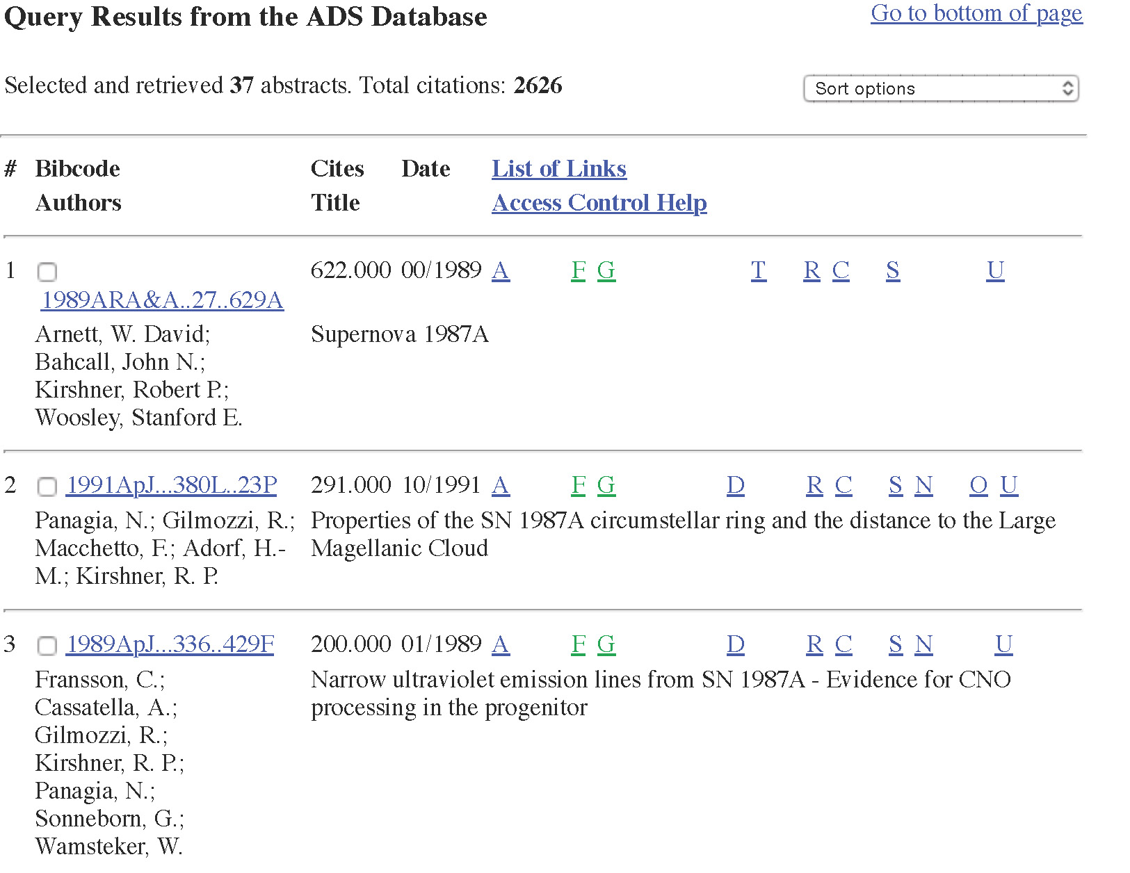
31 Years, 37 Papers!
ADS: Kirshner, R. + SN 1987A

Slide 8
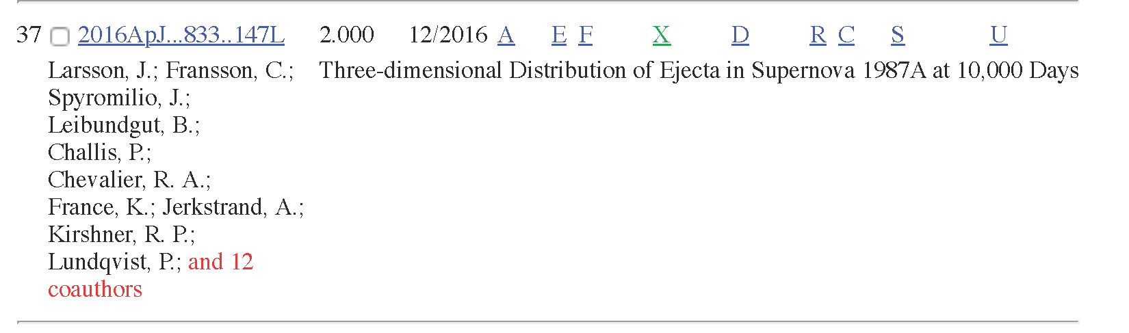
Including some new ones…

Slide 9
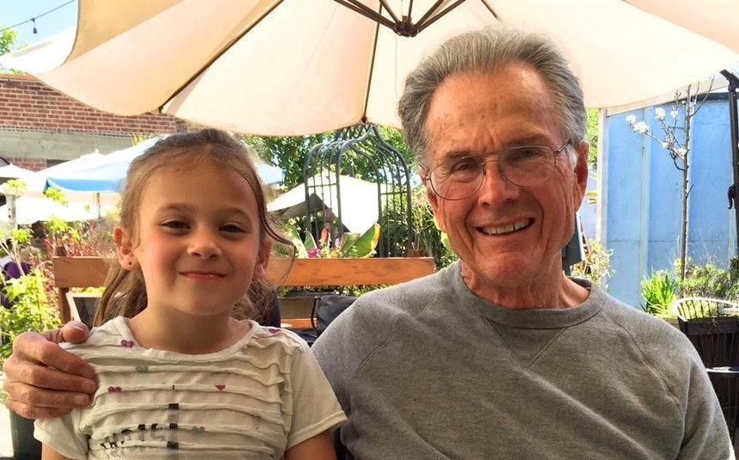
Dick McCray

Slide 10
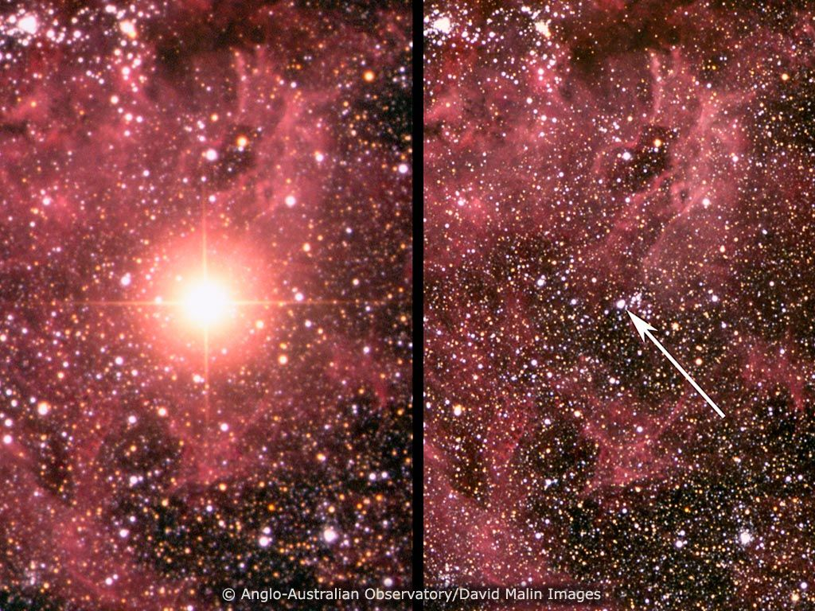
SN 1987A: February 23, 1987
After
Before
Sanduleak -69 202

Slide 11

Supernova of a Lifetime!
NOVA: Death of a Star 1988

Slide 12
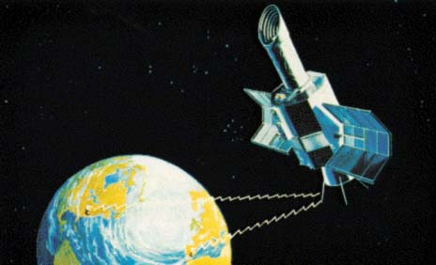
A 1987 Space Telescope: International Ultraviolet Explorer

Slide 13
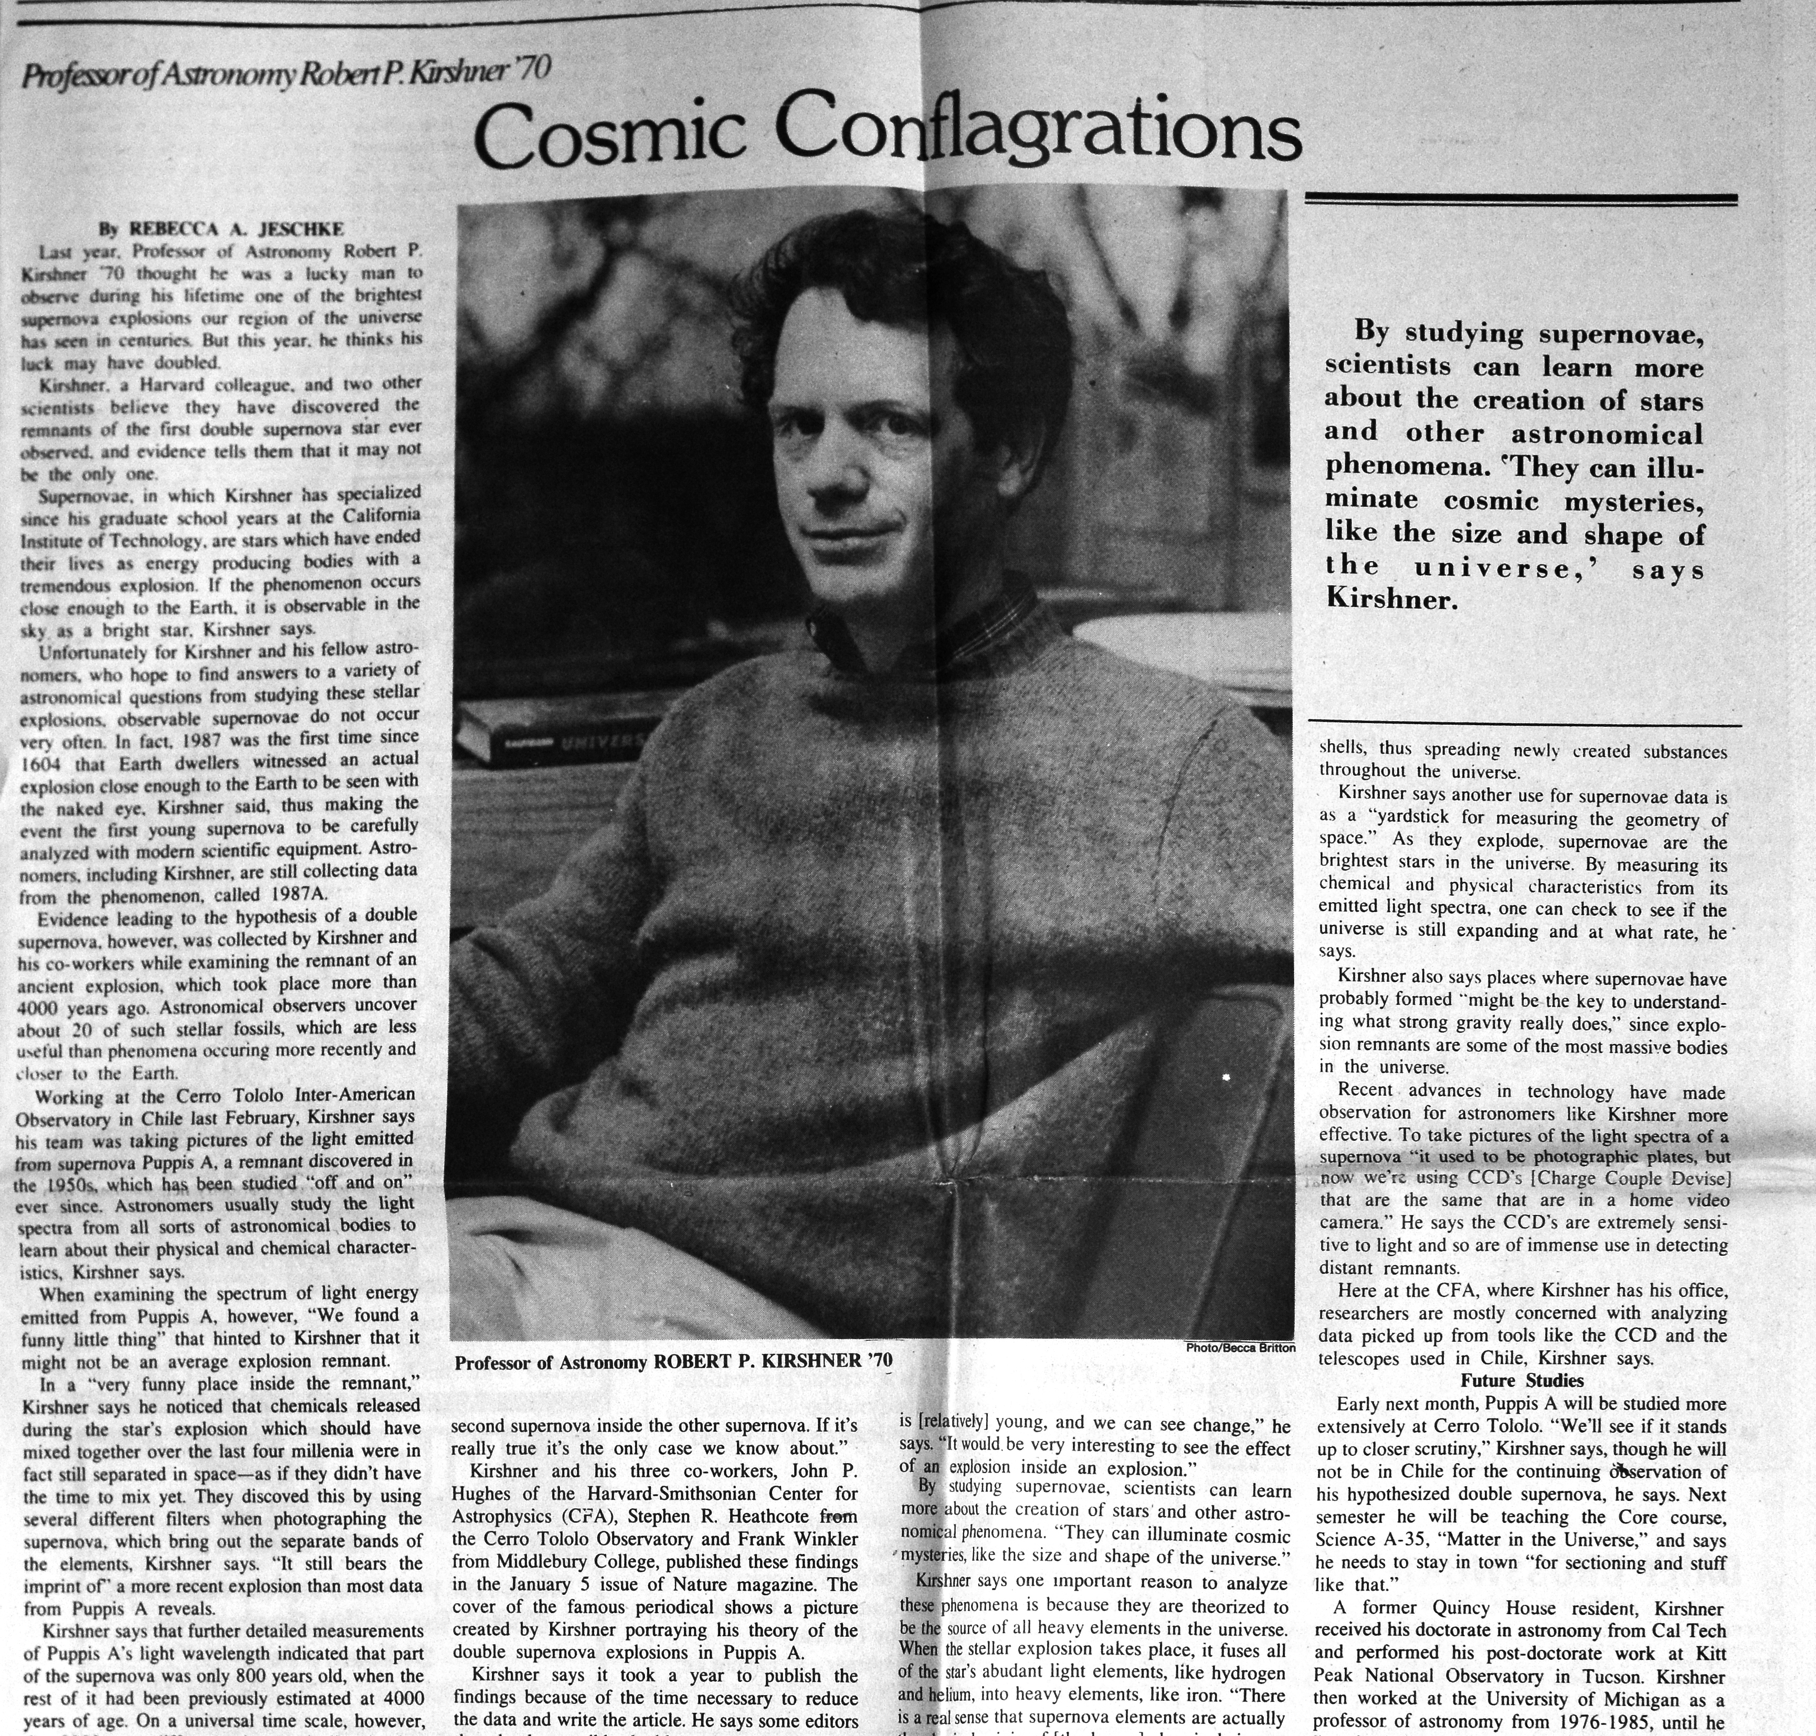
1988 RPK
Should have said, “acceleration”

Slide 14
Sanduleak -69 202

Slide 15
Driving while talking at Goddard Space Flight Center

Slide 16
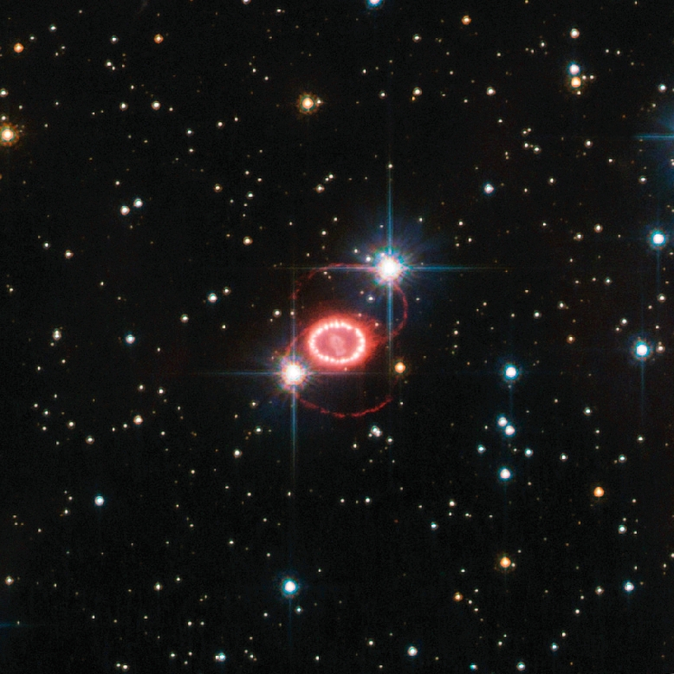

Slide 17
Yet more at the APS 1987 “April Meeting”– held in April!

Slide 18
Properties of Sk -69 202
Luminosity ~ 10⁵ L_{sun}
Temperature ~ 15 000 K
Radius ~ 40 R_{sun}
About 6 M_{sun} in the core (He and beyond)
Main sequence mass ~20 M_{sun}

Slide 19
A good rule:
You cannot positively identify a supernova progenitor by position alone!
You need to show that the candidate is absent when the SN fades!

Slide 20
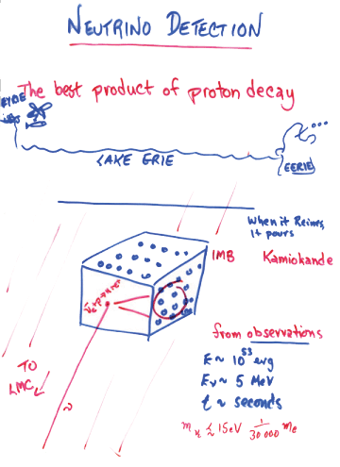
Humanity:
7 x 10⁹ people x
2 eyeballs/person x 10-6 ton/eyeball
~ 14000 ton detector
Close your eyes!
IMB
~5000 tons of water
~10 events

Slide 21
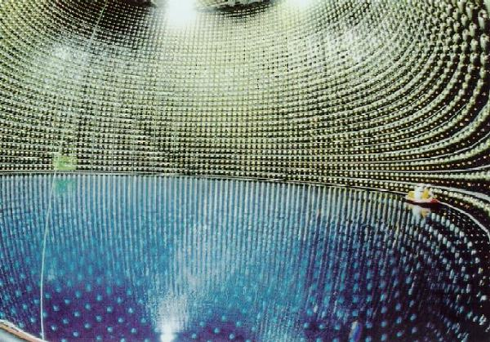

Slide 22
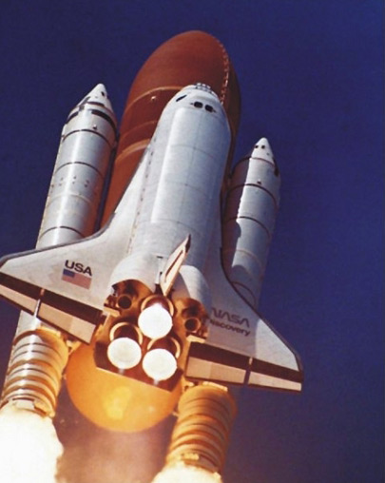
April 24, 1990

Slide 23
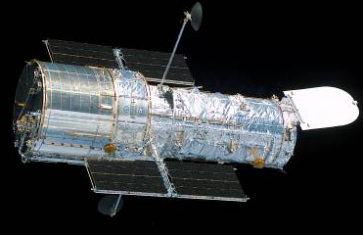

Slide 24
HST 87A Co-Investigators
SINS…and SAINTS
Robert Kirshner, PI Patrice Bouchet, Peter Challis, Roger Chevalier, Arlin Crotts*, John Danziger, Eli Dwek, Kevin France, Claes Fransson, Peter Garnavich, Kevin Heng, Josefin Larsson, Stephen Lawrence, Bruno Leibundgut, Peter Lundqvist, Seppo Mattila, Richard McCray, Nino Panagia, Jason Pun, Nathan Smith, Jesper Sollerman, George Sonneborn, Ben Sugerman, Nicholas Suntzeff , Craig Wheeler

Slide 25
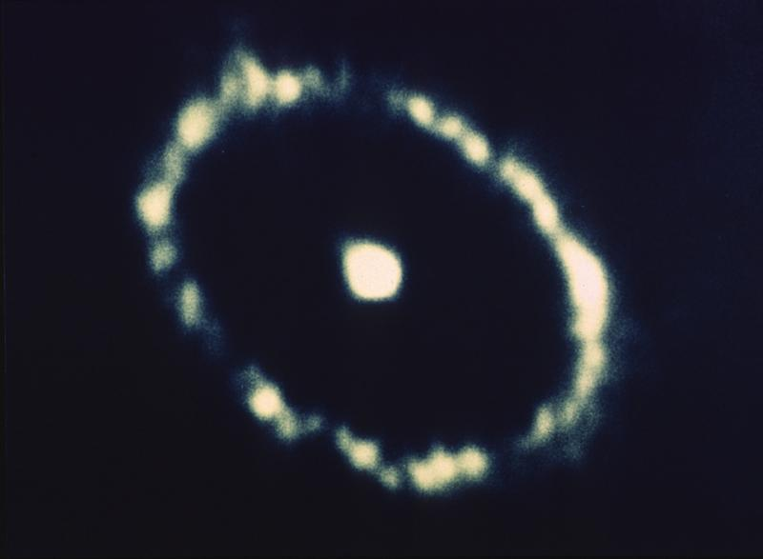
1990: Faint Object Camera image
Notes:
Imagination not strong enough to match reality

Slide 26
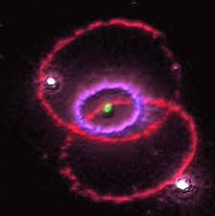
After the Hubble repair mission!

Slide 27
SN 1987A with HST
1994-2016

Slide 28
What are the hotspots?
Dick McCray’s cartoon

Slide 29
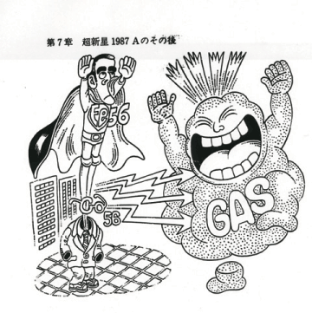
Yoyo Nomoto’s cartoon

Slide 30
SN 1987A with HST
1994-2016

Slide 31
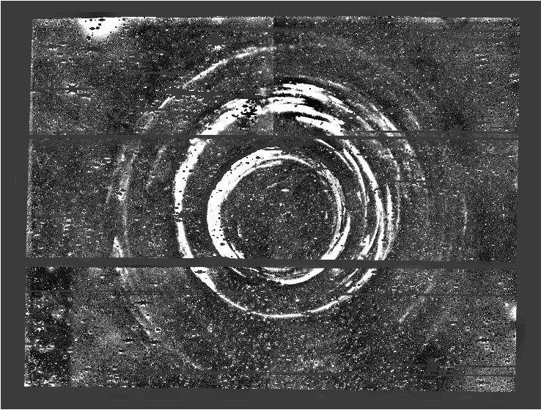
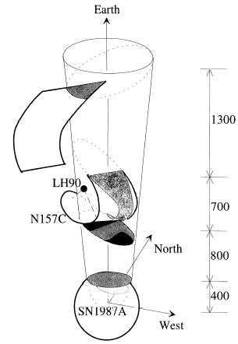
SN 87A Light Echoes
Armin Rest, STScI
Difference images 2001-2005
Xu, Crotts, & Kunkel (1994)

Slide 32
Geometry of Light Echoes
Dust
sheet
SN
87A
Observer
Armin Rest, STScI

Slide 33
Geometry of Light Echoes
Ellipsoids trace out surfaces of constant arrival time
Dust
sheet
20 year
light echo
20 year
ellipse
SN
87A
what we see
SN
87A
Observer
projected on the sky
10 light-years
Extra path: 2 x 10 light years
Light echo after 20 years
Armin Rest, STScI

Slide 34
Geometry of Light Echoes
Ellipsoids trace out surfaces of constant arrival time
Dust
sheets
20 year
light echoes
20 year
ellipse
SN
87A
what we see
SN
87A
Observer
projected on the sky
10 light-years
Extra path: 2 x 10 light years
Light echo after 20 years
Armin Rest, STScI

Slide 35
Geometry of Light Echoes
Ellipsoids trace out surfaces of constant arrival time
Dust
sheets
22 year
ellipse
22 year
light echoes
20 year
light echoes
20 year
ellipse
SN
87A
what we see
SN
87A
1 light-year
Observer
projected on the sky
10 light-years
Extra path: 2 x 10 light years
Light echo after 20 years
Extra path: 2 x 11 light years
Light echo after 22 years
Armin Rest, STScI

Slide 36
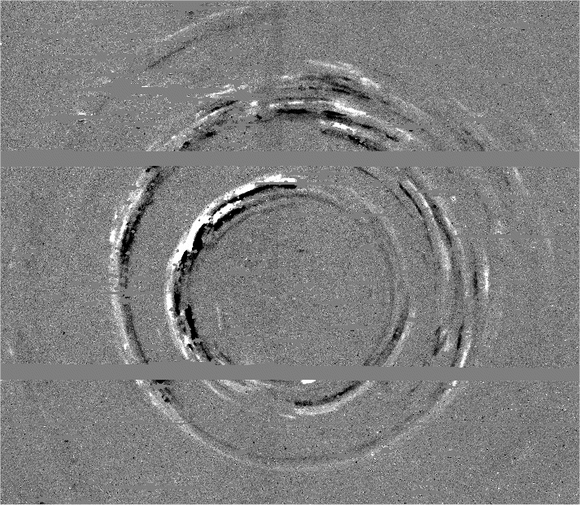
Geometry of Light Echoes
SN 87A difference image, 2003-2001
22 year
light echoes
20 year
light echoes
SN
87A
Armin Rest, STScI

Slide 37
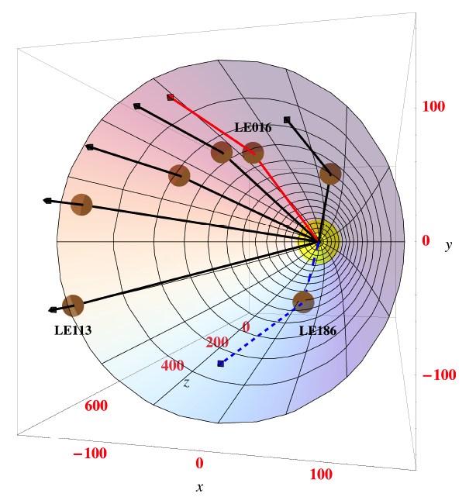
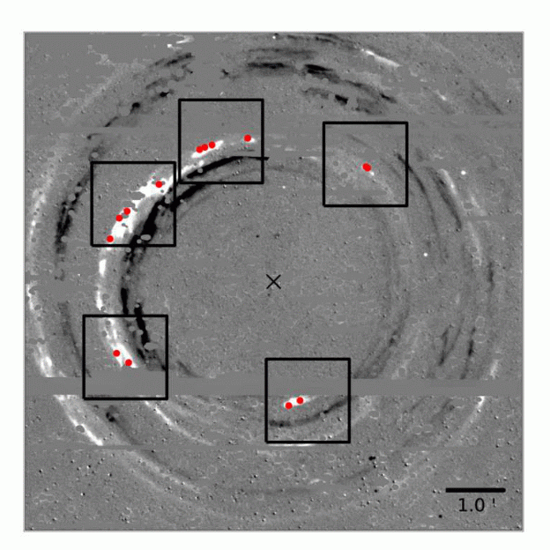
3D-spectroscopy of SN 87A
(Sinnott et al. 2013, ApJ, 767, 45)
Armin Rest, STScI

Slide 38
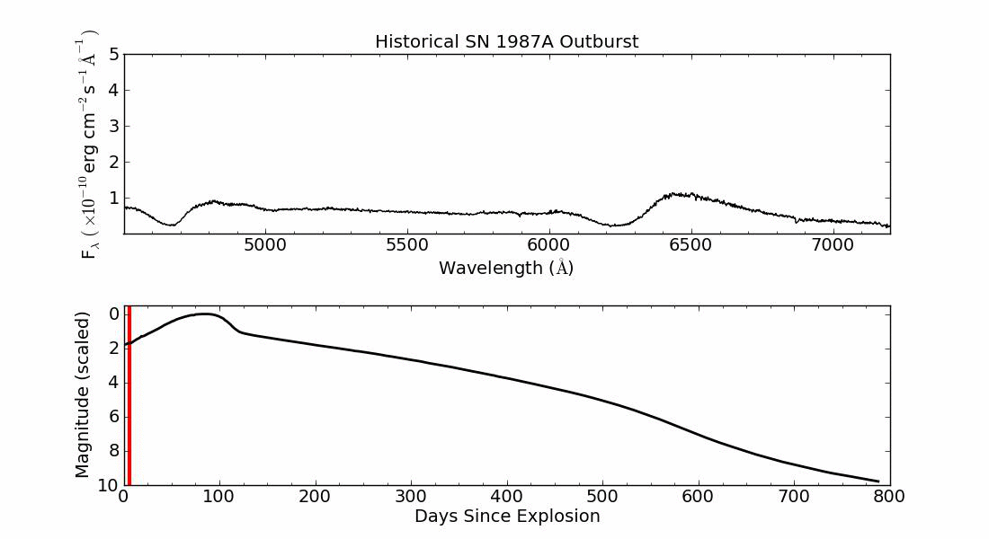
3D-spectroscopy of SN 87A
(Sinnott et al. 2013, ApJ, 767, 45)
Light echo spectrum:
  1st order: light-curve weighted spectra integrated over all epochs
  2nd order: Dependence on dust inclination and width
Flux
wavelength
Flux
Days since explosion
Armin Rest, STScI

Slide 39
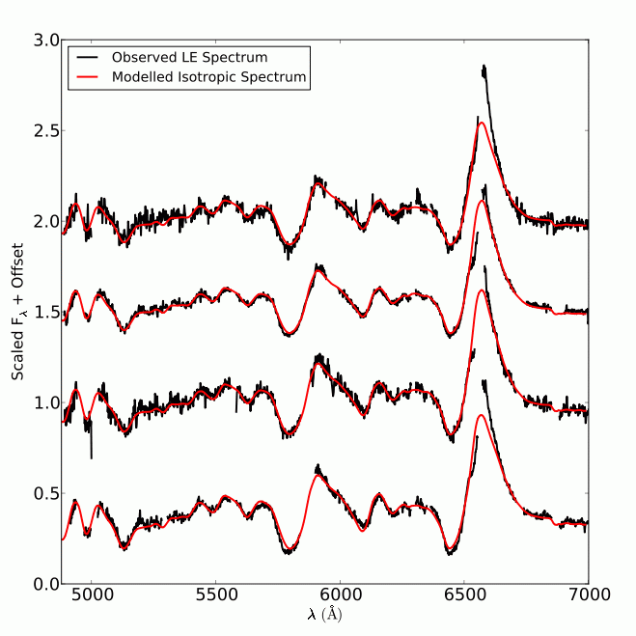
3D-spectroscopy of SN 87A
(Sinnott et al. 2013, ApJ, 767, 45)
Light echo spectrum:
  1st order: light-curve weighted spectra integrated over all epochs
  2nd order: Dependence on dust inclination and width
Light echo spectra models (red) and observations: excellent agreement except at Hα!
PA=16º
29º
Flux + constant
32º
34º
Wavelength (Angstrom)
Armin Rest, STScI

Slide 40
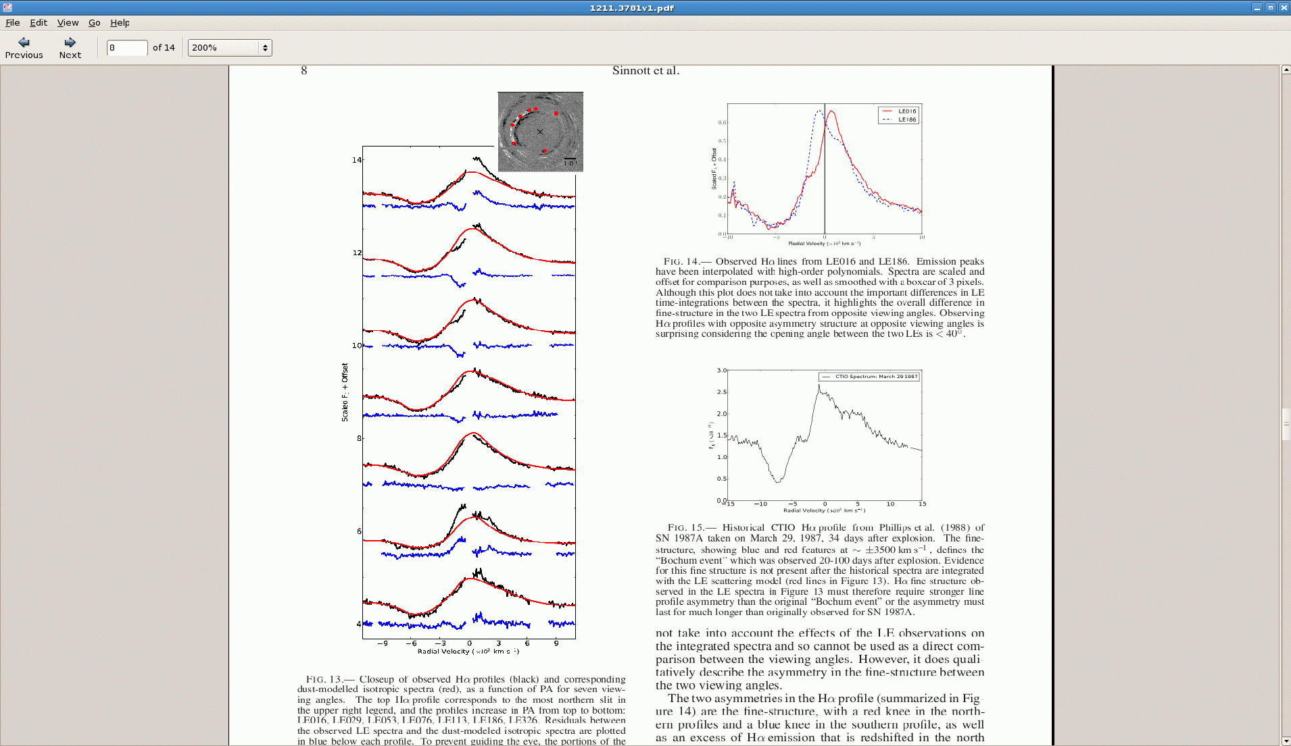
Hα
Sinnott et al. 2013, ApJ, 767, 45
PA=16º
29º
53º
Flux + constant
76º
113º
Dust
sheet
20 year
ellipse
186º
SN
87A
40º
Observer
326º
Radial Velocity (10³ km s⁻¹)
Armin Rest, STScI

Slide 41
Hα
Sinnott+13, ApJ, 767, 45
PA=16º
29º
53º
Flux + constant
76º
“Bochum event”, March 29 1987 (10⁻³ M_{o}, Chugai+95)
113º
186º
326º
Radial Velocity (10³ km s⁻¹)
Armin Rest, STScI
Notes:
-Lines seen in other Hydrogen lines
-similar time than mystery spots
-Mixing up of 56Co, penetrating through photosphere
-56Ni clumps in photosphere (Chugai 95): 10^-3 Msolar, 4000 km/s

Slide 42
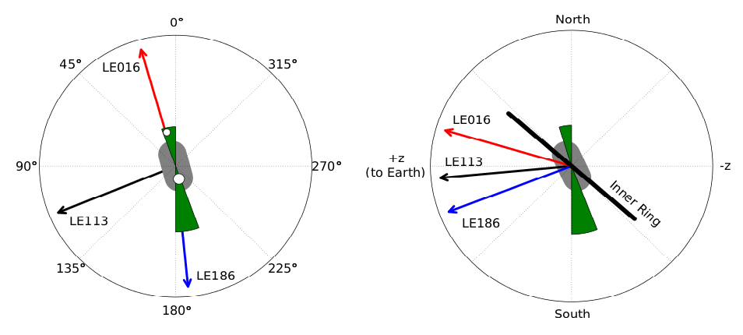
Hα
Sinnott+13, ApJ, 767, 45
PA=16º
29º
53º
Flux + constant
76º
Sinnott+13, ApJ, 767, 45
113º
186º
326º
Radial Velocity (10³ km s⁻¹)
Ejecta from Kjaer+10, see also Larrson+13
Armin Rest, STScI

Slide 43
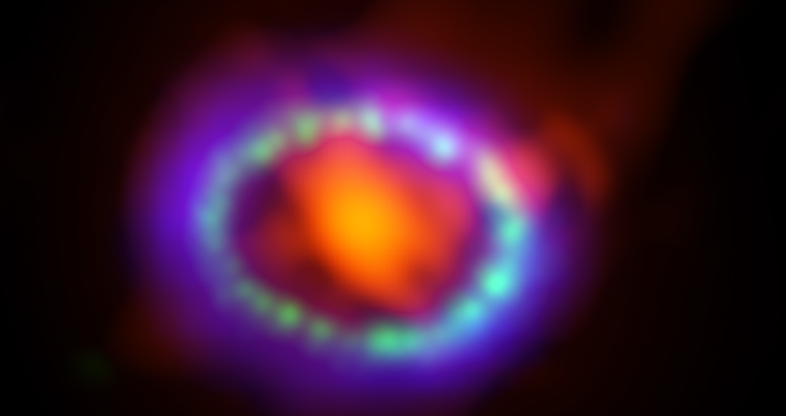
CHANDRA, ALMA & HST

Slide 44
STIS Slit positions for 3D reconstruction of debris: Larsson et al. (2016)
Next observation: TONIGHT!

Slide 45
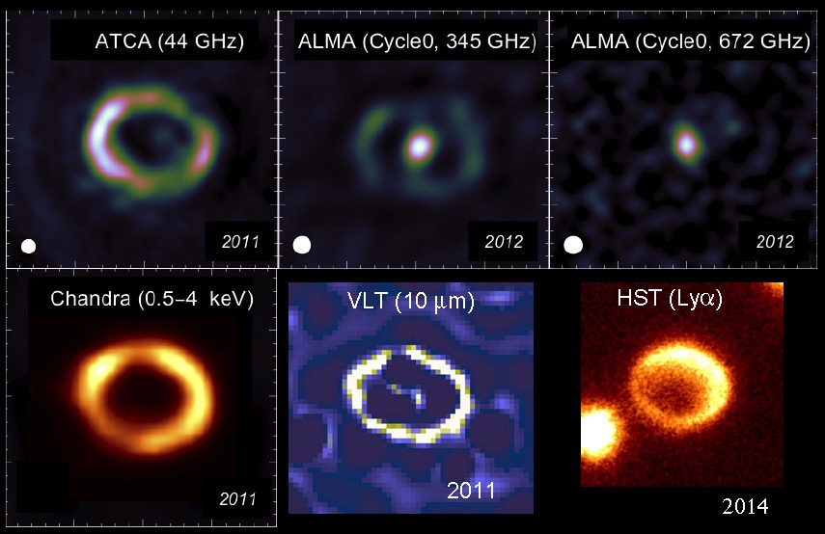
ALMA

Slide 46
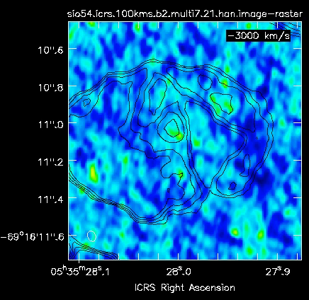
Slicing up the SiO emission from Alma
Indebetouw et al..

Slide 47
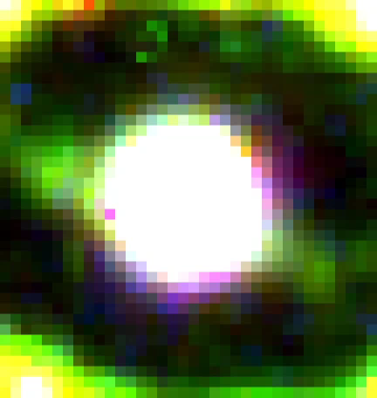
The End of the Beginning

Slide 48
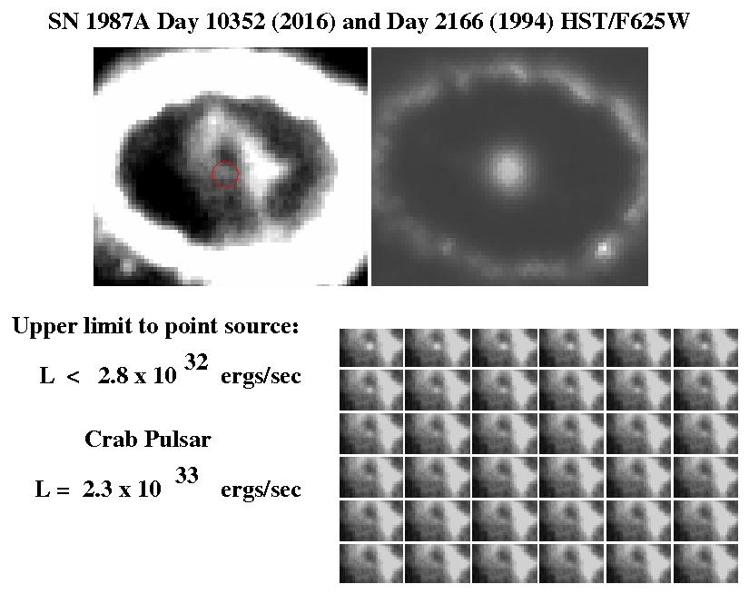
Where is that neutron star?
Notes:
Solar luminosity is

Slide 49
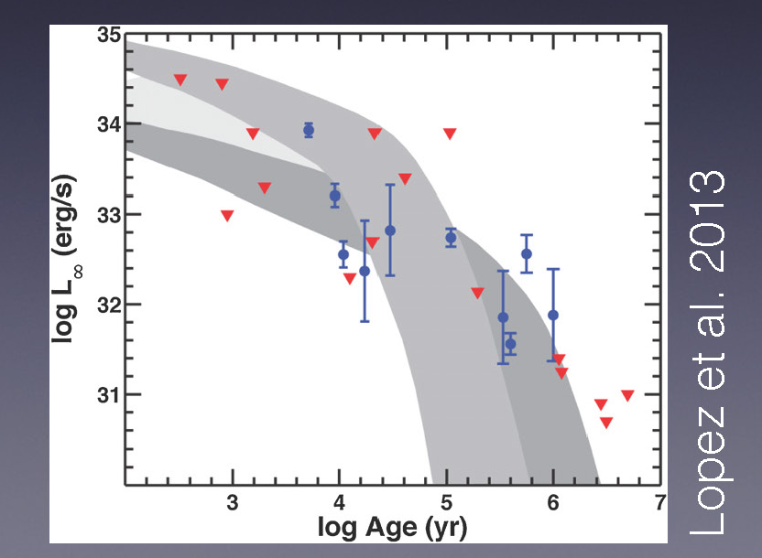
Where is that neutron star?
Dust?
Looking at the right wavelengths?
Collapse to a black hole?

Slide 50
Learn more!
M^{c}Cray & Fransson
Annual Reviews of Astronomy and Astrophysics 2016
The Remnant of SN 1987A
Kirshner Sky & Telescope February 2017
Supernova of a Lifetime
NOVA Death of a Star 1988

Slide 51
SN 1987A with HST
1994-2016

Slide 52
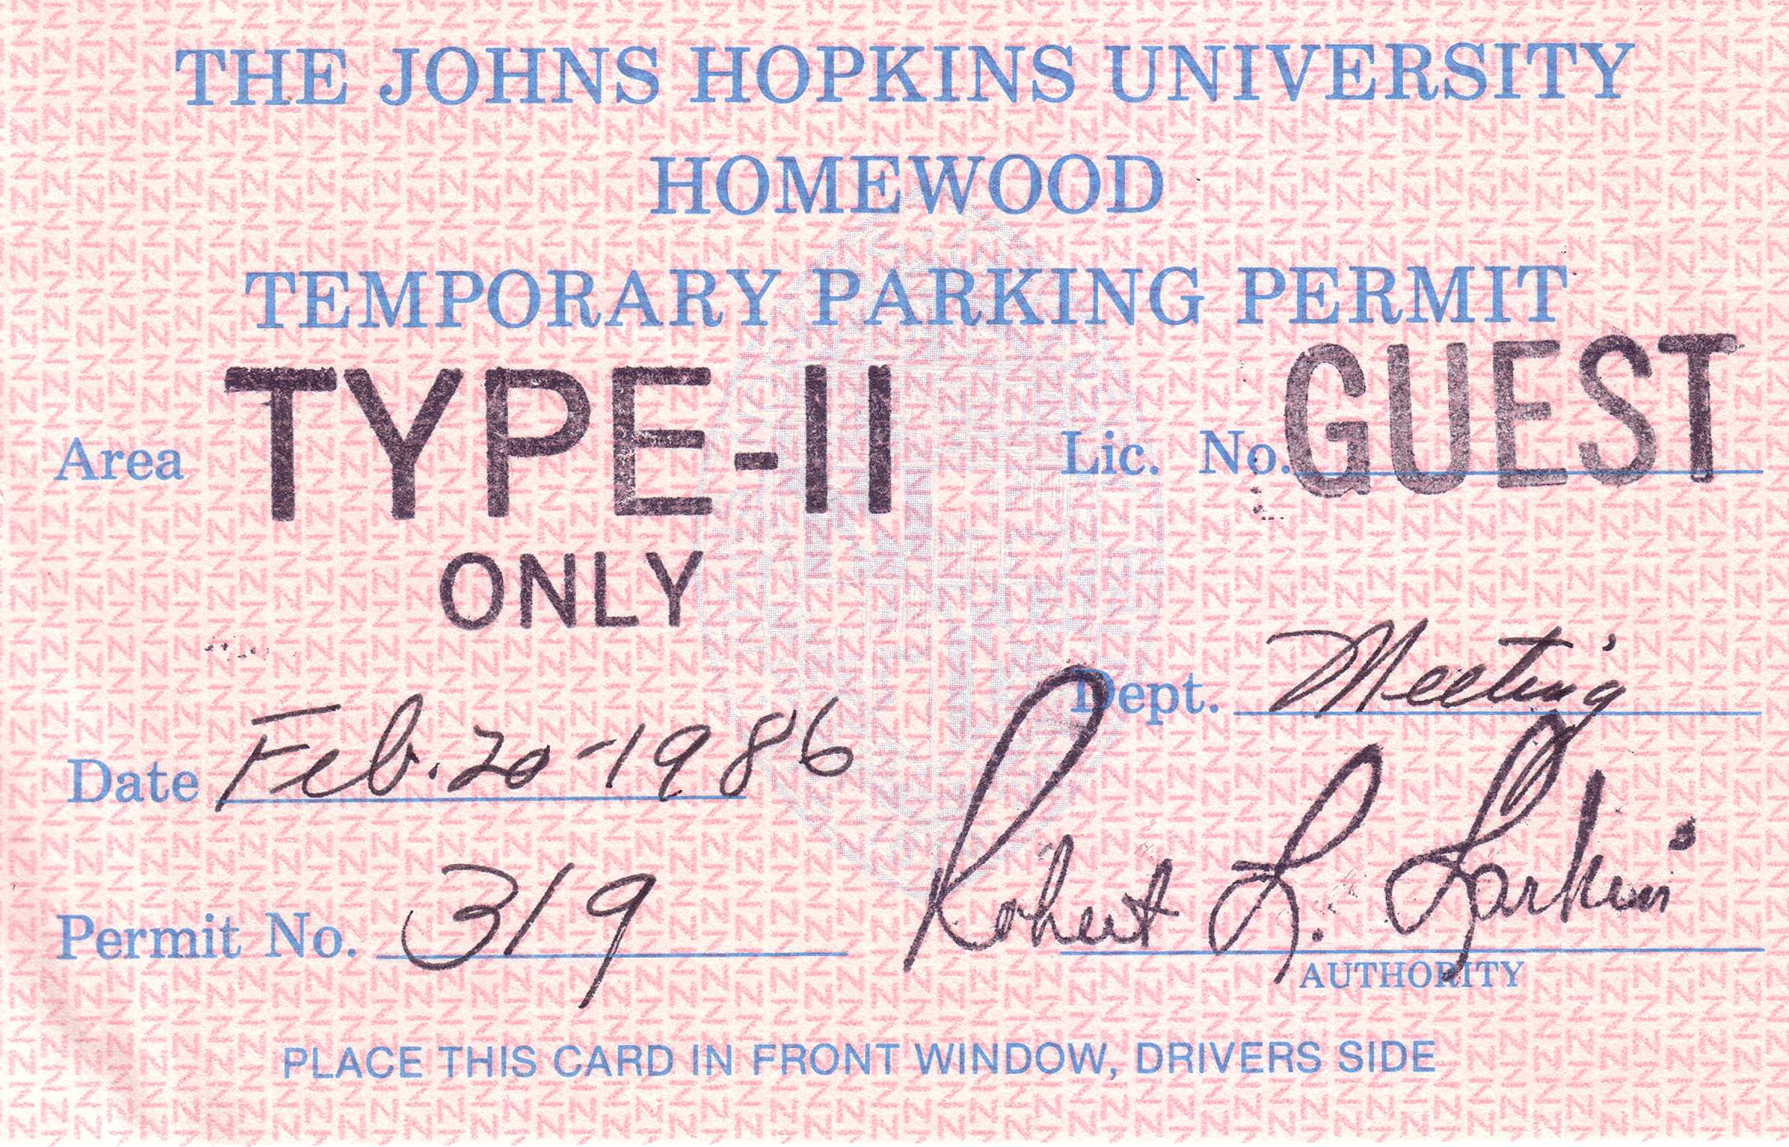

Slide 53
The rise of the ring!
Notes:
Kinetic energy of expansion converted (through shocks) to hot gas (Chandra X-rays) and relativistic particles (9 GHz radio)

Slide 54
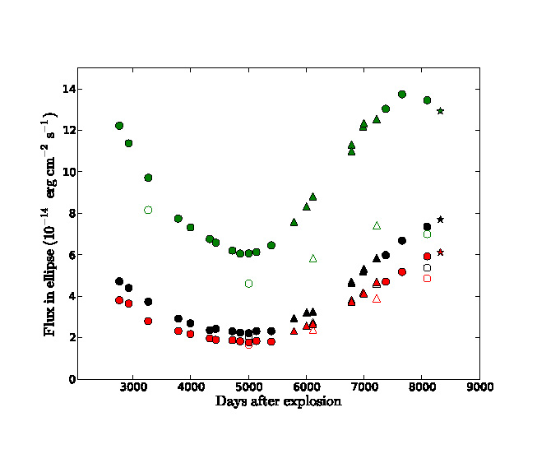
Something new: and it isn’t radioactivity!

Slide 55
Reconstructing 3D x/t = v_{x}; y/t = v_{y;} z = v_{r}t

Slide 56
Theoretical Velocity Distributiuons of ⁵⁶Ni

Slide 57
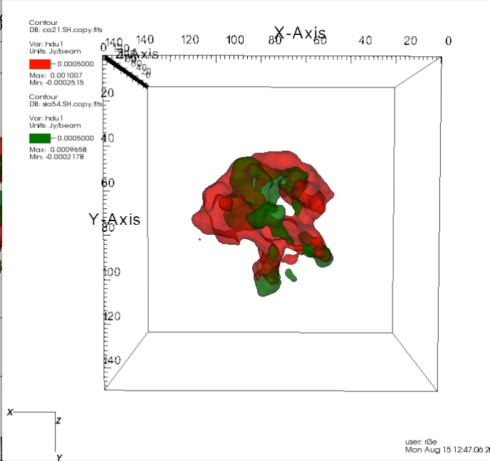

Slide 58
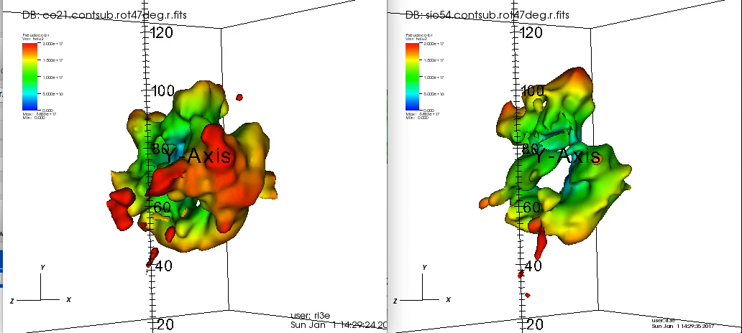

Slide 59
γ-rays observed by NUSTAR
1.5 x 10⁻⁴ M_{sun} of ⁴⁴Ti
Boggs et al. (2015)

Slide 60
Many messages!

Slide 61
SN 1987A with HST
1994-2016

Slide 62
Why Light Echoes?
Extragalactic SNe
Many surveys
100s of SNe per year!
Populations, rates, properties
Unresolved
Milky Way Galaxy
1 per 100 years
Close!
Environment
Remnant
Progenitor
Composition
No spectra!
Light Echo Spectra
Spectroscopic classification of historic events
3D view!
~10 MWG SNe in the last 1000 years
Armin Rest, STScI

Slide 63
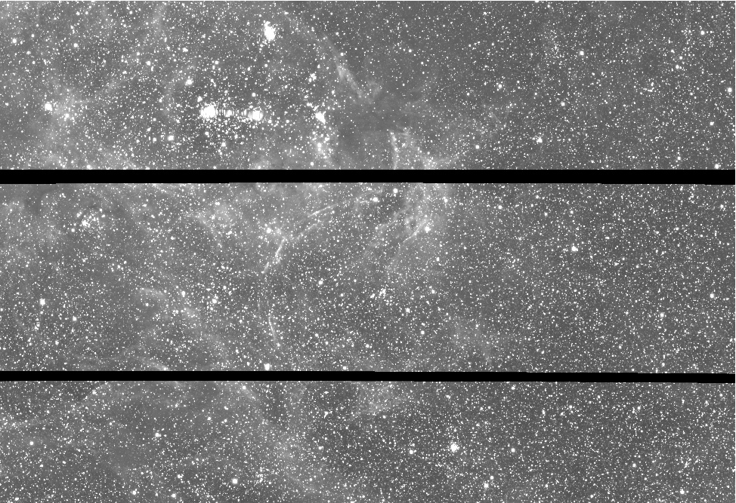
Armin Rest: Microlensing alerts?
Oct. 2001

Slide 64
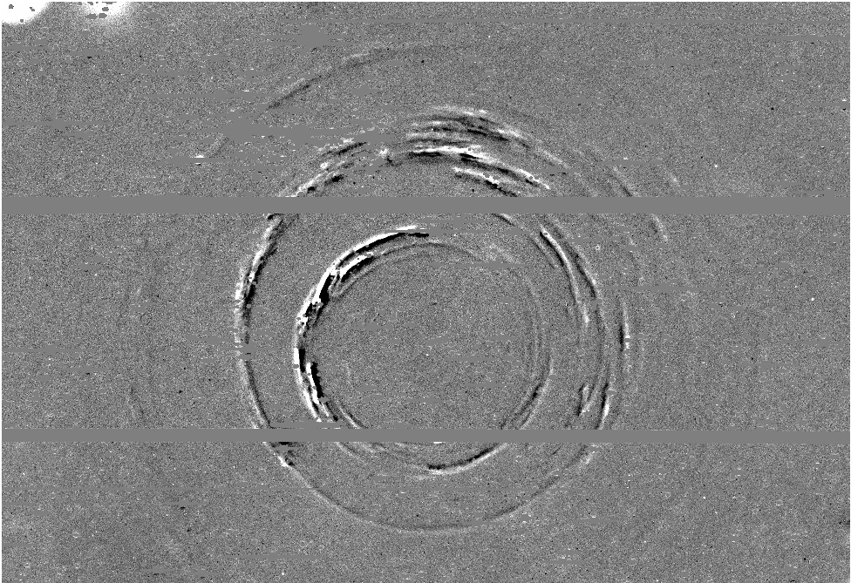
The Light Echoes of SN 1987A
2002 - 2001

Slide 65
Jerkstrand et al. 2011
1.5 x 10⁻⁴ M_{sun} of ⁴⁴Ti
Notes:
Non-thermal excitation!
Temperature and ionization low: 200 K!

Slide 66
The late-time lightcurve of SN 1987A
{0.07 solar mass} ⁵⁶Ni => ⁵⁶Co (113 days) => ⁵⁶Fe
⁵⁷Co (390 days); ⁴⁴Ti (85 years)
Notes:
Increase in optical flux from the debris: Not radioactivity!

