Slide 1
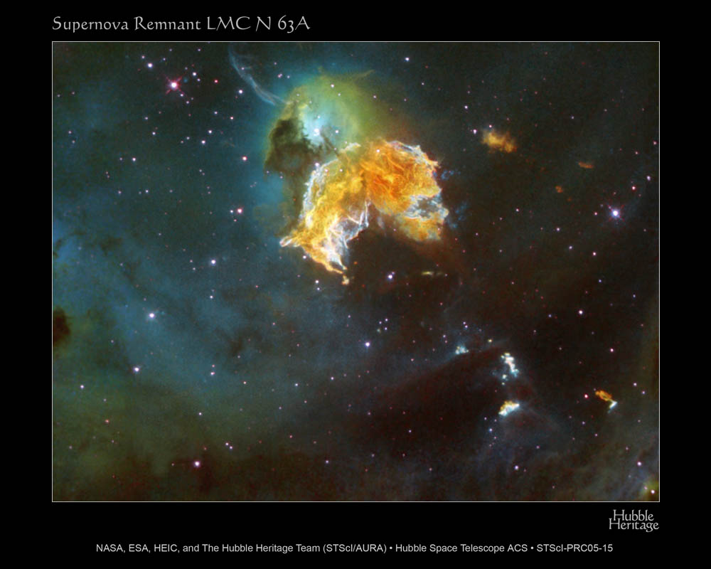
CSI in SNRs
You-Hua Chu
Inst of Astron and Astroph
Academia Sinica (ASIAA)
Taipei, Taiwan
(See poster by Ou et al.)

Slide 2
Outline
Core-Collapse (C-C) SNRs
Massive star evolution and CSM
Structure of young C-C SNRs
CSI in young C-C SNRs
Type Ia SNRs
Single degen. vs double degen.
Structure of young Type Ia SNRs
CSI in young Type Ia SNRs

Slide 3
Massive Star Evolution and ISM/CSM

Slide 4
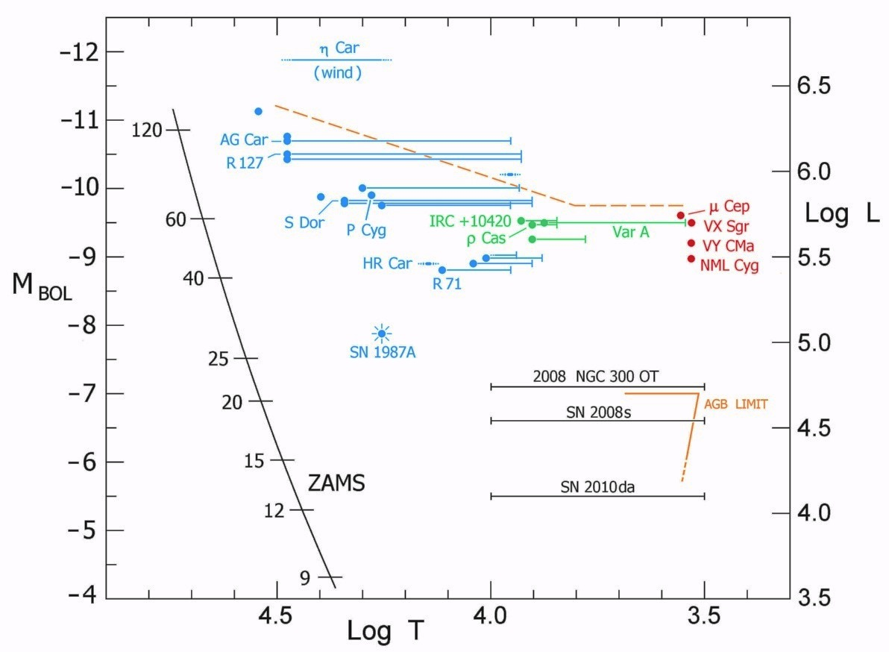
Massive Stars in the HR Diagram
Humphreys and Davidson Limit
Schuster, Humphreys, & Marengo (2006)

Slide 5
Massive Stars in the HR Diagram
LBV
Humphreys and Davidson Limit
100
80
WR
60
RSG
Luminosity
40
BSG
30
20
M
O B A F G K M
Notes:
LBV = luminous blue variable
BSG = blue supergiant
RSG = red supergiant

Slide 6
Interstellar & Circumstellar Bubbles
O star → LBV → WR (60 M)
O star → RSG → WR (35 M)
fast wind slow wind fast wind
1000 - 2000 km/s 10 - 50 km/s 2000 - 3000 km/s
10⁻⁷ M/yr 10⁻⁴ M/yr 10⁻⁵ M/yr
↓ ↓ ↓
interstellar circumstellar circumstellar
bubble nebula bubble
Low-mass  → RG, AGB → planetary neb.

Slide 7
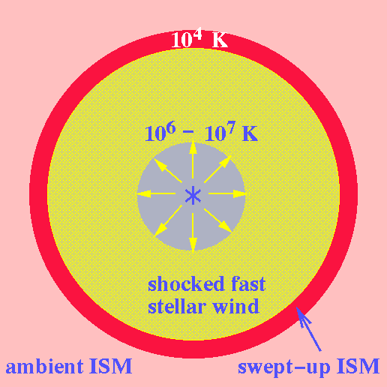
Interstellar Bubble
10⁷ - 10⁸ K
Castor, McCray, Weaver 1975; Weaver, et al. 1977

Slide 8
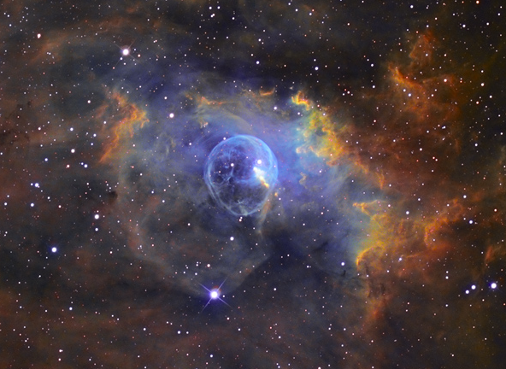
The Bubble Nebula
Copyright ©2002-2005 by Russell Croman

Slide 9
N11B - Young OB Association LH10

Slide 10
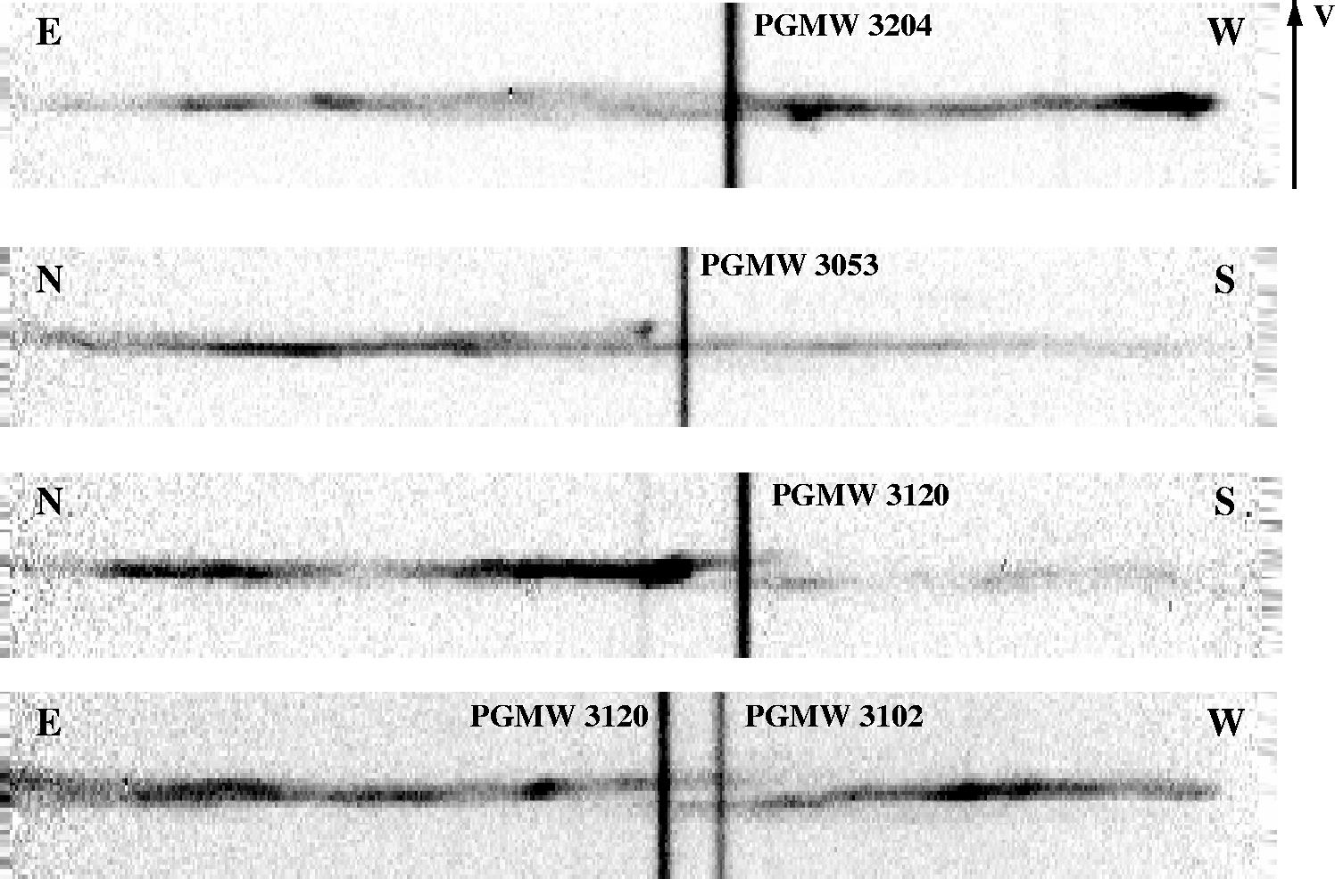
Echellogram of [N II] 6583 Line

Slide 11
Bubble Size ~ 15 pc
Exp Vel ~ 15-20 km/s
Ionized shell (H II)
- sound vel ~ 10 km/s
- no strong shocks
- no large density jump
- no limb-brightening
Neutral shell (H I)
- sound vel ~ 1 km/s
- large density jump
- limb-brightening
- frequently seen
Naze, et al. 2001, AJ, 122, 921

Slide 12
Bubble in the Orion Nebula

Slide 13
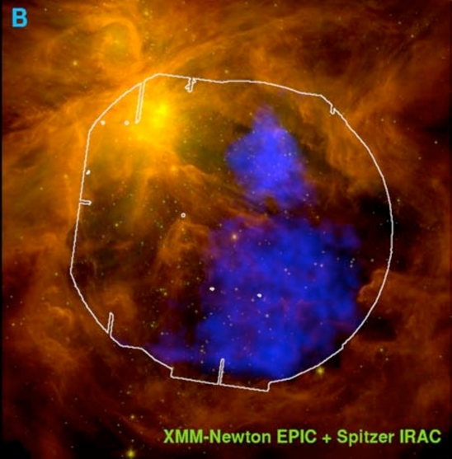
Bubble in the Orion Nebula

Slide 14
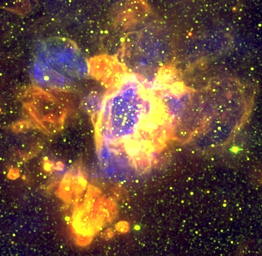
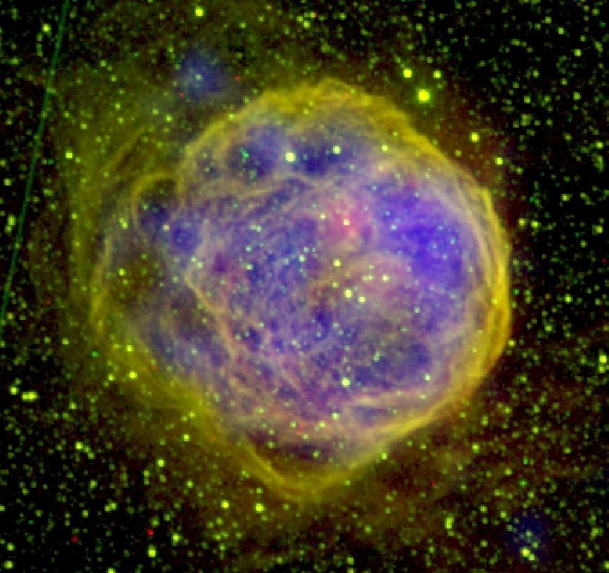
Superbubbles 100-200 pc in size
N44 N70

Slide 15
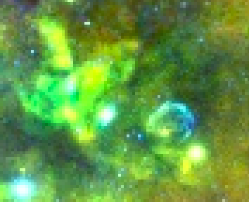
30 Dor
1987A
XMM-Newton X-ray

Slide 16
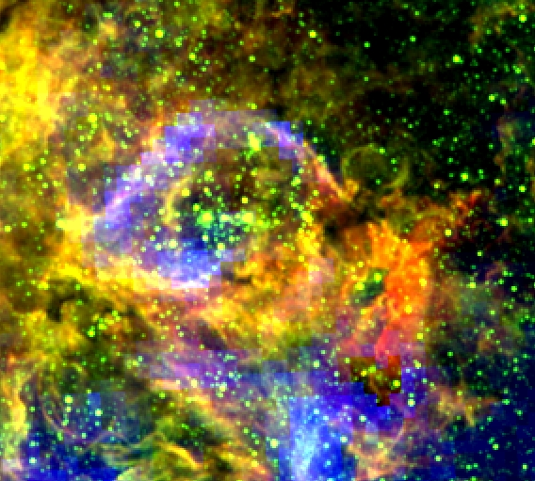
30 Dor
MCELS + XMM
1987A
XMM-Newton X-ray

Slide 17
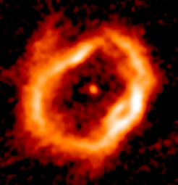
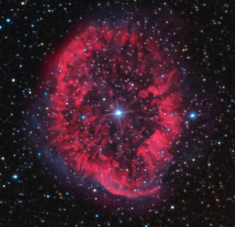
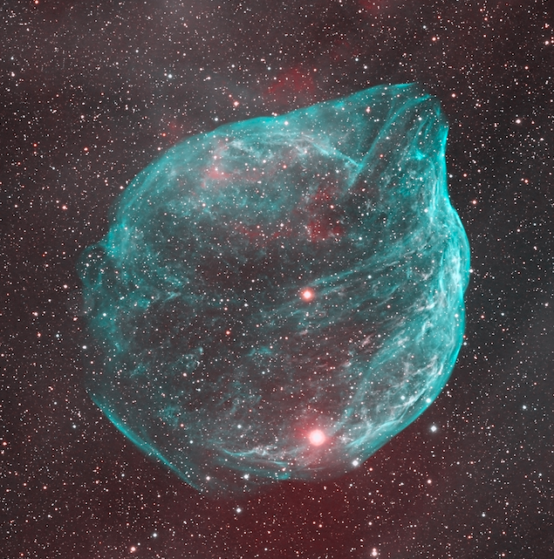
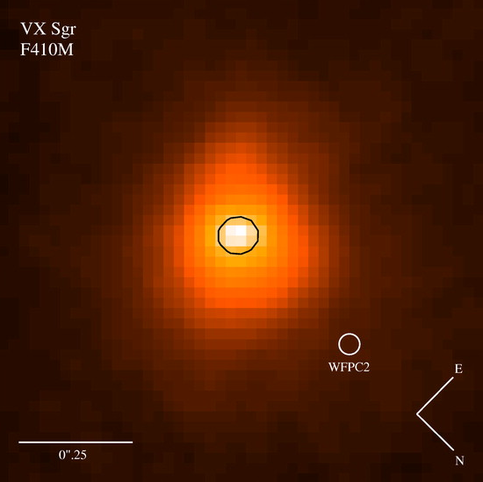
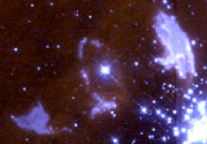
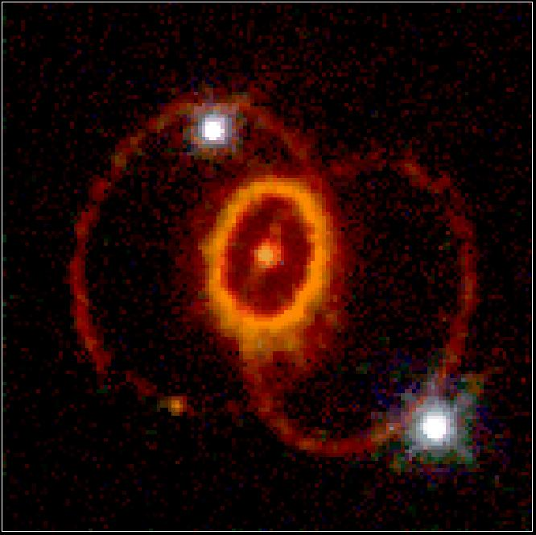
Massive Stars in the HR Diagram
LBV
100
80
WR
60
RSG
Luminosity
40
BSG
30
20
M
O B A F G K M
Notes:
LBV = luminous blue variable
BSG = blue supergiant
RSG = red supergiant

Slide 18
IS Bubble Circumstellar Nebulae
O Stars RSG LBV WR
Ne 10-100 cm⁻³ > 10⁴ cm⁻³ 10⁴ cm⁻³ 10² cm⁻³
D a few × 10 pc 10³ AU 1 pc a few pc
Vexp 15 km/s 10-50 20 (LMC) 50-100
50 (MW)

Slide 19
CSI: Core-Collapse SNe/SNRs

Slide 20
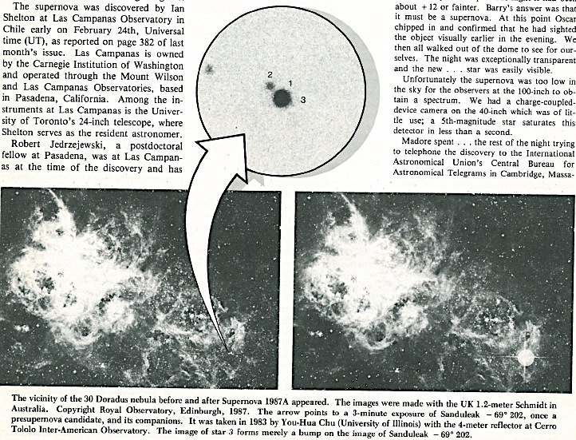
Progenitor of
SN 1987A
Sk -69 202
B3 I

Slide 21
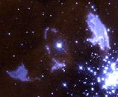
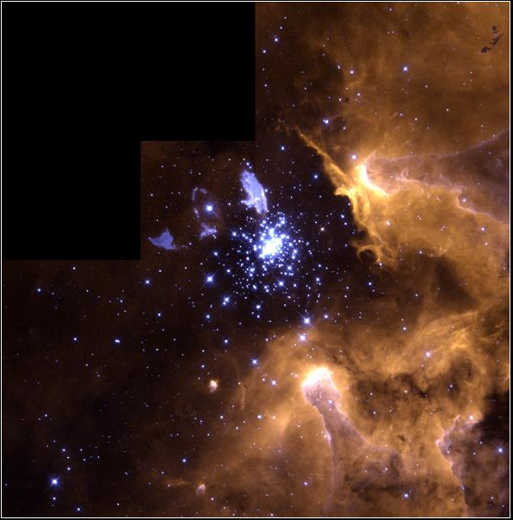
SN1987A and Sher 25
[N II]/Hα ~ 1-2
Inner ring ~ 0.4 pc
V_{exp} ~ 20 km/s
NGC3603
↓
↑ Sher 25
B1.5 I
←Sk –69 202
B3 I

Slide 22
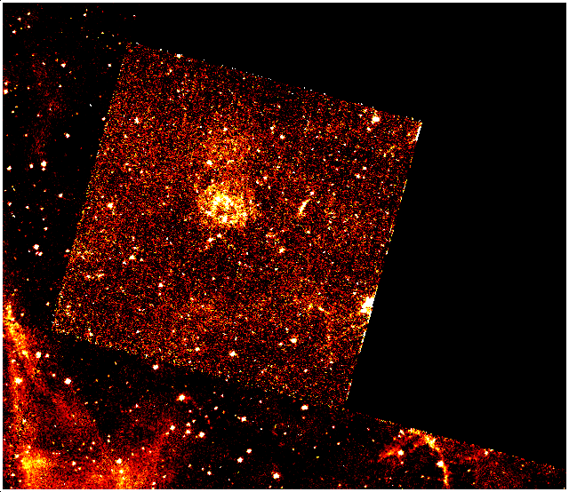
SNR 0540-69.3
The second youngest SNR in the LMC
[N II]-bright ring; size ~ 1 pc; V_{exp} < 50 km/s
Caraveo et al. 1998; Sandin et al. 2013
Chandra HRC image
HST WFPC2 image in [N II]

Slide 23
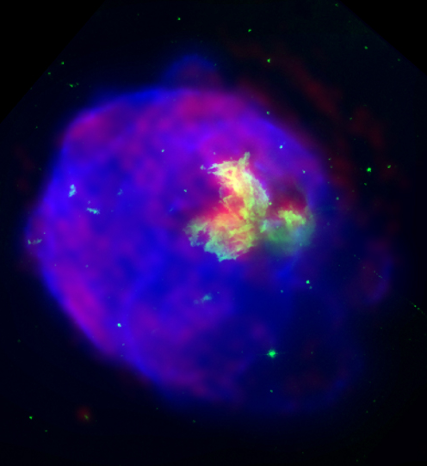
LMC SNR - N63A
SN Explosion in the Cavity
of an Interstellar Bubble
18 pc
Chandra X-ray; HST optical;
ATCS radio
HST Hα/[SII]/[OIII]

Slide 24
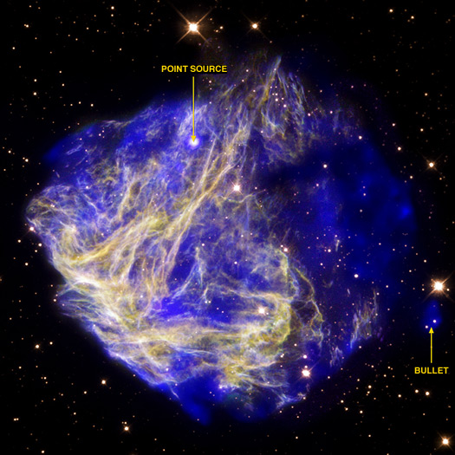
LMC C-C SNR - N49
SN Explosion in the Cavity
of an Interstellar Bubble

Slide 25
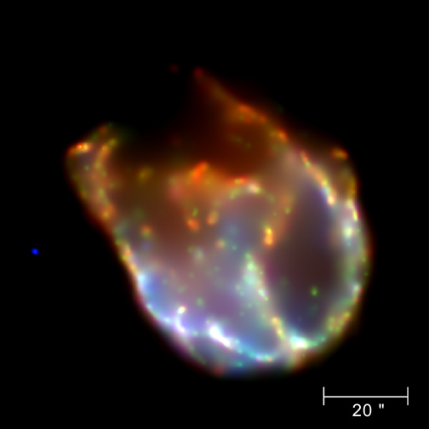
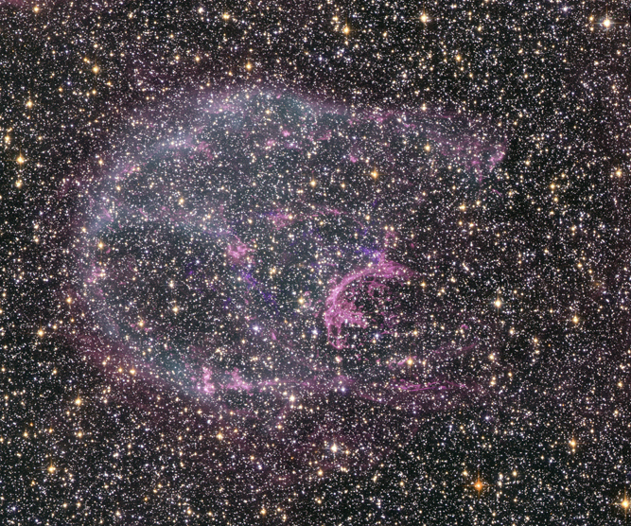
LMC SNR - N132D
SN Explosion in the Cavity
of an Interstellar Bubble
13×20 pc
Chandra X-ray
HST optical
Vogt and Dopita 2011, Ap&Sp Sci

Slide 26
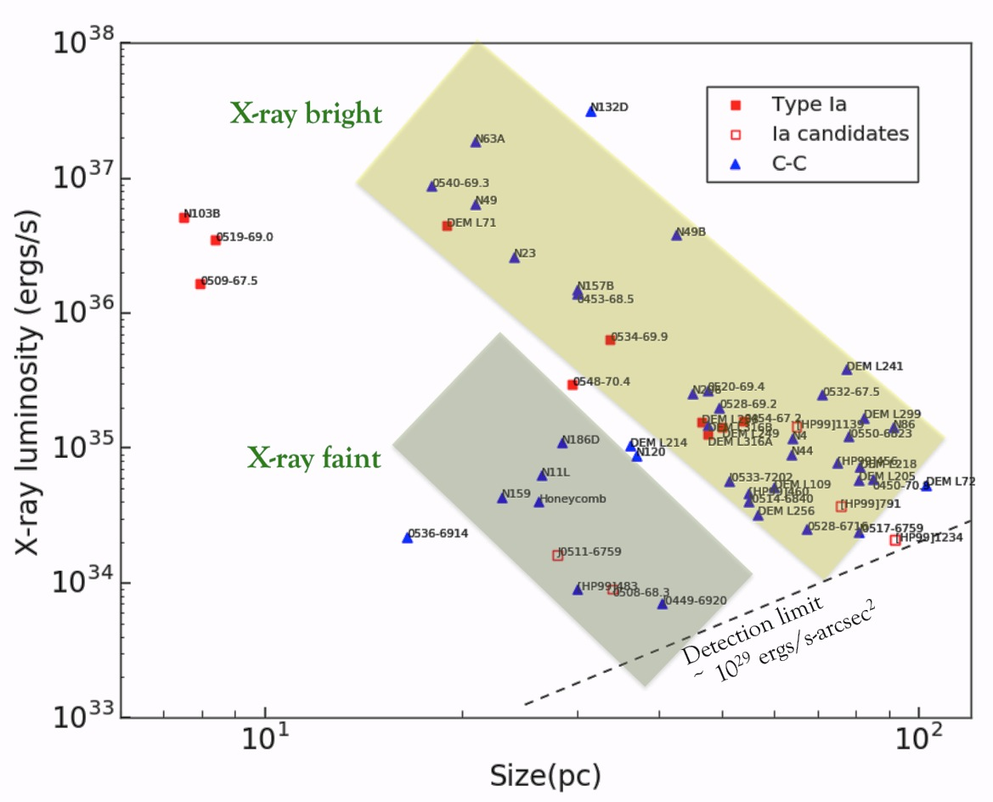
Lx – Size Relationship of SNRs

Slide 27
Lx – Size Relationship of SNRs
Few small (< 10 pc) C-C SNRs
- CSM-interaction short-lived?
- massive star with CSM go black hole?
Two sequences of C-C SNRs
X-ray-bright vs X-ray-faint
- density of the ambient ISM

Slide 28
Type Ia SNRs in ISM

Slide 29
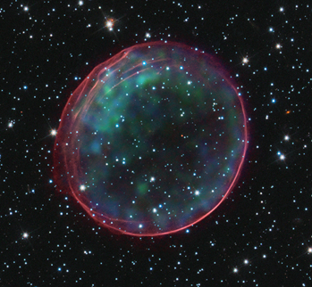
Two Young Balmer-Dominated SNRs
0509-67.5 0519-69.0
(See Ou et al. poster for more.)

Slide 30
Balmer-Dominated SNR DEM L 71
Central emission: SN ejecta
Shell emission: shocked ISM

Slide 31
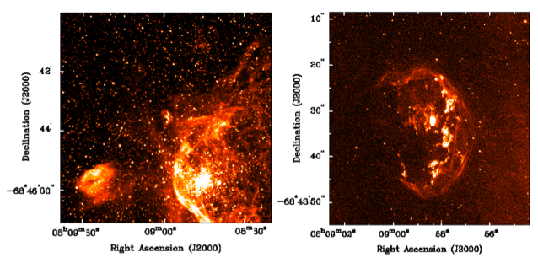
N103B – Type Ia SNR; X-ray spectrum; light echo
- projected in the outskirts of NGC1850
- Balmer-dominated shell + CSM knots
Li, Chu, et al. 2017, ApJ

Slide 32
Type Ia SNRs and CSM
(Single-degenerate)

Slide 33
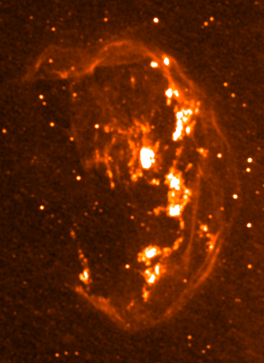
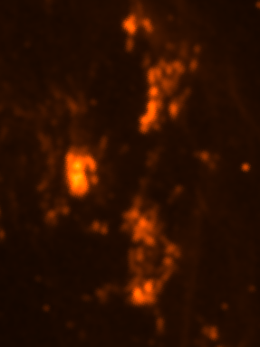

Slide 34
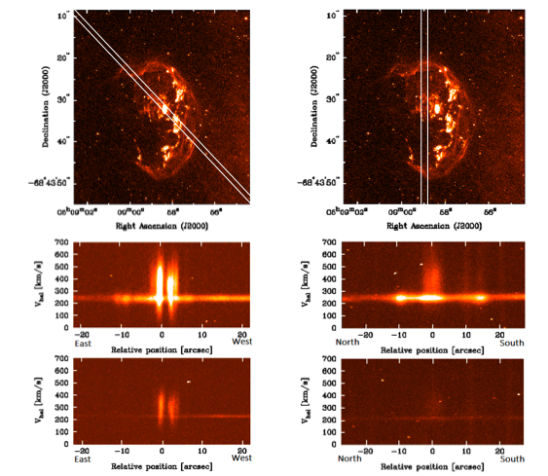

Slide 35
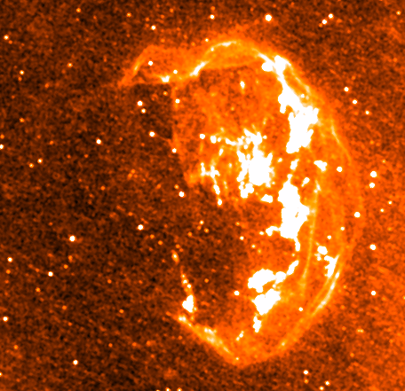
N103B

Slide 36
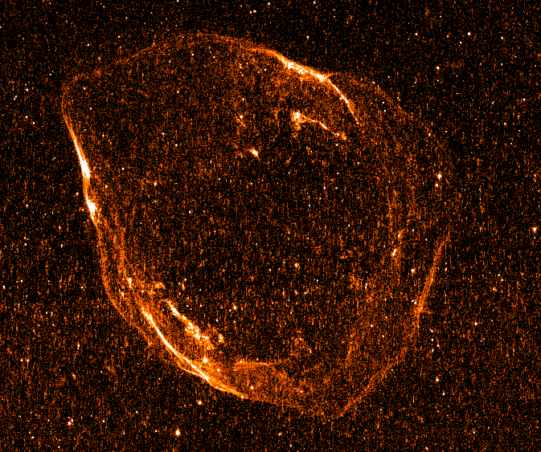
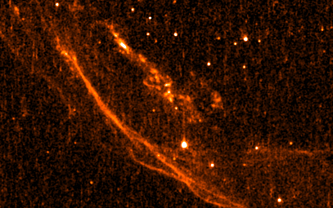
Type Ia SNR
DEM L71
Balmer-dominated
Knots
forbidden lines
n_{e} ~ 2000 cm⁻³

Slide 37
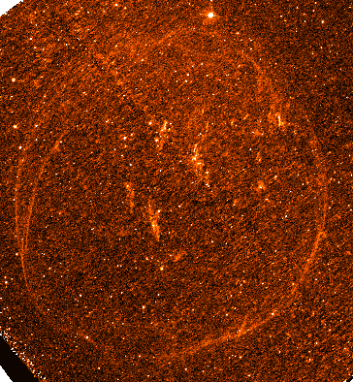
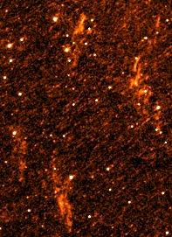
Type Ia SNR 0548-70.4

Slide 38
What Next?

Slide 39
IFU observations of LMC SNRs
Kinematics
Abundances
Densities
Surviving companion of SN
progenitor
Next-Generation CSI !

