Slide 1


Single versus Binary Star Progenitors of Type IIb Supernovae
SN 1987A, 30 years later
Feb 20, 2017
Niharika Sravan, Pablo Marchant, & Vicky Kalogera

Slide 2
Stripped Envelope Supernovae (SNe)
H
He
Core
SUPERNOVA
Type II
REMOVE OUTER LAYERS
IIb
H
He
Core
SE SNe
SUPERNOVA
Ib
Core
Core
He
Ic

Slide 3
THE PROGENITOR CONNECTTION
What mechanism(s) drive the stripping of stripped-envelope SNe is an open question
Answer is connected to what their progenitors are
Single Star Progenitors
Stellar Winds
Binary Star Progenitors
Close Binary Interactions
MECHANISMS DOMINATING STRIPPING
Notes:
Which mechanism = which progenitor

Slide 4
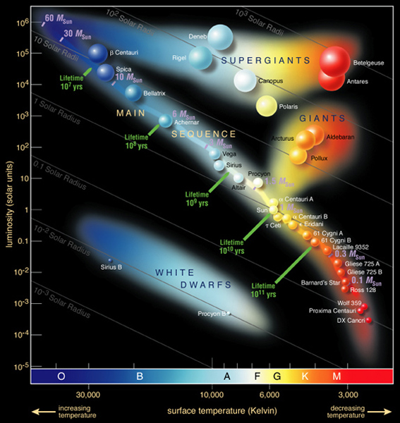
Focus:
Type IIb Sne
Progenitor Observations
Luminosity
Light Curves
Hydrogen envelope mass
Effective Temperature
Helium core mass
0.01 – 0.5 M☉
2 – 6 M☉
log₁₀(L/L☉) = 4.72 – 5.4
log₁₀(T_{eff}/K) = 3.58 – 3.8
Abundant
  ~ 10-12% ^{a,b,c} of all core-collapse SNe
  30-40% ^{a,b,c} of all SE SNe
Six with detected progenitors
Only stripped envelope SN progenitor with detected binary companion
  Luminosity (L☉)
T_{eff} (K)
ª Shivvers et al., 2016
^{b} Li et al., 2011
^{c} Smith et al., 2011
Type IIb

Slide 5
ZAMS
Single
Core-collapse
Hydrogen Envelope Mass
Binary
Luminosity
Effective Temperature
Helium Core Mass
Progenitor
Models
Observation
Evolve
Observed Progenitor Properties
Hydrogen Envelope Mass
Helium Core Mass
Luminosity
0.01 – 0.5 M☉
Effective Temperature
log₁₀(L/L☉) = 4.72 – 5.4
log₁₀(T_{eff}/K) = 3.58 – 3.8
2 – 6 M☉
Single vs binary star Progenitors of
type IIb Sne (METHOD)
Type IIb

Slide 6
MODEL parameter SPACE
Parameter search space
  Single star models*:
    M/M☉ = 10 – 80
  Binary star models*:
    M₁/M☉= 10 – 18
    M₂/M☉= 6 – M₁
    log₁₀(P_{orb} /d) = 0.0 – 4.0
    Conservative and non-conservative MT
  *solar metallicity, non-rotating
Type IIb
Notes:
the question – thus shed light on role of and characteristic of physics
the method

Slide 7
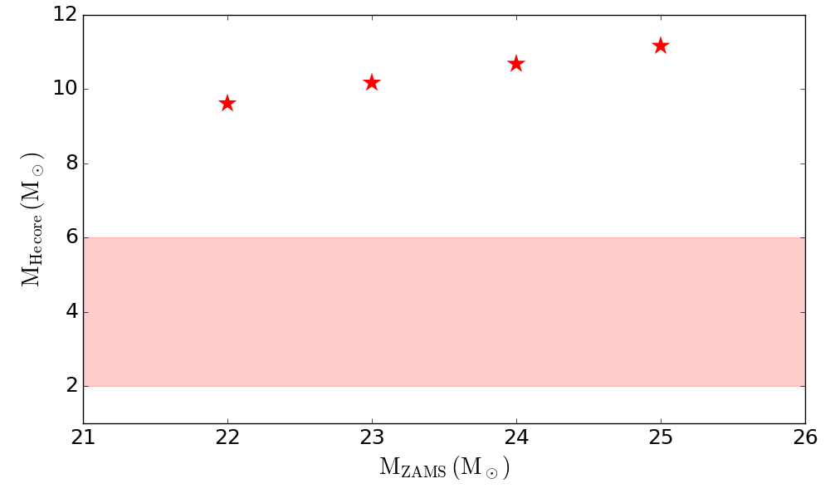
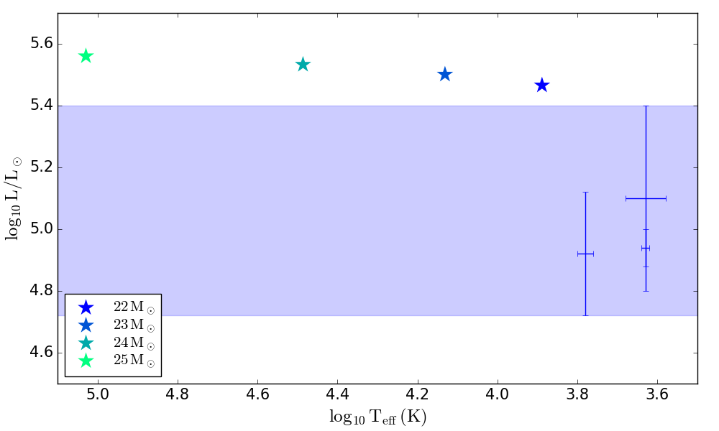
Can single stars be
type IIb Sn progenitors?
Helium core mass
Models
Models with residual Hydrogen envelope mass 0.01 – 0.5 M☉ (candidates)
Observations
Sravan et al., in prep
Models
NO
Observations
Luminosity and T_{eff}
Type IIb

Slide 8
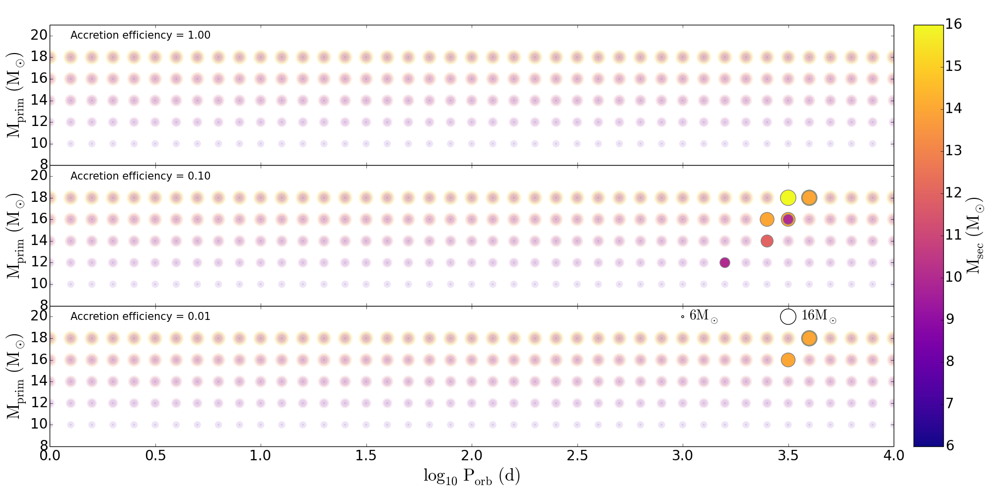
Can binary stars be
type IIb Sn progenitors?
Type IIb
Parameter space occupied by binary star models reaching core-collapse with 0.01 – 0.5 M☉ residual Hydrogen envelope (candidates)
Sravan et al., in prep

Slide 9
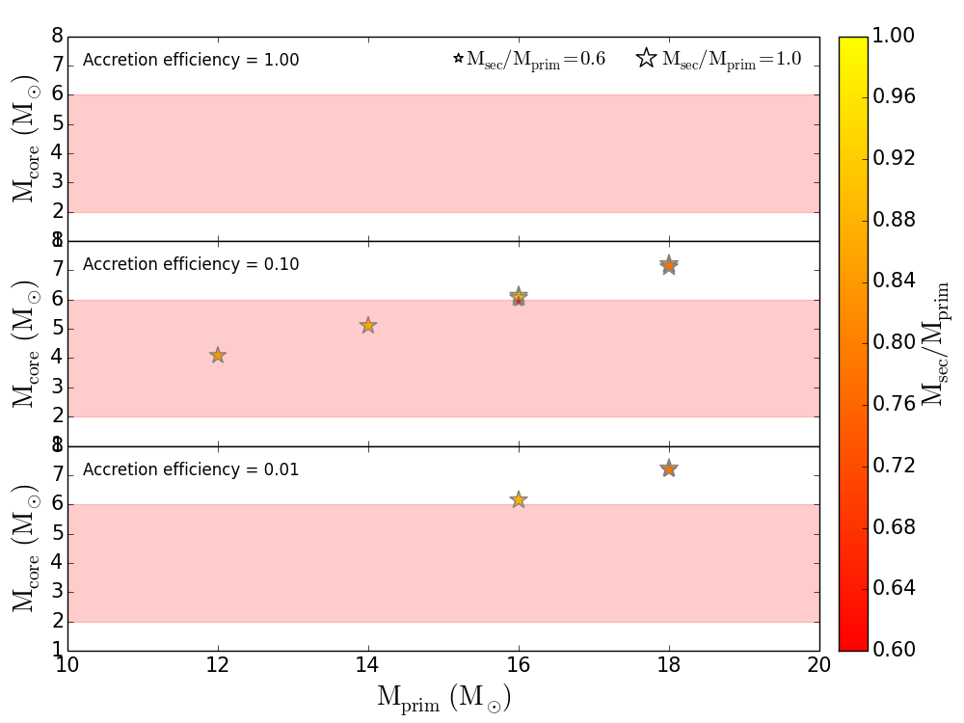
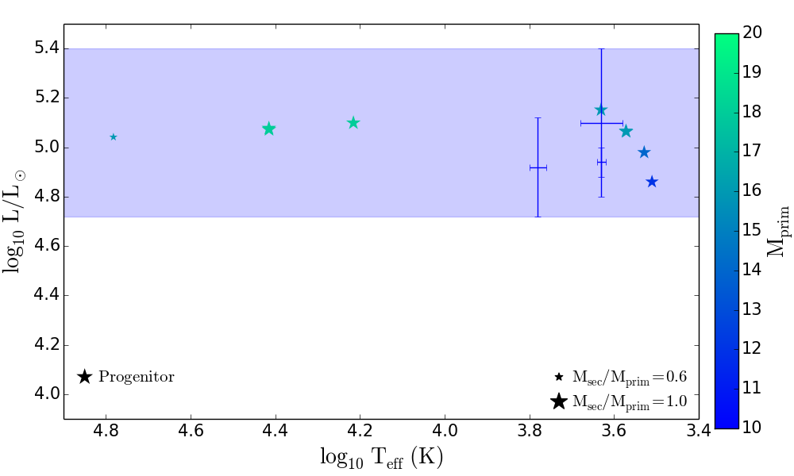
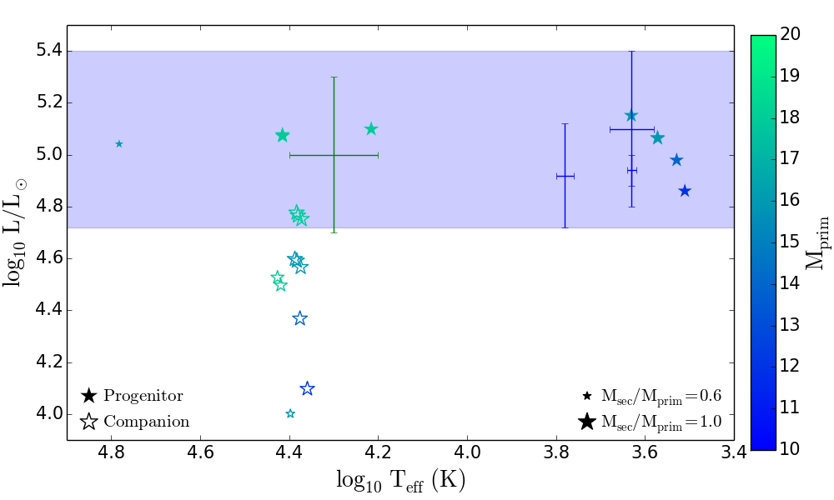
Can binary stars be
type IIb Sn progenitors?
Helium core mass
Observations
Models with residual Hydrogen envelope mass 0.01 – 0.5 M☉ (candidates)
Models
Sravan et al., in prep
Observations
YES!
Models
Luminosity and T_{eff}
Type IIb

Slide 10
Summary
We find solar-metallicity, non-rotating single stars cannot be Type IIb progenitors **
Solar-metallicity, non-rotating binary stars can be Type IIb progenitors ** These systems have:
  Mass ratios > 0.6
  3.2 < log₁₀(P_{orb,i}) < 3.6
  Companion luminosity: 4 < log₁₀(L/L☉)< 4.8
Predicted rate ~ 1% of all CC SNe
Notes:
Rates too low

Slide 11
Future Work
Complete parameter space:
  binary star models M_{prim} > 20M☉
Study light curves from IIb progenitor models
Notes:
Rates too low

Slide 12
Thank you!

