Slide 1
Spatio-temporal evolution of the nonresonant Bell’s instability in the precursors of young supernova remnant shocks
Oleh Kobzar
Department of Gamma-ray Astrophysics
Institute of Nuclear Physics, Polish Academy of Sciences, Kraków, Poland
Collaborators:
Jacek Niemiec – Institute of Nuclear Physics, PAS, Kraków, Poland
Martin Pohl – University of Potsdam and DESY-Zeuthen, Germany
The paper is submitted to MNRAS
Notes:
1

Slide 2
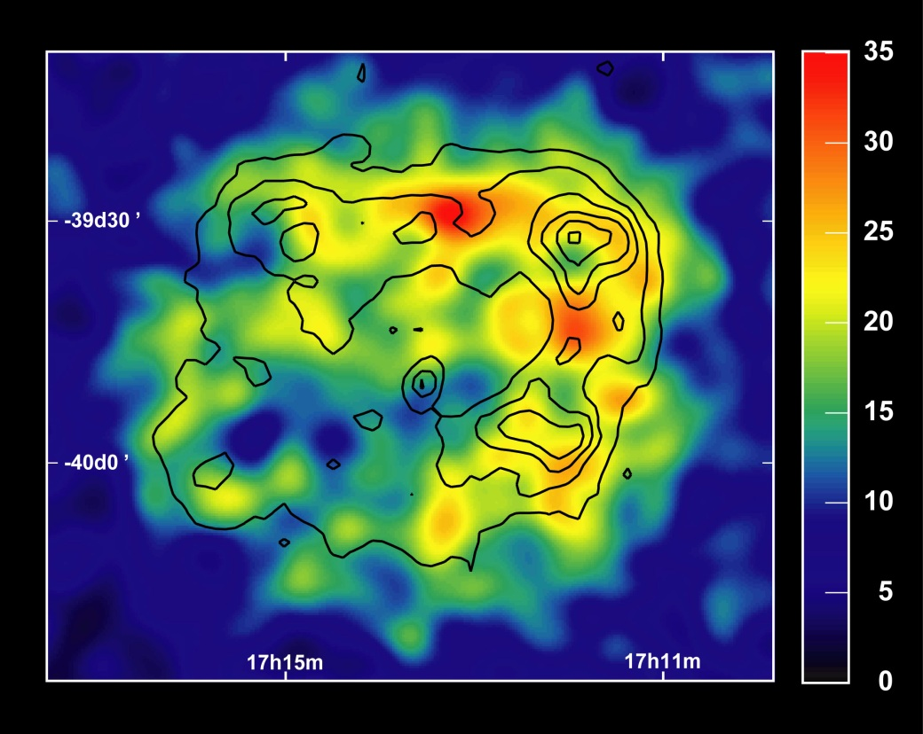
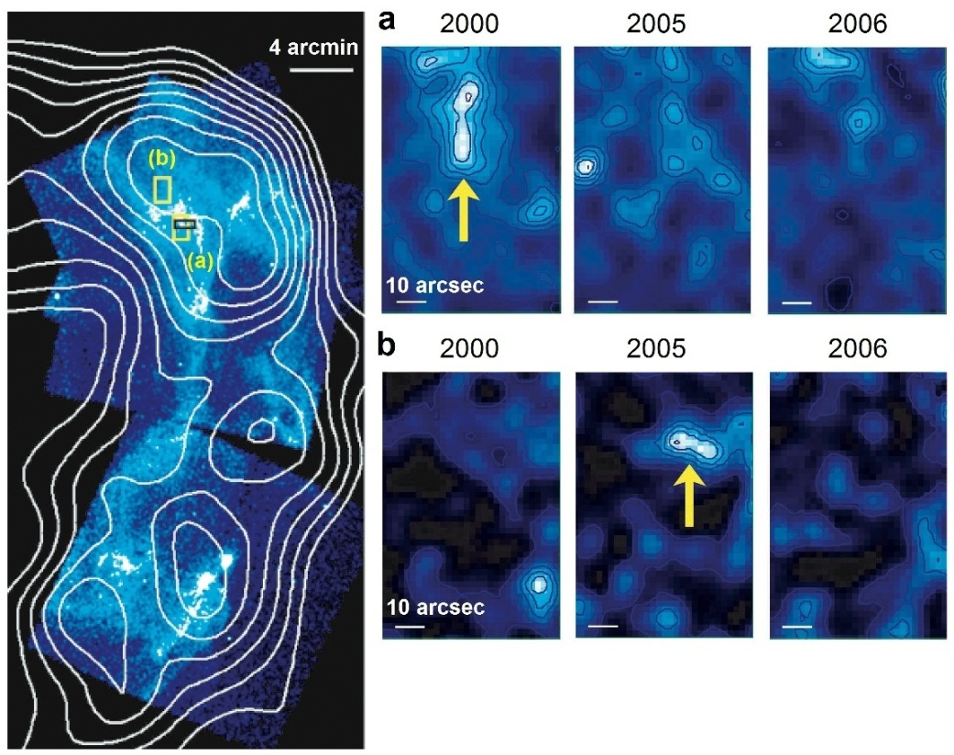
Physical picture
The main part of Galactic cosmic-ray flux is assumed to be provided by Diffusive Shock Acceleration (DSA) processes at young SNR shocks.
Magnetic field is required for efficient acceleration: E_{max} is determined by the amplitude of magnetic turbulence.
Bright X-ray filaments of synchrotron emission coincident with outer shocks of SNRs and variability of X-ray filaments on time scales ~1 year: evidence for strong magnetic fields.
Magnetic field amplitudes B ~ 100 μG – 1 mG (B_{ISM} ~ 3 μG).
HESS: SNR RXJ1713.7
Chandra (Uchiyama et al. 2007)
2
Notes:
2

Slide 3
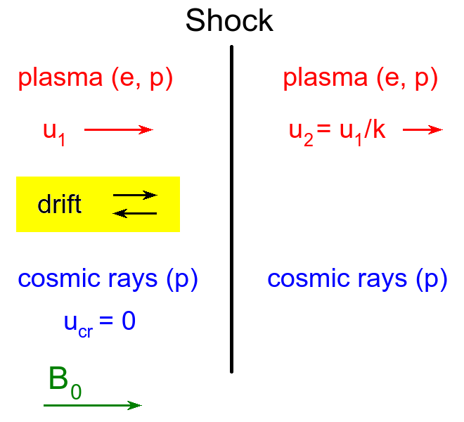
Magnetic field amplification
How and where is the magnetic turbulence produced?
How do particle interact with magnetic turbulence?
Precursor:
Slow relative motion of cosmic rays and cold plasma.
Electromagnetic turbulence is self-generated by accelerated particles via Bell’s instability (Bell 2004, Zirakashvili et al. 2008, Niemiec et al. 2008, Riquelme & Spitkovsky 2009, Stroman et al. 2009).
Important:
saturation process and level
it acts here
Shock rest frame is used on this picture
3
Notes:
3

Slide 4
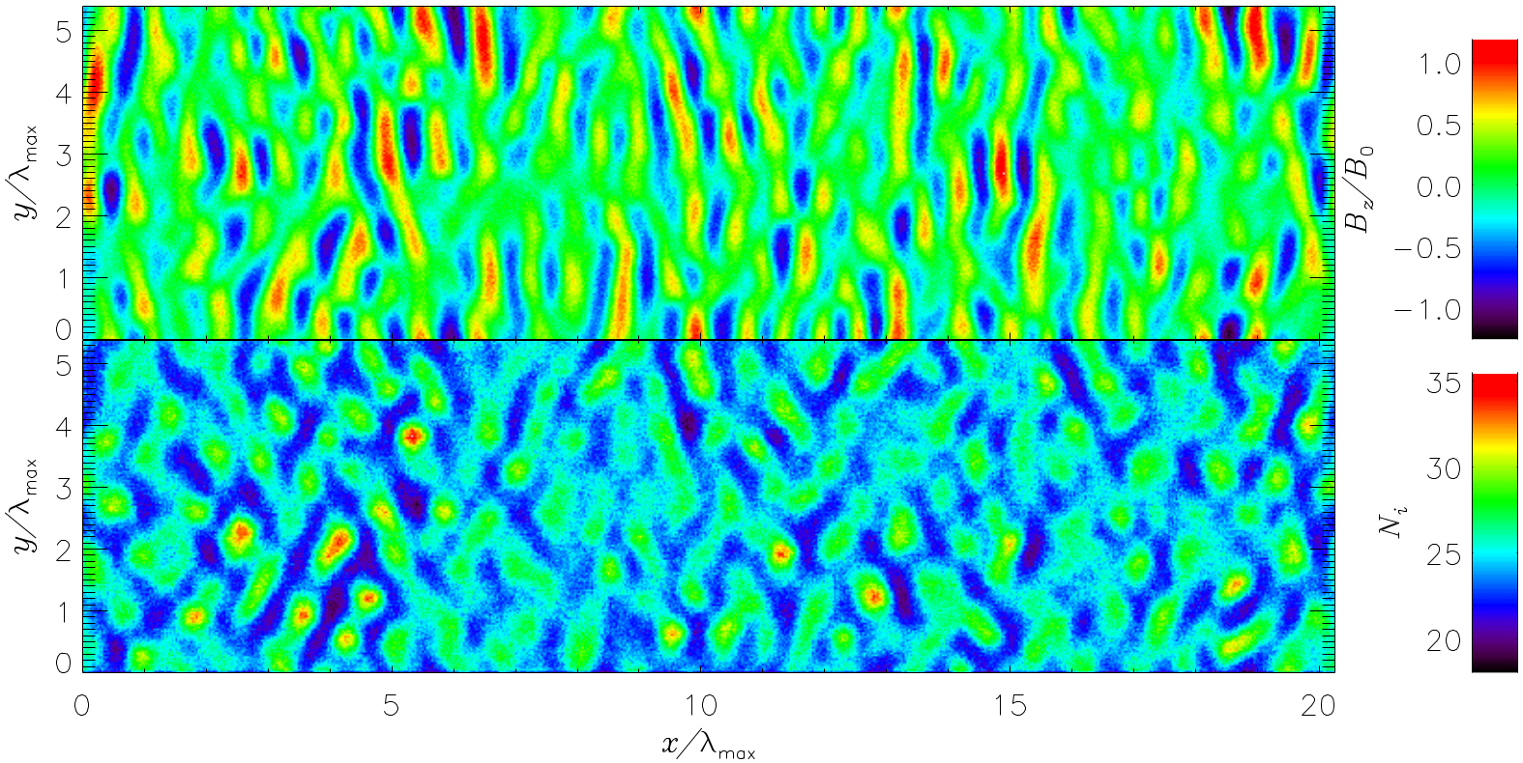
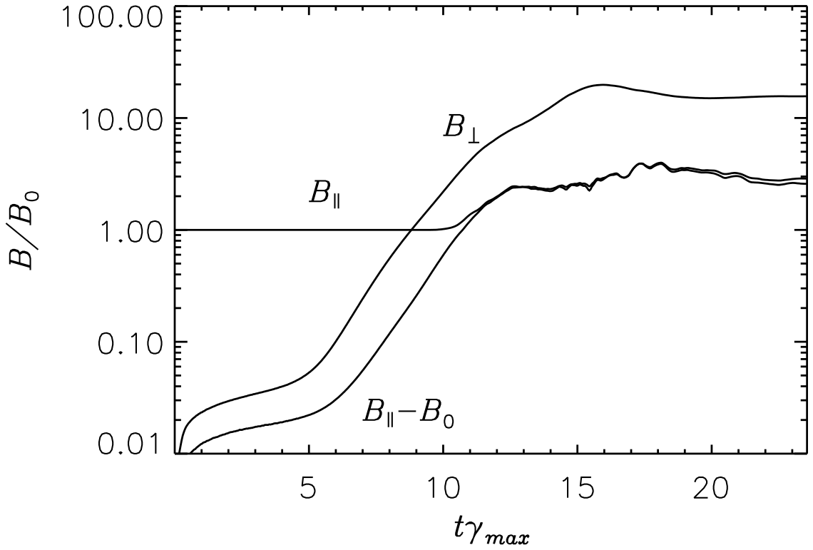
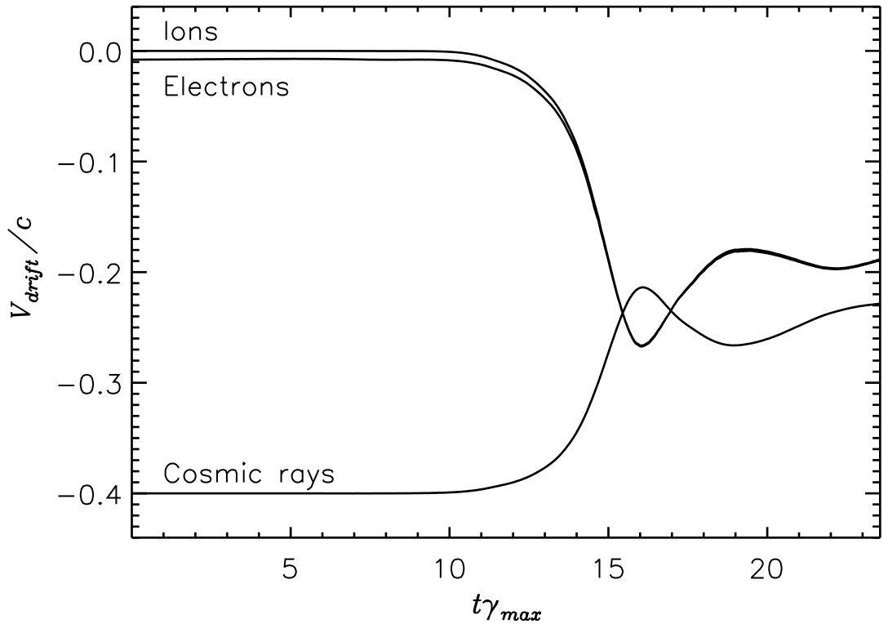
Nonresonant instability: status of the problem
Periodic boundary conditions were used in previous investigations (e.g. Stroman et al. 2009). It allowed us to study only the temporal development of the instability.
Magnetic field amplitude saturates at δB ≈ 10 – 20 B₀.
Relative drift between CRs and ambient plasma disappears.
Current investigation:
Open boundary conditions are implied in the plasma flow direction. It allows us to study both the temporal and the spatial development of the instability.
4
Notes:
4

Slide 5
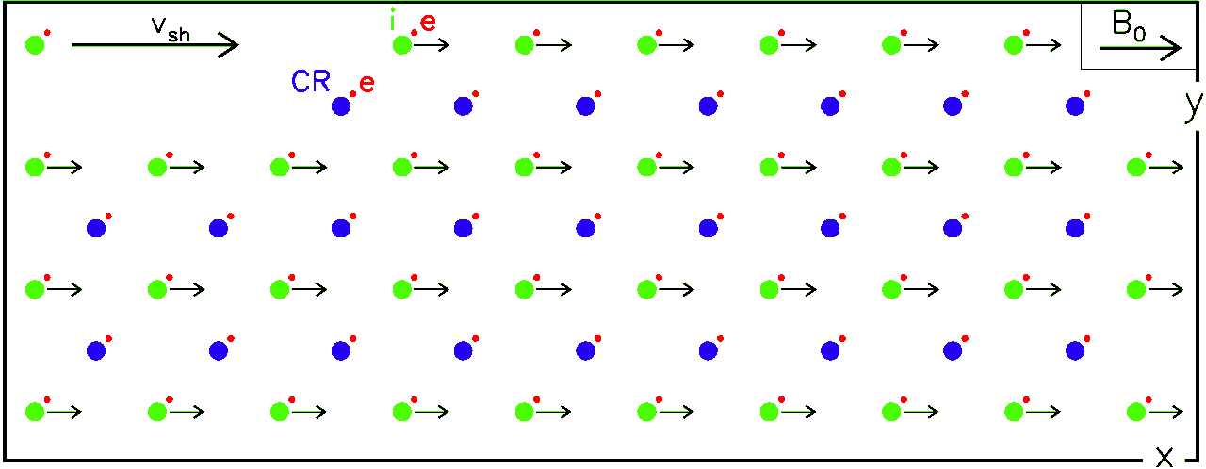
Very large-scale Particle-In-Cell simulation
2D-3V
plasma inflow
plasma outflow
Open boundaries account for mass conservation in the plasma flow.
L_{x} = 130,000 Δ ≈ 293 λ_{max} L_{y} = 12,000 Δ ≈ 27 λ_{max}
Simulation frame: Isotropic population of relativistic CR ions at rest. Electron-ion plasma beam moves with the shock velocity v_{sh} from left to right.
Physical parameters:
Reduced ion to electron mass ratio m_{i}/m_{e} = 50
CR-to-ambient plasma relative speed v_{rel} = 0.4c (electron thermal velocity v_{e,th} = 0.01c)
CR-to-ambient plasma density ratio 1/50
Initial CR relativistic Lorentz factor Г = 50
Alfven Mach number of the shock M_{A} = 40
5
Notes:
5

Slide 6
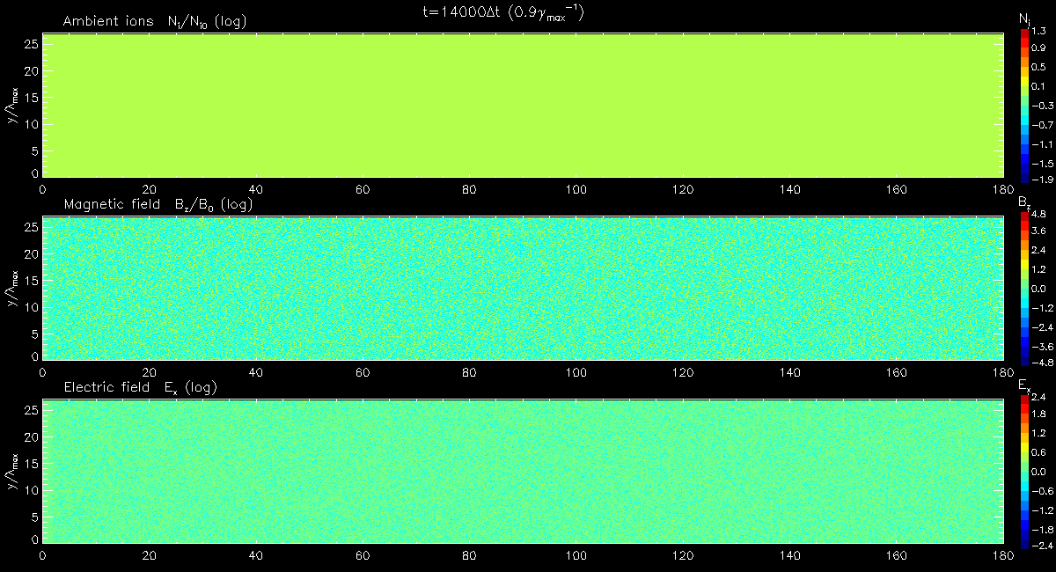
Global evolution of the nonresonant instability (From top to bottom: ambient ion density, B_{z} magnetic field, E_{x} electric field)
6
Notes:
6

Slide 7
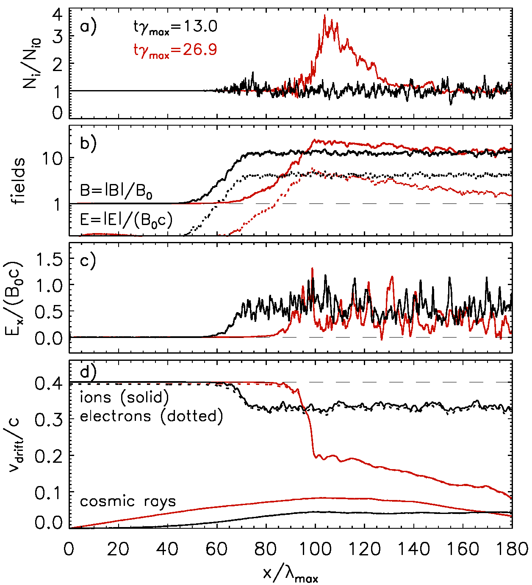
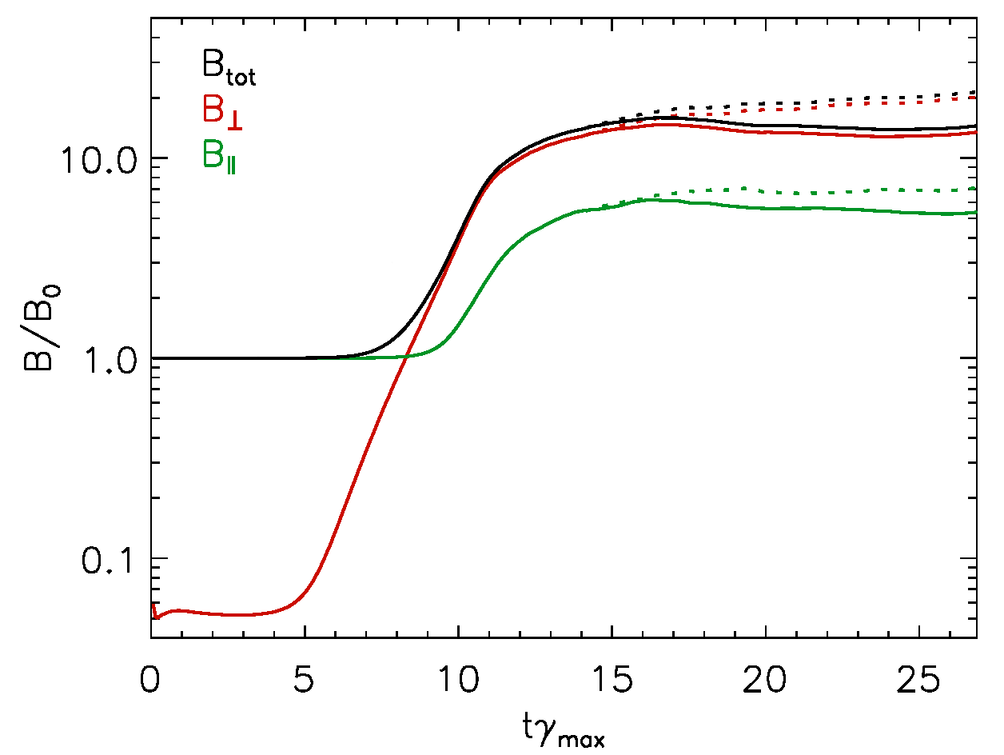
Global evolution of the nonresonant instability (Profiles of densities and fields, growth of magnetic turbulence)
Turbulent MF amplified and saturated at δB ≈ 15 B₀ as in studies with periodic boxes.
Additional amplification by about 30% through compression in shock-like structure.
Saturation through deceleration of bulk motions – relative CR-ambient plasma drift velocity decreases from 0.4c to ~ 0.05c.
Averaged E_{x} component is positive in the turbulent region.
7
Notes:
7

Slide 8
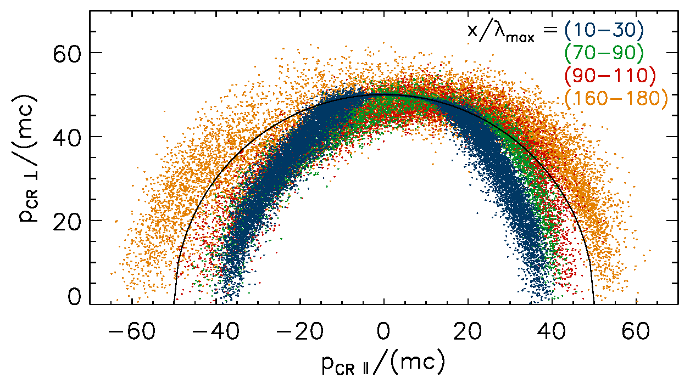
Evolution of the CR energy distribution
CRs are scattered by electromagnetic turbulence.
Most of the scattering is inelastic, due to turbulent electric field, and results in either acceleration or deceleration of individual CR particles.
Significant modification of CR distribution; strong anisotropy is introduced.
8
Notes:
8

Slide 9
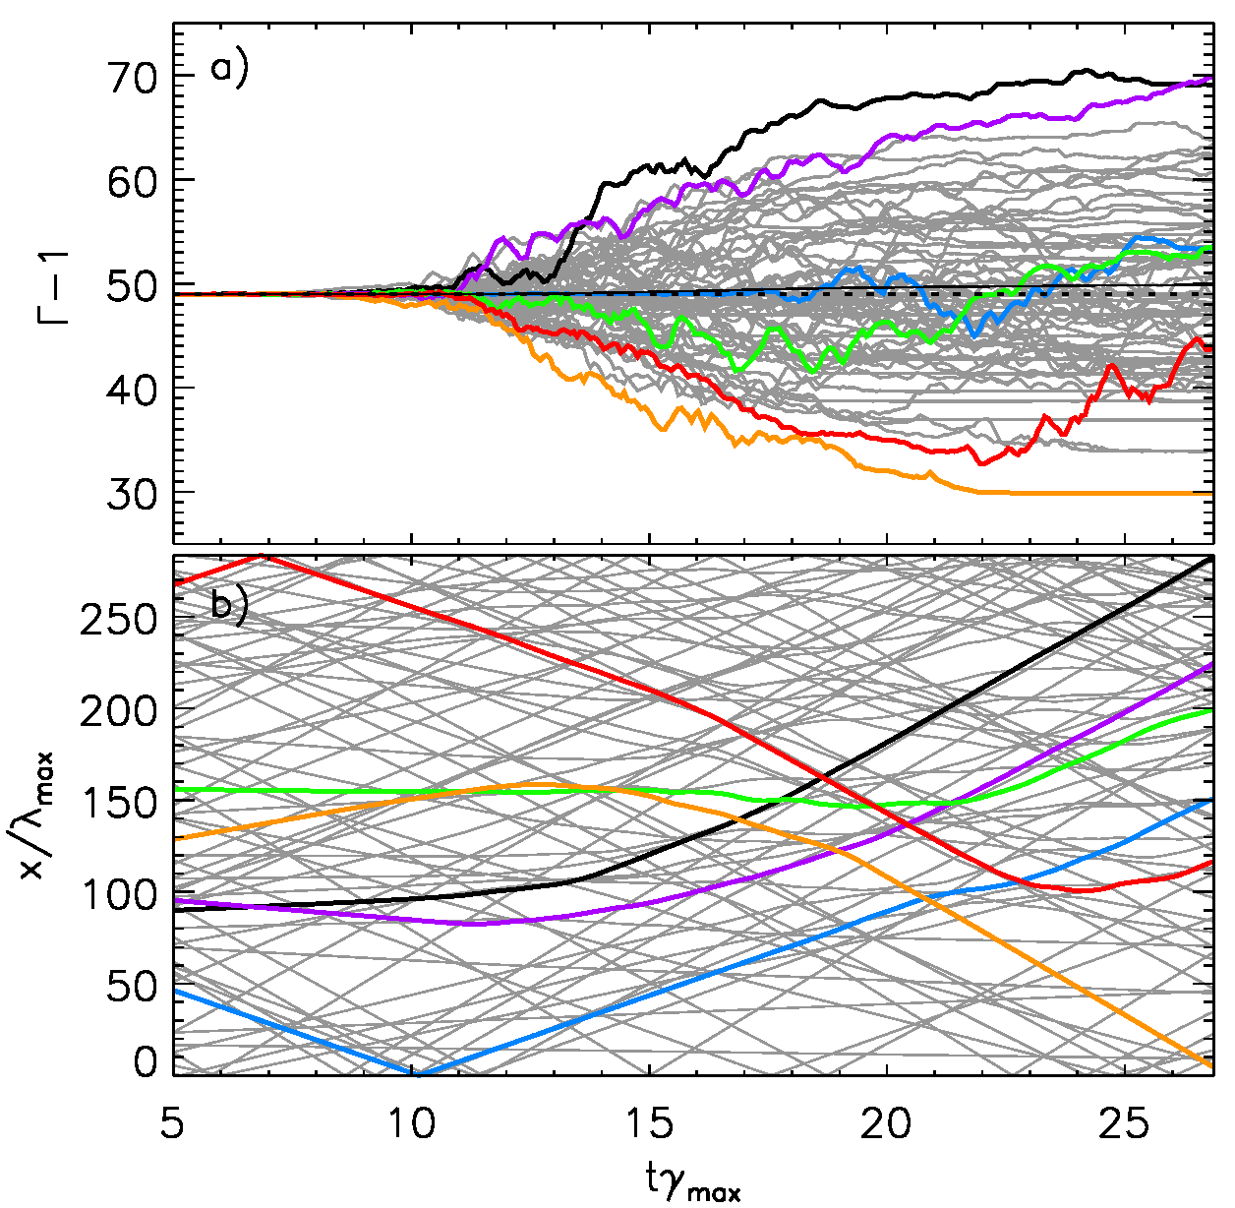
Evolution of the CR energy distribution
The mean CR energy increases from the initial Г – 1 = 49 to appr. 50.
CRs traveling along the plasma flow are accelerated,
whereas those moving against the flow become decelerated.
E_{x} component is on average positive in the turbulent region – energy transfer rate –E_{x} j_{ret}.
9
Notes:
9

Slide 10
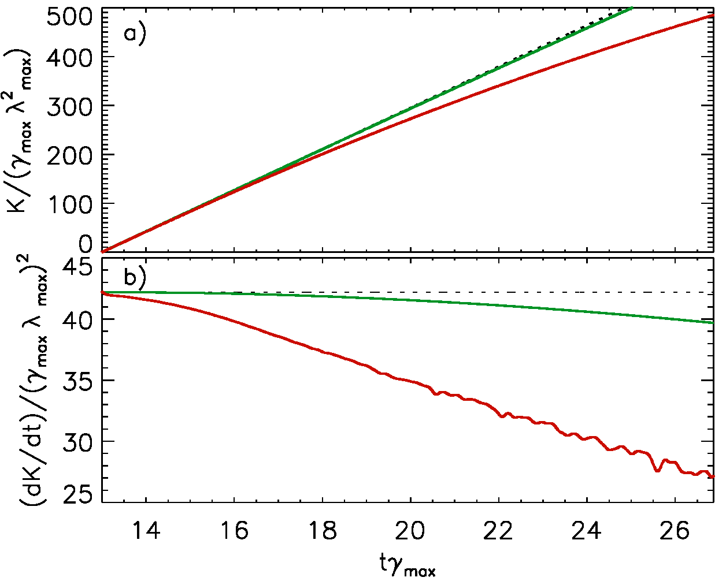
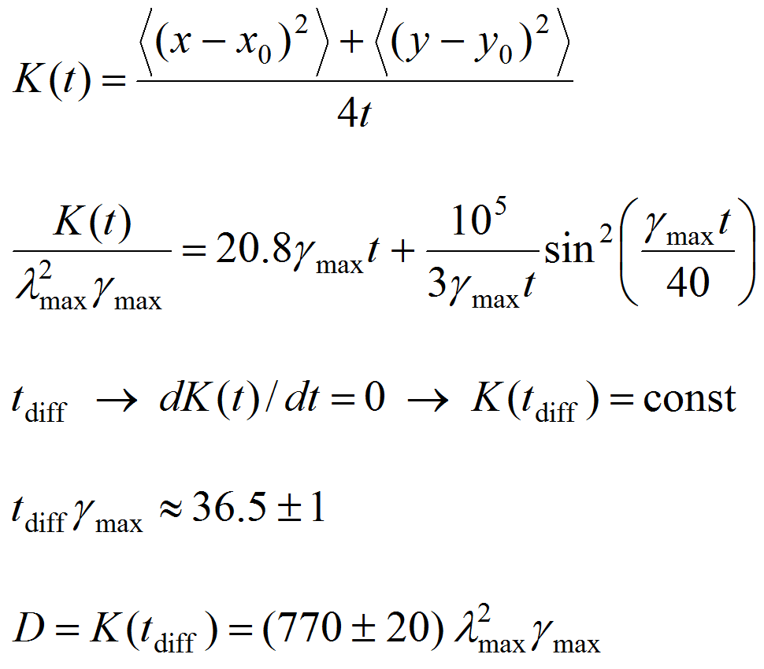
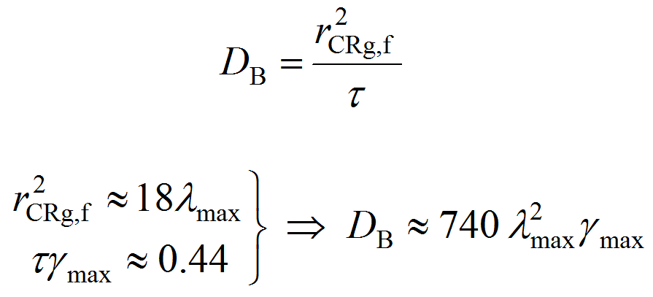
Diffusion of the CRs
running diffusion coefficient
at gyration in the initial field B₀
time needed for CRs to transition into the diffusion regime
spatial diffusion coefficient would be reached
Comparison with Bohm diffusion limit →
Spatial CR Scattering is compatible with Bohm diffusion
10
Notes:
10

Slide 11
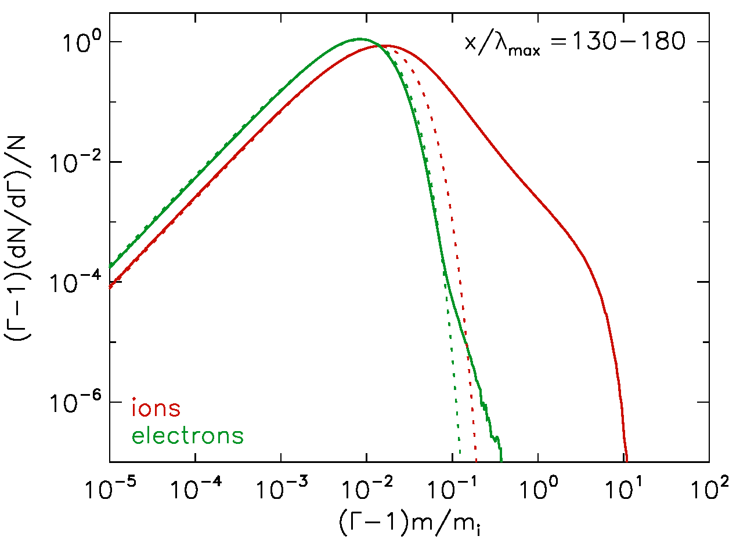
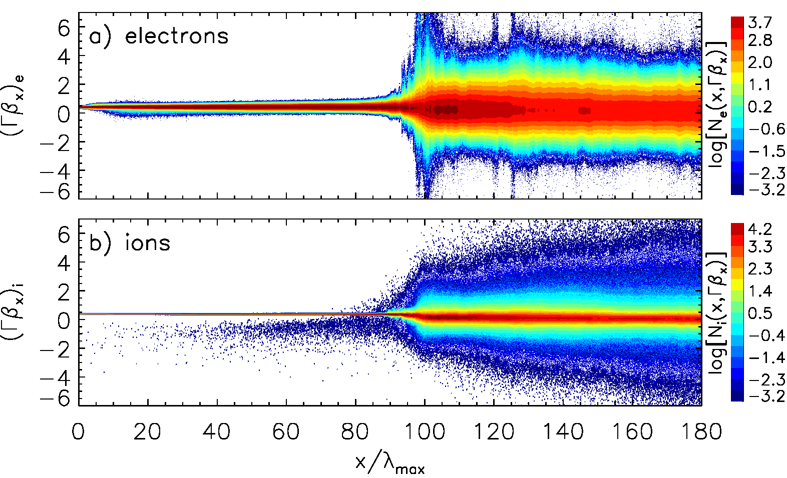
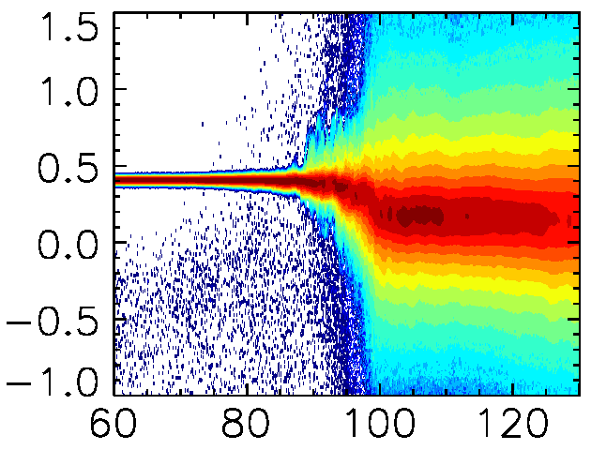
Ambient plasma heating
Ambient plasma slows down from initial drift velocity v = 0.4c to ~0.15c.
Plasma is strongly heated by the electromagnetic turbulence.
There is a bulk equipartition between electrons and ions.
Electron energy distributions are close to thermal.
Ion energy spectra have supra-thermal tails.
A fraction of plasma ions are reflected from the shock-like structure generating additional turbulence through filamentation instabilities.
11
Notes:
11

Slide 12
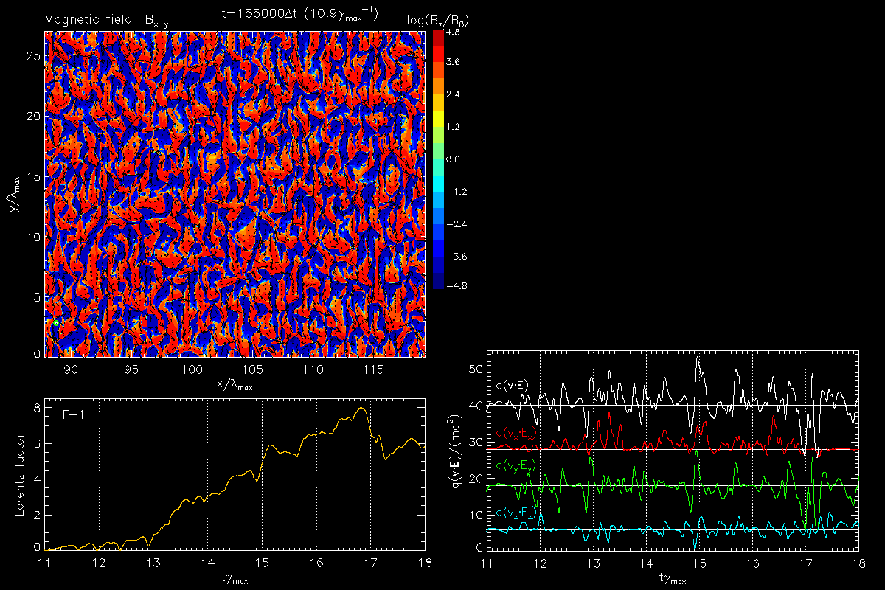
Ambient ion scattering
Energy growth rate dГ/dt is strictly coincident with dot product q(v⋅E).
x-component of the dot product q(v_{x}⋅E_{x}) has an averaged positive value (like averaged E_{x} field).
Plasma ions moving in positive x-direction are therefore accelerated.
Positive motional electric field E_{x} is responsible for bulk particle acceleration.
12
Notes:
12

Slide 13
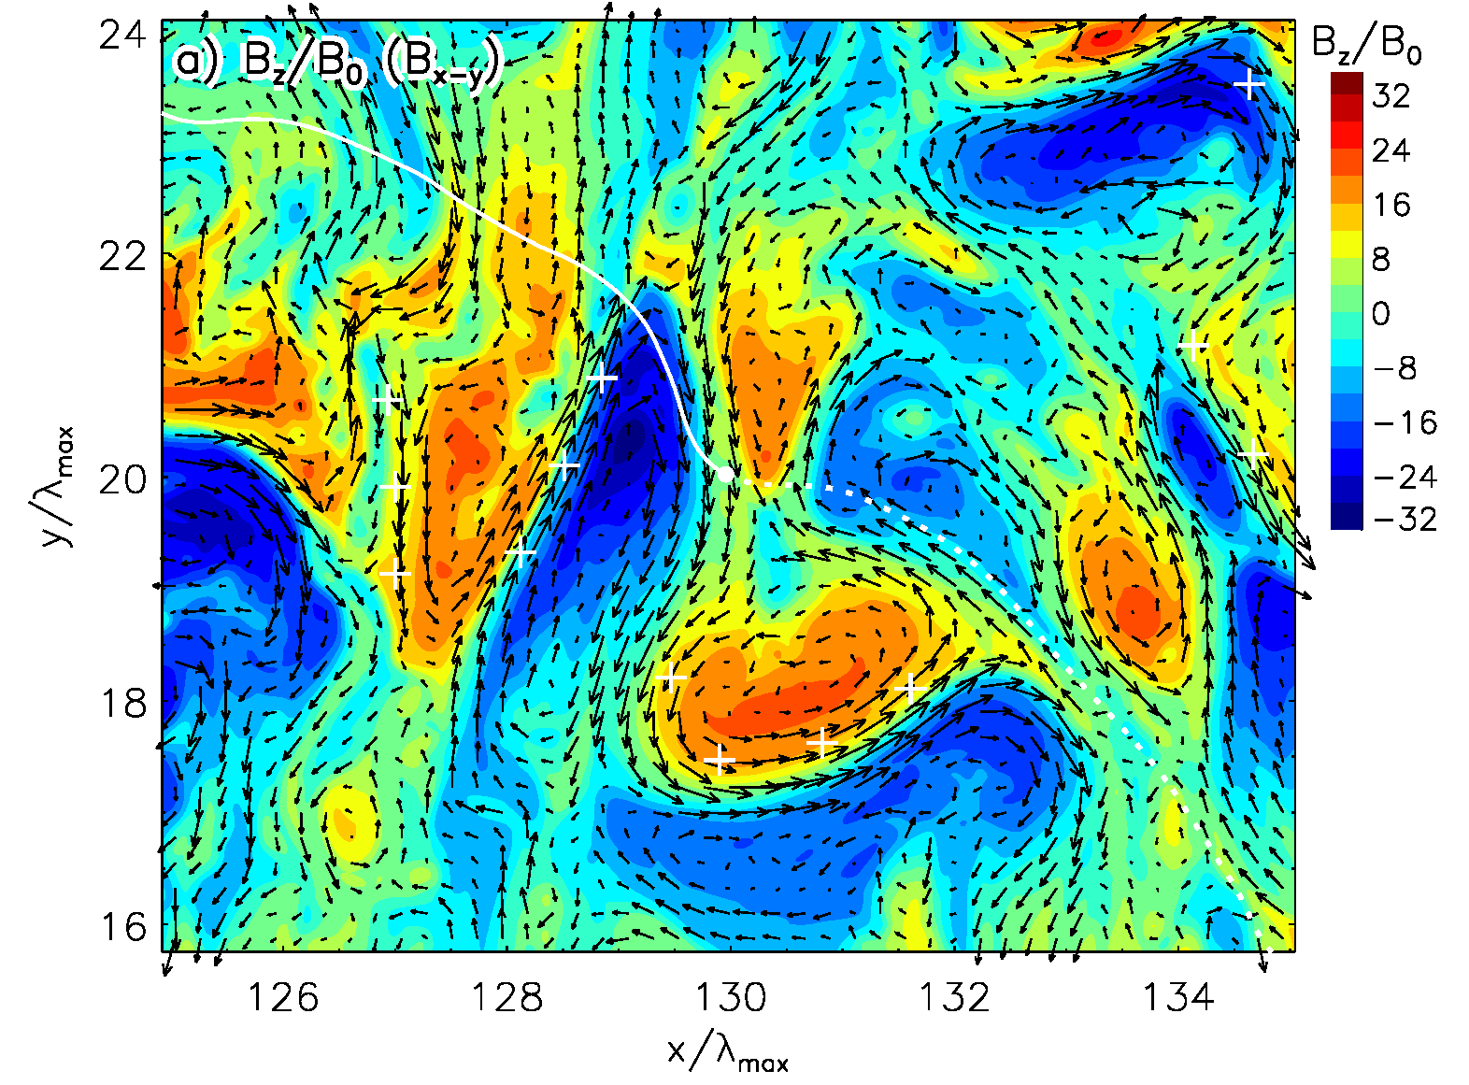
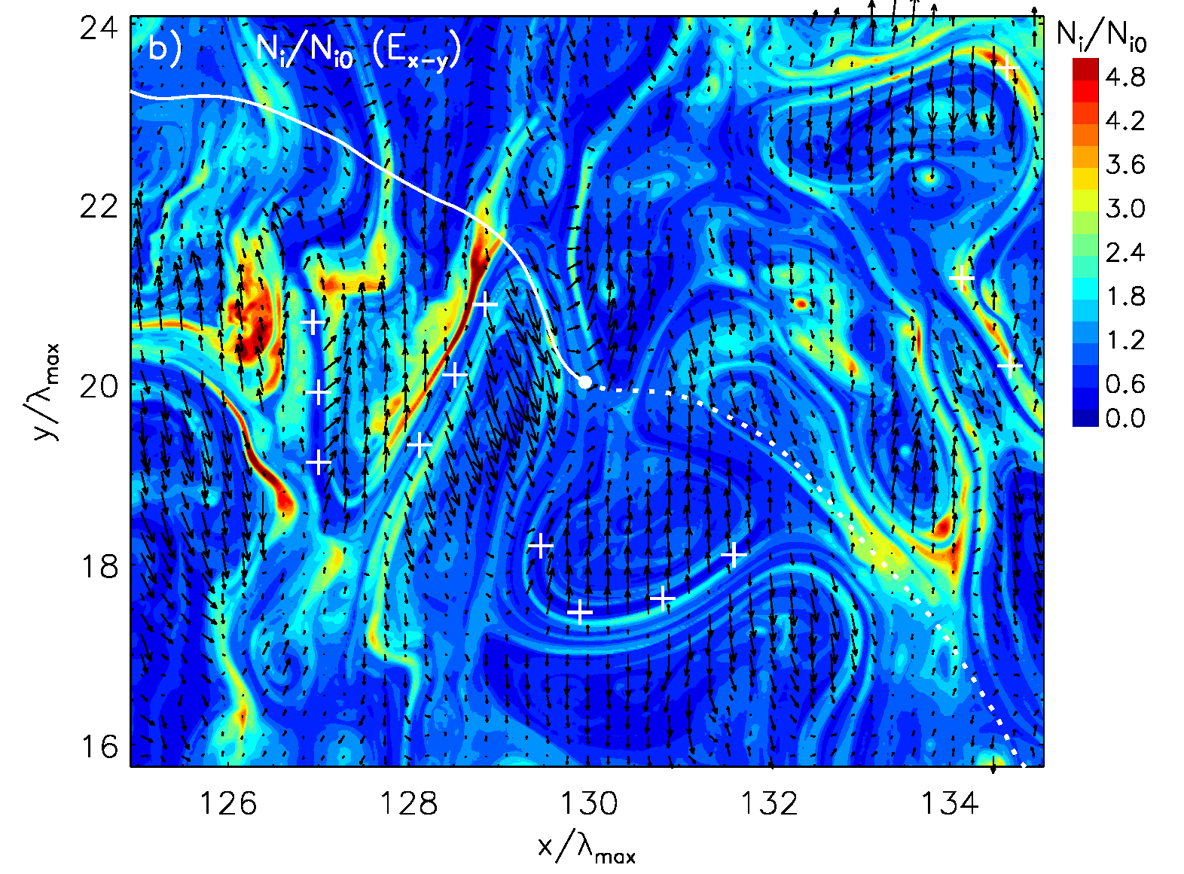
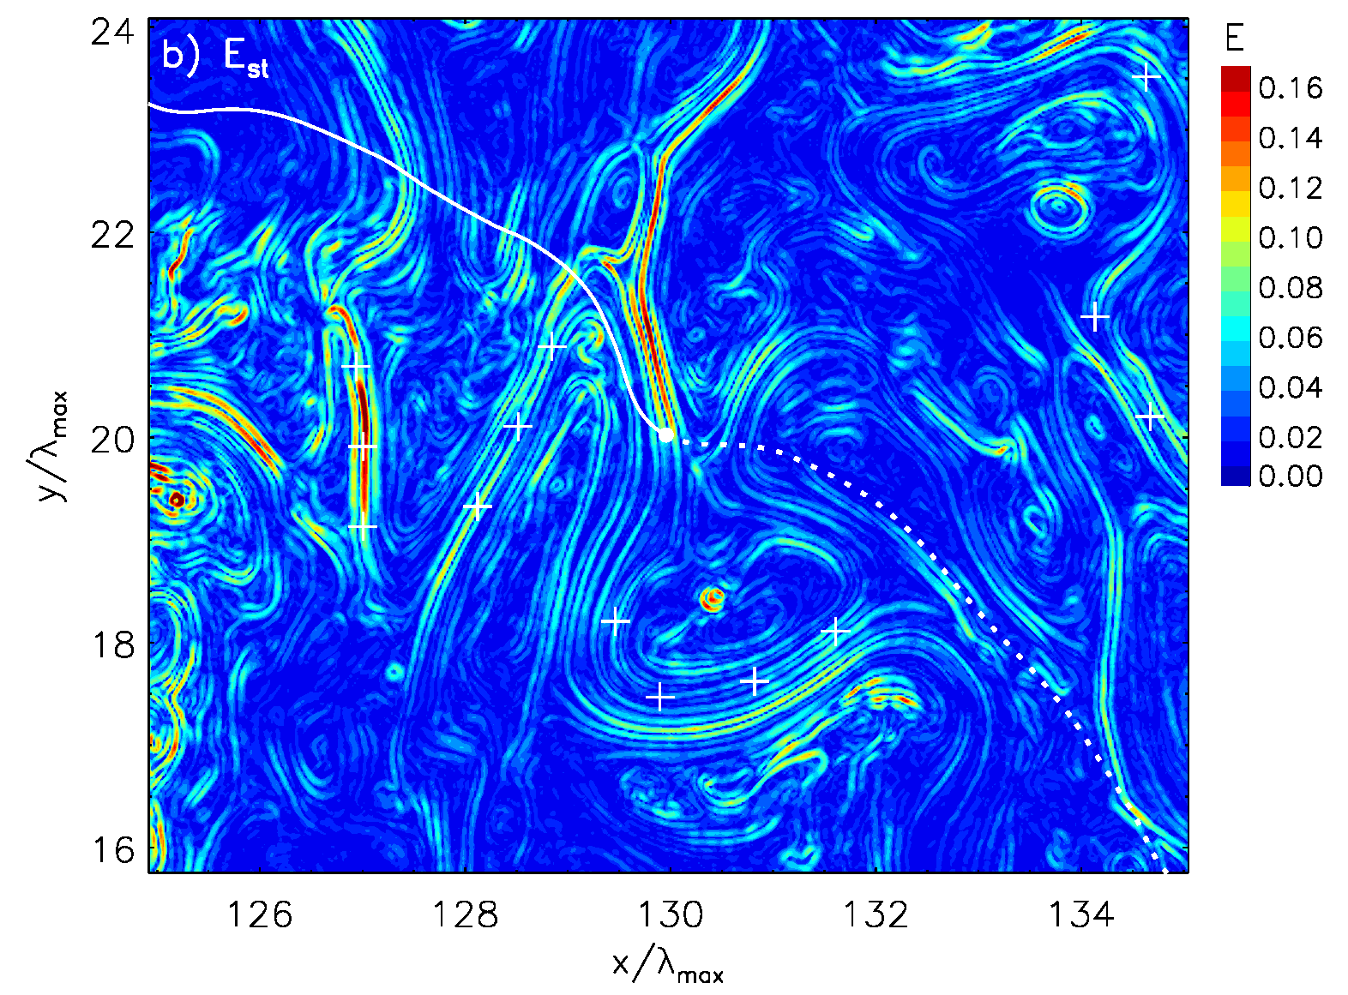
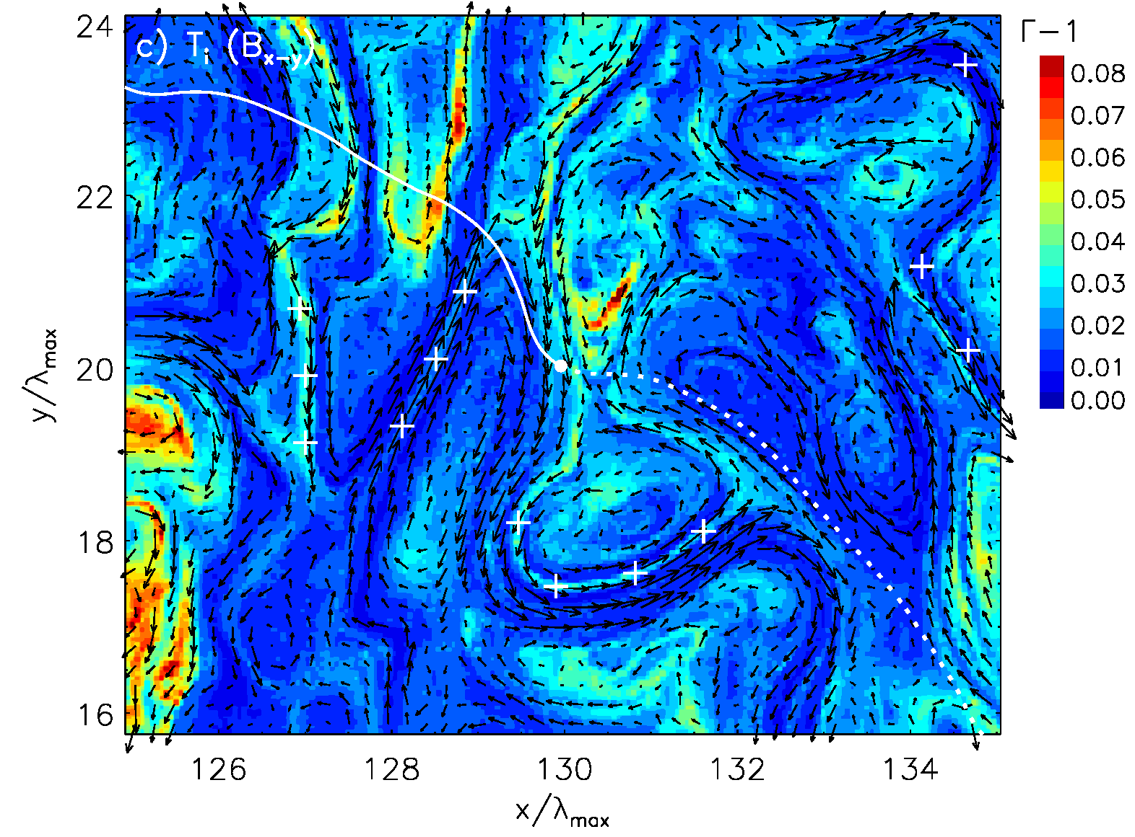
Microphysics of plasma heating
Particles are scattered in energy by the turbulent electric field.
Bulk plasma heating is not due to compression (nonadiabatic).
Highest temperatures are reached in plasma cavities – at sites of large-amplitude electrostatic charge-separation field.
13
Notes:
13

Slide 14
Summary
MF is amplified to δB ≈ (15 – 20) B₀ and saturates through deceleration of drifts as observed in previous studies.
MF can be amplified to large amplitudes in SNR shock precursors before it is overtaken by the approaching shock.
Additional amplification through compression in the shock-like structure, that should be present in realistic SNR shocks.
SNR shock precursors are highly turbulent. Particles are heated efficiently by electromagnetic turbulence. Second-order Fermi processes lead to stochastic scattering of plasma ions.
Turbulent electric field also inelastically scatters CRs, introducing significant anisotropy and modifying their energy distribution.
CR scattering is compatible with Bohm diffusion, when corrected for the coherence scale of the turbulence.
Thank you!
14
Notes:
14
14

