Slide 1
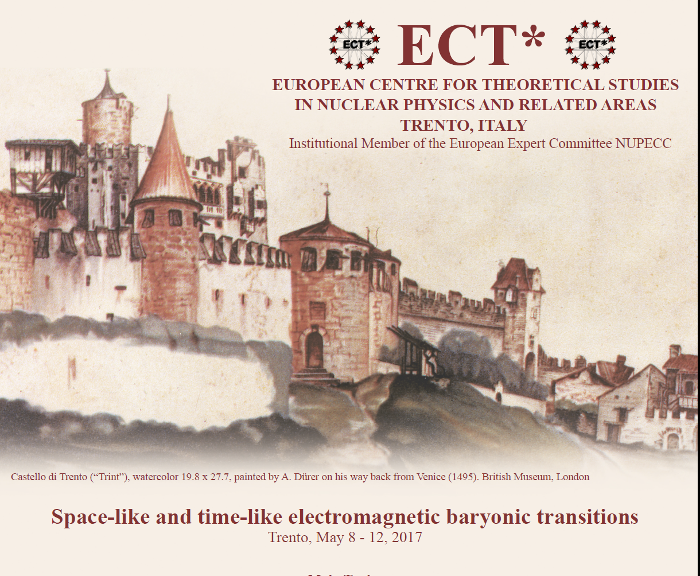


Emergent Structures from Quarks and Gluons in the Time-Like and Space-Like Regimes
a summary of our workshop or
a very biased view from a SL Experimentalist
Philip Cole
Idaho State University
12 May 2017

Slide 2
Our Research Vision
  We seek to bring together a representative sample of experimental, phenomenology, and theory groups, who are working on the nucleon resonance problem.
    Discuss the direction on the study of understanding the underlying structure of nucleons,
    Delineate the spectrum of excited baryon states,
    Describe and detail how quarks are confined and acquire mass through the mechanism of dynamical chiral symmetry breaking

Slide 3
Confirmed Speakers
Daniele Binosi (ECT* Trento)
Vladimir Braun (University of Regensburg)
William Briscoe (George Washington University)
Susanna Costanza (University of Pavia)
Annalisa D’Angelo (University of Rome)
Chaden Djalali (University of Iowa)
Michael Döring (George Washington University)
Christian Fischer (University of Giessen)
Bengt Friman (TU Darmstadt)
Tetyana Galatyuk (TU Darmstadt)
Leonid Glozman (University of Graz)
Ralf Gothe (University of South Carolina)
Kyungseon Joo (University of Connecticut)
Helmut Haberzettl (George Washington University)
Kenneth Hicks (Ohio University)
Hiroyuki Kamano (Osaka University)
Eberhard Klempt (University of Bonn)
Mikhail Krivoruchenko (ITEP, Moscow)
Victor Nikonov (University of Bonn and PNPI, Gatchina)
Teresa Peña (IST Lisbon)
Vladimir Braun (University of Regensburg)
Ralph Rapp (Texas A&M University)
Hiroyuki Sako (JAEA)
Piotr Salabura (Jagiellonian University in Krakow)
Toru Sato (Osaka University)
Hartmut Schmieden (University of Bonn)
Federico Scozzi (IPN Orsay and TU Darmstadt)
Kirill Semenov-Tyan-Shanskiy (PNPI, Gatchina)
Igor Strakovsky (George Washington University)
Joachim Stroth (Goethe University Frankfurt)
Annika Thiel (University of Bonn)
Lothar Tiator (University of Mainz)
Ralf-Arno Tripolt (ECT* Trento)
Jochen Wambach (TU Darmstadt and ECT* Trento)
Qiang Zhao (IHEP-Beijing)
Am I missing any speakers?
Those who could not come are very, very welcome to contribute to the White Paper

Slide 4
Reason for the Workshop
This ECT* workshop has brought together several different experimental and theoretical communities, whose research
spans the kinematical regimes in q² between the space-like and time-like regions
  q² = 0 [anchor point] photon-beam (unpolarized & linearly- and circularly polarized experiments (ELSA, JLab, LEPS, & MAMI)
  q² > 0 [time-like] meson-beam experiments (GSI and J-PARC) proton-antiproton beam experiments (FAIR)
  q² < 0 [space-like] electron-beam experiments (JLab)

Slide 5
Following topics will be covered
  Electromagnetic baryon excitations through meson electroproduction
  Theoretical approaches for baryon transition form factors in the space-like region
  Baryon spectroscopy from photoproduction and meson beam experiments
  Amplitude analysis and extraction of baryonic resonances properties
  Electromagnetic transitions through dilepton production
  Unified description of space-like and time-like baryon electromagnetic transitions
  Vector mesons in medium
  Prospects for future experimental studies

Slide 6
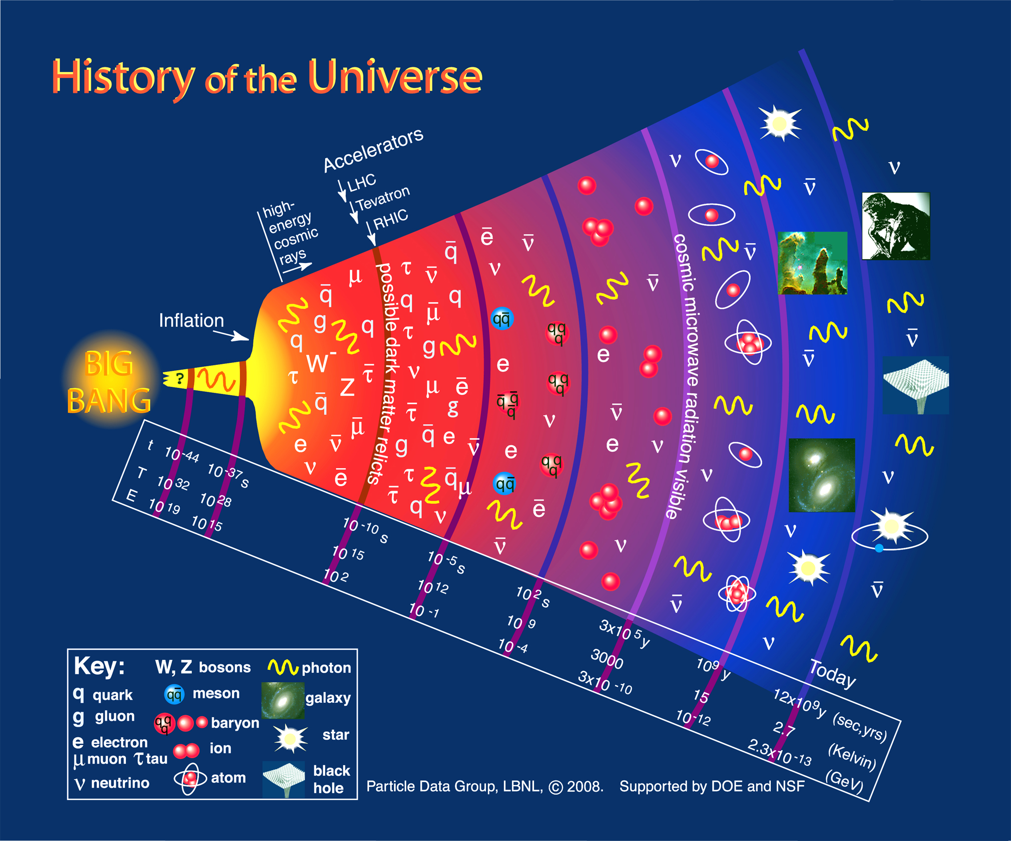
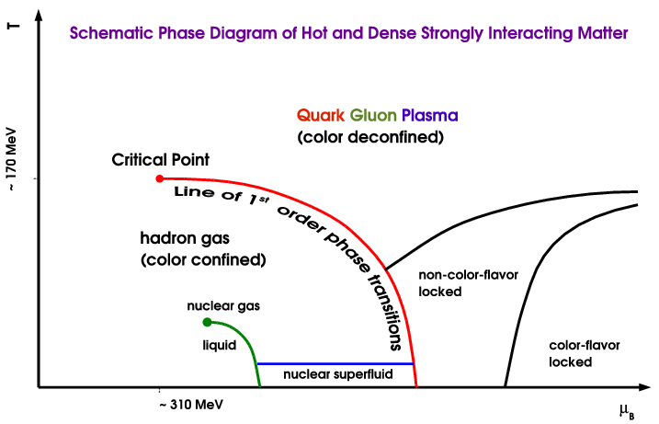
N* in the History of the Universe
CEBAF
ELSA
Mami
Quark Gluon Plasma
(color deconfined)
N*
Hadron Gas
(color confined)
N*
Dramatic events occur in the microsecond old Universe.
The transition from the QGP to the baryon phase is dominated by excited baryons.
A quantitative description requires more states than found to date => missing baryons.
During the transition the quarks acquire dynamical mass and the confinement of color occurs.
Annalisa D’Angelo

Slide 7
Coupled-channels picture of resonance excitation (EBAC)
[Motivation]
πN
ππN
γN → N* → ηN
KΛ KΣ
The same N* resonance must be found in different reaction channels in a consistent way!
T
πΝ→πΝ
T
ηΝ→πΝ
T
γΝ→πΝ
T
ρΝ→πΝ
T
σΝ→πΝ
T
ΚΛ→πΝ
T
ΚΣ→πΝ
T
πΝ→ηΝ
T
ηΝ→ηΝ
T
γΝ−>ηΝ
T
ρΝ→ηΝ
T
σΝ→ηΝ
T
ΚΛ→ηΝ
T
ΚΣ→ηΝ
T
πΝ→γΝ
T
ηΝ→γΝ
T
γΝ→γΝ
T
ρΝ→γΝ
T
σΝ→γΝ
T
ΚΛ→γΝ
T
ΚΣ−>γΝ
T=
T
πΝ→ρΝ
T
ηΝ→ρΝ
T
γΝ→ρΝ
T
ρΝ→ρΝ
T
σΝ→ρΝ
T
ΚΛ→ρΝ
T
ΚΣ→ρΝ
T
πΝ→σΝ
T
ηΝ→σΝ
T
γΝ→σΝ
T
ρΝ→σΝ
T
σΝ→σΝ
T
ΚΛ→σΝ
T
ΚΣ→σΝ
T
πΝ→ΚΛ
T
ηΝ→ΚΛ
T
γΝ→ΚΛ
T
ρΝ→ΚΛ
T
σΝ→ΚΛ
T
ΚΛ→ΚΛ
T
ΚΣ→ΚΛ
T
πΝ→ΚΣ
T
ηΝ→ΚΣ
T
γΝ→ΚΣ
T
ρΝ→ΚΣ
T
σΝ→ΚΣ
T
ΚΛ→ΚΣ
T
ΚΣ→ΚΣ

Slide 8
Bill Briscoe

Slide 9
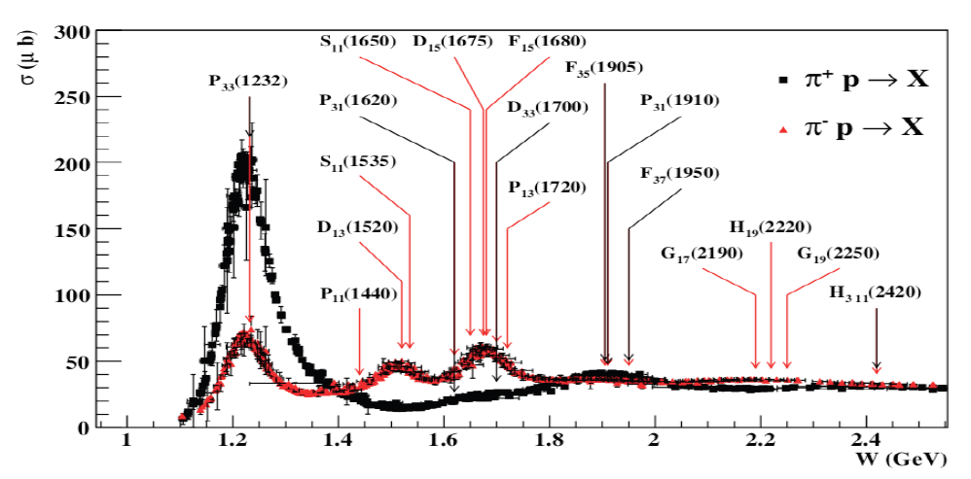
Baryon resonances (N*s and Δ*s)
σ (mb)
N*s are broadly overlapping
Hard to disentangle without polarization observables
Notes:
Delta++/Delta0 cross section ratio is 3. Mention CR-coefs + Qual Prob.

Slide 10
Helmut Haberzettl

Slide 11
Helmut Haberzettl

Slide 12
Structure of excited baryons
  effective degrees of freedom
  transition charge densities
  running quark mass
  => nature of states
N(1680)5/2⁺
[56,2⁺]₂
2
L_{3q}
[70,1⁻]₁
N(1675)5/2⁻
N(1520)3/2⁻
N(1535)1/2⁻
e’
π, η, ππ, K
e
γ_{v}
1
N*,△*
Q
N
N, Y
[56,0⁺]₀
A_{1/2}, A_{3/2}, S_{1/2}
E₁₊, M₁₊, S₁₊
Δ(1232)3/2⁺
N(940)1/2⁺
N(1440)1/2⁺
N(1710)1/2⁺
[70,0⁺]₀
0
0
1
N [ħω]
2
I.G. Aznauryan et al., Analysis of p(e,e’Nπ); V.I. Mokeev et al., Analysis of p(e,e’pπ⁺π⁻)
Annalisa D’Angelo
Notes:
The N* spectrum teaches us about the underlying symmetries, to access the internal structure we need to probe the nucleon with virtual photons that measure the resonance strength versus the time-distance scale. What one measures are the helicity amplitudes A1/2, A3/2, and S1/2 or equivalent electromagnetic multipoles. I will focus on 3 states highlighted here.

Slide 13
Eberhart Klempt

Slide 14
Evidence for New N* in KY Final State
State N(mass)J^{P} | PDG pre 2010 | PDG 2016 | KΛ | KΣ | Nγ
N(1710)1/2⁺ | *** | **** | **** | ** | ****
N(1880)1/2⁺ |  | ** | ** |  | **
N(1895)1/2⁻ |  | ** | ** | * | **
N(1900)3/2⁺ | ** | *** | *** | ** | ***
N(1875)3/2⁻ |  | *** | *** | ** | ***
N(2150)3/2⁻ |  | ** | ** |  | **
N(2000)5/2⁺ | * | ** | ** | * | **
N(2060)5/2⁻ |  | ** |  | ** | **
Study these states in electroproduction and extend to higher masses
Annalisa D’Angelo
Notes:
This slides shows a summary of the results in this analysis. The green column shows the rating by the PDG. The two columns show the importance of the strangeness channel in this results.

Slide 15
Eberhart Klempt

Slide 16
Ralf Gothe

Slide 17
Masayuki Niiyama

Slide 18
Masayuki Niiyama

Slide 19
Hartmut Schmieden

Slide 20
Ralf Gothe

Slide 21
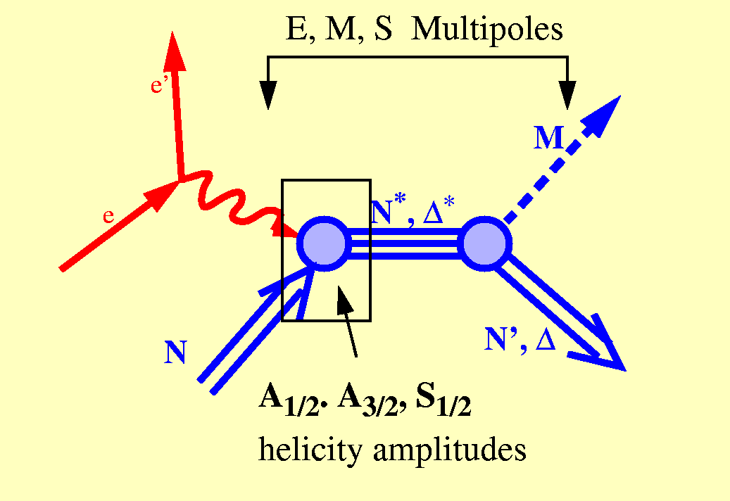
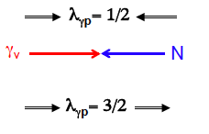
Electroproduction
The helicity amplitudes are related to the matrix elements of the electromagnetic current via:
Transverse
  A_{1/2}
  A_{3/2}
Longitudinal
  S_{1/2}
A_{½}: <N*,S_{z}*=+½|ε_{μ}⁽⁺⁾J^{μ}_{em}|N,S_{z}=−½>
A_{3/2}: <N*,S_{z}*=+3/2|ε_{μ}⁽⁺⁾J^{μ}_{em}|N,S_{z}=+½>
S_{½}: <N*,S_{z}*=+½|ε_{μ}⁽⁰⁾J^{μ}_{em}|N,S_{z}=+½>
Notes:
EBAC: dynamical coupled channel analysis is based on the world data set on piN. gammaN, and gamma*N and constrained by unitarity. (to Npi, Neta, N2pi)
This allows the extraction of the meson-baryon contributions under minimal model assumptions

Slide 22
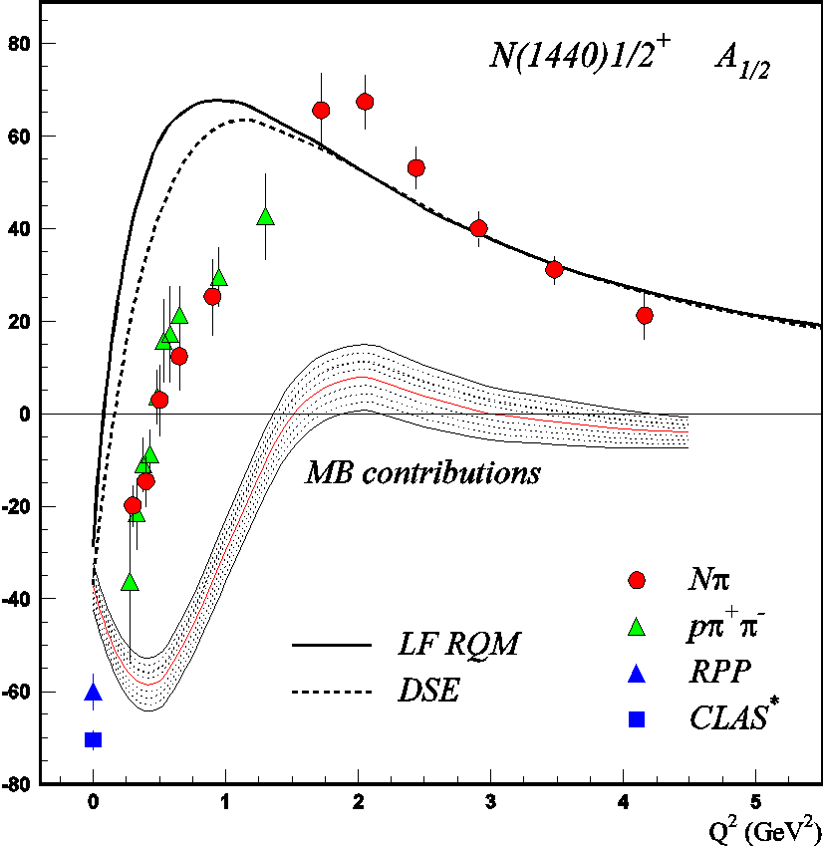
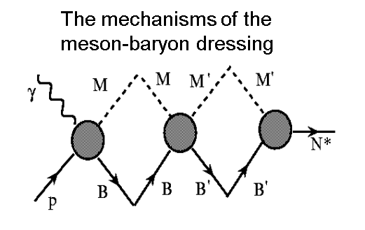
V. D. Burkert, Baryons 2016
DSE describe successfully the nucleon elastic and the transition
N→Δ(1232)3/2⁺, N→N(1535)1/2⁻ form factors with the same dressed
quark mass function (J.Segovia, et al., PRL 115, 171801 (2015)).

Slide 23
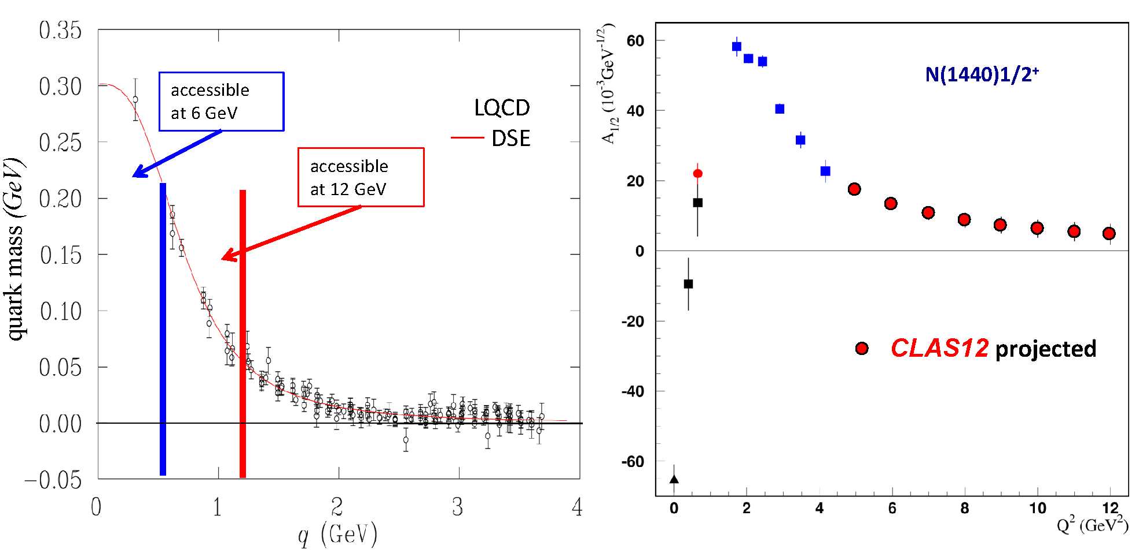
Probing the running quark mass with CLAS12
Nucleon resonance transitions amplitudes probe the quark mass function from constituent quarks to dressed quarks and elementary quarks.
Kyunseon Joo

Slide 24
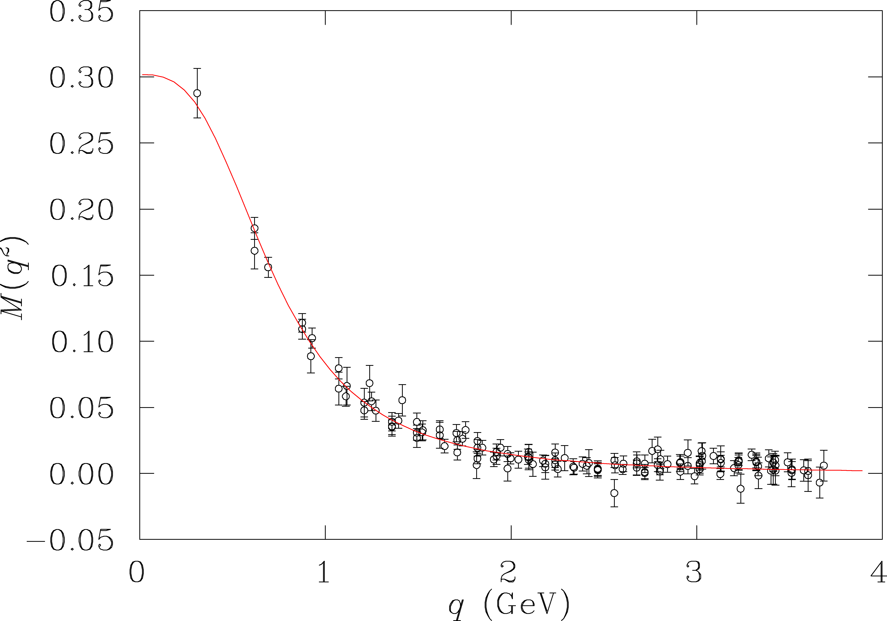
One clear goal
Resolution of probe
π,ρ,ω,..
Allows us to address central the question:
What are the relevant degrees of
freedom at varying distance scale?
Low Q²
q
Ν,Ν∗,Δ,Δ∗
LQCD/DSE
3-q core+MB cloud
quark mass (GeV)
3-q core
High Q²
e.m. probe
pQCD
Notes:
24
Why do we use electromagnetic probes to study hadron structure? I think the answer is that the e.m. probe allows us to efficiently address the central question of hadron physics: What are the relevant degrees of freedom at varying distance scales? To simply illustrate this I show here the quark propagator mass calculated in LQCD, Dyson Schwinger, and other approaches as a function of the momentum transfer. In the em probe we can vary the resolution and momentum transfer. In doing so, we probe the effective degrees of freedom in the nucleon from meson-nucleon, to constituent quarks, to elementary partons. The study of nucleon resonance transitions provides a testing ground for our understanding of these effective degrees of freedom. Right plot correspond to gluon dressing of bare QCD quark, that is reponsible for transition from down to middle plot on the left panel.Dressed constituent quarks create bare quark core (Q2>5.0 GeV^2).On the top of bare quark core we have meson-baryon cloud (Q2<5.0 Ge^2)shown in upper plot of the left panel

Slide 25
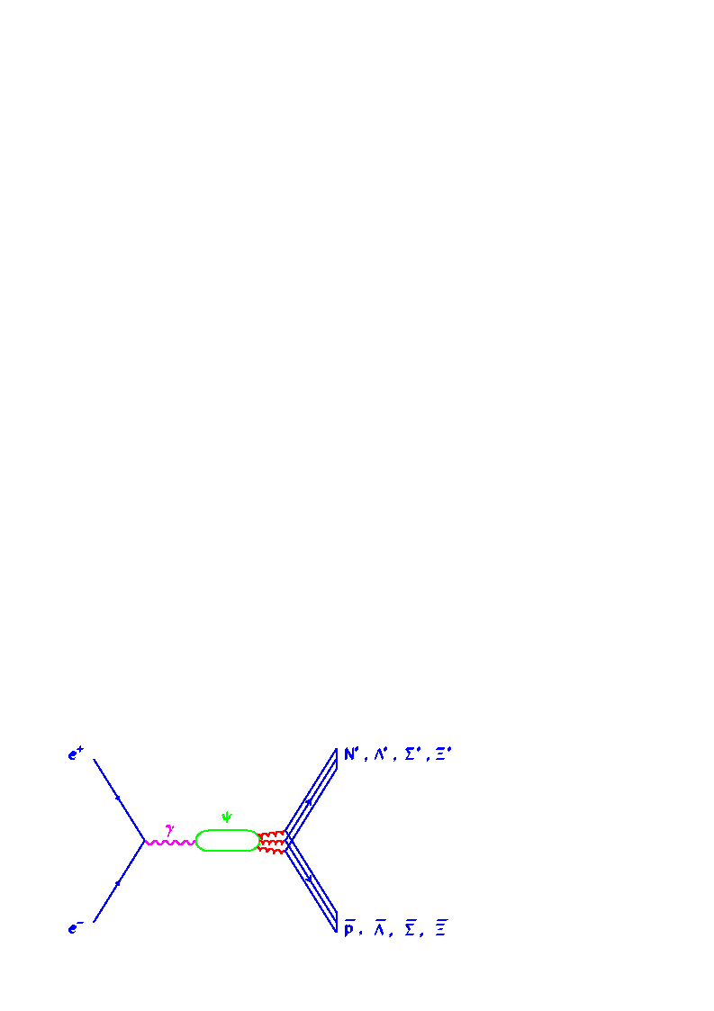
Baryon spectroscopy from J/ψ decays at BES/BEPC
New mechanism for baryon production & an ideal isospin filter
BingSong Zou MENU 07
Notes:
25

Slide 26
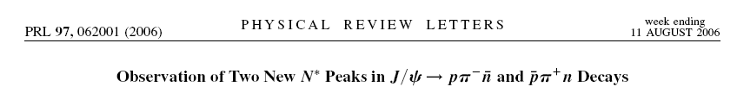
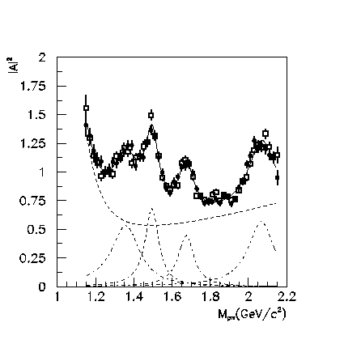
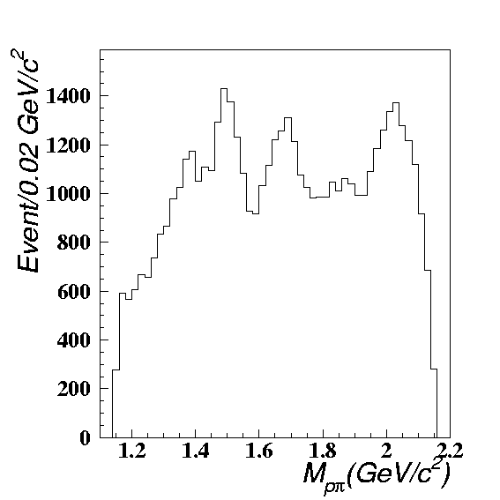
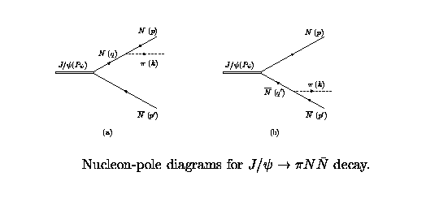
N*(1520)
N*(1535)
N*(1650)
N*(1675)
N*(1680)
Ν∗(1440)
Ν∗(2065)
N*(1440)
?
Off-shell nucleon contribution
BingSong Zou MENU 07
Notes:
26

Slide 27
Space-like q² > 0
Time-like q² > 0
Teresa Peña

Slide 28
q² > 0
−q² = Q² > 0
Teresa Peña

Slide 29
Jim Ritman

Slide 30
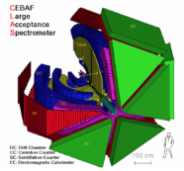
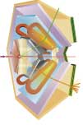
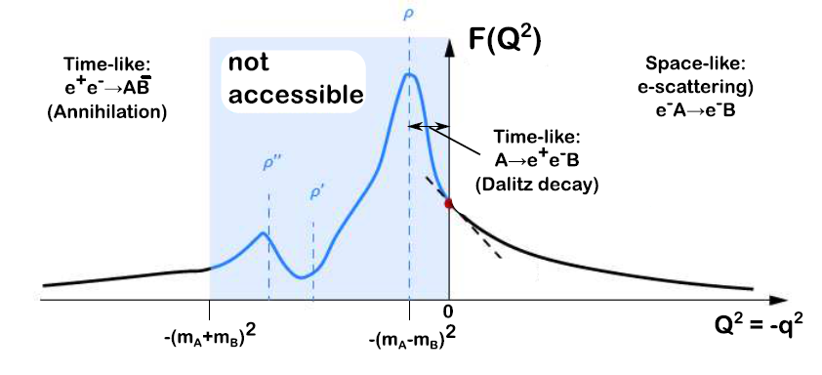
Electromagnetic baryonic transitions in time-like and space-like regions: towards a global picture?
Time-Like electromagnetic form factors
Space-Like electromagnetic form factors
preliminary studies with HADES/GSI
Precise data from JLab/CLAS up to -q²=4 GeV²
F(q²)
n
Inverse pion electroproduction
e⁺
q² <0 fixed
π ⁻
R
γ*
p
γ*
e⁺
R
e⁻
p
e⁻
F(q²)
π⁻
q² =(M _{ee} )²> 0
variable
p
e⁻⁻
Theoretical tools: Dispersion Relations, Dyson-Schwinger, Vector Dominance, Constituent Quarks ?
Béatrice Ramstein

Slide 31
hic sunt dragones
Stefan Leupold

Slide 32
Jim Ritman

Slide 33
Karin Schönning

Slide 34
Karin Schönning

Slide 35
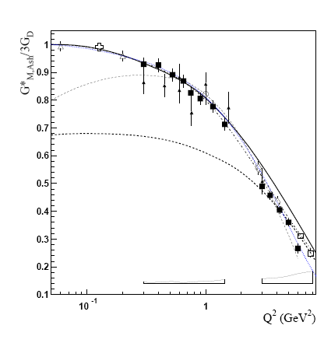

Electromagnetic structure of baryons
Dalitz decays
Δ₃₃ (J=3/2) → N (J=1/2)γ
space-like
N*→Ne+e-
e+e-→NN^{(*)}
e-N→e-N*
„pion cloud”
„quark core”
N
I. G. Aznauryan and V. D. Burkert,
Prog. Part. Nucl. Phys. 67, 1 (2012)
R→ Nγ* : em. Transition Form Factors
R (J≥3/2) : (3) G_{M} (q²), G_{E} (q²) , G_{C} (q²)
R (J=1/2) : (2) G_{M/E} (q² ), G_{C} (q² )
.. or covariant eTFF
for example for J=1/2
„QED”
M. I. Krivoruchenko, et. al
Annals Phys. 296, 299 (2002)
Piotr Salabura

Slide 36

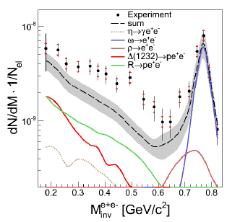
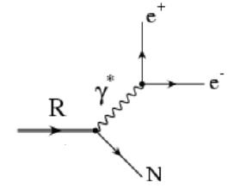
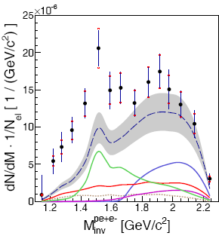
p+p→ppe⁺e⁻ @ 3.5 GeV
HADES coll. EPJA50(2014) 82
„QED” cocktail :
several contributing resonances : N*(1520), N*(1720), Δ(1620), Δ(1905),..
Excess above „QED” cocktail . Seems to originate from N*(1520) region
Piotr Salabura

Slide 37
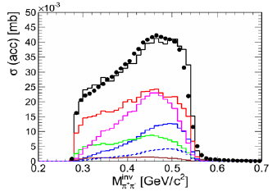
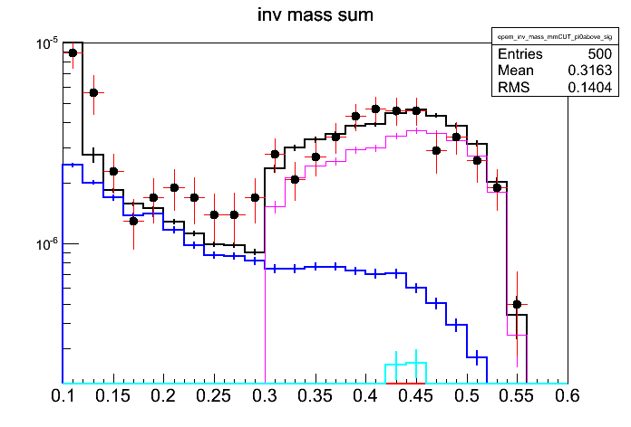
Towards a new extraction of N* couplings in the 2π channel and pioneering studies of time-like electromagnetic transitions (HADES)
Goals: New data for baryon spectroscopy
Hadronic channels (ππ) : Partial Wave Analysis with Bonn-Gatchina model (A. Sarantsev)
4 data samples from HADES (π⁻p→ nπ⁺π⁻ / π⁻p→π⁻π⁰ p ) + photon and pion database
→ e.g. N(1520) branching ratio to Δπ, ρN ,σN
- Electromagnetic channels (e⁺e⁻) Very first information for e.m. transitions in time-like region
Partial Wave Analysis π⁻p→nπ⁺π⁻
√s=1.49 GeV/c²
Quasi-free π⁻p→ne⁺e⁻
In HADES
M_{ππ}
ρ→e⁺e⁻
M_{ee}
Total
π⁰ →e⁺e⁻γ
η→e⁺e⁻γ
N⁰(1520)→ne⁺e⁻
Δ⁰(1232)→ne⁺e⁻
preliminary
ρ→π⁺π⁻
(I=1)
preliminary
M^{inv}_{ππ} ( GeV/c²)
M^{inv}_{ee} ( GeV/c²)
Impact on:
→ Space-like transition form factors extracted from ep → e’Nππ (CLAS data)
→ understand the role of ρ meson in time-like e.m. baryonic transitions (HADES data)
→ medium effects (ρ coupling to baryon resonances)
B. Ramstein

Slide 38
Federico Scozzi

Slide 39
For a nice exposition of spin density matrix elements.
See Bengt Friman’s talk
and
Andrey Sarantsev’s talk

Slide 40

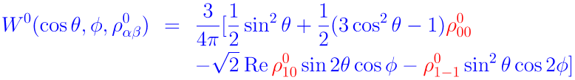
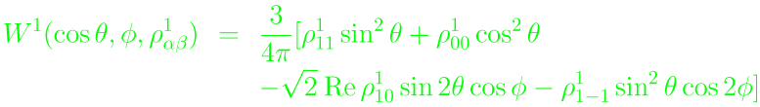
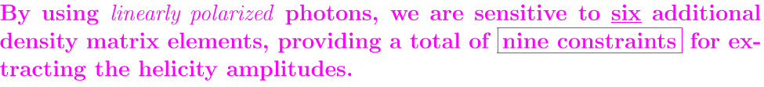

Slide 41

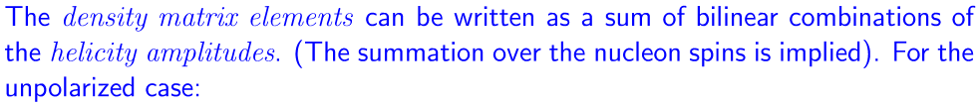


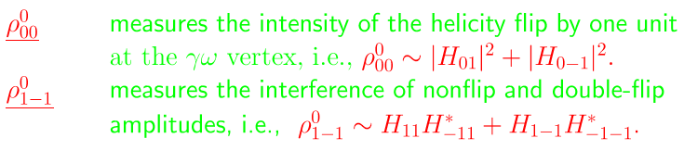

Slide 42
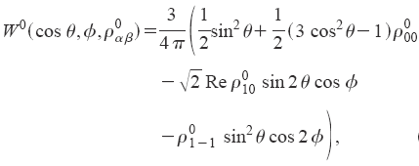
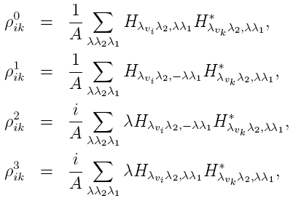
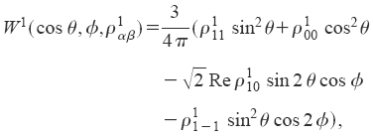






Unpolarized decay distribution:
Linearly-polarized decay distribution:
e.g. The polarized beam asymmetry:
Zhao, Al-Khalili & Cole, PRC71, 054004 (2005); Pichowsky, Savkli & Tabakin, PRC53, 593 (1996)

Slide 43
Andrey Sarantsev

Slide 44
Miklós Zétényi

Slide 45

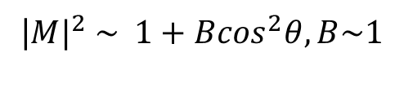
Lepton angular distributions
Lepton emission angles
E. Speranza, B. Friman, M. Zetenyi
Physics Letters B 764 (2017) 282–288
A.Sarantsev to be published
Spin density matrix
for example γ* direction
$$ρ_{λ′,λ}^{had}=\frac{e^{2}}{q^{4}}{ε_{}^{μ}\left(k,λ^{′}\right)H}_{μν}ε^{ν}(k,λ)^{∗}$$
„Helicity frame”
hadron decay to γ*
QED: γ* decay to e+e-
photon polarisation vectors
transverse
longitudinal
transverse
for example for Δ→Ne+e- at small q²
|${M|}^{2} \sim 1+B\cos^{2}θ, B\sim 1$
Piotr Salabura

Slide 46
Federico Scozzi

Slide 47
Federico Scozzi

Slide 48
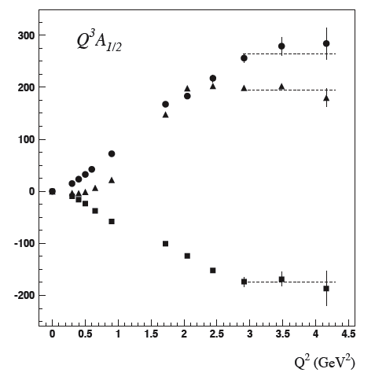
A_{1/2} Electrocouplings
P₁₁(1440)
D₁₃(1520)
S₁₁(1535)
scaled by Q³

Slide 50
Ralf Gothe

Slide 51
Where does the
analysis of the time-like
regime fit in to this scheme?
Ralf Gothe

Slide 52
Lothar Tiator

Slide 53
Lothar Tiator

Slide 54
In this summary of our workshop from
a very biased view of a SL Experimentalist
I have said almost nothing or absolutely nothing on
  Dyson-Schwinger Equation approaches
  Covariant Spectator Theory approach
  PWA approaches
  Phenomenological approaches
  Pion form factors across the q² divide
  Spectral functions
  VDM as commonly understood….
  Lattice QCD
  And probably a host of other very important topics
This leads us to...

Slide 55
Discussion Focus and Ultimate Goals
Establish the nucleon excitation spectrum and reaction models with emphasis on the high-mass region and gluonic excitations;
Measure space-like and time-like baryonic transition form factors, and thereby quantify the role of the active degrees of freedom in the nucleon excitation spectrum;
Pin down the dressed-quark mass as a function of quark momentum, which will critically deepen our understanding of mass generation dynamics and emergence of quark-gluon confinement.
Provide the analysis tools to enable comparisons of future lattice QCD simulations with experimental results.
White Paper

Slide 56
Physics Opportunities with Meson Beams
William J. Briscoe (GW), Michael Döring (GW), Helmut Haberzettl (GW), D. Mark Manley (KSU), Megumi Naruki (Kyoto Univ.), Igor I. Strakovsky (GW), Eric S. Swanson (Univ. of Pittsburgh)
(Submitted on 26 Mar 2015)
Over the past two decades, meson photo- and electro-production data of unprecedented quality and quantity have been measured at electromagnetic facilities worldwide. By contrast, the meson-beam data for the same hadronic final states are mostly outdated and largely of poor quality, or even nonexistent, and thus provide inadequate input to help interpret, analyze, and exploit the full potential of the new electromagnetic data. To reap the full benefit of the high-precision electromagnetic data, new high-statistics data from measurements with meson beams, with good angle and energy coverage for a wide range of reactions, are critically needed to advance our knowledge in baryon and meson spectroscopy and other related areas of hadron physics. To address this situation, a state of-the-art meson-beam facility needs to be constructed. The present paper summarizes unresolved issues in hadron physics and outlines the vast opportunities and advances that only become possible with such a facility.
Such as
Bill Briscoe

Slide 57
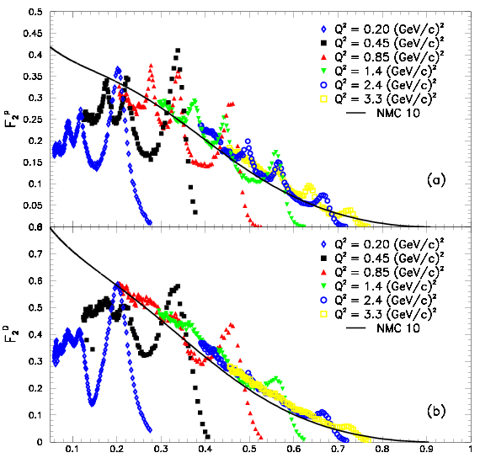
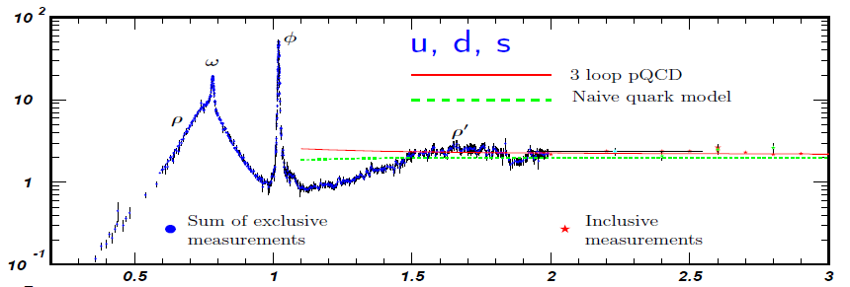
Change in Degrees of Freedom
As function of q²
Spacelike: F₂-Structure Funct.
JLAB
Data
Timelike: e⁺e⁻ → hadrons
p
Im Π_{em}(M) / M²
M [GeV]
d
● Q² _{dual} ~ 2.5-3 GeV²
● depends on channel?
ξ ≈ x
average → Quark-Hadron Duality
lower onset-Q² in nuclei?
Ralf Rapp

Slide 58
Some Questions to Ponder
How to compare Helicity Amplitudes between SL and TL?
Can the data in the SL region afford constraints for those in the TL regime? (e.g. Covariant Spectator Theory, Teresa Peña).
What is the relationship between the density matrix elements for SL → TL? Again do they offer any constraints on the Helicity Amplitudes between the SL and TL regimes?
Will there be scaling in q² > 0 and q² < 0 (i.e. Q² > 0)?
Can we find a consistent ab initio approach for the QCD d.o.f. in determining the SL and TL transition FFs?
What role does the MB Cloud play? (again for SL and TL)? And how to separate? [Through comparing to other models?]
What are the relevant d.o.f. as a function of q² for the SL and TL regimes?

Slide 59
Phil Cole is organizing
a dedicated session on
space-like and time-like
transition form factors.
Ralf Gothe

Slide 60
Additional Slides

Slide 61
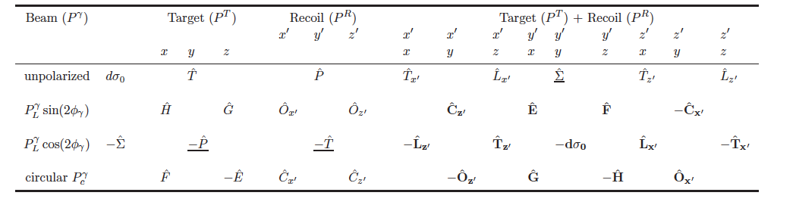
Complete photoproduction experiments
γ + p K⁺ + Λ (pπ⁻)
Process described by 4 complex amplitudes
8 well-chosen measurements are needed to
determine amplitude.
Up to 16 observables measured directly
3 inferred from double polarization observables
13 inferred from triple polarization observables
Λ weak decay has large analyzing power
A. Sandorfi, S. Hoblit, H. Kamano, T.-S.H. Lee, J.Phys. 38 (2011) 053001
Notes:
In the search for new baryon states, complete or over-complete experiments have become the holy grail of baryon analysis. The photo-production of single pseudo-scalar mesons is described by four complex parity conserving amplitudes requiring in principle 8 well-chosen measurements to determine the production amplitudes. If the measurement includes unpolarized cross sections, linearly and circularly polarized photon beams, transverse and longitudinally polarized nucleons, and the measurement of recoil polarizations, then 16 observables can be measured at each energy and polar angle. This is especially the case for hyperon production e.g. K-Lambda, where the parity violating Lambda decay also measures its polarization. These are the qualities shown in the table. These are obviously not independent of each other and can serve as cross check.
For example, from the complete measurement of double polarization observables one can infer the 3 single polarization observables recoil polarization P, target polarization T, and beam asymmetry Sigma….. and from the triple polarization measurements we can infer 12 double polarization observables and the unpolarized cross section. Needless to say, that the precision of the computed quantities will likely not be as high as the direct measurements.

