Slide 1





Dilepton Radiation from compressed Baryonic matter
Joachim Stroth, Goethe University Frankfurt am Main / GSI
Space like and Time like electromagnetic Baryonic transitions
May 8-12, 2017; ECT*; Trento, Italy

Slide 2
Motivation
Spectrometer performance
Strangeness
Virtual Photon Radiation
Future
Summary

Slide 3
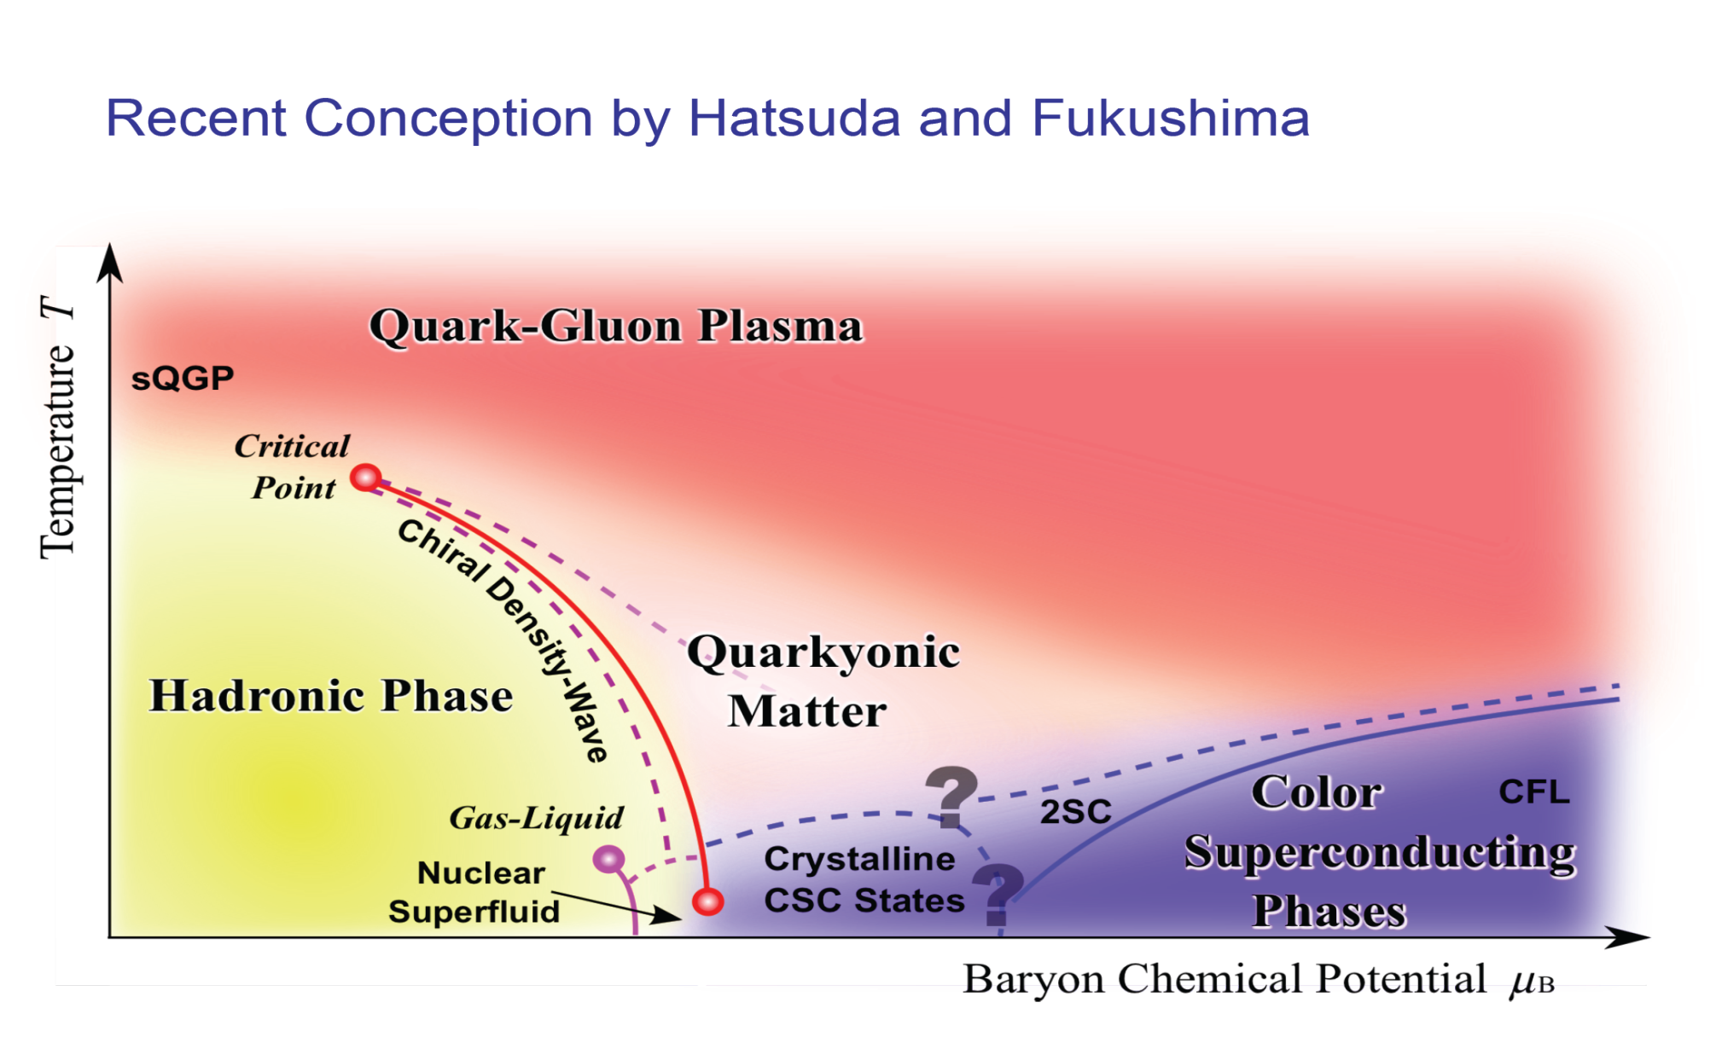
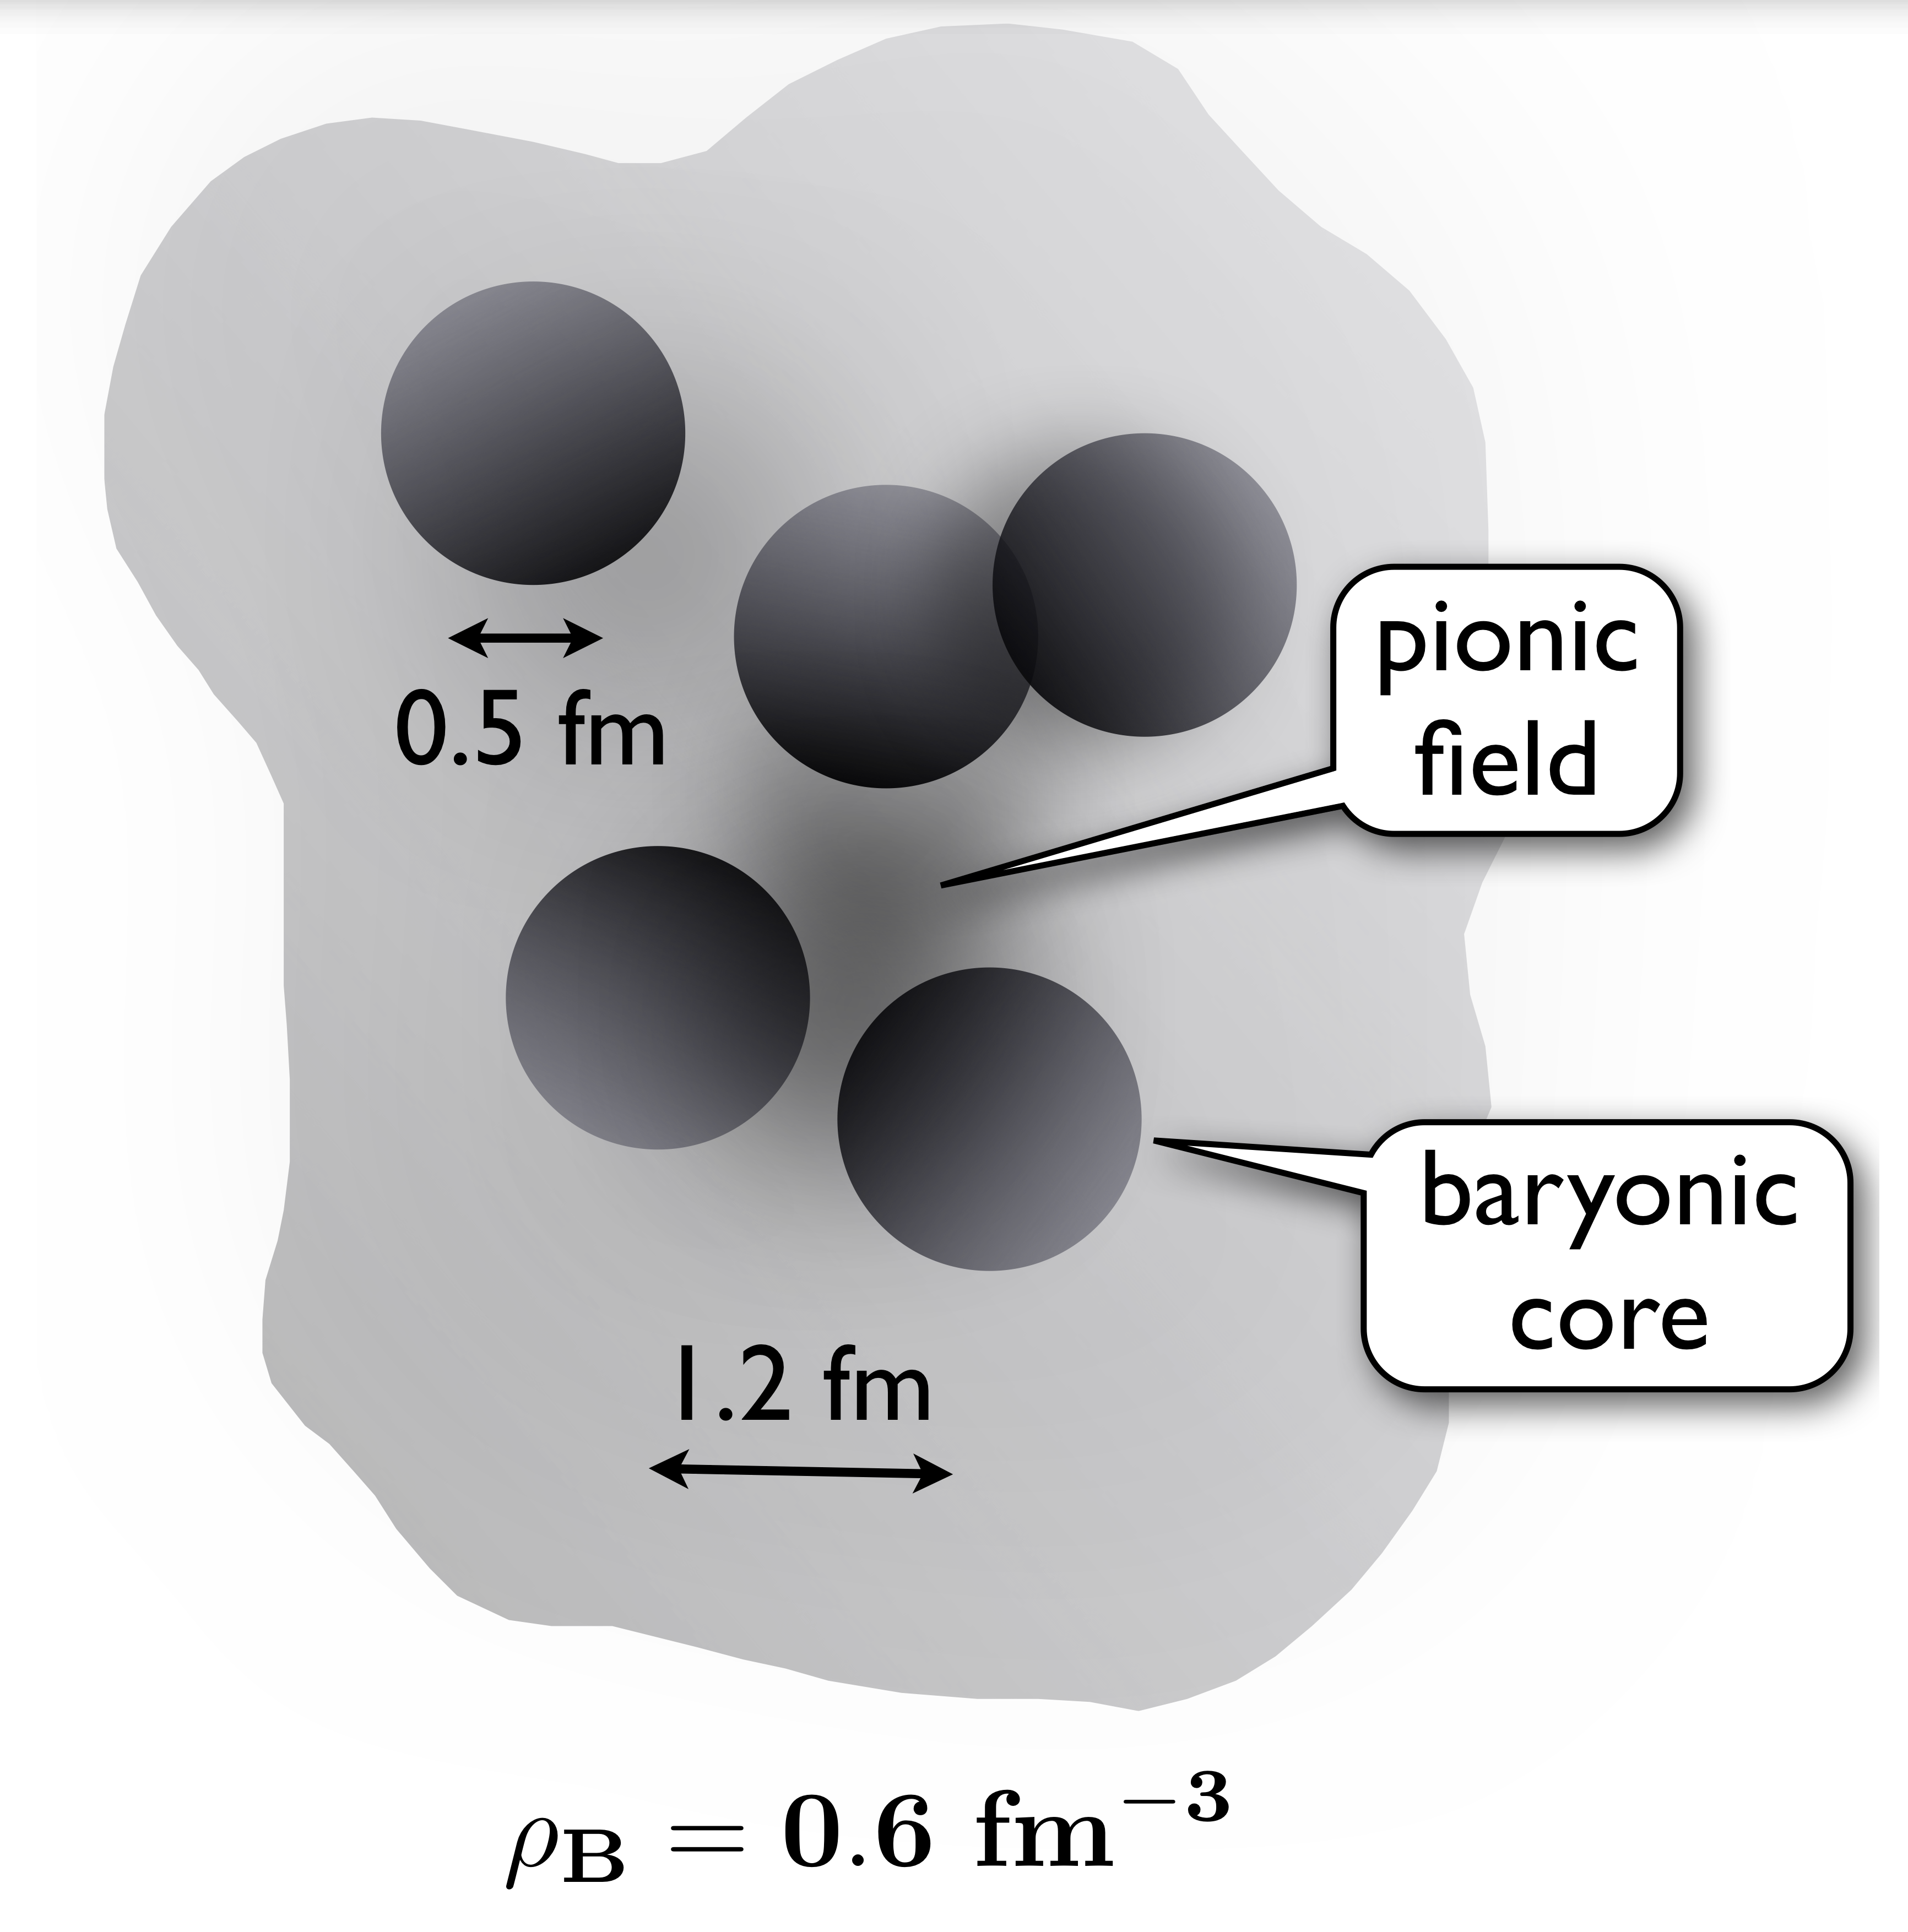
The QCD Phase Diagram
Search for:
  New (exotic) phases
  1. order transition to deconfined matter
  Critical point
  EOS of dense (and hot) QCD matter
Low-temperature approach:
  Chiral perturbation theory
Courtesy of K. Fukushima & T. Hatsuda
J.W. Holt, M. Rho, W. Weise arXiv1411.6681

Slide 4
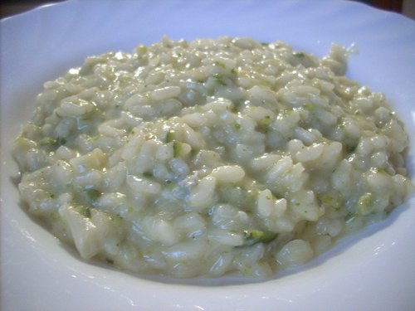
The QCD Risotto …
... what, if you cook it too long !?

Slide 5
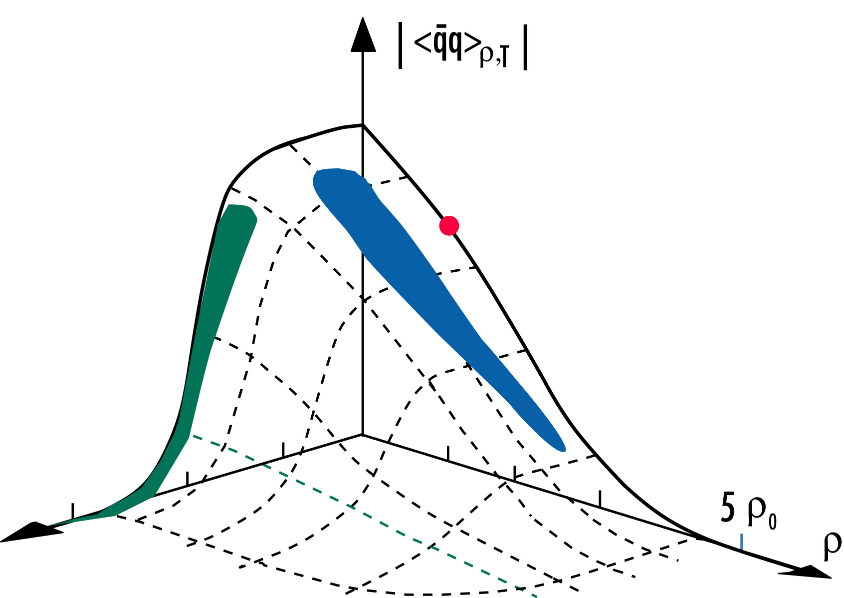
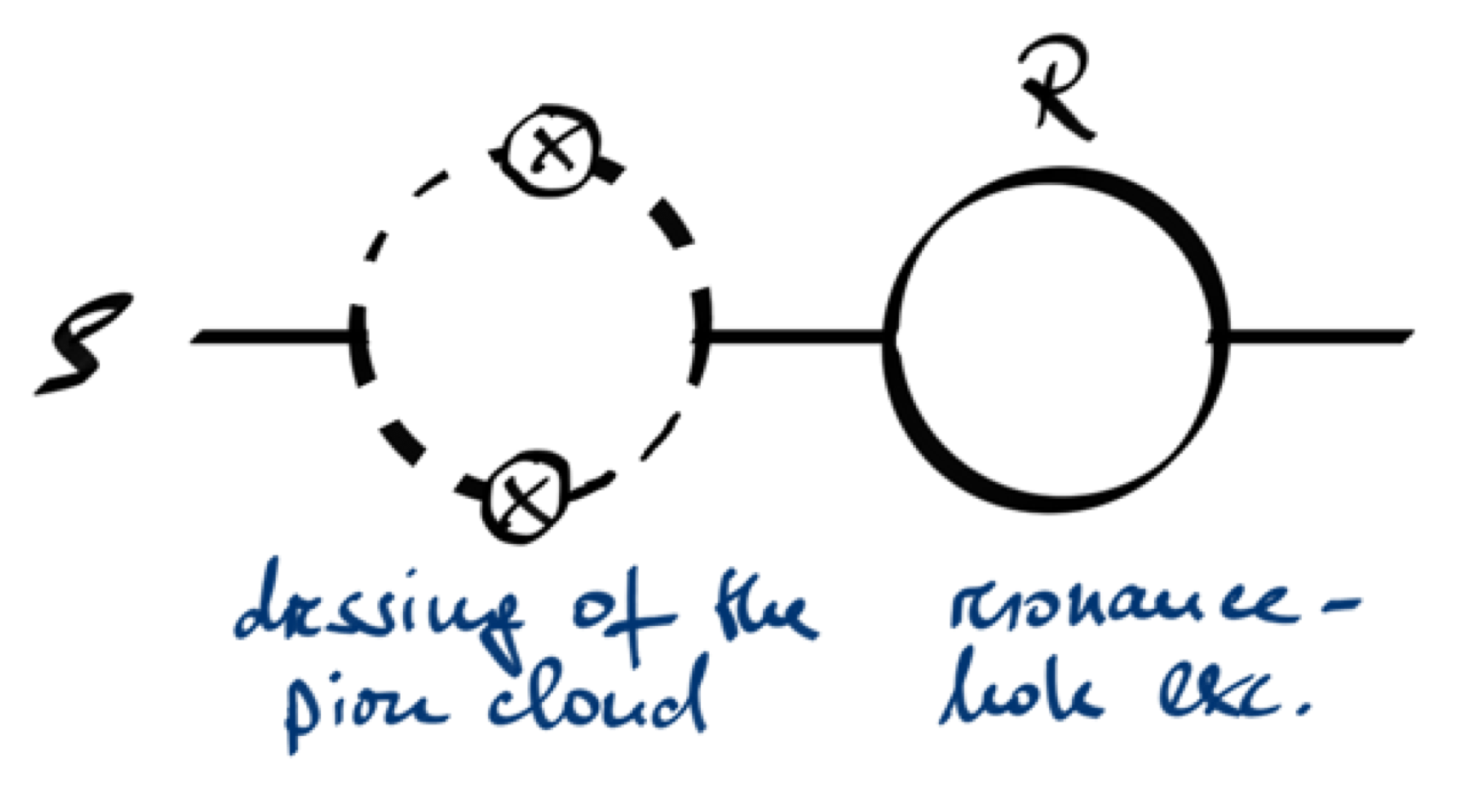
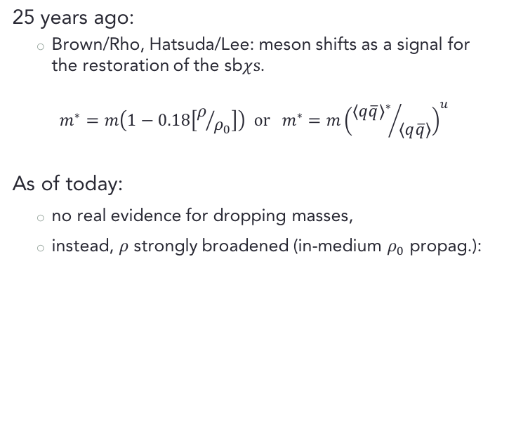
The Quest for In-medium Modifications
25 years ago:
  Brown/Rho, Hatsuda/Lee: meson shifts as a signal for the restoration of the sb$χs$.
$$m^{∗}=m\left(1−0.18\left[ρ/{ρ_{0}}\right]\right) or m^{∗}=m{\left({{\left\langle q\overline{q}\right\rangle }^{∗}}/{\left\langle q\overline{q}\right\rangle }\right)}^{u}$$
As of today:
  no real evidence for dropping masses,
  instead, $ρ$ strongly broadened (in-medium $ρ_{0}$ propag.):
cf. talk by Ralf Rapp

Slide 6
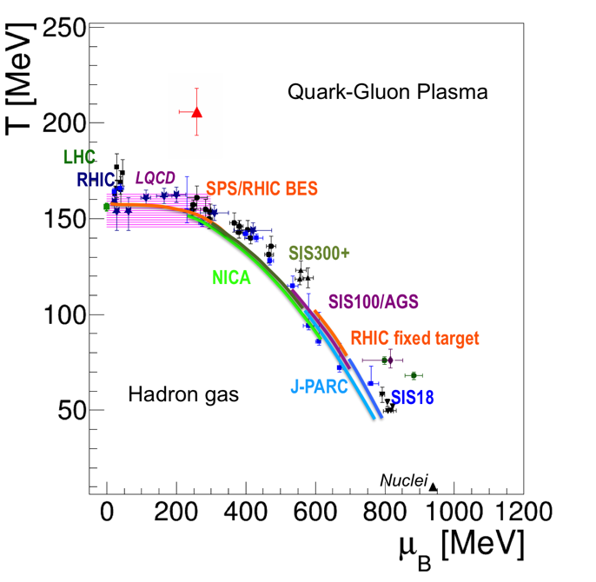
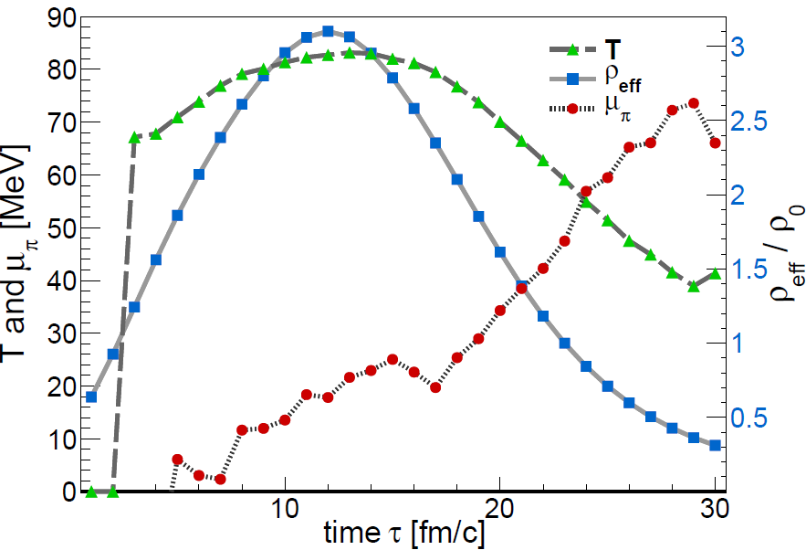
Explore the QCD Phase Diagram at high Density
Heavy-ion collision at SIS18 energies:
  Baryon-dominated system throughout the evolution.
  Comparatively long lifetime of the dense ”fireball”.
  Central cell (3x3x3 fm³) thermodynamic
  properties from coarse graining UrQMD.
Au+Au 1.23A GeV
T. Galatyuk, F. Seck, et al.,arXiv-1512-08688

Slide 7
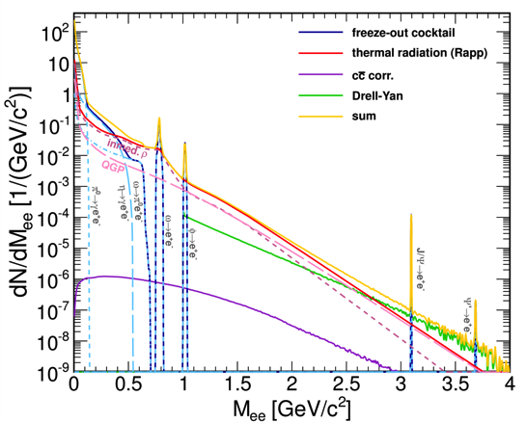
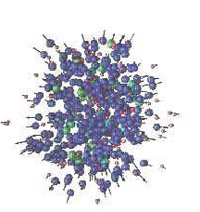


Theoretical Approaches to Medium Radiation
Medium radiation from Thermal Emission Rates:
$$\frac{d^{3}\dot{N}}{dMdydp_{t}dα}≡\int_{t=0}^{∞}{\frac{d^{4}ε}{dp}\left[T\left(x\right),μ_{B}\left(x\right),\vec{v}\left(x\right)\right]}dx$$
coarse graining
isentropic expansion
shining
$$ρ_{0},T_{0},V_{0}$$
UrQMD
Dilepton emission from
Microscopic Transport.

Slide 8
Spectrometer performance

Slide 9
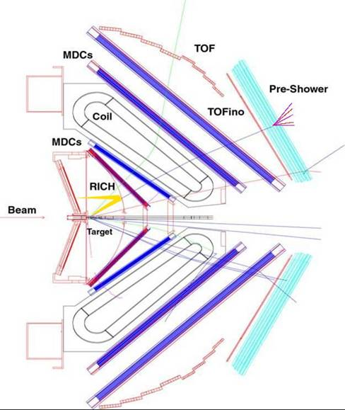
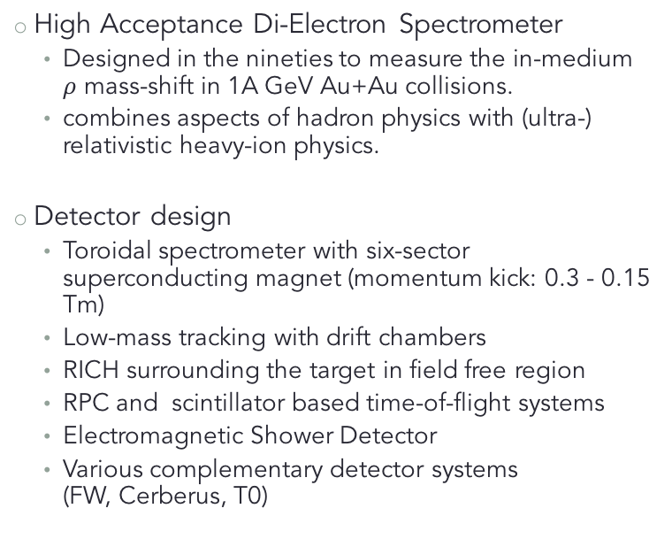
The HADES Spectrometer
High Acceptance Di-Electron Spectrometer
  Designed in the nineties to measure the in-medium
  $ρ$ mass-shift in 1A GeV Au+Au collisions.
  combines aspects of hadron physics with (ultra-) relativistic heavy-ion physics.
Detector design
  Toroidal spectrometer with six-sector superconducting magnet (momentum kick: 0.3 - 0.15 Tm)
  Low-mass tracking with drift chambers
  RICH surrounding the target in field free region
  RPC and scintillator based time-of-flight systems
  Electromagnetic Shower Detector
  Various complementary detector systems
  (FW, Cerberus, T0)
RPC
FW
θ > 7º

Slide 10
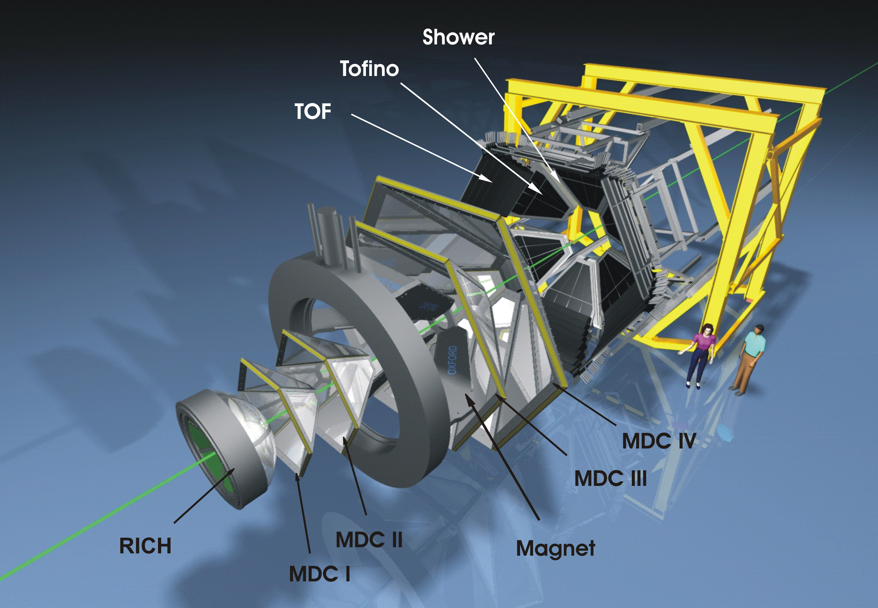
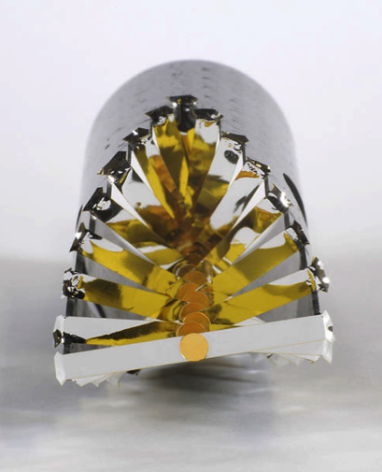
20 mm

Slide 11
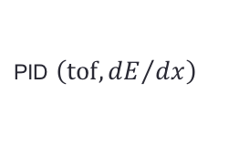

Performance (hadrons)
PID $\left(\text{tof}, {dE}/{dx}\right)$
$$ε_{acc.}×ε_{det.}×ε_{reco.}$$
Large acceptance around mid-rapidity.
Centrality and event plane via forward hodoscope (FW)
reduced acceptance for elementary (exclusive channels)

Slide 12
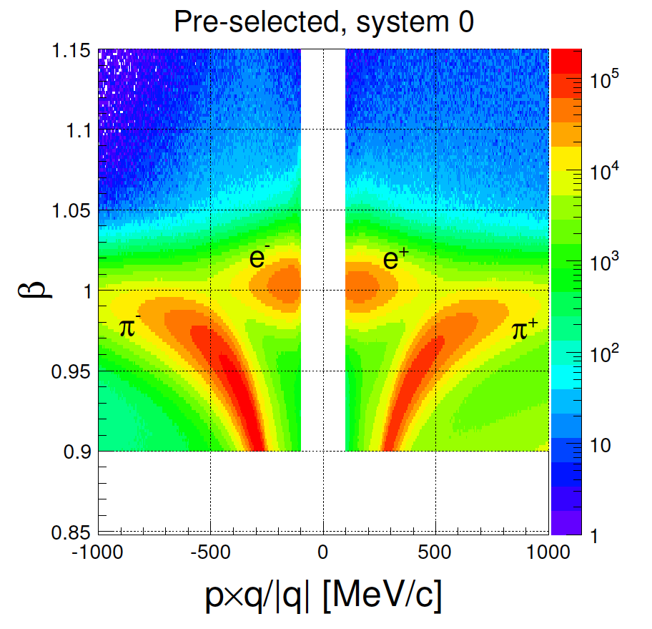
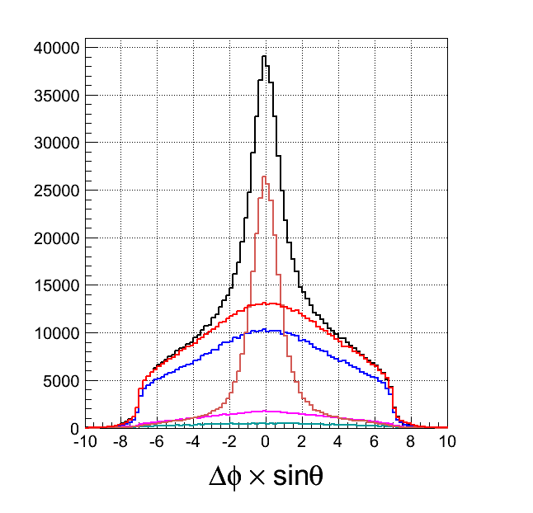
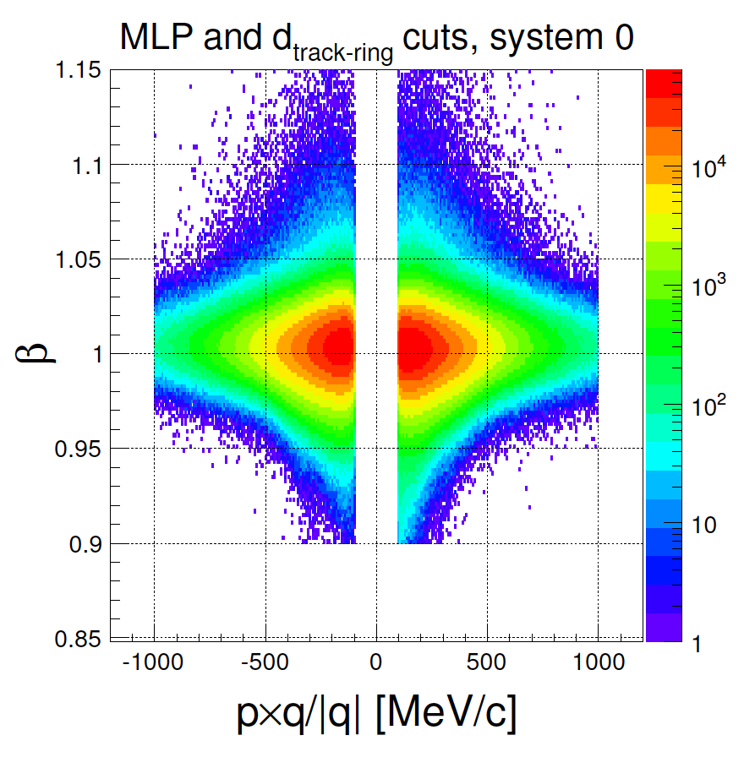
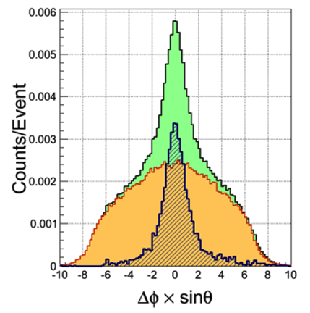
Electron/positron ID
Ring Matching Monte Carlo
Multivariate analysis (neural network) using:
  Particle velocity
  dE/dx in MDC and ToF
  Electromagnetic shower
  Cherenkov radiation
Purity derived from “RICH rotation”
  Random matches
Before PID cuts
Data
0
5
0
1
5
1
4
4
2
2
3
3
After PID cuts
MDC
RICH

Slide 13
Strangeness

Slide 14
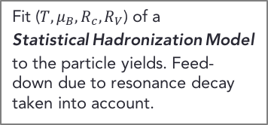
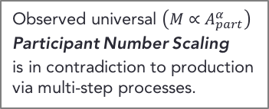
Hadron Production in $Au+Au (\sqrt{s}=2.4 A\text{GeV}$)
Hadron yields and their centrality dependence in accord with the assumption of a ”thermalized” system.
Fit ($T,μ_{B},R_{c},R_{V}$) of a
Statistical Hadronization Model
to the particle yields. Feed-down due to resonance decay taken into account.
Observed universal $\left(M∝A_{part}^{α}\right)$
Participant Number Scaling
is in contradiction to production via multi-step processes.

Slide 15
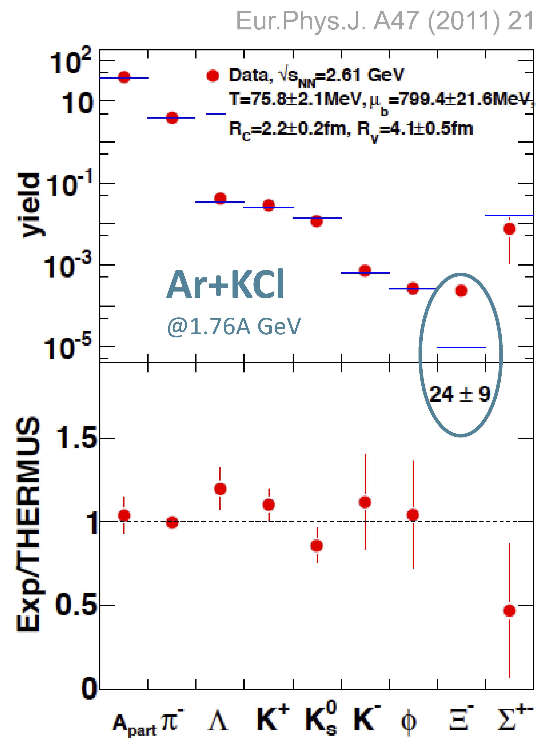
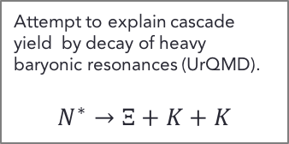
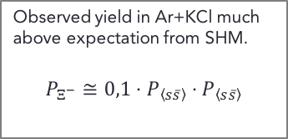
Production of Double-strange Hyperons ($Ξ^{−}$)
Observed yield in Ar+KCl much above expectation from SHM.
$$P_{Ξ^{−}}≅{0,1⋅P}_{\left\langle s\overline{s}\right\rangle }⋅P_{\left\langle s\overline{s}\right\rangle }$$
Attempt to explain cascade yield by decay of heavy baryonic resonances (UrQMD).
$$N^{∗}→Ξ+K+K$$
Jan Steinheimer et al.; arXiv-1503-07305

Slide 16
Dilepton Radiation

Slide 17
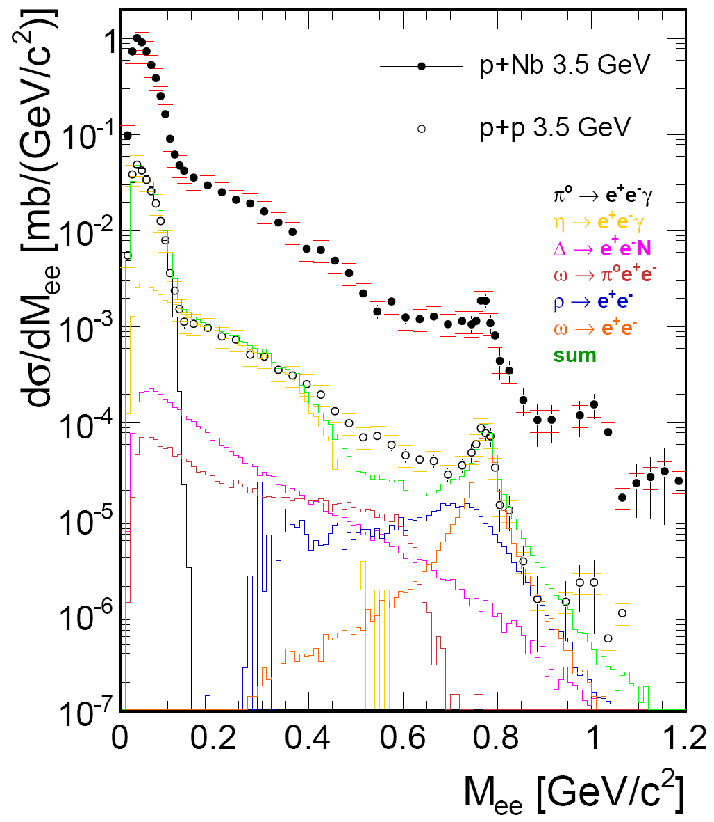
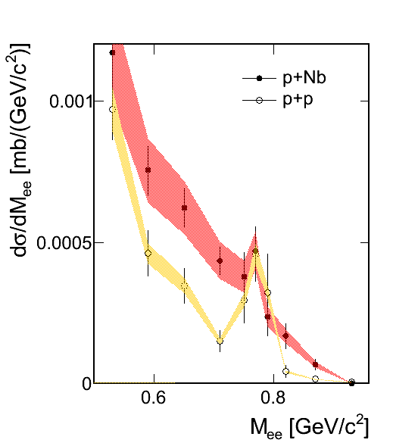
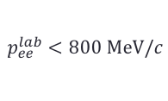

Dilepton emission in pp and pA collisions
First measurement of $ω$ decay in cold matter in the relevant momentum range. Indication for strong broadening of the $ω$.
p+p:
extraction of inclusive cross sections by fitting
conventional sources to the experimental spectrum:
  πº: 17 ± 2.7 ± 1 mb
  Δ: 7.5 ± 1.7 mb
  η: 1.14 ± 0.2 mb
  ω: 0.273 ± 0.07 mb
  ρ: 0.223 ± 0.06 mb
p+Nb:
Strong reduction of the ω peak.
$$p_{ee}^{lab}<800 \text{MeV}/c$$

Slide 18
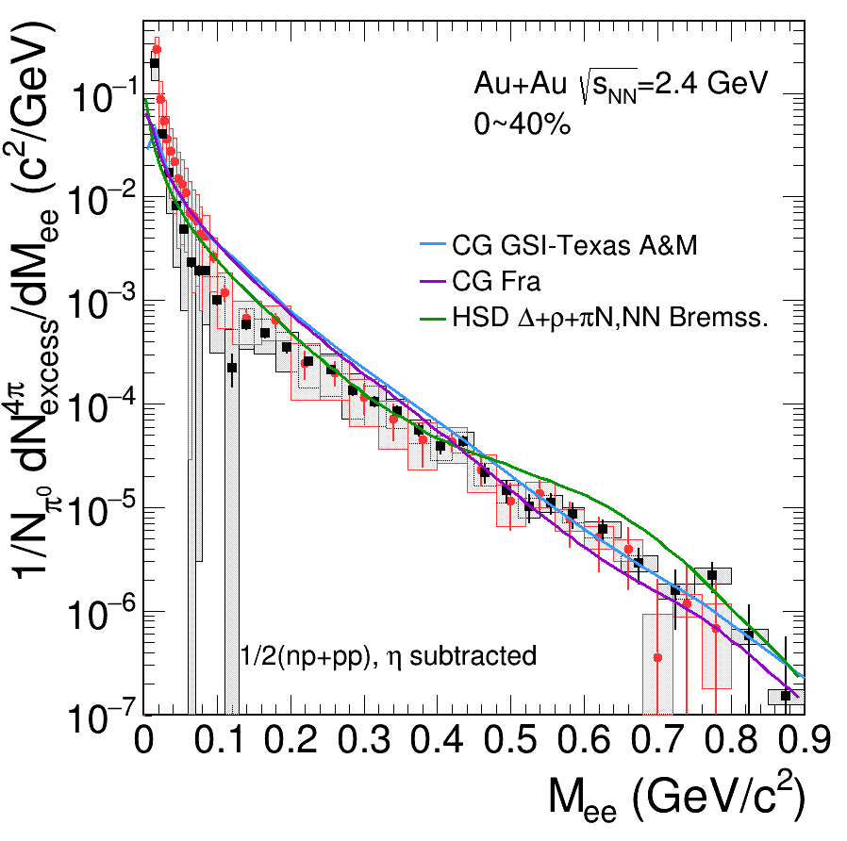

Inclusive Dielectron Yields from $Au+Au (\sqrt{s}=2.4 A\text{GeV}$)
Acceptance corrected excess radiation.
Contributions from first chance and late emission subtracted.
preliminary
preliminary

Slide 19
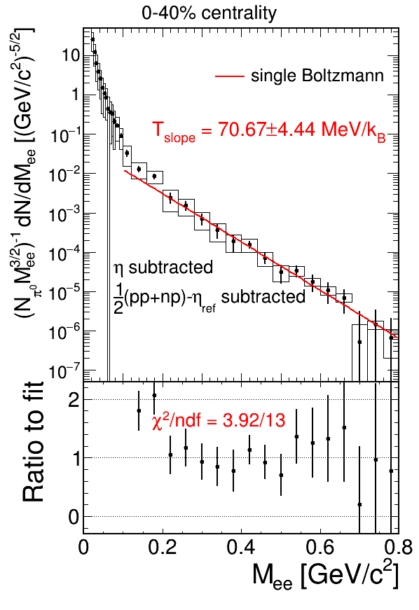
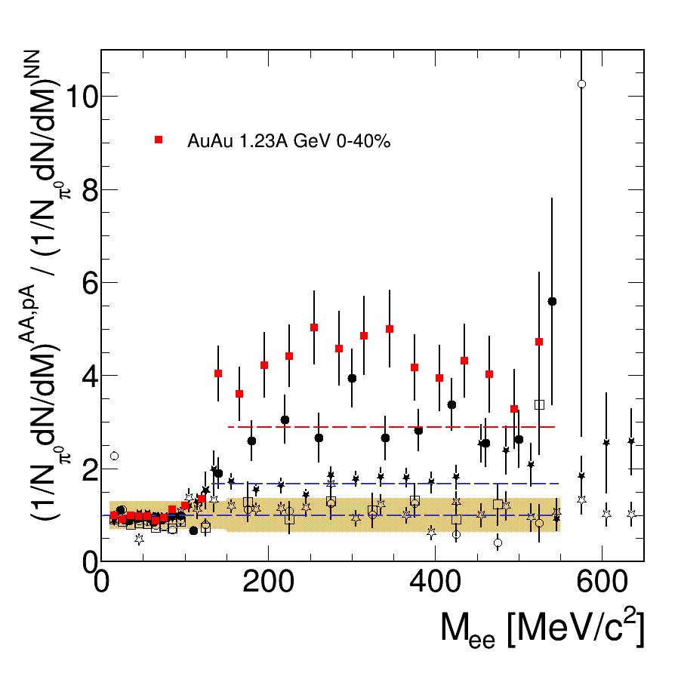



Lifetime & Temperature
Au+Au
Enhancement in the region above 150 MeV/c² reflects generations of resonances before final pion is emitted.
preliminary
preliminary
Residuals
C+C

Slide 20
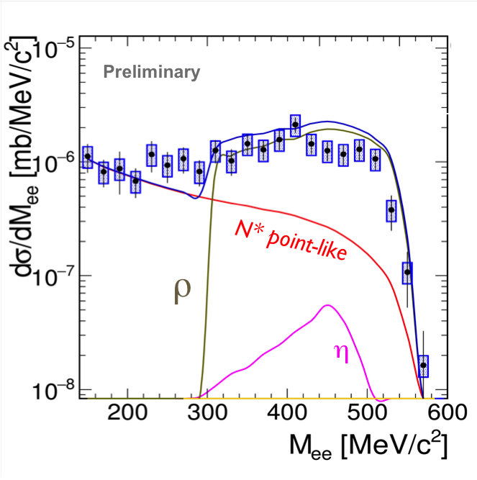
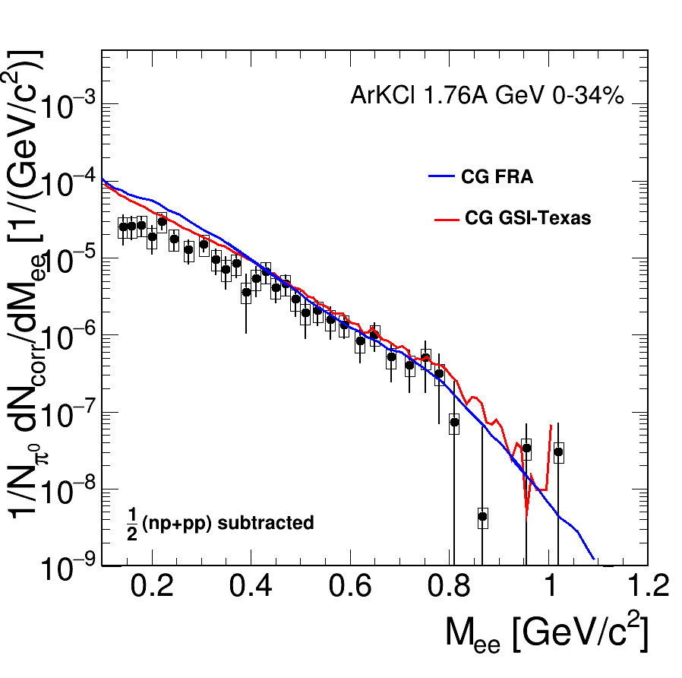
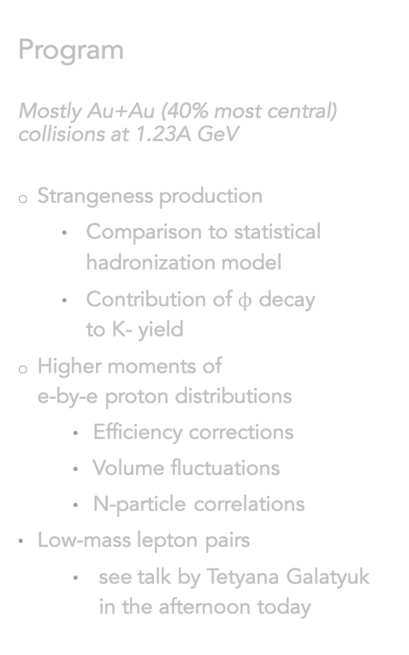

The role of virtual pions in dilepton production
Three different collision systems, three surprises but likely the same underlying mechanism
n
p
$$π^{−}$$
ρ
$$N^{∗}$$
γ∗
ρ
γ∗
γ∗
ρ
p
n
p
n
h

Slide 21
Future

Slide 22
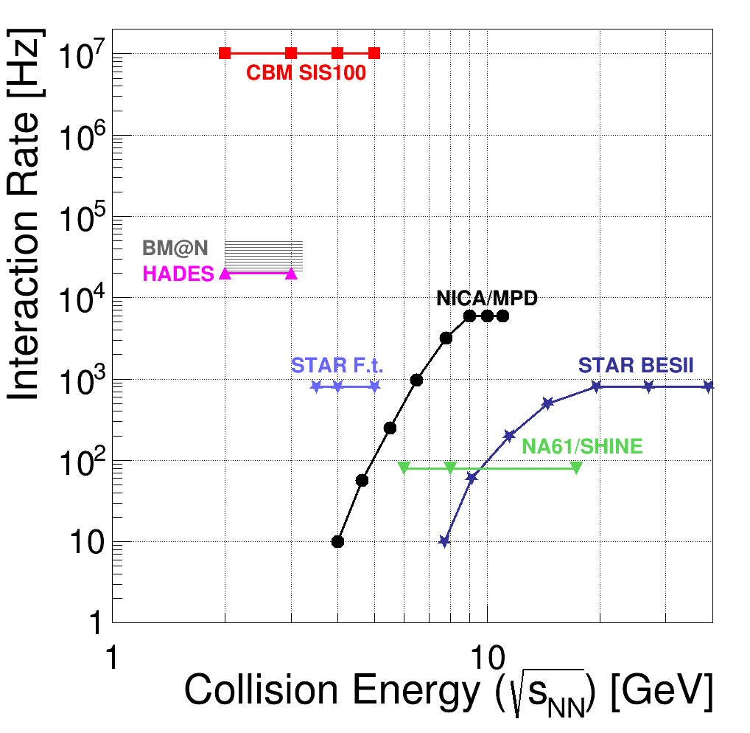
HADES Strategy
Until 2018
(upgrade, preparation for FAIR phase 0)
  Installation of CBM/HADES UV photo-detector and ECAL
  Install new forward detection system, STS and fRPC
2018-202x
(experiment campaign at SIS18 - FAIR phase 0)
  DAQ und MDC FEE upgrade – 200 kHz interaction rate
  Backward neutron detector (neuLAND modules)
  Strong physics program at SIS18, 1 run per year
202x on
(HADES at SIS100)
  Transfer spectrometer to new experimental hall
  Cold matter physics (p+A)
  Exclusive measurements (p+p)
  (A+A collisions for comparison)

Slide 23
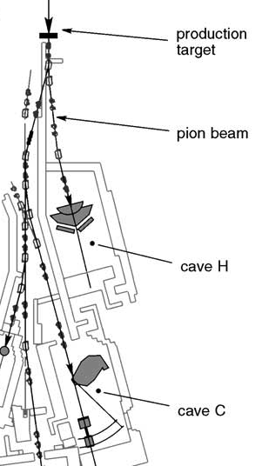
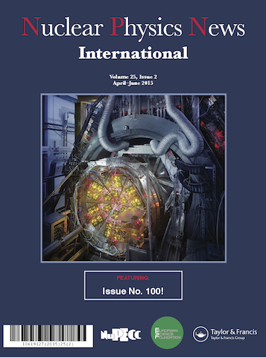
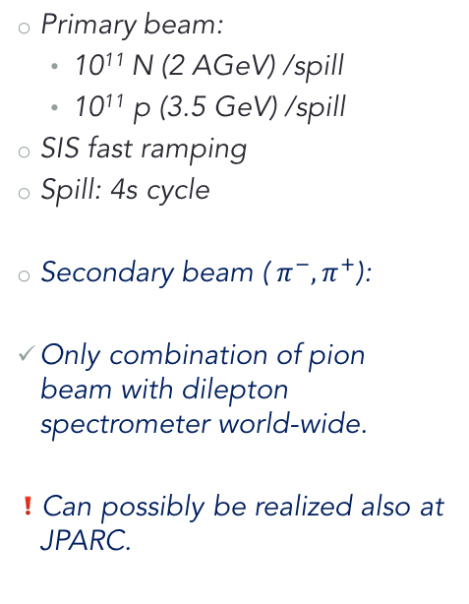
The HADES Pion Beam Facility
Primary beam:
  10¹¹ N (2 AGeV) /spill
  10¹¹ p (3.5 GeV) /spill
SIS fast ramping
Spill: 4s cycle
Secondary beam (${ π}^{−}, π^{+}$):
Only combination of pion beam with dilepton spectrometer world-wide.
Can possibly be realized also at JPARC.
Prog. Part. Nucl. Phys. 42 (1999) 274
Nuclear Physics News 25,2 (2015)

Slide 24
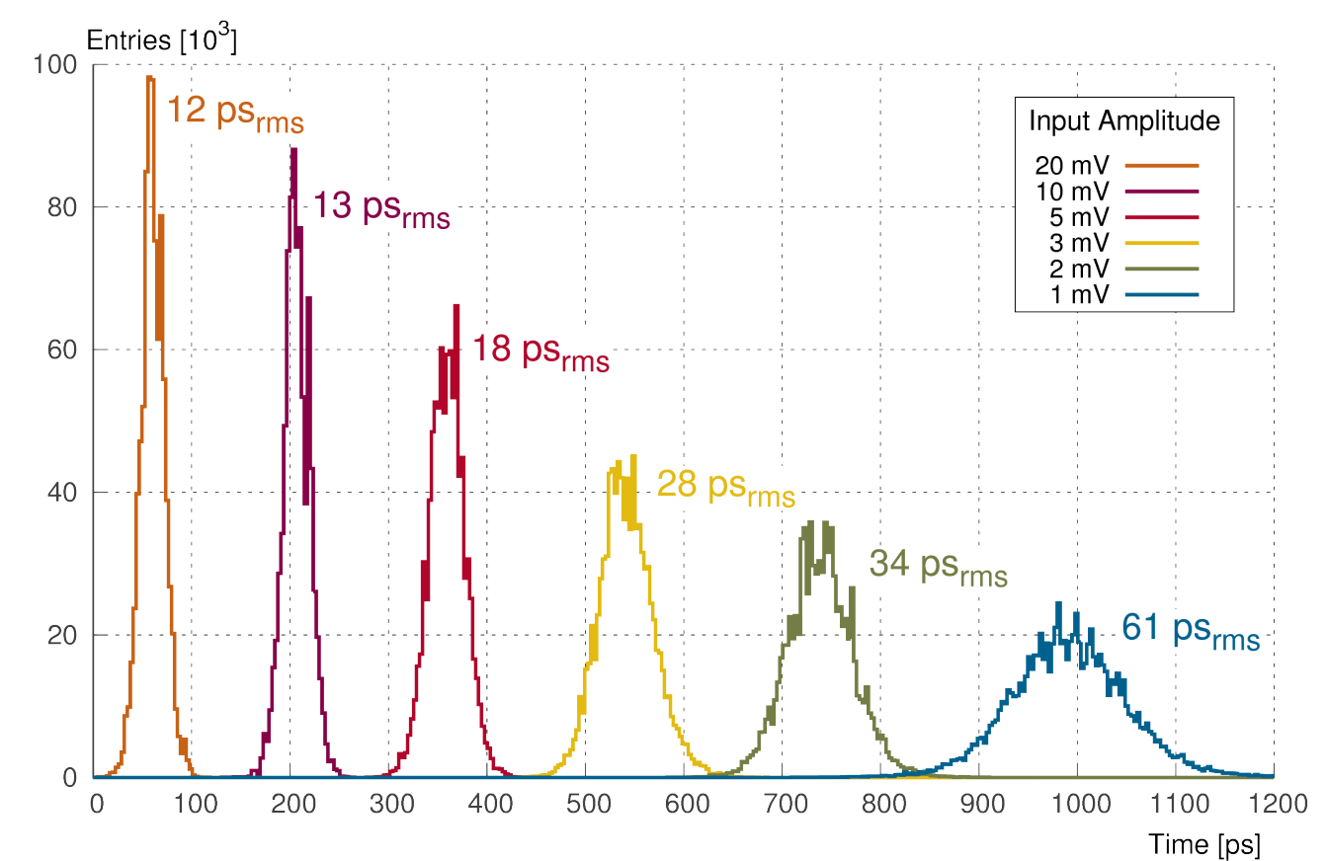
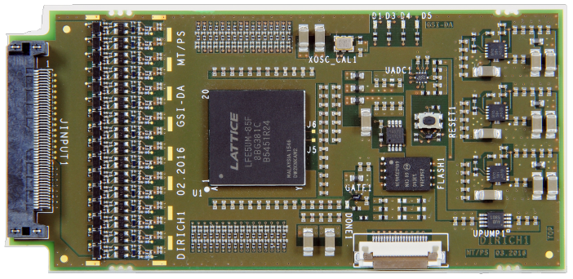
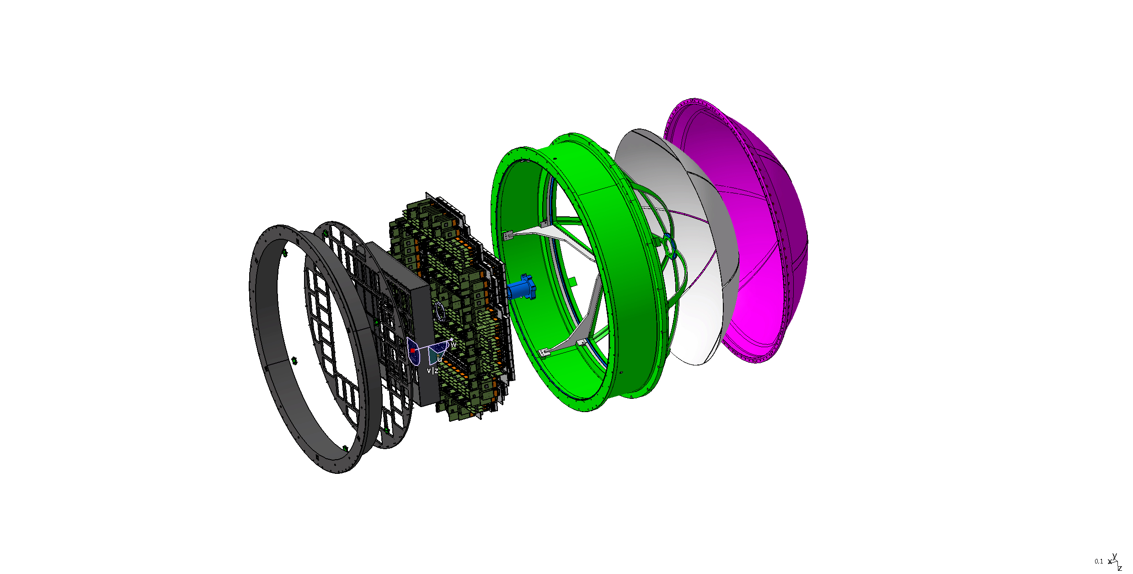
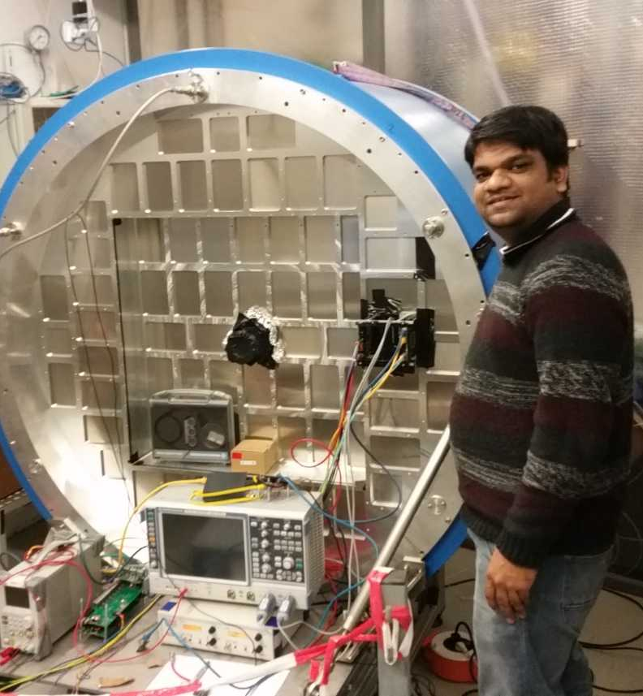
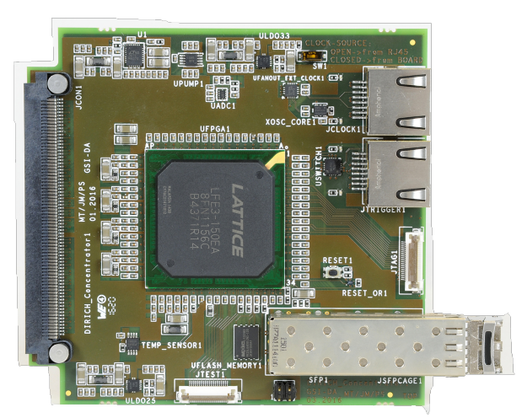
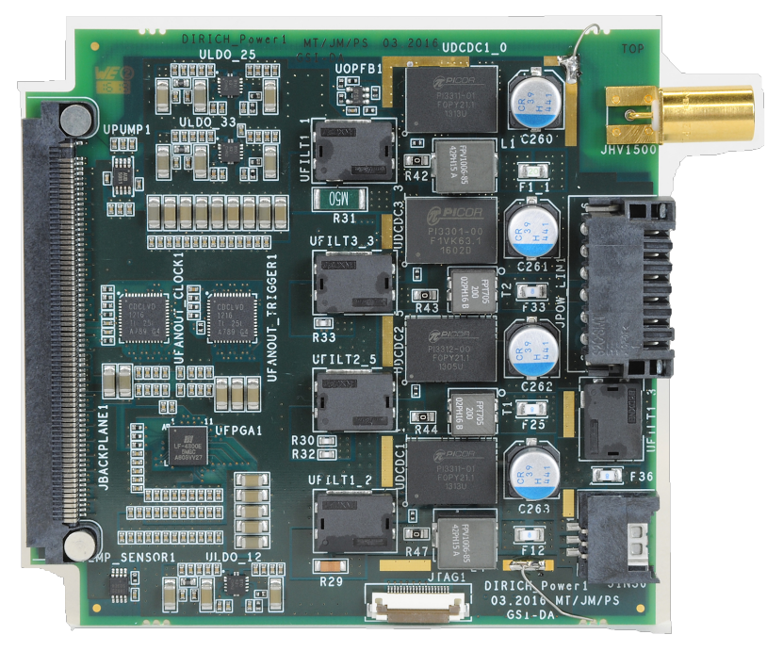
RICH MAPMT UV Detector (with CBM)
Added value
Replaces aging CsI photo detector
will provide substantially improved detection efficiency
MAPMT (Hamamatsu) based detector modules
Joint design and realization effort
Design compatible for use in HADES and CBM RICH

Slide 25
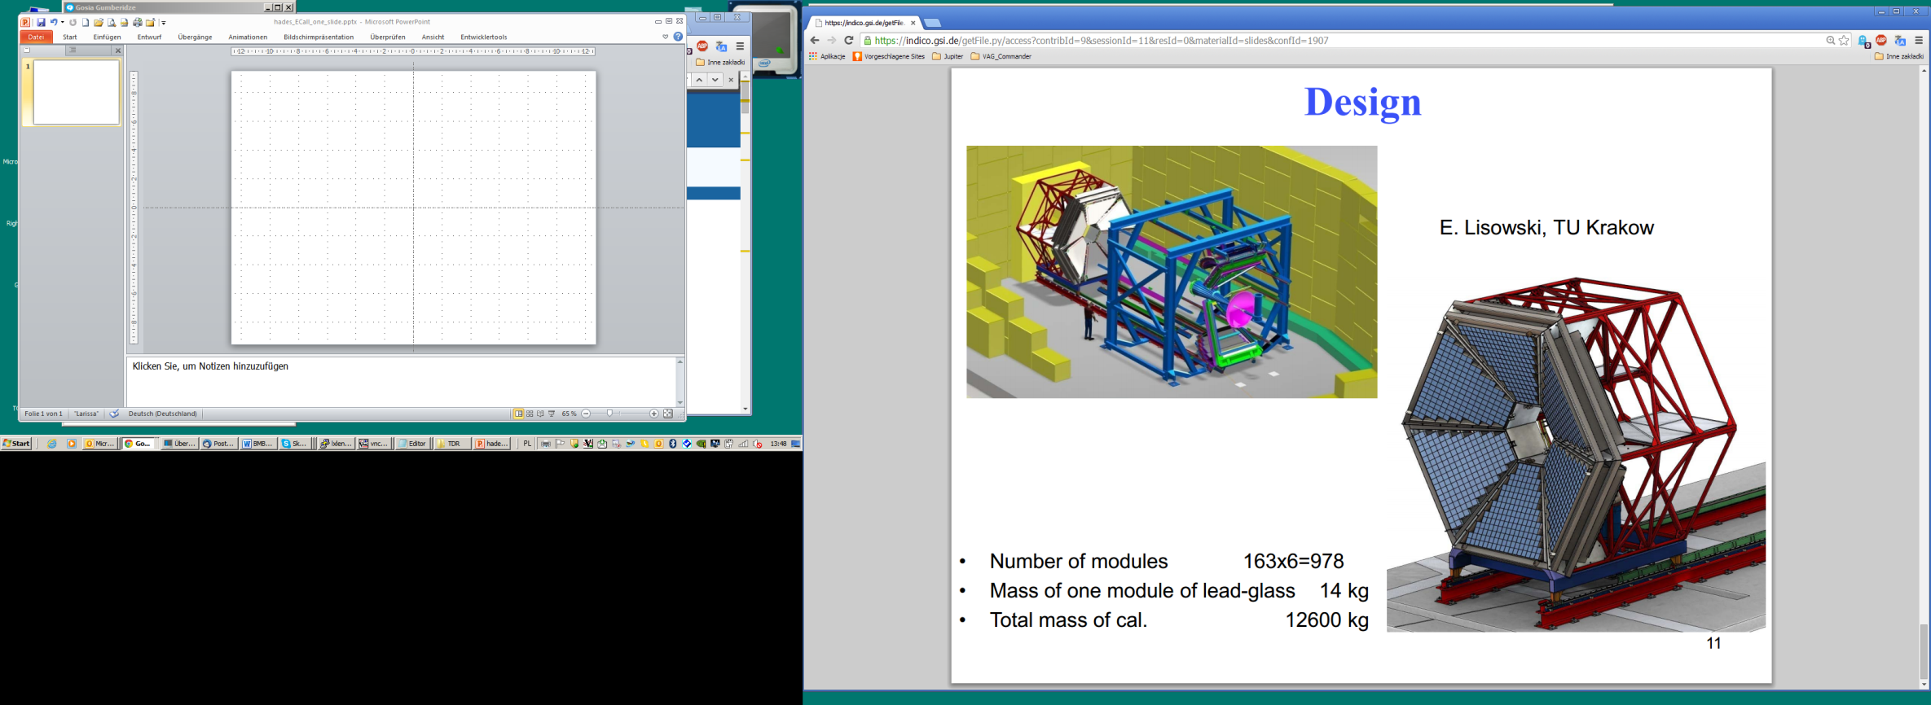
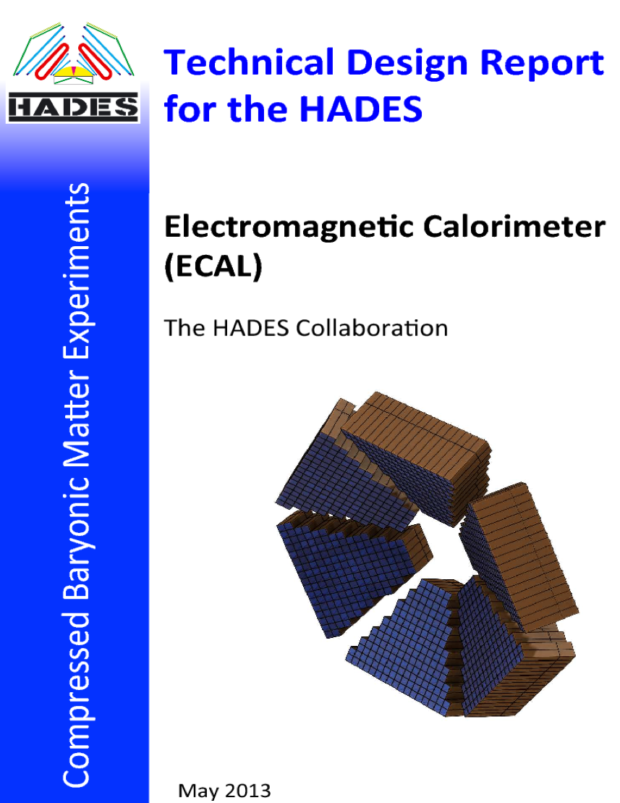

The Electromagnetic Calorimeter
Based on recycled OPAL
lead glass.
TDR approved 2013
Replaces SHOWER
Added value:
  Neutral mesons
  Electromagnetic decays of baryons / hyperons
  Augments e⁻ e⁺ identification

Slide 26
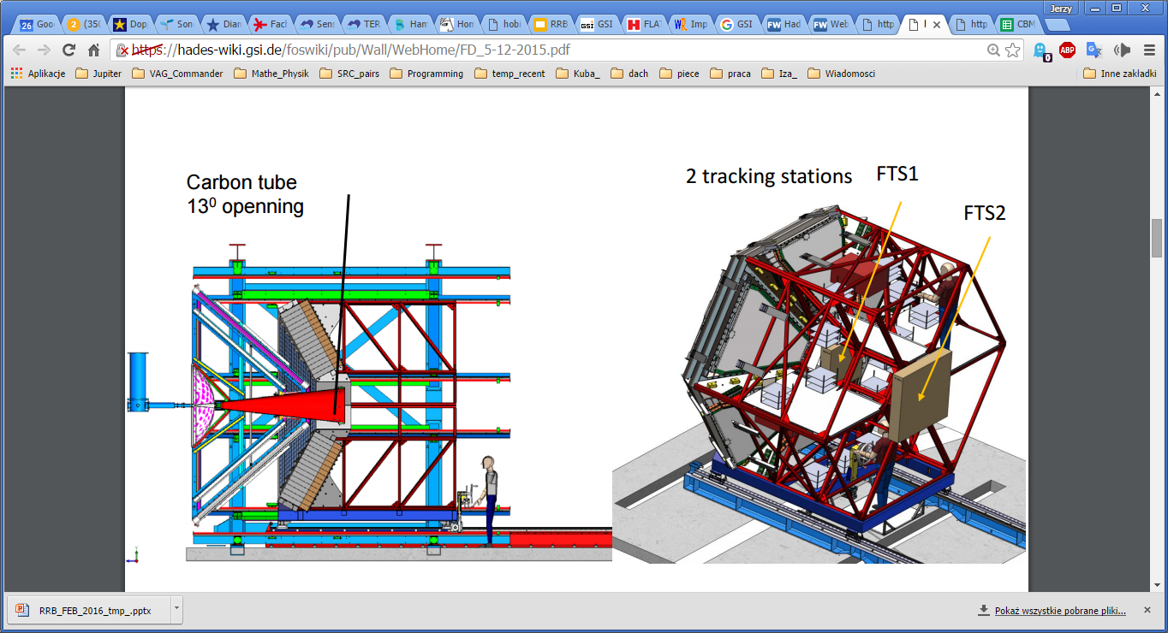
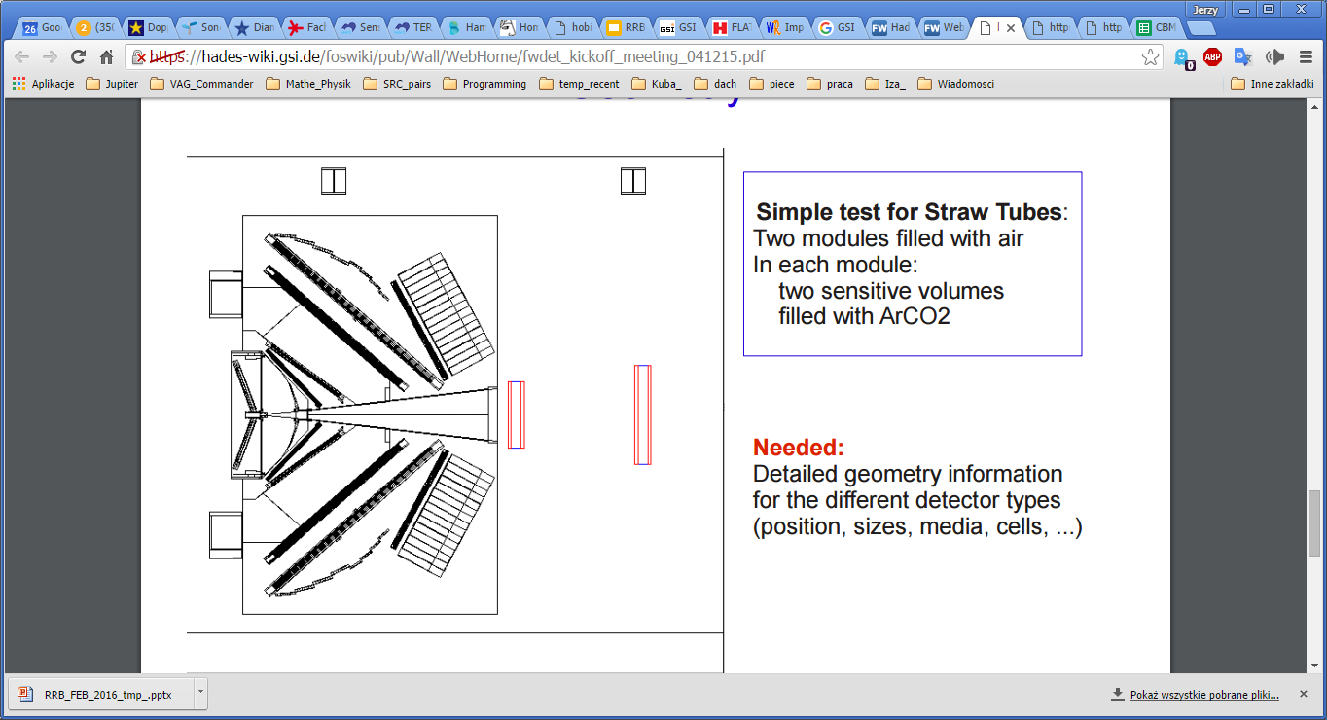
Forward detector system (with PANDA)
dE/dx via ToT
Added value
Substantially increased acceptance for exclusive channels.
Will not be used for A+A runs.
Tracking stations (FTS1, FTS2) based
on PANDA Straw technology
Forward TOF based on RPC
prototypes developed for neuLAND.
HADES acceptance: 18º<θ<85º
FDetector acceptance: 0.5º<θ<6.5º

Slide 27



HADES Program for Phase-0
SIS18
Electromagnetic structure of baryons in the time-like region.
Strangeness in (baryonic, non-strange) resonances.
Excitation spectrum of strange resonance.
Microscopic structure of dense & hot matter and cold matter (SRC).
Signatures for exotic properties of dense baryonic matter.
$$π,p→PE$$
$$π,p→A$$
$$A→A$$
Program will be optimized w.r.t. beam time available, accelerator performance, spectrometer upgrade

Slide 28
The HADES Collaboration

