Slide 1
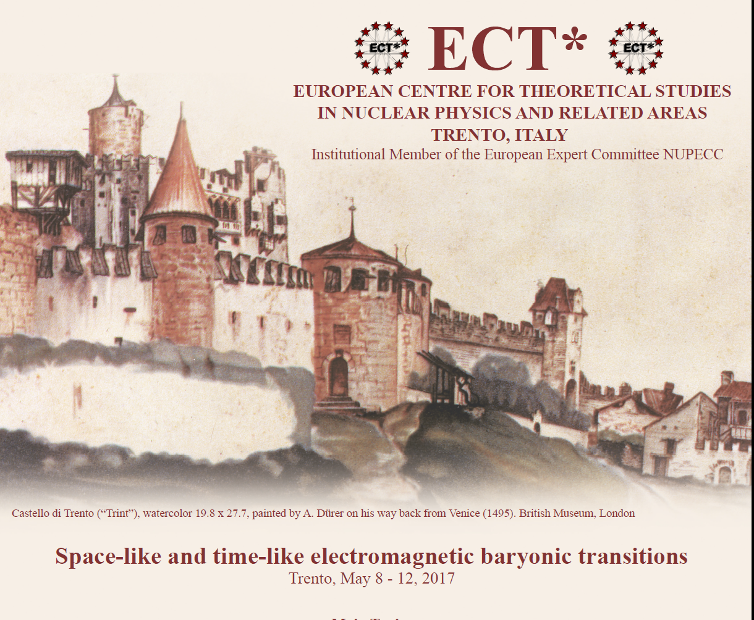

Slide 2
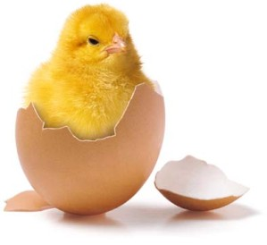
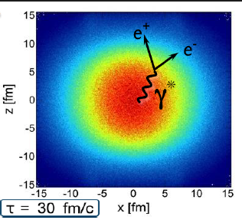
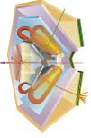
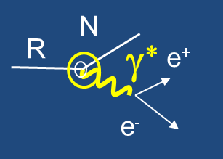
Genesis of the meeting
Discussions related to the interpretation of the HADES results
e⁺e⁻ and meson (π, η, ρ, ω, φ, Κ ) production in hadronic reactions (E/A ~1-3 GeV)
HADES@GSI
Hadronic matter studies
proton, pion, light
and heavy ion beams
Time-like
electromagnetic
transitions
LH2 (p) or nuclear targets
Hadronic channels
in πp reactions
e.g. π⁻ p → π⁺π⁻ n
π⁻ π°p
Baryon spectroscopy

Slide 3
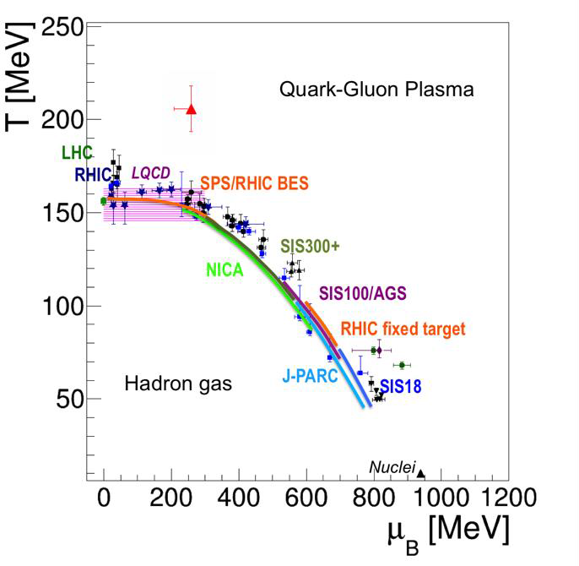
Connecting hadronic matter studies and baryon spectroscopy
e⁺e⁻ emission as a probe of hadronic matter
Role of ρ coupling to baryons in hadronic matter emissivity at different temperatures
Connection with chiral symmetry restoration via QCD sum rules
Constraints from baryon spectrocopy

Slide 4
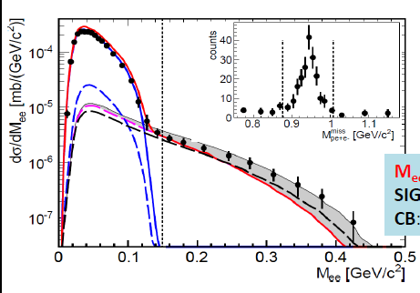
Pioneering studies of Time-like baryon transitions
Dalitz decay (N*/Δ→ Ne⁺e⁻ ) of baryonic resonances excited in pp/pn and πp
π° Dalitz
Δ(1232) Dalitz decay first measurement
Sensitivity to N-Δ(1232) electromagnetic
form factor
Δ Dalitz
On-going studies of e⁺e⁻ invariant masses
and angular distributions in $N$ reactions
in the region of N(1520)
q²=
Promising studies ….. but still a long way to go before a real extraction
of form factors in the Time-like region

Slide 5
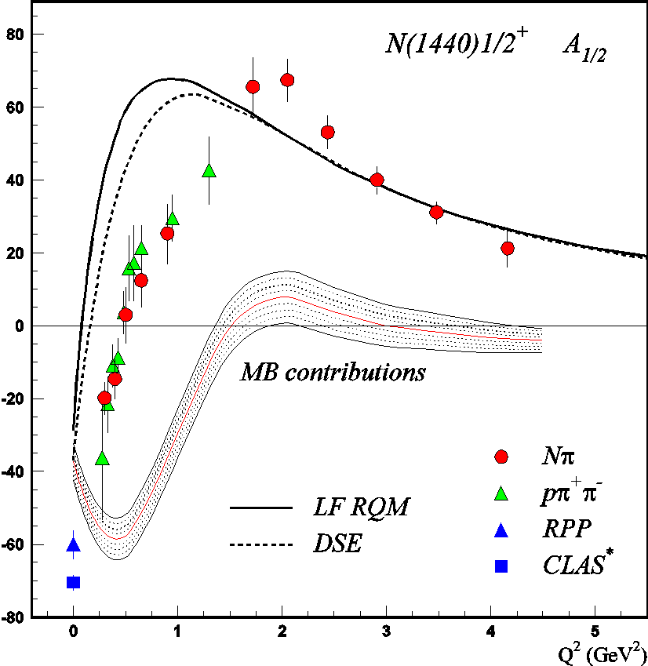
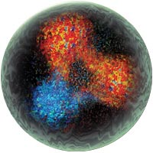
High precision studies in the Space like region
Broad range of q²
To be pursued at large q2
at JLab12GeV
Different decay channels
Variety of models
V. D. Burkert, Baryons 2016

Slide 6
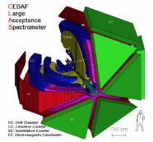
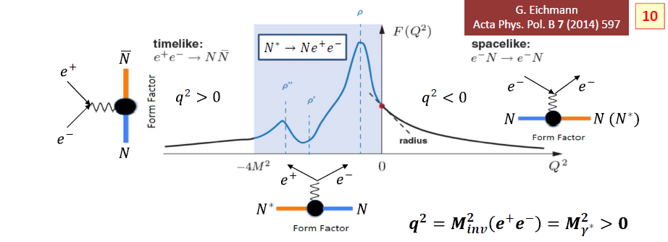
Electromagnetic baryonic transitions in Time-Like and Space-Like region: towards a global picture ?
Time-Like electromagnetic form factors
Space-Like electromagnetic form factors
Precise data from JLab/CLAS up to -q²=4 GeV²
No data
Inverse pion electroproduction
e⁻
q² <0 fixed
F(q²)
n
π ⁻
R
γ*
p
γ*
e⁺
R
e⁻
p
e⁻
F(q²)
π⁻
q² =(M _{ee} )²> 0
variable
p
e⁻⁻
Theoretical tools: Dispersion Relations, Dyson-Schwinger, Vector Dominance, Constituent Quarks ?

Slide 7
Baryon spectroscopy
Modern tools for N* and Δ* studies (amplitude analysis, reaction theory, dispersion relations, DSE, LQCD,…)
High quality data from electron and photon scattering (polarization is crucial)
Pion beam data incomplete and/or of poor quality:
new data from HADES:2π production channels in the N(1520) region and extension foreseen to η,ω, K production channels
soon studies at JPARC
Consensus of the baryon spectroscopy community: Physics opportunities with meson beams - Briscoe, William J. et al. Eur.Phys.J. A51 (2015) no.10, 129

Slide 8
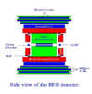
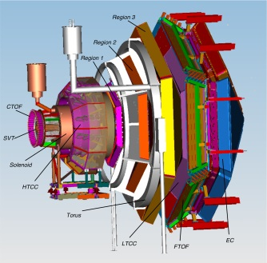
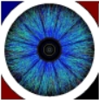
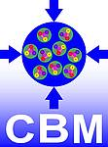
Many running experiments and new projects
BESIIII
MAMI
CLAS12@Jlab12GeV
HADES
STAR
Physics opportunities with meson beams - Briscoe, William J. et al. Eur.Phys.J. A51 (2015) no.10, 129

Slide 9
The « structure » of our workshop
Baryon spectroscopy
Experiment
Theory
Medium effects
Time like electromagnetic structure
Space like electromagnetic structure
Unified description
+ discussion sessions
Future studies

Slide 10
World class speakers
Vladimir Braun (University of Regensburg)
William Briscoe (George Washington University)
Susanna Costanza (University of Pavia)
Annalisa D’Angelo (University of Rome)
Chaden Djalali (University of Iowa)
Michael Döring (George Washington University)
Christian Fischer (University of Giessen)
Bengt Friman (TU Darmstadt)
Tetyana Galatyuk (TU Darmstadt)
Leonid Glozman (University of Graz)
Ralf Gothe (University of South Carolina)
Helmut Haberzettl (George Washington University)
Kenneth Hicks (Ohio University)
Kyungseon Joo (University of Connecticut)
Hiroyuki Kamano(Osaka University)
Eberhard Klempt (University of Bonn)
Mikhail Krivoruchenko (ITEP, Moscow)
Victor Nikonov(University of Bonn and PNPI, Gatchina)
Teresa Pena (IST Lisbon)
Ralph Rapp (Texas A&M University)
Hiroyuki Sako (JAEA)
Piotr Salabura (Jagiellonian University in Krakow)
Toru Sato (Osaka University)
Hartmut Schmieden (University of Bonn)
Federico Scozzi (IPN Orsay and TU Darmstadt)
Kirill Semenov-Tian-Shansky (PNPI Gatchina)
Igor Strakovsky (George Washington University)
Joachim Stroth (Goethe University Frankfurt)
Annika Thiel (University of Bonn)
Lothar Tiator (University of Mainz)
Ralf-Arno Tripolt (ECT* Trento)
Jochen Wambach (TU Darmstadt and ECT* Trento)
Miklos Zetenyi (WRCP Budapest and EMMI Darmstadt)
Qiang Zhao (IHEP-Beijing)
Thanks for your support and participation !

Slide 11
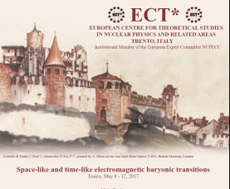
Goals of the meeting
Broaden our horizons
« cross-fertilization »,
initiate new collaborations,..
How?
talks
Panel discussions, coffee breaks, Nice dinners,….
« the ECT* spirit »

Slide 12
Thanks to the ECT* scientific council and staff
Funding of the meeting
Jochen Wambach: director of ECT* and speaker at the workshop !
Two other talks from ECT* speakers (D. Binosi, Ralf-Arno Tripolt)
secretaries : Gianmaria Ziglio and Ines Campo
Thanks for taking care of all the logistics !
We wish all of you a very pleasant and fruitful meeting

