Slide 1
Baryon Resonance production and em. decays in proton and pion induced reaction with HADES
Motivation:
vector meson(ρ) in HI physics
electromagnetic structure of baryons
role of of ρ ↔ baryon couplings, Vector Dominance Model
Results from NN - exclusive channels
preliminary results from run with pion
2pion Production from π- p and γp
e+e-
P. Salabura
M. Smoluchowski Institute of Physcis
Jagiellonian University, Kraków
Poland

Slide 2
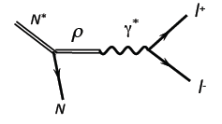
Motivation
Heavy ion physics:
-in medium hadron properties
- Nuclear matter emissivity μ_{B}, T
Proton-proton, pion-proton
- Vector Meson baryon couplings
- em trasnistion FF
ρ meson in nuclear matter:
baryonic loops directly related to :
π
N*
Resonance Dalitz decay
ρ
ρ
ρ
ρ
Δ(1232)
+ ...
+
N⁻¹
N⁻¹
Σ_{ρππ} Σ_{ρR(Δ, N*)}
dominant role of baryonic resonances for in-medium Self-Energy Σ_{ρR}
more in talks of Joachim, Jochen, Ralf,..

Slide 3
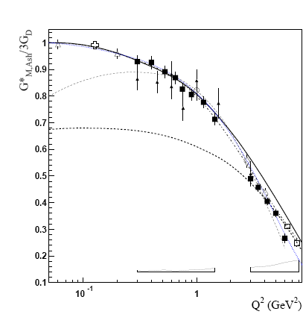

Electromagnetic structure of baryons
Dalitz decays
Δ₃₃ (J=3/2) → N (J=1/2)γ
space-like
N*→Ne+e-
e+e-→NN^{(*)}
e-N→e-N*
„pion cloud”
„quark core”
N
I. G. Aznauryan and V. D. Burkert,
Prog. Part. Nucl. Phys. 67, 1 (2012)
R→ Nγ* : em. Transition Form Factors
R (J≥3/2) : (3) G_{M} (q²), G_{E} (q²) , G_{C} (q²)
R (J=1/2) : (2) G_{M/E} (q² ), G_{C} (q² )
.. or covariant eTFF
for example for J=1/2
„QED”
M. I. Krivoruchenko, et. al
Annals Phys. 296, 299 (2002)

Slide 4
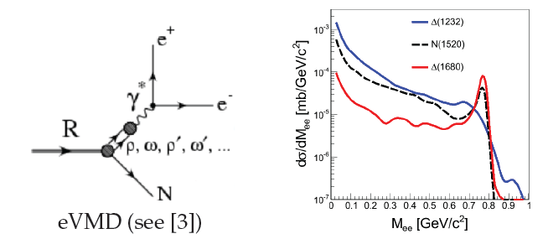
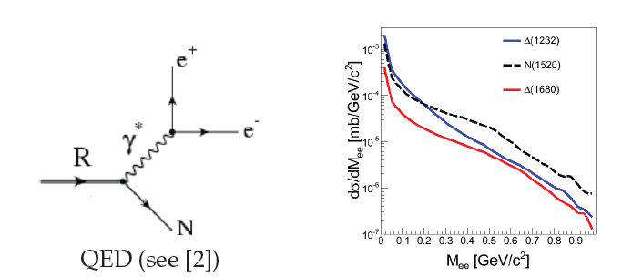
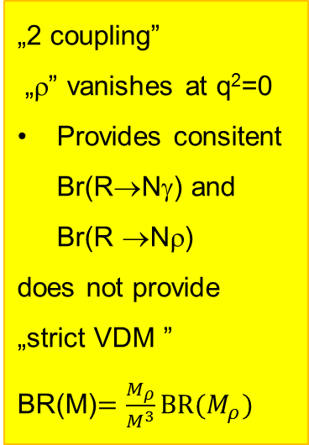
Dalitz decays of Baryon resonance
QED: point-like R-γ* vertex
Coupling constants fixed from R->Nγ
dependence on spin, parity
M. Zetenyi et al. PRC 67, 044002 (2003).
M. I. Krivoruchenko et al. Ann. Phys. 296, 299 (2002).
extended VDM1:
M. I. Krivoruchenko et al.
Ann. Phys. 296, 299 (2002).
extended VDM2:
Kroll, Zumino
H.B. O’Connell, et al.
Prog. Part. Nucl. Phys. 39, 201 (1997).
M. Zetenyi, G. Wolf PRC86(2012) 065209
el. Transition FF (M_{ee})
„2 coupling”
„ρ” vanishes at q²=0
Provides consitent Br(R→Nγ) and Br(R →Nρ)
does not provide
„strict VDM ”
BR(M)$=\frac{M_{ρ}}{M^{3}}BR(M_{ρ})$

Slide 5

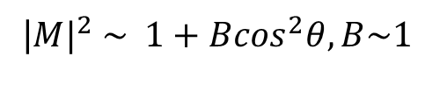
Lepton angular distributions
Lepton emission angles
E. Speranza, B. Friman, M. Zetenyi
Physics Letters B 764 (2017) 282–288
A.Sarantsev to be published
Spin density matrix
for example γ* direction
$$ρ_{λ′,λ}^{had}=\frac{e^{2}}{q^{4}}{ε_{}^{μ}\left(k,λ^{′}\right)H}_{μν}ε^{ν}(k,λ)^{∗}$$
„Helicity frame”
hadron decay to γ*
QED: γ* decay to e+e-
photon polarisation vectors
transverse
longitudinal
transverse
for example for Δ→Ne+e- at small q²
|${M|}^{2} \sim 1+B\cos^{2}θ, B\sim 1$

Slide 6
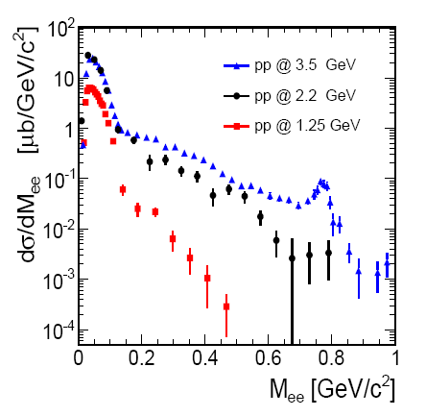
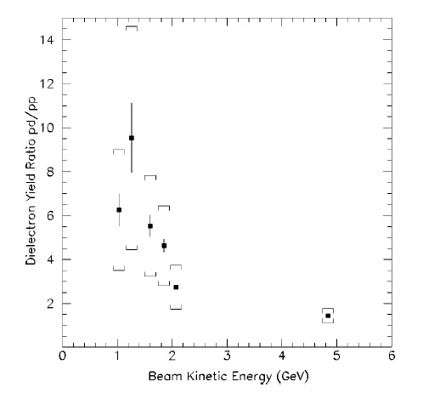
e+e- sources at SIS18 energies
excitation function !
DLS/HADES data: isospin effects !
π°→γ e+e-
η→e+e- γ
η ω
M>M_{π}⁰
ω→e+e-
σ (dp)/σ(pp)
η, Δ
~2
Δ→Ne+e-
1 2 3 4 5 E_{beam} (GeV)
DLS: PRC57 (1998)1867
HADES PLB715(2012)314,arXiv:1703.08575
M_{e+e-} < 0.15 GeV/c² dominated by π⁰ Dalitz
M_{e+e-} > 0.15 GeV/c² : Resonance (Δ, N*)→Ne+e- , NN bremsstrahlung ,η →γe+e- , ω→e+e-
Strategy : combined analysis of hadronic and dielectron exclusive channels

Slide 7
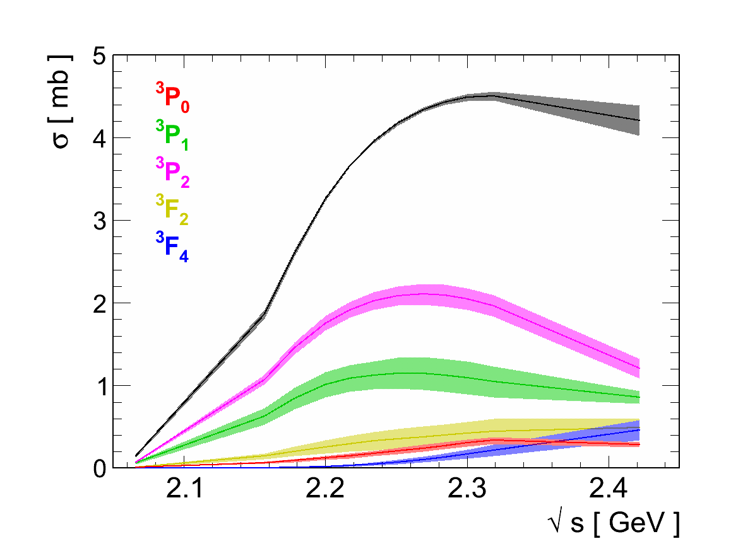
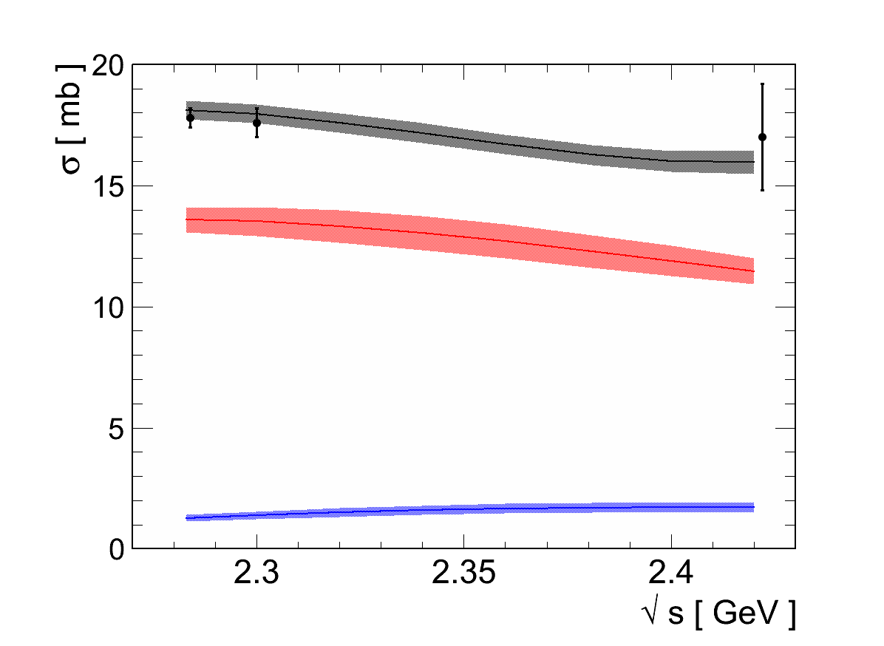
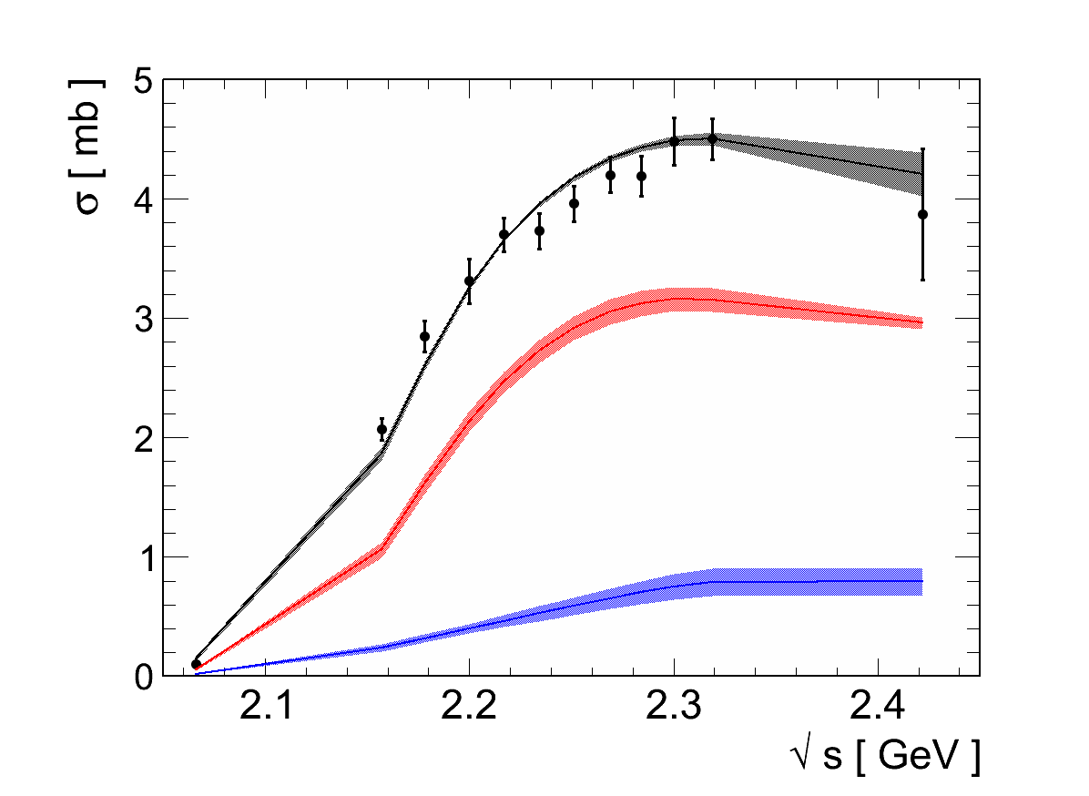


exclusive (π⁺, π⁰) in pp@1.25 GeV
13 PNPI + 2 HADES data sets
$$npπ^{+}$$
$$ppπ^{0}$$
Bonn-Ga PWA solutions
FINAL STATES:
P₃₃(1232) and
P₁₁(1440) in πN state
HADES coll:
Eur. Phys. J. A51 (2015) 137
red Δ(1232)P₃₃
blue N(1440)P₁₁

Slide 8
Δ⁺/N(1440) {→ pπ⁰ →pe+e- γ }
pp→ppe+e- @ 1.25 GeV
HADES coll. arXiv:1703.07840
accepted PRC(2017)
π⁰ reconstruction - examples
Inv. mass
production angle
e+e- data after acceptance and π⁰ BR corrections
hadronic data
PWA solutions for pNπ
Helicity angle
No adjustment of PWA solutions for e+e- data
Very good description of dielectron channel

Slide 9
Δ⁺ { → pe⁺e– } pp→e+e-pp @ 1.25 GeV
HADES coll. arXiv:1703.07840
accepted PRC(2017)
G_{M}(0)~3 , G_{E}(0)~0 , G_{C}(0)~0
G. Ramalho, M. T. Pena, et al Phys. Rev. D 93 014003 (2017),
pion cloud
Quark core
more in Teresa talk

Slide 10
Angular distributions for M_{e+e-} >M_{π} (Δ→pe+e-)
acceptance corrected
Δ Production in CM
electron in helicity frame
PWA solution for P₃₃ from hadronic channels
dσ/dcosθ ~ 1 + B cos²θ ; B=1.17±0.34
Δ⁺ →pe+e- : model based on PWA solution for P₃₃ and Dalitz decay (Ramahlo & Pena)
Δ⁺ →pe+e- : model assuming dominance of G_{M} ; transverse photon polarization
BR (Δ→pe+e-)=
4.19 10⁻⁵ ± 0.62 (sys) ± 0.32(stat)
Consistent description by Δ(1232)→pe+e-
First measurement !

Slide 11
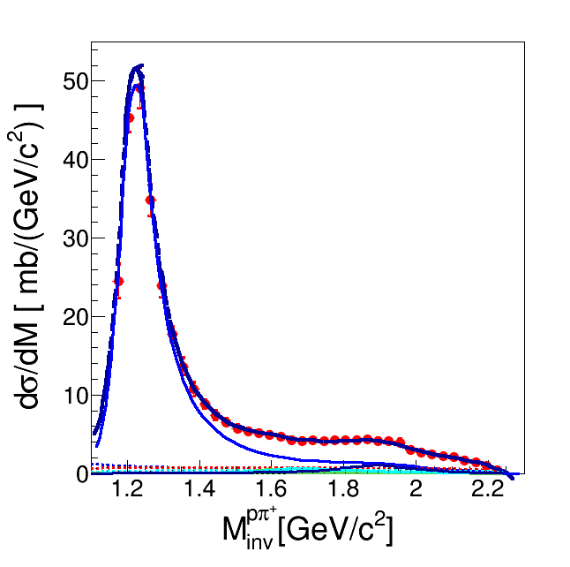
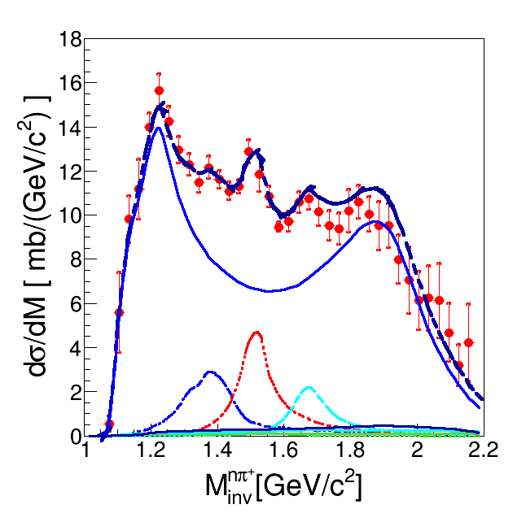
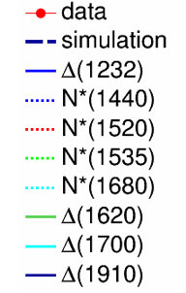
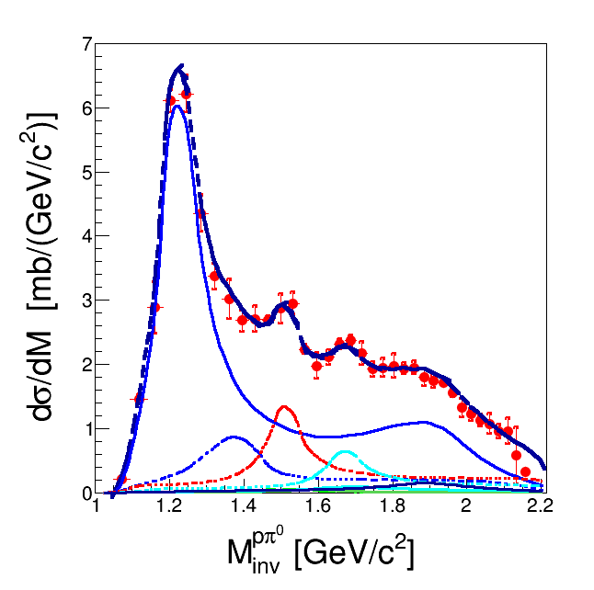
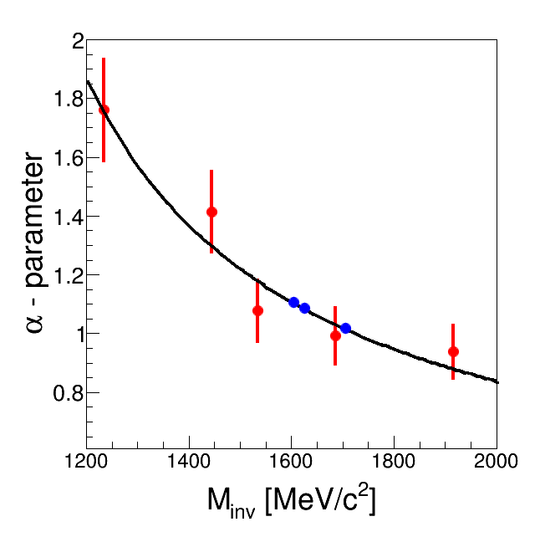


Higher mass resonances pp@3.5 GeV
n p π⁺
Resonance model:
Z. Teis et al., Z. Phys. A356 (1997) 421
J. Weil et al. (GiBUU) Eur. Phys. J. A48 (2012) 111
HADES : EPJA 50(2014) 42
Many overlapping R=(Δ, N*) resonances
R ( $\overline{q_{3}})$
p p π⁰
p₁
p₂
$\overline{t}=(\overline{q_{3}}−\overline{q_{1,2}}$)
angular parametrisation
as a function of
t for all resonances
t- channel dominance

Slide 12

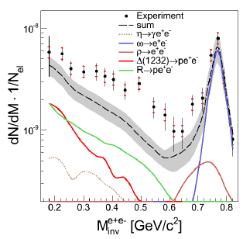
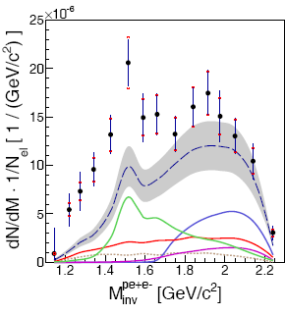
p+p→ppe⁺e⁻ @ 3.5 GeV
HADES coll. EPJA50(2014) 82
„QED” cocktail :
several contributing resonances : N*(1520), N*(1720), Δ(1620), Δ(1905),..
Excess above „QED” cocktail . Seems to originate from N*(1520) region

Slide 13
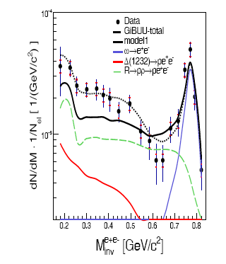
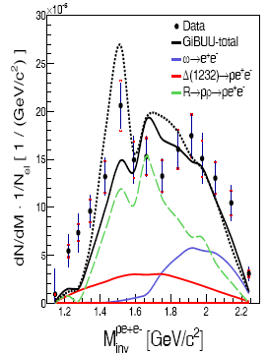
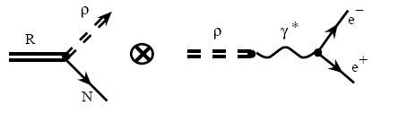
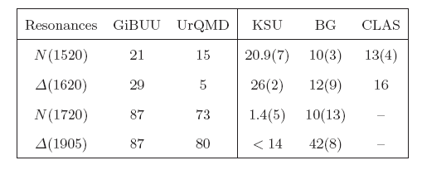
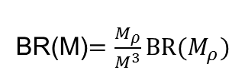
Comparison to models with strict VDM
Resonance model + strict VDM
with ρ dominance
BR(M)$=\frac{M_{ρ}}{M^{3}}BR(M_{ρ})$
better description achieved by „HADES resonance decomposition” (more N*(1520) ) AND lower (!) BR for Nρ decay (B-G upper limits)
HADES resonance decomposition + BR from GiBUU (PDG) overestimate data by factor 2
Resonace -> Nρ Branching Ratios
Contr. to e+e-
38%
15%
22%
7%

Slide 14
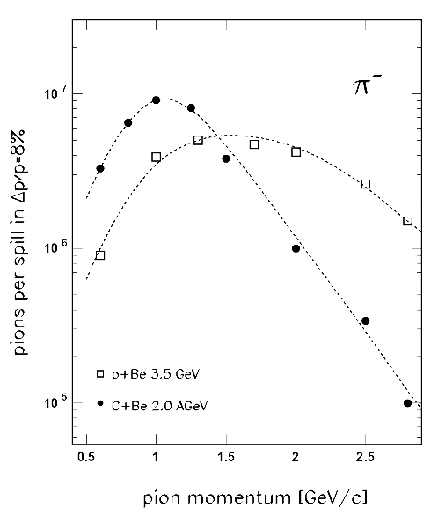
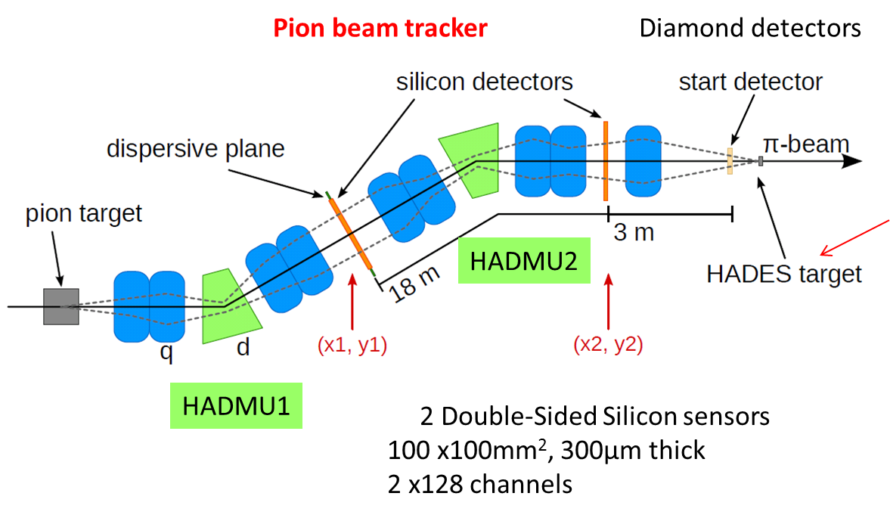
pion beam in HADES 2014
Polyethylen
(CH₂)_{n} and C
Reaction N+Be 8-10* 10¹⁰ N₂ ions/spill (4s)
secondary π⁻ with I ~ 2-3 10⁵/s p = 654.1, 683.5, 738.9 , 791 MeV/c (√s ∈1.46-1.55 GeV)
PE (CH₂ )_{n} and C targets
Pion momentum Δp/p =2.2% (σ), ~50% acceptance of pion beam line
in beam tracking system: (X1,X2/Y1/Y2) for pion mometum determination : Δp/p =0.1%
Investigated channels: n π+ π- / p π- π⁰ / ne+e- : off-shell coupling of ρ to resonance

Slide 15
Separation of channels
elastic pπ⁻ (normalization)
nπ+π⁻
791
791
938,8 MeV (σ= 1.7%)
939,4 MeV (σ= 1.0%) beam tracker
PE
C
p
PE
C, C e.b.e
p
pπ-π⁰
791
791
132,8
133,2 beam tracker
SAID

Slide 16
A.Saranstev B-G PWA
Included
in fit
CB-ELSA, MAMI

Slide 17
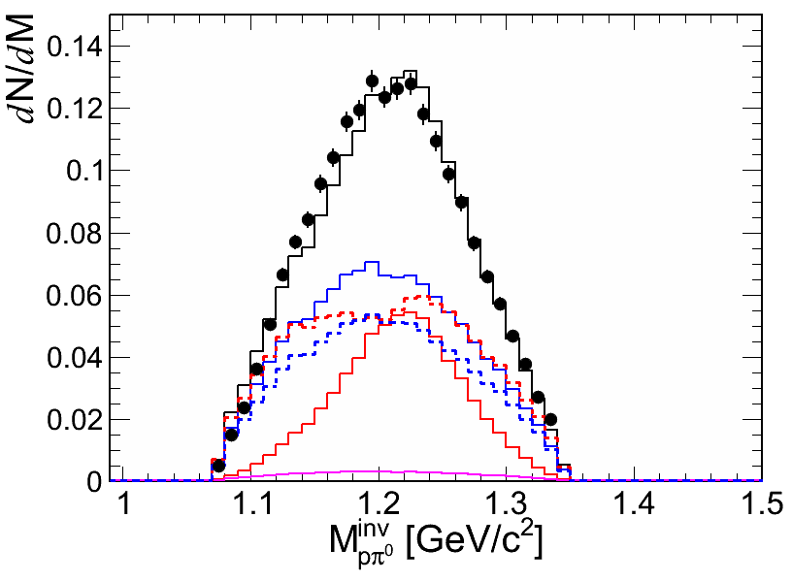
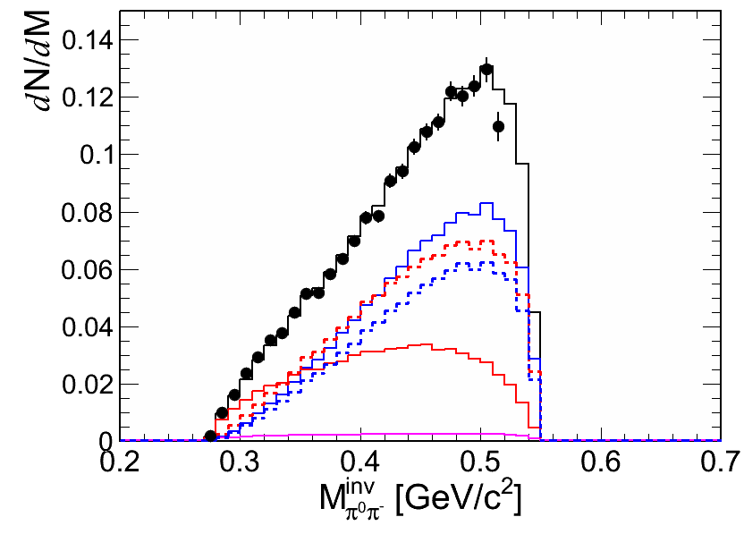
Invariant masses
PRELIMINARY
683,5 MeV/c
n π⁺ π⁻
n π⁺ π⁻
acceptance corrected
σN, Δπ, ρN
p π⁰ π⁻
p π⁰ π⁻
ρN, Δπ

Slide 18
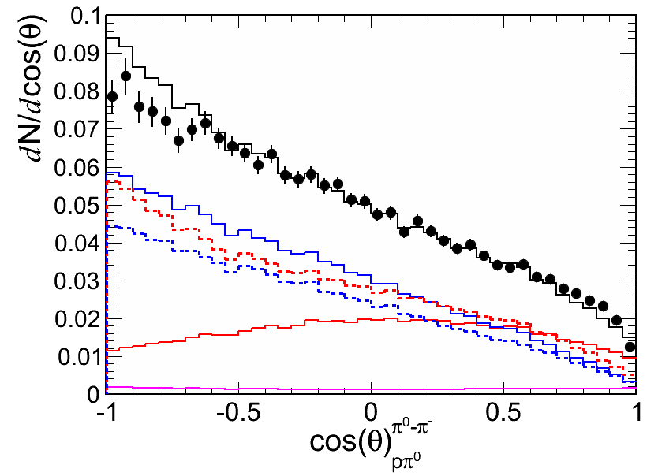
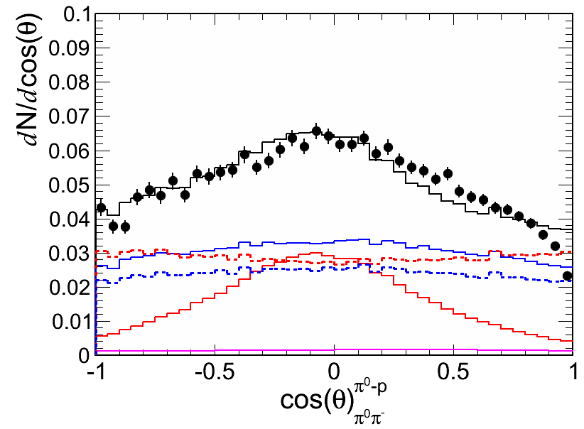
Angular distributions
n π⁺ π⁻
n π⁺ π⁻
683,5 MeV/c
acceptance corrected
p π⁰ π⁻
p π⁰ π⁻

Slide 19
Total cross sections
PRELIMINARY
π-p→π⁺π⁻ n
PWA solutions & HADES cross sections
nρ - total
3/2⁻ (D13+..)
1/2⁻ (S11+..)
3/2⁺ (P33+..
Total ρ cross section:
σ_{ρ} = 1.3 mb (PWA solutions) BR D₁₃ (1520)→ Nρ ~ 12 ± 2 %

Slide 20
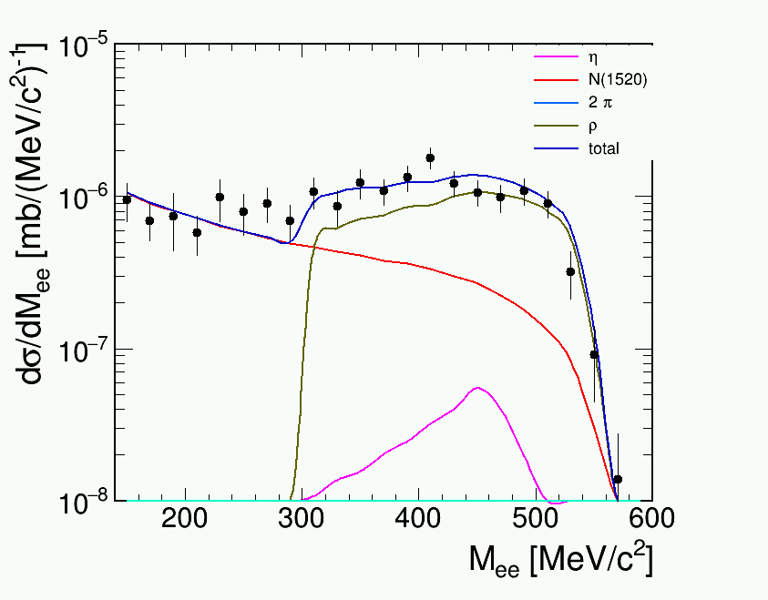
Exclusive π-p→e+e- n
PRELIMINARY
QED
10³
from PWA
Very strong contribution from ρ (along strict VMD)
More details in talk of Federico on Wednesday

Slide 21
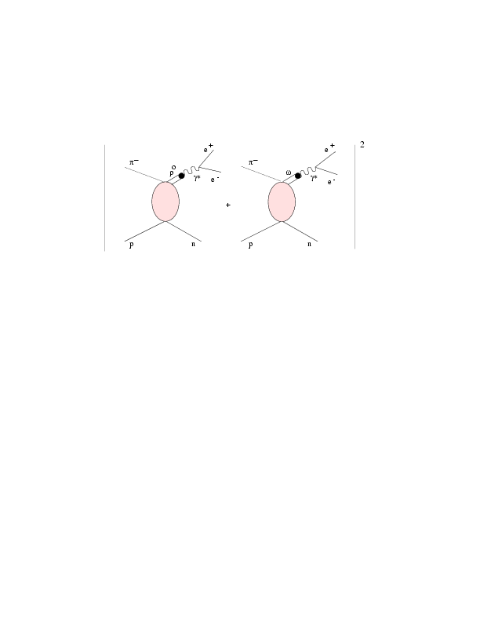
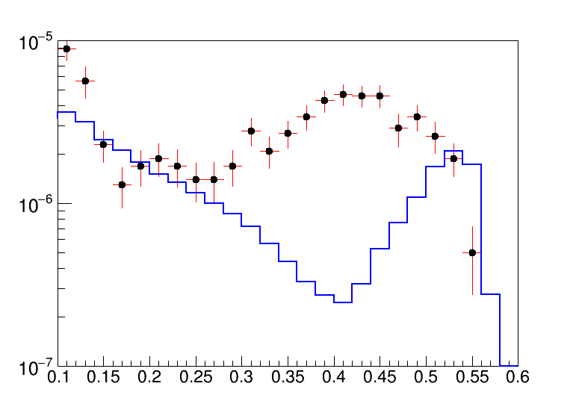
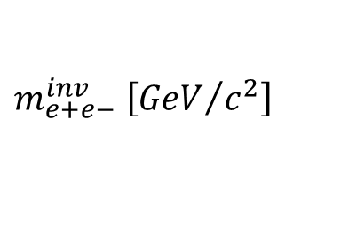
e+e- production from microscopic models
Resonance contribution N*/Δ + Interference effects (important ≤ ρ/ω threshold!)
M. Lutz et al..
Predictions !
M.F.M. Lutz , B. Frimann, M. Soyuer .
Nuclear Physics A 713 (2003) 97–118
(S-wave ρ-N)
Kaempfer , A Titov , R.Reznik
Nucl. Phys. A721(2003)583
M.Zetenyi, G. Wolf PRC86(2012) 065209
(S + P –wave ρ-N)
Very large differences in e+e- yield up to factor 10 !
10⁻³
μb/GeV
M.Zetenyi et al..
dσ/dM [μb/GeV]
10⁻⁴
10⁻⁵
$$m_{e+e−}^{inv} \left[{GeV}/{c^{2}}\right]$$

Slide 22
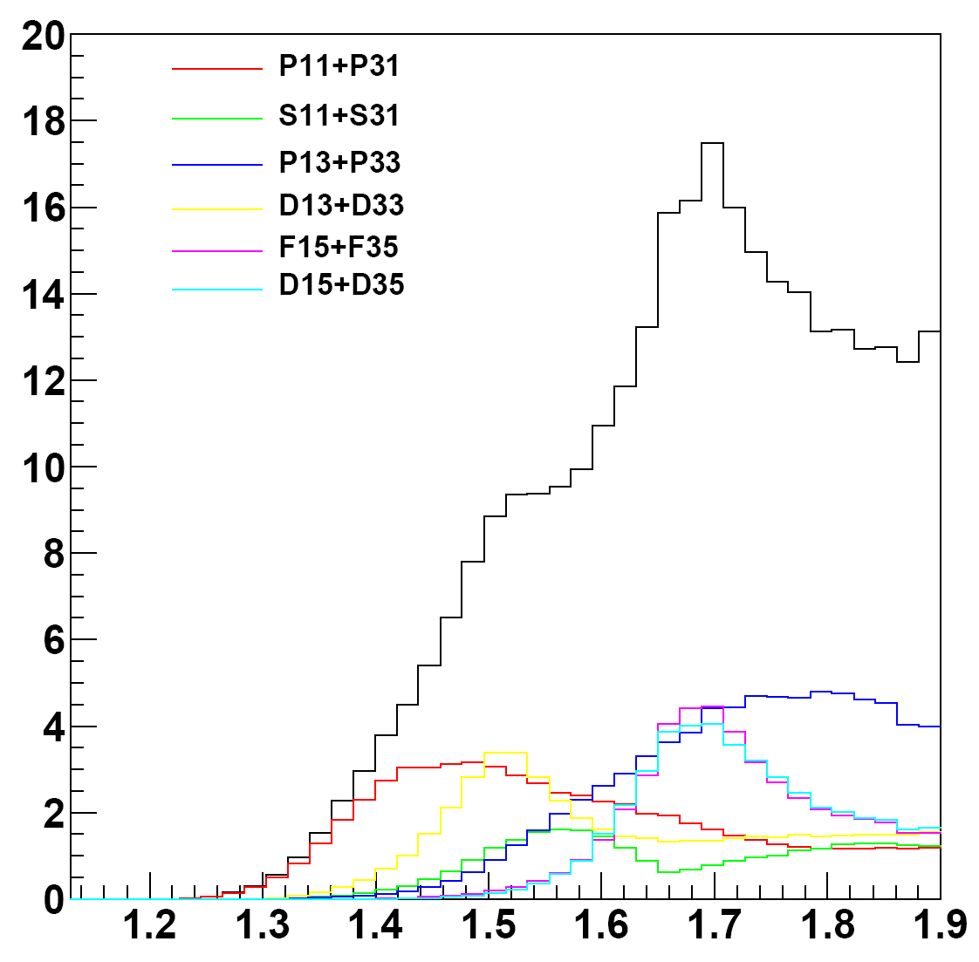
Beam Eenergy Scan
Outlook
πN→2πN : Bon/Gatchina PWA
σ [mb]
N(1440,1710) +Δ(1910)
N(1535) +Δ(1620)
N(1720) +Δ(1600)
N(1520) +Δ(1700)
N(1675) +Δ(1925)
N(1680) +Δ(1905)
4`d
3`d
2`d
GSI π⁻ momentum range 0.65-2.5 GeV/c ↔ √s :1.46 : 2.3 GeV
√s
Range of BES
HADES: 2πN, ηN (calorimter), KΛ, VM,…

Slide 23
Summary
Strong coupling of ρ meson to baryon resonances supported by NN and πN dielectron data
VMD inspired models of etFF are in agreement with Δ→ pe+e- data
Pion reactions offers cleanest way to measure resonance-vector meson couplings but
extraction of etFF is demanding (high statisics, multi-differantial analysis ) needs development of method which reduces model dependence.
Combined PWA of hadronic and e+e- channels ?
Extraction of spin density matrix elements (first results- see Federico , Andrey, Miklos talks)?

Slide 24
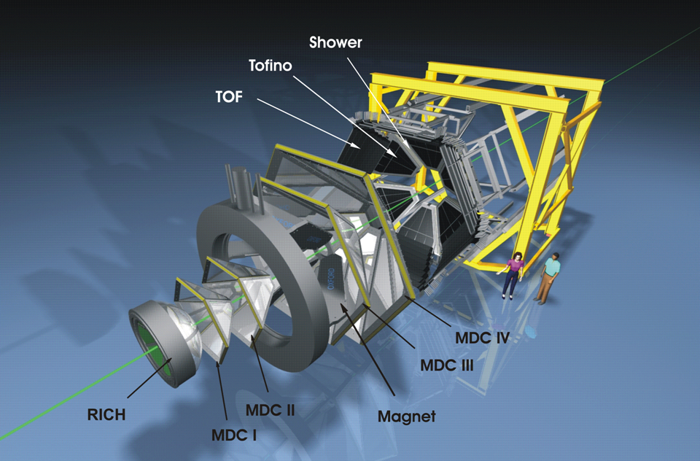

The HADES collaboration
  Cracow (Univ.), Poland
    Darmstadt (GSI), Germany
      Dresden (FZD), Germany
        Dubna (JINR), Russia
        Frankfurt (Univ.), Germany
        LIP, Portugal
        Giessen (Univ.), Germany
        München (TUM), Germany
        Moscow (ITEP,RAS), Russia
        Nicosia (Univ.), Cyprus
        Orsay (IPN), France
      Rez (CAS, NPI), Czech Rep.
    Sant. de Compostela (Univ.), Spain
SIS
GSI
and with particular thanks to A. Sarantsev
Notes:
The HADES detector is installed on the GSI facility, but HADES is a european collaboration. Actually 150 persons working in about 156institutions all over Europe. 15” tot 45”

Slide 25
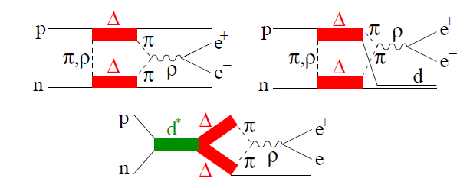
pp→ppe+ vs pn→pne+e-
Δ-Δ
Δ
ρ-like
π - etFF
HADES coll, arXiv:1703.08575
EPJA(2017)to be published
Normalized to same π⁰
σ_{np.}/ σ_{pp}
Δ Dalitz
Strong off – shell ρ contribution in n-p collisions (absent in p-p)
Δ-Δ FSI emission from pion exchange line - pion eFF Clement & Bashkanov EPJA 50 (2014) 107 R. Shyam and U. Mosel Phys. Rev. C 82:062201, 2010
π - etFF

Slide 26
Angular distributions for M_{e+e-} >M_{π} (Δ→pe+e-)
acceptance corrected
OBE calculations
helicity frame
„ρ-like”
E. L. Bratkovskaya, at. al
Phys. Lett. B 348, 325 (1995).
„Δ”
B
Δ→pe+e- model: Dalitz decay with
dσ/dcosθ ~ 1 + cos² θ
dσ/dcosθ ~ 1 + B cos²θ ; fit B=1.52±0.58
ρ→e+e- model: isotropic
dσ/dcosθ ~ 1 + B cos²θ ; fit with
B= -0.4 ± 0.2. For π+π- →e+e- expected B= -1 !
Change of photon polarization with γ* mass

Slide 27
Lepton angular distributions (helicity fame) M>400 MeV
cosθ <0
0<cosθ <0.5
cosθ >0.5
ρ_{ij}
ρ₁₁
ρ₁₋₁
ρ₁₀
cosθ

Slide 28
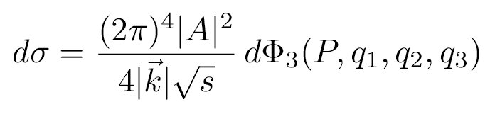
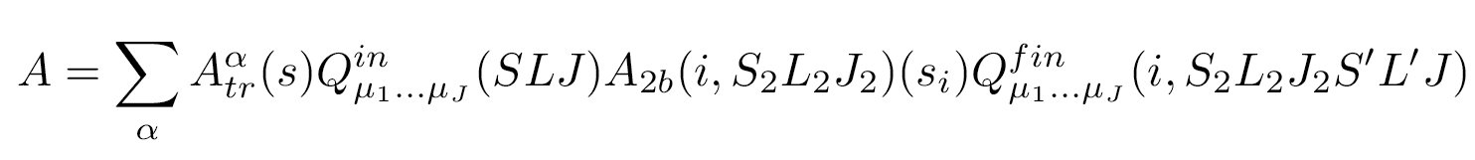
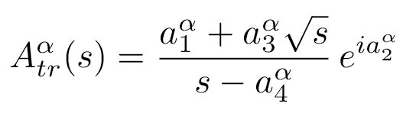
p+p @ 1.25 GeV – P₃₃ Δ(1232), P₁₁ N(1440) resonance production
below ppη production threshold
Partial Wave Analysis
Final: S₂L₂J₂
PWA applied to hadronic – NNπ channel
in collaboration with Bonn-Gatchina group
p
p
Initial : SLJ
maximum log-likelihood
event-by-event
A. V. Anisovich et al.
Eur. Phys. J. A34 (2007) 129
Final: S’L’
Coherent sum of partial waves
Energy dependent solutions: many experimental sets treated together by max. Log-likehood method event by event
Detector acceptances taken into account
initial
NN system
system of two
final particles
two-final particle
system and spectator
transition amplitude
final state amplitude
(resonant, non resonant)

Slide 29
Partial Wave Analysis (Bonn/Gatchina )
A.Saranstev et al..
An excellent tool widely used in hadron spectroscopy (γN, πN, pp reactions)
Based on K-Matrix approach (coupled channels): allows to fit several reactions channels at the same time with strong unitarity constraints
Take into account specific detector acceptances and efficiencies
(data are analysed together with phase space Monte Carlo passed through detector response)
Fit is done on event by event basis with maximum likehood method (correlation in multidimensional space following are taken into account!)
At present ~0.34 mln data points taken in global fit with χ² /DOF= 1.6
In HADES we use Energy dependent extraction of amplitudes: several energy points are analysed together with different final states. Resonance properties (masses, widths are not subject to fit)
Already several channels analysed and published (pp→pkΛ, pp →pnπ+, ppπ⁰ )

Slide 30
Δ⁺ {→ pπ⁰ →pe+e- γ } –dielectron spectra
π⁰ Dalitz e+e- mass
(in HADES acceptance)
electron angle in helicity frame
(in HADES acceptance)

Slide 31
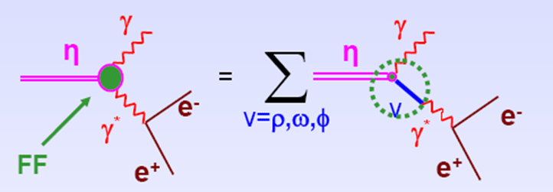
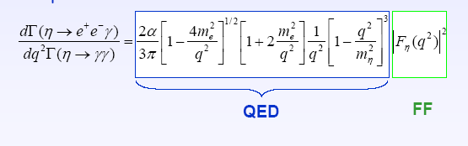
Vector Meson Dominance in work for mesons..
example: η decay
KLOE2
φ→π⁰ e+e-
VMD
very important for hadronic corrections in muon g-2 ..

Slide 32
ππ production in pion and photon -induced react.
R₁ has well defined J, P
for example for pion-nucleon
S-wave J^{P} = 1/2–
L_{2I, 2J} = S₁₁ or S₃₁
P-wave J^{P} = 1/2⁺ or 3/2 ⁺
P₁₁ , P₁₃ or P₃₁ , P₃₃
Reaction amplitude A:
Pion induced reactions:
Photon induced reactions:
Λ -helicity ampl
In both same K matrix accounts for hadronic part : resonances with masses M_{α}, coupling to channels g(i,j), phase space for decay ρ and background terms f_{ij}

Slide 33
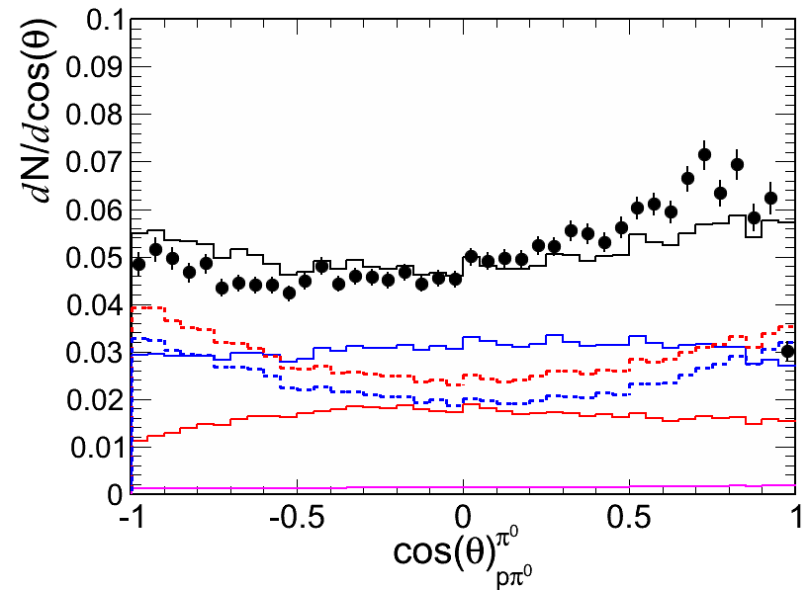
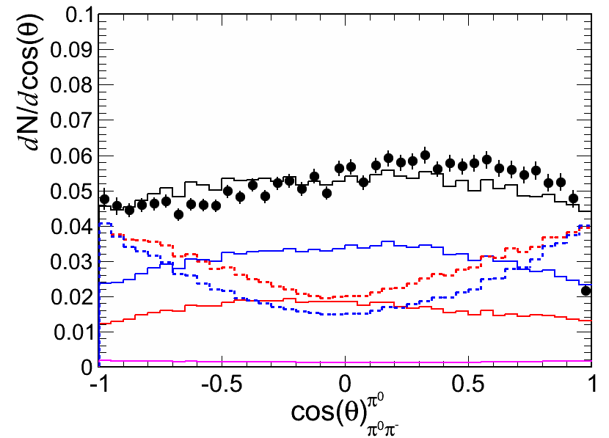
Angular distributions
683,5 MeV/c
n π⁺ π⁻
acceptance corrected
n π⁺ π⁻
p π⁰ π⁻
p π⁰ π⁻

Slide 34
Separation into initial states (waves)
π⁻p→π⁰π⁰ n
γp→π⁰π⁰ p
I, J^{P}
D₁₃(1520)+..
σ [mb]
D₁₃(1520)+..
σ[μb]
P₁₁(1440)+..
P₁₁(1440)+..
F₁₅(1680)+..
Data Cristal Ball
Data Bonn
√s [GeV]
In 1.45-1.55 GeV in 2 pion production only few resonances matters D₁₃(1520), P₁₁(1440)

Slide 35
Separation into final states: Δπ, Nσ(I=0), N*π
π-p→π⁰π⁰ n
γp→π⁰π⁰ p
Δπ
Nσ
N(1440) π
N(1520) π
Δπ
Nσ
N(1440) π
N(1520) π
σ [mb]
σ[μb]
√s [GeV]
Dominat channels in 2π⁰ are Δπ and Nσ (2π⁰ in I=0)
ρ does not contribute because it is I=1, hence does not decay to 2 π⁰

Slide 36
e+e- inclusive inv. mass vs model
EXP
π- PE @ 690 MeV/c
PLUTO coctail based on known σ
SIM
PRELIMINARY
N_{beam} =N_{el} /(σ _{el} * ρd) (target dens)
N_{PE} ^{e+e-} = N_{beam}(σ_{P} + 0.5σ_{C}) ρd
π⁰ Dalitz
2π⁰ Dalitz
η→γe+e-
D₁₃(1520) →ne+e- (QED)
(with σ = σ_{tot} ^{πN→γN} )
ρ(from PWA)→e+e-
! BR(M)~ „strict VMD” (1/M³ )
Δ→ne+e- (QED)
(σ_{P} + 0.5σ_{C} )(M) [mb]

Slide 37
Real photon production π-p→γn
data from π-p→γn and γn→ π-p (related via detailed balance) analysed together
Separation into resonances:
@ √s ~1.5 GeV : dominance of D₁₃ and S₁₁
D₁₃ in fair agreement with the cross section extracted from pion analysis and BR(Nγ)
3/2⁻ N(1520) ≠ 3/2⁺ !!
For point-like particle
N_{e+e-} ≅ N_{γ} * α (=1/137)
but details of dΓ/dm depends on spin and parity of the resonance
M. Zetenyi et al. PRC 67, 044002 (2003).

