Slide 1
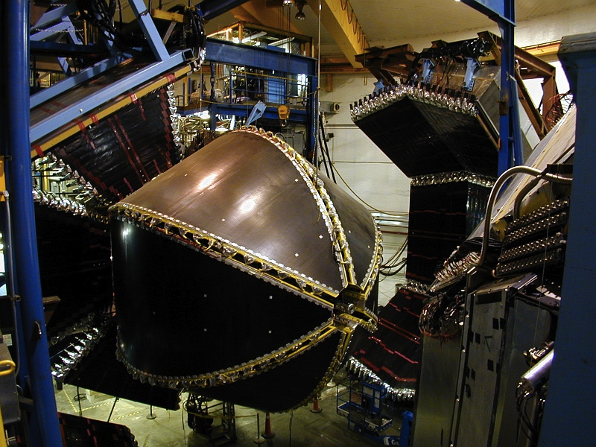
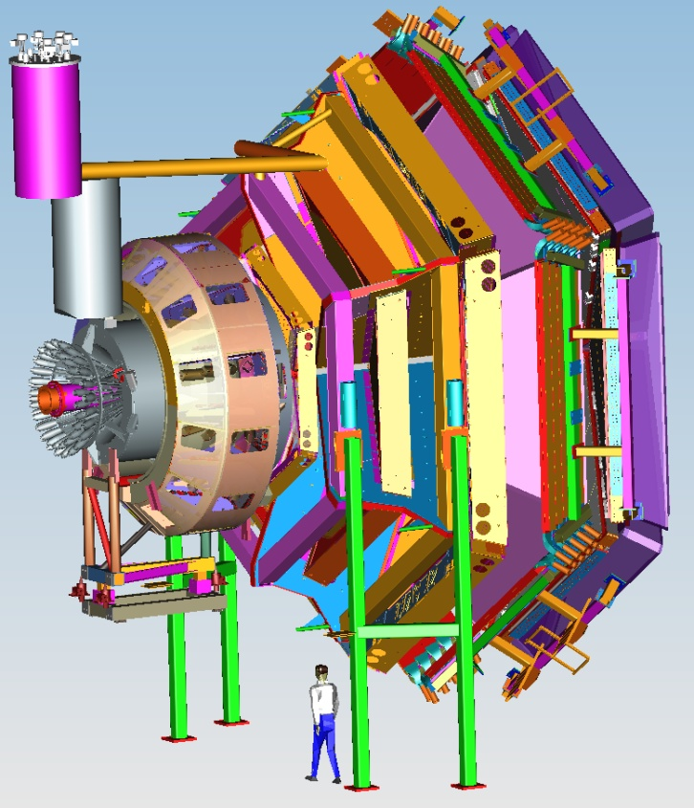
Single pion electroproduction off proton in the resonance region with CLAS at Jefferson Lab
Kyungseon Joo
ECT* Workshop
University of Connecticut
May 11, 2017

Slide 2
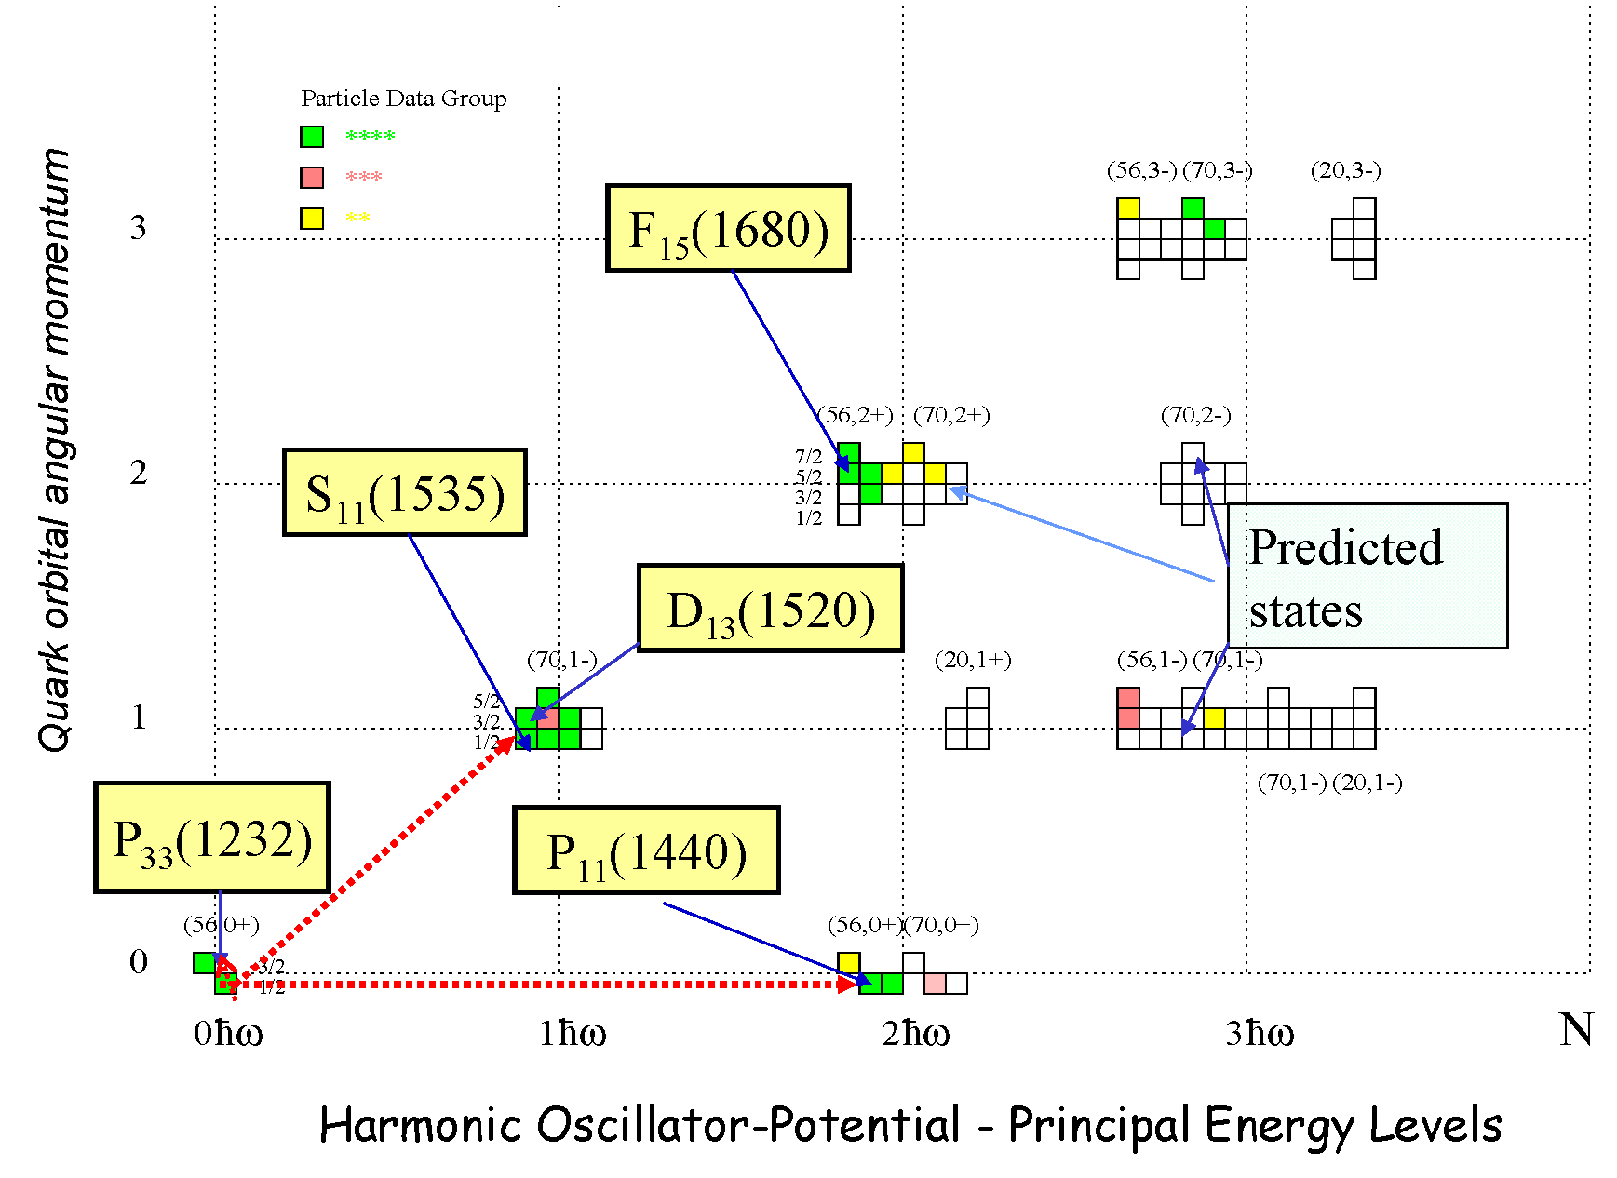
SU(6) x O(3) Classification of N*

Slide 3
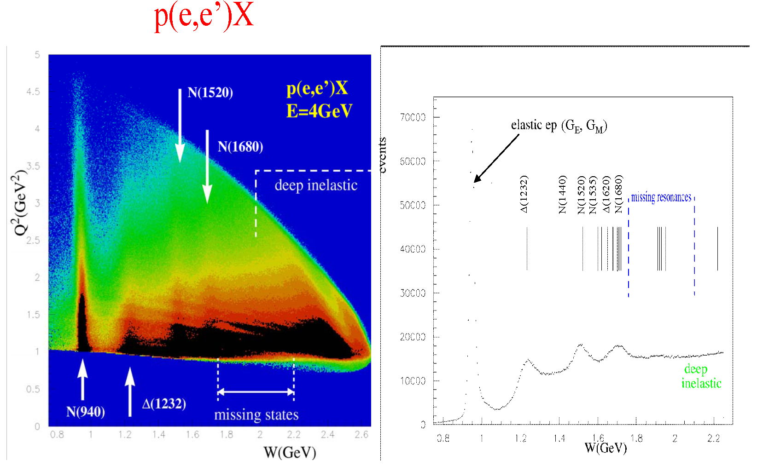
Inclusive electron scattering
In contrast to elastic scattering, resonances cannot be uniquely separated in inclusive scattering → need to measure exclusive processes.

Slide 4
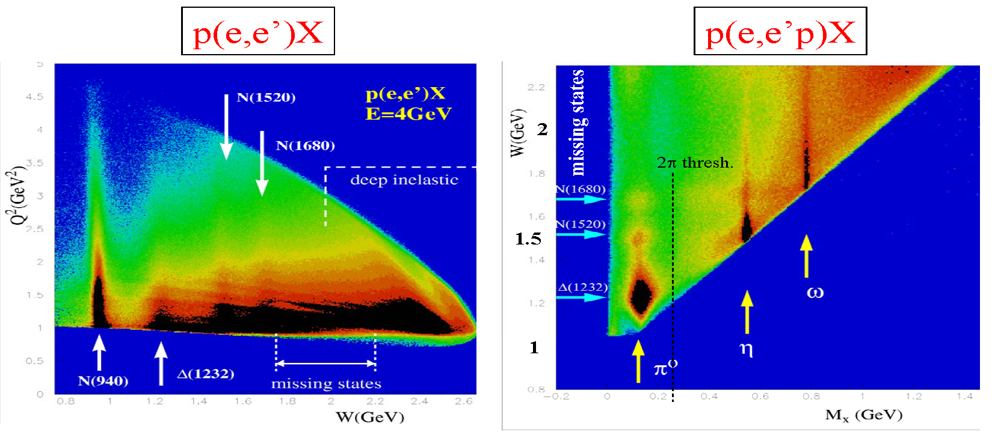
Inclusive vs. Exclusive
Resonance states can be better isolated by exclusive processes.

Slide 5
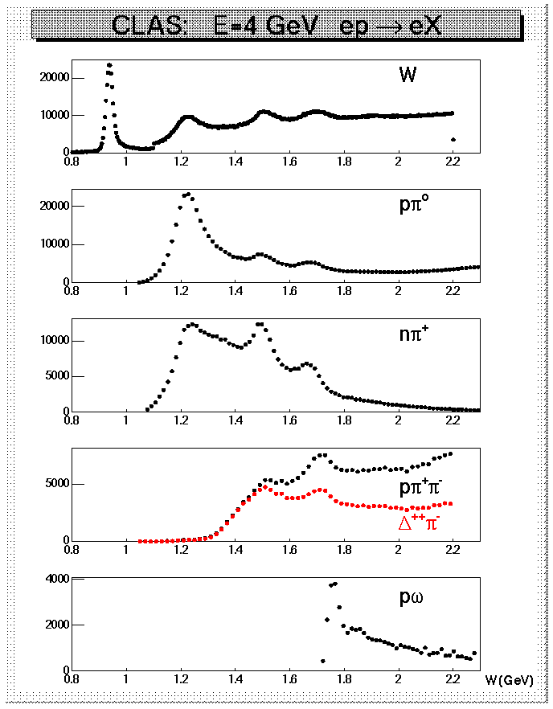
W-Dependence of Selected Channels
p(e,e’)X (trigger)
p(e,e’p)π⁰
p(e,e’π⁺)n
p(e,e’pπ⁺)π⁻
p(e,e’pπ⁺)X

Slide 6
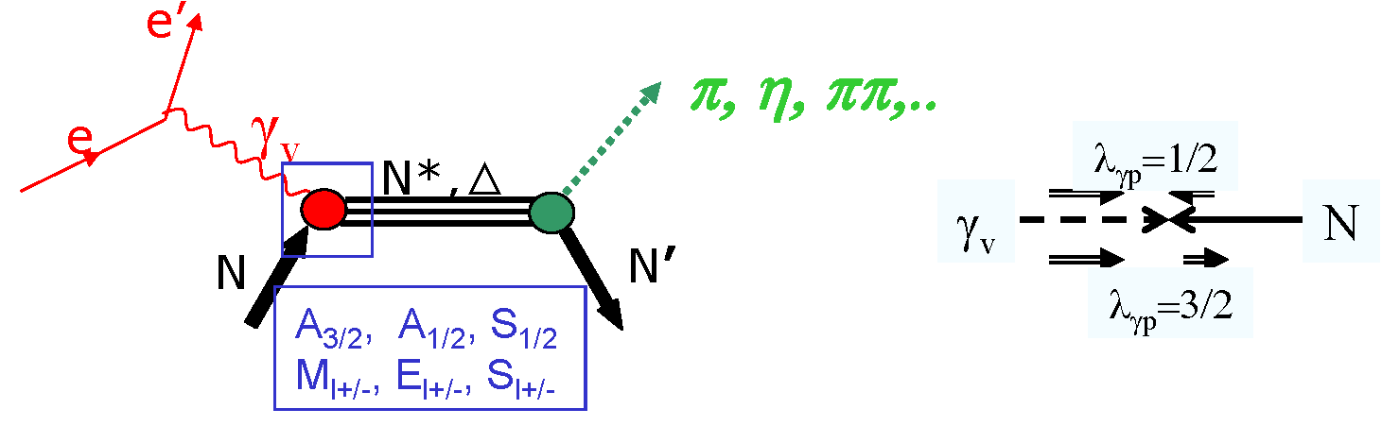
Studies of N* Spectrum and Structure with CLAS
Search for undiscovered resonance states.
  confirm or dismiss weaker candidates (*, **, ***).
  characterize the systematic of the N* spectrum.
Measure the strength of resonance excitations versus distance scale in meson electroproduction with CLAS to identify effective degrees of freedom.

Slide 7
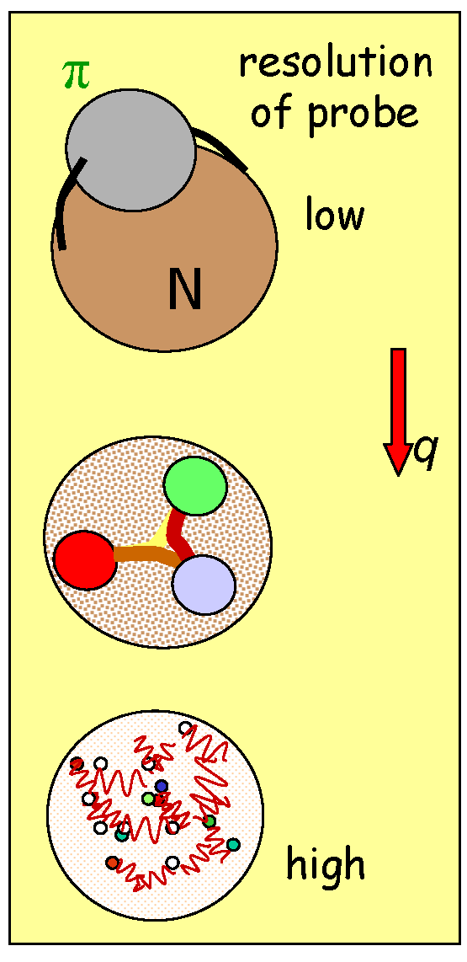
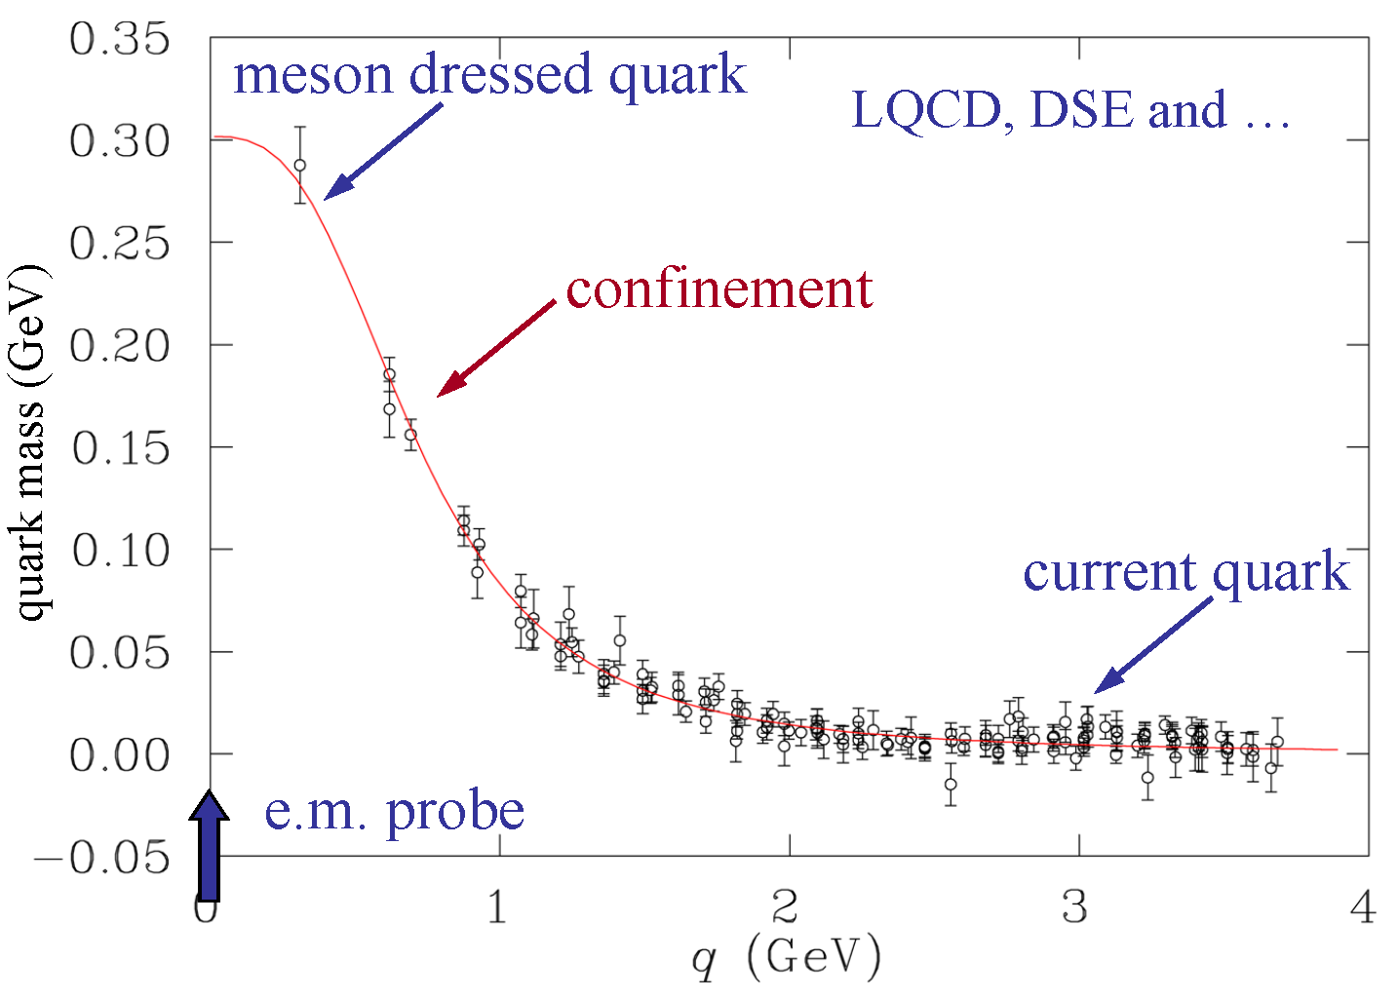
Hadron Structure with Electromagnetic Probes
Understand the effective degrees‐of‐freedom underlying the N* spectrum and the forces between them.
e.m. probe

Slide 8
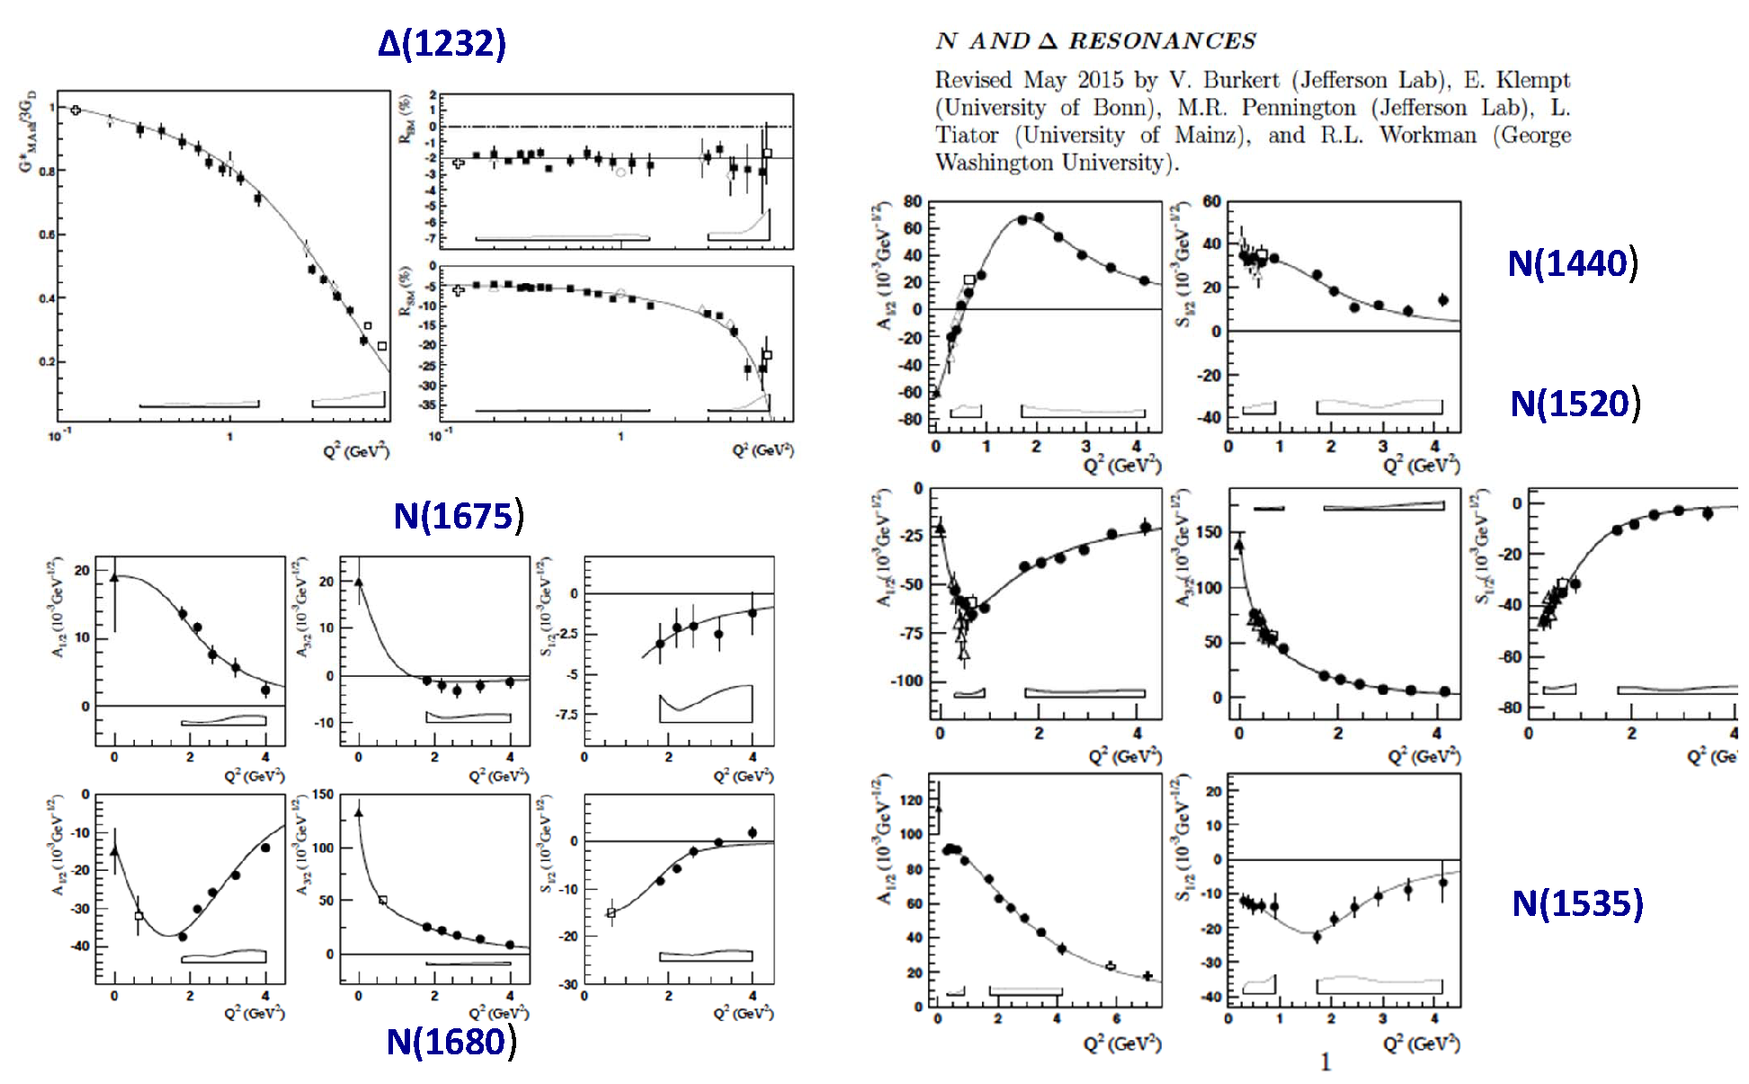
Electrocouplings in RPP 2015

Slide 9
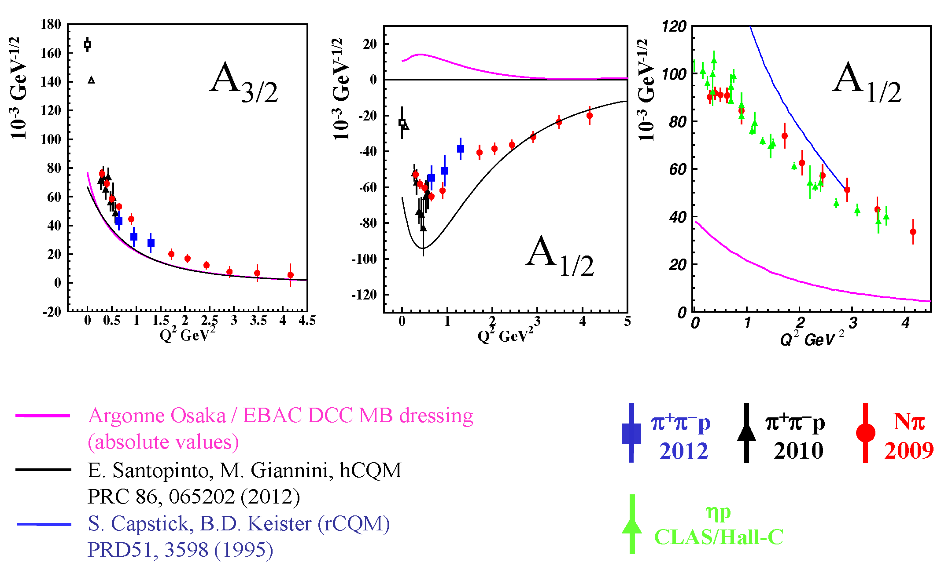
Electrocouplings of N(1520)D₁₃ and N(1535)S₁₁

Slide 10
N* Studies of π⁰ Electroproduction with CLAS
First resonance (Δ resonance) region: pπ⁰ channel data are dominant.
Second resonance region: pπ⁰ channel data covers only low Q² range. Most analyses are done by pη, nπ⁺ and pπ⁺π⁻ channel data.
Third resonance region: No pπ⁰ channel data exist.
It is important to have consistent results for all channels, and pπ⁰ channel data are important for a coupled channel analyses.
Δ(1232)3/2+
N(1440)1/2+
N(1520)3/2-
N(1535)1/2-
N(1650)1/2-
N(1675)5/2-
N(1680)5/2-
N(1710)1/2+

Slide 11
New π⁰ Electroproduction results in the resonance region from low Q² to high Q²

Slide 12
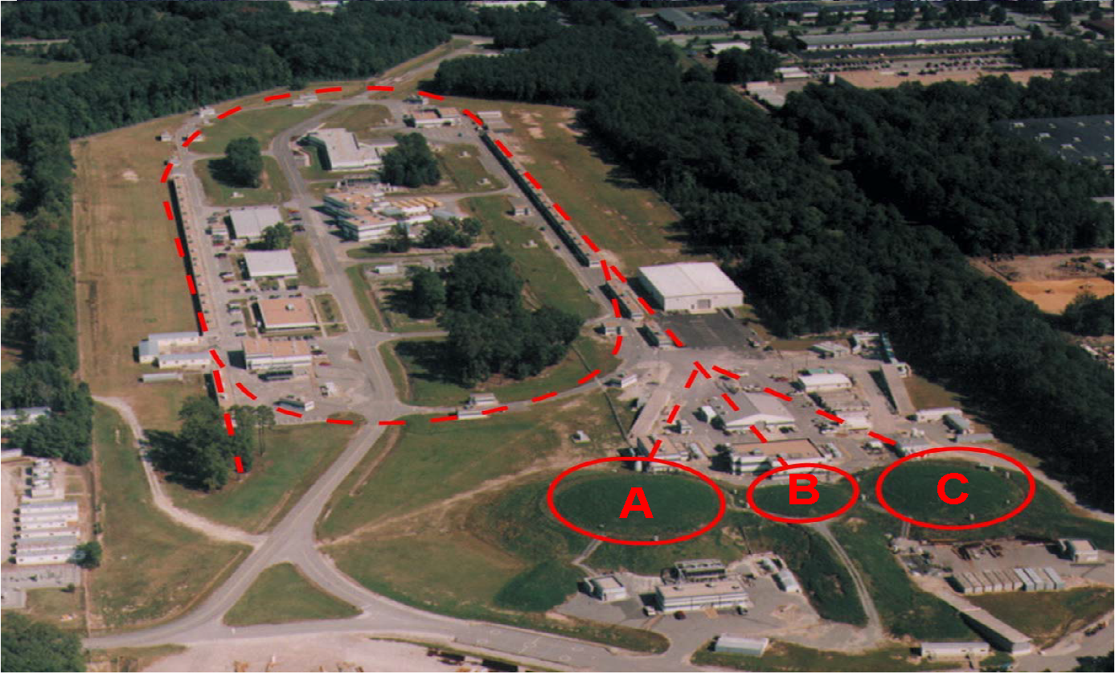
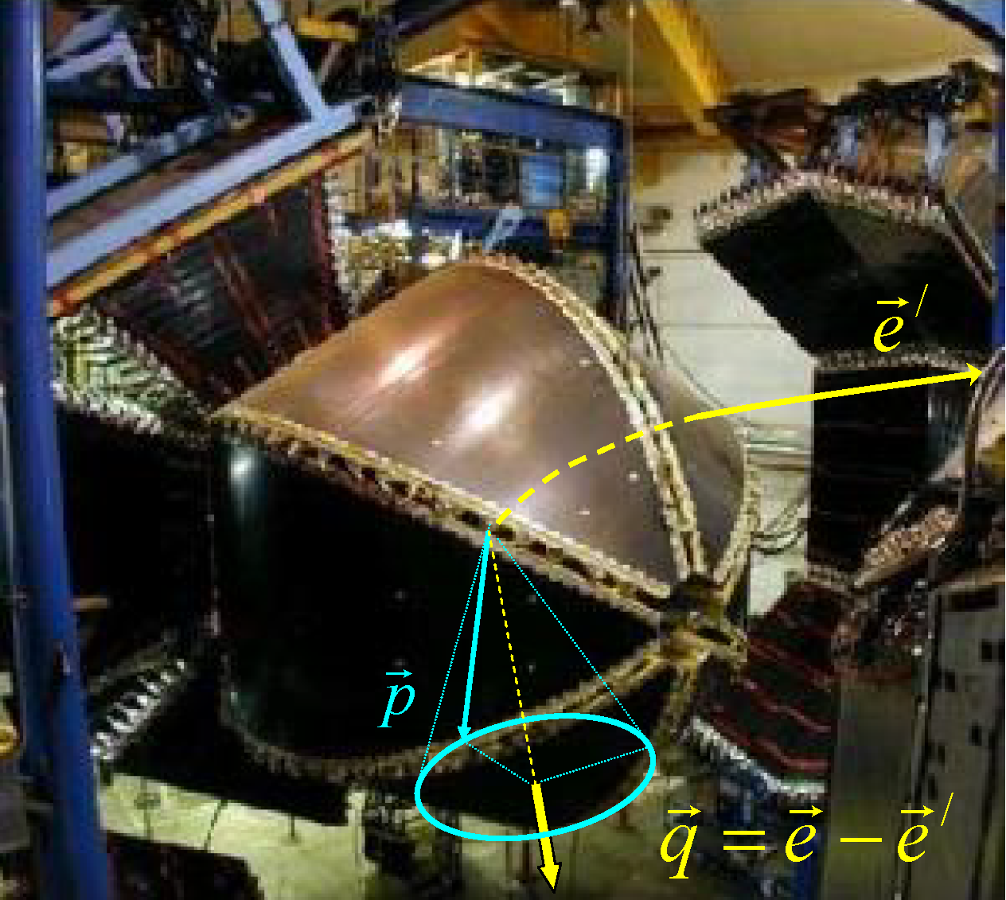
CEBAF and CLAS at Jefferson Lab
Six identical sectors
5T toroidal B-field
Δθ=15-140 degrees
Δφ = 0-50 degrees
Δp/p = 10⁻²-10⁻³
Polarized targets
E_{max}: 6 GeV
I_{max} : 200 μA
Duty Factor: 100%
σE/E: 2.5 10-5
Beam Pol: 80%
E_{γ}(tagged): 0.8- 5.5 GeV

Slide 13
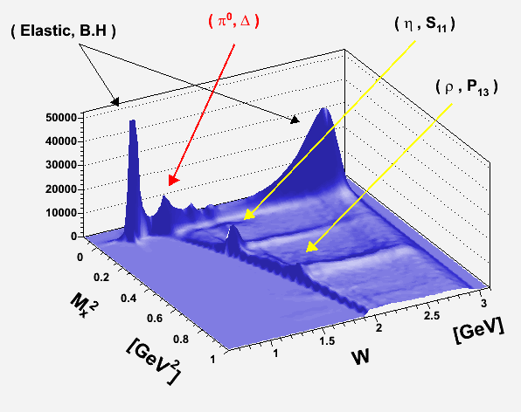
Missing Mass² vs W for
ep→e’pX
Final data sample from 6 GeV run (e16)

Slide 14
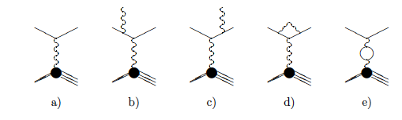
Radiative Corrections (RC)
Radiative corrections for exclusive processes
- Mo and Tsai method is limited to inclusive RC. (2 structure functions)
- 4 structure functions (unpolarized)
- 5 structure functions (with polarized beam)
- 18 structure functions (with polarized beam and polarized target)
- Even though it is QED corrections, RC should be also
made for hadronic variables since q=e-e’ changes:
(Q², x_{B}, t, φ) or (Q², W, cosθ, φ) for exclusive processes (EXCLURAD)
initial
final
vacuum loops

Slide 15
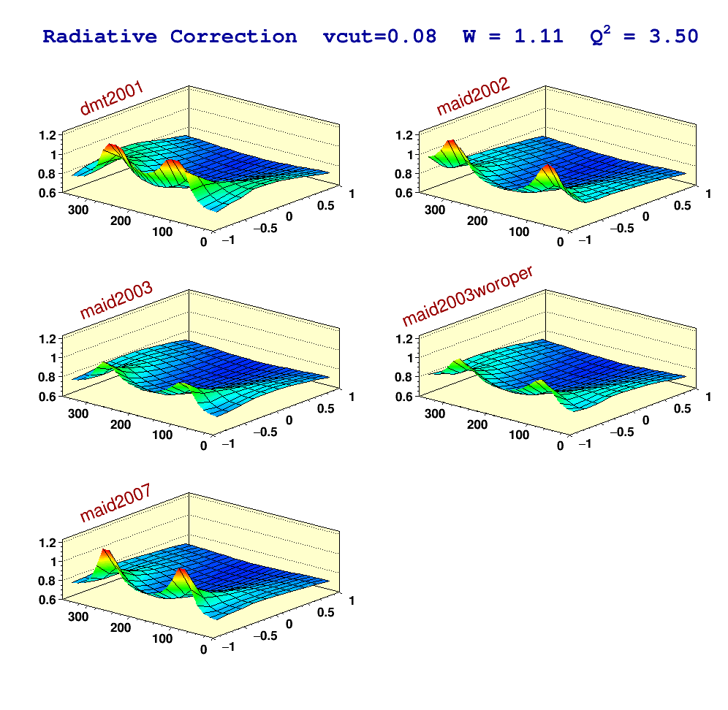
Radiative Corrections

Slide 16
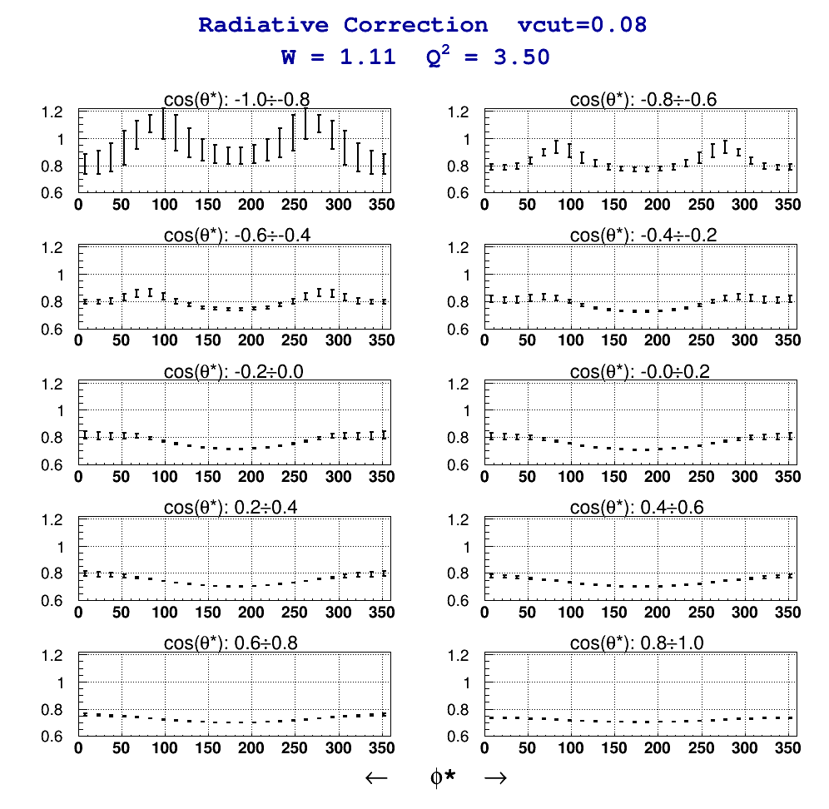
Radiative Corrections

Slide 17
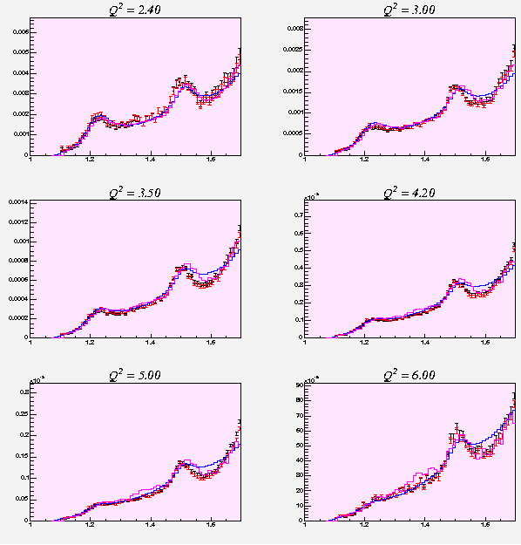
Normalization (inclusive electron scattering)
Inclusive electron scattering cross section has been made (1.1 <W< 1.7), and compared with Keppel and Brasse parameterizations.
W
Data
Keppel
Brasse

Slide 18
Normalization (e-p elastic scattering)

Slide 19
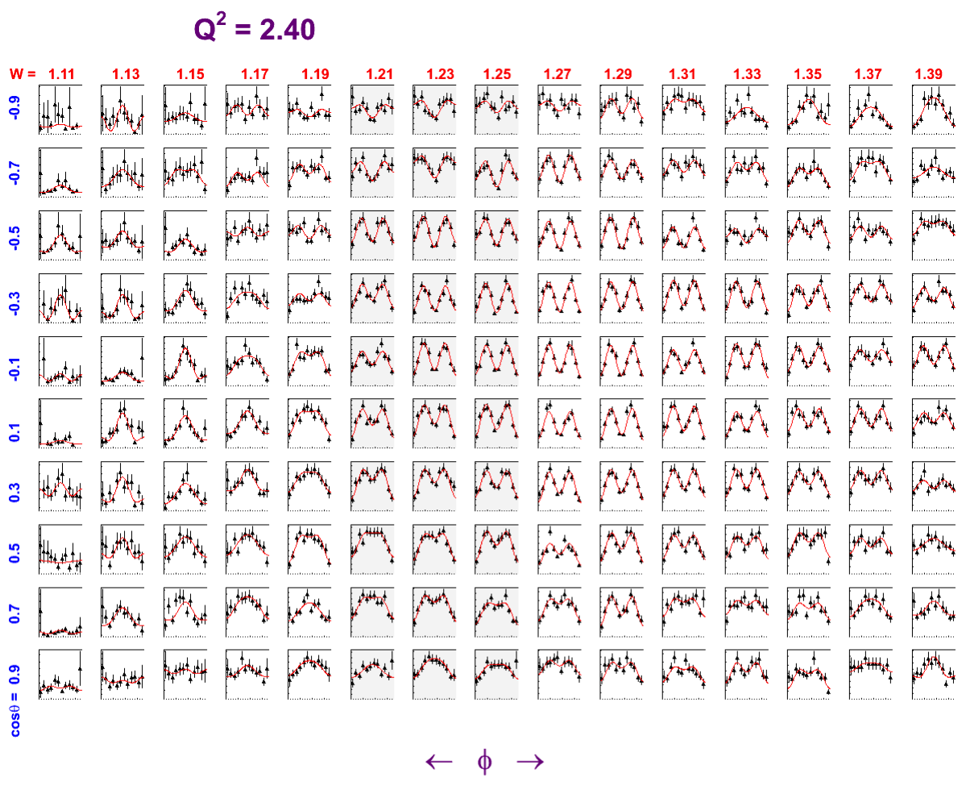
Differential cross section of π⁰ electroproduction
φ

Slide 20

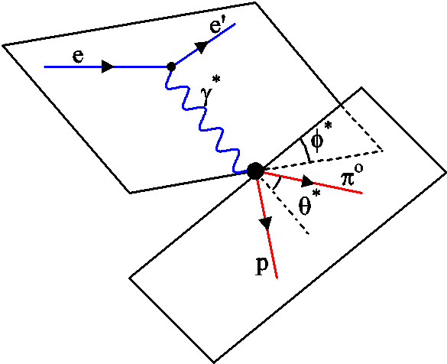
π⁰ electroproduction in the resonance region
.
Measurement requires out-of-plane detection of hadronic decay.
Structure functions extracted from fits to φ* distributions for each (Q² ,W, cosθ*) point.
Longitudinal sensitivity w/o Rosenbluth separation

Slide 21
Power of Interference
Unpolarized structure function
  Amplify small resonance multipole by an interfering larger resonance multipole
Im(S₁₊) Im(M₁₊)
Large
P₃₃(1232)
σ_{LT} ~ Re(L*T)
= Re(L)Re(T) + Im(L)Im(T)
Small
Polarized structure function
  Amplify resonance multipole by a large background amplitude
Im(S₁₋) Re(E₀₊)
Bkg
σ_{LT’} ~ Im(L*T)
= Re(L)Im(T) + Im(L)Re(T)
P₁₁(1440)
Resonance

Slide 22
Power of Interference (sensitivity to P₁₁(1440))
ep eπ⁺n
σ_{LT’} structure function is sensitive to imaginary part of P₁₁(1440) through interference with real Born background.
Shift in S_{1/2}
Shift in A_{1/2}

Slide 23
Structure functions
1.23
1.44
1.52
1.67
W
μb
μb
μb
μb
σ_{T}+εσ_{L}
Data
MAID07
JANR
0.45
cosθ*
cosθ*
μb
μb
μb
μb
0.55
Good agreement in the Δ region for both models;
In the second resonance region JANR seems to have a minor advantage, especially at higher Q²;
In the third resonance regions both models should be further adjusted to the experimental data.
cosθ*
cosθ*
μb
μb
μb
μb
0.65
cosθ*
cosθ*
μb
μb
μb
μb
0.75
cosθ*
cosθ*
μb
μb
μb
μb
0.85
Q²,
cosθ*
cosθ*

Slide 24
Structure functions
1.23
1.44
1.52
1.67
W
μb
μb
μb
μb
σ_{LT}
Data
MAID07
JANR
0.45
cosθ*
cosθ*
μb
μb
μb
μb
0.55
Good agreement in the Δ region for both models;
Good agreement in the second resonance region;
Decent agreement in the third resonance region with discrepancy at extreme values of cosθ.
cosθ*
cosθ*
μb
μb
μb
μb
0.65
cosθ*
cosθ*
μb
μb
μb
μb
0.75
cosθ*
cosθ*
μb
μb
μb
μb
0.85
Q²
cosθ*
cosθ*

Slide 25
Structure functions
1.23
1.44
1.52
1.67
W
μb
μb
μb
μb
σ_{TT}
Data
MAID07
JANR
0.45
cosθ*
cosθ*
μb
μb
μb
μb
0.55
Decent agreement in the Δ region for both models
In the second resonance region MAID 07 seems to have some advantage, both models need to be further adjusted;
In the third resonance regions MAID 07 seems to have some advantage, both models need to be adjusted.
cosθ*
cosθ*
μb
μb
μb
μb
0.65
μb
cosθ*
μb
μb
μb
cosθ*
0.75
cosθ*
cosθ*
μb
μb
μb
μb
0.85
Q²,
cosθ*
cosθ*

Slide 26
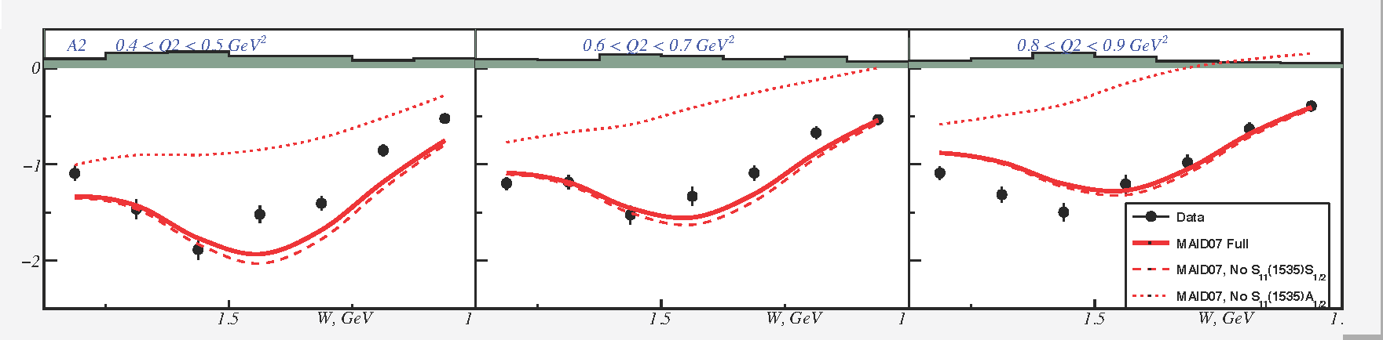
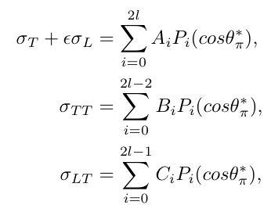
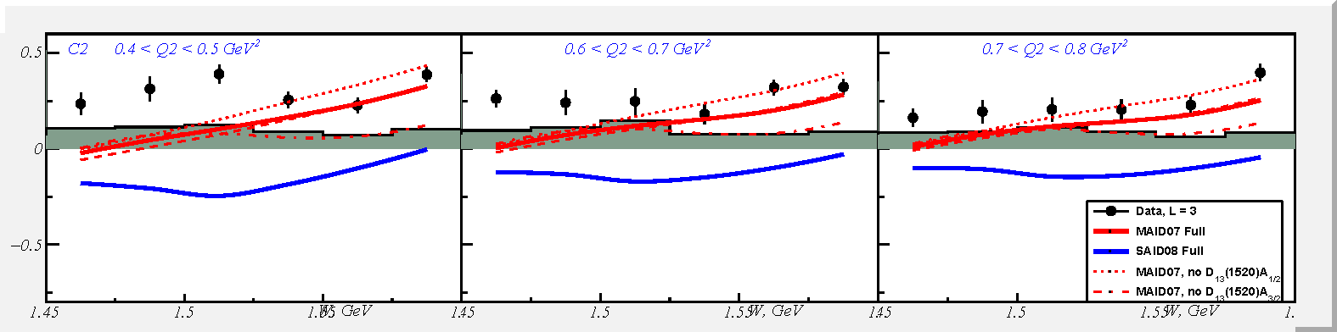
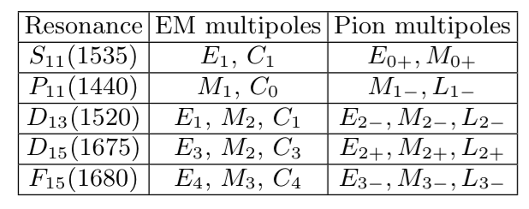
Legendre Expansions (2nd resonance region)
Sensitivity to S₁₁(1535)
0.4<Q²<0.5
0.6<Q²<0.7
0.7<Q²<0.8
MAID07
SAID
A₂
1.5
1.5
1.5
W
A2 is sensitive to S₁₁(1535)A_{1/2}
C₂
1.5
1.5
1.5
W
MAID07 is generally in a good agreement with data.

Slide 27
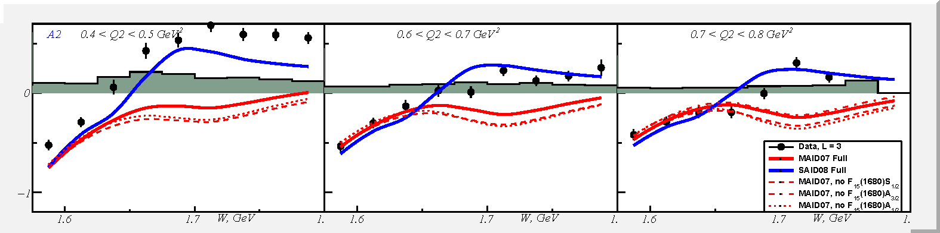
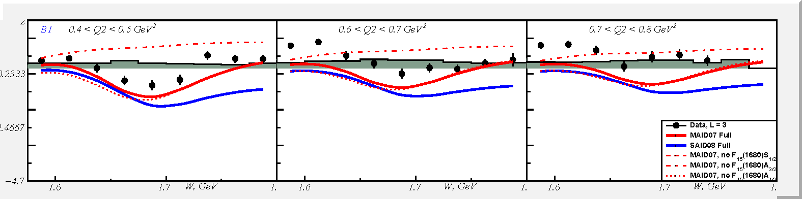
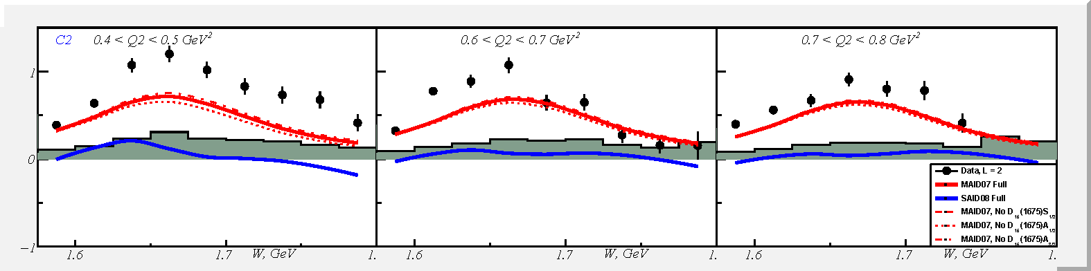
Legendre Expansions (3rd resonance region)
Sensitivity to F₁₅(1680)
0.4<Q²<0.5
0.6<Q²<0.7
0.7<Q²<0.8
MAID07
SAID
A₂
1.6
1.7
1.6
1.7
1.6
1.7
W
B₁
B₁ is sensitive to F₁₅(1680)A_{3/2}.
1.6
1.7
1.6
1.7
1.6
1.7
W
C₂
1.6
1.7
1.6
1.7
1.6
1.7
W

Slide 28
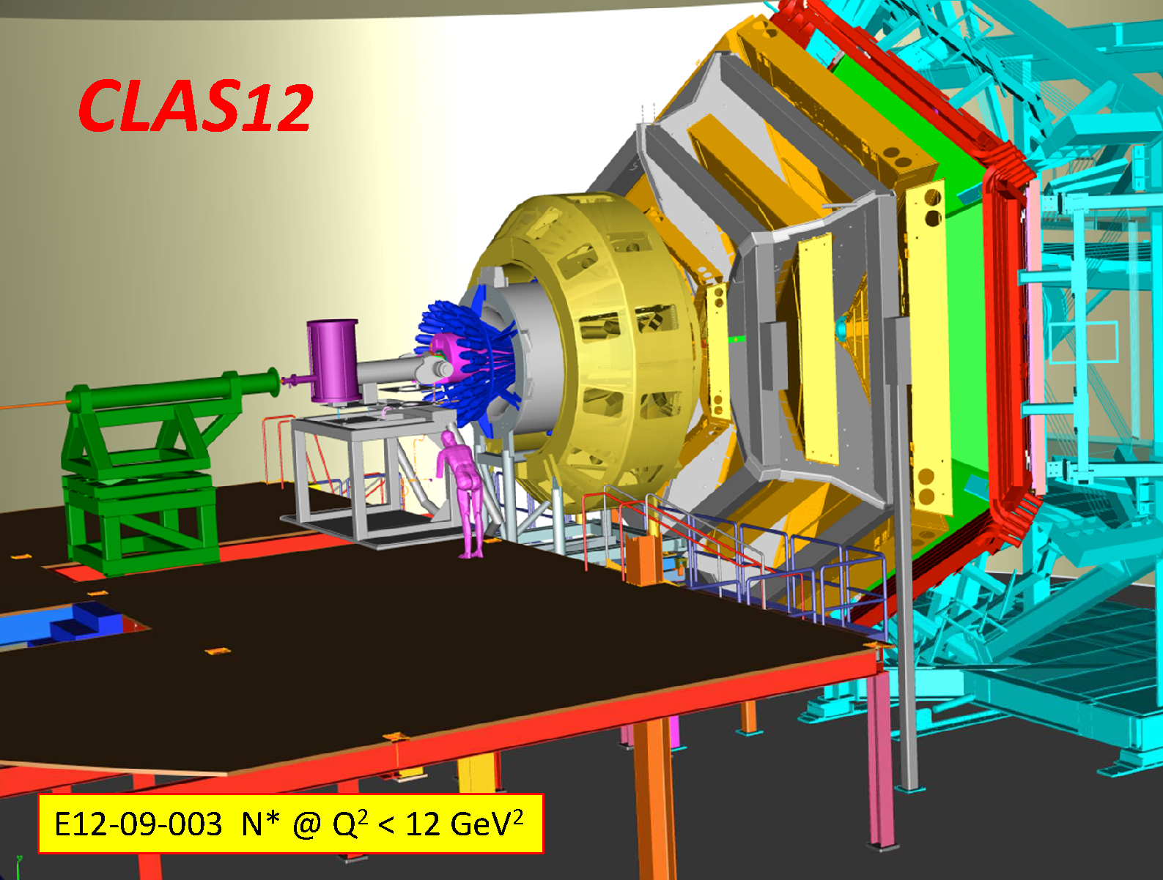
N* Physics @ CLAS12

Slide 29
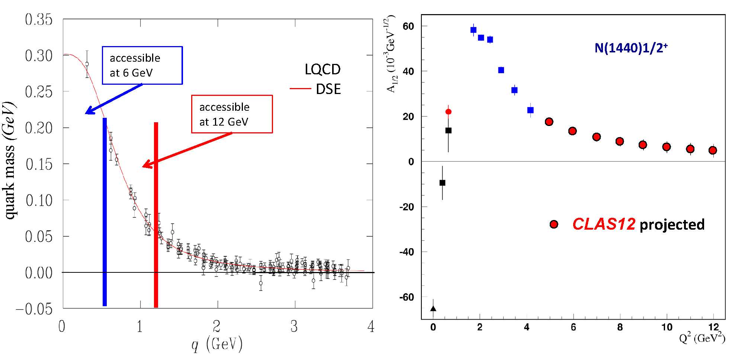
Probing the running quark mass with CLAS12
Nucleon resonance transitions amplitudes probe the quark mass function from constituent quarks to dressed quarks and elementary quarks.

Slide 30
Summary
For the first time, N* electrocouplings in the third resonance region will become available from a pπ⁰ channel;
Multi-channel partial wave analysis frameworks have been key in further establishing the nucleon excitation spectrum;
With CLAS12, electro‐excitation of prominent states up to high Q² to probe the transition from the dressed to the bare quark core.

