Slide 1
Discussion on In-Medium Effects and Relations to Spectroscopy/Reactions
ECT* workshop on space- and timelike electromagnetic baryonic formfactors
May 08-12, 2017 (ECT* Trento)

Slide 2
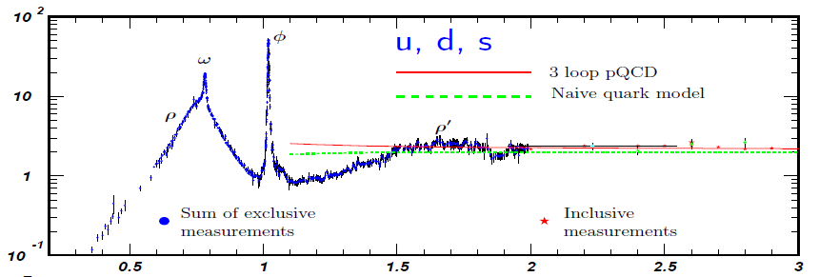
Change in Degrees of Freedom
As function of q²
Spacelike: F₂-Structure Funct.
JLAB
Data
Timelike: e⁺e⁻ → hadrons
p
Im Π_{em}(M) / M²
M [GeV]
d
● Q² _{dual} ~ 2.5-3 GeV²
● depends on channel?
ξ ≈ x
average → Quark-Hadron Duality
lower onset-Q² in nuclei?

Slide 3
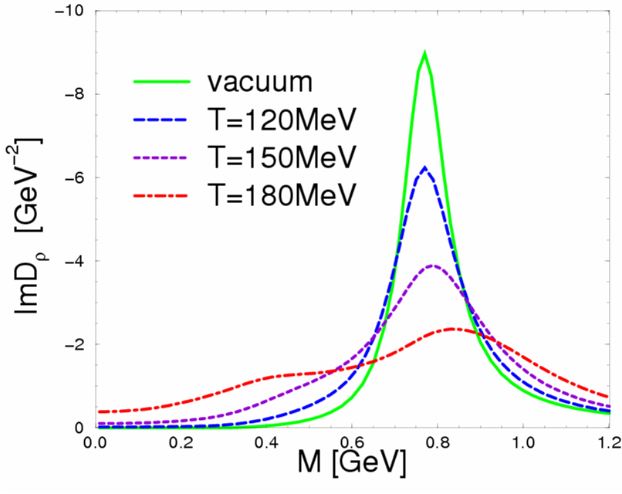
As function of temperature/density
ρ_{B}/ρ₀
0
0.1
0.7
2.6
● Duality threshold
Q²_{dual} (T,μ_{B}) ?
● Universality of hadron melting?

Slide 4
Chiral Symmetry + Restoration
● Gluonic vs. chiral-breaking mass
M_{h} = (m₀)_{glue} + (Δm)_{chiral-break}
● Prospects for determining hadronic+EM couplings of chiral partners
ρ - a₁ , N - N(1535), Δ(1232) - N(1520)
and what to conclude from them …
● Implications/relations of PWAs on chiral structure and interactions
of baryons

