Slide 1
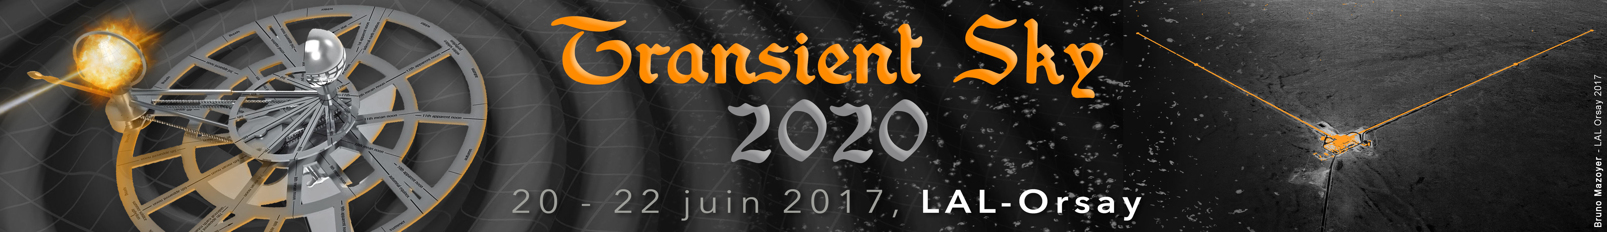


Multi-messenger astronomy
with gravitational waves
S. Antier
CNRS/IN2P3/LAL
TS2020, Orsay
21/06/2017

Slide 2
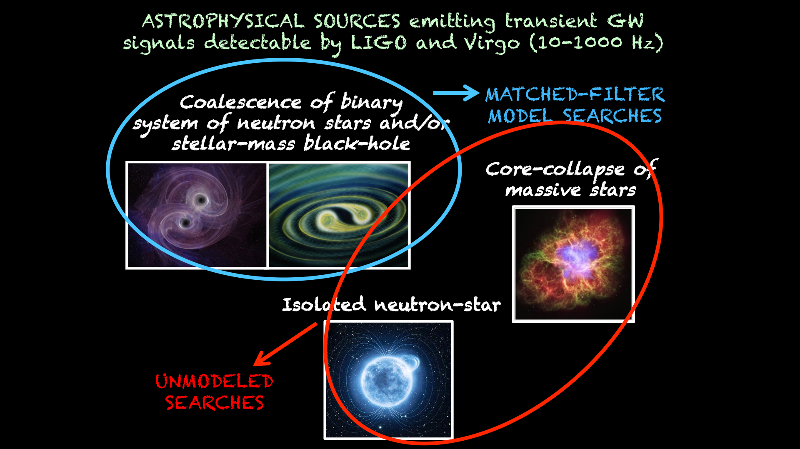
Multi-messenger astronomy with LIGO/Virgo
Cf. Marica Branchesi

Slide 3
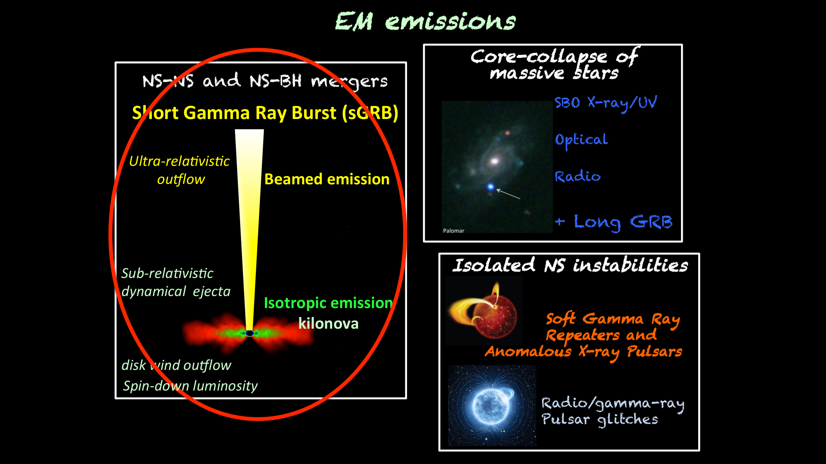
Multi-messenger astronomy with LIGO/Virgo
neutrino
Cf. Marica Branchesi
Request a large number of facilities in multi-wavelength

Slide 4
EM and GW: Model dependencies
Are the GW and EM emissions simultaneous ?
What is the possible time delay between GW and EM?
What are the uncertainities in the observed EM event time?
What is the temporal on-source window to use?

Slide 5
Multi-messenger astronomy with LIGO/Virgo (O2)
Multi-messenger group with LIGO/Virgo > 90 MoU signed
Astronomical institutions, agencies and groups of astronomers from 20 countries
More than 200 instruments covering the full spectrum (space and ground space telescopes)
Notes:
A lot of The Ligo/Virgo community

Slide 6
Multi-messenger astronomy with LIGO/Virgo
Triggered analysis
Search that uses EM or neutrino observations to drive the detection of GWs
Coïncidence Search
Compare sets of candidates events
EM Follow-up
Search EM/neutrino counterpart candidates after GW identification

Slide 7
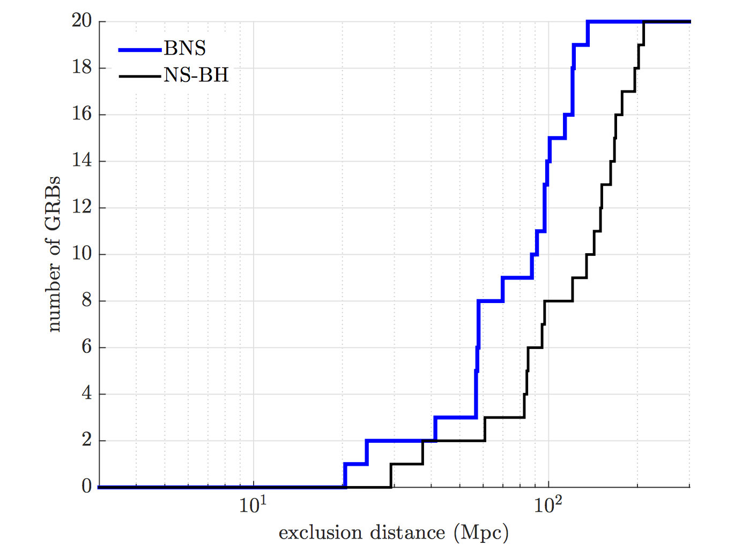
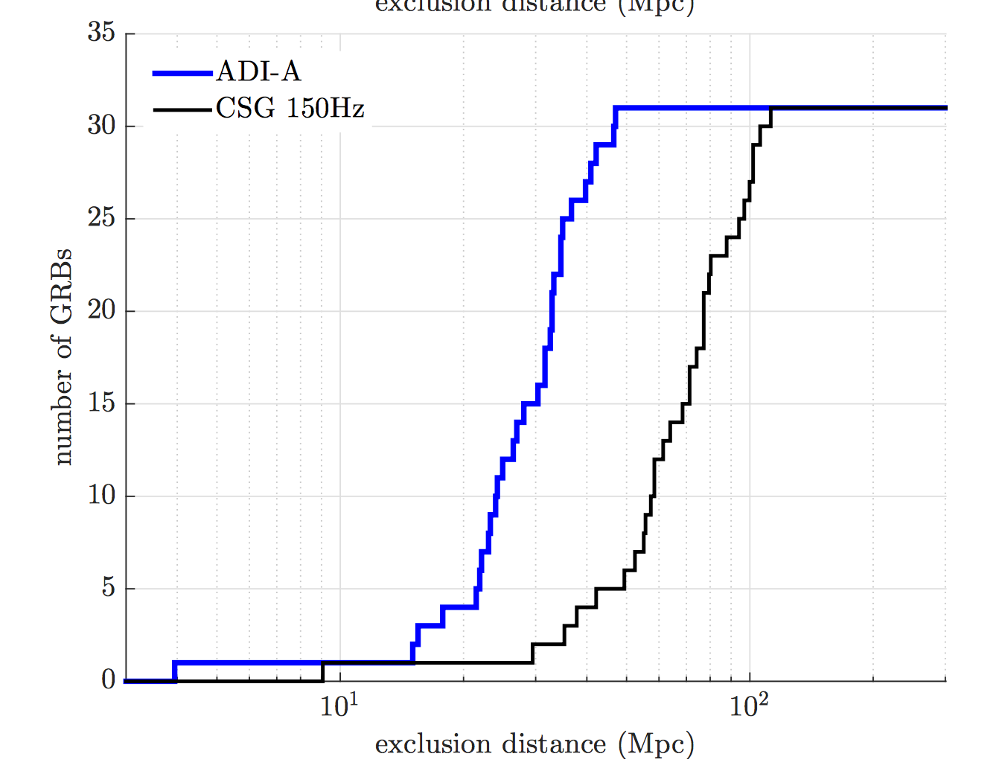
External triggers and GWs: triggered analysis
GRB prompt emission, SN explosion in local galaxies, flares SGR, pulsar glitches, low and high energy neutrino
Known event time and sky position
reduction in search parameter space for GW searchs
gain in search sensitivity
Unmodeled GW search (31 GRBs)
with 10⁻² Moc² energy in GW (optimistic)
Binary system coalescence (19 short GRBs)
150 Mpc
31 Mpc
90 Mpc
71 Mpc
Non GW-detection result: lower bounds on the progenitor distance
Abbog et al. 2016, ApJ in press, arXiv:1611.07947

Slide 8
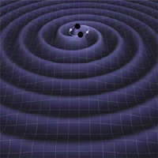
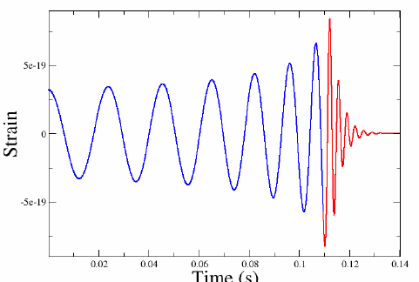

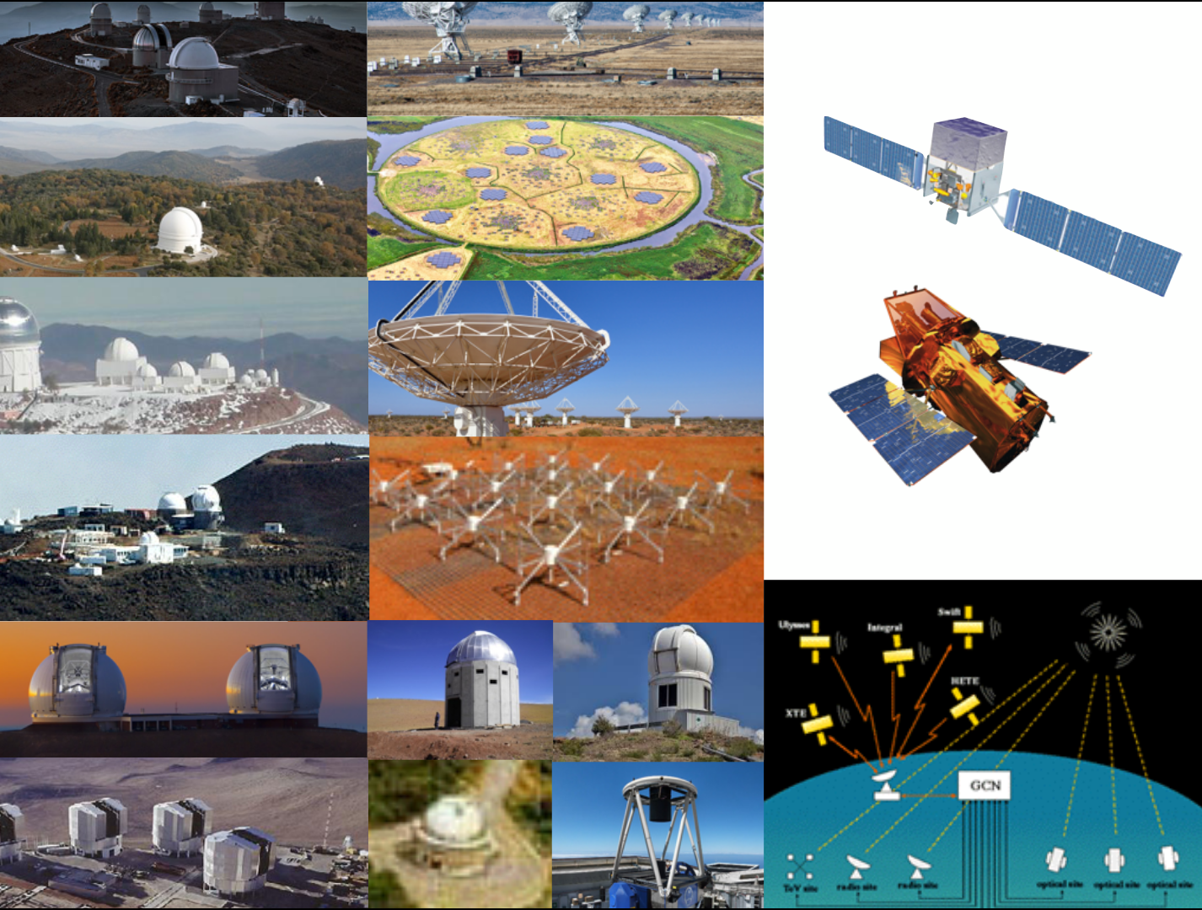
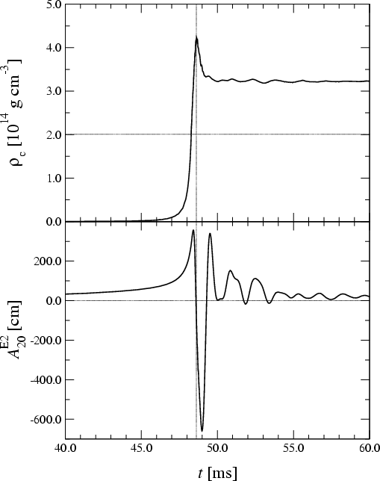
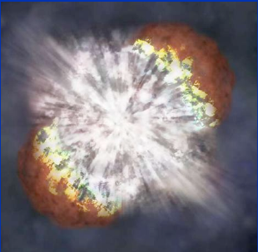
EM follow-up process during O2
Due to poor detector quality
(ex: identification of unknown noise)
Modeled search
Covers NS-NS
and NS-BH systems
Few minutes
NO
Automatic validation of the trigger
(trigger significance, detector sanity, data quality, source localization)
Telecon with interferometers, and pipelines experts and EM advocates and det. Caracterisation
Unmodeled search
Covers GW transients in 16-5000 Hz
without assuming prior knowledge of signal waveforms
YES
30 min – 1h30
Alert sent to MoU parters
Parameters estimations : hours, days

Slide 9
EM follow-up process during O2
Information sent for the MoU partners
During O1 and O2 run
Sky probability maps in healpix projection and in fits
Released with GCN protocol: notices and circulars
Basic source classification
Accessible page on the « Gravitational wave Candidate Data Base »
  Prompt low-latency analysis results as the detection pipeline
  FAR (<1/ month)
  Date/time of the event
During O2 run: additional info
CBC events:
  3D skymaps (source distance)
  Astrophysical origin flag, tell if the trigger is an astrophysical source
  EM_bright flag is quoted, given probability that there is any NS associated to the event

Slide 10
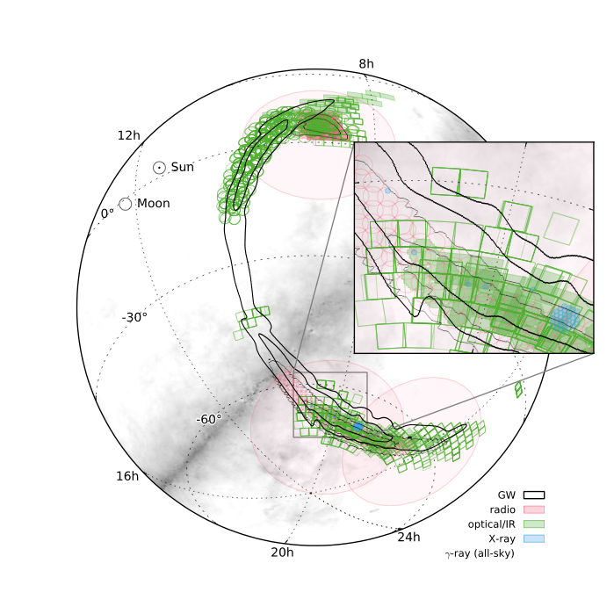
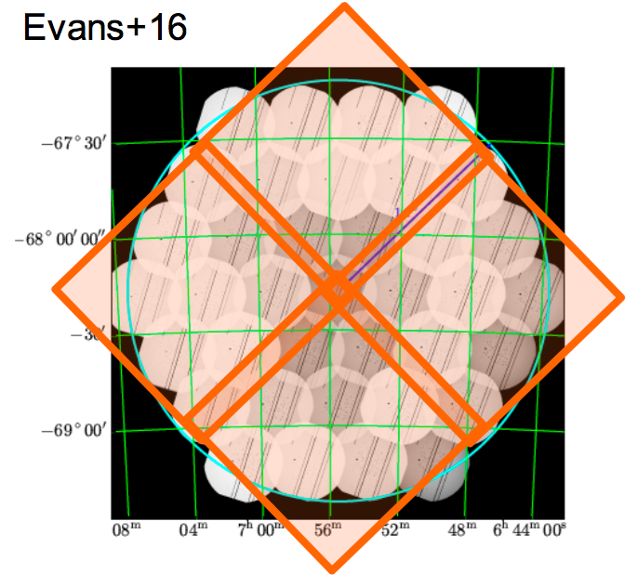
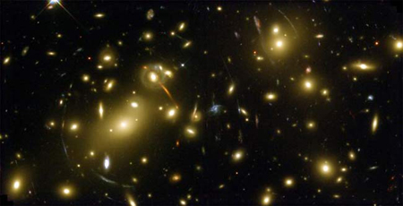
TRACK THE EM/NEUTRINO OF GW ALERTS
GW sky localisation error box (hundreds deg²)
Wide Field of view instruments
Follow-up with narrow fields instruments
Caracterisation of the counterparts candidates
Needs specifics observational strategies
WHERE ? WHEN ? TO SEARCH ?
Trigger candidates
Tiling stategy
Galaxy-targeting
Needs a large astronomical collaboration
GW150914 error localisation box

Slide 11
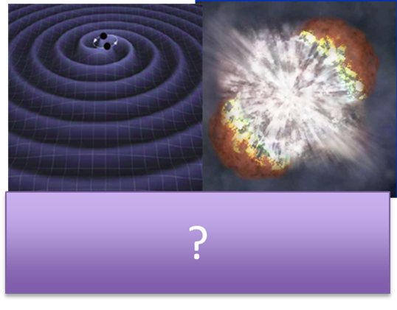
TRACK THE EM/NEUTRINO OF GW ALERTS
COINCIDENCE SEARCH – EARLY SEARCH
Neutrinos
Gamma-ray
X-ray
Ice-cube + Antares
Monitor the all sky
Model dependant
less contaminants
all-­sky survey
Beamed emission
less contaminants
No wide-field telescope

Slide 12
TRACK THE EM/NEUTRINO OF GW ALERTS
EARLY SEARCH
Lot of contaminants
10⁴-­10⁵ variable objects over 100 sq. degrees
Difficult to monitor the whole sky
Optical
Radio
Less contaminants
Wide-field array at low frequencies (MHz)
Faint sources
Long delay between GW and radio emission

Slide 13
TRACK THE EM/NEUTRINO OF GW ALERTS
COINCIDENCE SEARCH – TYPICAL SEARCH
Neutrinos | High Energy
High coverage of the skymap (> 90%) | Medium coverage in 100 GeV - TeV
Typically search: ± 500 s | Typically search: ± 60 s Follow-up (few ks)
Track muon neutrino candidate Icecube: Coïncidence searches with other data streams, including the high-energy starting events and Supernova triggers. | HAWC: Sliding window: 0.1 – 100 s
Gamma-ray | X-ray/ Optical
High coverage of the skymap (> 70%) | X-ray Small covergae (< 5%) Medium coverage Optical (> 20 %)
Typically search: ± 20/100 s | Typically search: Follow-up (ks)
Analysis on the count rate on different timescales: 0.256 (1 – 8) 40 s | X-ray: Galaxy targeting (> 50) PS1/ATLAS/iPTF: 10 – 40 exposure time SVOM/GWAC: crosss matching analysis
TRANSIENTS FOUND
< 10 Neutrinos
< 5 High Energy – Gamma
> 100 Optical

Slide 14
TRACK THE EM/NEUTRINO OF GW ALERTS
FOLLOW-UP OF TRANSIENTS CANDIDATES
Follow-up of a Pan-STARR candidate (30/12/2015) realised during the GW151226
18786, PS115dpn
Gemini, 18811, tentatively
unsual spectrum
VLA,18846
C-band, obs
IPTF, 18848, detected R-band previously observed, data archival
GMOS, 18848,
Similar GCN18111
Swift/XRT, 18849, no X-ray emission, UVOT detected src as rank 3
VLA, 18873,
no variability of radio counterpart
GRAWITA, 19145, LUCI infrared spectra, perticular supernovae Ibn
GTC, 19258, z=0.1749 H-alpha NII emission lines
PS115dpn followed
in multi-wavelengh
X-ray (XRT), Ultraviolet (UVOT), Optical (PS1,iPTF), Near-Infrared (GRAWITA), Radio (VLA)
Spectroscopy (GTC, GMOS)

Slide 15
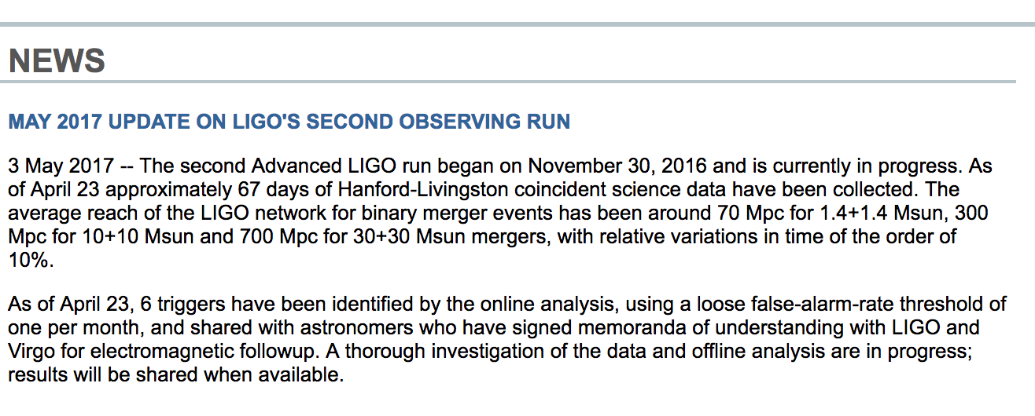
O2 run status
Number of alerts:
6 event candidates, identified by online process
Shared with EM partners above a very low false alarm threshold (~1/month)
→ they cannot be considered (and will mostly not be) detections!
Sensitivity:
BNS 70 Mpc,
BBH (M=10+10 Mo) 300 Mpc,
BBH (M=30+30 Mo) 700 Mpc

Slide 16
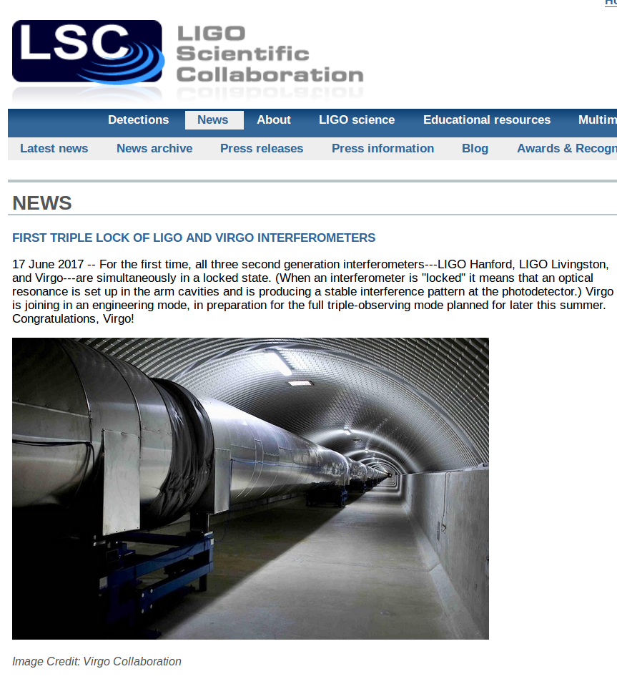
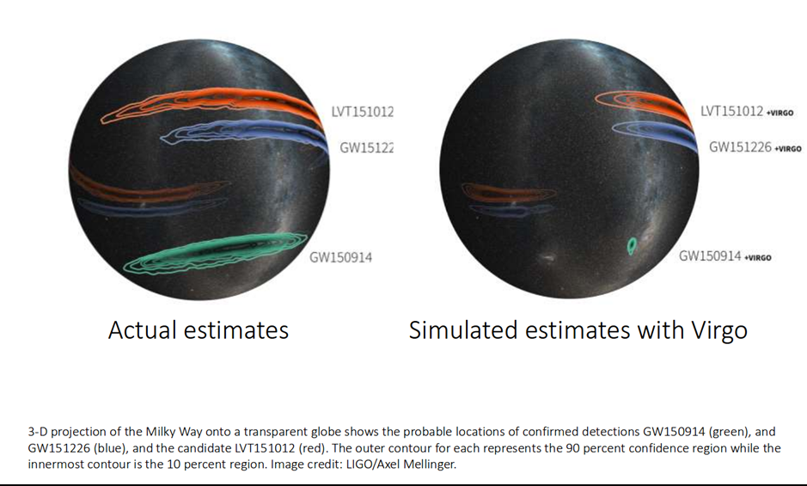
O2 run status
Virgo (sensivity > 20 Mpc) will fundamentally transform the character of time domain astronomy in the context of GW observations

Slide 17
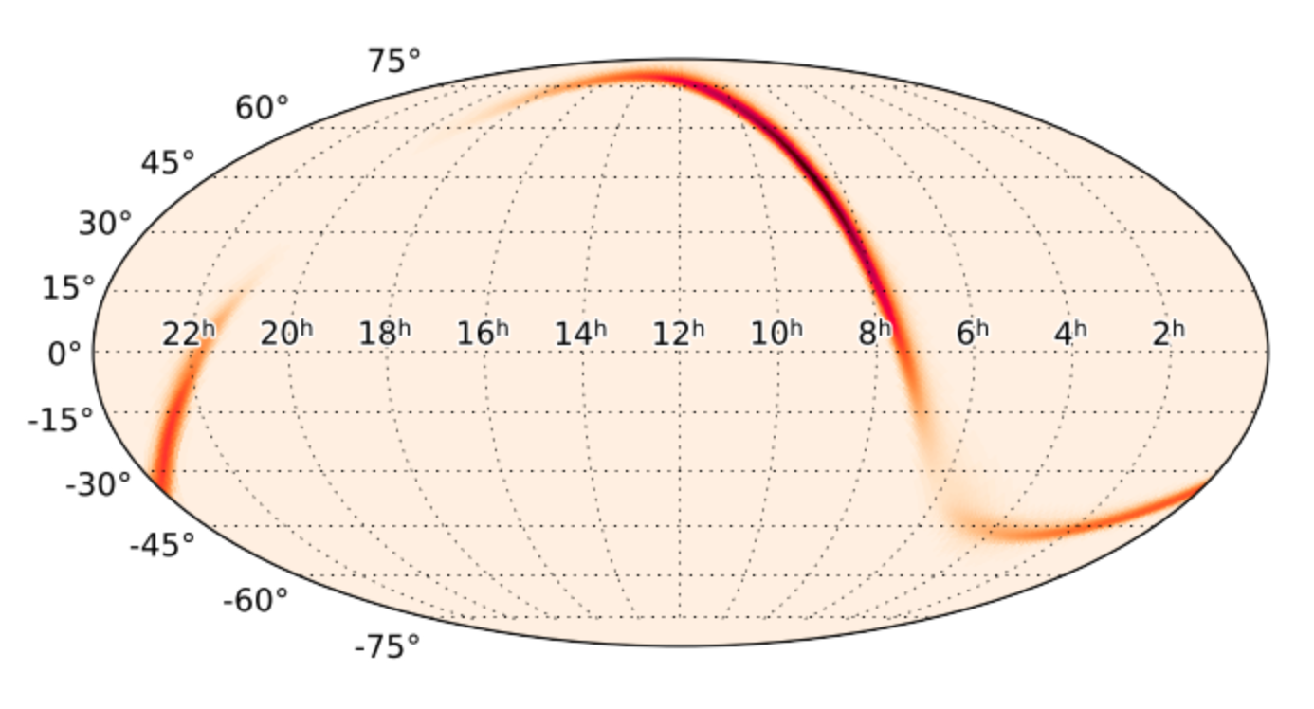
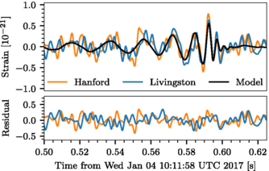
GW170104
LVC 2016 Phys. Rev. Les. 118, 221101
Trigger time | Jan 4 2017 10:11:59 UT
First LVC GCN (20364) | + 6.3 h after the T0
 | FAR = one per 6 months
 | 50 % credible region spans about 1632 deg²
First LVC GCN (20385) | + 2.6 days after the T0
 | FAR < 1/100 yrs
 | 50 % credible region spans about 2065 deg²
Last update of the skymap
90% credible region: 1609 deg²

Slide 18
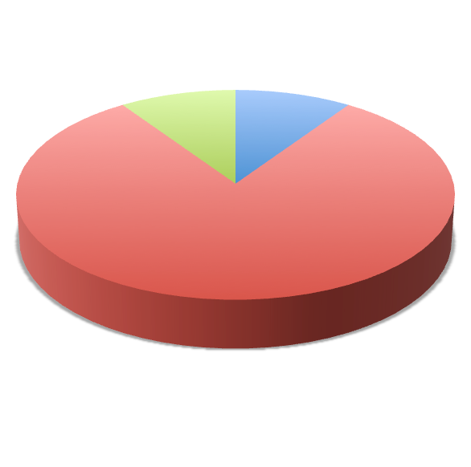
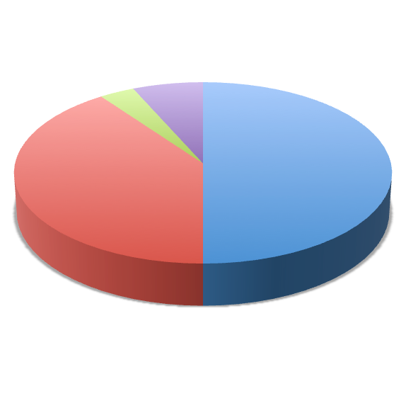
GW170104 follow-up
30 groups and 50 instruments involved in the EM/Neutrino follow-up
70 GCNs shared with the group sent https://gcn.gsfc.nasa.gov/other/G268556.gcn3
Neutrino
Radio
High energy
Radio
High energy
Optical
Optical
30 instruments to tile the sky­‐map
22 instruments to characterize the candidate counterparts
Coïncidence and radpid Follow-up
Classification of the candidates (hundreds of candidates)
Atlaseu candidate: reported in 15 GCNs
discovered 1 day after the trigger time within the 16% probability contour.
transient ATLAS17aeu possible host galaxy was located at z=0.199, and the flux was fast fading.
A series of gamma-ray archival analysis revealed that ATLAS17aeu could be consistent with the afterglow of GRB070105A, detected previously by POLAR (GCN#20387) and ASTROSAT (GCN#20389) and which happened 21h fater the GW event.
Other follow-up observations in optical and X-ray (GCN#20390,20400,20415), radio (GCN#20396) confirm that the fading flux was consistent with GRB afterglow and not related to the GW event.
IPN, Konus‐Wind, AstroSat-CZTI classified GRB170105A as long GRB (GCN#20412,20406,20413).
The possible TNG host galaxy could also be observed (GCN#20735).

Slide 19
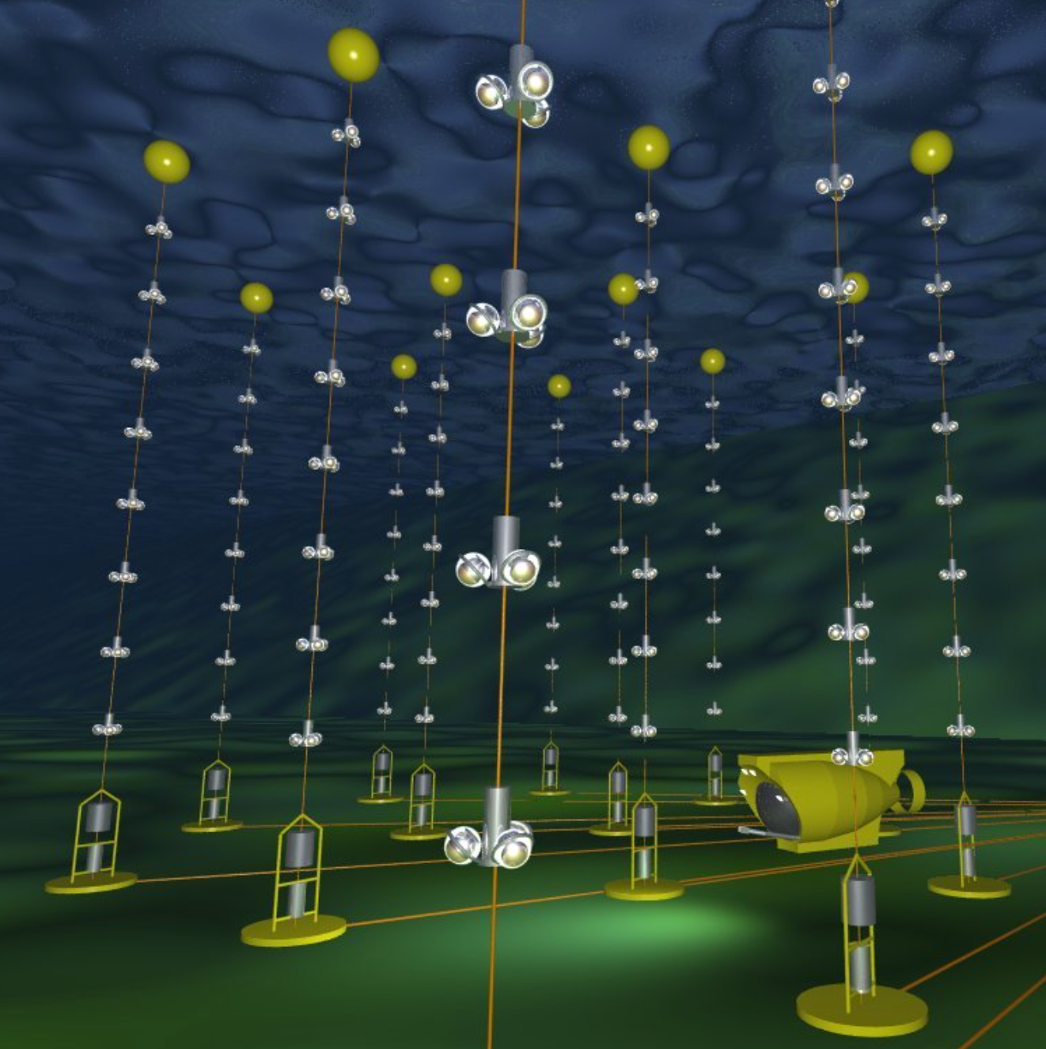
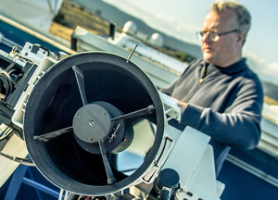
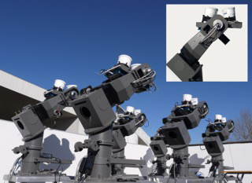
FRENCH GROUP AND GWs
LVC groups: mainly in Virgo team
MOU EM-FOLLOW UP
Antares
Triggers Analysis
Burst: LAL, APC
Merger: LAPP, APC
Detchar: LAL, LAPP
Interferometers
Control: APC, LAL, LAPP, LKB
EM-follow-up/GRB: LAL, APC, ARTEMIS, LAPP
Optics : LMA, LAPP, APC
Vacuum : LAL, LAPP
Quantum noise : APC, LAL, LAPP, LKB, LMA
Lasers: ARTEMIS
TAROT
SVOM/GWAC
And FERMI/GBM, GRAWITA ….

Slide 20
GW alerts strategy
LIGO-Virgo: Triggger out (2018 -)
LIGO-Virgo: Triggger IN (2018 -)
GW triggers
Rate | 5 – 15 / yr (80 Mpc)
Confidence level | FAR < 1/100 yr (public) FAR (2017) ~1/month (MoU)
Description of the triggers | Automatic analysis from the two groups: CBC and Burst (few min delay), Parameter estimation (few hours)
Actions | Automatic process checks including data quality checks, FAR, if the trigger looks similar to known noise. For O3, if FAR > 1/100 yr, alerts sent automatically. The alert could be retracted after a while.
Triggered analysis
External ToO | in coincidence with Swift/BAT and Fermi/GBM, SVOM using offline analysis
Start of the analysis | No delay, as soon we receive the alert
Delay of the observations | Duration ks, first analysis after 1h-days Specific features 2 types of analyses: one without any asumption of waveform [-600, max(+60s),T90s], the other is on short GRB based on CBC [-5,1] For sub-threshold, latency is longer (weeks)
In case of triggers | telecon inside LVC and GCN and VO for further observation

Slide 21
LIGO-VIRGO: Alerts and open data
FORMAT OF THE ALERT/EXCHANGE WITH OTHER COMMUNITY
VO events
GCN with updates: generally first update of the skymap 48h after T0
Last update few month after
GW data base destinated to MoU partners
Wiki open to partners
Telecon
Data Policy
OPEN DATA (only LIGO): delay of the release 18 months
Double detection GRB/GW: Policy of the delivery of the alert and open data to be discussed
Tools needed
FAR/src Nature given to community → could be used for filtering GW alerts
Follow-up reported manually, complex to use with ALADIN Tools
Online database of the counterpart candidates
VO events send by all the partners to automatize the follow-up campaign
Other ideas: shared observatory time

Slide 22
LIGO - VIRGO: Transient sky in 2020
Point of view from your community about transient sky in 2020 ?
It’s a big challenge to find the EM counterpart for LIGO/Virgo due to the wide sky localization error box
Only an international coherent EM-follow-up search (transients candidates with wide FOV), caracterisation of the sources with narrow field instruments) is a key to sucess
  Needs adequate tools to report counterpart triggers (data base ? )
  Needs to harmonize X-rays/optical catalogs for better identification
  Needs wide FOV instruments in X-rays and optics
  Needs online pointings to spread the observations among the sky localisation error box
Triggered search of GWs with GRB and supernovae
another very interesting search, reduce the parameter space

Slide 23
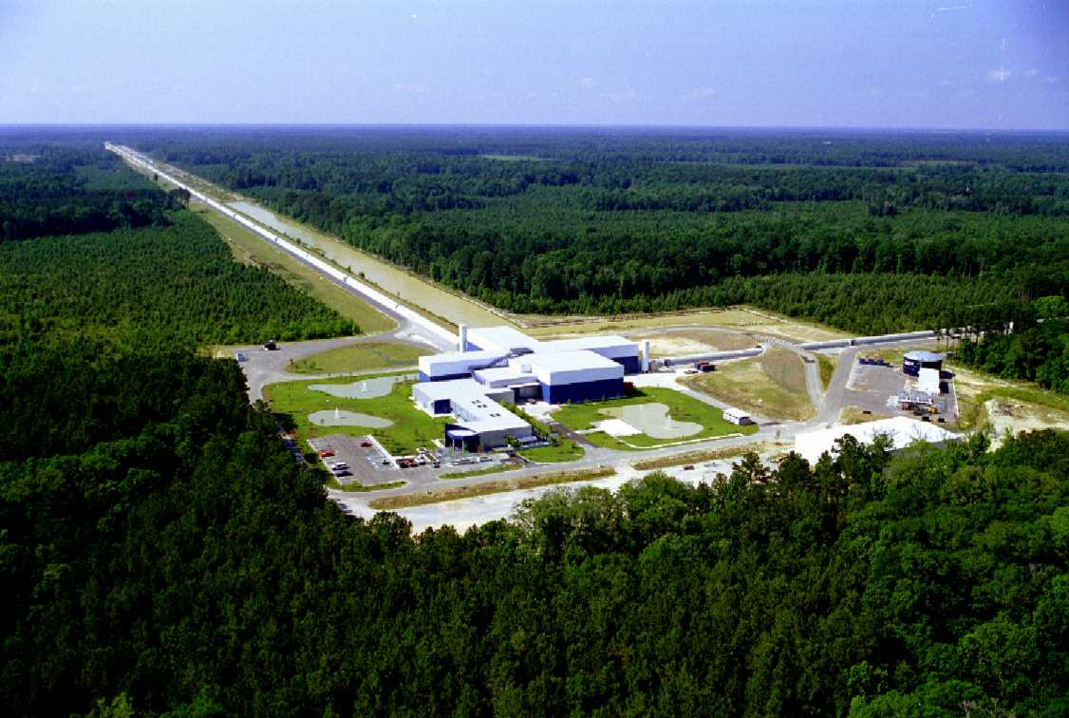
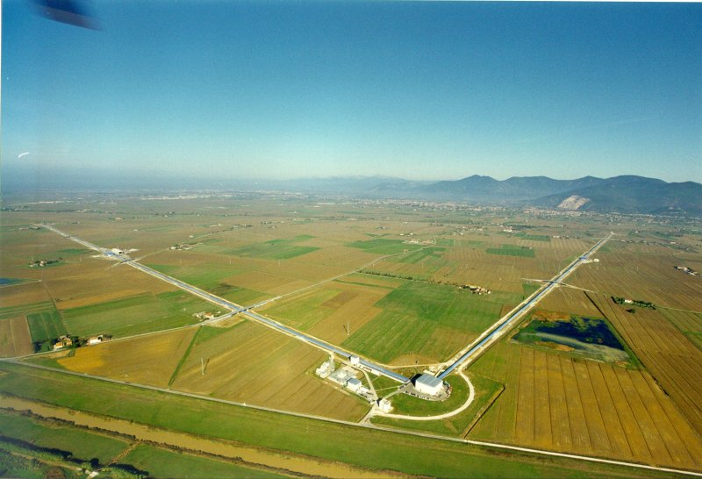
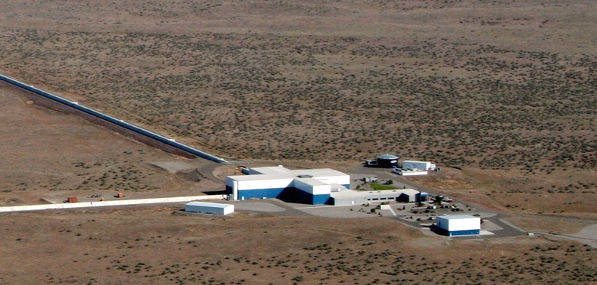
DISCUSSION COULD START !

Slide 24
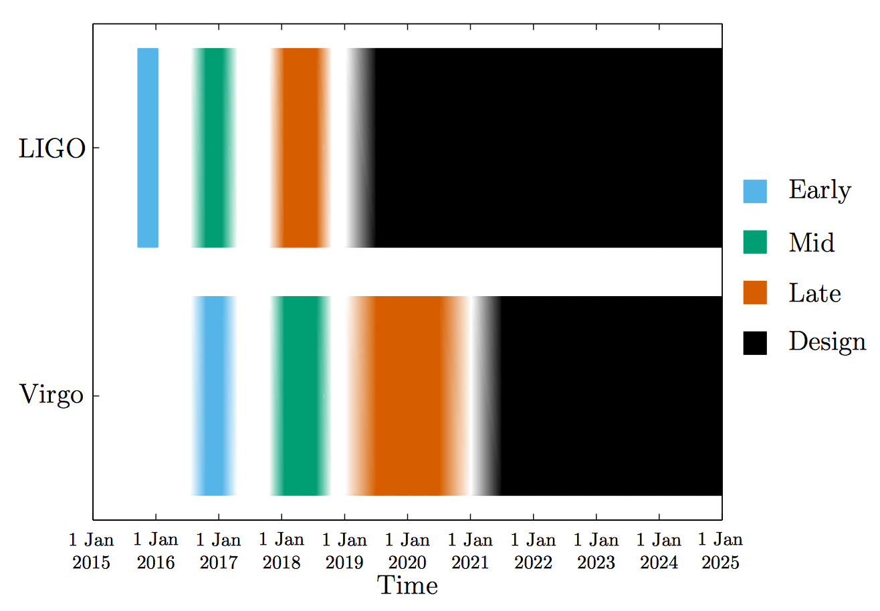
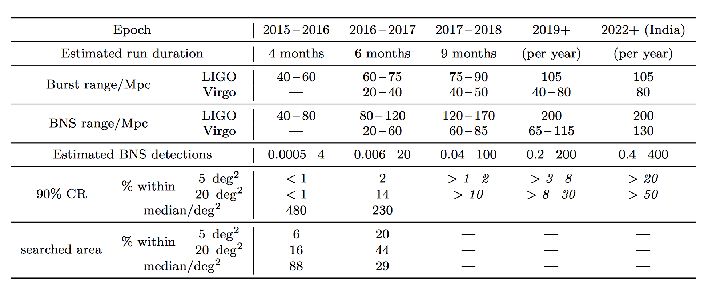
O3 and Beyond
Observing schedule, sensitivities, and source localization for BNS, LVC 2016, LRR, 19, 1

