Slide 1
Measuring the Neutrino Mass Ordering with KM3NeT-ORCA
João Coelho
APC Laboratory
03 March 2017

Slide 2
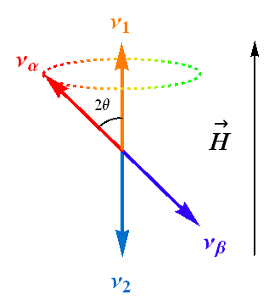
Neutrino Oscillations
Neutrinos are created in a superposition of mass states
Time evolution generates flavour oscillations
Simple QM

Slide 3
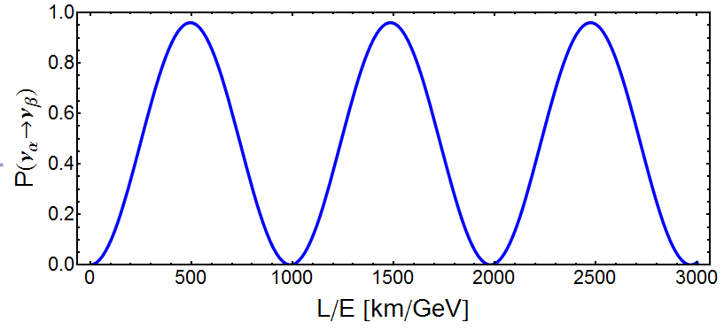
Neutrino Oscillations
α (Δm²)⁻¹
sin²2θ

Slide 4
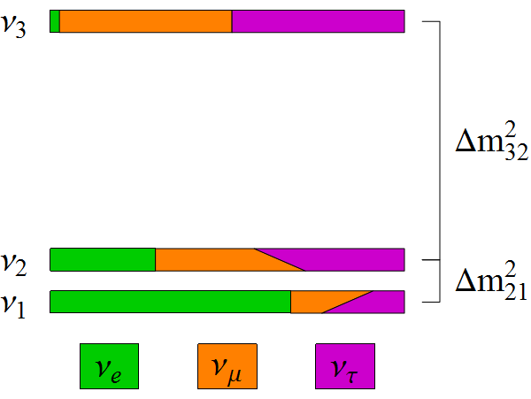
Neutrino Oscillations
There are 3 neutrinos, so things are a bit more complicated
Two independent differences in mass-squared (Δm²₂₁, Δm²₃₂)
3 mixing angles (θ₁₂, θ₁₃, θ₂₃) and 1 CPV phase δ_{CP}
sin²θ₁₃
~ sin²θ₂₃
~ sin²θ₁₂
cosδ_{CP}

Slide 5
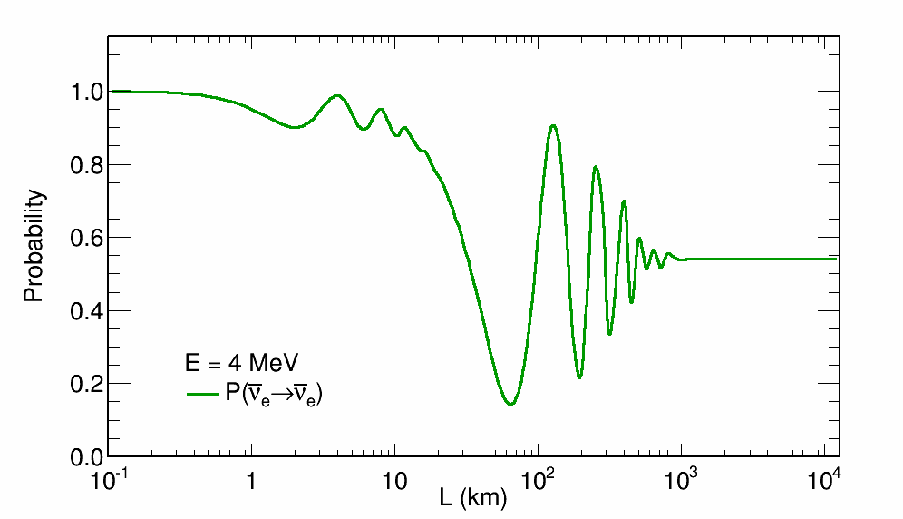
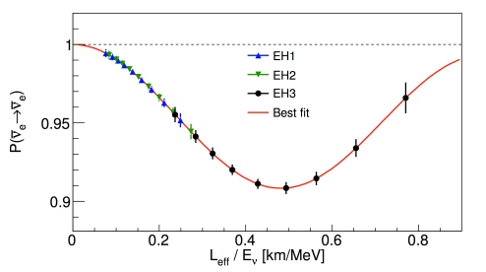
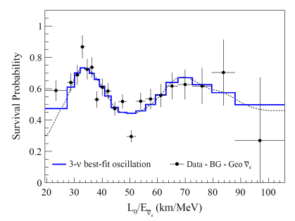
The Data: MeV
Reactor and solar nu’s measure θ₁₂, θ₁₃ and Δm²₂₁
Δm²₃₂, θ₁₃
Daya Bay
KamLAND
Δm²₂₁, θ₁₂

Slide 6
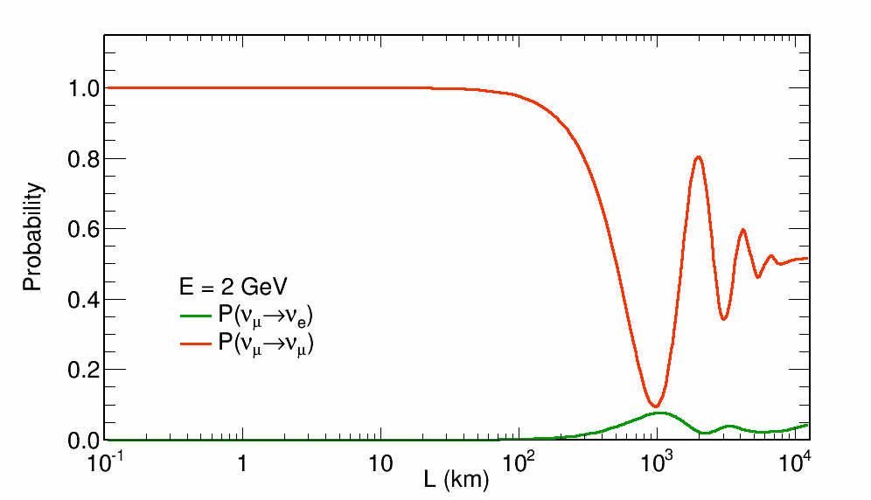
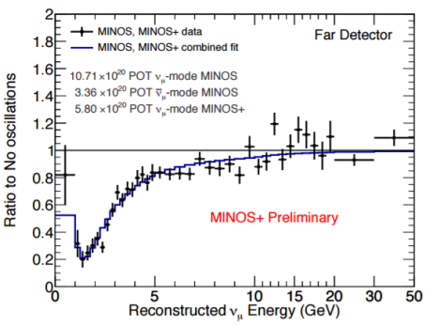
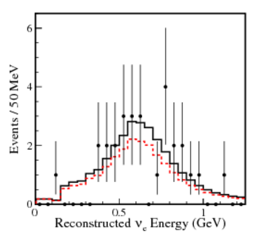
The Data: GeV
Atmospheric and accelerator nu’s measure θ₂₃ and Δm²₃₂
Also sensitive to θ₁₃ and δ_{CP} .
MINOS
Δm²₃₂, θ₂₃
T2K
δ_{CP} , θ₁₃

Slide 7
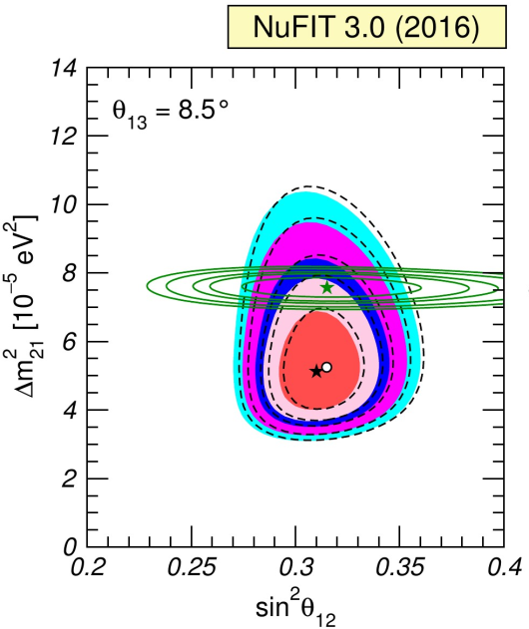
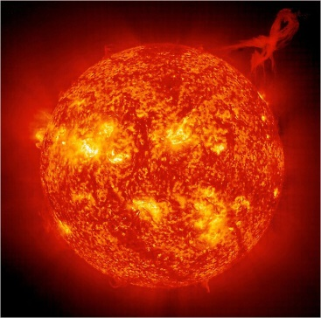
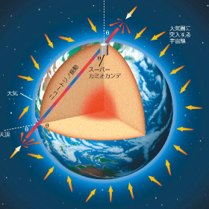
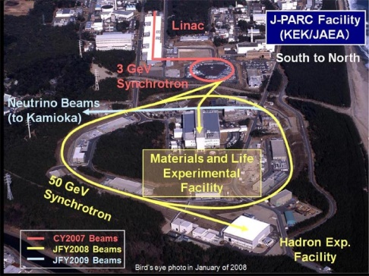
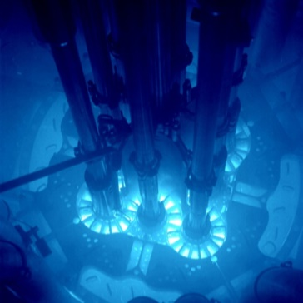
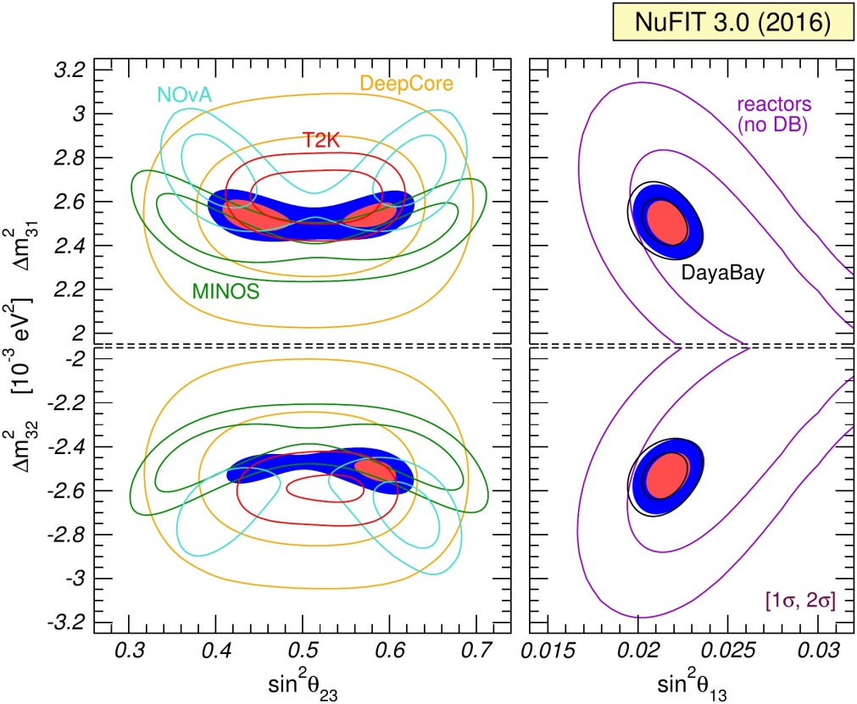
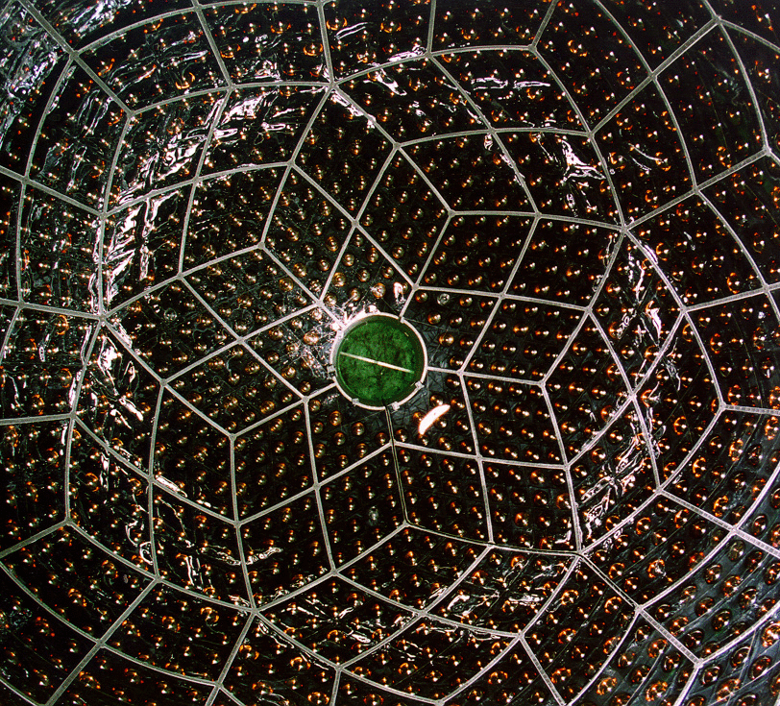
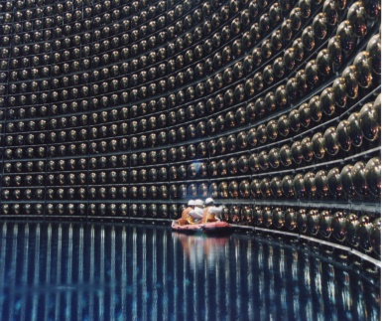
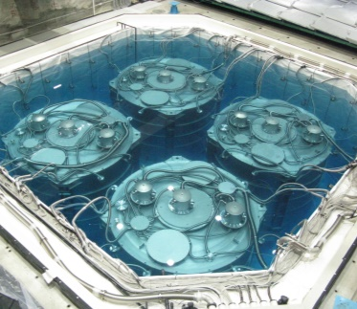
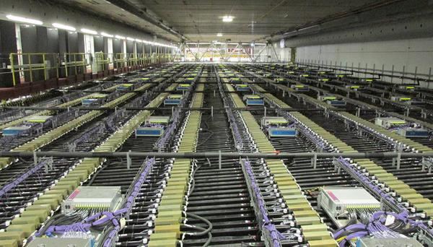
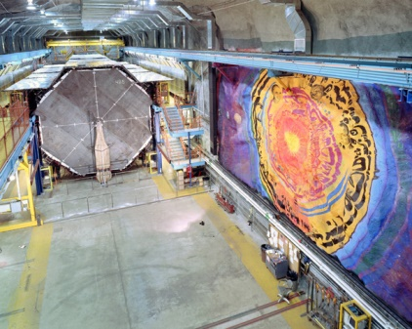
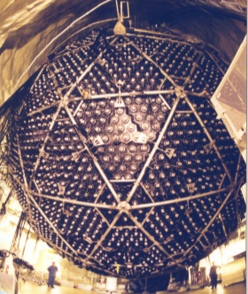
Global Picture
arXiv:1611.01514 [hep-ph]
Multiple sources
Multiple detectors

Slide 8
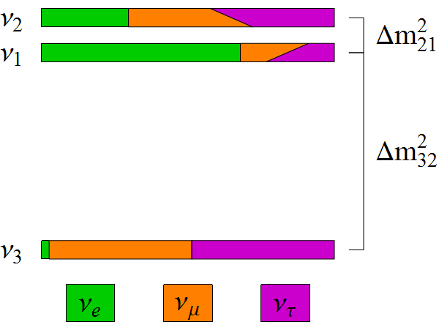
Missing Pieces
symmetries
Is θ₂₃ = π/4? Underlying symmetry?
Do neutrinos violate CP? (δ_{CP})
What is the mass ordering? (Mass Hierarchy)
Normal Hierarchy
Inverted Hierarchy
same?
Δm²₃₂ < 0 ?
(Δm²₃₁ < Δm²₃₂ ??)
JUNO
δ_{CP} ?

Slide 9
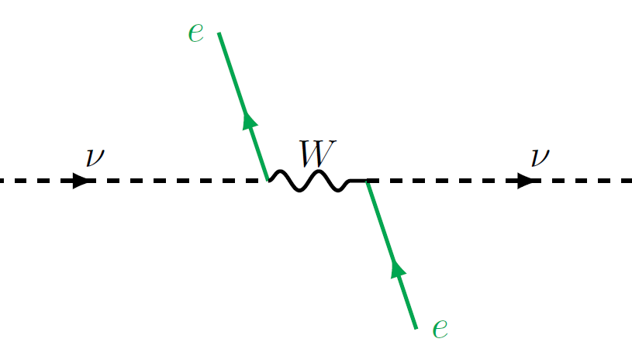
One weird trick to measure the
Mass Hierarchy…

Slide 10
Matter Effects
H₀
V

Slide 11
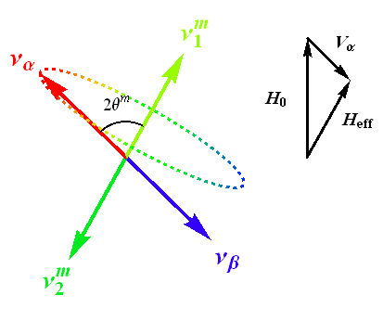
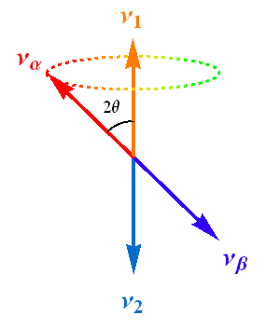
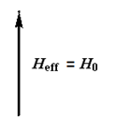
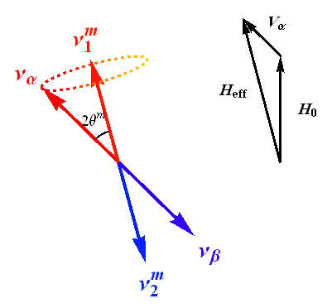
Matter Effects
H_{eff} = H₀ + V_{α}
H_{eff} = H₀ - V_{α}

Slide 12
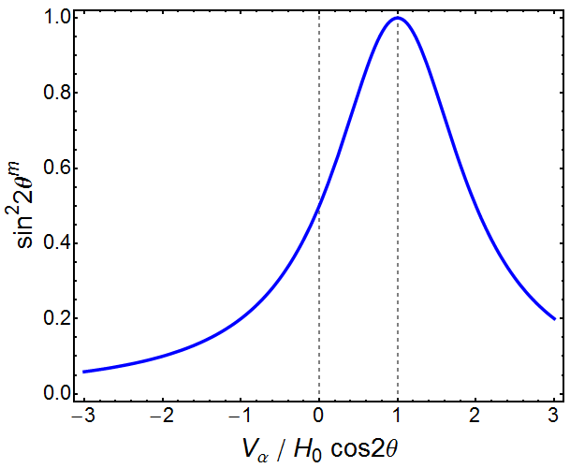
Matter Effects

Slide 13
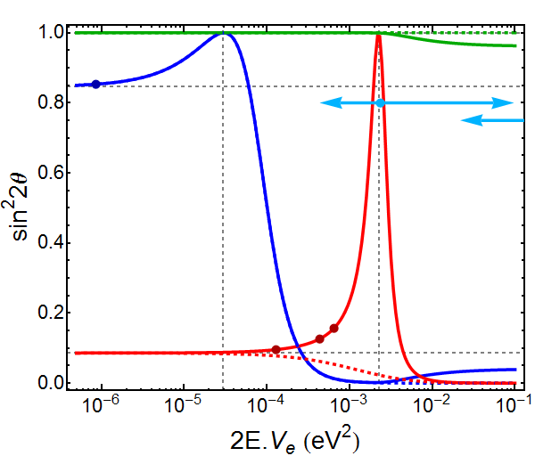
Resonances
θ₂₃
Δm²₂₁ cos2θ₁₂
Δm²₃₁ cos2θ₁₃
θ₁₂
θ₁₃

Slide 14
Resonances
θ₂₃
NH
θ₁₂
θ₁₃
IH

Slide 15
Resonances
θ₂₃
ORCA
JUNO
ARCA
θ₁₂
DUNE
θ₁₃
NOvA
T2K

Slide 16
Atmospheric Neutrinos

Slide 17
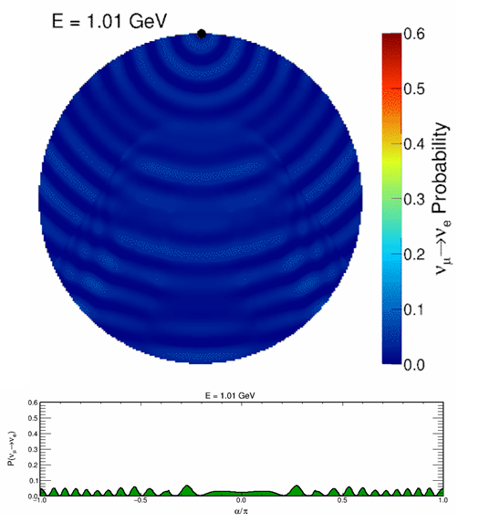
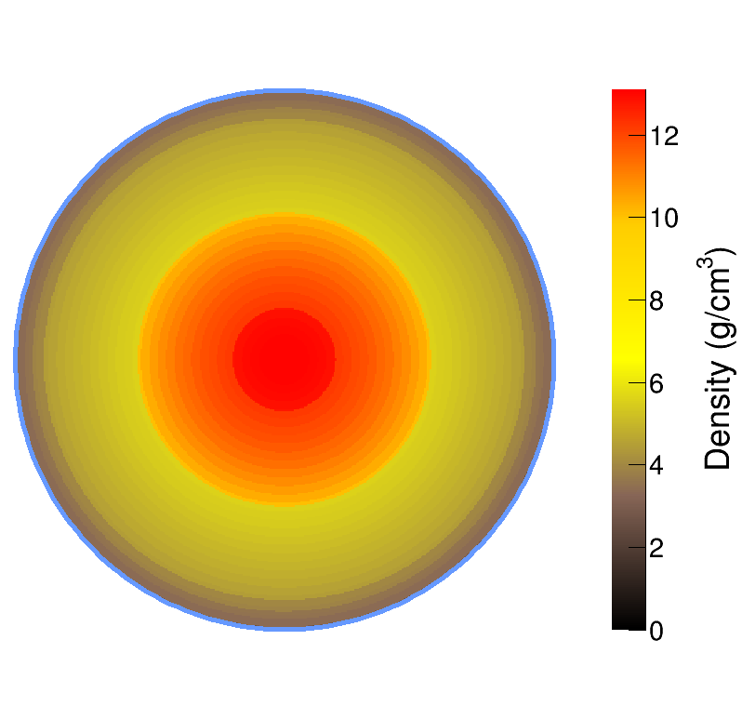
Atmospheric Neutrinos
mantle
core
Oscillations are resonant at certain energies
E_{res} ~ 7 GeV in Mantle
E_{res} ~ 3 GeV in Core
Nue appearance at the surface

Slide 18
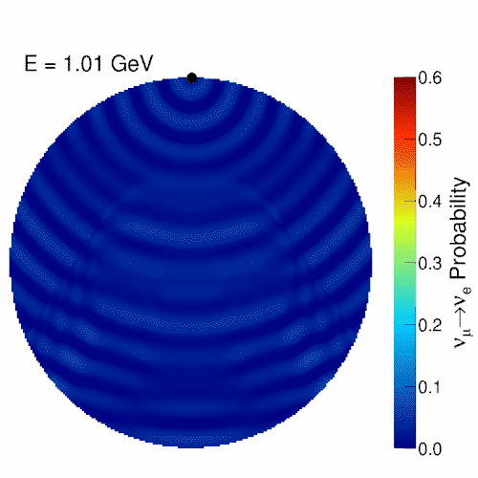
Atmospheric Neutrinos
mantle
core
Oscillations are resonant at certain energies
E_{res} ~ 7 GeV in Mantle
E_{res} ~ 3 GeV in Core
Nue appearance at the surface

Slide 19
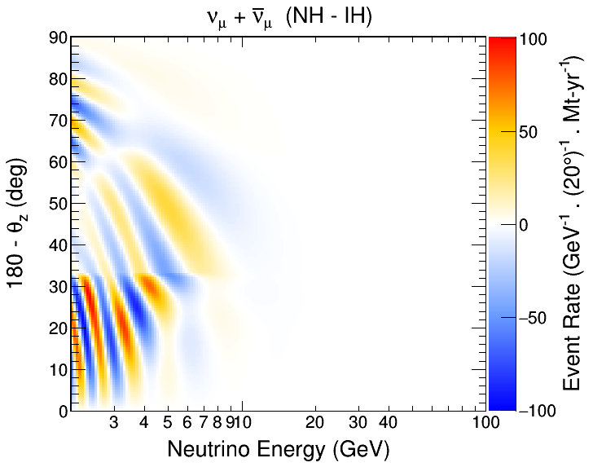
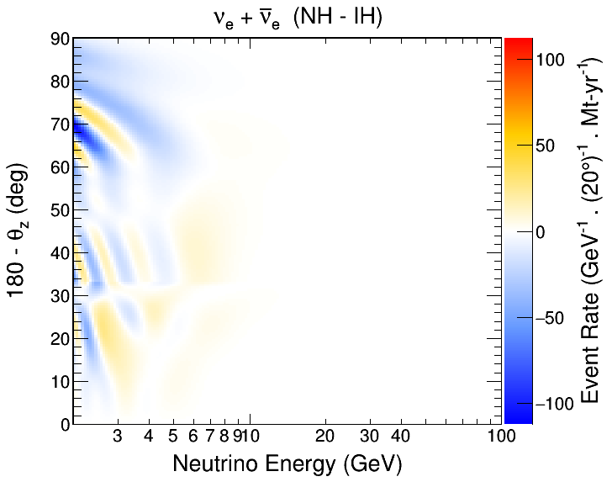
The Challenge
θ_{Z}
Measure neutrino direction and energy
Search for oscillation patterns from matter effects
Sensitive to difference in patterns between NH and IH
Requires large statistics and good energy and direction res.

Slide 20
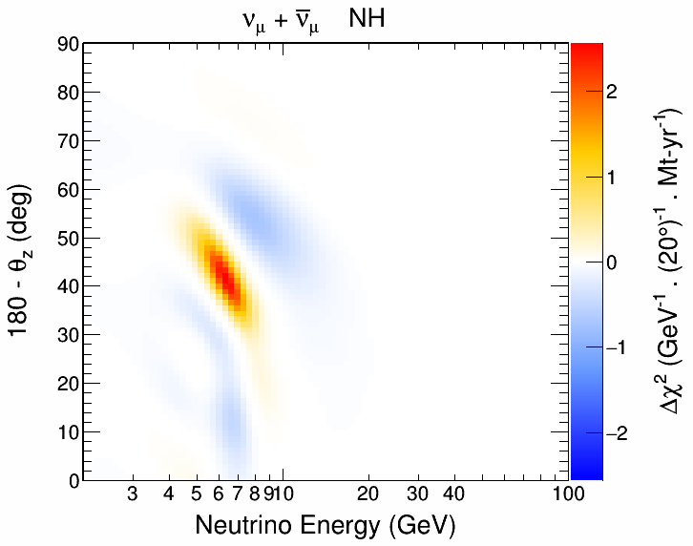
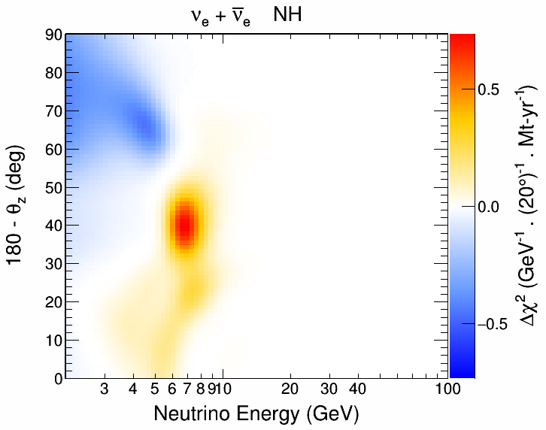
The Challenge
θ_{Z}
Measure neutrino direction and energy
Search for oscillation patterns from matter effects
Sensitive to difference in patterns between NH and IH
Requires large statistics and good energy and direction res.

Slide 21
KM3NeT Collaboration
www.km3net.org
>200 scientists
>40 Institutions
9 Countries
ORCA Site:
40km from Toulon
ARCA Site

Slide 22
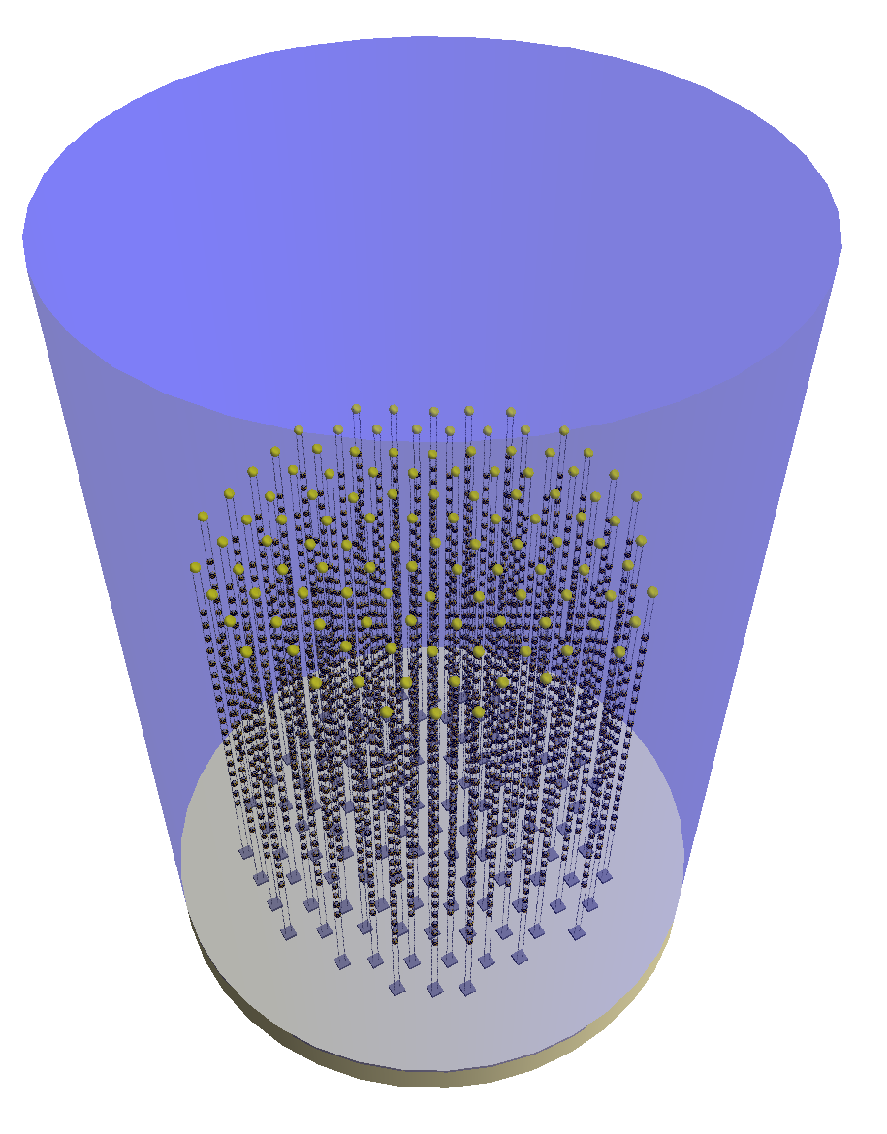
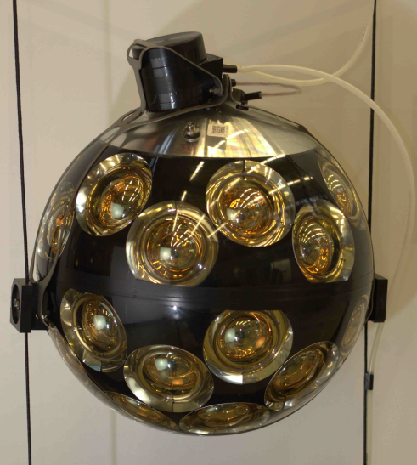
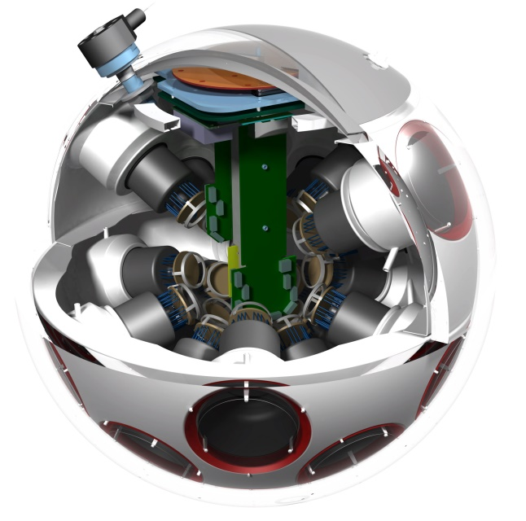
The ORCA Detector
~6 Mt instrumented
115 strings (~50 kt ~ 2 × SK)
18 DOMs / str (~3 kt ~ MINOS)
31 PMTs / DOM
Total: 64k PMTs
20 m
43 cm
9 m
~200 m
Optimized for MH sensitivity
~210 m

Slide 23
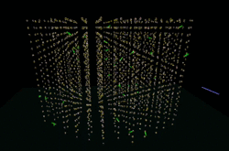
The ORCA Detector
~6 Mt instrumented
115 strings (~50 kt ~ 2 × SK)
18 DOMs / str (~3 kt ~ MINOS)
31 PMTs / DOM
Total: 64k PMTs
20 m
43 cm
9 m
~200 m
Optimized for MH sensitivity
http://www.cherenkov.nl/
~210 m

Slide 24
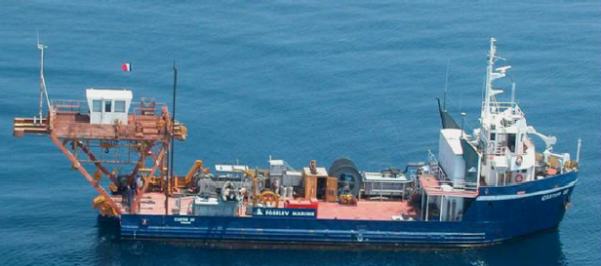
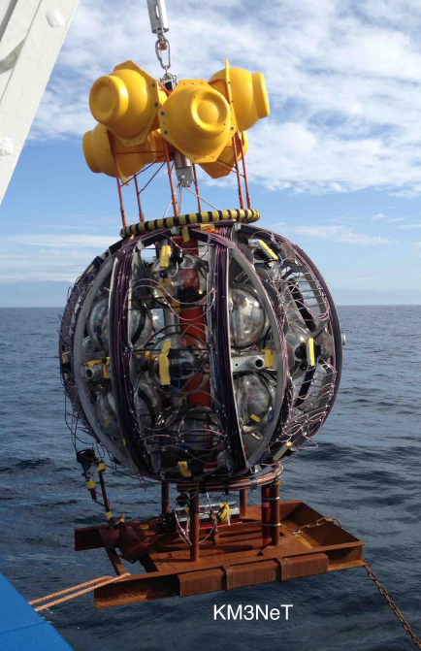
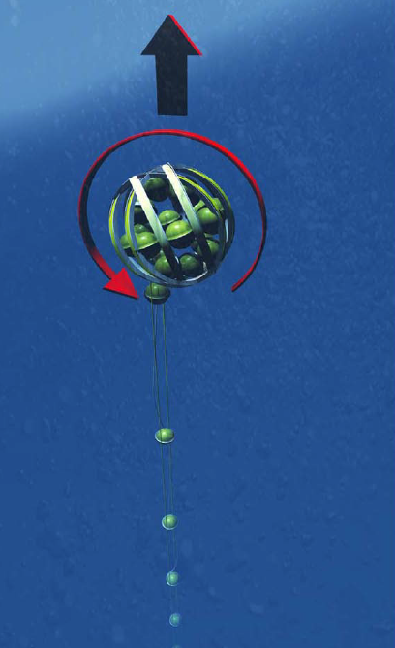
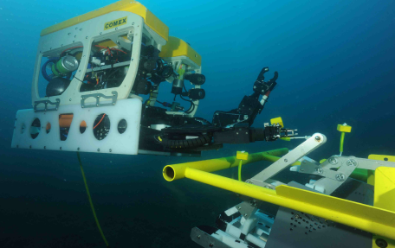
Deployment
String fitted to Launcher Vehicle
Delivered at a depth of 2450m
Dynamic Positioning: 1m precision
ROV connects cable to junction box
Boat triggers unfurling of the string
Watch ARCA string deployment at:
https://www.youtube.com/watch?v=tR8jwgG6uzk
ROV
LV
Unfurling

Slide 25
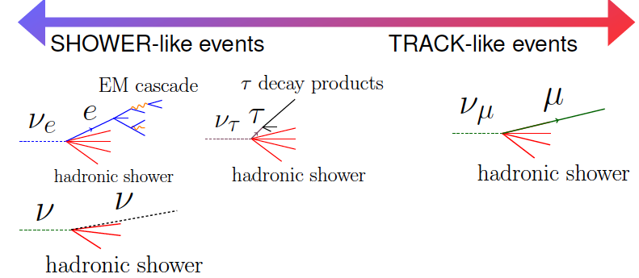
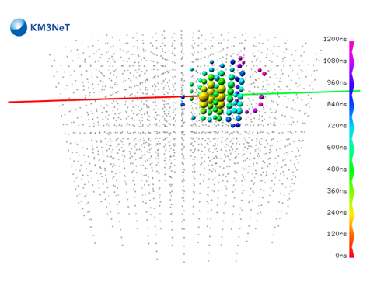
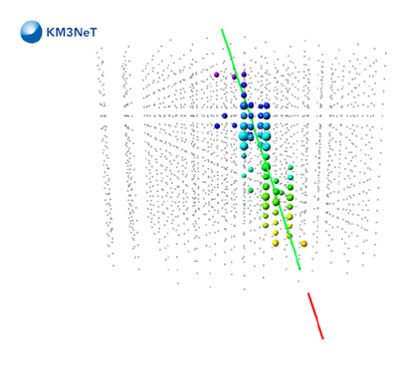
Measuring Neutrinos
Track-like
Shower-like

Slide 26
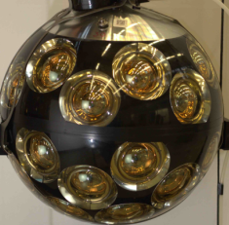
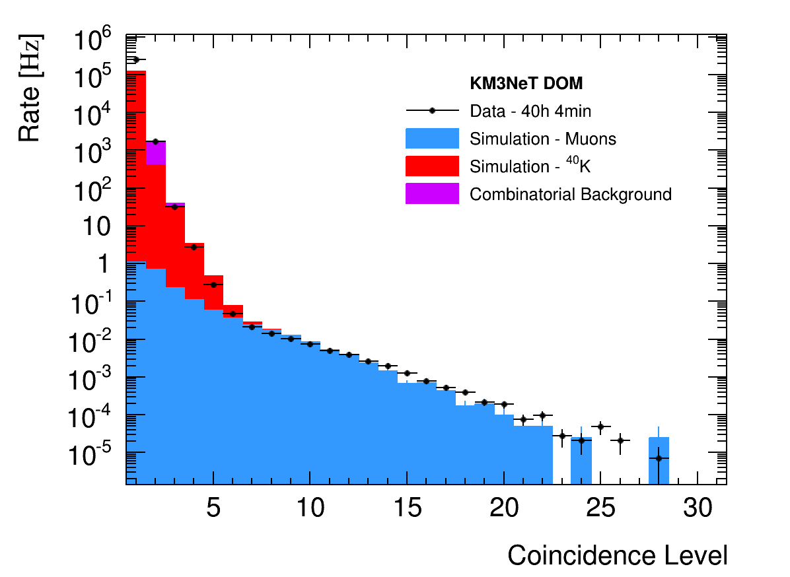
Trigger
Optical background mostly from ⁴⁰K decays in the water
Measured: 8 kHz uncorr., 340 Hz level-two coinc. / PMT [Eur. Phys. J. C 74, 3056 (2014)]
Look for coincidences in time and PMT direction to reduce trigger rate.
Causality further restricts space and time correlations for extra power.
Final trigger rate ~59 Hz, with 70% of events containing a cosmic ray muon.
β
⁴⁰K
⁴⁰Ca
⁴⁰Ca
β
⁴⁰K
⁴⁰K
⁴⁰K
β
⁴⁰Ca

Slide 27
Reconstruction
Start with a track or shower hypothesis
Use causality to perform a robust hit selection
Find vertex and direction that best match hit pattern
Estimate track range for computing track energy (0.24 GeV / m)
Estimate Shower energy and direction from hit distribution after initial fit to the vertex position and time
Track Hypothesis
Shower Hypothesis
θ_{C}

Slide 28
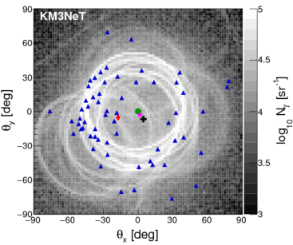
Reco Performance
Energy resolution: ~25% (Close to limit arXiv:1612.05621)
Angular resolution: Better than 10 degrees at relevant energies
ν_{μ}-CC
ν_{e}-CC
θ Res.
θ Res.
ν_{μ}-CC
ν_{e}-CC
E Res.
E Res.

Slide 29
Event Selection
Events are classified through a Random Decision Forest (RDF)
At 10 GeV:
90% of ν_{e}-CC are shower-like
70% of ν_{μ}-CC are track-like
Most atmospheric muons are removed by containment cuts

Slide 30
Full Statistical Analysis
Profile over 4 oscillation & 5 systematic parameters
Generate pseudo-experiments and compute
For each MH assumption, LLR distribution will peak at different values
Median sensitivity: probability of observing median LLR of wrong hierarchy for PEs generated with fixed true hierarchy
IH
NH
μ_{IH}
μ_{NH}
σ_{IH}

Slide 31
Sensitivity Results
~3σ MH sensitivity in 3 years
The combination of NH and upper octant of θ₂₃ would significantly improve sensitivity (5σ in 3 years)
The value of δ_{cp} has small but non-negligible impact on sensitivity
In the IH, sensitivity is mostly independent of octant of θ₂₃
Best case scenario could achieve >5σ by mid 2021 (1.5 years)

Slide 32
Other Parameters
High statistics and excellent resolution → Measure Δm²₃₂ and sin²θ₂₃
Competitive with NOvA and T2K projected sensitivity in 2020
Achieve 2-3% prec. in Δm²₃₂ and 4-10% in sin²θ₂₃
Inverted Hierarchy
T2K 2015
1σ contours
T2K 2020
NOvA 2020
MINOS
KM3NeT
KM3NeT (No E-Scale)

Slide 33
Beyond the Standard Model

Slide 34
Extended Models
Arbitrary
Perturbation
Non-Standard Interactions (NSI)
Sterile Neutrinos (3+N Flavours)
NC Contribution

Slide 35
Enhanced Matter Effects
NSI (ε_{eτ} = 0.2)
Steriles (“Curr.” Limits)
Visit https://goo.gl/CJyFoK for more

Slide 36
Non-Standard Interactions

Slide 37
NSI Motivation
Arbitrary
Perturbation
Non-Standard Interactions (NSI)
Dimension-6
+ Naturalness
TeV Scale
~ 10⁻²

Slide 38
Non-Standard Interactions
Direct limits are very weak on 3 of the 6 possible new couplings
Rich phenomenology, i.e. complicated analysis with many free parameters
Still need to study the ideal approach for ORCA
Often correlated:
J. A. B. Coelho et al., Phys. Rev. D86, 113015 (2012)
Direct Bounds
See T. Ohlsson, Rep. Prog. Phys. 76, 044201 (2013) for a review

Slide 39
Resonances w/ NSI
ε_{ee} = 1
ε_{eτ} = 0.5, ε_{ττ} = 0.25
θ₂₃
θ₂₃
θ₁₂
θ₁₂
θ₁₃
θ₁₃

Slide 40
NSI Phase Space
Very different from MH for nue
Sensitivity in both channels, but numu is correlated with MH
Still under unrealistic assumptions:
Perfect flavour selection
No systematics or nuisance pars.
ε_{eτ} = 0.2, ε_{ττ} = 0.04

Slide 41
NSI Phase Space
Very different from MH for nue
Sensitivity in both channels, but numu is correlated with MH
Still under unrealistic assumptions:
Perfect flavour selection
No systematics or nuisance pars.
ε_{eτ} = 0.2, ε_{ττ} = 0.04

Slide 42
ORCA et al.
[1] JHEP 0908:090 (2009)
[2] Phys. Lett. B594:347 (2004)
[3] PRD 86, 113015 (2012); PRD 88, 072011 (2013)
[4] Phys. Rev. D 84, 113008 (2011)
[5] M. Day and A. Karle, P3.093 Neutrino 2016
[6] J. A. B. Coelho, arXiv:1702.04508 (2017)
[7] Phys. Lett. B739:357 (2014)

Slide 43
Sterile Neutrinos

Slide 44
Sterile Neutrino Motivation
|U_{τ4}|²
NC Contribution
LSND: ν_{μ} →ν_{e} at
L/E ~ 1 km/GeV
Δm²₄₃ ~ 100x Δm²₃₂
|U_{e4}|²
|U_{μ4}|²

Slide 45
Resonances w/ Steriles
New resonant peak due to Δm²₄₁
Some intermediate behaviour between θ₁₃ and θ₁₄ resonances
θ₂₃ suppression seems to be fairly independent of Δm²₄₁
Δm²₄₁ = 0.3 eV²
θ₂₃ Suppression
θ₁₂
θ₂₃
θ₁₄
V_{e}
V_{n}
m₄²
θ₃₄
m₂²
θ₁₃
m₃²
m₁²
θ₂₄

Slide 46
Resonances w/ Steriles
New resonant peak due to Δm²₄₁
Some intermediate behaviour between θ₁₃ and θ₁₄ resonances
θ₂₃ suppression seems to be fairly independent of Δm²₄₁
Δm²₄₁ = 10 eV²
θ₂₃ Suppression
θ₁₂
θ₂₃
θ₁₄
V_{e}
V_{n}
m₄²
θ₃₄
m₂²
θ₁₃
m₃²
m₁²
θ₂₄

Slide 47
ORCA Studies
Strong sensitivity with ν_{μ} channel
Very different from 3ν resonance
Still under unrealistic assumptions:
Perfect flavour selection
No systematics or nuisance pars.

Slide 48
Preliminary Sensitivities
Promising sensitivity in U_{τ4} mixing
Consider only 1-year of data (statistics dominated)
[1] PRD 85, 077301 (2012); PRL 117, 151801 (2016)
[2] J. J. Evans, Neutrino 2016; PRL 117, 151803 (2016)
[3] Phys. Rev. D 91, 052019 (2015)
[4] PRL 117, 071801 (2016); arXiv:1702.05160 (2017)
[5] J. A. B. Coelho, arXiv:1702.04508 (2017)
[6] Phys. Rev. D 64, 112007 (2001)

Slide 49
And more…

Slide 50
Earth Tomography

Slide 52
Summary
ORCA is being built in the Mediterranean sea to measure oscillations with atmospheric neutrinos
Main goal is to determine the Neutrino Mass Hierarchy
ORCA will also improve measurements of other oscillation parameters such as Δm²₃₂ and θ₂₃
Lots of potential for other searches: sterile neutrinos, NSI, earth tomography, tau neutrinos, etc.
NMH could be determined by 2023
Read our LoI at: J. Phys. G 43 (2016) 0840 https://arxiv.org/abs/1601.07459

Slide 53
Thank you!

Slide 54
Objectives
ORCA: Determine the Neutrino Mass Hierarchy (NMH)
ARCA: Discover/Observe high-energy neutrino sources in the universe
m²
Normal Hierarchy
Δm²₃₂ > 0
m²
Inverted Hierarchy
Δm²₃₂ < 0

Slide 55
Construction Status

Slide 56
Funding and Schedule
Construction is ongoing
2 strings in operation (ARCA)
7 strings funded for ORCA (11 M€ inc. infrastructure)
Total ORCA cost: ~45 M€
Ongoing funding requests to complete full detector
7 Strings
Operational
115 Strings
Full Detector
MH
Determination
ORCA Construction
2016
2017
2018
2019
2020
2021
2022
2023
2024
2025

Slide 57
Racing to the MH
5σ
3σ
Many experiments are aiming at measuring the Mass Hierarchy
ORCA has the best chance of reaching a 5 sigma measurement

Slide 58
Atmospheric Neutrinos
Factor of ~2 between nue and numu
Factor of ~2 between nu and nubar
ν_{μ} + anti-ν_{μ} = (ν_{μ} + anti-ν_{μ} + ν_{e} + anti-ν_{e}) -> (ν_{μ} + anti-ν_{μ})

Slide 59
Resonance Formulas
Depends on
sign of Δm²₃₁ (MH)

Slide 60
Optical Noise
Optical background in full detector ~500 MHz.
Neutrino events ~40 hits in a ~500 ns window
Expect 250 noise hits (~15% purity)
Trigger approach ~5 ns time residuals
Calibrated using 2-fold coincidences
Can achieve ~3 noise hits per trigger (>90% purity)
ν_{μ}-CC
ν_{μ}-CC

Slide 61
Trigger Performance
Input a conservative noise rate of 10 kHz uncorr. (500Hz level-two coinc.)
Achieve a total triggered rate of 59 Hz
About 70% of events contain a muon (41 Hz)
High efficiency for ν_{μ} and ν_{e} above 4 GeV
Slightly more efficient for up-going neutrinos (Larger PMT coverage)
Neutrino Rate:
~ 1 ν / 10 min
ν_{e}-CC

Slide 62
Reco Performance
Better than 13˚ directional resolution above 5 GeV
Energy res. sensitive to vertical spacing between DOMs at low energies
ν_{μ}-CC
ν_{e}-CC
θ Res.
θ Res.
ν_{μ}-CC
ν_{e}-CC
E Res.
E Res.

Slide 63
Optimizing DOM Spacing
Simulated small (6m) vertical spacing detector
Mask off 1/3, 1/2 or 2/3 of DOMs to emulate larger spacing
Smaller spacing enables measurement at lower energies
Larger spacing improves statistics due to larger volume
Simulated small (6m) vertical spacing detector
Mask off 1/3, 1/2 or 2/3 of DOMs to emulate larger spacing
Smaller spacing enables measurement at lower energies
Larger spacing improves statistics due to larger volume
Tune spacing to obtain maximum sensitivity to Mass Hierarchy
ν_{μ} + ν_{μ} CC
ν_{e} + ν_{e} CC

Slide 64
Optimizing DOM Spacing
Simulated small (6m) vertical spacing detector
Mask off 1/3, 1/2 or 2/3 of DOMs to emulate larger spacing
Smaller spacing enables measurement at lower energies
Larger spacing improves statistics due to larger volume
Tune spacing to obtain maximum sensitivity to Mass Hierarchy
Derived from data in the KM3NeT 2.0 LoI: https://arxiv.org/abs/1601.07459

Slide 65
Simple χ² Analysis
9m spacing achieves best sensitivity
9m
12m
True NH
6m
Mass Hierarchy Sensitivity
True IH

Slide 66
Sterile Neutrinos (3+1)
|U_{τ4}|²
|U_{e4}|²
|U_{μ4}|²
App. Hints
Super-K
Super-K
MINOS+
MINOS+
IceCube
Solar+Reactors
Super-K: Phys. Rev. D 91, 052019 (2015)
IceCube: Phys. Rev. Lett. 117, 071801 (2016)
MINOS+: Justin Evans, Neutrino 2016
Solar+React.: Mod. Phys. Lett. A 28, 1330004 (2013)
App. Hints
MINOS
IceCube

Slide 67
Tau Coupling
DeepCore
ORCA/PINGU
Super-K and DeepCore probed low-E with similar sensitivity
cosθ_{z} < -0.9
|U_{μ4}|² at IC limit
|U_{τ4}|² = 0.18
Probability Difference
δ₂₄ = {0, π/2, π, 3π/2}
IceCube Analysis
Region
U_{τ4} = 0
A. Terliuk, P2.024 Neutrino 2016
ORCA/PINGU can probe the U_{τ4} coupling at low energies
At high energies, effect is related to U_{μ4}
New constraints on U_{μ4} impact sensitivity at low energy too

