Slide 1
Revue des mesures de temps ASIC/FPGA du pôle MicRhAu

Slide 2
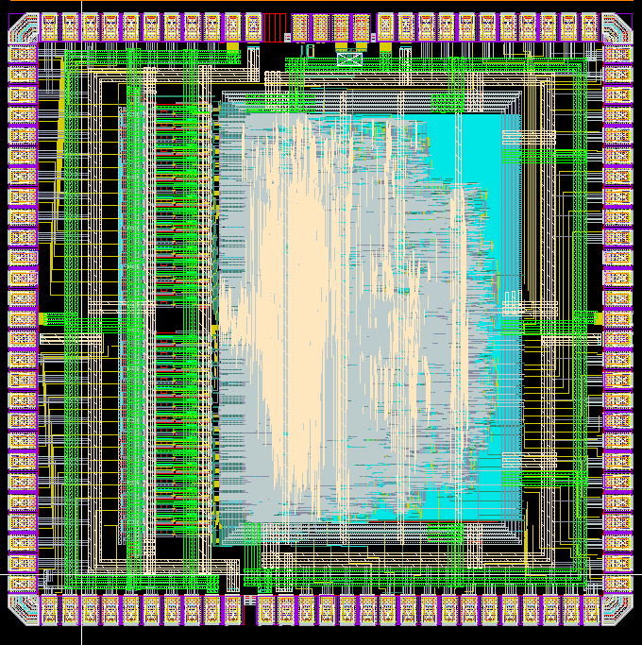
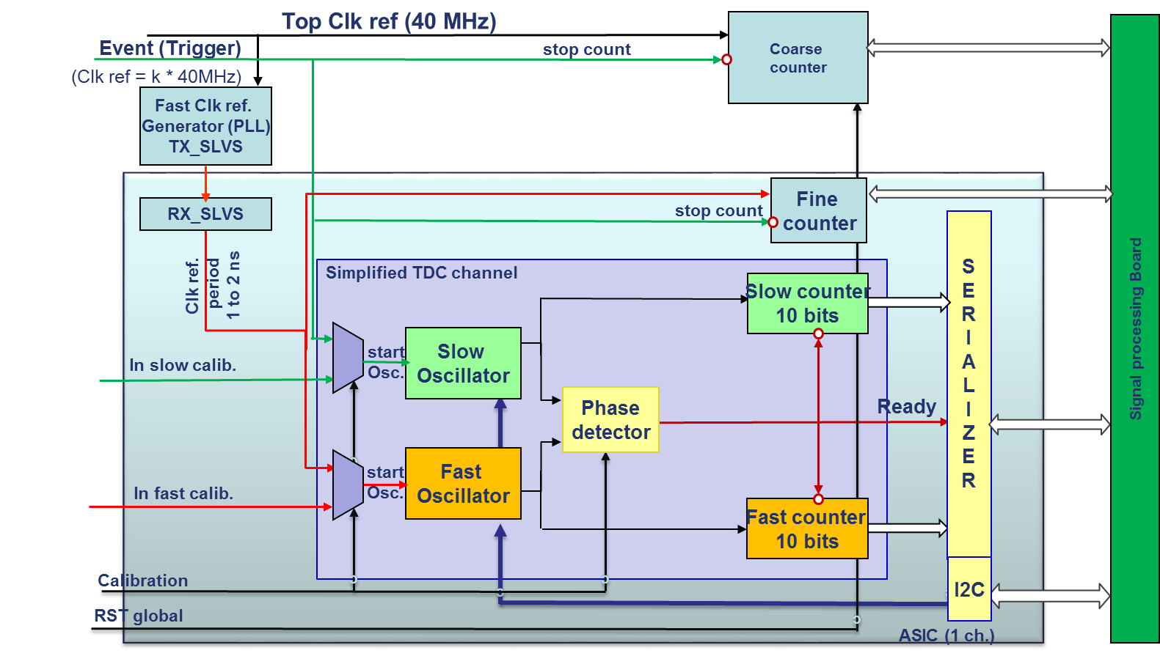
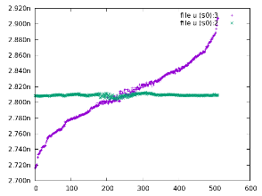
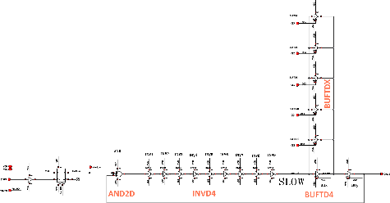
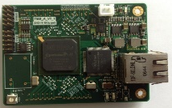
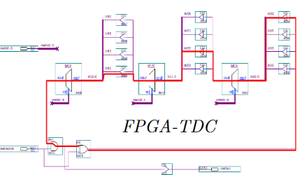
Time line
TDC_BRICK
VGRO
LSB=60ps
Phase Detect~1ps_{RMS} S-curve
XOR ring oscillator
CRONOTIC
32-ch, LSB:20ps target
CRONOTIC2
Multi-detecteur de phase
[TODO, Thèse CIFRE]
HODOPIC
DLL
LSB=200ps
Resolution=700ps_{RMS}
ASIC
2013
2014
2015
2016
2017
C. Girerd,
VGRO sur Cyclone III
LSB=20ps over 2.4ns range
CMS_muon → Sept2017
64-ch, TDC of 35 ps_{RMS}
(Generator)
200 ps_{RMS} With detector
[TODO]
FPGA
24-ch, TDC of 25 ps_{RMS} Tsinghua university for RPC/MGRPC
Remarque : erreur incompressible de pas de quantifiquation
LSB~RMS*sqrt(12)
LSB ≠ resolution RMS

Slide 3
TDC_BRICK (IBM 130nm)
Start
Slow Ring
Oscillator
Enable
N0
Counter
Phase
detector
Latch
TDC result
Fast Ring
Oscillator
N1
Counter
Stop
Enable
- Simple architecture: Low Area, low consumption, can implemented in standard cells
The TDC resolution is given by the frequency difference between oscillators
In theory the resolution can be very small, as small as the frequency difference
ASIC | [1] Youngmin Park Wentzloff | [2] Jianjun Yu
Process | 65 nm | 130 nm
Resolution | 1 ps * | 8 ps
DNL/INL | 0.5/0.8 ** | 0.5/0.8
FPGA | [3] Sachin S. Junnarkar | This Work
Process | ALTERA Stratix II | Cyclone III
Resolution | 11.8 ps (rms) | ~ 10 ps *
DNL/INL | 0.5 / 1 | -
*Range 0 to 130 ps
** Simulation
* under test
Slides from C.Girerd

Slide 4
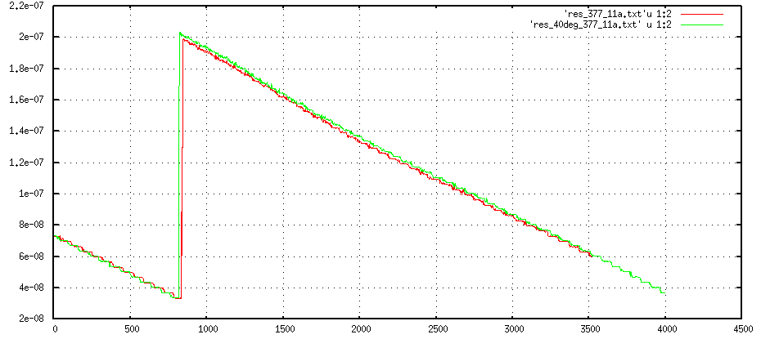
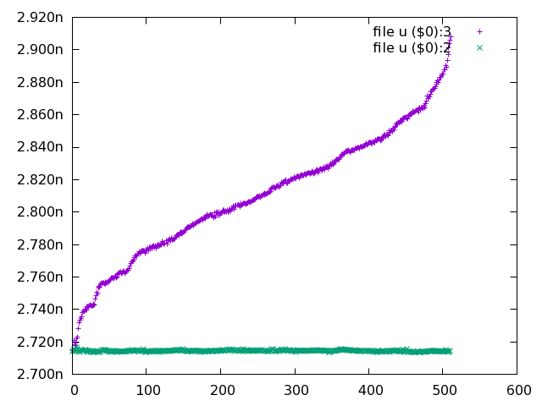
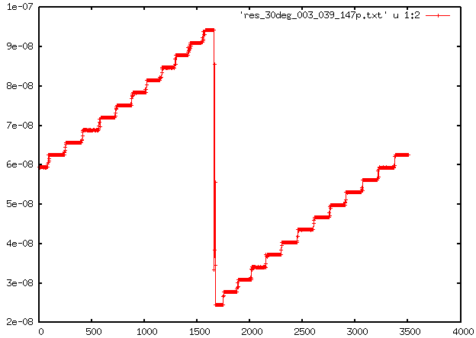
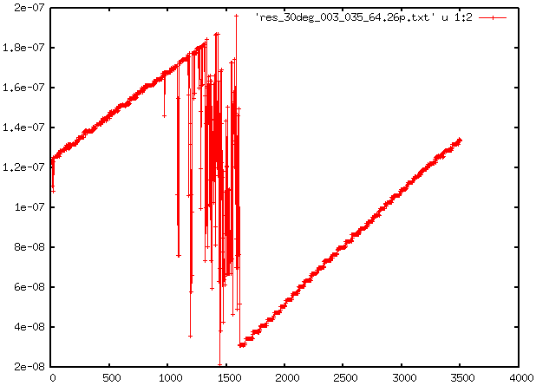
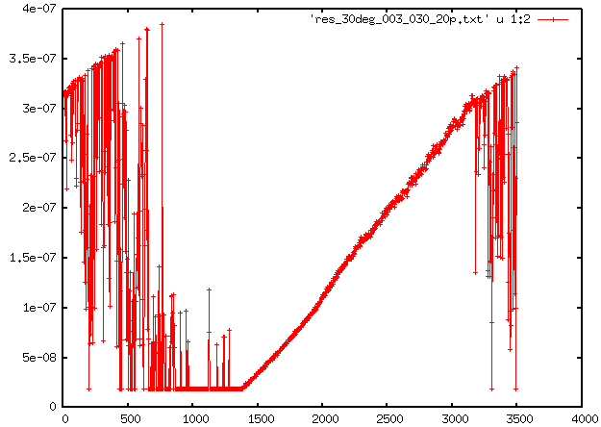
TDC_BRICK (IBM 130nm)
Presenté à VLSI 2014, marseille
period [ns]=f(code)
Sdev [s]
Xtalk
Delay_IN Pas=150[ps]
Si LSB=150ps ➔ OK sur 3ns
Si LSB=60ps ➔ OK sur 1ns
Si LSB=20ps ➔ pas OK

Slide 5
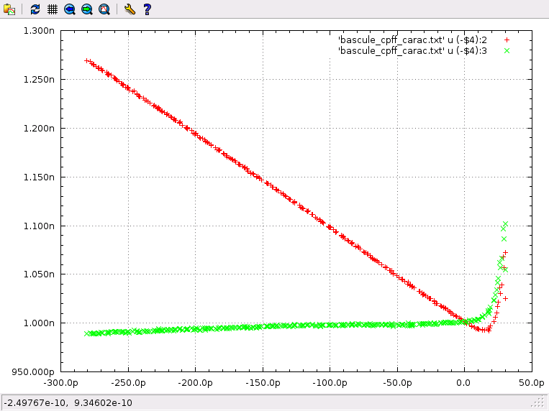
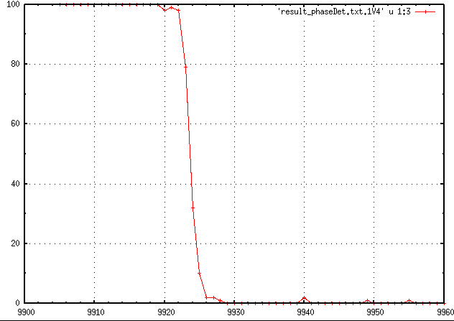
TDC_BRICK (IBM 130nm)
Propagation delay D to Q
Propagation delay CLK to Q
Minimum set-up time = 15 ps
(include generator jitter)
6 ps width
RMS resolution = 1ps
(include generator jitter)

Slide 6
Clock reference of 1 GHz is used as stop signal on the fast oscillator
CRONOTIC (TSMC 130nm)
Vdd
D
Q
Slow
Oscillator
slow
Counter
Event (start)
Vdd
D
Q
R
T = (N0*T0)-(N1*T1)
Phase
detector
TDC result
R
Enable
D
Q
Fast
Oscillator
fast
Counter
Clk_Ref (stop)
R
Ready
Reset
Start
Stop
Clk ref
T
Event
1
2
3
4
5
Phase detection
T0
Oscillator stop
T1
t
1
2

Slide 7
CRONOTIC (TSMC 130nm)
Top Clk ref (40 MHz)
Coarse
counter
Event (Trigger)
stop count
(Clk ref = k * 40MHz)
Fast Clk ref.
Generator (PLL)
TX_SLVS
c
stop count
Fine
counter
RX_SLVS
S
E
R
I
A
L
I
Z
E
R
Clk ref.
period
1 to 2 ns
Simplified TDC channel
Slow counter
10 bits
Signal processing Board
start
Osc.
Slow
Oscillator
In slow calib.
c
Phase
detector
Ready
start
Osc.
Fast
Oscillator
c
In fast calib.
c
Fast counter
10 bits
c
Calibration
I2C
RST global
c
ASIC (1 ch.)

Slide 8
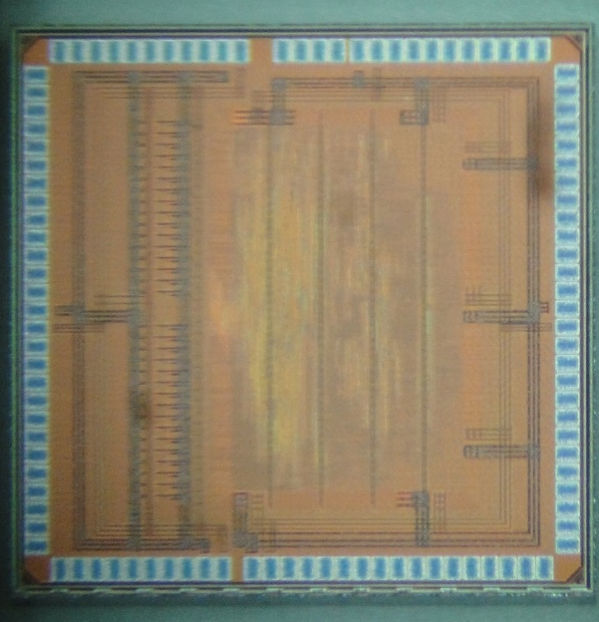
CRONOTIC (TSMC 130nm)
TSMC 130 nm process
32 channel
Triple-voting rad-hard digital
Dimensions :
2,400 x 2,450 mm²
Submitted Nov 2nd 2016
ASIC returned from fab by end of January
Packaging is done (CQFP 128)
Test board must be designed, it started by beginning of March
Credit : M. Dahoumane

Slide 9
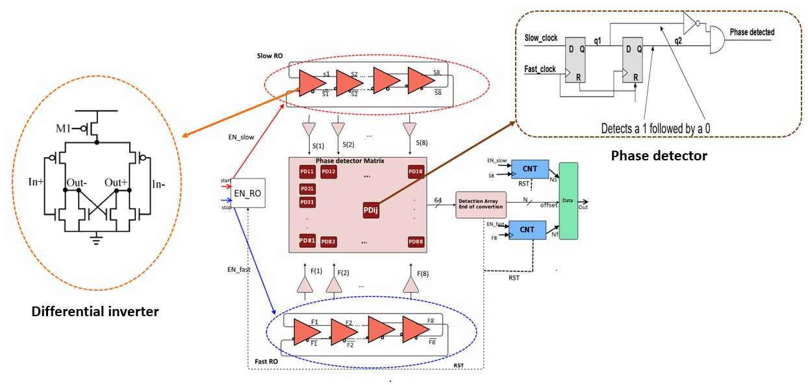
CRONOTIC 2
Détecteur de phase multiples
Deux Ring oscillateurs (f_Slow < f_Fast)
8 éléments de retard en différentielle ➔ 16 transitions S(1) à S(8), S(1) à S(8) et F(1) à F(8), F(1) à F(8)
Une matrice de détection de phase PDij avec i=[1..8] et j=[1..8]
La résolution LSB = delay_slow – delay_fast
Réduire le temps mort, et le jitter cumulé

Slide 10
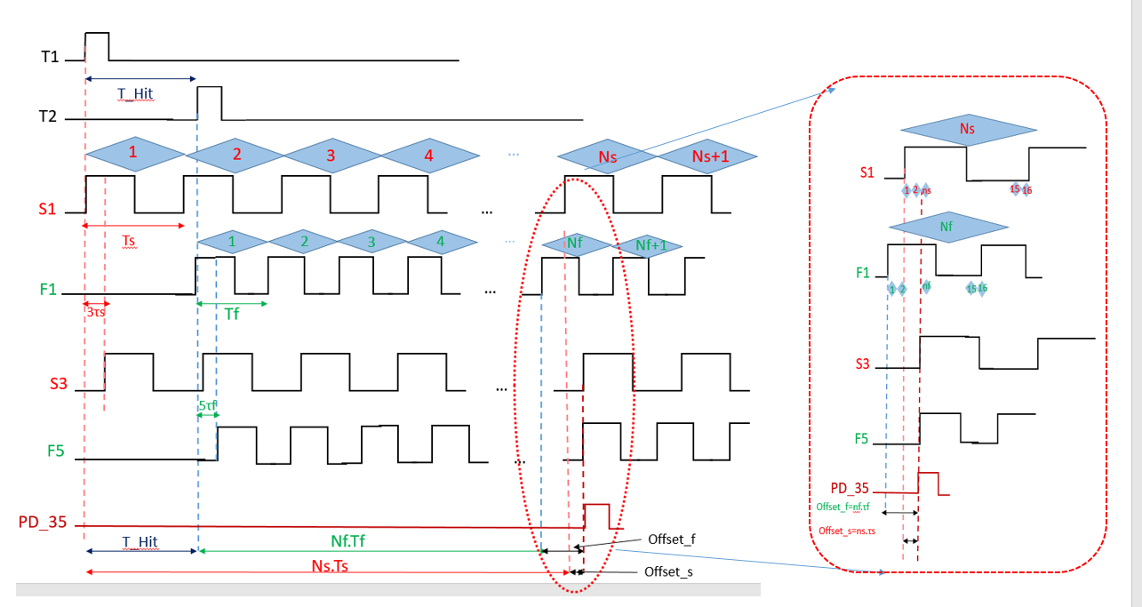
CRONOTIC 2
T_Hit = (Ns Ts - Nf Tf ) + (ns τs – nf τf )
T_Hit= (16N+n)(τs-τf) ➔ avec Ts=16τs, Tf=16τf si Ns=Nf et ns=nf

Slide 11
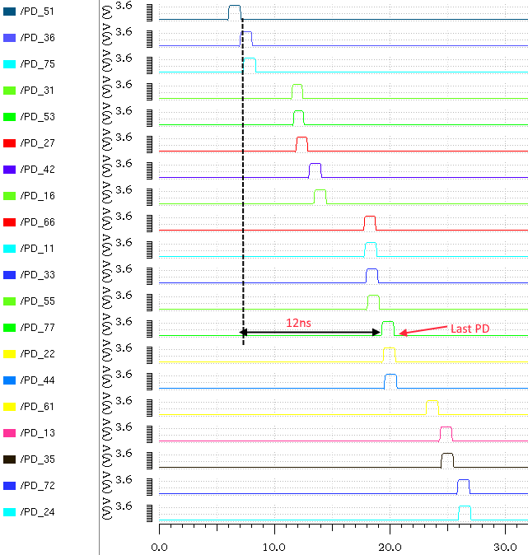
Re-ordonner la position des détecteur de phase
time [ns]

