Slide 1
A TPC for MeV Astrophysics
13 April,2017-Ecòle Polytechnique
Cosmic Rays & Supernova Remnants love story:
The Importance
Of MeV energies
Martina Cardillo [INAF- IAPS] martina.cardillo@iaps.inaf.it

Slide 2
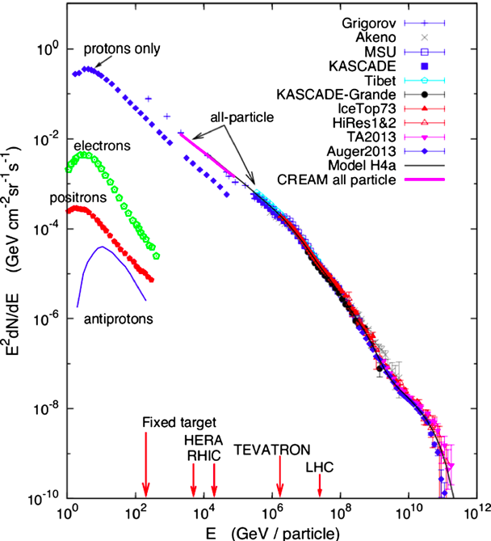
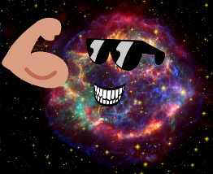
Cosmic-Ray overview
High-energy particles (mostly protons and nuclei) up to 10²⁰ eV
Bending below 30 GeV due to solar modulation
Power-law distribution with an index α≃2.7 up to PeV energies
Two main features:
Steepening at PeV energies, α ≃ 3.1 (Knee, 1 part/m²/yr)
Hardening at about E=10¹⁸ eV (Ankle, 1 part/km²/yr)
Galactic component likely originates in the SNR shocks
Galactic component
Knee
Ankle
Energetics → with only 10% of SN energy we can explain CR energy density $ε_{CR}≅{10}^{40}erg/s$

Slide 3
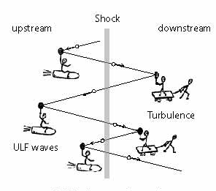
SNR and Diffusive Shock Acceleration
SNRs have to be able to accelerate particles up to 10¹⁵ eV
First order Fermi acceleration:
Fast and high gain $\frac{∆E}{E}\sim \frac{V_{s}}{c}$
Power-law injection index γ_{E} = 2
$$N\left(E\right)dE∝E^{−γ_{E}}dE=4πp^{2}p^{−γ_{p}}dp$$
$$γ_{p}=\frac{3ℛ}{ℛ−1}$$
$$ℛ=\frac{u_{u}}{u_{D}}=\frac{4M_{s}^{2}}{3+M_{s}^{2}}$$
Strong shock: $M_{s}→∞$ , $ℛ→4$, $γ_{E}→2$
Acceleration time must to be lower than the source age and the loss time
$$D\left(p\right)=\frac{1}{3}cr_{L}{\left(\frac{L_{c}}{r_{L}}\right)}^{δ′}$$
Magnetic Field Amplification
$$t_{acc}≈\frac{D\left(p\right)}{V_{s}^{2}}=min⁡(t_{age},t_{loss})$$
$$r_{L}=\frac{γmv}{eB}$$

Slide 4
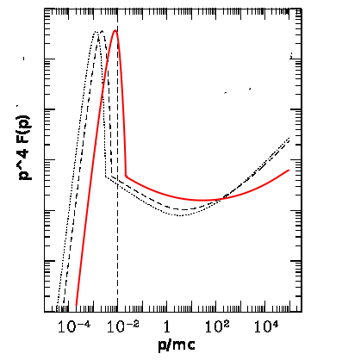
Non-Linear Diffusive Shock Acceleration
Magnetic field Amplification leads to CR back reaction
→ no more test particle
Precursor Formation
concavity (γ_{E} < 2)
Lower Downstream Temperature
thermal peak at lower energies
Blasi 2004
Amato 2014

Slide 5
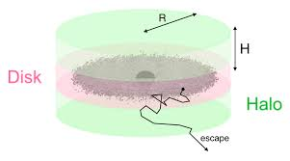
Observed Spectrum: CR propagation
Leaky Box Model
$$τ_{esc}≈\frac{H^{2}}{D(E)}$$
$$D\left(E\right)=D_{0}E^{δ}$$
$$N(E)≈\frac{N_{s}(E)ℛ_{SN}τ_{esc}}{2πR_{D}^{2}H}{≈E}^{−(γ_{E}+δ)}$$
We can have an estimation of the diffusion index measuring secondary to primary ratio (B/C).
$$\frac{N_{SEC}(E)}{N(E)}∝E^{−δ}$$
$$N_{SEC}\left(E\right)≈N(E)ℛ_{spal}τ_{esc}≈E^{−(γ_{E}+2δ)}$$
Degeneration broken considering CR anisotropy due to discreteness of the sources (no leaky box)
$$0.7> δ>0.3$$
$$2< γ_{E}<2.4$$
$$δ\sim 0.3$$
$$γ_{E}\sim 2.3−2.4$$

Slide 6
Messengers and Instruments
Direct Detection
(E<100 GeV)
Particles
Proportional tubes and scintillators (e.g. CREAM, TRACER)
Magnetic Spectrometers and silicon tracker (e.g. PAMELA, AMS-02)
Gamma-rays
Silicon Tracker and calorimeter (AGILE, Fermi-LAT)
Indirect Detection
(E>100 GeV)
Particles
Scintillators and Multiple Resistive plate chambers (e.g. KASCADE-Grande, Argo )
Water Cherenkov (e.g. Milagro)
Hybrid: water Cherenkov and fluorescence (e.g. Auger)
Gamma-rays
Imaging Atmospheric Air Cherenkov (e.g. HESS, VERITAS, MAGIC)

Slide 7
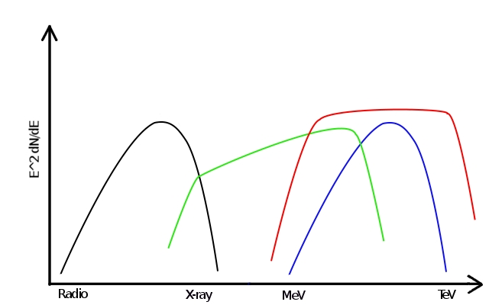
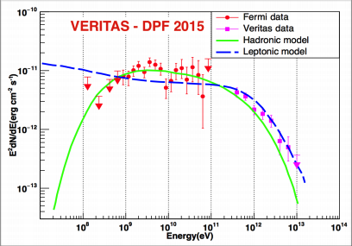
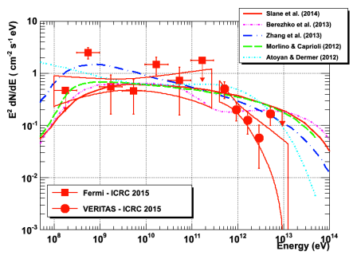
SNRs and CRs: direct proofs
GAMMA-RAY PHOTONS
No deviations → source direction
Same spectrum of primary protons
E_{γ,M}≃10% E_{p,M}
$$p+p_{target}→…+π^{0}→2γ$$
Low-Energies
200 MeV
Confirming hadronic origin
→ We can distinguish leptonic from hadronic component only at E<200 MeV
High-Energies
CTA
Ghiotto 2015
Revealing PeV emission from young SNRs
→ In spite of the large number of young SNRs detected in the gamma-ray band, none of these seems to reach E= 100 TeV
Nahee 2015
10 TeV
10 TeV

Slide 8
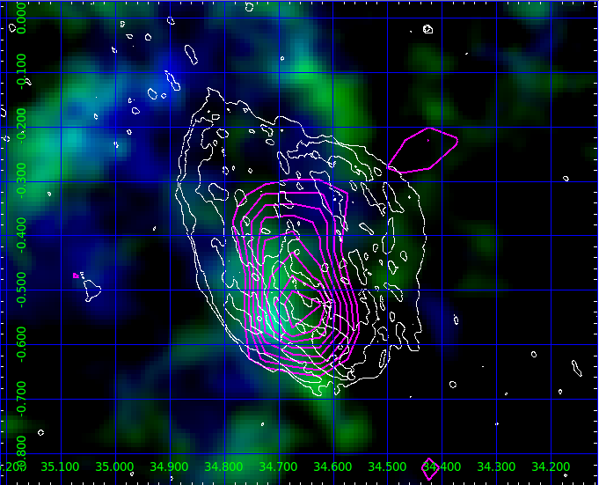
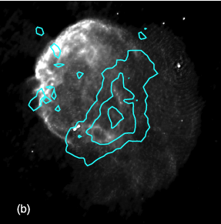
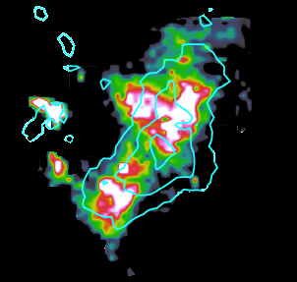
Low-energy gamma-rays
Background: CO (NANTEN)
White count: radio (VLA)
Magenta count: gamma (AGILE)
Castelletti et al. (2011)
Background: radio (VLA)
Cyan count: gamma (VERITAS)
Background: CO (PMO)
Cyan count: gamma (VERITAS)
Cardillo et al.(2014)
Middle aged SNRs (t ≥ 10⁴ yrs) with a slow shock velocity (v_{s}~ 100 km/s)
Interaction with a molecular cloud (high average density, n~200 cm⁻³) → correlated with GeV (and TeV for IC443) gamma-ray emission
Correletion with part of the radio emission in W44, no correlation in IC443

Slide 9
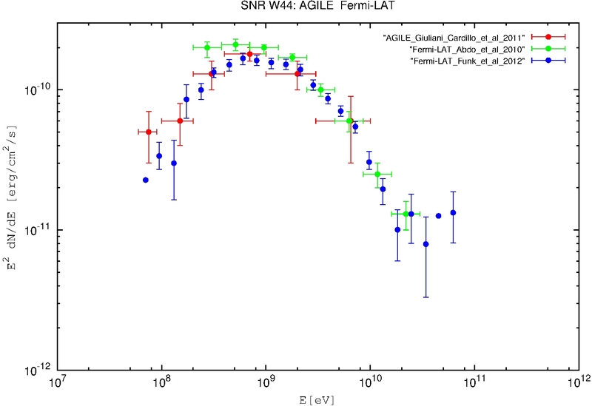
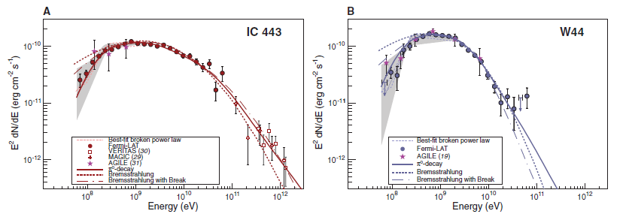
Low-energy gamma-rays
Gamma-ray emission below 200 MeV detected, for the first time, by AGILE from the SNR W44, then confirmed by Fermi-LAT, also in IC443
W44
The low-energy behavior can be explained only with hadronic models → the first direct proof of CR proton presence in correspondence of a SNR shock
Giuliani,Cardillo et al. 2011
Cardillo et al. 2014
However….
Ackermann et al. (2013)

Slide 10
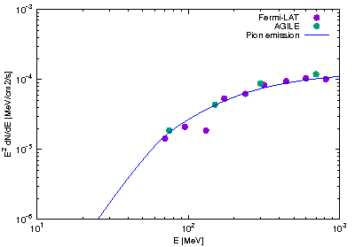
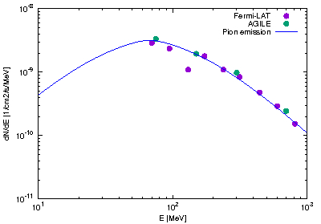
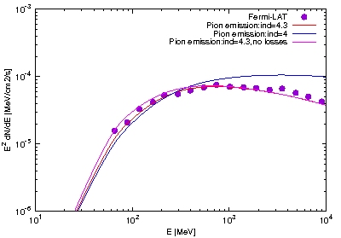
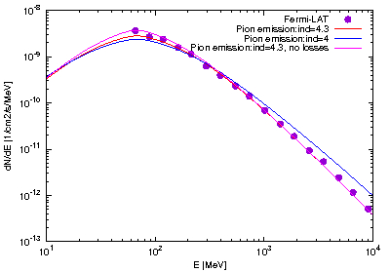
The Pion bump Issue
W44
67,5 MeV
First of all, we need to reach even lower energies in order to see directly the ‘pion bump’ and not only its indirect effects.
But there is a more important issue..
IC443
67,5 MeV

Slide 11
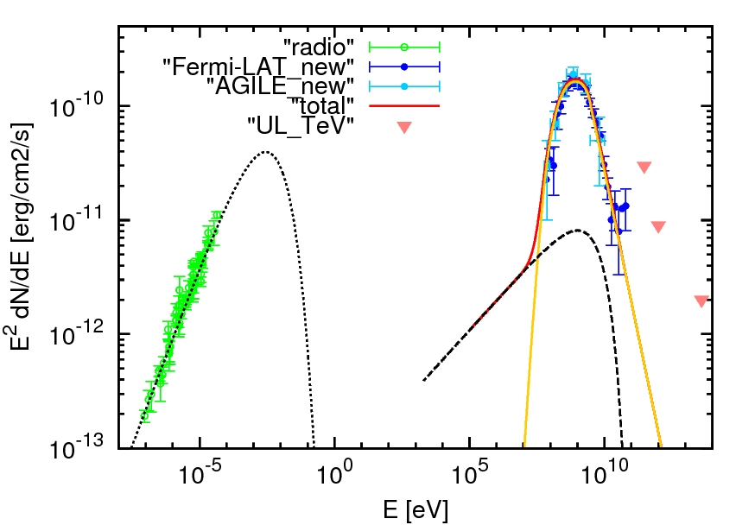
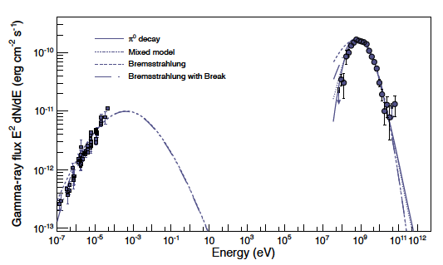
Acceleration…
W44
Cardillo et al. 2014
Ackermann et al. (2013)
Freshly accelerated CRs with a spectral index α=(3r_{sh})/(r_{sh}-1) at low-energies
Broken power-law α=2.2 below E~10 GeV and α=3.2 above E~10 GeV
Malkow steepening due to Alfvèn damping
PROBLEMS WITH ACCELERATION
Presence of a broken PL and of a so steep HE spectral index → not expected from diffusive shock acceleration theory;
The shock of middle-aged remnants are slow → acceleration efficiency $ξ_{CR}$ cannot be sufficiently high (→ $P_{CR}=ξ_{CR}ρv_{sh}^{2}$)

Slide 12
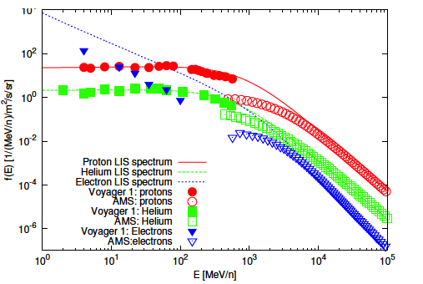
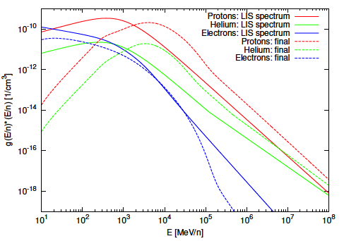
…or reacceleration?
Pre-existing Galactic CR protons, Helium nuclei and electrons (Voyager spectra)
Reacceleration → hardening of spectral indices steeper than α=(3r_{sh})/(r_{sh}-1)
Compression → higher energies, higher spectrum (s=(n₂/n₀)/r_{sh})
Contributions from secondary particles and low-efficiency accelerated CRs
Simple PL spectrum (r_{sh} = 3.5÷4 → γ_{p}=4.2-4) with no steepening but HE cut-off due to the limited time (fully ionized pre-shock medium)
A lot of parameters: magnetic field, density, interaction time, correlation length, shock velocity…
Crushed Cloud model
(Blandford & Cowie 1982)
Potgieter 2014
Aguilar 2015
Cardillo, Amato, Blasi 2016
Cardillo, Amato, Blasi 2016

Slide 13
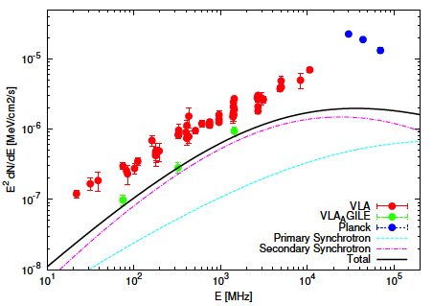
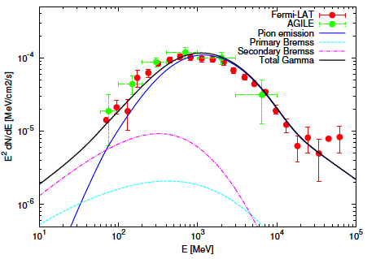
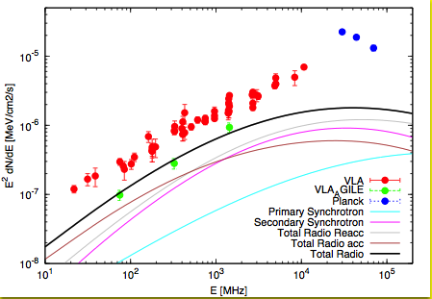
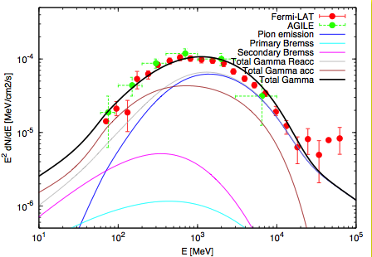
…or reacceleration?
Cardillo, Amato, Blasi 2016
Reacceleration
Cardillo, Amato, Blasi 2016
Reacceleration
+
acceleration

Slide 14
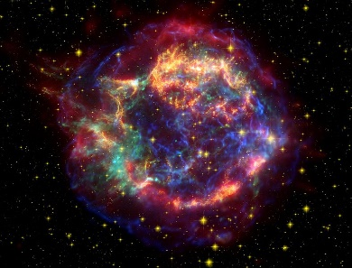
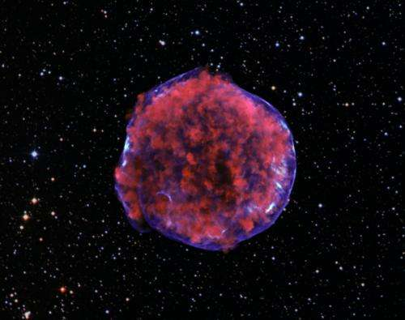
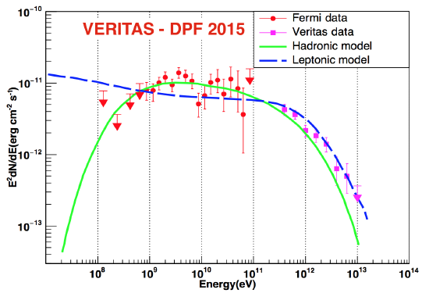
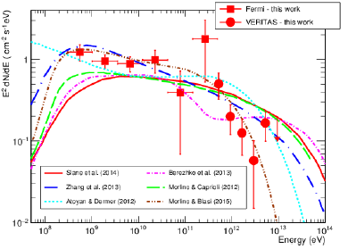
The importance of young SNRs at MeV energies
In order to have more chances to confirm the presence of freshly accelerated CRs in correspondence of the SNRs shocks, we need to detect young-fast ($≥{10}^{3} km/s$) shocks SNRs at E<200 MeV.
Cas A
Tycho

Slide 15
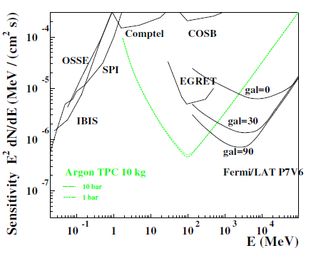
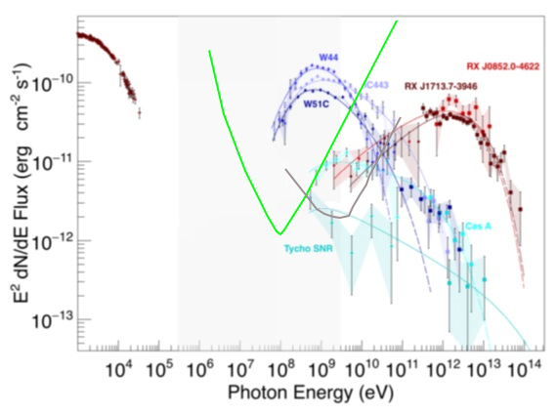
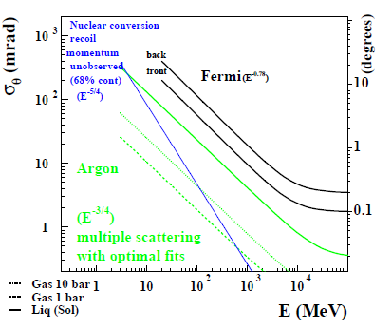
3 year sensitivity
(Bernard Document)
TPC performance

Slide 16
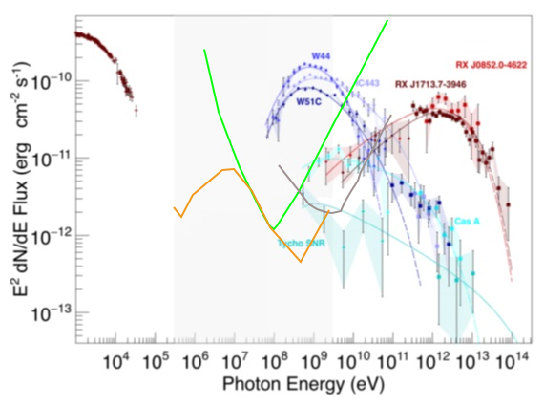
TPC & e-ASTROGAM
TPC- 3years
e-ASTROGAM - 1yr
Fermi-LAT – 3yrs

Slide 17
Conclusions
We can have the direct proof of CR acceleration in the SNRs at very high energy (PeV → CTA) and at lowest gamma-ray energies (E<200 MeV → ?)
Despite the large amount of instruments, we had detected no PeV SNRs and only two middle-aged SNRs at E< 200 MeV thanks to AGILE and Fermi-LAT → probably reaccelerated CRs
We need to detect young SNRs with fast shocks at E<200 MeV in order to confirm the presence of freshly accelerated CRs
Acceleration (and also reacceleration) models depend from parameters like magnetic field, correlation length, density (…) that we can know thanks to other wavelegths
We really need an instrument with improved capabilities at MeV energies in order to give the final answer to the question:
how is the CR origin?

Slide 18
Thank you
very much!

