Slide 1

Dissipation as a resource for stabilizing quantum states with superconducting qubits
Mazyar Mirrahimi
INRIA Paris (QUANTIC team)
Joint work with
Paris: Zaki Leghtas, Joachim Cohen, Nicolas Didier, Jérémie Guillaud.
Yale: Uri Vool, Kurtis Geerlings, Shyam Shankar, Michel Devoret.

Slide 2
STATE STABILIZATION VS STATE PREPARATION
Robustly prepare and protect against decoherence a quantum state or a manifold of quantum states (QEC).
LKB photon box: a first quantum feedback experiment stabilizing photon number states.
C. Sayrin et. al., Nature 477, 73-77, 2011.

Slide 3
QUANTUM FEEDBACK AND TIME-SCALE ISSUE
Short coherence times (typically 100-1000 times shorter for superconducting qubits) require fast electronics and simple control schemes.
Superconducting circuits vs atomic physics and optics
Strong and tunable couplings and non-linearities;
Flexibility in Hamiltonian design;
Time and frequency domain control of microwave signals with commercial electronics.
Solution: Analog feedback circuits, dissipation (reservoir) engineering

Slide 4
DISSIPATION (RESERVOIR ENGINEERING)

Slide 5
OUTLINE
Cavity mediated qubit cooling
Autonomous stabilization of a Bell state
Remote entanglement accumulation
Autonomous quantum error correction

Slide 6
CAVITY-MEDIATED QUBIT COOLING
Stabilization goal: Resetting a qubit to its ground state

Slide 7
STRONG DISPERSIVE REGIME
Courtesy of D. Schuster et al., Nature 2007.

Slide 8
SELECTIVE DRIVES

Slide 9
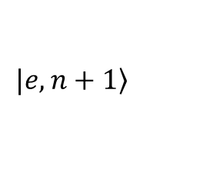
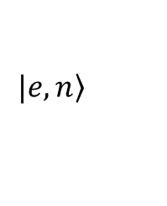


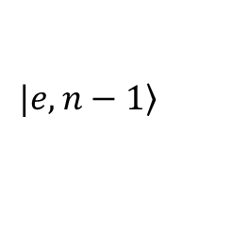


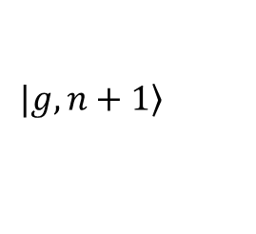

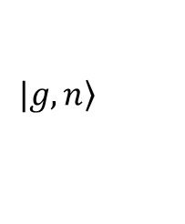
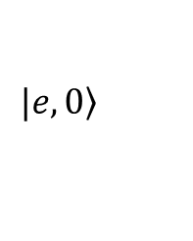
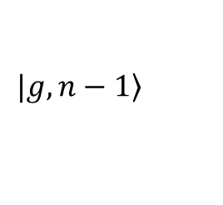
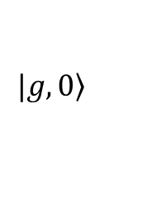


COOLING SCHEME
cavity spectrum
……...
qubit spectrum
…

Slide 10

COOLING SCHEME
cavity spectrum
……...
qubit spectrum
…

Slide 11
COOLING SCHEME
cavity spectrum
……...
qubit spectrum
…

Slide 12
COOLING SCHEME
cavity spectrum
……...
qubit spectrum
…

Slide 13
COOLING SCHEME
cavity spectrum
……...
qubit spectrum
…

Slide 14

COOLING SCHEME
cavity spectrum
……...
qubit spectrum
…

Slide 15
COOLING SCHEME
cavity spectrum
……...
qubit spectrum
…

Slide 16
EXPERIMENTAL RESULTS

Slide 17
OUTLINE
Cavity mediated qubit cooling
Autonomous stabilization of a Bell state
Remote entanglement accumulation
Autonomous quantum error correction

Slide 18
AUTONOMOUS STABILIZATION OF A BELL STATE

Slide 19
AUTONOMOUS STABILIZATION OF A BELL STATE

Slide 20
AUTONOMOUS STABILIZATION OF A BELL STATE

Slide 21
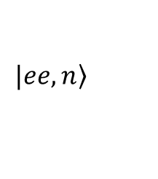



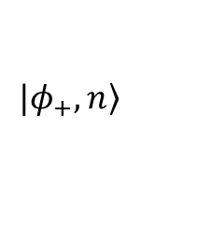
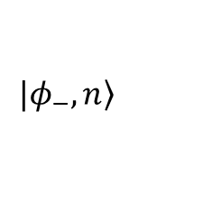
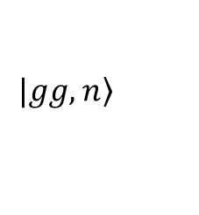
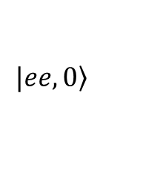
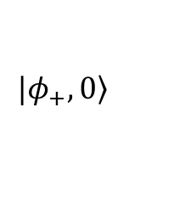
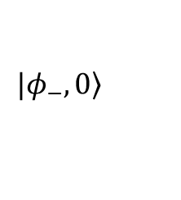
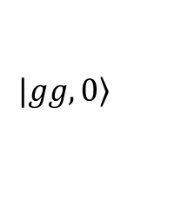




cavity spectrum
……...
qubit spectrum
…
…

Slide 22
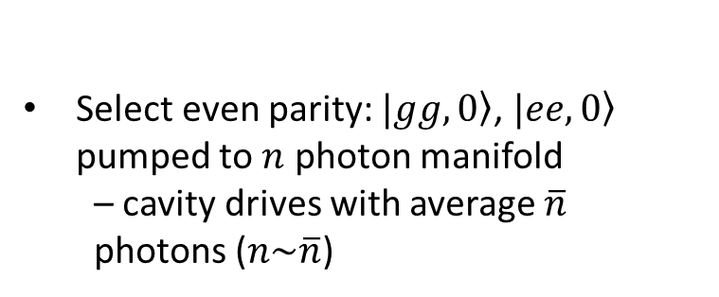
cavity spectrum
……...
qubit spectrum
…
…

Slide 23
cavity spectrum
……...
qubit spectrum
…
…

Slide 24


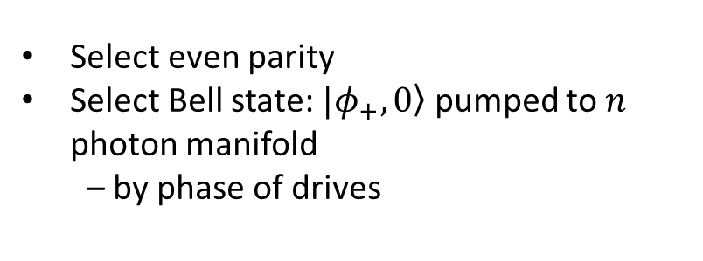
cavity spectrum
……...
qubit spectrum
…
…

Slide 25
cavity spectrum
……...
qubit spectrum
…
…

Slide 26


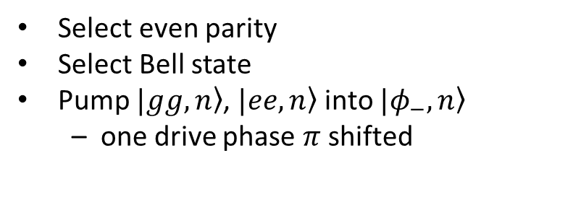
cavity spectrum
……...
qubit spectrum
…
…

Slide 27
cavity spectrum
……...
qubit spectrum
…
…

Slide 28

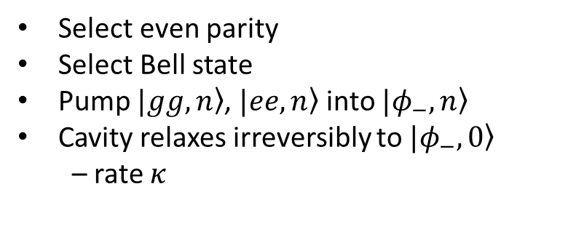
cavity spectrum
……...
qubit spectrum
…
…

Slide 29
cavity spectrum
……...
qubit spectrum
T₁ jump
…
…

Slide 30
cavity spectrum
……...
qubit spectrum
T₁ jump
…
…

Slide 31
cavity spectrum
……...
qubit spectrum
T₁ jump
…
…

Slide 32
cavity spectrum
……...
qubit spectrum
Corrected!
…
…

Slide 33
cavity spectrum
……...
qubit spectrum
T_{φ} jump
…
…

Slide 34
cavity spectrum
……...
qubit spectrum
T_{φ} jump
…
…

Slide 35
cavity spectrum
……...
qubit spectrum
T_{φ} jump
…
…

Slide 36
cavity spectrum
……...
qubit spectrum
T_{φ} jump
…
…

Slide 37
cavity spectrum
……...
qubit spectrum
Corrected!
…
…

Slide 38
EXPERIMENTAL RASULT

Slide 39
OUTLINE
Cavity mediated qubit cooling
Autonomous stabilization of a Bell state
Remote entanglement accumulation
Autonomous quantum error correction

Slide 40
REMOTE ENTANGLEMENT ACCUMULATION
Josephson Parametric Convertor (JPC) in amplification mode: generating a two-mode squeezed states of the microwave radiation.
E. Flurin et al., PRL, 109, 183901, 2012.

Slide 41
REMOTE ENTANGLEMENT ACCUMULATION

Slide 42
REMOTE ENTANGLEMENT ACCUMULATION

Slide 43
REMOTE ENTANGLEMENT ACCUMULATION

Slide 44
REMOTE ENTANGLEMENT ACCUMULATION

Slide 45
REMOTE ENTANGLEMENT ACCUMULATION

Slide 46
REMOTE ENTANGLEMENT ACCUMULATION

Slide 47
NUMERICAL SIMULATIONS
N. Didier et al., ArXiv: 1703.03379

Slide 48
NUMERICAL SIMULATIONS
Small squeezing rate: better robustness to transmission inefficiency but slower convergence rate.

Slide 49
OUTLINE
Cavity mediated qubit cooling
Autonomous stabilization of a Bell state
Remote entanglement accumulation
Autonomous quantum error correction

Slide 50
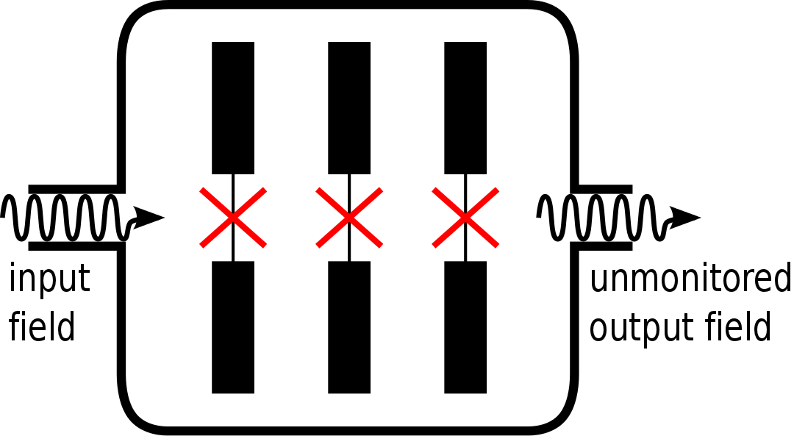
AUTONOMOUS QUANTUM ERROR CORRECTION
3-qubit bit-flip error correction
Three transmon qubits b₁, b₂ and b₃ coupled to a single low-Q resonator a

Slide 51
AUTONOMOUS QUANTUM ERROR CORRECTION
Protect states of the form against bit-flip errors
We assume :
  Strong dispersive regime :
  Symmetry :
Selectivity
Indistinguishability between |000> and |111>

Slide 52

CORRECTION ON ONE QUBIT
correct state :
E₁
E₀
E₁
in the rotating frame defined by

Slide 53
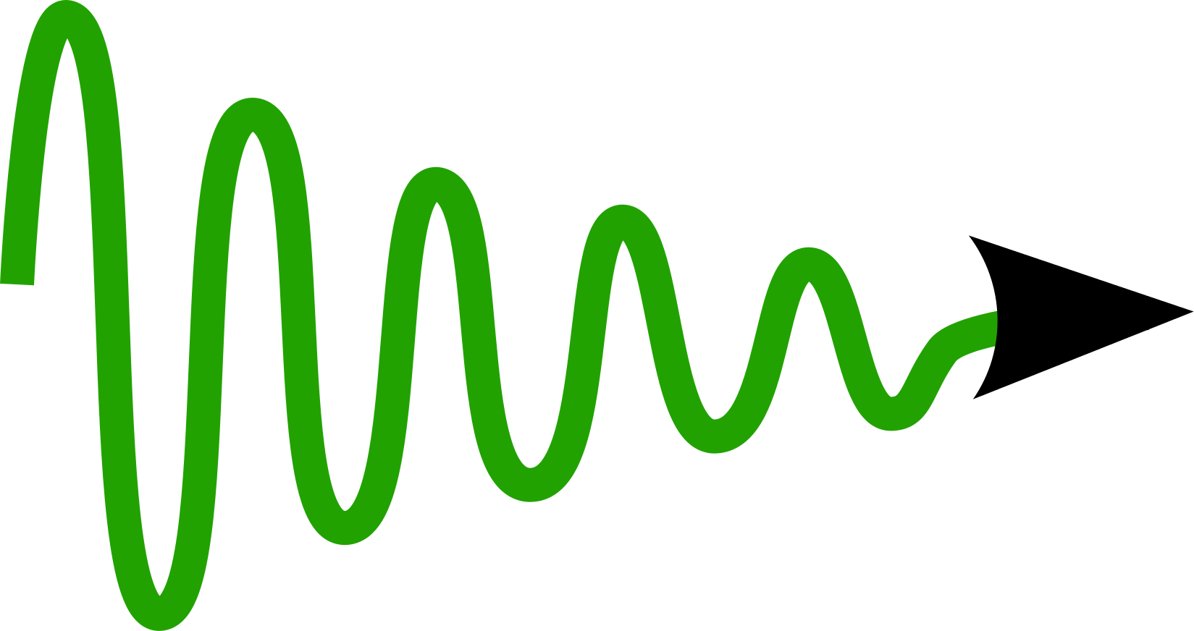
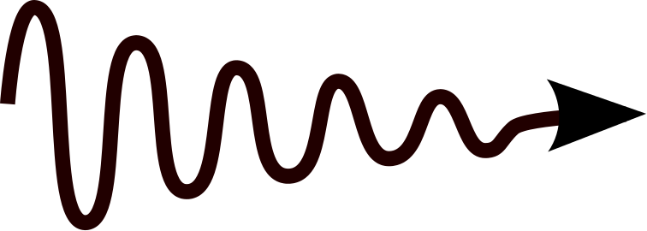

CORRECTION ON ONE QUBIT
E₁
E₀
E₁
- Initial state
Error
Transition
Recovery

Slide 54
CORRECTION ON ONE QUBIT
E₁
E₀
E₁

Slide 55
CORRECTION ON ONE QUBIT
E₁
E₀
E₁
Selectivity :
Indistinguishability :

Slide 56
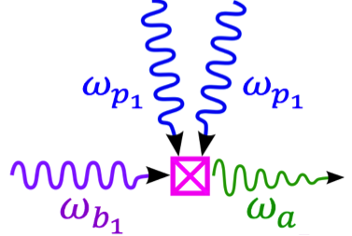
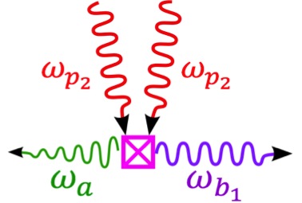
CORRECTION ON ONE QUBIT
We apply two pumps at frequencies
such that
Pump 1
Pump 2

Slide 57
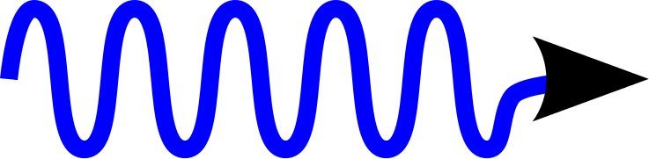

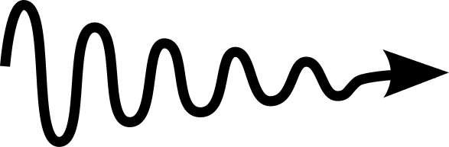

CORRECTION ON ALL QUBITS
  Three transmon qubits b₁, b₂ and b₃ coupled to a single low-Q resonator a with two additional drives g₁₂ and g₂₃
b₁
b₂
b₃
g₁₂
a
g₂₃

Slide 58
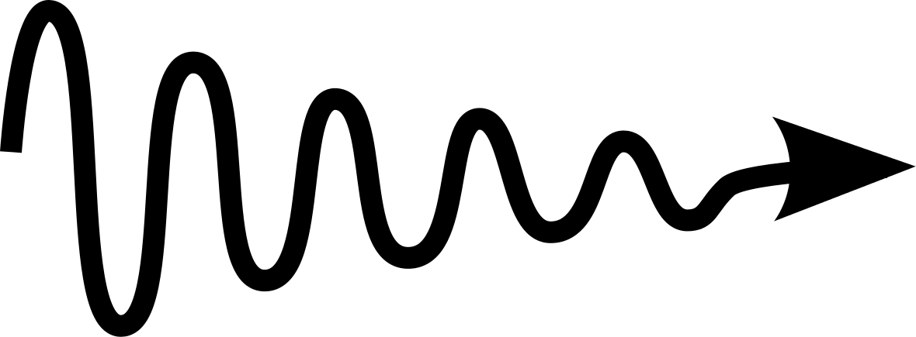
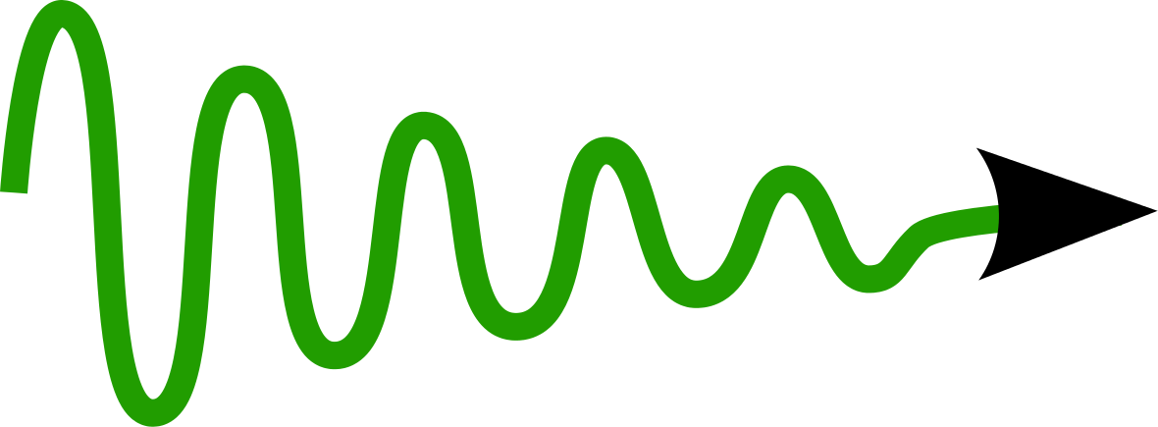
CORRECTION ON ALL QUBITS
E₂
E₃
|001>,|110>
|010>,|101>
g₂₃
γ_{x}
g₁₂
γ_{x}
γ_{x}
E₀
E₁
|100>,|011>
|000>,|111>
Γ_{c}

Slide 59
CORRECTION ON ALL QUBITS
2 pumps at frequencies: ω_{p1}=|ω_{a}-ω_{b1}|/2 and ω_{p2}=|ω_{a}+ω_{b1}|/2
+2 pumps at frequencies: ω₁₂ = |ω_{b1}-ω_{b2}|/2 and ω₂₃ = |ω_{b2}-ω_{b3}|/2
Strong dispersive regime : | χ_{a,bj} | >> κ
Symmetry : | χ_{a,b1}+χ_{a,b2}+χ_{a,b3} | << κ
Notes:
HAMILTONIEN

Slide 60
NUMERICAL RESULTS
 | ϒ_{X}/2π | κ/2π | χ_{a,b2}/2π | χ_{a,b3}/2π | χ_{a,b1}/2π | Ω_{p}/2π
SIM 1 | 1 kHz | 350 kHz | 15 MHz | 15 MHz | 30 MHz | 280 kHz
SIM 2 | 2 kHz | 500 kHz | 15 MHz | 15 MHz | 30 MHz | 400 kHz
SIM 3 | 3 kHz | 600 kHz | 15 MHz | 15 MHz | 30 MHz | 480 kHz
SIM 4 | 4 kHz | 700 kHz | 15 MHz | 15 MHz | 30 MHz | 560 kHz
Initial state :
Effective correction rate :
J. Cohen and M. Mirrahimi, PRA, 90, 062344, 2014.

Slide 61
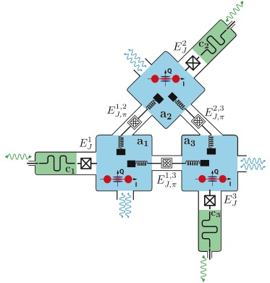
TOWARDS FULLY AUTONOMOUS QEC
J. Cohen, PhD Thesis, 2017.

Slide 62
CONCLUSION
Resources for robust dissipation engineering (only CW drives):
Strong dispersive coupling between qubits and cavities
Separation of time-scales between high-Q and low-Q systems (Purcell filters)
Some amount of symmetry
Parametric methods
These resources are provided by superconducting circuits

