Slide 1
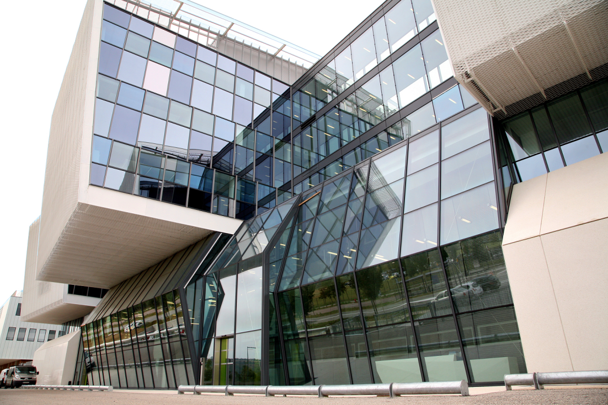




Gate@CRCT
Luc SIMON,
INSERM 1037, Centre de Recherche en Cancérologie de Toulouse, France
Medical Physics Department, IUCT-Oncopole, Toulouse, France
Team leader → manuel.bardies@inserm.fr

Slide 2
tGATE, news from Toulouse

Slide 3
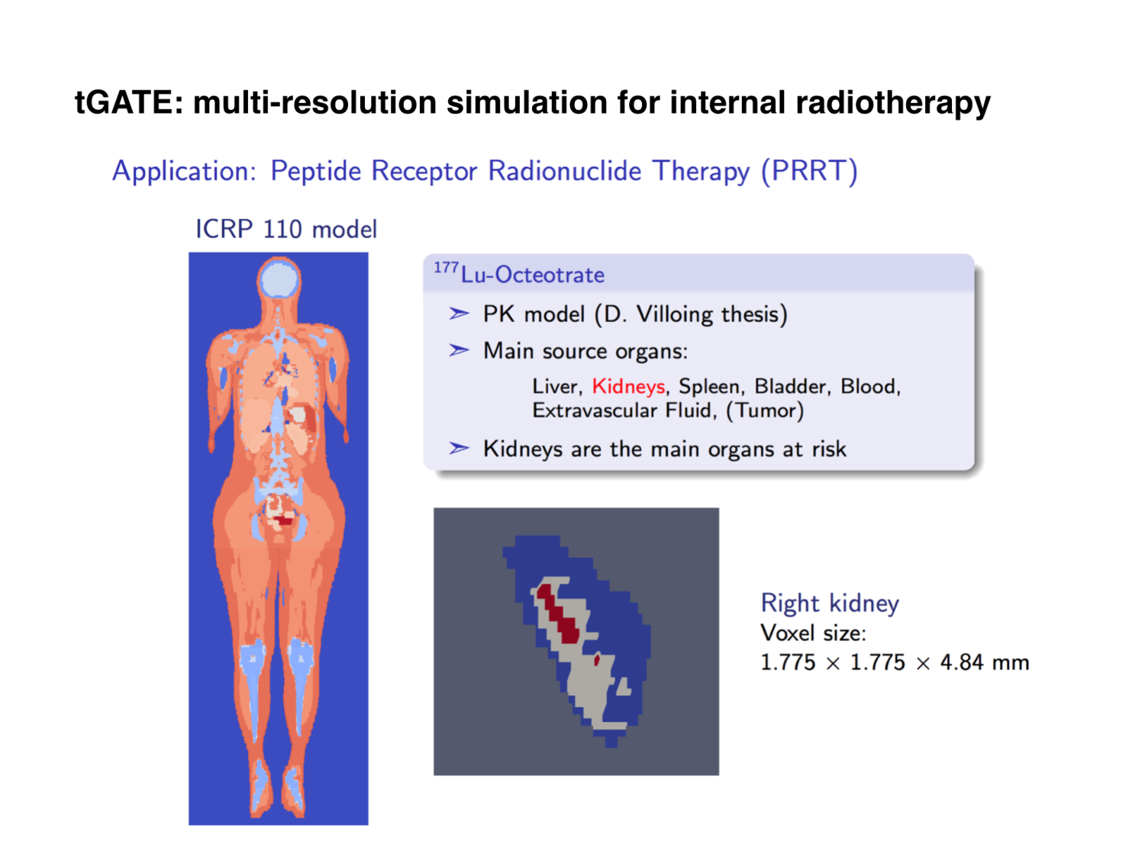

Slide 4
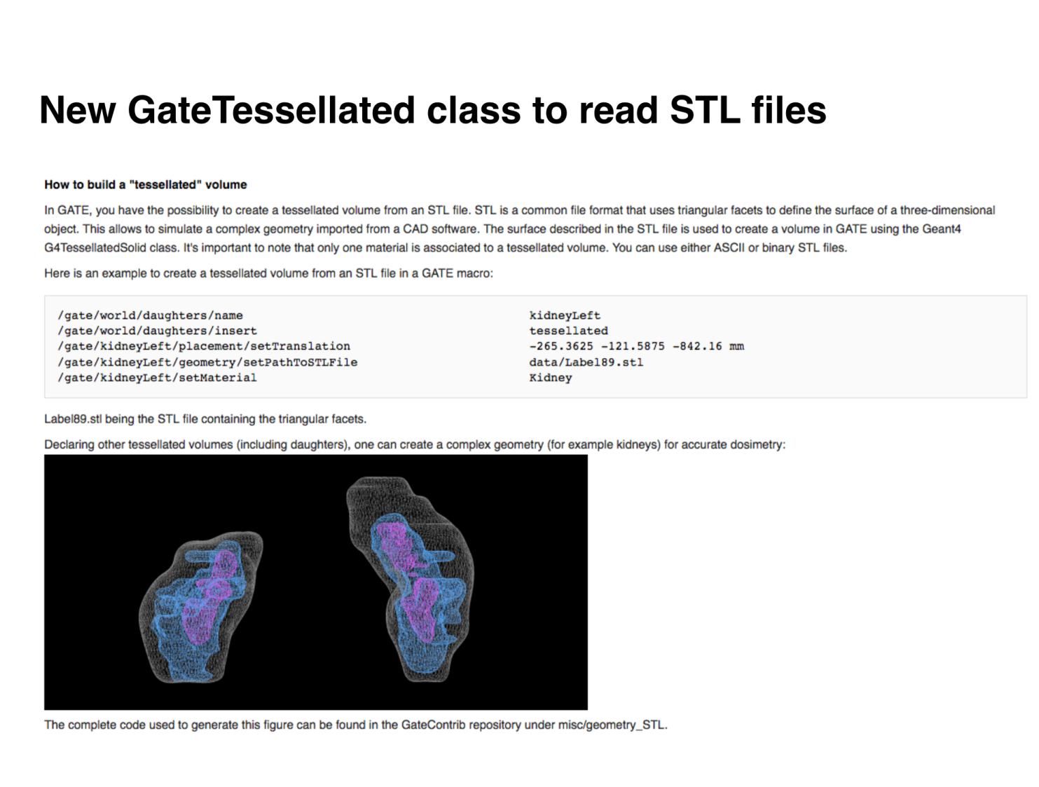
Thanks to Dr Maxime CHAUVIN…

Slide 5
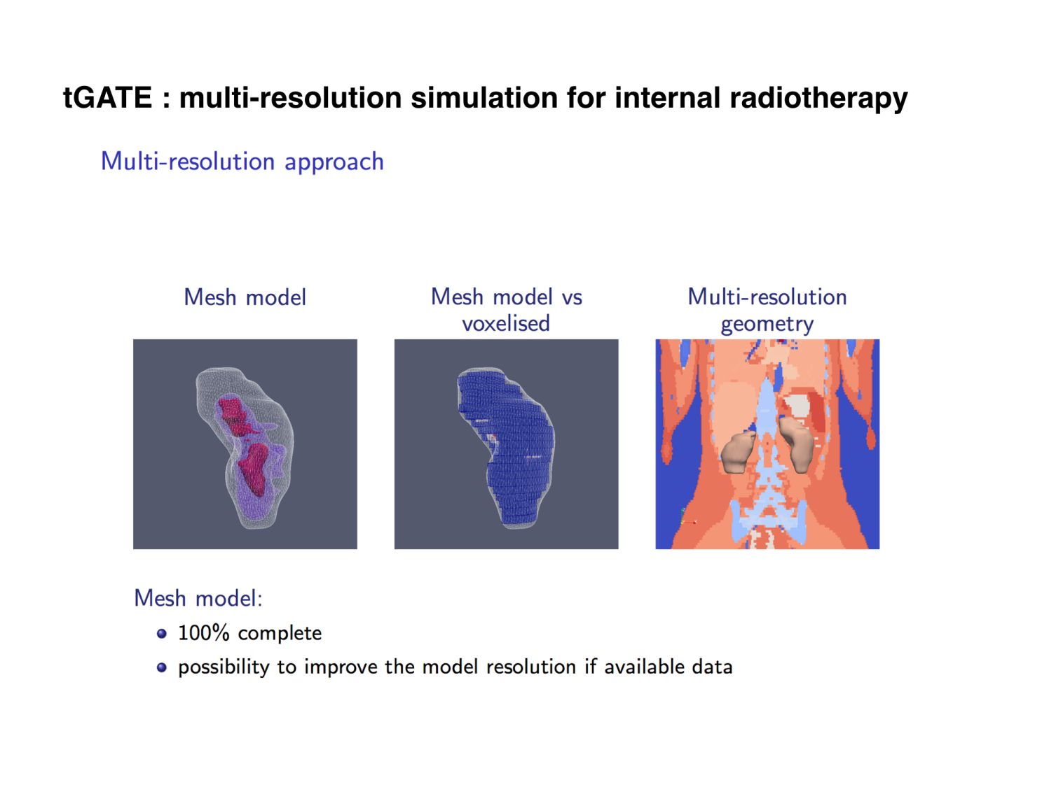

Slide 6
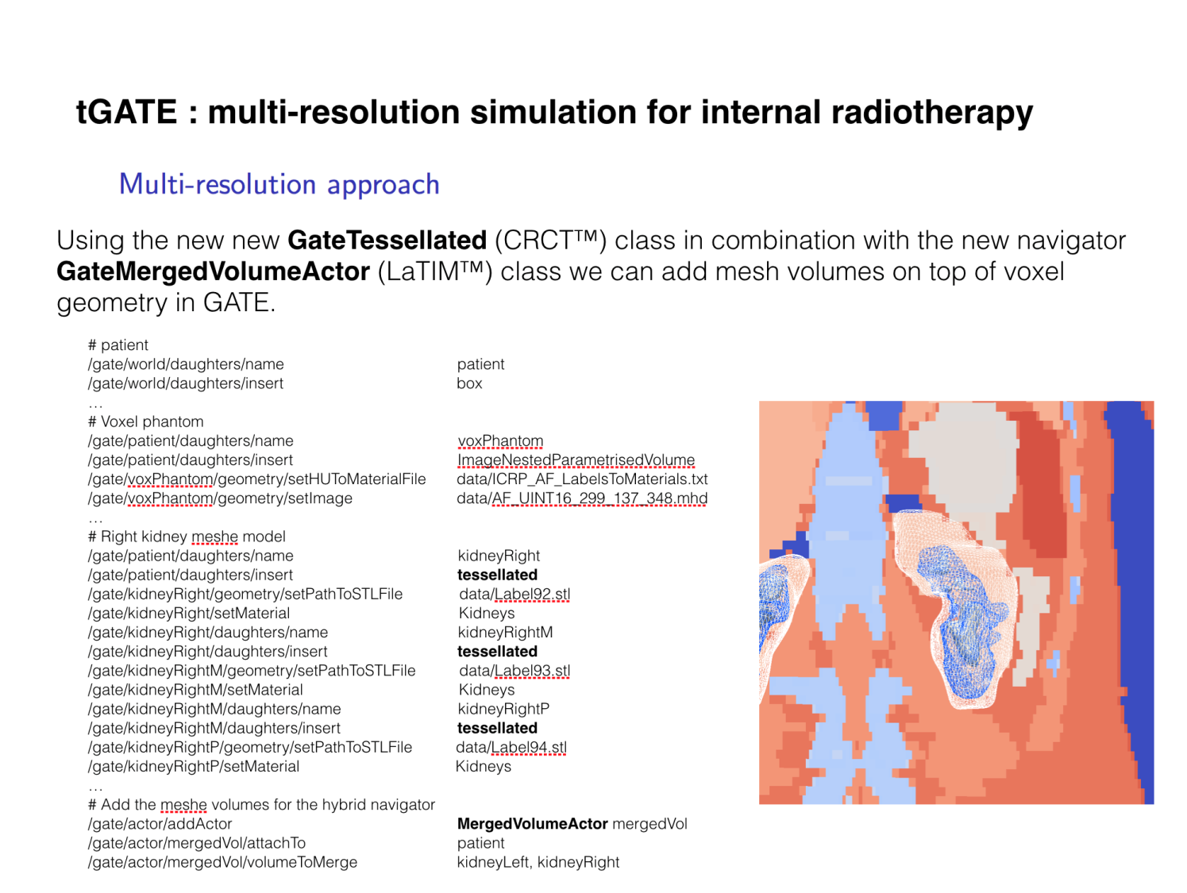

Slide 7
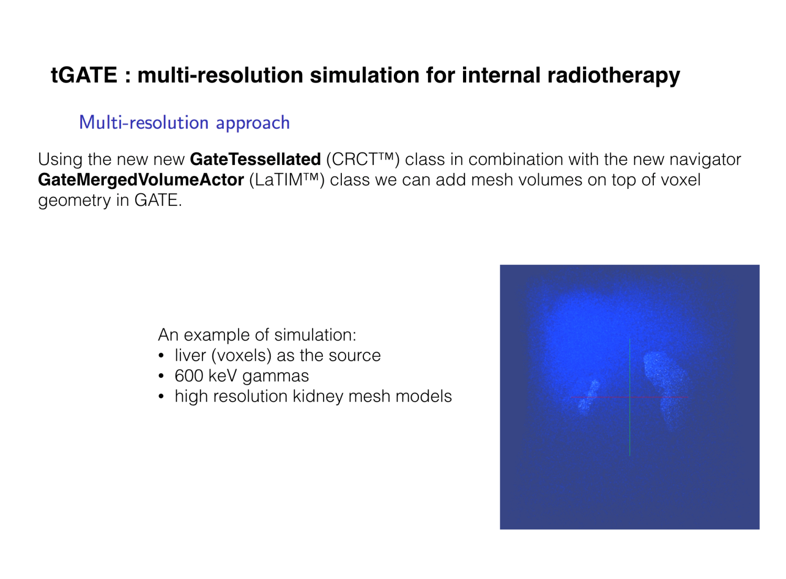

Slide 8
About dose actor

Slide 9
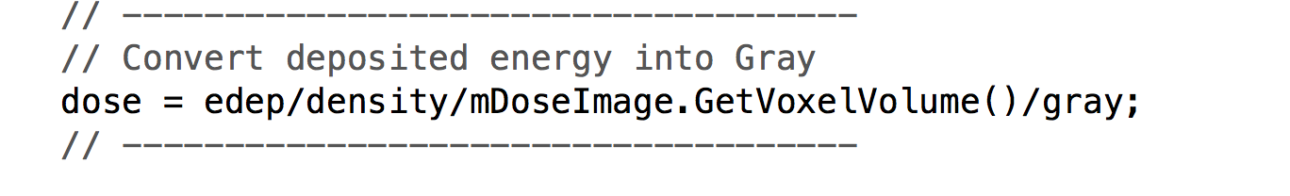
Dose Actor issue
A pull request was also achieved concerning GateDoseActor.cc
Three tries (well… git is not so easy…)
Last one is ok
Why → GateDoseActor.cc can compute “Dose To Water” and “Dose to Media”
DOSE TO MEDIA → no comment…

Slide 10
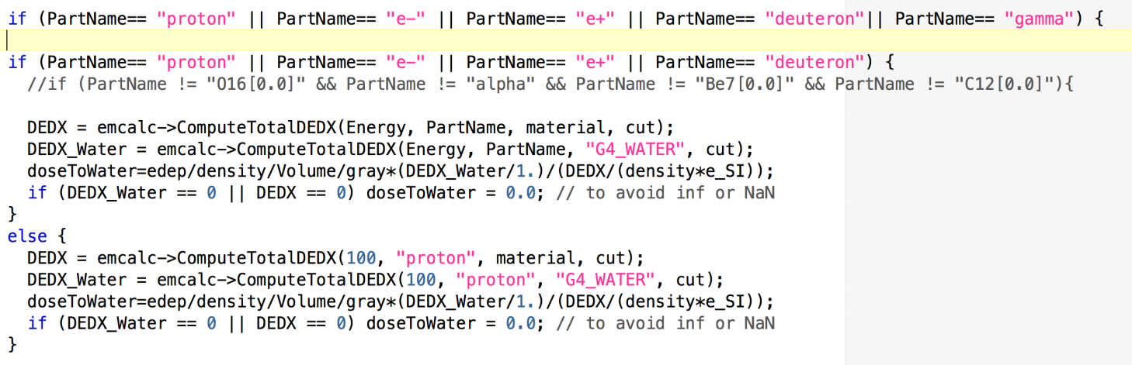
Dose Actor issue
DOSE TO MEDIA → no comment…
DOSE TO WATER→ a test is made on particles

Slide 11
What happens if gamma come in this “if” ?
They don’t? No dose is deposited by photons
Well I got a lot of photons when I enable verbosity !
Well, I suppose that if photon energy is < electron cut, the dose is deposited locally
Ok so, it should be consistent?

Slide 12
Another minor remark: gray conversion is pertinent only if you simulate the same number of particles than in the real life... If not, you do relative dosimetry
1 Gy is deposited by 6.24E+12 photons of 1 MeV giving ALL their enery to the media.
Another minor remark: in ESTRO2017 last week in Vienna, Nick Reynaert exposed that dose to water must be computed with the ratio water/media of
μen/ρ
and not Sw…
To be investigated…

Slide 13

A last tip
Maxime created a docker image of Ubuntu with GATE8.0 installed
What is docker ? In this context, it is a kind of virtual machine, running on every OS
How to ? Install docker. Then just type:
docker run –it manureva/ubuntu-gate
First time
it downloads the image (or part of it) and creates the container and run it
Yeah !!! you are in an Ubuntu environment with Gate (no visu)
Useful to send jobs on a computer.

Slide 14
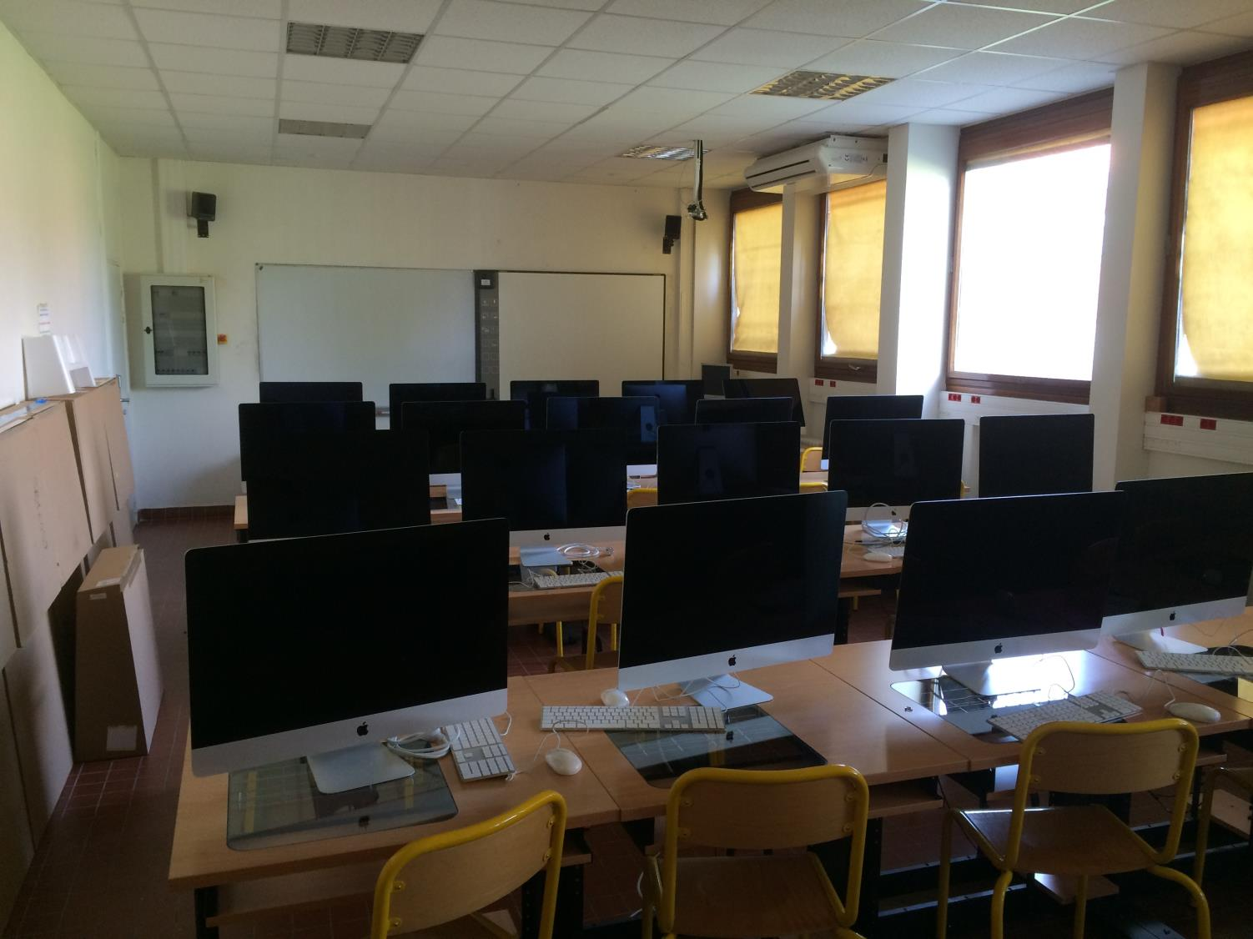
Gate courses?
CRCT wants to “invest” in the development of Medical Physics/imaging courses
Very interested in the EduGate project (but not active)
Have the required infrastructure (+ Gate, etc.)…
Projects to be discussed within the Steering Committee
A 8 hours GATE training was performed for MP Master1 students

Slide 15
