Slide 1
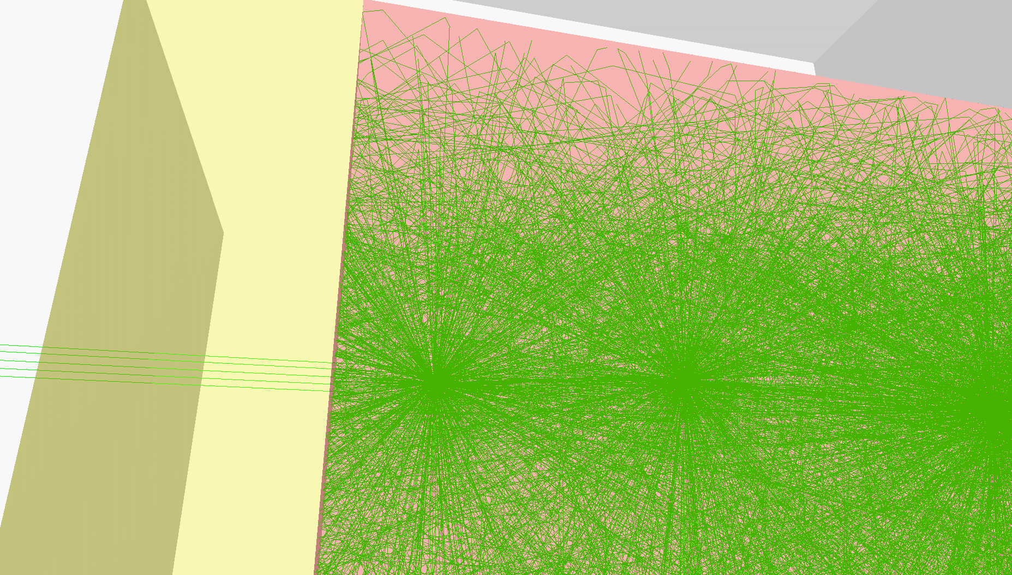
Advanced optical simulation of scintillation detectors in GATE V8.0
First implementation of a reflectance model based on measured data
OpenGATE Meeting
Laboratoire de Physique de Clermont
May 11th, 2017
Mariele Stockhoff

Slide 2
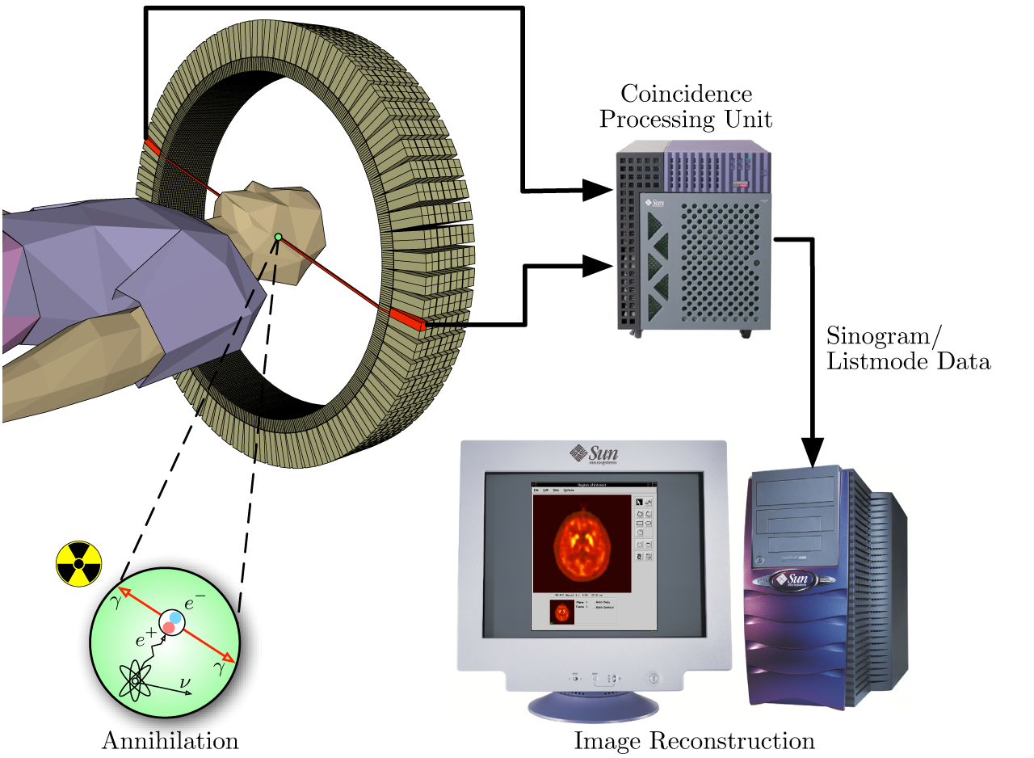
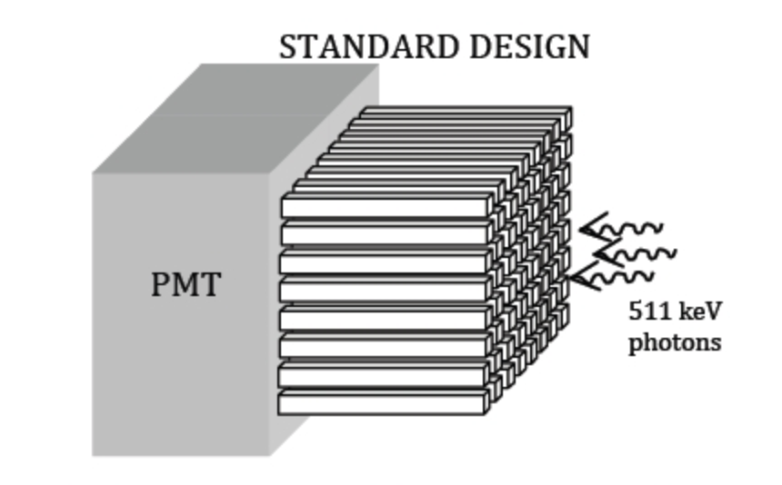
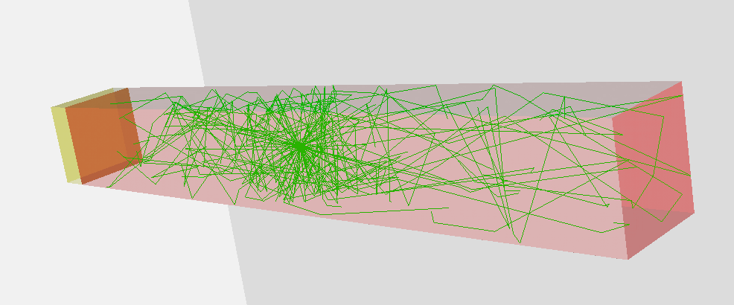
Positron Emission Tomography (PET)
Improvement of scintillation crystal characteristics with simulation:
material
geometry
surface finish incl. reflector
→ changes the reflection behavior of photons
PET detector:
Scintillation crystals + Photodetector
18000 photons/511keV
Notes:
Mention detector composition of PET
Scintillator to stop 511keV Annihilationphotons
+ Photodetector (SiPM or PMT)
The intensity of the measured light is proportional to the energy of the incident particle.
Transition:
we are concentrating on crystal and surface reflection

Slide 3
Approach based on measured surfaces
Look-Up-Table (LUT)
Plugin RealSurface1.0* implemented in GEANT4 in 2009
+ good agreement for polished and rough surfaces
limited pool of available surfaces
constant reflection parameter
specific experimental set-up
only available in GEANT4
*Janecek M and Moses W W 2010. Simulating scintillator light collection using measured optical reflectance IEEE Trans. Nucl. Sci. 57 964-70
Notes:
Only BGO
Need complex set-up + half sphere of scintillation material($$)
Reflection probability constant
low sampling rate
No compatibility to GATE
transition: in general

Slide 4
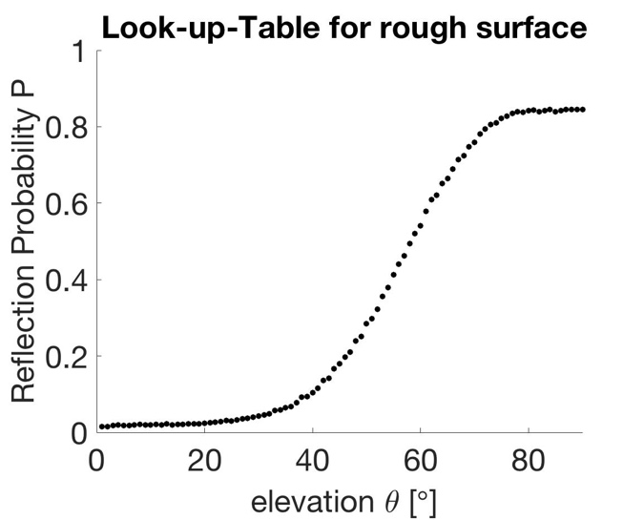
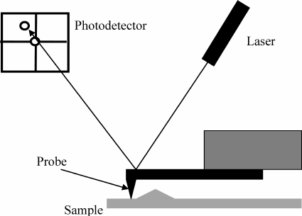
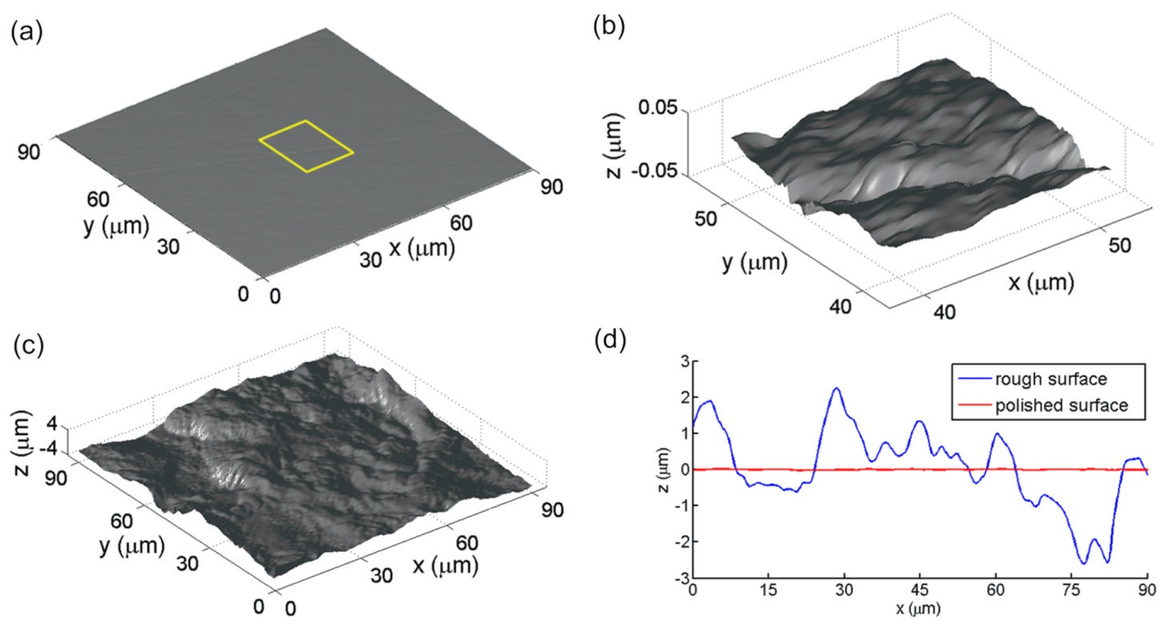
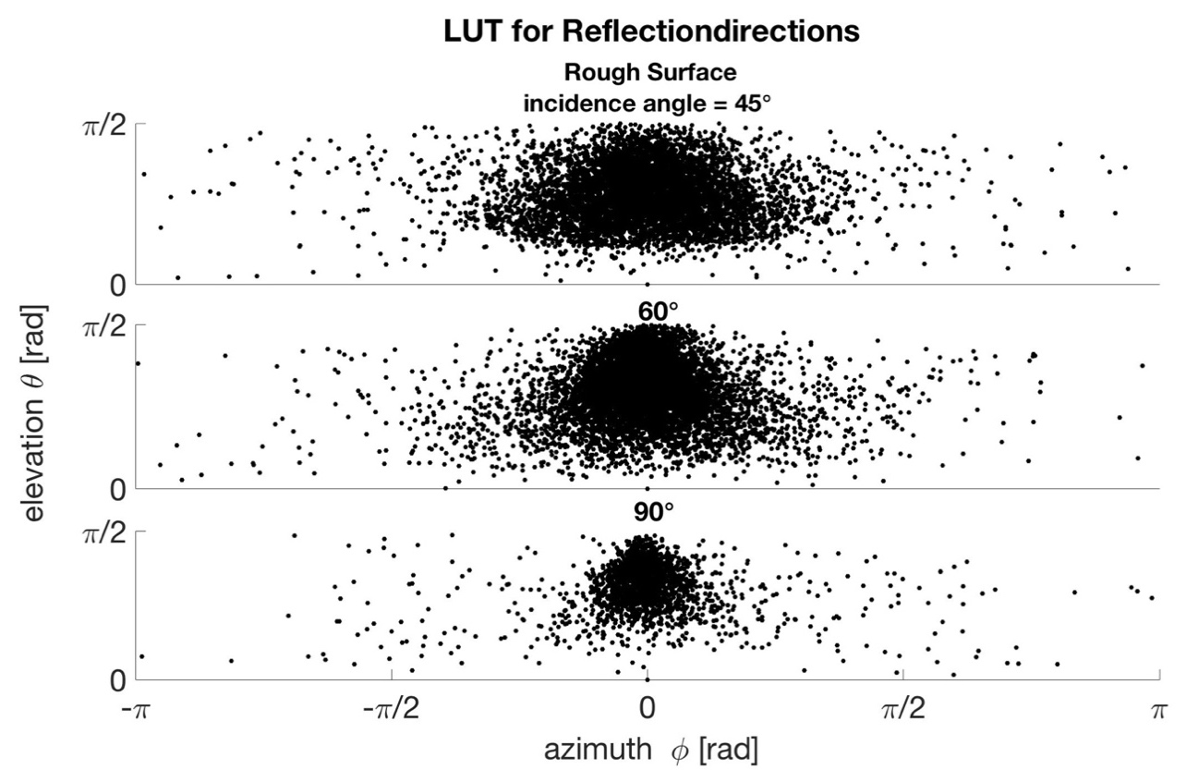
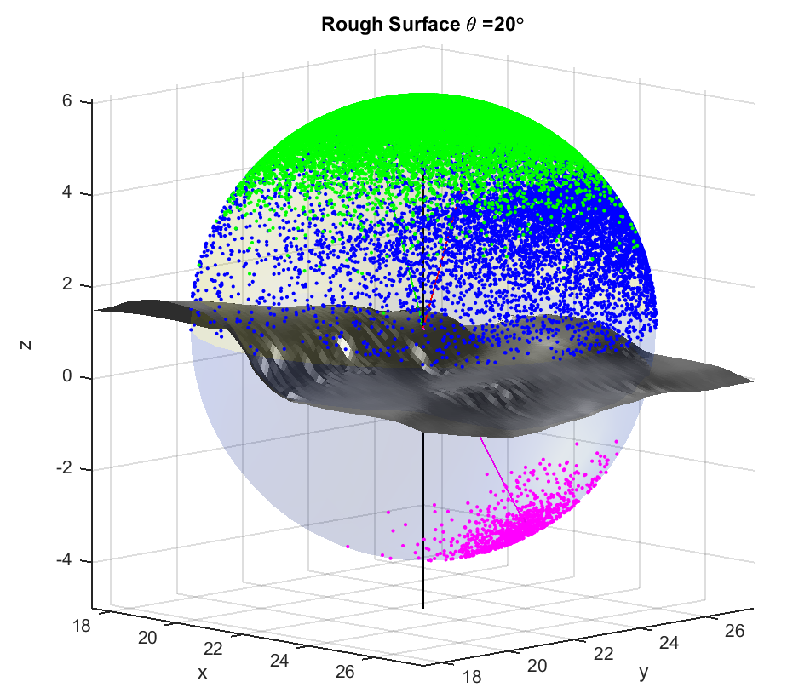
AFM to LUT
Atomic Force Microscopy To Look-Up-Tables
PROBABILITY
REFLECTION DIRECTION
AFM measurements
LUT Computation
by virtually illuminating the surface
Notes:
Mention published papers about LUT approach
Focus on implementation

Slide 5
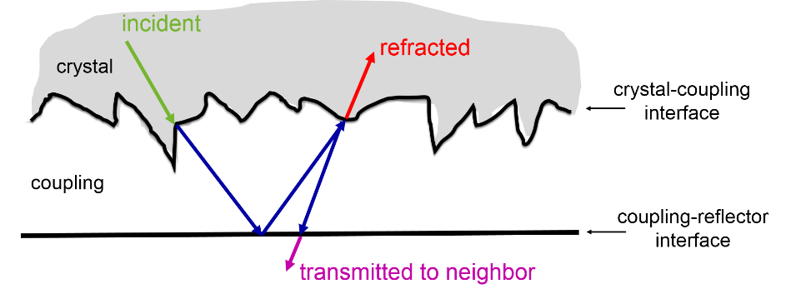
Integrating reflector and surface finish

Slide 6
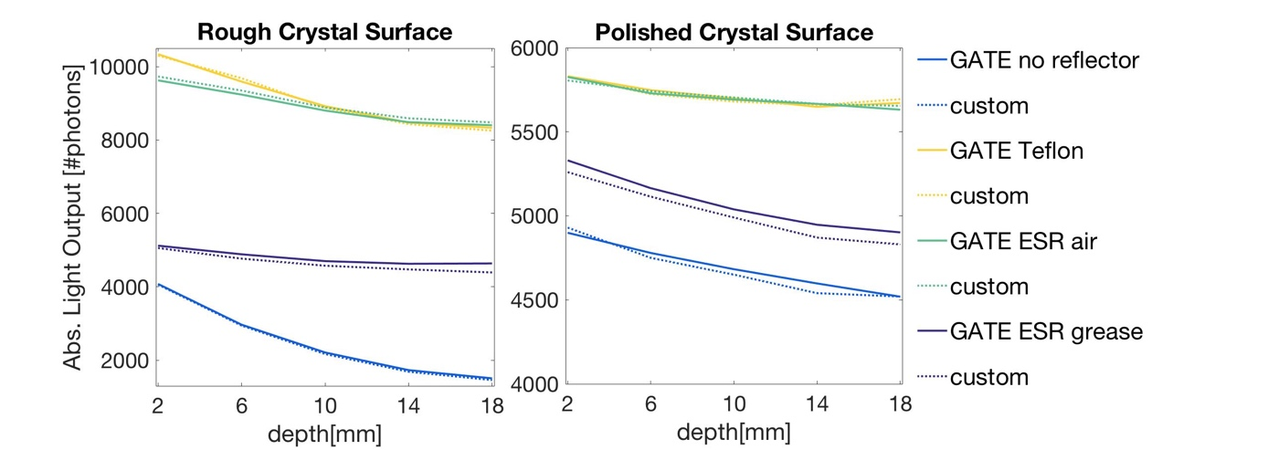
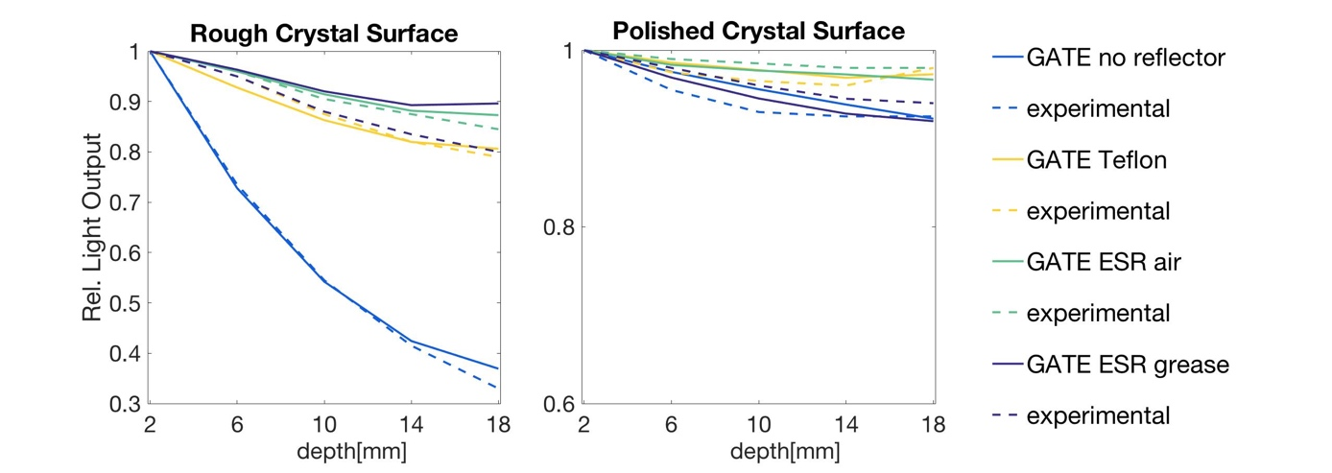
Validation against experimental DATA
Implementation in Gate V8.0
Custom Code Validation →
Stockhoff, M. et. al, 2017 “Advanced optical simulation of scintillation detectors in GATE V8.0: First implementation of a reflectance model based on measured data,” Phys. Med. Biol.

Slide 7
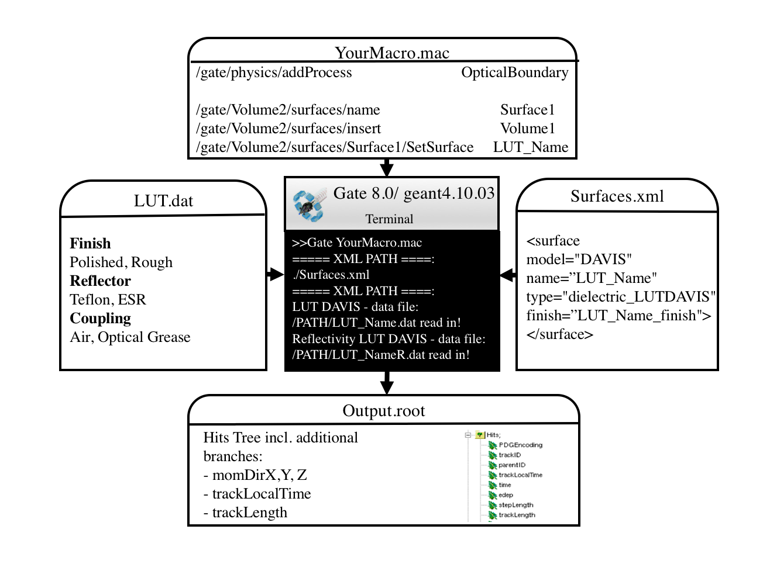
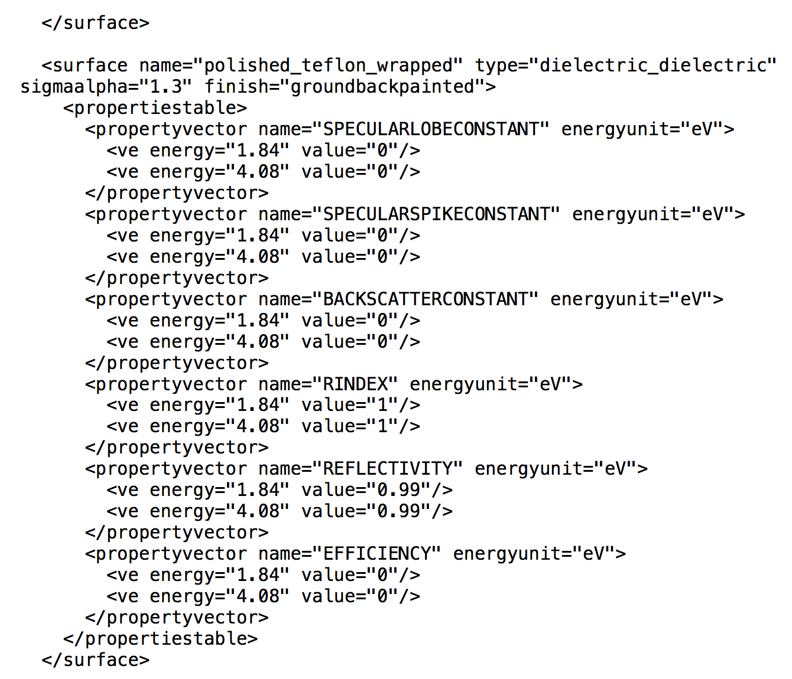
How to enable
LUT Davis model
UNIFIED
ccmake process: GATE_USE_OPTICAL flag ON

Slide 8
GUI for custom LUT calculation (future developments)
Figure. Davis LUT User Interface. Left. Input for reflector/coupling parameters. Bottom. Input of measured surface data and output file name. Center. Visualization of the surface data and selected reflector spectrum.

Slide 9
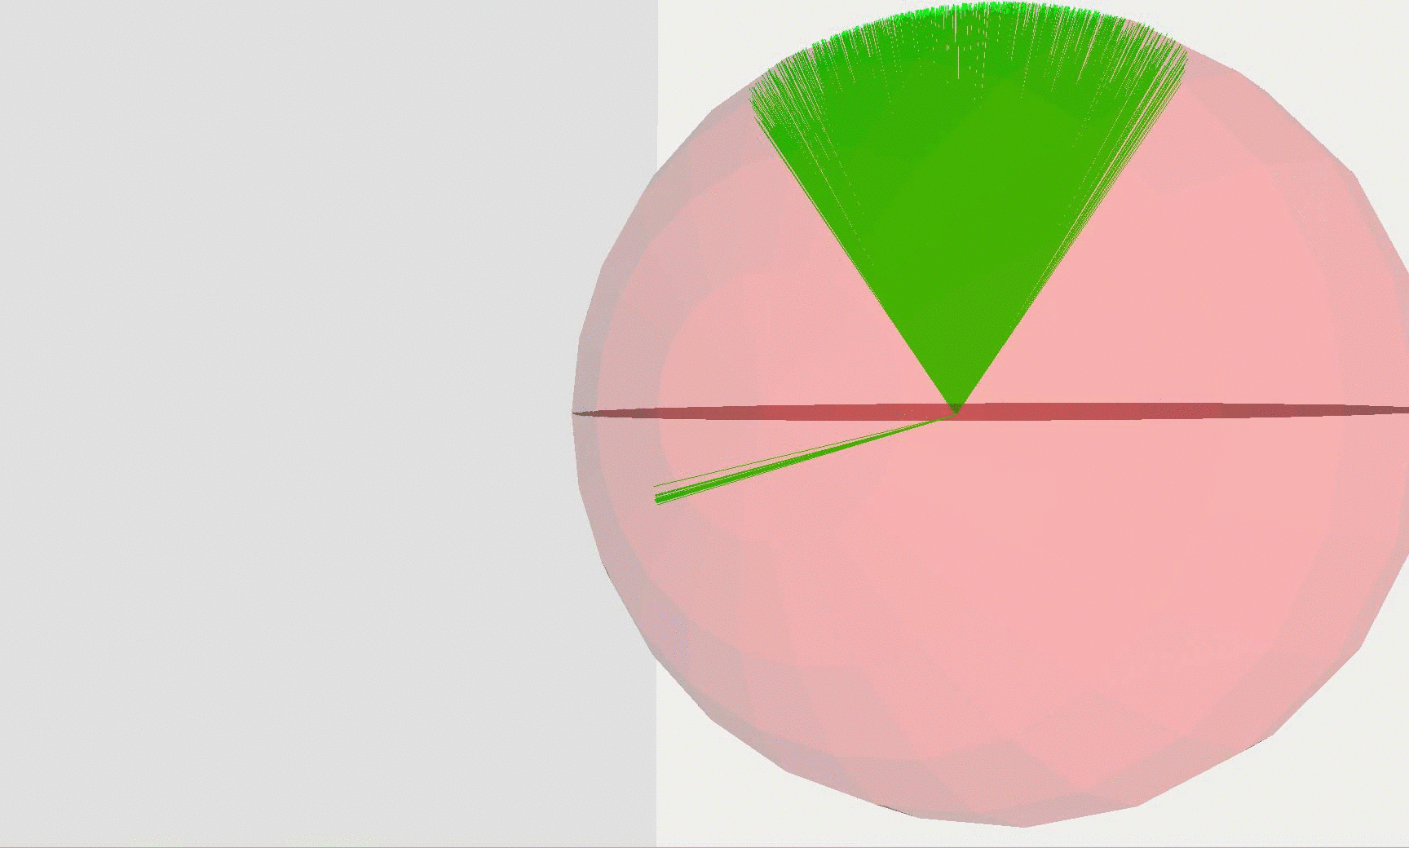
Conclusion
Validation of LUTs with custom code and experimental data
Implementation of more accurate reflectance model
  in Gate V8.0
  Geant4 patch release June ’17
Implemented new branches for ROOT output
Future: User Interface for Computation of Custom LUTs

Slide 10

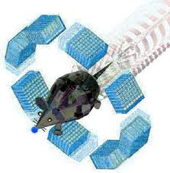


Acknowledgements
Dr. Emilie Roncali
Prof. Dr. Simon Cherry
Dr. Sun Il Kwon
MIPET Group
Dr. Sebastien Jan
Dr. Albertine Dubois
GATE
Prof. Dr. Karl Ziemons
Dr. Peter Gumplinger

Slide 11
References
Agostinelli, S. et al., 2003. GEANT4—a simulation toolkit. Nucl. Instrum. Methods A, July, 506(3), p. 250–303.
Cherry, S. R., Sorenson, J. A. & Phelps, M. E., 2012. Physics in Nuclear Medicine. Philadelphia(PA): Elsevier Saunders.
Janecek, M. & Moses, W. W., 2009. Measuring light reflectance of BGO crystal surfaces. IEEE Trans Nucl Sci., 55(5), p. 2443–9.
Janecek, M. & Moses, W. W., 2010. Simulating scintillator light collection using measured optical reflectance. IEEE Trans. Nucl. Sci., Volume 57, pp. 964-70.
Jan, S. et al., 2004. GATE: A simulation toolkit for PET and SPECT. Phys Med Biol., September, 49(19), pp. 4543-4561.
OpenGATE collaboration, 2017. Generating_and_tracking_optical_photons. [Online] Available at: http://wiki.opengatecollaboration.org/index.php/Users_Guide_V7.2:Generating_and_tracking_optical_photons[Accessed January 2017].
Roncali, E. & Cherry, S., 2013. Simulation of light transport in scintillators based on 3D characterization of crystal surfaces. Phys. Med. Biol., Volume 58(7), p. 2185–2198.
Stockhoff, M. et. al, 2017 “Advanced optical simulation of scintillation detectors in GATE V8.0: First implementation of a reflectance model based on measured data,” Phys. Med. Biol.
Roncali, E. , Stockhoff, M., and Cherry S., 2017 “An integrated model of scintillator-reflector properties for advanced simulations of optical transport”, Phys. Med. Biol.

Slide 12
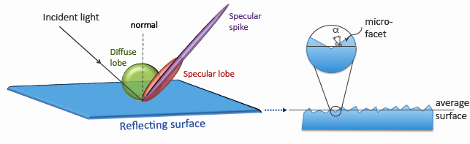
Software and Models
GATE and GEANT4
POLISHED/ GROUND: pure Lambertian reflection, no surface definition
http://wiki.opengatecollaboration.org/index.php/Users_Guide_V7.0:Generating_and_tracking_optical_photons
UNIFIED: additional parameters to define reflection characteristics
→Approach: Reflectance Model Based on Measured Data (Look-up-Tables)
Notes:
Orientation of micro-facets cannot be chosen
Pool of parameters makes it almost impossible for the user to find the right settings
Even when measured not accurate/ not representing the real reflection scheme
Transition: models are not accurate and we propose …

Slide 13
Two Step Validation
LUT
LUT
VALIDATED
VALIDATED
Custom Monte Carlo Code
Gate/geant4 BETA Version
Experimental Data
VALIDATED
#photons/DOI
#photons/DOI
#photons/DOI
Energy/DOI
Rel. Light Output
Rel. Light Output
Rel. Light Output

Slide 14
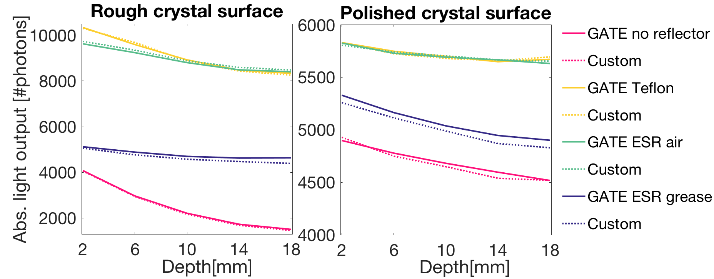
GATE V8.0 vs. Custom Code
Validation
Notes:
Maximum LO differences for rough surfaces are <1.3%, except for ESR grease which diverges by 5.3% at 18 mm. For polished surfaces the maximum absolute difference is less than 100 photons (1.5%). These differences are within statistical variation for such Monte Carlo simulations and codes are considered in excellent agreement. Small discrepancies in the LUTs are likely amplified when using a specular reflector such as ESR, because it reflects a photon according to its incidence angle, while the Lambertian reflection is independent on the incident direction.

Slide 15
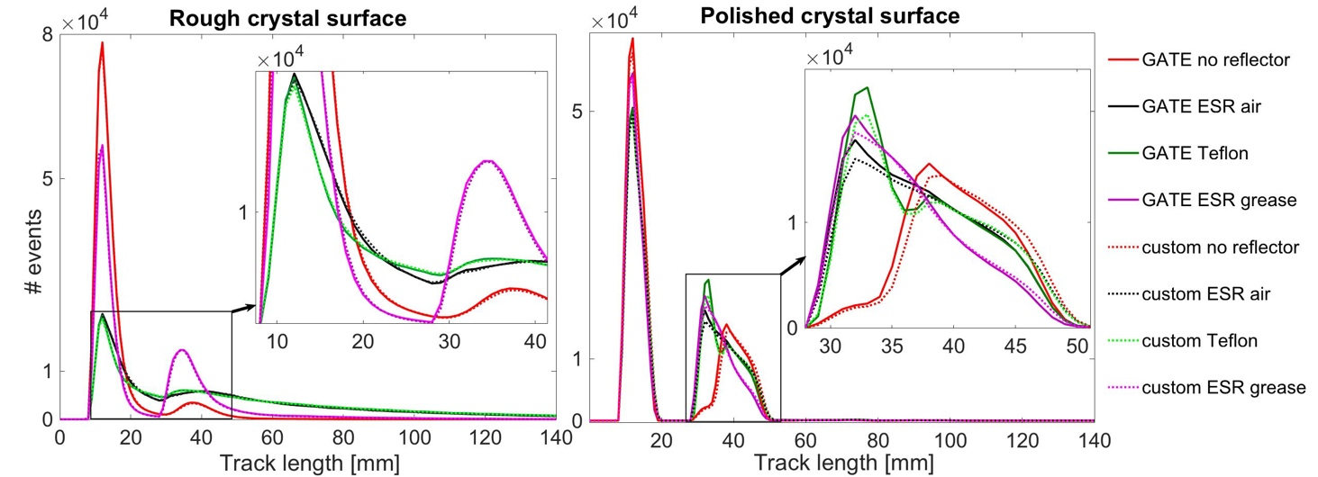
GATE V8.0 vs. Custom Code(1)
Tracklength of Photons
Notes:
Track length (total distance travelled in the crystal) of 5·10⁵ scintillation photons emitted at a DOI of 10 mm and detected by the photodetector. The impact of the crystal surface finish is reflected by the change in the peak shape and amplitude. The track lengths simulated with GATE are very similar to those generated with custom code (R² >0.99), indicating excellent agreement of the codes.
Figure 5 shows that the photon track length for custom and GATE simulation is extremely close for all combinations of surface finish and reflector, indicating that the transport of optical photons is modelled similarly in both codes. Results are also in good agreement with results from (Cates, et al., 2015).

Slide 16
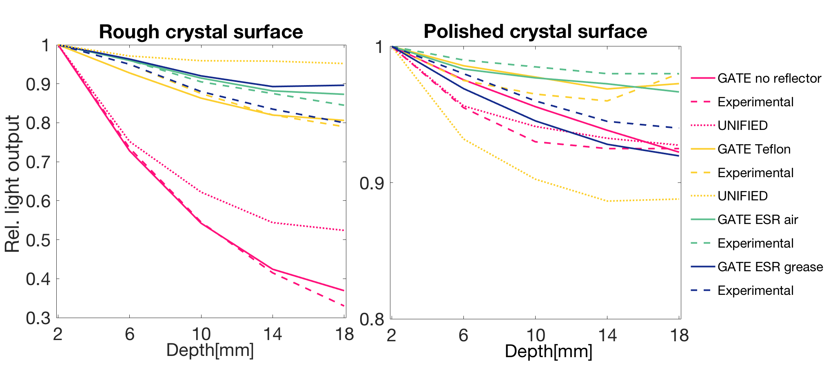
GATE V8.0 vs. Experimental Data
Notes:
For polished surfaces, the maximum difference is less than 2% for all configurations. For all rough surfaces but ESR-grease the GATE simulation produces LO values close to experimental data, with a maximum difference of 3.9% (Figure 6). The LUT for ESR-grease diverges by 9% at 18 mm.
The coupling to the photodetector and reflector wrapping are inherently variable processes, with limited reproducibility, and have a strong effect on the light collection (Roncali, et al., 2017). As we assume perfect crystal-reflector assemblies in the simulation, discrepancies with experiments might occur. The crystal transmittance increases when optical grease is used as a coupling medium instead of air, due to a smaller index mismatch. Imperfect assumptions for reflector coupling thus have a larger effect in the case of a ESR-grease reflector (Figure 6).
The polished surface is reasonably well described by the UNIFIED model, with a maximum deviation of 9% with Teflon wrapping. However, the error for rough bare surfaces is 20% and 16% with Teflon. This is because both the reflection probability and direction of reflection depend on multiple factors such as the thickness of the reflector, its refractive index, and the wavelength of the reflected photon, which cannot be reliably simulated with the UNIFIED model.

Slide 17
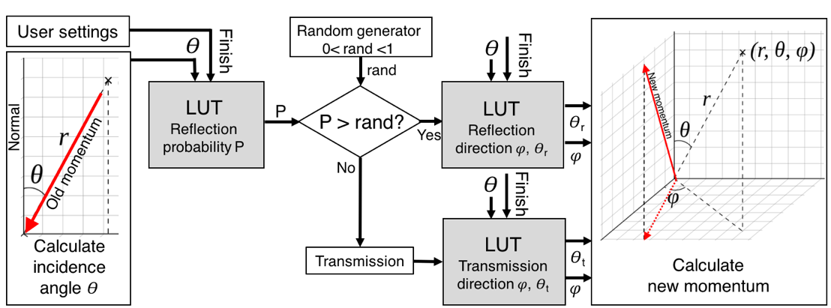
Implementation
Figure: Processing steps during the simulation.

