Slide 1
Monte Carlo simulation activities at MedAustron
Open Gate Meeting
May, 11th, 2017
Loïc Grevillot, MPE, Ph.D.

Slide 2
Outline
MedAustron status
Modeling of the fixed beam line for protons (Alessio‘s PhD)
GATE-RTion project

Slide 3
MedAustron status
Proton treatments started in IR3 in December 2016 !
Today (5 months later), up to 10 patients a day are treated and pediatric treatments started in April 2017.
IR2 second clinical room is in commissioning phase.
IR1 research room available since October 2016.

Slide 4
Modeling of the proton fixed beam line

Slide 5
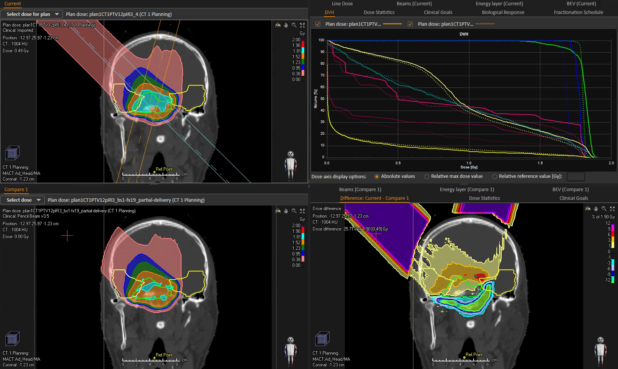
Gate-RTion project
What is needed
to use GATE clinically for independent dose calculation purposes?
Background:
More and more clinical users are using (or planning to use) GATE in Light Ion Beam Therapy (LIBT) facilities for clinical purposes.
Currently 7 LIBT facilities have been identified: MedAustron (Austria), CPO and Nice (France), Skandion (Sweden), PSI (Switzerland), Christie NHS Foundation (UK, Manchester and London): 4 facilities are already using GATE for clinical applications, 3 facilities are starting to use GATE.
On 3/3/2017, a GATE satellite workshop organized by David Sarrut, David Boersma and Loïc Grevillot at Skandion during the Swedish DOTSKAN meeting can be considered as the kick-off meeting of this project.
A typical application is to use GATE to support TPS commissioning,
or to use GATE as an independent dose calculation tool to reduce patient specific QA measurements

Slide 6
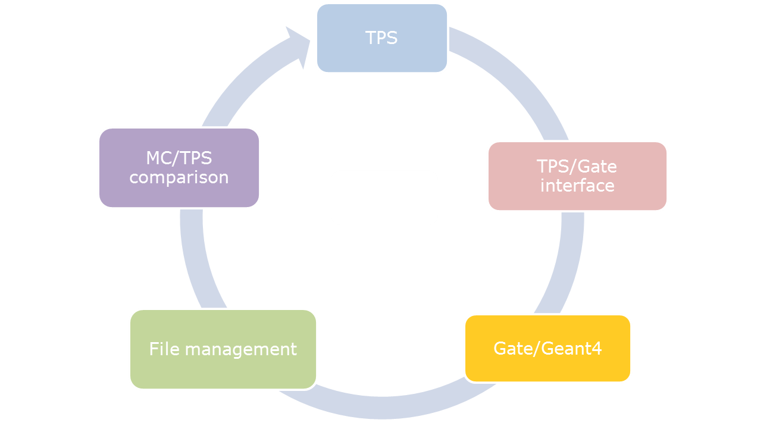
Gate-RTion project
What is needed
to use GATE clinically for independent dose calculation purposes?
Purpose:
To facilitate the use of GATE for clinical purposes and its integration into clinical environments (e.g. TPS validation or independent dose calculation verification).
Rational:
Every user who wants to establish GATE into a clinic is facing the same issues. Therefore, we want to share and coordinate efforts with the users interested to join the project.
Representation of a typical medical workflow required to use GATE clinically

Slide 7
Gate-RTion project
What is needed
to use GATE clinically for independent dose calculation purposes?
What are the user needs ?
To validate the GATE functionalities related to LIBT simulation.
A long term (frozen) GATE release for several years.
A number of tools aside GATE to perform all the clinical tasks necessary to integrate and use efficiently GATE into a clinical environment.
Concept of the GATE-RTion release
A selected and fixed version of GATE for all participating LIBT facilities.
Involved users shall preferentially stick to the exact same trio GATE/GEANT4/ROOT for validation.
Any major modification of the code would require full or partial re-validation.
Minor corrections of the code could be brought via the patching concept
-> The GATE-RTion release shall be delivered with a list of associated tools, documentation, validation tests and examples.
The following slides are a proposal and are introducing the vision of the GATE-RTion project. Details must of course be discussed and agreed with OpenGate SC members!

Slide 8
Gate-RTion project: overview
GATE-RTion project
GATE-V1.0
Documentation / Benchmarks / Examples, incl. validation examples / Validation reports / Guidelines / else?
Including the tools aside GATE-RTion!
GATE-V8.0
(validation)
GATE-RTion-V1.0
Beam Modeling tools
(patching)
DICOM processing tools
GATE-RTion-V1.X
Cluster tools
(validation)
GATE-RTion-VX.0

Slide 9
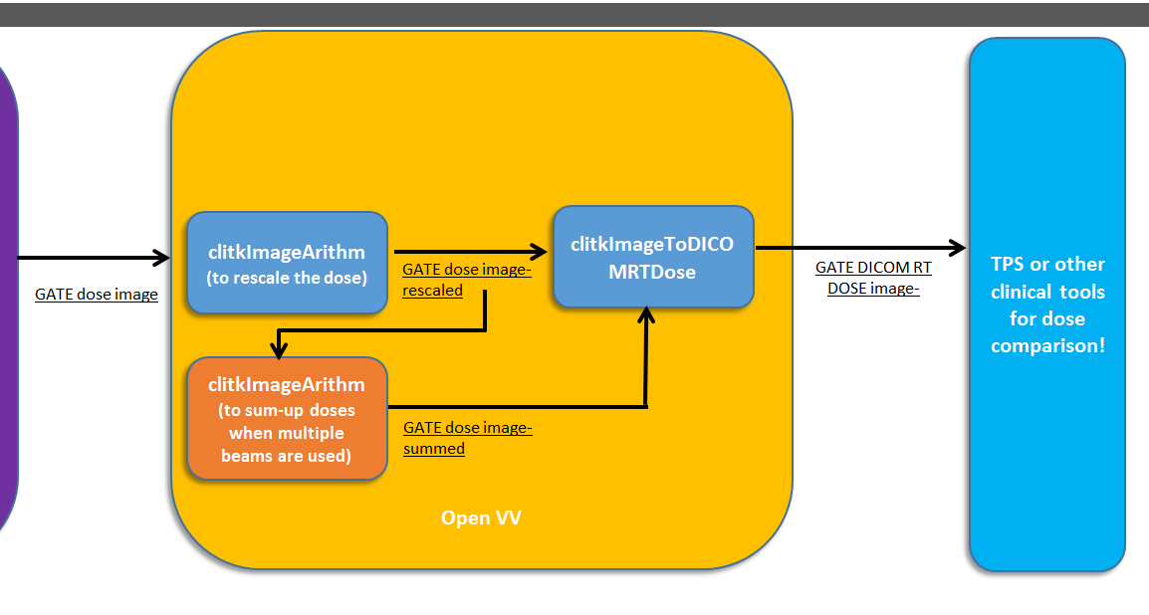
Gate-RTion project: workflow example
Generic treatment plan validation workflow (MedAustron experience)

Slide 10
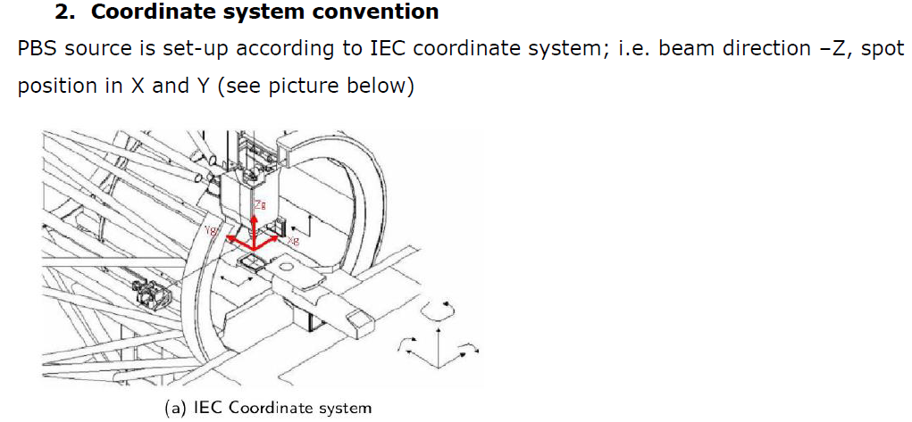
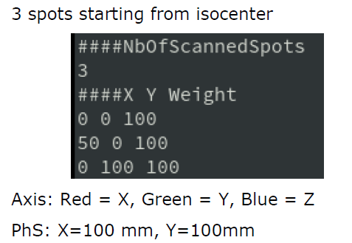
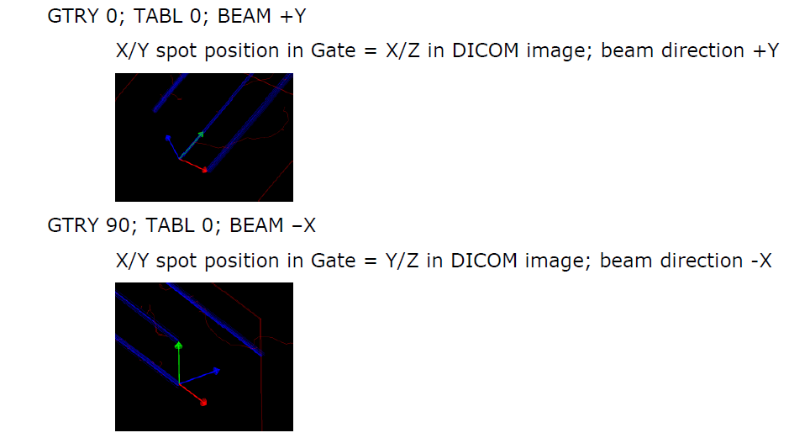
Gate-RTion project: validation example
Validation of the TPS source functionality
Purpose: To verify that the spot positions and number of particles delivered are as planned.
Coordinate systems of PBS and TPS sources
Simulation set-up
Validation results

Slide 11
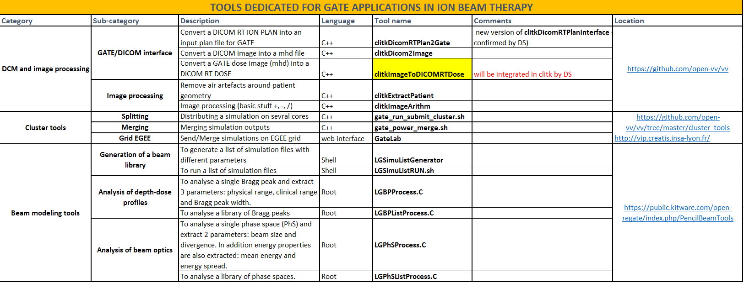
Gate-RTion project: list of tools
Shall we use the OpenReGate website to document the tools of GATE-RTion releases?

Slide 12
Gate-RTion project: status
Status of the project?
A group of interested users has been identified
A GATE-RTion release plan has been proposed in 3 steps:
GATE-RTion-V1.0 with features necessary for proton therapy
GATE-RTion-V2.0 with features necessary for carbon ion therapy
GATE-RTion-V3.0 with additional features (nice to have)
A list of GATE functionalities necessary for LIBT simulation has been identified and prioritized according to the release plan (1,2,3)
A list of tools necessary for LIBT simulation has been identified and prioritized
A list of validation tests has been proposed
Currently, it seems that:
All functionalities for the GATE-RTion-V1.0 are available
All necessary tools are available
A list of relevant tests has been proposed
But, still a lot of work to do:
write documentation
validation/testing/cleanup of the RT stuff in GATE V8.0
collect all "tools" in a single easy-to-install bundle
define the GATE-RTion online home
Etc.

Slide 13
Gate-RTion project: conclusion
Expected outcome:
Networking activities between clinical users (working group?).
Better physics-lists recommendation and validation from clinical users.
Improved documentation, examples, benchmarks and code validation (for the ion beam therapy related functionalities)
Improved international visibility of GATE for Ion Therapy applications.
Development of GATE validation and commissioning guidelines (“white book?”) for LIBT facilities.
Establishment of GATE as a reference platform for LIBT facilities.

Slide 14
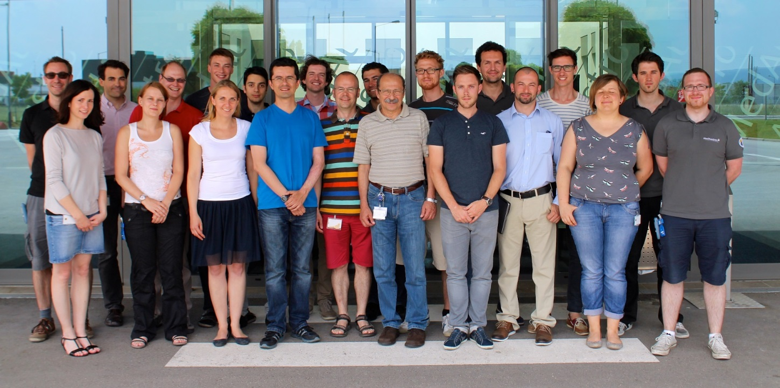
Thanks for your attention!
Medical Physics department!

Slide 15
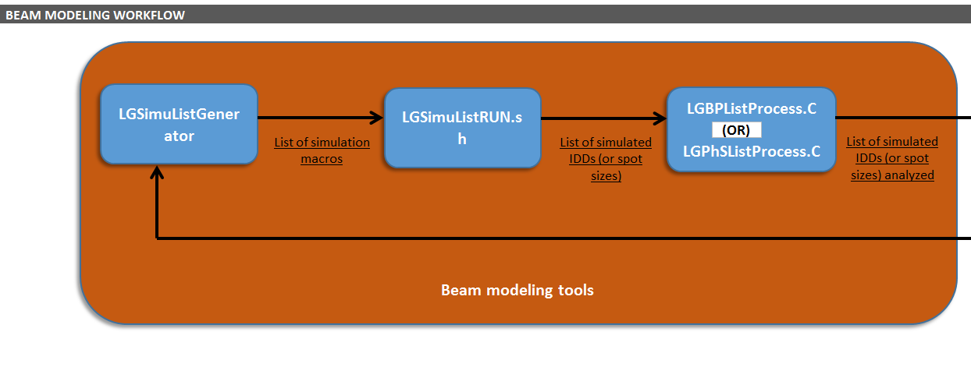
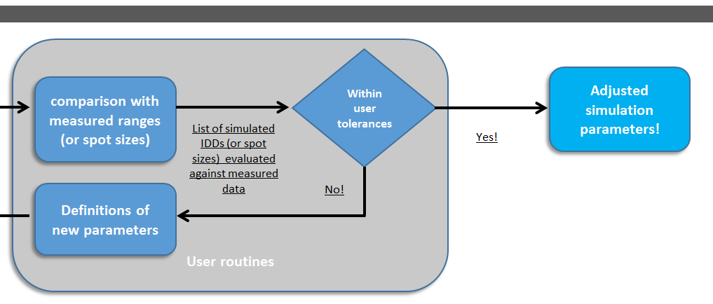
Gate-RTion project: workflow example
Generic beam modeling workflow (MedAustron experience)

