Slide 1
Current and future activities at the Medical University of Vienna
^{1,2}Andreas Resch, ^{1,2}Hermann Fuchs, ¹Fatima Padilla, ^{1,2}Dietmar Georg
¹Division Medical Radiation Physics Department of Radiation Oncology / Medical University Vienna & AKH Wien
²Christian Doppler Laboratory for Medical Radiation Research for Radiation Oncology

Slide 2
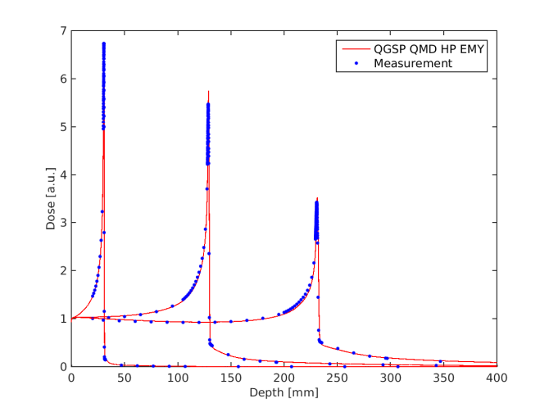
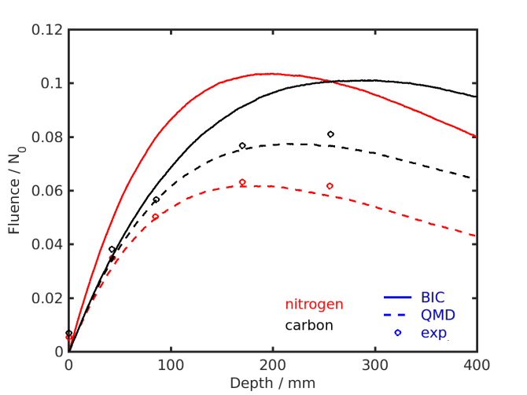
Benchmarking Gate/Geant4 for ¹⁶O ion beams
Objective: Determine accuracy and optimal settings
Reference data:
Depth Dose Distributions measured at HIT
Good agreement for all 5 tested hadron configurations
Good agreement for EMY and EMZ
Fragmentation (Charge changing CS) measured at GSI (670MeV/u)
QMD model best ➔ suggested
Gate 7.2

Slide 3
Pencil Beam algorithm for ¹⁶O ion beams
Base data created with GATE (in water)
Dose in 3D
using radial symmetry
Increased statistics ➔ speed up
Reduced memory
Scoring grid: $Δr=0.2 \text{mm}$, $Δz=0.\text{1} \text{mm}$
Phantom (cylinder) size: $0<r<200 \text{mm}$, $0<z<\text{400 }\text{mm}$
total and proton contribution scored separately
dose average LET: in 1 dim

Slide 4
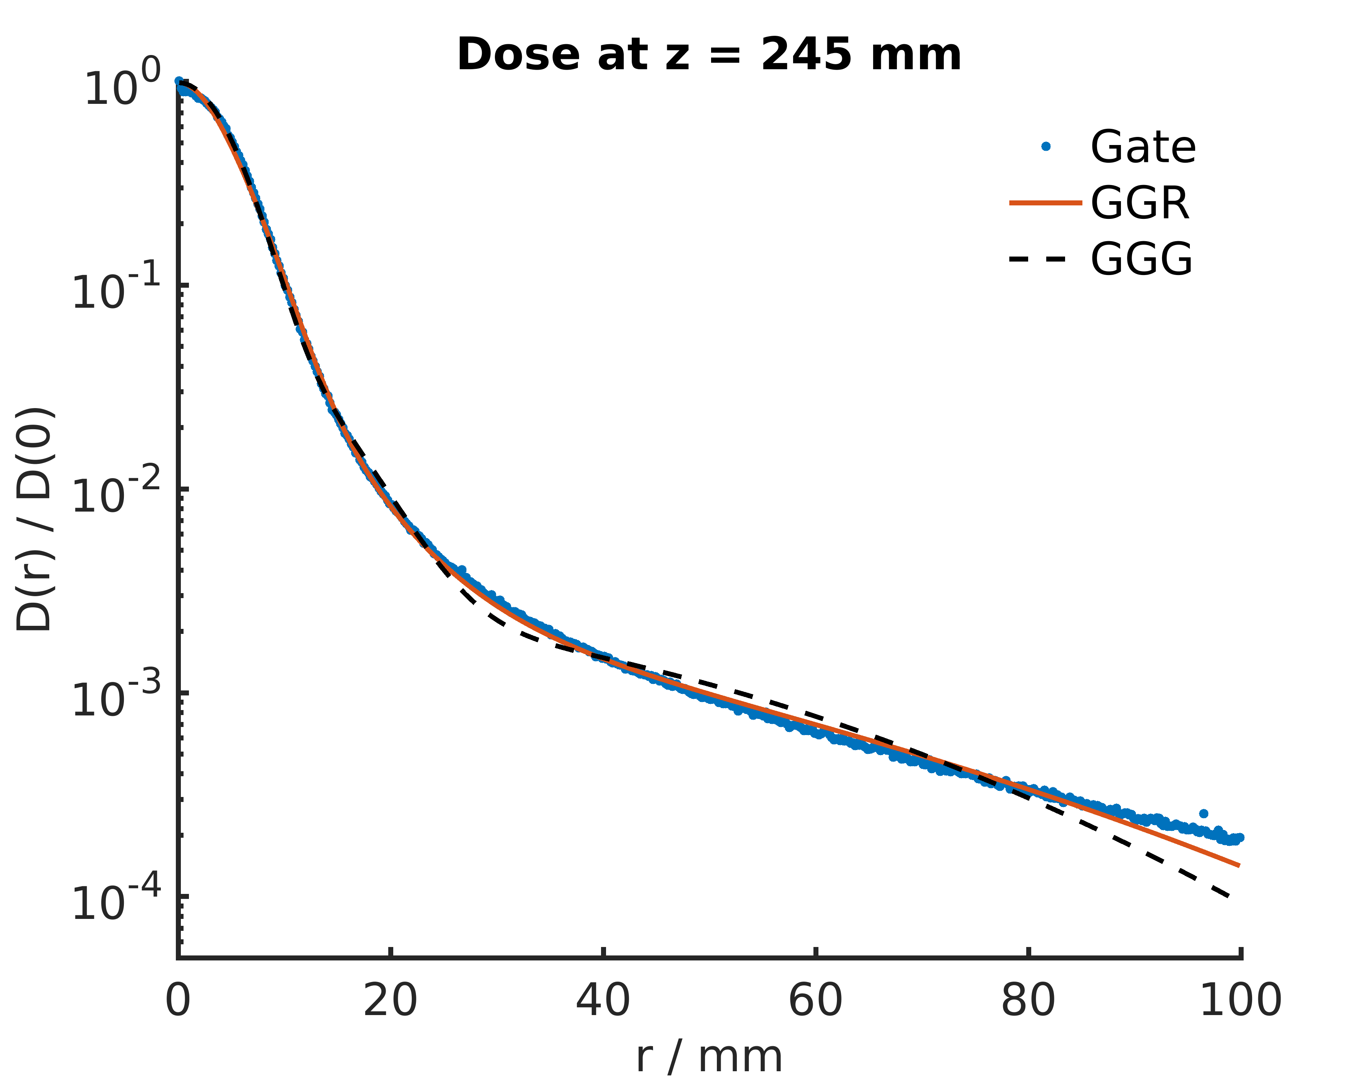
Pencil Beam algorithm for ¹⁶O ion beams
Parametrization of GATE results
2 fit functions evaluated
Triple Gaussian (GGG)
Gaussian + Gaussian + Rutherford (GGR)
X² fit very sensitive to
start values
dose threshold
MC noise
Weighted X² fitting stable
$w={\left(d^{2}r\right)}^{−1}$
Regularization
Lateral dose distribution of a 430 MeV/u ¹⁶O ion beam in water

Slide 5
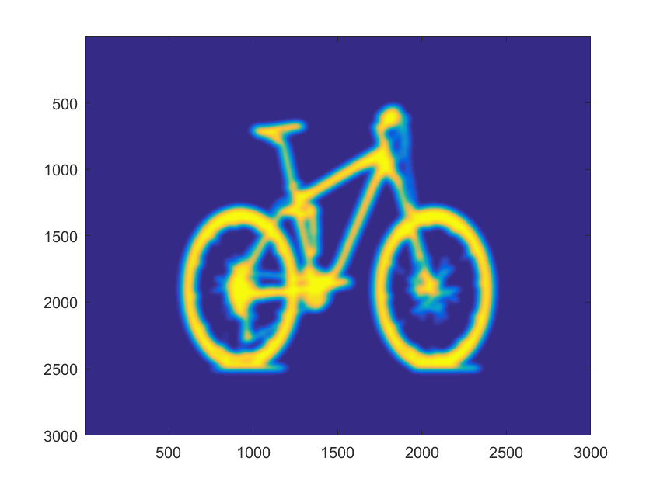
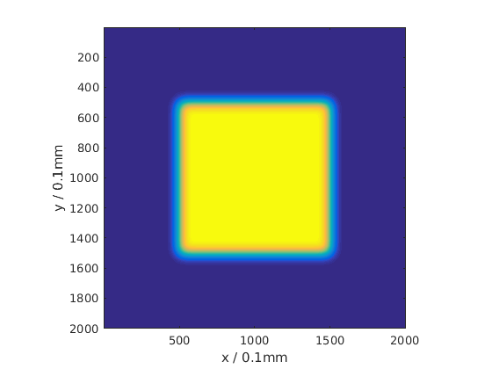
Pencil Beam algorithm for ¹⁶O ion beams
Implementation of PB algorithm into stand alone research tool
Generate arbitrary PB spot distributions
Calculate dose in 3D using
Parametrization (Triple Gaussian or Double Gaussian with Rutherford)
GATE base data (discrete energies only)
Create Gate macro files automatically
Validation ongoing

Slide 6
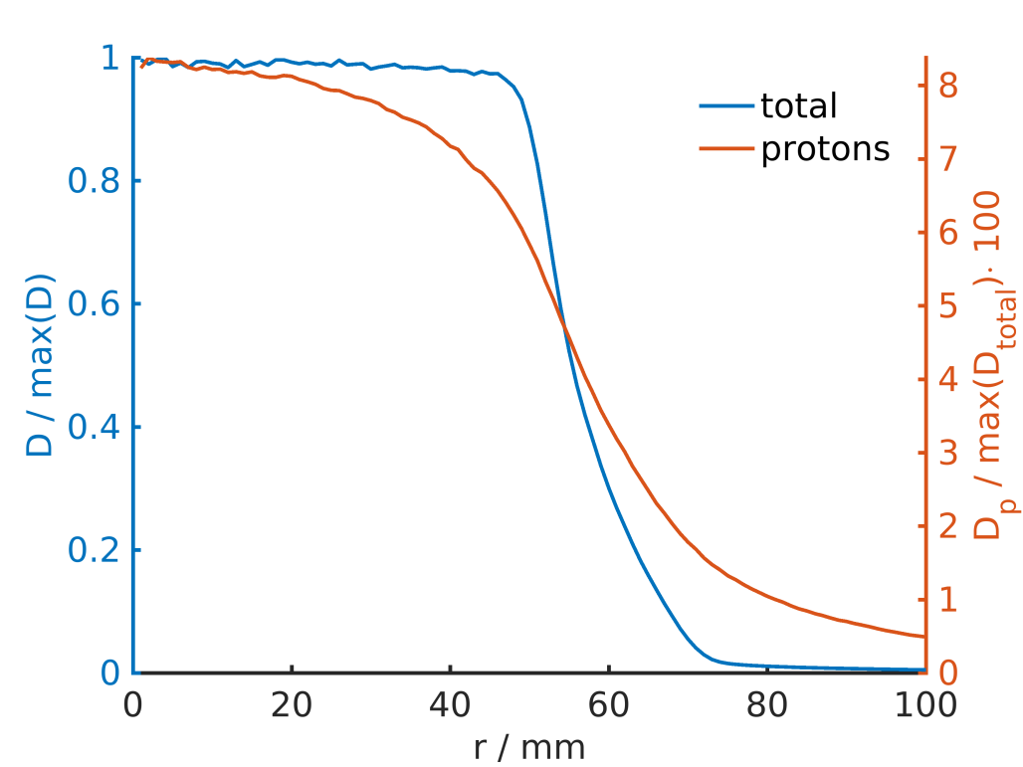
¹⁶O ion beams: field size effects
10x10cm² PB field simulated with GATE (gps)
Build up of dose contributed by protons towards the center
Next steps:
Spread out Bragg Peak simulations
Tool to create spot intensities

Slide 7
Proton Pencil Beam dose algorithm in presence of magnetic fields
F. Padilla
Base data generated with GATE 7.1:
Proton energies 40 – 250 MeV
Homogeneous magnetic fields (0, 0.5, 1.5 and 3T)
Direct parametrization of the water lateral profiles
Gaussian central beam
Independent exponential tailing functions for halo region
C++ / Root implemented
0 T
3 T

Slide 8
First stage validation: slab phantom (MC)
F. Padilla

Slide 9
Second stage validation: patient data (MC) + experimental
F. Padilla
Ongoing evaluation period:
MC simulations: realistic patient data. Implementation of the algorithm in an existing treatment planning software foreseen
Experimental data
Research beam line @MedAustron
1T electromagnet - 3% homogeneity
Experimental design using GATE
Field map implementation?

Slide 10
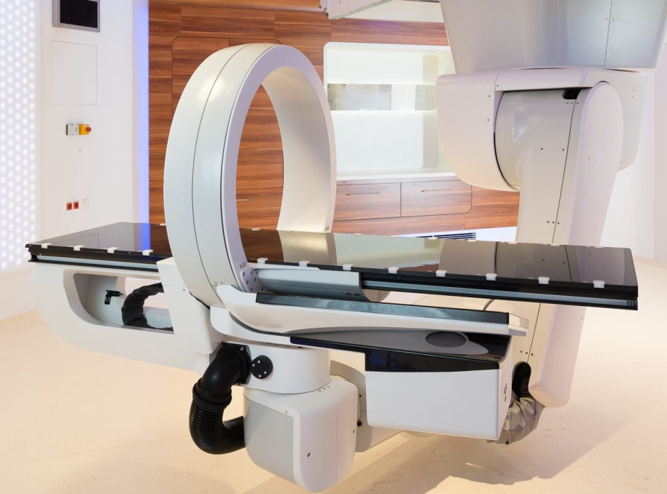
Recently started
H. Fuchs
@MedAustron, dual energy flat panel
cone beam CT in use
Cooperation with MedPhoton in modelling the imaging ring system
Head scatter evaluation
M.Sc. thesis
Research room @MedAustron started operation
First MC beam model available (thanks to Alessio Elia, MedAustron)
Validation ongoing M.Sc. thesis
Investigation on the impact of the treatment nozzle on beam parameters

Slide 11
GATE annotations

Slide 12
GATE startDAQCluster changed
H. Fuchs
When using gjs (GATE job splitter), simulations are split using
startDAQCluster
In Gate 8.0 the usual cluster approach stopped working
Simulations are no longer stopped after the defined time interval
Best way to fix?
For RT application, split by particle number should work
Future developments might include time
(How) should we solve this issue?

Slide 13
GATE physics list builder
What works?
Some commands do not work (Gate 7.2):
/gate/physics/processes/ProtonInelastic/setModel G4BinaryCascade
Some do work (Gate 7.2):
/gate/physics/addProcess RadioactiveDecay
Documentation up to date?
repeatedly an issue in Gate mailing list
Re-establish disable/enable physics processes from macro file?
Current workaround:
create custom physics list in Geant4 + re-compile
tedious & cumbersome

Slide 14
Actors: Diligence
Some actors limited to certain geometries
Cylindrical symmetry dose actor
Beam direction (0 0 1) required
GateCrossSectionProductionActor
Beam direction (0 0 1) required
Generalized to all (x, y, z) $x,y,z ∈\{−1,0,1\}$, but not $x,y,z ∈[−1,1]$
No warning or error if requirement violated
For safety: GATE should (ideally) abort if requirements violated (effort)
Documentation of the limitations

Slide 15
Tools
Various tools available on our git repository
.mhd, .txt and .root reader & merger (python or matlab)
Automated cluster use:
Split & Submit to cluster
Merge: check for missing files, merge and re-submit missing splits
Contact:
andreas.resch@meduniwien.ac.at
hermann.fuchs@meduniwien.ac.at

Slide 16
GATE workshop @ ESTRO
H. Fuchs
Joint operation with Uwe and Loic
Applied for workshop at ESTRO
New workshop format
17-18 of November
The multidisciplinary Gate/Geant4 Monte Carlo platform in medical physics: clinical applications and research
Looking for
Support
Presenters/Participants

Slide 17
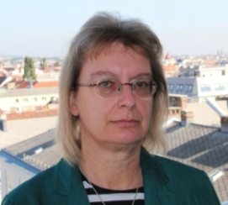
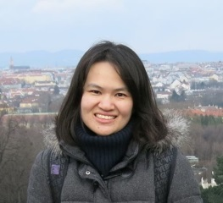
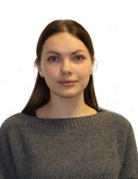
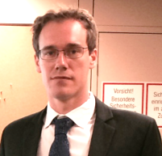
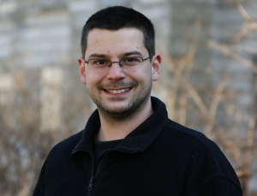
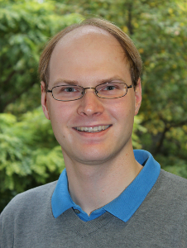
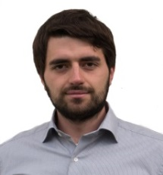
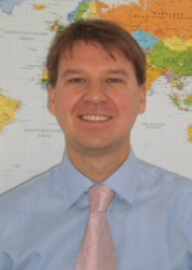
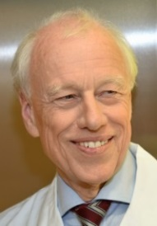
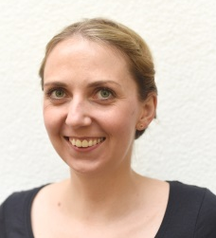
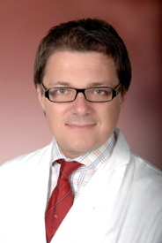
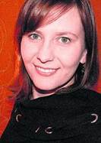
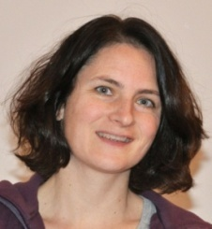
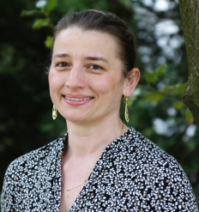
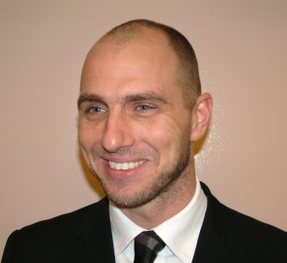
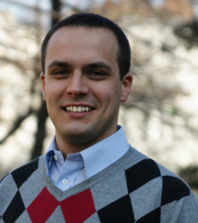
Acknowledgements
http://www.meduniwien.ac.at/hp/radonc/
and many others ……

