Slide 1
GATE status
Releases and developments

Slide 2
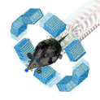
Geant4 and GATE releases
Geant4 version | Date release | CLHEP version | Gcc version
10.2 | 12/2015 | 2.2.0.4 | 4.8 to 5.2
10.3 | 12/2016 | 2.3.4.3 | 4.8 to 6.2
Geant4
GATE v8.0: current GATE release from 04/2017
Recommended configuration
Geant4: v8.0 validated for Geant4 10.3 (remains backward compatible with Geant4 10.2)
Compiler: gcc 4.8 to 6.2
ROOT: last versions of ROOT 5 and ROOT 6
ITK: version 4.9 or later
CLHEP: version embedded from Geant4 available since GATE V7.0 Users can also use the external CLHEP version recommended by Geant4 (2.3.4.3)

Slide 3
Git/GitHub status
!! Gate public repository on GitHub is now the only and official one !!
It holds:
2 official branches
develop (default branch)
master
4 specific branches
djboersma-TPS_fix
EnergySpread
dicom-dev
deformActor
Devs. to be included in the next release
Snapshot of the current release
c
What about them?

Slide 4
Git/GitHub status
!! Gate public repository on GitHub is now the only and official one !!
It holds:
4 tags and 4 corresponding releases (from GATE v7.0 to v8.0)
c

Slide 5
Git/GitHub status
Gate public repository on GitHub is now the only and official one
It holds:
4 tags and 4 corresponding releases (from GATE v7.0 to v8.0)
Private Git server previously hosted at IMNC is no longer available

Slide 6
Git/GitHub status
Since GATE v8.0, all examples have been definitely removed from the Gate source code repository
Now available on a new user-oriented repository named GateContrib
Open and publicly available on GitHub as part of the OpenGATE collaboration organization
https://github.com/OpenGATE/GateContrib

Slide 7
Git/GitHub status
Each example is stored under imaging, dosimetry, gpumacros or misc and contains:
1.
Macros

Slide 8
Git/GitHub status
Each example is stored under imaging, dosimetry, gpumacros or misc and contains:
2.
Macros
Associated data (binary files), stored using Git LFS (Git extension for versioning large files)

Slide 9
GATE release v8.0
New developments
New module for thermotherapy applications: modeling of hyperthermia therapy and heat diffusion in biological tissues
New associated example: GateContrib / imaging / Thermal
!! Requires to install ITK and to turn the CMake flag GATE_USE_ITK to ON !!
New reflectance model for optical simulation of scintillation detectors based on measured surfaces
New associated example: GateContrib / imaging / LUTDavisModel
!! Requires to manually modify some Geant4 classes and to turn the CMake flag GATE_USE_DAVIS to ON !!
New tessellated volume: read-in STL input files, the most and widely used CAD format
New associated examples: GateContrib / misc / geometry_STL
Suzanne
Kidneys

Slide 10
GATE release v8.0
New developments
New DICOM format reader: for now, it only supports the reading of DCM images
New associated example: GateContrib / imaging / DICOM / mhd-dcm-comparison
!! Requires to install ITK and to turn the CMake flag GATE_USE_ITK to ON !!
New hybrid navigator: supports particle tracking in a volume which combines an analytical and voxelized description
New associated example: GateContrib / misc / hybrid_volume_navigator
New fast90Y source model: speeds-up the ⁹⁰Y bremsstrahlung photon production without simulating the electron transport of the β emission
New associated example: GateContrib / imaging / fastY90

Slide 11
GATE release v8.0
New developments
New LET (Linear Energy Transfert) actor
New associated example: GateContrib / dosimetry / LET
New TEPC (Tissue Equivalent Proportional Counter) actor
New associated example: GateContrib / dosimetry / TEPCActor
Improvement of FFD (Fixed Forced Detection) for X-ray imaging
Improvement of associated example: GateContrib / imaging / CT / fixedForcedDetectionCT
Fast SPECT simulation with adapted FFD
New associated example: GateContrib / imaging / SPECT_FFD
!! Requires to install RTK and to turn the CMake flag GATE_USE_RTK to ON !!
New AugerDetector actor: detector response modelling using the actor approach
Improvement of fast PromptGamma yield actor (vPGTLE, Track Length Estimator) and TPSPencilBeam (use less memory)

Slide 12
Gate-users mailing-list archive
Temporarily (?) not available due to major reorganizations at the gmane.org website
We hope that it will be back online soon…
In the meanwhile, we can make the mailman archive on our own server public, so that Google can see it
Should we also consider to switch to other archives system (The Mail Archive, Nabble, MarkMail, MARC, MailBrowse, ....) ?
Still in progress…

Slide 13
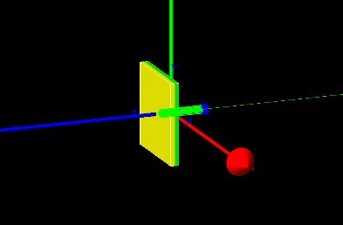
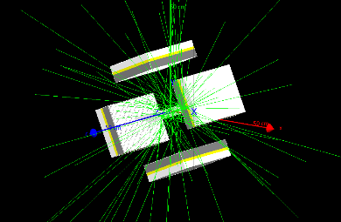
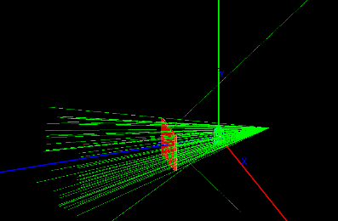
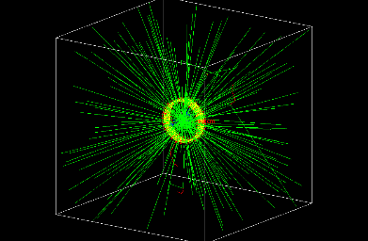
Benchmark tests
We have included in GATE v8.0 a new benchmarking system
To validate installation
To ensure regular updates of the new modules to be developed
It provides
3 tests dedicated to radiation therapy applications
benchRT_gamma
benchRT_proton
benchRT_carbon
4 tests dedicated to imaging applications
benchImaging_optical
benchImaging_ct
benchImaging_spect
benchImaging_pet
All benchmark tests can be easily run with make test

Slide 14
How to run benchmark tests
It requires a specific CMake configuration
To enable benchmarking system
(Required if GATE_USE_ECAT7 is set to ON)
To get reference results (stored on Midas)
If let to OFF (default), benchImaging_pet
and benchImaging_optical tests will not be performed

Slide 15
How to run benchmark tests
After make and make install, type make test
$ make test
Running tests...
Test project /home/adubois/Simulation/gate/gate_v8.0-build
Start 1: benchRT_gamma
1/7 Test #1: benchRT_gamma .................... Passed 16.67 sec
Start 2: benchRT_proton
2/7 Test #2: benchRT_proton ................... Passed 1.54 sec
Start 3: benchRT_carbon
3/7 Test #3: benchRT_carbon ................... Passed 5.86 sec
Start 4: benchImaging_ct
4/7 Test #4: benchImaging_ct .................. Passed 40.47 sec
Start 5: benchImaging_optical
5/7 Test #5: benchImaging_optical ............. Passed 4.27 sec
Start 6: benchImaging_spect
6/7 Test #6: benchImaging_spect ............... Passed 31.91 sec
Start 7: benchImaging_pet
7/7 Test #7: benchImaging_pet ................. Passed 15.84 sec
100% tests passed, 0 tests failed out of 7
Total Test time (real) = 116.57 sec
1. Execute Gate macros
2. Perform some comparisons based on
List of specific files to be compared
Some diff commands: diff, diff_stat, diff_dose
3. Return result (success/failure)
At the end of make test process, you should see

Slide 16
Benchmark tests: need updates
For now, our benchmarking system requires exact reproduction of the reference results
No statistical fluctuations are allowed
If we explicitly set the random number seed, we should expect to get the same output
But sometimes floating point operations are slightly different between different platforms (each have their different rounding errors)
As suggested by David Boersma, the benchmark code needs to be updated to reflect that
Not test for exact equality
But instead do a statistical test or simply ignore small numeric differences
Report failure only if the discrepancy is too large
Could have found a solution with ndiff tool
Still in progress…

