Slide 1
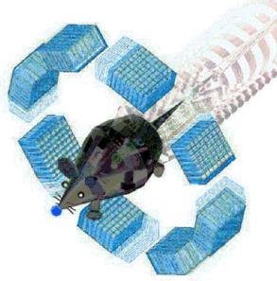
TrueBeam model with GATE INSERM U1037 (CRCT) Toulouse Jeremy LESTE, Tony YOUNES, Sara BEILLA, Xavier FRANCERIES, Laure VIEILLEVIGNE, Luc SIMON, Manuel BARDIES
OpenGate Technical Meeting
May 11th 2017
Clermont-Ferrand

Slide 2
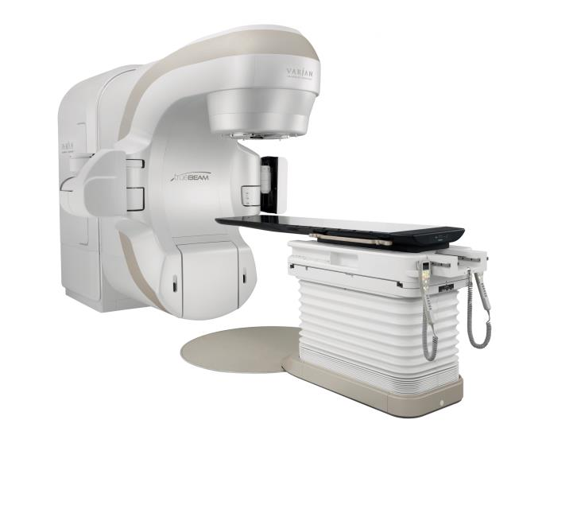
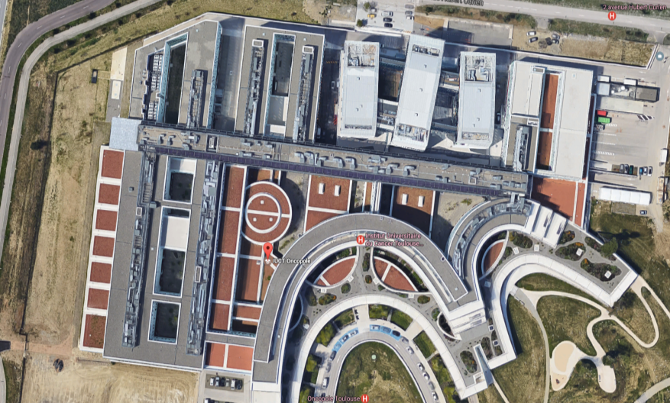
The Varian TrueBeam Linear Accelerator
CRCT Team15
Two real machines are available at IUCT-Oncopole
TrueBeam
Assessment and validation for clinical situation

Slide 3
The Varian TrueBeam Linear Accelerator
Confidential data provided by the manufacturer (available on myvarian.com)
The Truebeam Package includes :
A geometry description Some geometrical details are missing
.IAEAphsp and .IAEAheader files (version 2)
Approx. 50 Gb for each energy mode: 6FF, 6FFF, 10FF, 10FFF
21 bytes/part
All particles start from a plane located before primary jaws

Slide 4
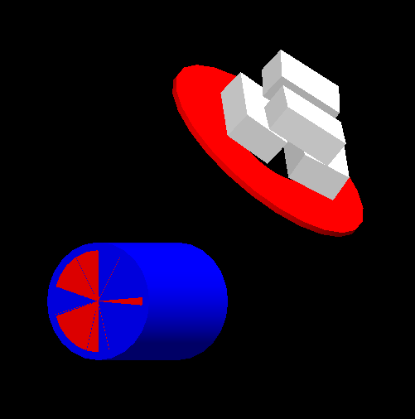
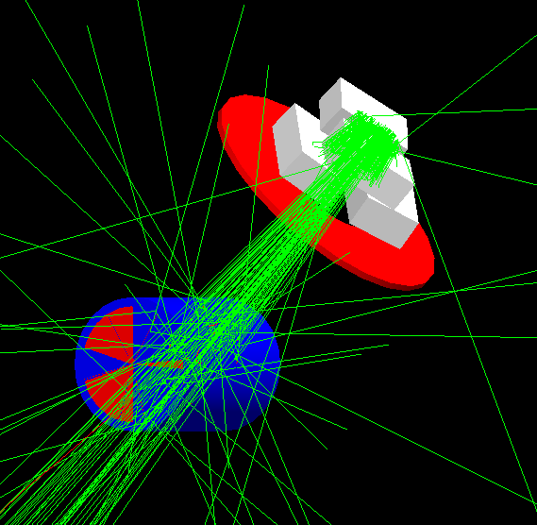
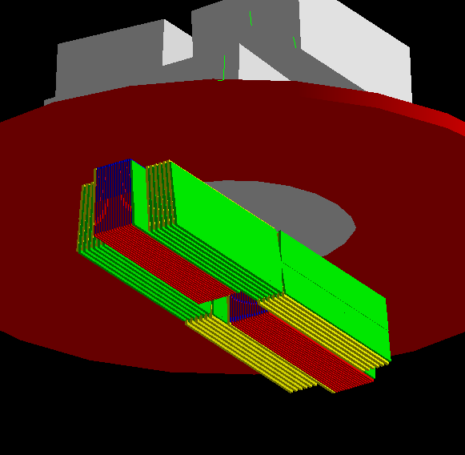
The model
A bash script generates the TrueBeam macro files for GATE including:
Phase space planes
One to attach IAEA files provided by Varian
One to attach IAEA files generated by a previous GATE simulation (speed up the computation)
X and Y Jaws
Mylar
Baseplate
A set of simple phantoms
MLC HD (120 leafs, central leafs ok, last leafs in progress)
EPID (work in progress)
CT scan (possible but not with the script)

Slide 5
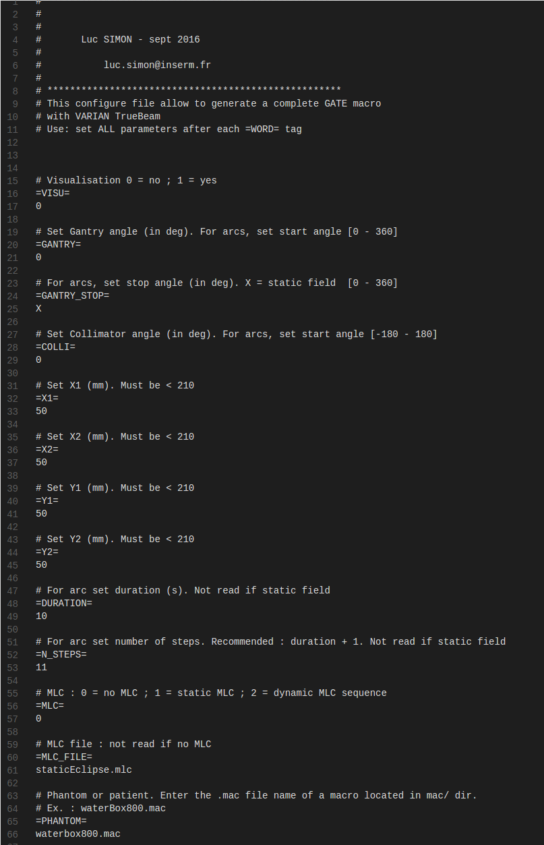
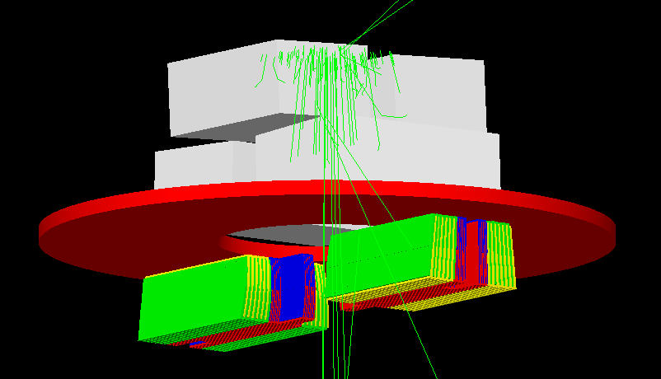
The model
User choose: (using a configuration text file)
X/Y field size
Gantry rotation (head)
MLC file from Varian Eclipse TPS (static ok, dynamic work in progress)
EPID (distance)
A macro for the “phantom”
A macro for the Gate Actor
Possibility to split in multiple jobs adapted to our clusters architecture
new one 25 iMacs (100 cores – 3.2 GHz)
Managed by HTCondor
Using a Docker Gate Image (works approx. as a virtual machine)
See: manureva/ubuntu-gate:16.04-7.2

Slide 6
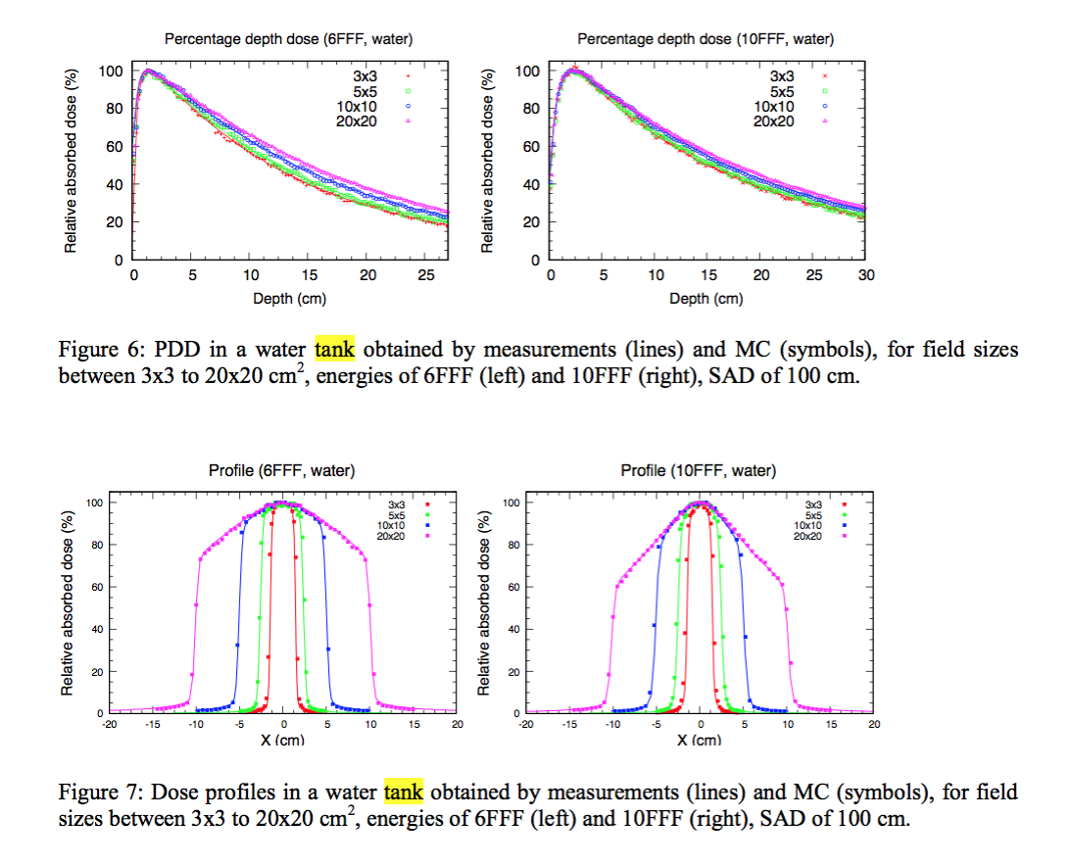
Validation in water
Beilla et al.
Physica Medica in press

Slide 7
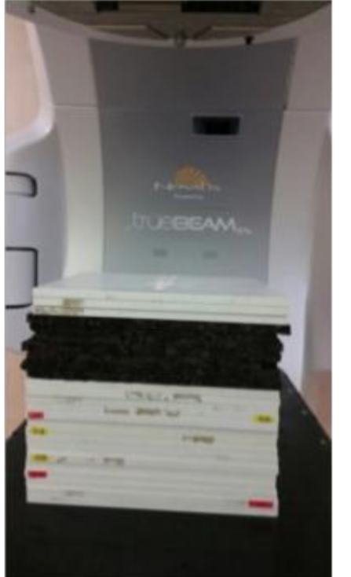
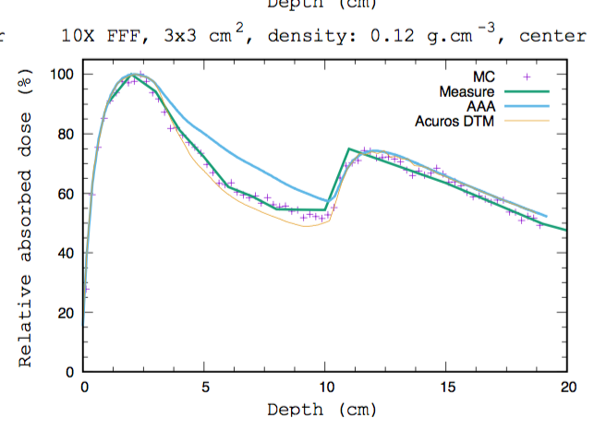
Validation in very low density media
Phantom Water/Cork
IUCT clinical algorithm: Eclipse AAA v13
d=0,12 (Lung -DIBH)
(Deep Inspiration Breath Hold, ex. lung SBRT)
Beilla et al.
Physica Medica in press

Slide 8
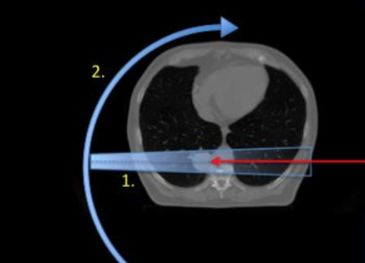
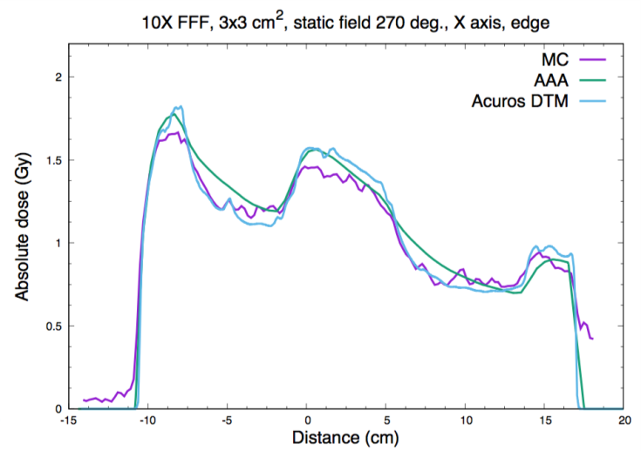
Assessment for a lung cancer patient (SBRT)
Beilla et al. Physica Medica in press
d=0,12 (Lung –DIBH)
AAA:
Over-estimates dose in lung ?
Underestimates dose in tumor ?

Slide 9
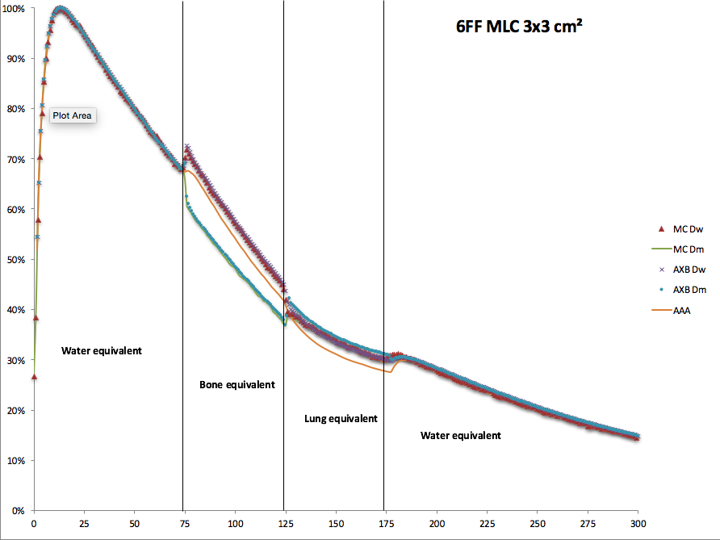
MLC: Heterogeneity study
Relative dose absorbed dose (%)
Distance (mm)
Younes et al. Accepted at AAPM 2017

Slide 10
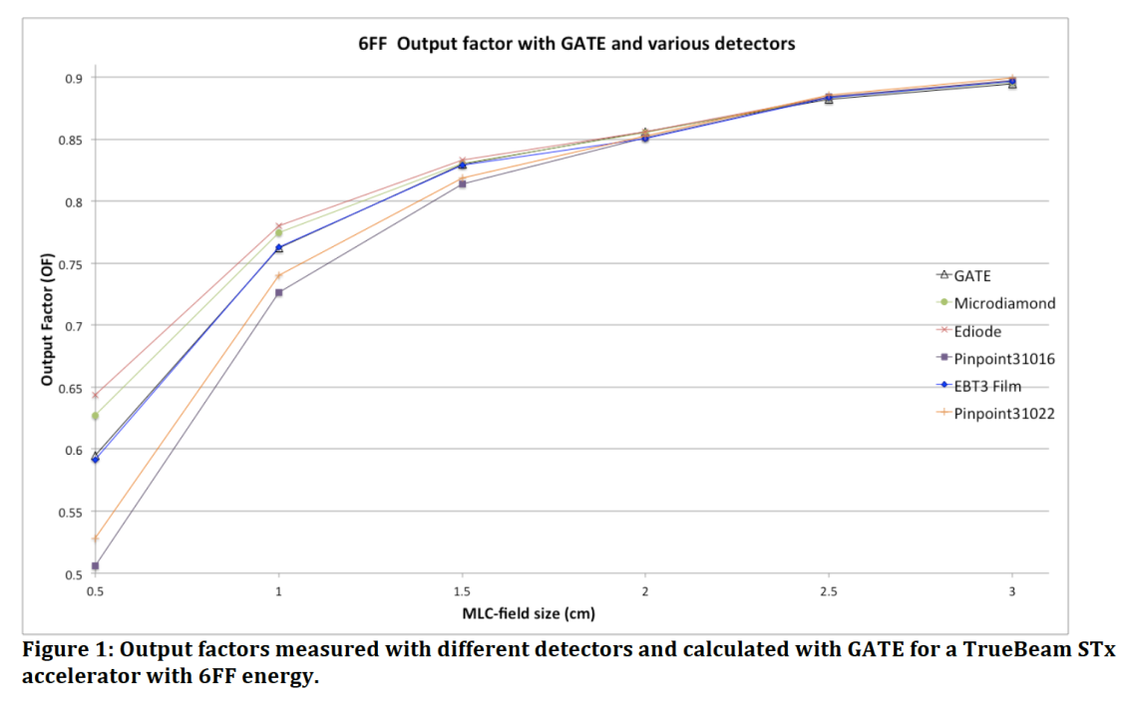
MLC: Output Factor study
Younes et al. Accepted at AAPM 2017

Slide 11
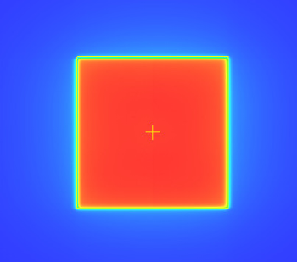
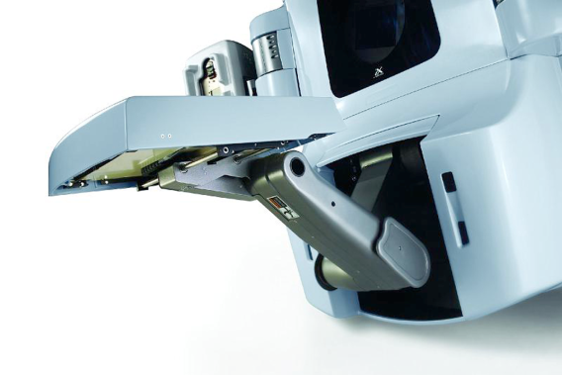
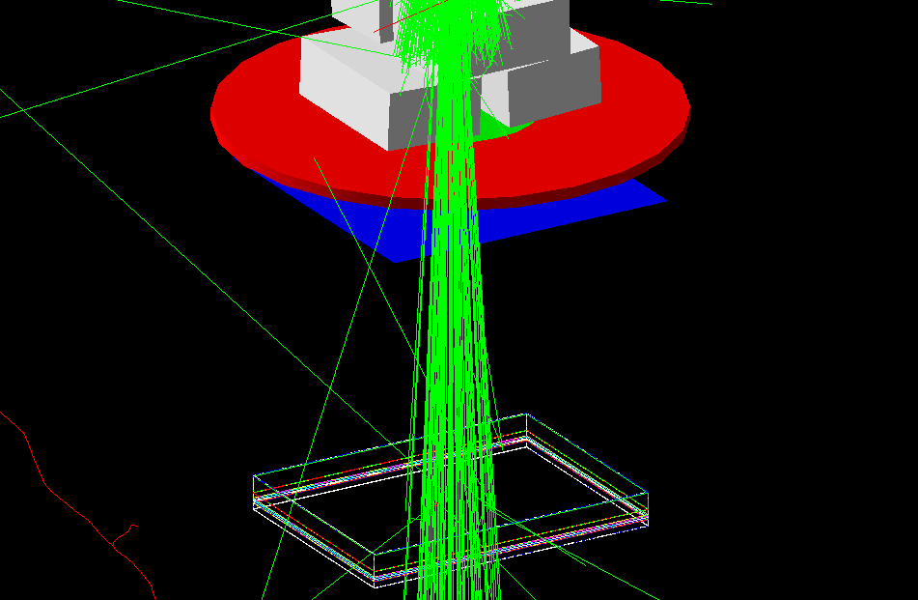
EPID (electronic portal imager device)
EPID dose images
Gate output : Dose.raw
Project STEREPID (Physicancer 2016): to use EPID dose images for QA and 3D in-vivo dosimetry (small fields + SBRT)
Monte Carlo simulation gives a predictive dose image
Comparison with dose image acquired on the TrueBeam

Slide 12
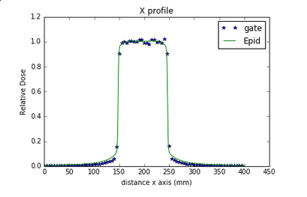
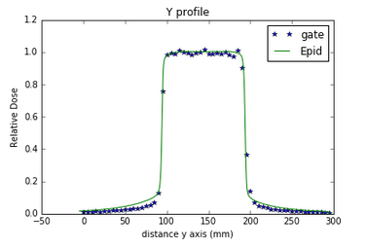
EPID (electronic portal imager device)
First results in agreement with measurement but need improvement
Details of the EPID composition missing
Low sensibility (need a significant amount of particle)
Compromise of resolution and statistic noise

Slide 13
Thank you

