Slide 1


Pre-clinical and clinical dosimetry in internal radiation therapy and imaging
OpenGATE meeting – Clermont-Ferrand – 11-12 May, 2017
Giovanna Rosa Fois, Lydia Maigne, François Smekens
Laboratoire de Physique de Clermont, Pôle Physique pour la Santé et l’Environnement, UMR 6533 CNRS/IN2P3 – Université Clermont Auvergne,
Campus Universitaire des Cézaux, 4, avenue Blaise Pascal, TSA 60026, CS 60026, 63178 – Aubière Cedex, France
LPC - Pôle Physique pour la Santé et l'Environnement - Fois - OpenGATE meeting - Clermont-Ferrand, May 2017

Slide 2
Overview
Internal dose estimates using MIRD method: general view
Preclinical and clinical studies performed at LPC: - [¹⁷⁷Lu]DOTA-Ts29.2 in RIT of colorectal cancer
  - [¹³¹I]ICF01012 in TRT for melanoma treatment
  - ^{99m}Tc-NTP 15-5 for cartilage imaging in arthrosis related pathologies
Dosimetry calculations using GATE
Future developments
LPC - Pôle Physique pour la Santé et l'Environnement - Fois - OpenGATE meeting - Clermont-Ferrand, May 2017

Slide 3

Introduction
DOSE = Cumulated Activity X S-factor
$$\tilde{A}= \int_{0}^{∞}{A\left(t\right)dt}$$
Cumulated activity: is represented by the area under the time activity curve
ACTIVITY DISTRIBUTION: - bio-distribution by organ harvesting;
- SPECT-CT imaging after radiotracer injection.
S-factor: is the mean absorbed dose in the target per nuclear transformations in the source
It is calculated by GATE Monte Carlo simulations.
LPC - Pôle Physique pour la Santé et l'Environnement - Fois - OpenGATE meeting - Clermont-Ferrand, May 2017

Slide 4
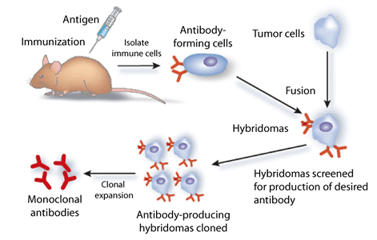
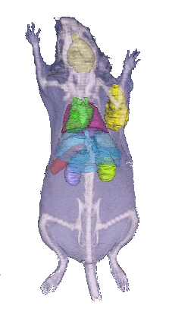
[¹⁷⁷Lu]DOTA-Ts29.2
RIT (RadioImmunoTherapy)
Ts29.2 is a murine monoclonal antibody specific for human tetraspanin-8 (TSPAN8)
TSPAN8 gene is overexpressed in human colorectal cancer (CRC)
Targeting TSPAN8 in CRC with radiolabeled Ts29.2
Dosimetry in pre-clinical trials:
mouse model obtained from segmented CT-scan
The ratio of absorbed doses in the tumor to non-targeted organs was evaluated
Publication:
LPC - Pôle Physique pour la Santé et l'Environnement - Fois - OpenGATE meeting - Clermont-Ferrand, May 2017

Slide 5
[¹³¹I]ICF01012
Radionuclide Therapy:
ICF01012 is a melanin ligand
Melanin targeting is of interest for the treatment of disseminated melanoma
Time activity data: SPECT-CT imaging and Bio-distribution experiments
S values calculated through GATE simulations
Extrapolation to human
Detailed study for eyes
Choroid
RPE
Retina
V₁=RPE + retina + choroid
V₂=Iris + ciliary bodies
Manuscript submitted for publication to PMB
“Radiation dosimetry of [131I]ICF01012 in rabbits: application to targeted radionuclide therapy for human melanoma treatment”
E.Jouberton, Y.Perrot, B.Dirat, T.Billoux, P.Auzeloux, P.Labarre, J-M.Chezal, C.Valla, M.Filaire, A.Vidal, C.Millardet, E.Miot-Noirault, F.Cachin, L.Maigne, F.Degoul
LPC - Pôle Physique pour la Santé et l'Environnement - Fois - OpenGATE meeting - Clermont-Ferrand, May 2017

Slide 6
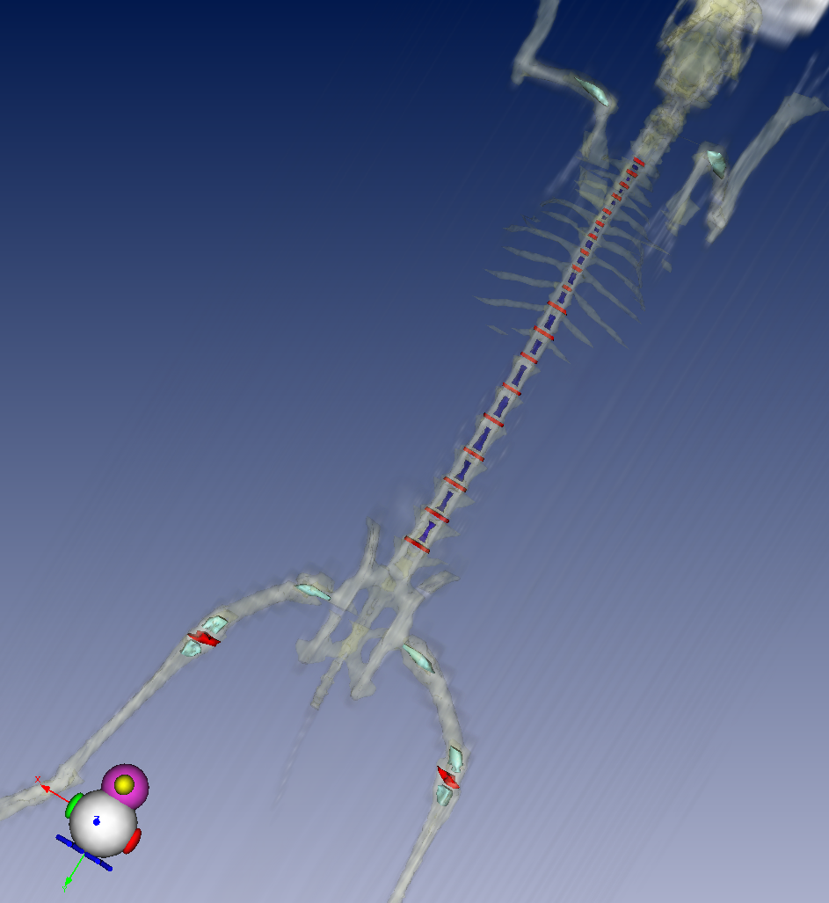
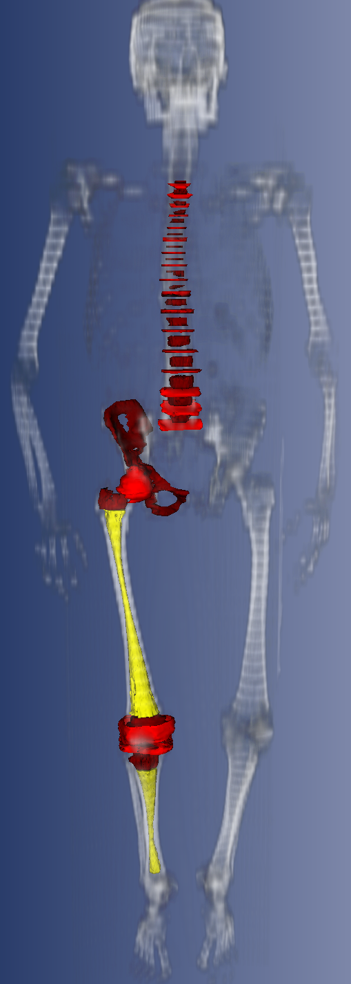
^{99m}Tc-NTP 15-5
Validation of a molecular imaging targeting cartilage proteoglycans
Dosimetry profile associated to ^{99m}Tc-NTP 15-5 imaging of cartilage
Activity distribution: organ sampling from rabbits
S-factors values calculated from rabbit CT-scan and human CT-scan
GATE calculation using Split Exponential Track Length Estimator (seTLE)
a first efficiency study showed a 210 increase in efficiency using seTLE
toward clinical trials
Talk accepted for AAPM meeting, Denver 2017
“Dosimetry study of ^{99m}Tc-NTP 15-5 imaging of cartilage in preclinical trials using the GATE Monte Carlo platform”
G.R.Fois, E.Jouberton, C.Valla, N.Sas, F.Cachin, E.Miot-Noirault, L.Maigne
Poster accepted for AAPM meeting, Denver 2017
“Implementation of S-factor calculation for personalized radionuclide therapy dosimetry into the GATE platform”
G.R.Fois, F.Smekens, L.Maigne
LPC - Pôle Physique pour la Santé et l'Environnement - Fois - OpenGATE meeting - Clermont-Ferrand, May 2017

Slide 7
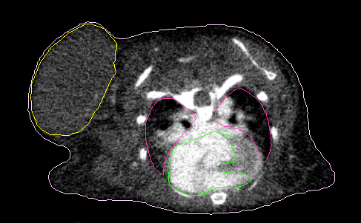
Internal dosimetry procedure: S-factor calculation with GATE
OUR PROCEDURE:
1) Creation of a DICOM-RT file with contoured images from CT scan:
DICOM-RT: extension applied to radiation therapy
RT Structure set: defines areas of significance (such as TV, OAR, body contours, ecc.)
ROI Contour: contains contours vertices coordinates.
2) From vertices coordinates of the contour we build a binary mask
Analyze format: header .hdr + raw
3) Simulation in GATE
Geometry Nested parametrization method
Source Voxelized source
GATE OUTPUT : S-factors for our geometries [absorbed dose per unit cumulated activity]
LPC - Pôle Physique pour la Santé et l'Environnement - Fois - OpenGATE meeting - Clermont-Ferrand, May 2017

Slide 8

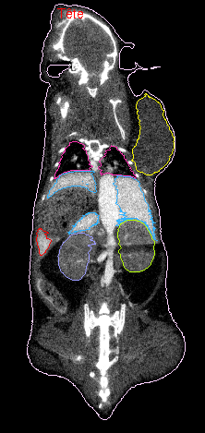
Summary and future perspectives
IDEA/GOAL: simplify internal dosimetry calculations in GATE
potential users: - radiation protection of patients during nuclear medicine diagnostic procedures ;
- dosimetry in treatment using radionuclide therapy ;
- new radiopharmaceuticals for diagnosis and treatment.
NEEDS:
DICOM-RT
THANKS for your attention
LPC - Pôle Physique pour la Santé et l'Environnement - Fois - OpenGATE meeting - Clermont-Ferrand, May 2017

