Slide 1
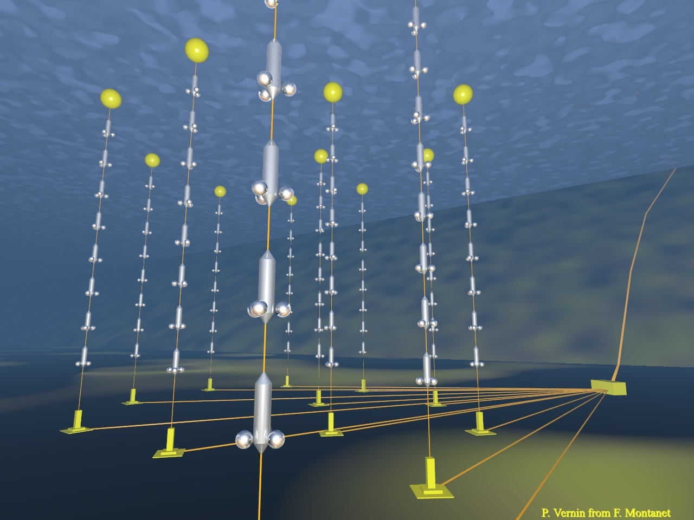


Status of the ANTARES
Deep-Sea Neutrino Telescope
Paschal COYLE- CNRS/CPPM-Marseille
on behalf of the ANTARES Collaboration
Workshop on Gravitational Waves and High Energy Neutrinos– Paris - May 23, 2009

Slide 2
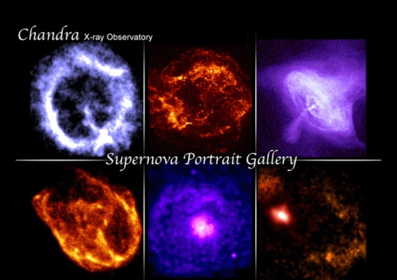
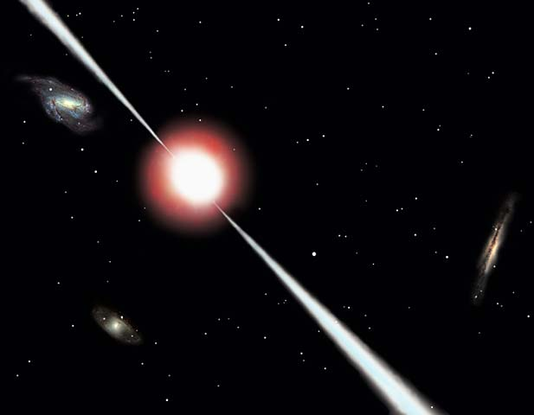
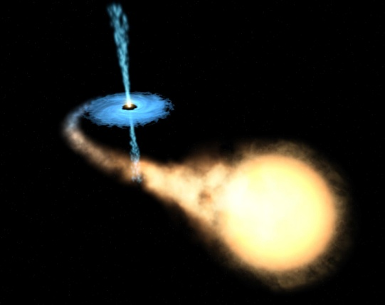
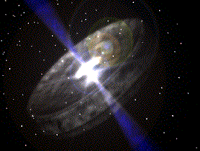
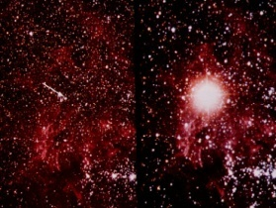
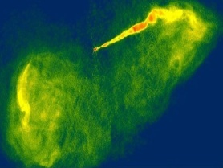
ANTARES Science
SNR
High energy neutrino astrophysics:
Active Galactic Nuclei, Gamma Ray Bursts, Galactic Centre, SN Remnants, μ-quasars...
Search for New Physics:
Dark matter, Monopoles...
Earth-Sea Science:
oceanography, sea biology, seismology, environment monitoring...
GRB
Binary systems
AGN
Micro-quasars
?
~MeV | GeV-100 GeV | GeV-TeV | TeV-PeV | PeV-EeV | > EeV

Slide 3

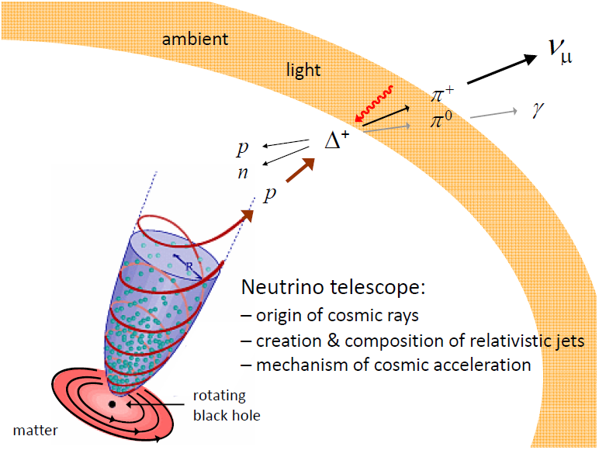
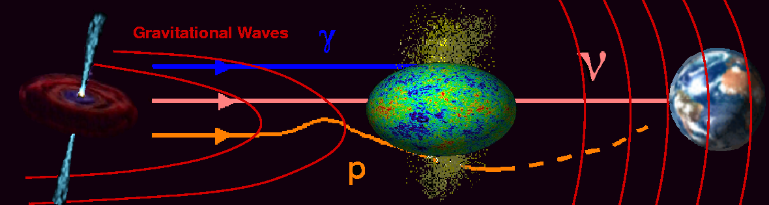
Neutrinos and Multi-Messenger Astronomy
Neutrinos
Not deflected by magnetic fields
Not absorbed by dust
Distance horizon not limited by interaction with CMB/IR
Unambiguous probe of hadronic processes
can be correlated with optical signals
Identify source of cosmic rays

Slide 4
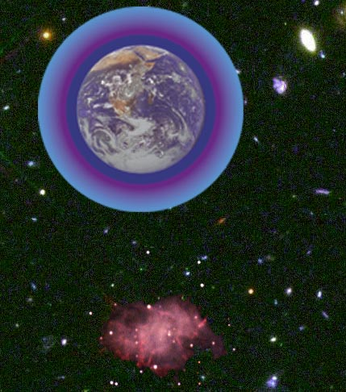
Detection principle
3D PMT
array
Cherenkov light
from μ
ν_{μ}
42°
Sea floor
μ
The reconstruction is based on local coincidences compatible with the Cherenkov light front
ν_{μ}
interaction
- Main detection channel: ν_{μ} interaction giving an ultra-relativistic μ
Energy threshold ~ 10 GeV

Slide 5

The ANTARES Collaboration
NIKHEF, Amsterdam
KVI Groningen
NIOZ Texel
ITEP,Moscow
University of Erlangen
ISS, Bucarest
IFIC, Valencia
UPV, Valencia
CPPM, Marseille
DSM/IRFU/CEA, Saclay
APC, Paris
LPC, Clermont-Ferrand
IPHC (IReS), Strasbourg
Univ. de H.-A., Mulhouse
IFREMER, Toulon/Brest
C.O.M. Marseille
LAM, Marseille
GeoAzur Villefranche
University/INFN of Bari
University/INFN of Bologna
University/INFN of Catania
LNS – Catania
University/INFN of Pisa
University/INFN of Rome
University/INFN of Genova
5
Notes:
M. Spurio- ANTARES
5

Slide 6
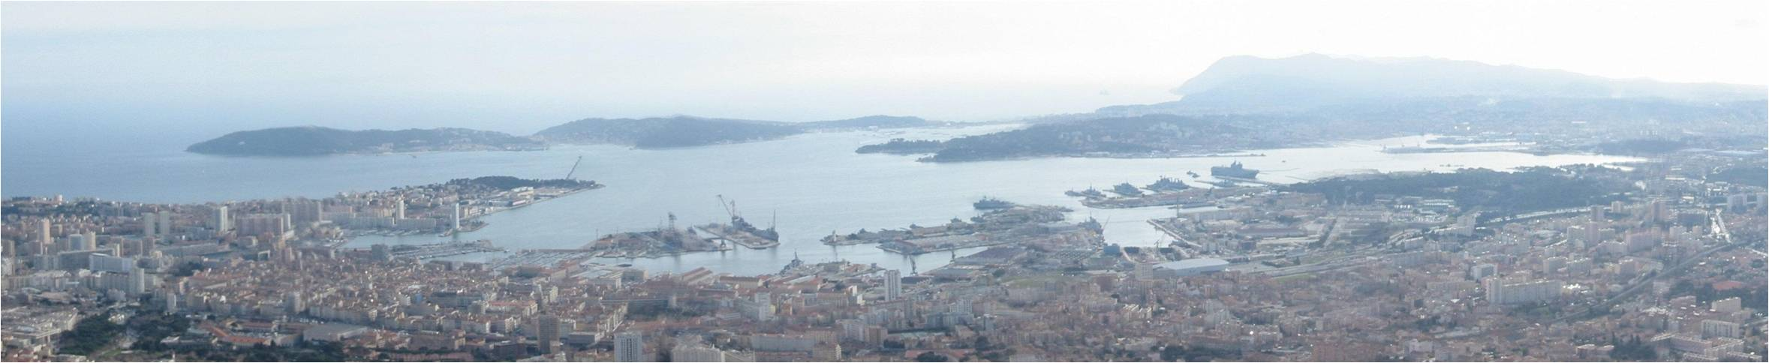
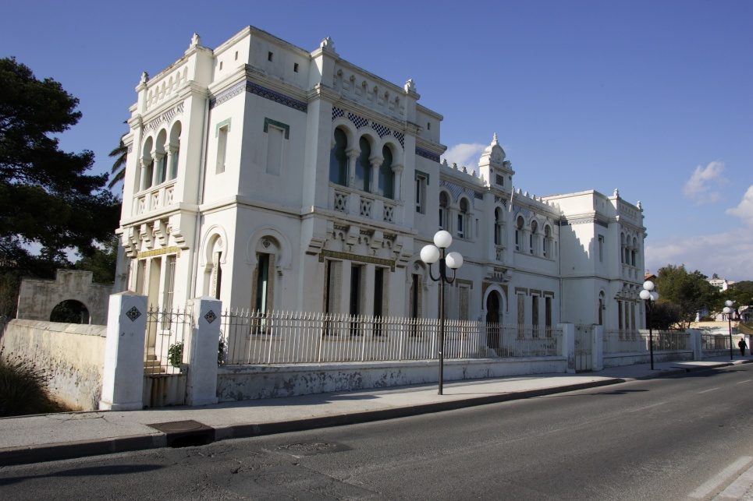
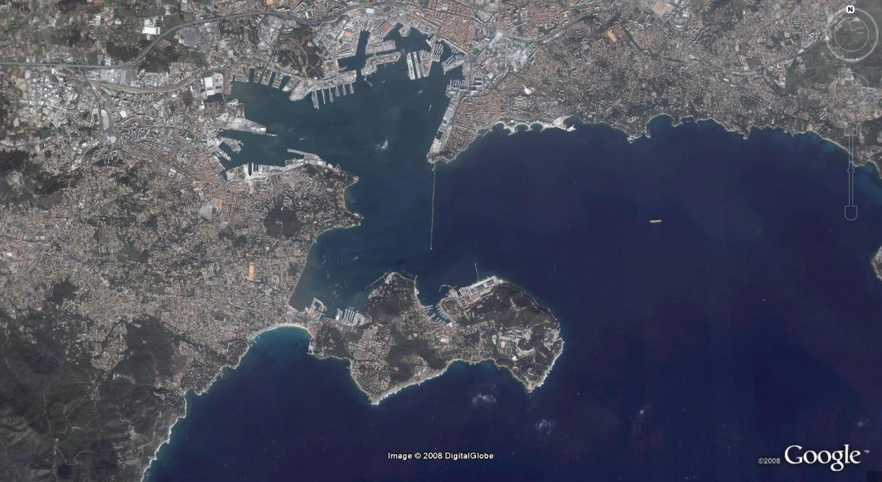
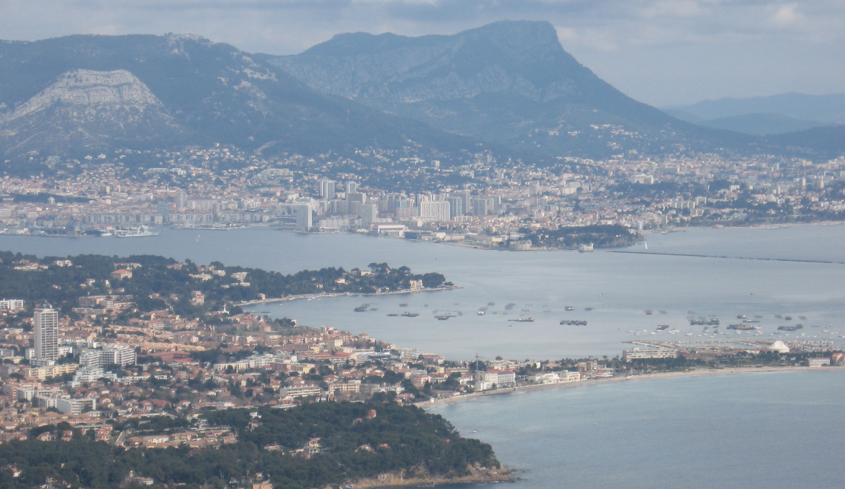
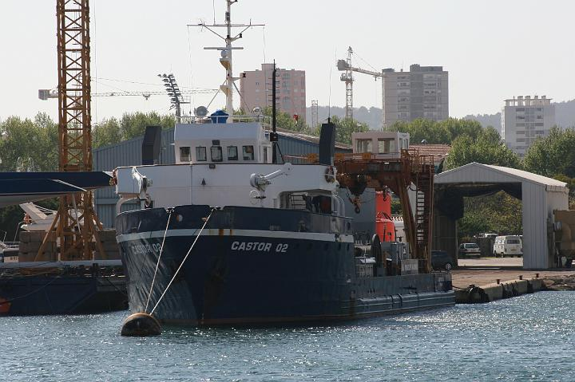
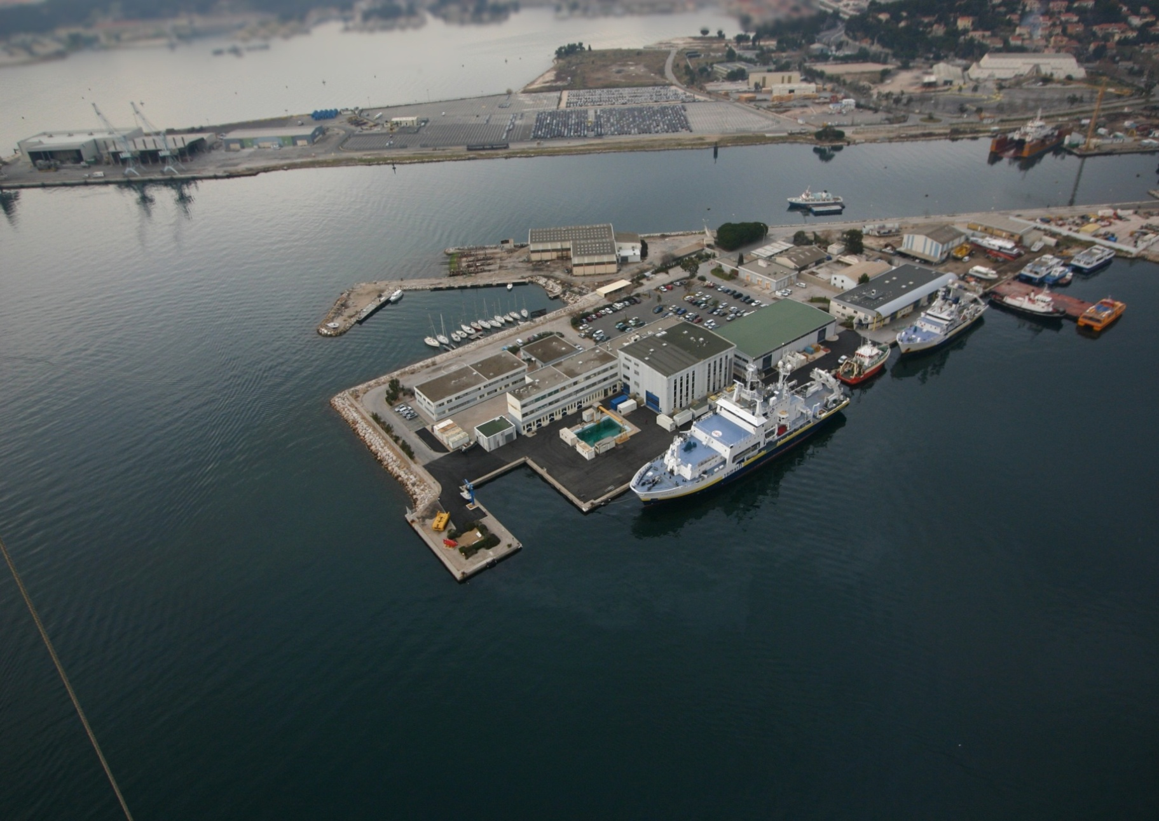
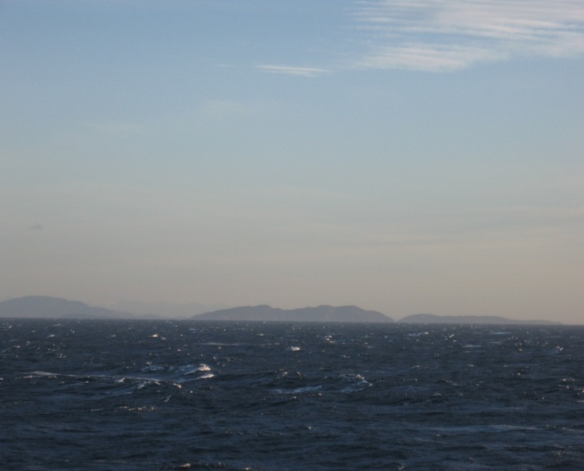
The ANTARES Site & Infrastructure
Shore Station
Site
20 km from nearest land
Submarine cable
40 km
IFREMER Toulon Centre
FOSELEV Marine Shipyard

Slide 7
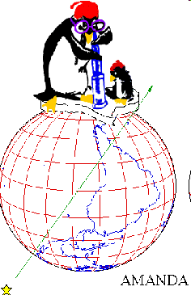
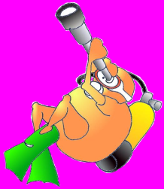
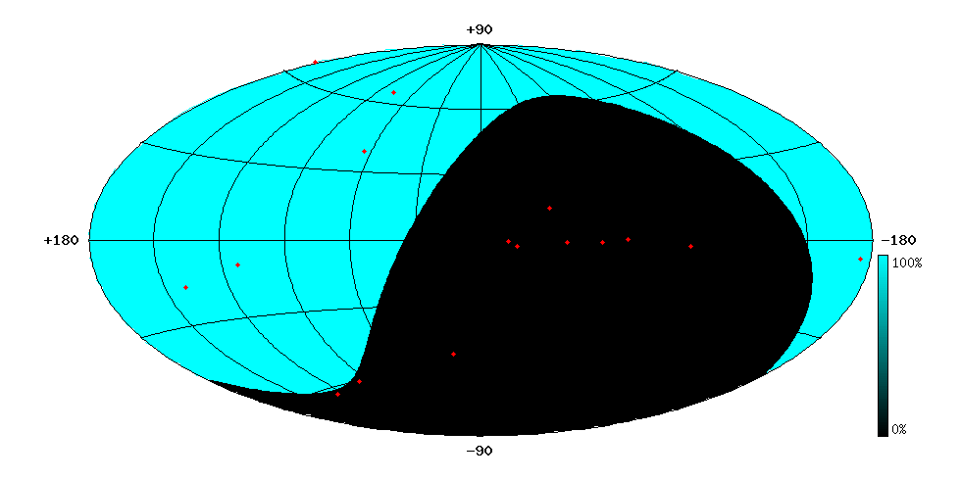
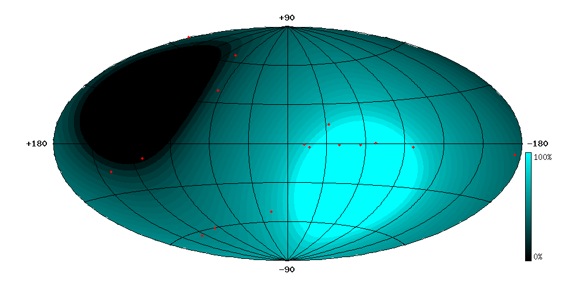
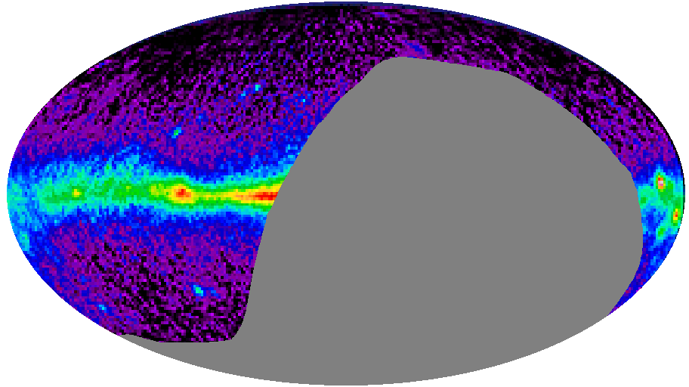
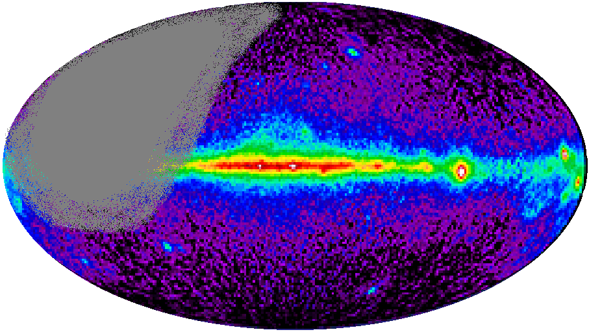
Region of sky observable by Neutrino Telescopes
AMANDA/IceCube (South Pole)
(Ice: ~2°/0.6°)
ANTARES/KM3 (43° North)
(water: ~0.2°/0.1°)
Mkn 421
Mkn 501
Mkn 501
CRAB
RX J1713.7-39
CRAB
SS433
SS433
GX339-4
VELA
Galactic
Centre

Slide 8
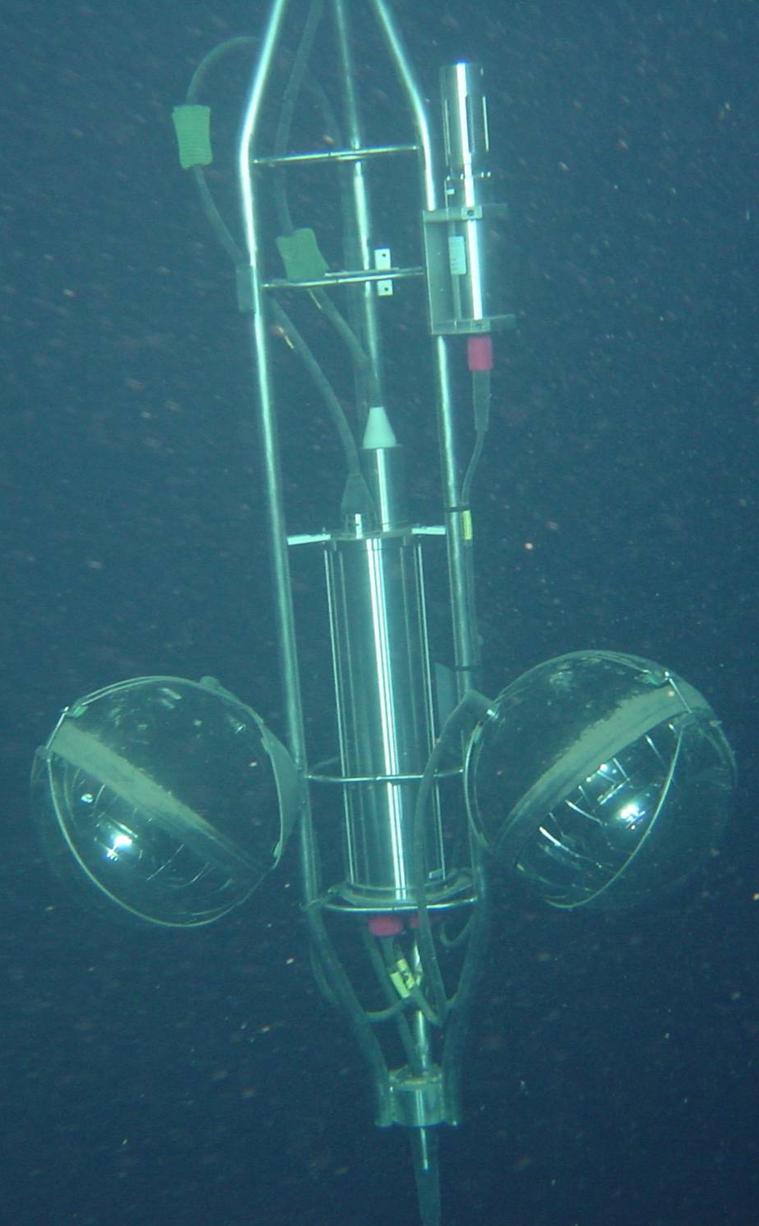
The ANTARES Detector
900 PMTs
12 lines
25 storeys / line
3 PMTs / storey
2500m
40 km to
shore
450 m
Junction
Box
70 m
Interlink cables

Slide 9
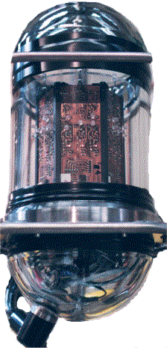
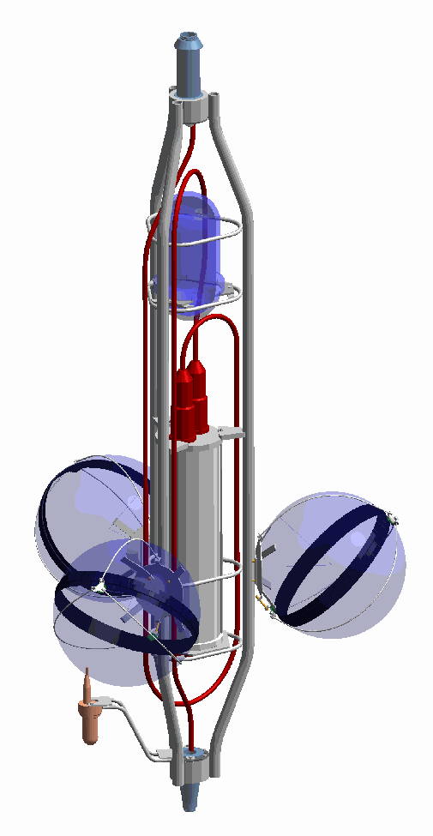
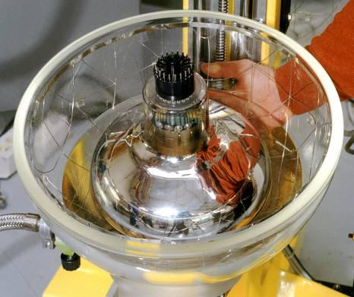
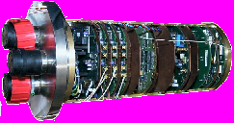
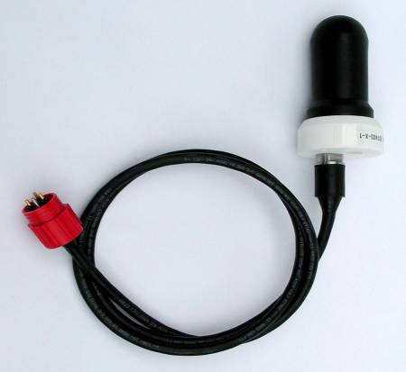
Basic Detector Element: a storey
titanium frame: support structure
Optical Beacon
with blue LEDs:
timing calibration
Optical Module:
10” Hamamatsu PMT
in 17” glass sphere
(σ_{TTS} ≈ 1.3 ns)
photon detection
Local Control Module
(in Ti cylinder):
Front-end ASIC, DAQ/SC, DWDM,
Clock, tilt/compass, power distribution…
Hydrophone:
acoustic positioning

Slide 10
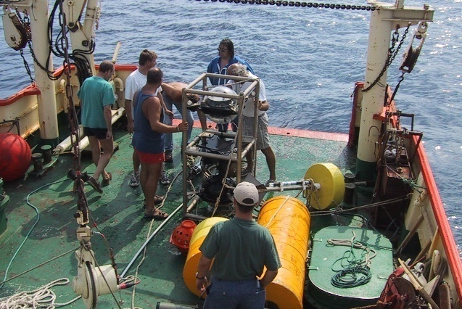
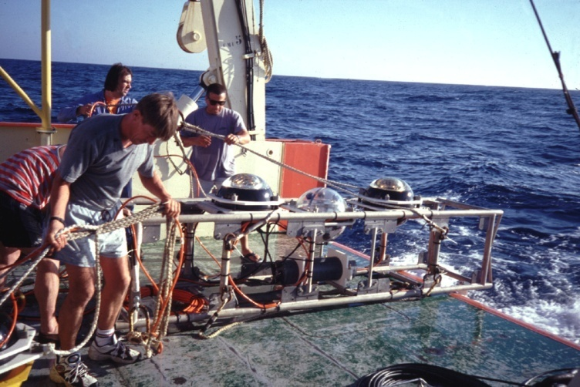
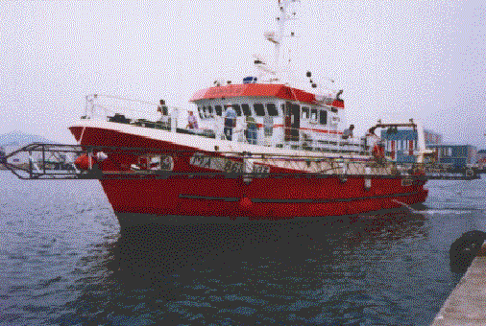
ANTARES Site Exploration
1996 - 2000 Measurements with autonomous lines
Optical background study: 15 deployments
2) Biofouling-sedimentation study: 4 deployments
3) Optical properties study: 28 deployments

Slide 11
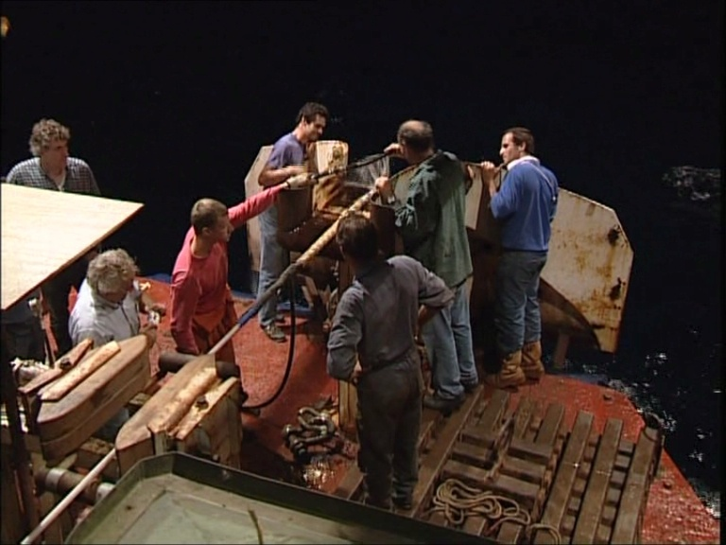
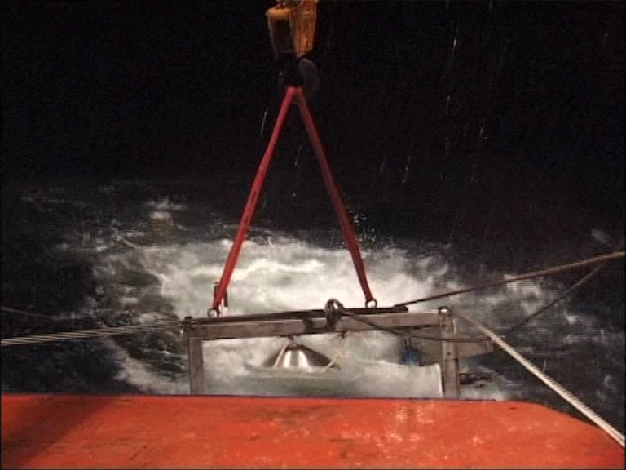
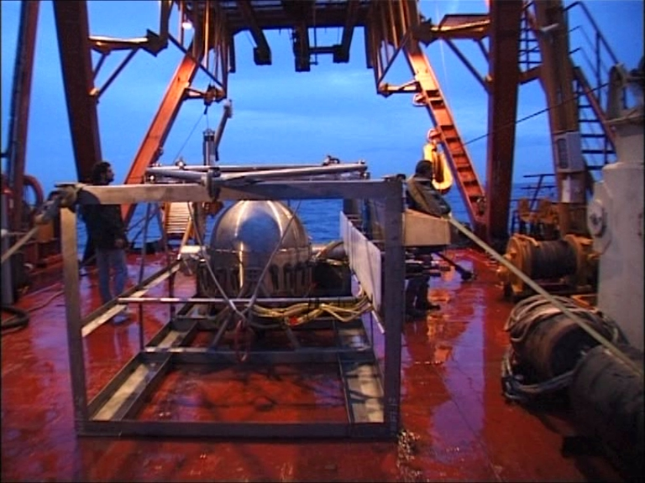
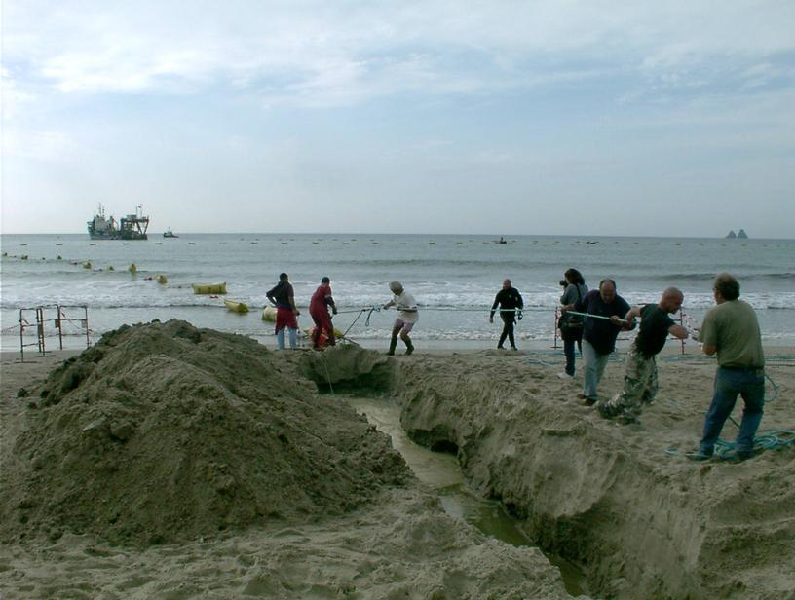
Building the Detector - 1
Main Cable and Junction Box
2001 Deployment of 45 km electro-optical cable (Alcatel)
2002 Deployment of Junction Box

Slide 12
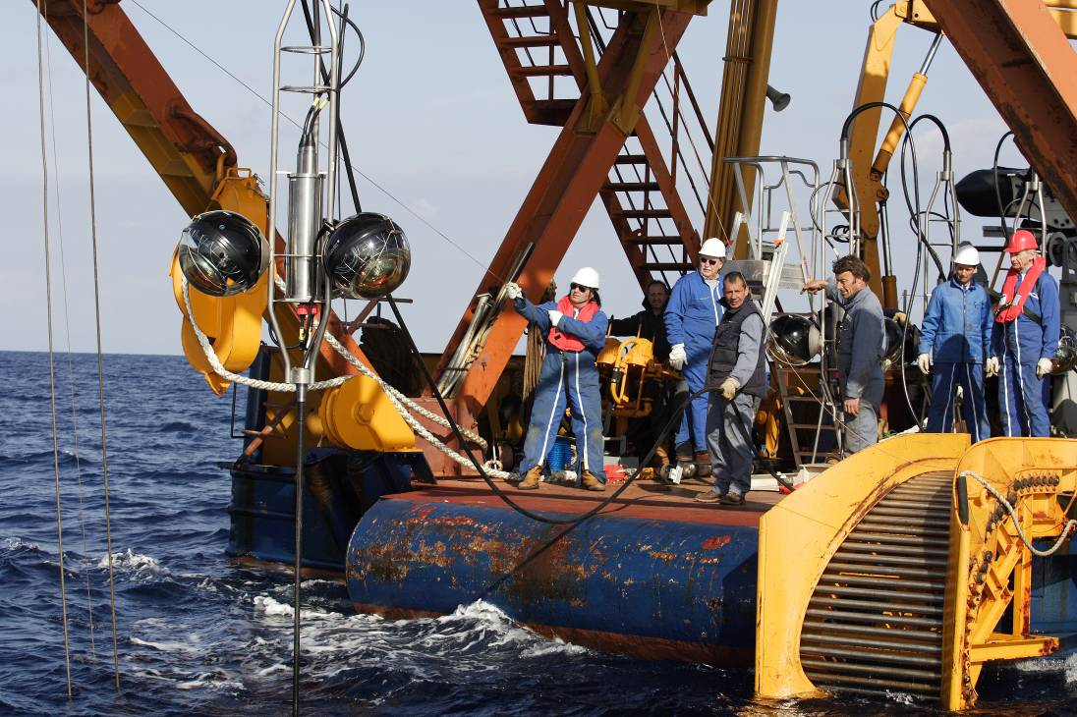
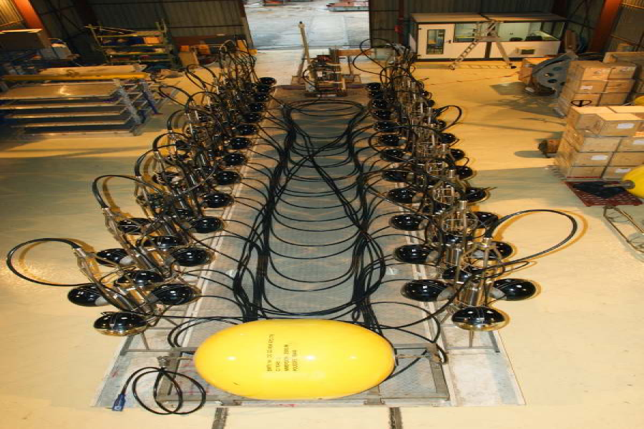
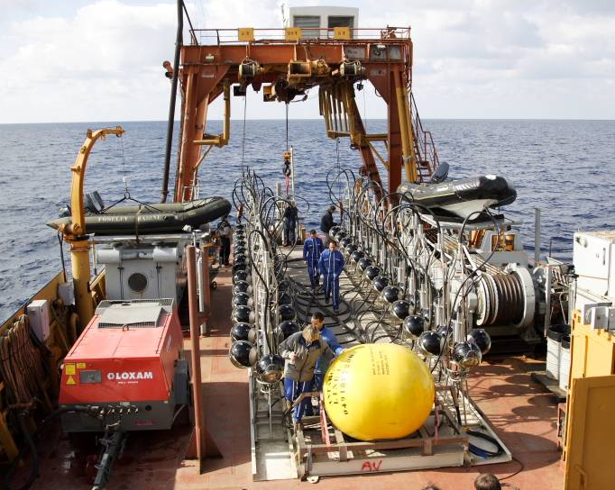
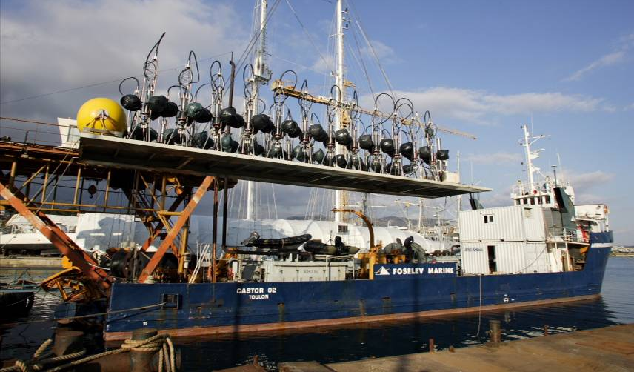
Building the Detector - 2
Line Deployment
2003-2005 Various prototype lines
2006 Lines 1, 2
2007 Lines 3, 4, 5, 6, 7, 8, 9,10
2008 Lines 11, 12

Slide 13
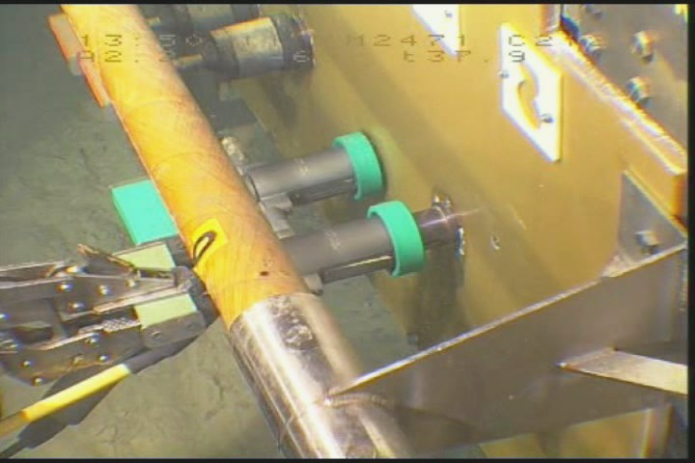
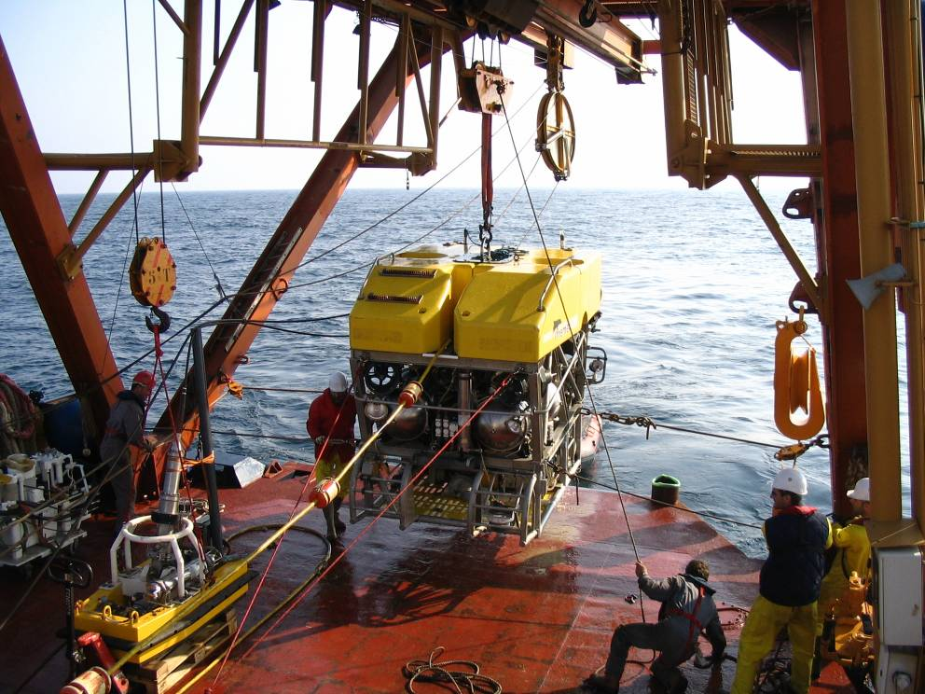
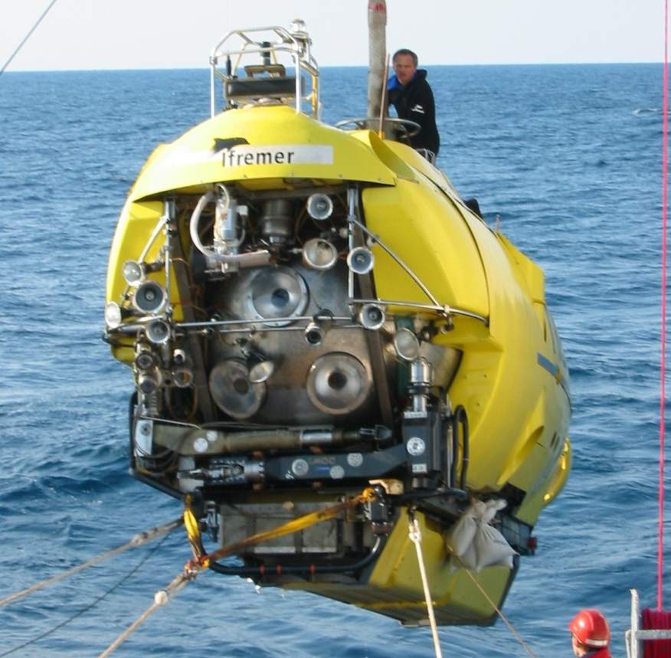
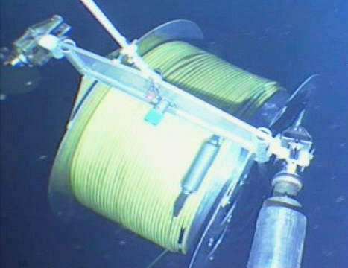
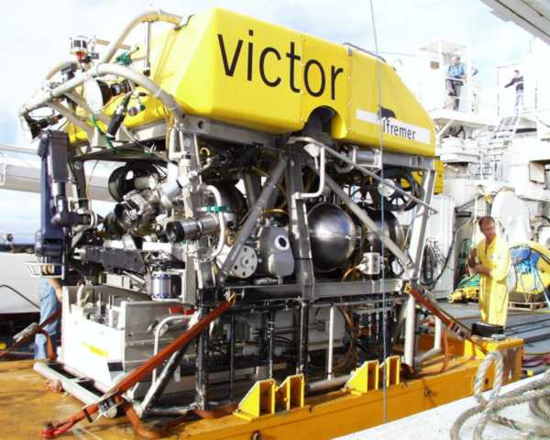
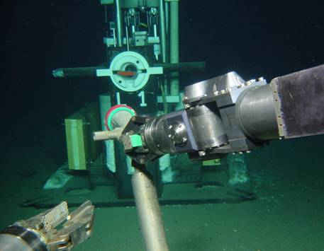
Building the Detector - 3
Line Connections
2006 Line 1, Line 2
2007 Lines 3 - 5, Lines 6 -10
2008 Lines 11, 12
Manned submarine Nautile
Robot submarine Victor

Slide 14
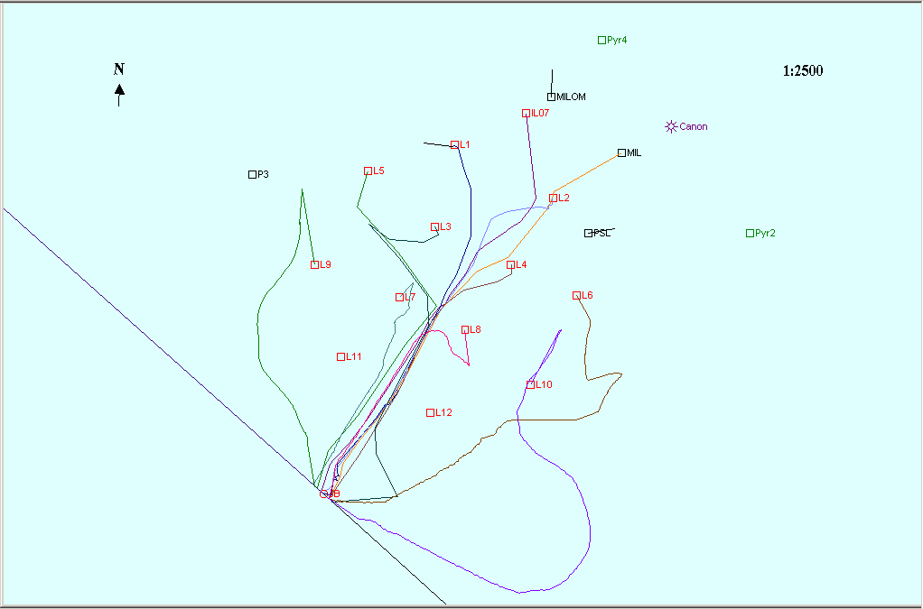
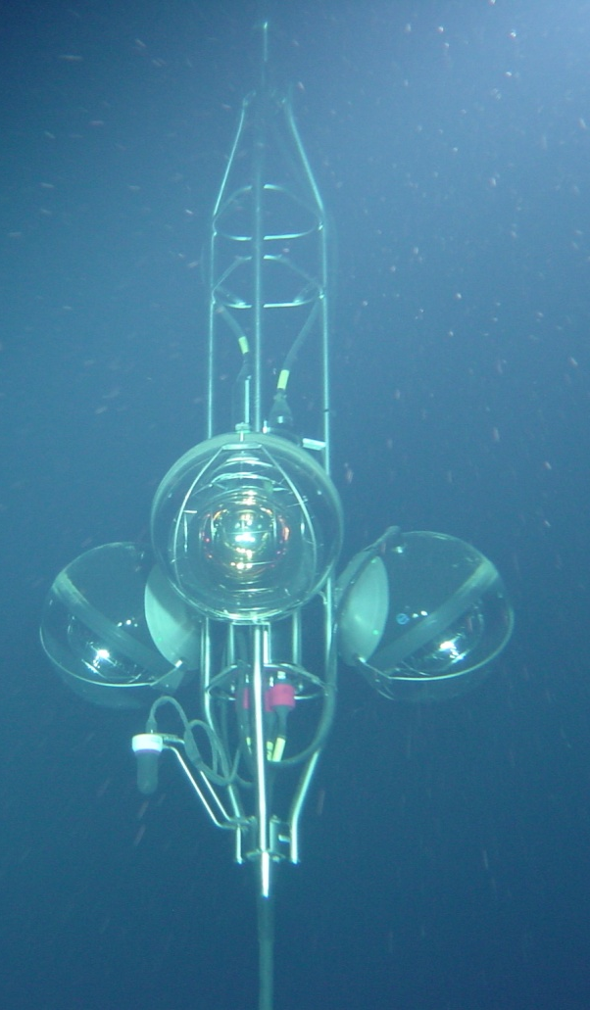

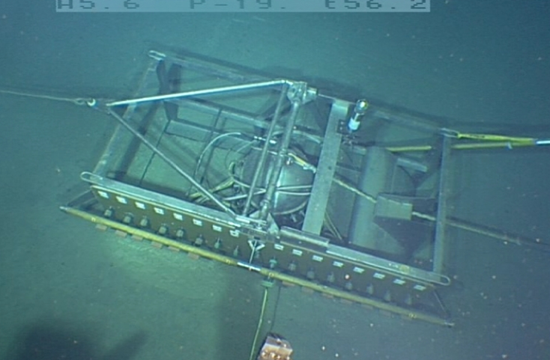
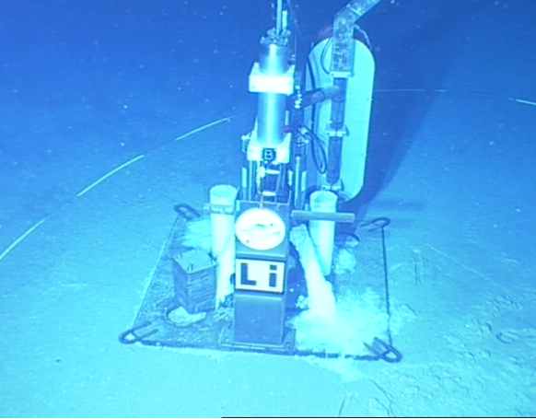




Detector on Seabed
Junction Box
100 m
Line bases
N
Line storeys
IL07
L1
L5
L2
L3
L9
L4
L7
L6
L8
L11
L10
Submarine
cable
to shore
L12
seismometer
Junction box

Slide 15

Detector status after completion
88% of modules operational
Regular maintenance of
in-situ infrastructure
foreseen

Slide 16







Counting Rates (short timescale)
2 min
Continuous baseline:
Radioactivity in the sea (⁴⁰K)
+ bioluminescent bacteria
Bursts:
bioluminescence from
Macroscopic organisms
⁴⁰K

Slide 17

Counting Rates (long timescale)
MILOM
L1F1
L1F25
IL07
MILOM
& L1
L1 & L2
Ant. 5L
Ant. 10L
& IL07
Full Antares
MILOM
out
Cable Fault
MILOM
Only
2005
2006
2007
2008
2009
Long term variations due to seasonal and sea current variability

Slide 18





In situ calibration with Potassium-40
Gaussian peak on
coincidence plot
Integral
under
peak
^{γ}
Cherenkov
Precision (~5%)
monitoring of OM efficiencies
Peak offset
e⁻ (β decay)
⁴⁰K
Cross check of time calibration
⁴⁰Ca

Slide 19

Time evolution of K40 coincidence rate
All OM pairs of Line1 during more than 2 years
OM gain drop reduces efficiency
Recovery after threshold retuning
Recovery due to HV off during period of cable repair

Slide 20



Light Absorption Measured using Beacons
~150 m
~70 m

Slide 21


Position Alignment
Z(m)
Example for
Sea current
v= 25 cm/s
r_{max} = 22m
Measure every 2 min:
Distance line bases
to 5 storeys/line
and also storey
headings and tilts
r(m)
r = (a z - b ln[1-cz] ) v²

Slide 22



Line position measurements
Acoustic positioning:
Hydrophone positions
from July→Dec 2007
Acoustic positioning:
Precision ~ few cms
Within a line
Between lines
Storey 1
Storey 8
Storey 14
Storey 20
Storey 25
Radial displacement

Slide 23
Data Acquisition
x,t,Q
~1 MB/s→
F.E.
F.E.
F.E.
F.E.
F.E.
F.E.
off-shore
Time
(slices ~100ms)
on-shore
Ethernet switch
PC n-1
PC n
PC n+1
Storage
1-10 MB/s
Trigger
Trigger
Trigger
M. Circella – Status of ANTARES
VLVnT08

Slide 24
Online Triggers
3N- directional scan
= 1 local coincidence (20ns) of 2 out of 3
or a single large amplitude (>3spe)
Trigger 3N = 5 within 2.2μs,
and causally related
2T3
Trigger 1T3 = 2 in 3 adjacent storeys
Trigger 2T3 = 2 x 1T3 within 2.2 μs
Galactic Centre-directional trigger

Slide 25


Number of triggers
5 lines (2007)
10 or more lines (2008)
19.10⁶ μ
65.10⁶ μ
CABLE
REPAIR
Total : 240 days = 80% of calendar
Selected :167d = 70% of total
Total : 243 days = 83% of calendar
Selected :173d = 71% of total

Slide 26


Atmospheric Muons
height
Example of a reconstructed down-going muon, detected in all 12 detector lines:
time

Slide 27


Neutrino-induced muon
height
Example of a reconstructed up-going muon (i.e. a neutrino candidate) detected in 6/12 detector lines:
time

Slide 28

Detected Neutrinos
June 2007 – Dec 2008: 5+10+12 lines
313 active days
1111 upward neutrino candidates
p, α
ν_{μ}
p
ν_{μ}
γ
up-going
down-going

Slide 29


Expected Performance (full detector)
Neutrino effective area
Angular resolution
N_{det}=A_{eff} × Time × Flux
For E_{ν}<10 PeV, A_{eff} grows with energy due to the increase of the interaction cross section and the muon range.
For E_{ν}>10 PeV the Earth becomes opaque to neutrinos.
For E_{ν}<10 TeV, the angular resolution is dominated by the ν-μ angle.
For E_{ν}>10 TeV, the resolution is limited by track reconstruction errors.

Slide 30


Point Source Sensitivity
KM3NeT 1 an (détecteur typique)‏

Slide 31

Toward a km³-scale detector in the Mediterranean sea
Antares (1/50 km³)
Toulon, France
-2500m
Nestor
Pylos, Greece
-4000m
Nemo
Capo Passero, Italy
-3350m

Slide 32






Mediterranean Efforts
Antares (1/50 km³)
Toulon, France
-2500m
Since 2000
R&D
∼ 80 members
Nestor
Pylos, Greece
-4000m
Since 1996
Data taking
∼150 members
Since 1990
R&D
∼ 50 members
Nemo
Capo Passero, Italy
-3350m

Slide 33


The challenge
12 lines, 900 PMTs
  Maximise physics potential
    Instrumented volume >1km3
    Angular resolution ~0.1 degrees (E>10 TeV)
  Build in a reasonable time ∼ 4 years
    New deployment techniques
    Speed-up integration time
    Sub contract part of the production
    …
  At a reduced cost
    Simplified architecture
    Reduced maintenance
    Multi-line deployments
    …
100-200 lines, 5000-10000 PMTs

Slide 34
Timeline towards construction
EU support (FP6-FP7)
ESFRI/ASPERA roadmaps
Feb 2006
Mar 2008
Oct 2009
Mar 2011
Design Study
Preparatory phase
Construction phase
Data taking
CDR
TDR
Final
prototyping
Good match to advanced LIGO/VIRGO facilities

Slide 35



Outlook
ANTARES infrastructure completed since May 29th 2008
  First lines in operation since 2006
  Detector operation and calibration under control
  Maintenance capability demonstrated
Exciting physics program ahead
  Over a thousand neutrino reconstructed
  Unexplored region of the sky
  astronomical sources, dark matter, oscilllations, ……)
  Multi-messenger approach strongly encouraged
  Real-time readout and in-situ power capabilities facilitates
  a large program of synergetic multi-disciplinary activities: acoustics, biology, oceanography, seismology……
Major step towards the KM3NeT multi-disciplinary
deep-sea research infrastructure

