Slide 1
ASTERICS-OBELICS 1st International School Giovanni LAMANNA 6 juin 2017

Slide 2
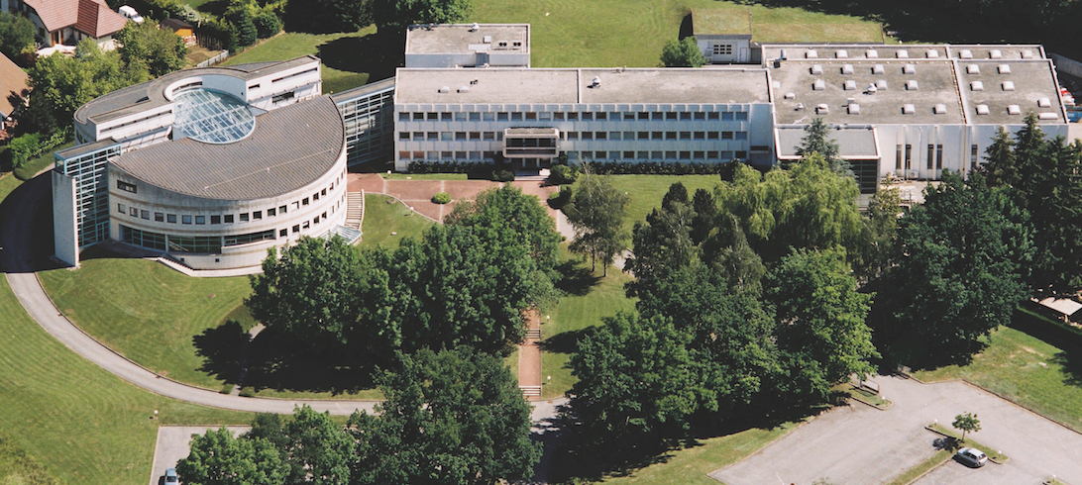
Fundamental research in Annecy
Created in 1976, LAPP is one of the 19 laboratories of the CNRS National Institute for Nuclear and Particle Physics (IN2P3). Research domain of the elementary particles, their fundamental interactions as well as the exploration of the links between the infinitely small and the infinitely large : Matter & Universe (particle and astroparticle physics)
Frontier technologies in different fields: mechanics, electronics, computer science, scientific software and e-infrastructures. …
LAPP was born 40 years ago by the wish of CNRS scientists from Paris to have a French laboratory close to CERN.
150 researchers engineers, technicians, administrative personnel, students and visitors..
LAPP hosts the Data and Computing Centre MUST (also WLCG Tier2) and has a Theory Laboratory (LAPTh) within its premises.

Slide 3
Fundamental research in Annecy
80’s : LAPP participates to important experiments at CERN, such as UA1 that enabled the W and Z bosons discovery [Nobel Prize 1984]
90’s : LAPP expands and diversifies its activities
LEP (e+e-) experiments at CERN - the Standard Model is tested with great accuracy
Astroparticle Physics field:
gravitational waves, high energy cosmic rays, gamma-rays, cosmology.
Experiments on far away sites:
Suisse, Italy, California, Namibia, Japon, Spain, ISS
LAPP is associated to important discoveries:
Z and W bosons (1983)
Higgs boson (2012)
Neutrinos oscillation
Gravitational waves (2015)

Slide 5
ASTERICS
Bringing together the astronomy, astrophysics and particle astrophysics communities
Supporting the implementation of the ESFRI to see them interoperate as an integrated, multi-wavelength and multi-messenger telescope
Astronomy ESFRI & Research Infrastructure Cluster
ASTERICS - 653477

Slide 6
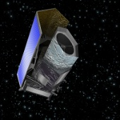
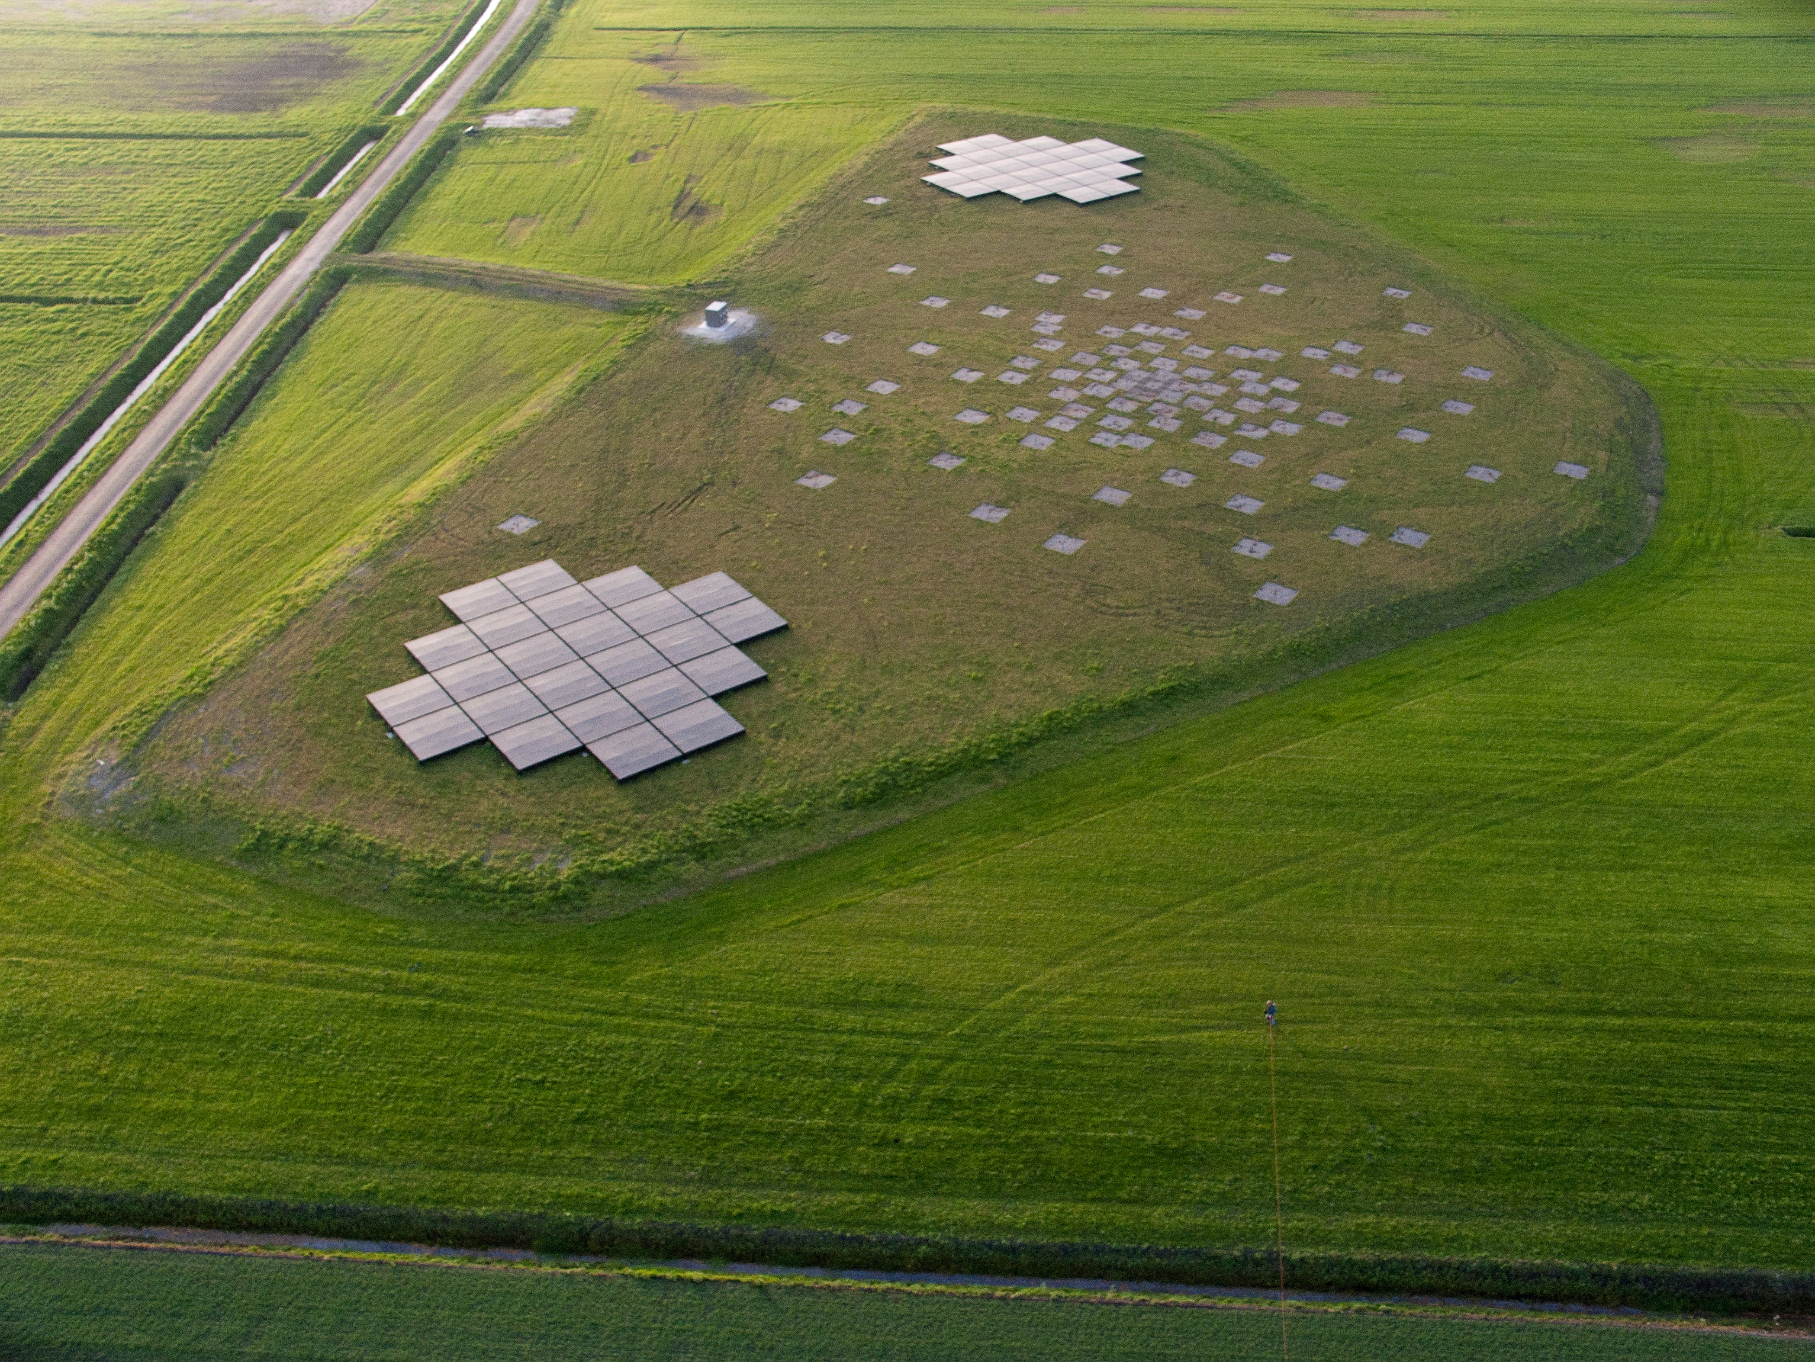
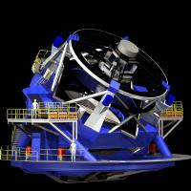
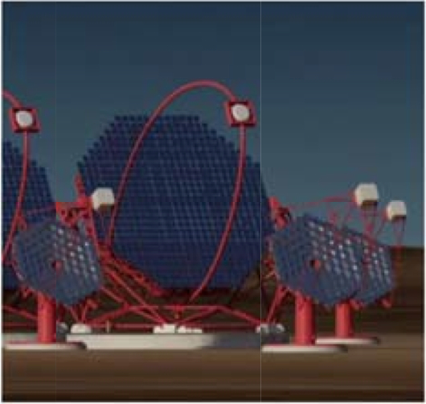
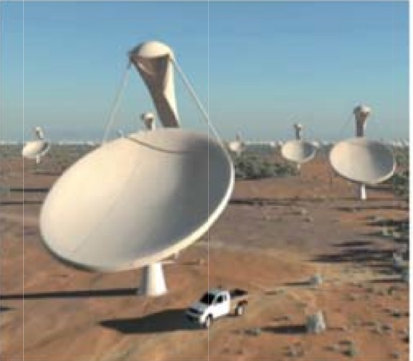
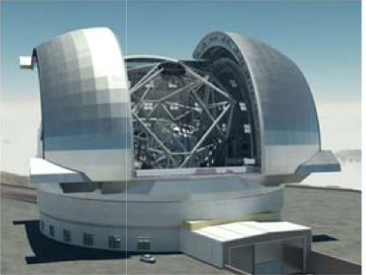
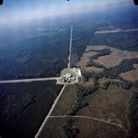
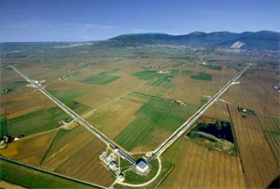
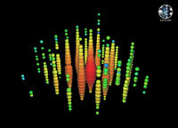
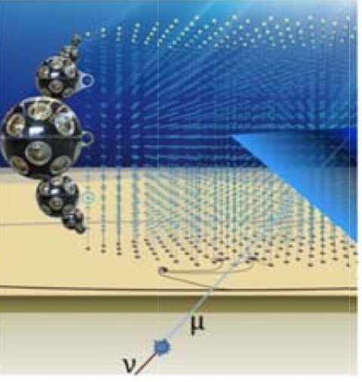
Radio
Infrared
Visible light
X-rays
Gamma rays
LOFAR
HESS
LSST
EUCLID
E-ELT
SKA
CTA
Gravitational Waves Cosmic Neutrinos
KM3NeT
LIGO & VIRGO
ICECUBE

Slide 7
ASTERICS
Bringing together the astronomy, astrophysics and particle astrophysics communities
Supporting the implementation of the ESFRI to see them interoperate as an integrated, multi-wavelength and multi-messenger telescope
ASTERICS is comprised of five work packages:
ASTERICS Management Support Team (AMST),
Dissemination, Engagement and Citizen Science (DECS),
Observatory E-environments Linked by common ChallengeS (OBELICS),
Data Access, Discovery & Interoperability (DADI),
Connecting Locations of ESFRI Observatories and Partners in Astronomy for
Timing and Real-time Alerts (CLEOPATRA)
Astronomy ESFRI & Research Infrastructure Cluster
ASTERICS - 653477

Slide 8
WP3 - OBELICS
Among the ASTERICS largest work packages.
Targeting common ESFRI-projects « Data Challenges ».
Generate large sets of data.
Need computing resources, intensive simulation and large storage space.
Scopes:
Enable interoperability and software re-use.
Enable open standards and software libraries for multi-messenger data.
Develop common solutions, share prototypes, exchange experience.
Objectives:
Create an open innovation environment across ESFRI facilities.
Expected impact:
Economies of scale and saving resources.
Contribute to the construction and operation of ESFRI projects.
Astronomy ESFRI & Research Infrastructure Cluster
ASTERICS - 653477

Slide 9
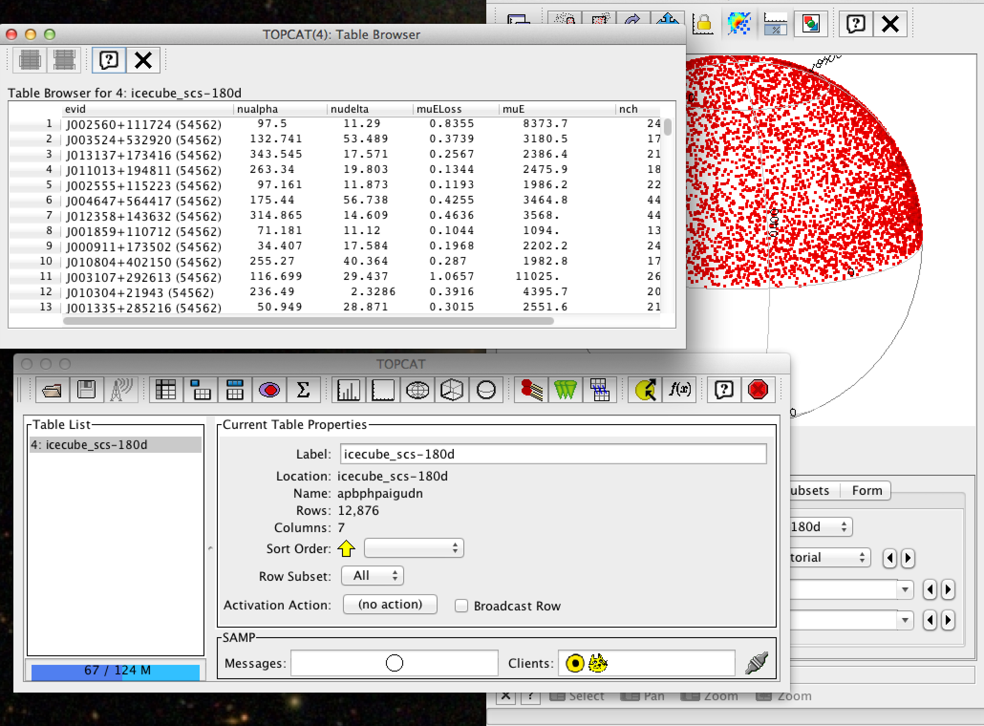
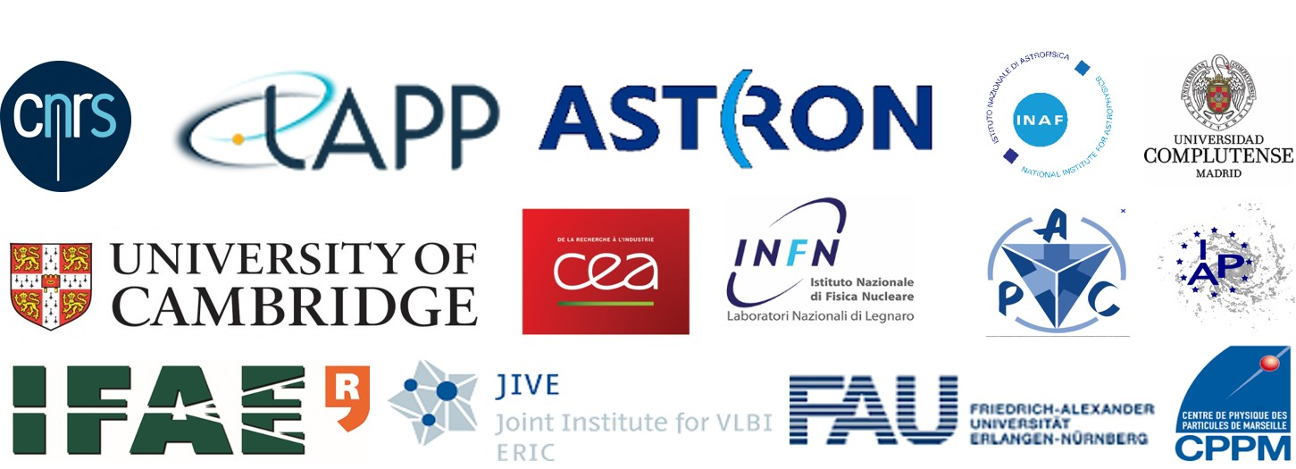
WP3 - OBELICS
Working on commons along the “data flow”:
Twelve international partners cooperating around three main steps of data pipelines of major ESFRI projects in Astronomy.
Data generation
Data systems integration
Data analysis
Astronomy ESFRI & Research Infrastructure Cluster
ASTERICS - 653477

Slide 10
OBELICS SCHOOL
1st ASTERICS-OBELICS International School, 6-9 June 2017
Specifically intended for a large audience including PhD students, postdocs, senior researchers from the domain of astrophysics and astroparticle physics .
The school will include theory and hands-on sessions on Efficient code writing, Parallel & GPU programming & Python libraries for astronomy & astrophysics.
Astronomy ESFRI & Research Infrastructure Cluster
ASTERICS - 653477

Slide 11
OBELICS SCHOOL
-> My warm welcome to you all attending the school.
-> My special thank to:
- our tutors.
- OBELICS colleagues,
- members of the international programme committee
- LAPP scientists contributing to the local organizing committee
- LAPP administrative department and our sponsors
I wish you an interesting and fruitful school !
Have a good time in Annecy !

